Slide 1
HTML – Form

Slide 2
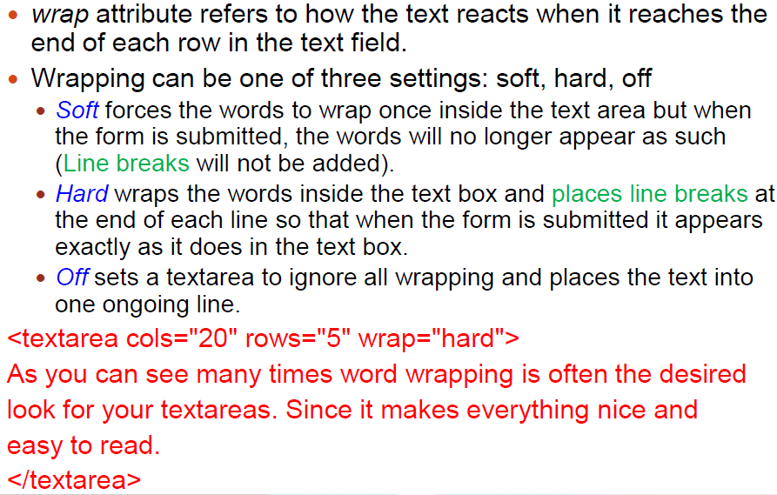
TextArea

Slide 3
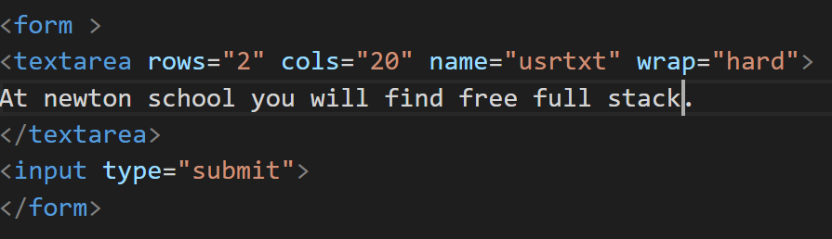
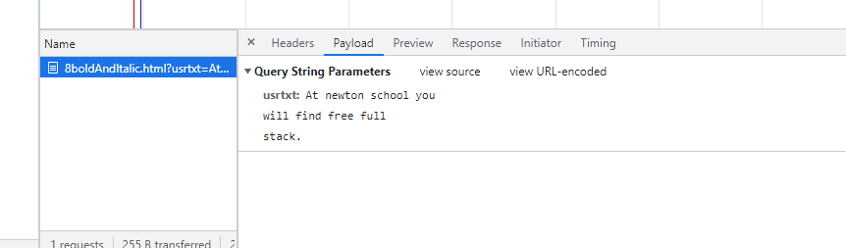
Wrap=“hard”

Slide 4
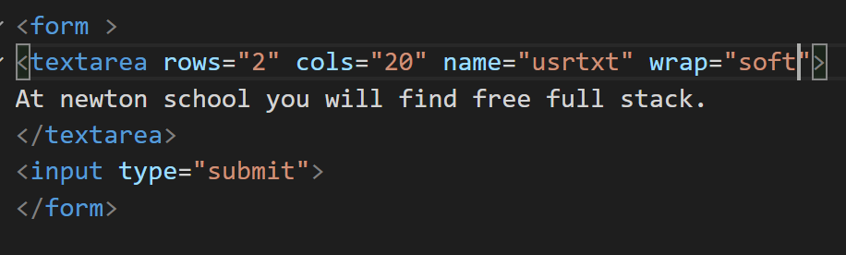
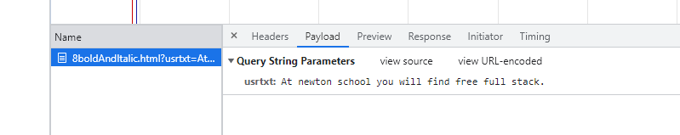
Wrap=“soft”

Slide 5
HTML Forms Method
GET:
Appends the form data to the URL, in name/value pairs.
NEVER use GET to send sensitive data! (the submitted form data is visible in the URL!).
The length of a URL is limited (2048 characters).
Useful for form submissions where a user wants to bookmark the result.
GET is good for non-secure data, like query strings in Google.
POST:
Appends the form data inside the body of the HTTP request (the submitted form data is not shown in the URL).
POST has no size limitations, and can be used to send large amounts of data.
Form submissions with POST cannot be bookmarked.

Slide 6
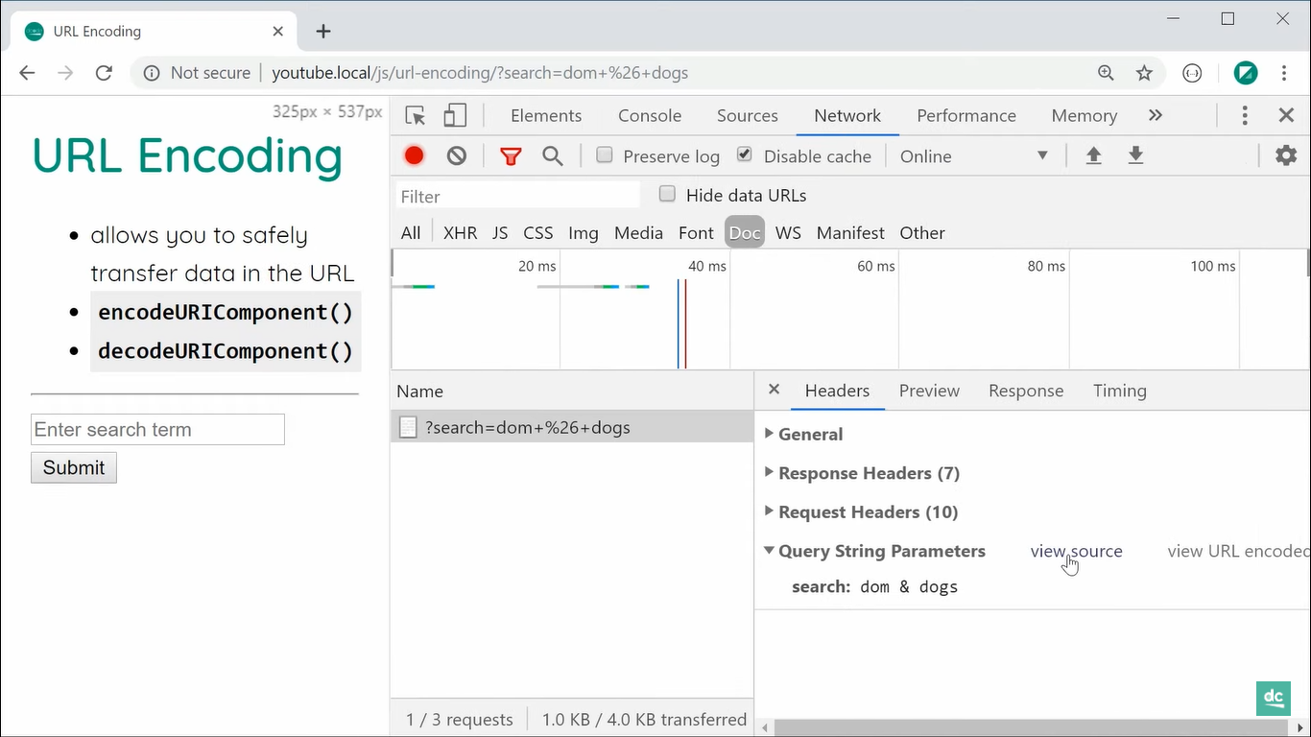

Slide 7
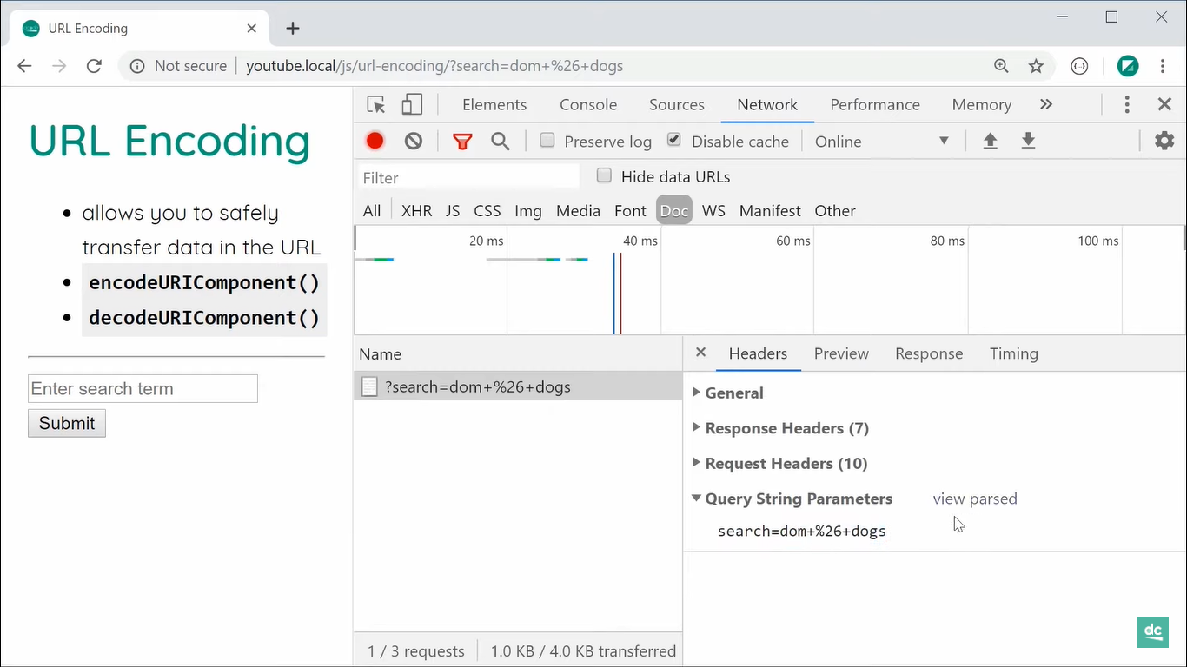

Slide 8
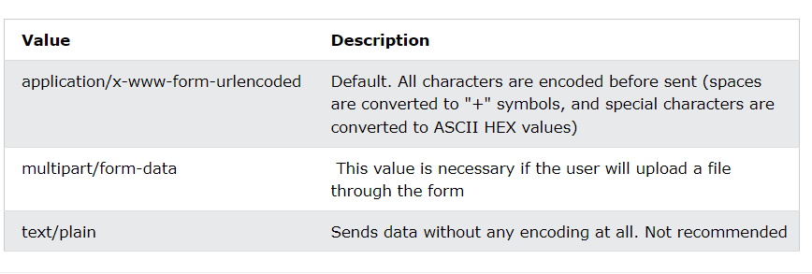

Form – enctype attribute

Slide 9
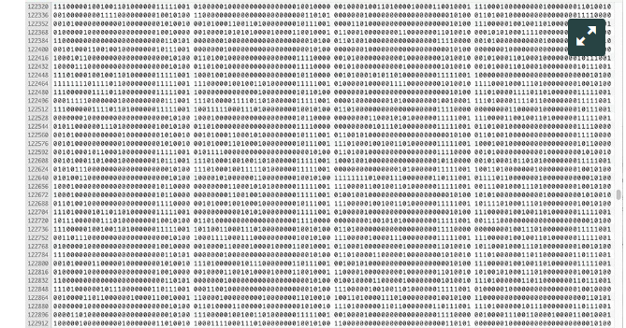
Binary Files – 8bits

Slide 10
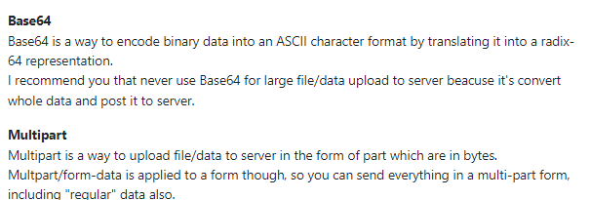
Base64 vs multipart/form-data

Slide 11
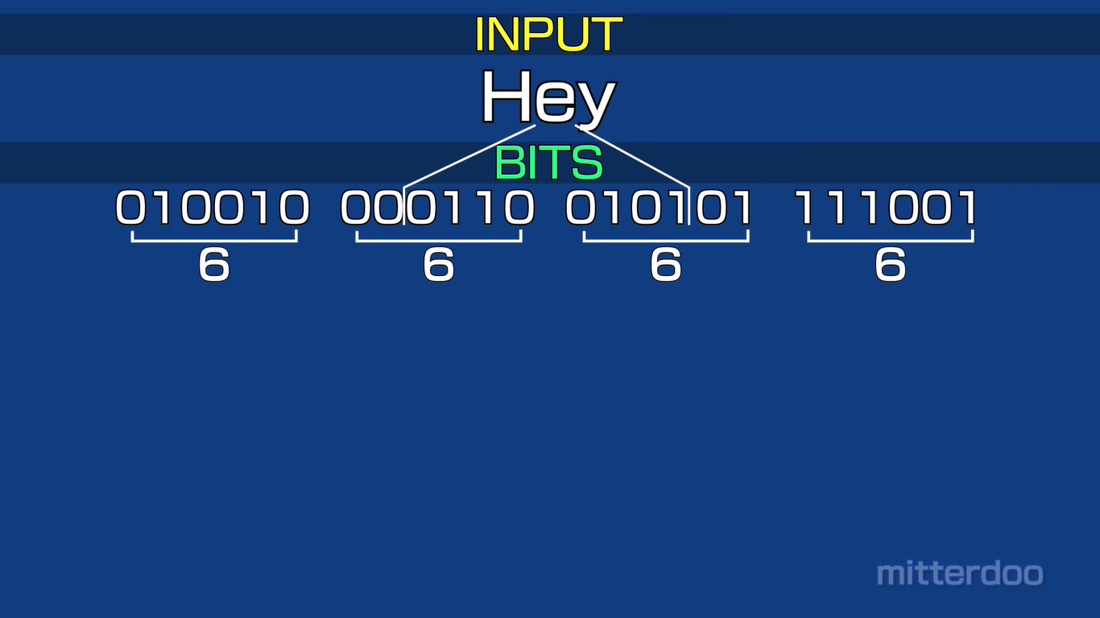
Base 64

Slide 12

Base 64 – index table

Slide 13
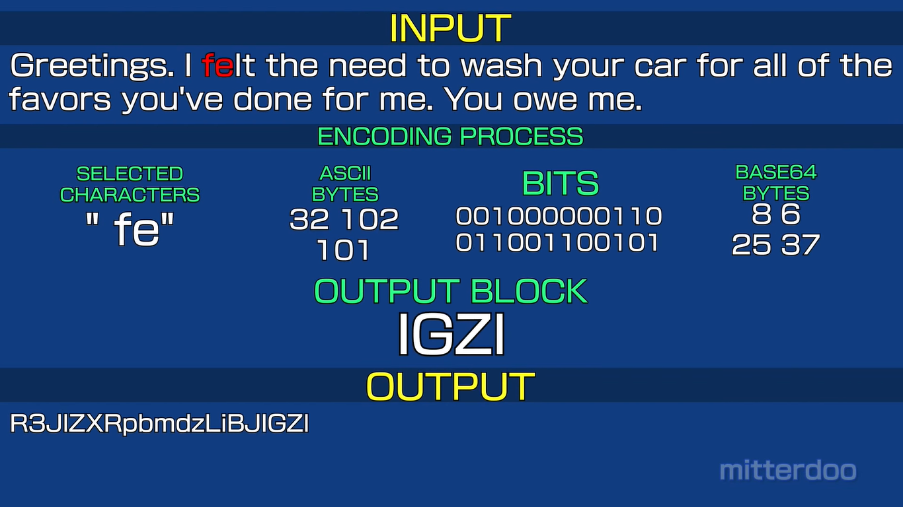
Base 64 format

Slide 14
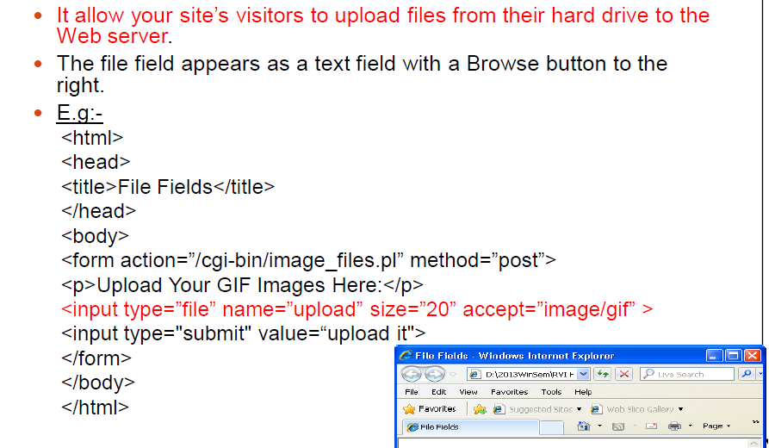
File Field

Slide 15
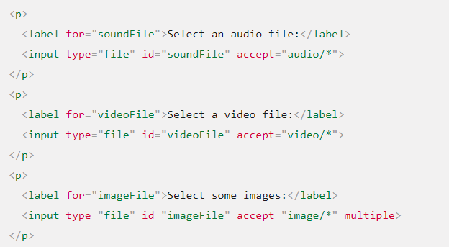

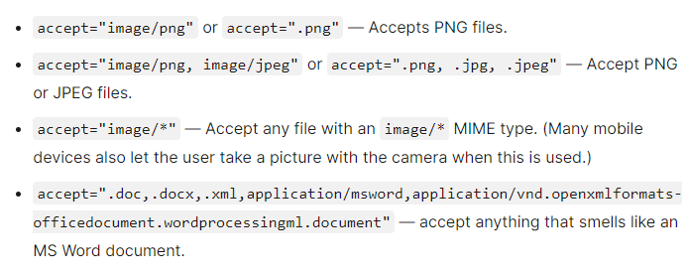
File Type

Slide 16
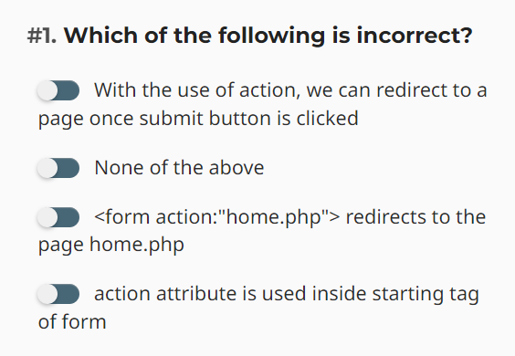
Question

Slide 17
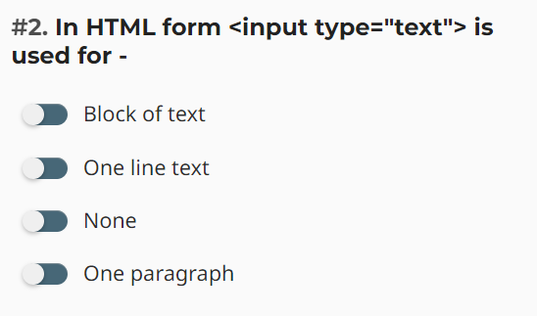
Question

Slide 18
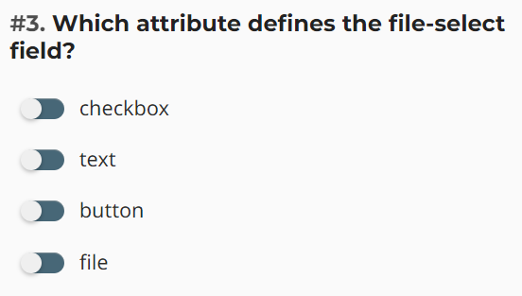
Question

Slide 19
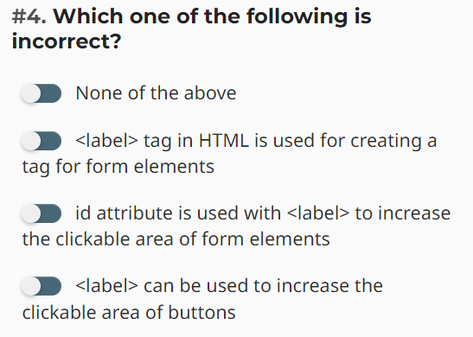
Question

Slide 20
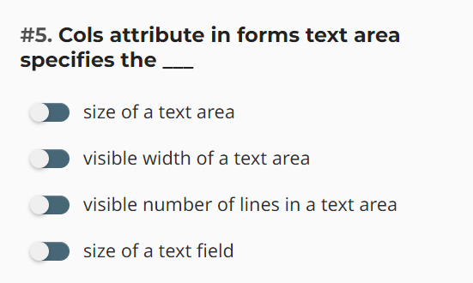
Question

Slide 21
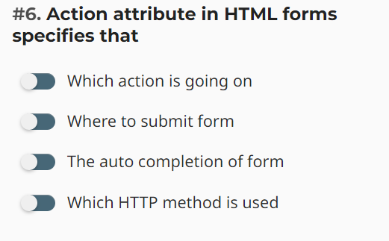
Question

Slide 22
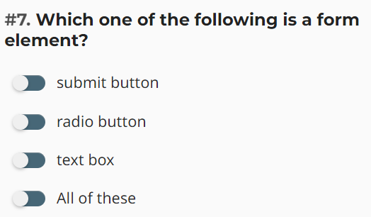
Question

Slide 23
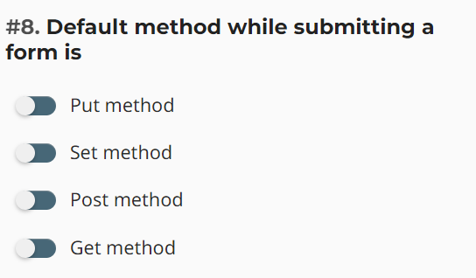
Question

Slide 24
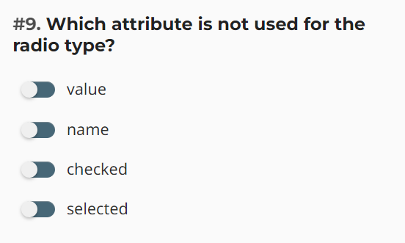
Question

Slide 25
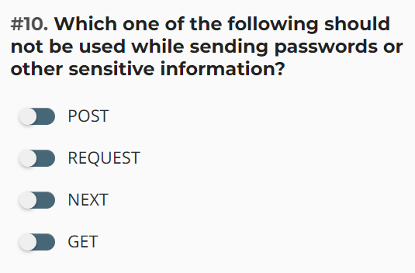
Question

Slide 26
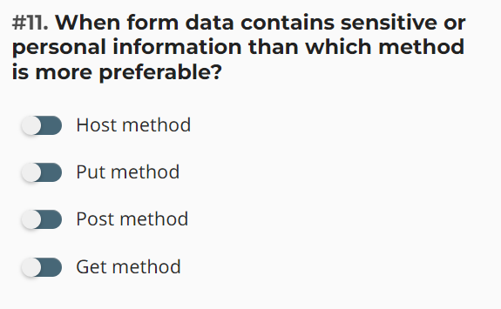
Question

Slide 27
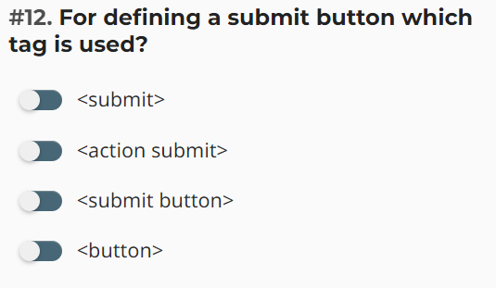
Question

Slide 28
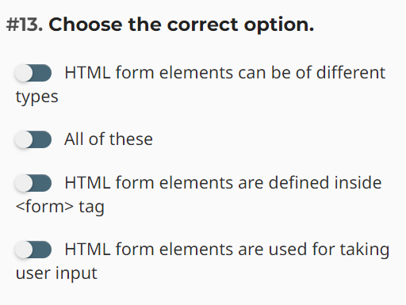
Question

Slide 29
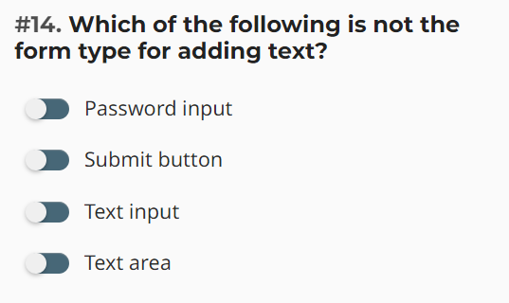
Question

Slide 30
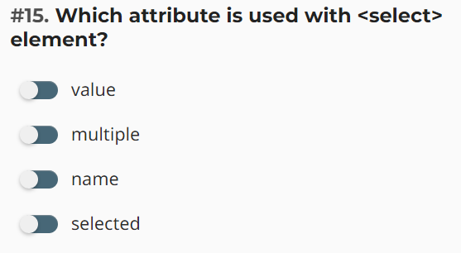
Question

Slide 31
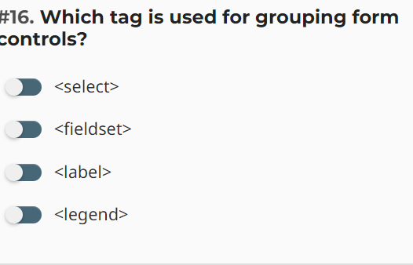
Question

Slide 32
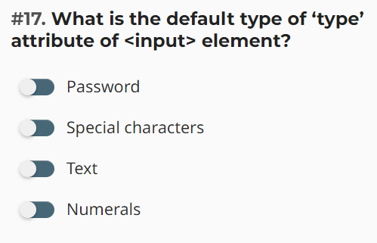
Question

Slide 33
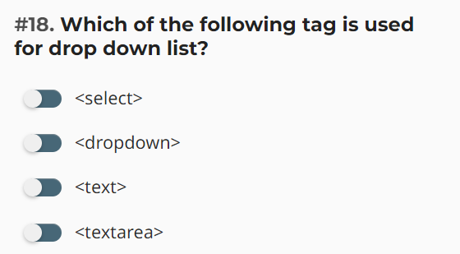
Question

