Slide 1
HTML – img tag,formatting tag,semantic,list

Slide 2
Image
HTML Images
Use the HTML <img> element to define an image.
Use the HTML src attribute to define the URL of the image.
Use the HTML alt attribute to define an alternate text for an image, if it cannot be displayed.
Use the HTML width and height attributes to define the size of the image

Slide 3
Image continue
<img src="credologo.jpg" alt="credosystemz.com" width="104" height="142">

Slide 4
Anchor tag with image

Slide 5
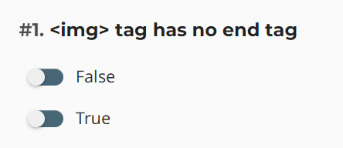
Question

Slide 6
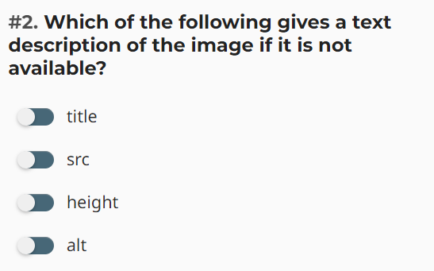
Question

Slide 7
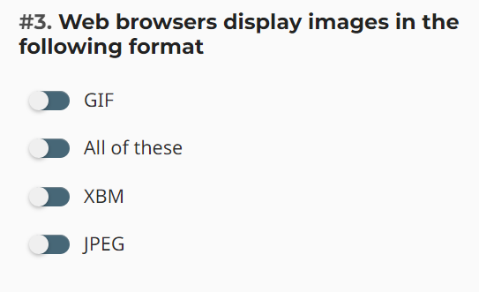
Question

Slide 8
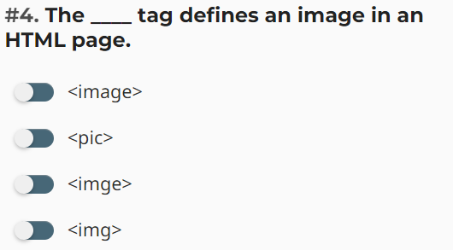
Question

Slide 9
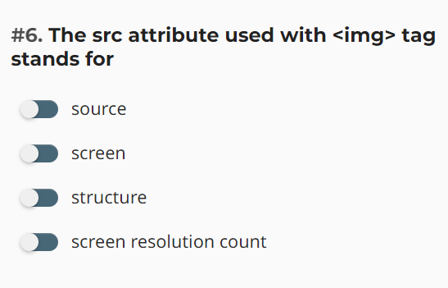
Question

Slide 10
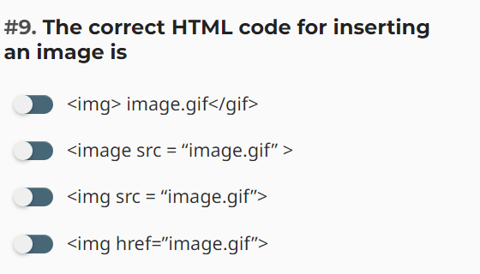
Question

Slide 11
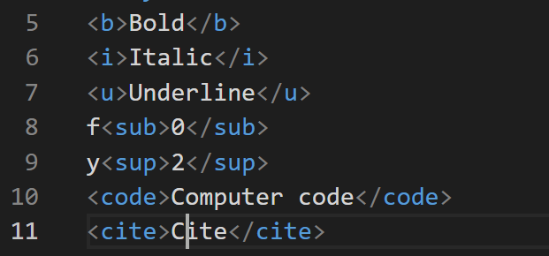
Formatting Tags

Slide 12

Question

Slide 13
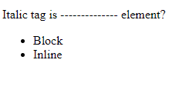
Question

Slide 14
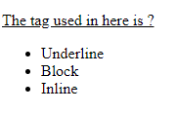
Question

Slide 15
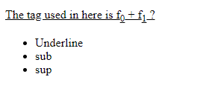
Question

Slide 16
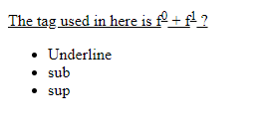
Question

Slide 17
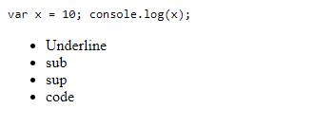
Question

Slide 18
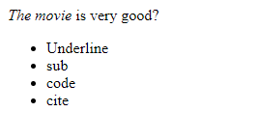
Question

Slide 19
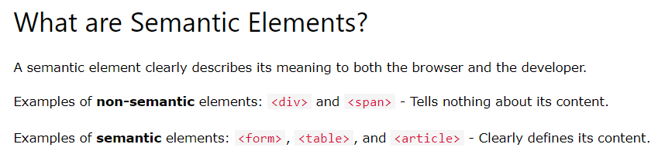
SEMANTIC ELEMENTS

Slide 20
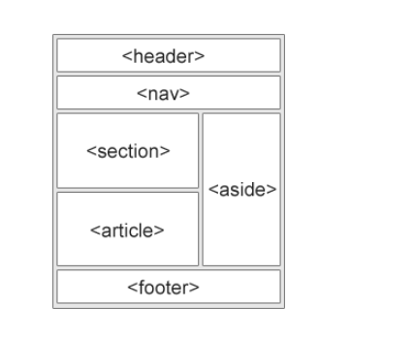
Semantic elements

Slide 21

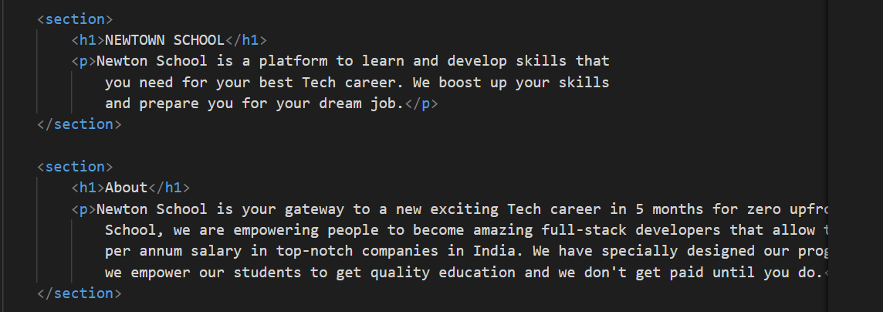
SECTION

Slide 22
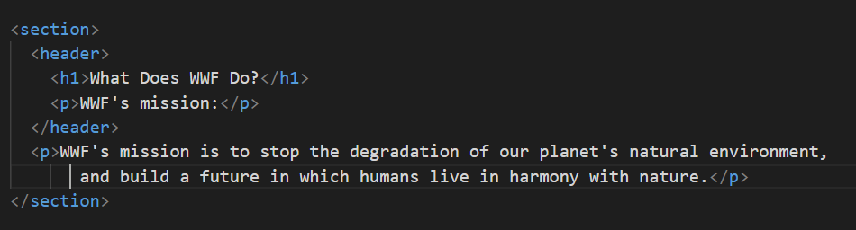
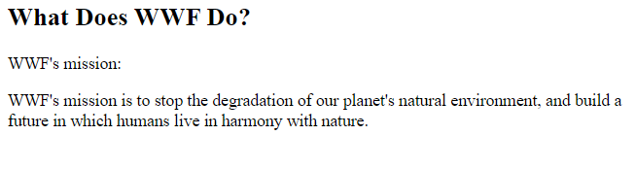
HEADER

Slide 23
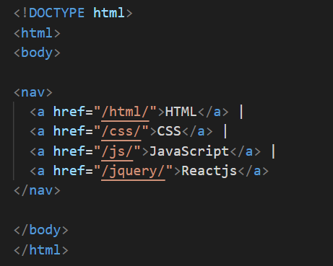

NAV

Slide 24
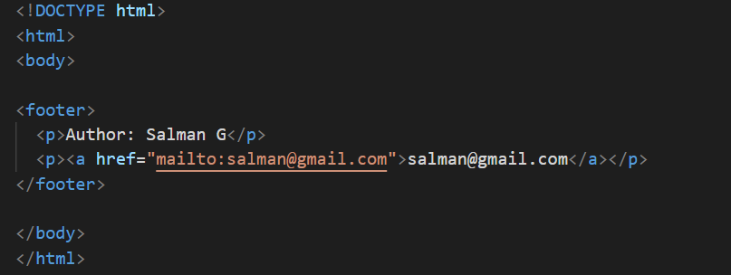
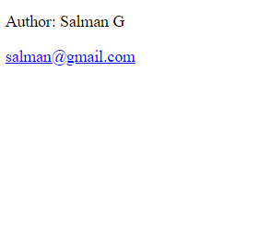
FOOTER

Slide 25

Sidebar menu

Slide 26
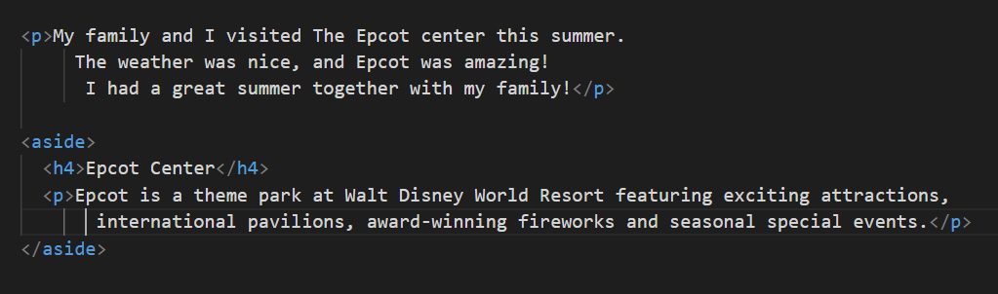
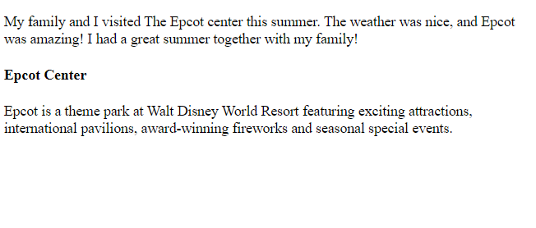
ASIDE

Slide 27
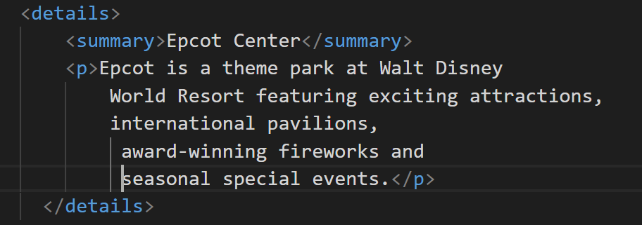

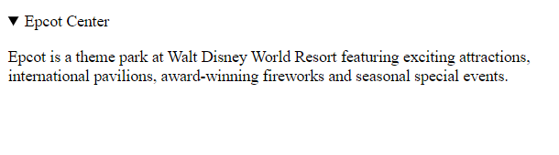

Slide 28
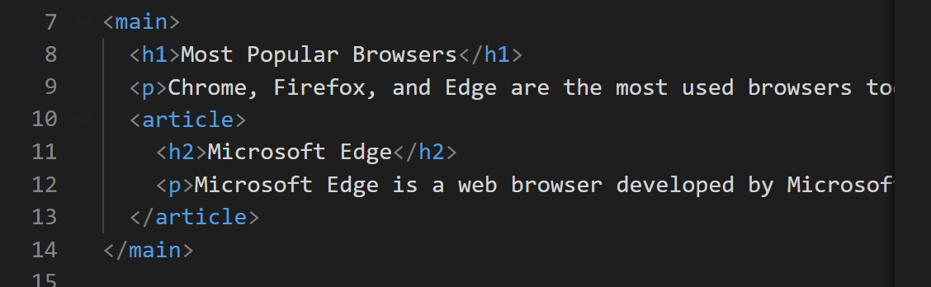
Main tag

Slide 29
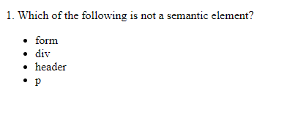
Question

Slide 30
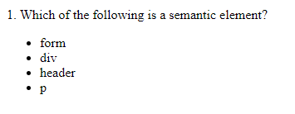
Question

Slide 31

Question

Slide 32
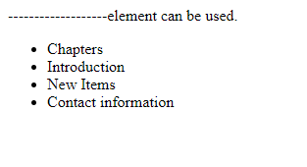
Question

Slide 33
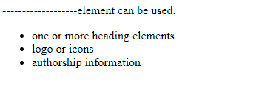
Question

Slide 34
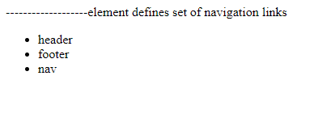
Question

Slide 35
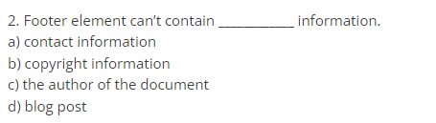
Question

Slide 36
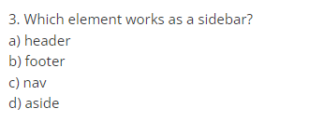
Question

Slide 37
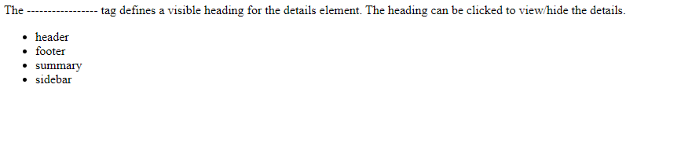
Question

Slide 38
HTML Elements continue..
HTML Lists
HTML lists are defined with the <ul> (unordered/bullet list) or the <ol> (ordered/numbered list) tag, followed by <li> tags (list items):
<ul> <li>Coffee</li> <li>Tea</li> <li>Milk</li> </ul>
<ol> <li>Coffee</li> <li>Tea</li> <li>Milk</li> </ol>

Slide 39
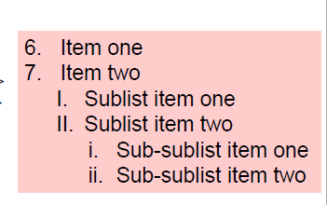
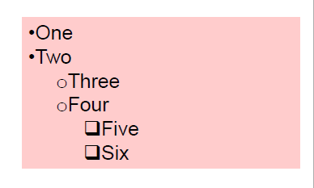
List

Slide 40
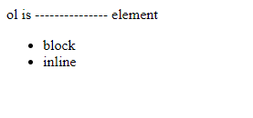
Question

Slide 41
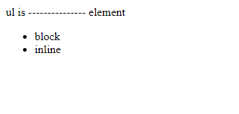
Question

Slide 42

Question

Slide 43

Question

Slide 44

Question

Slide 45
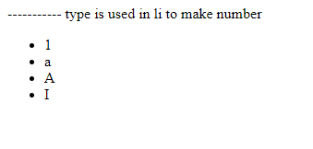
Question

Slide 46
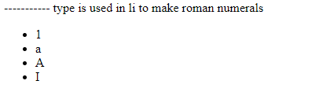
Question

Slide 47
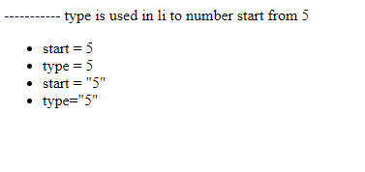
Question

