Slide 1
DOM - Training

Slide 2

TREE DATA STRUCTURE

Slide 3
DESCRIPTION
A DATA STRUCTURE THAT CONSISTS OF NODES IN A PARENT/CHILD RELATIONSHIP.
Tree are non-linear ( many different path).

Slide 4
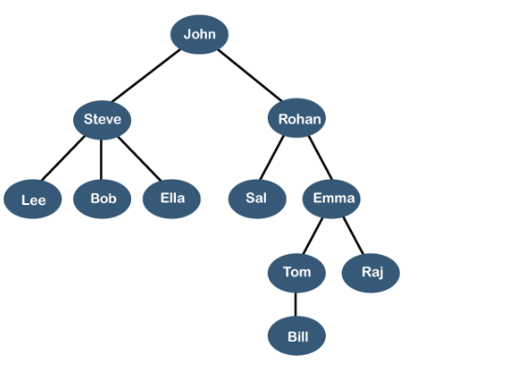
REAL TIME EXAMPLE LINKEDIN FRIENDS

Slide 5
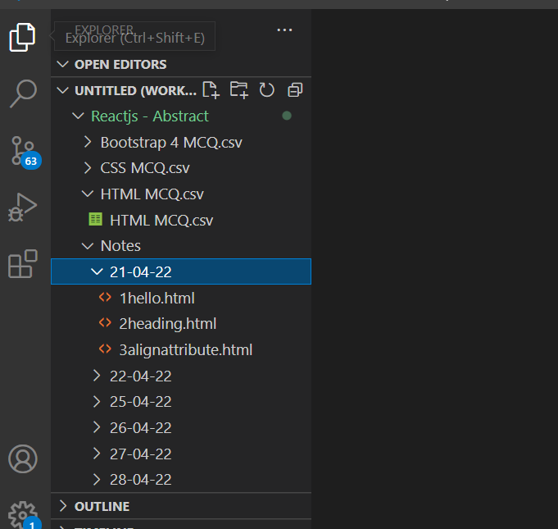
FILE SYSTEM

Slide 6
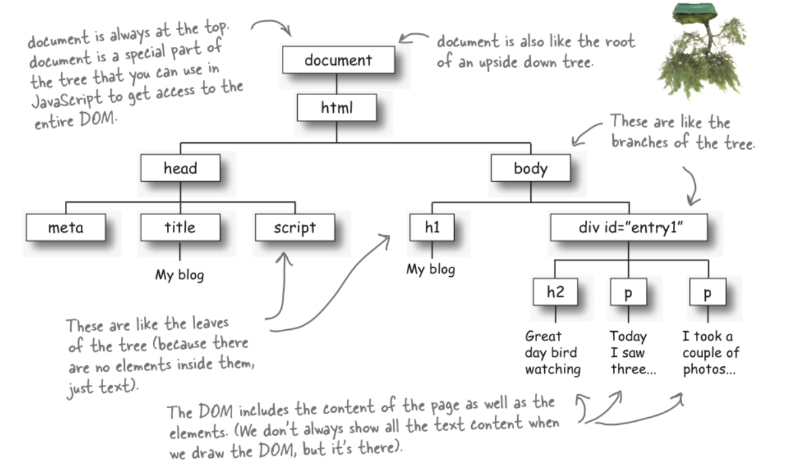
What is DOM ?
When a web page is loaded, the browser creates a Document Object Model of the page
The HTML DOM model is constructed as a tree of Objects:

Slide 7
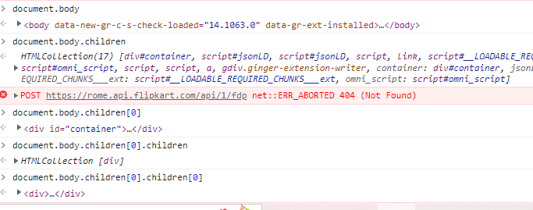
HTML DOM

Slide 8
DOM Methods
getElementById - To change/modify the content of an HTML element
<script>
document.getElementById("p1").innerHTML = "New text!";
</script>
Changing HTML Content
<script>
document.getElementById("myImage").src = "landscape.jpg";
</script>
Changing the Value of an Attribute
<script>
document.getElementById("myP").style.backgroundColor = "red";
</script>
Changing Style property
<script>
document.getElementById("myP").classList.add(“box”); </script>

Slide 9
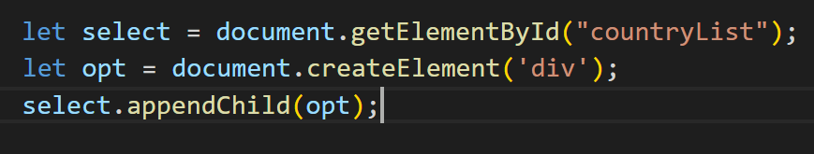
Creation of Element:

Slide 10
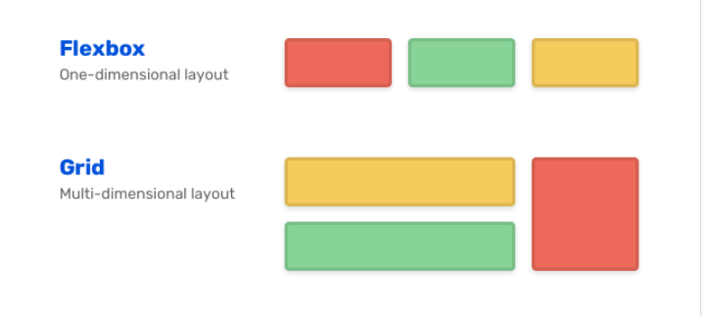
Flex box and grid

Slide 11
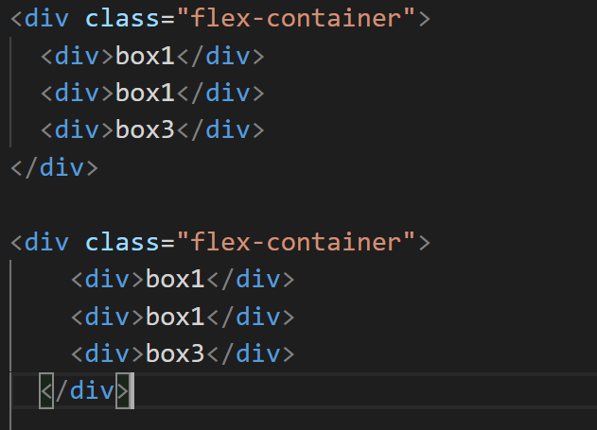
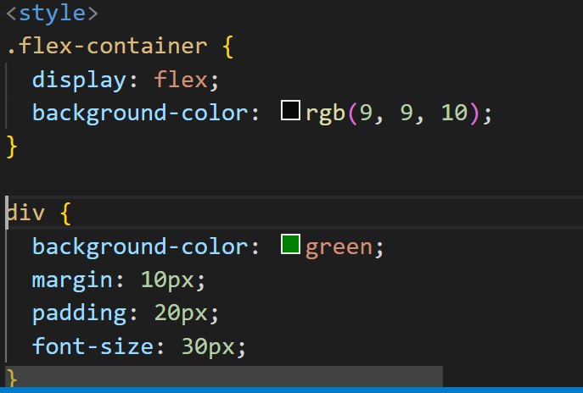
flexbox

Slide 12
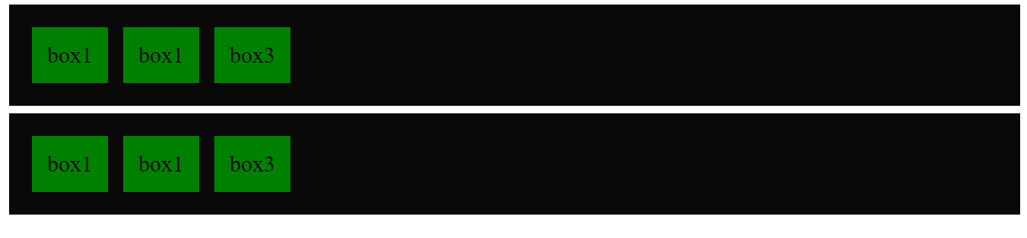
FlexBoX

Slide 13
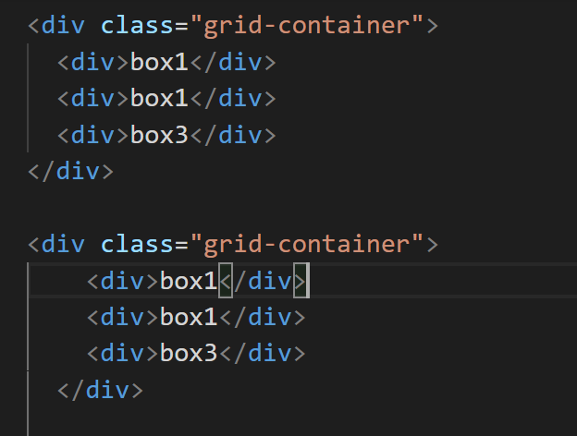
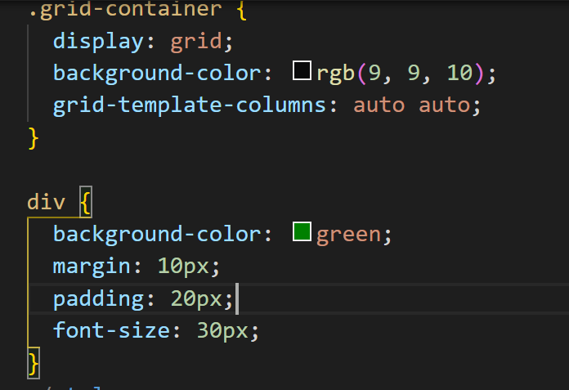
Grid

Slide 14
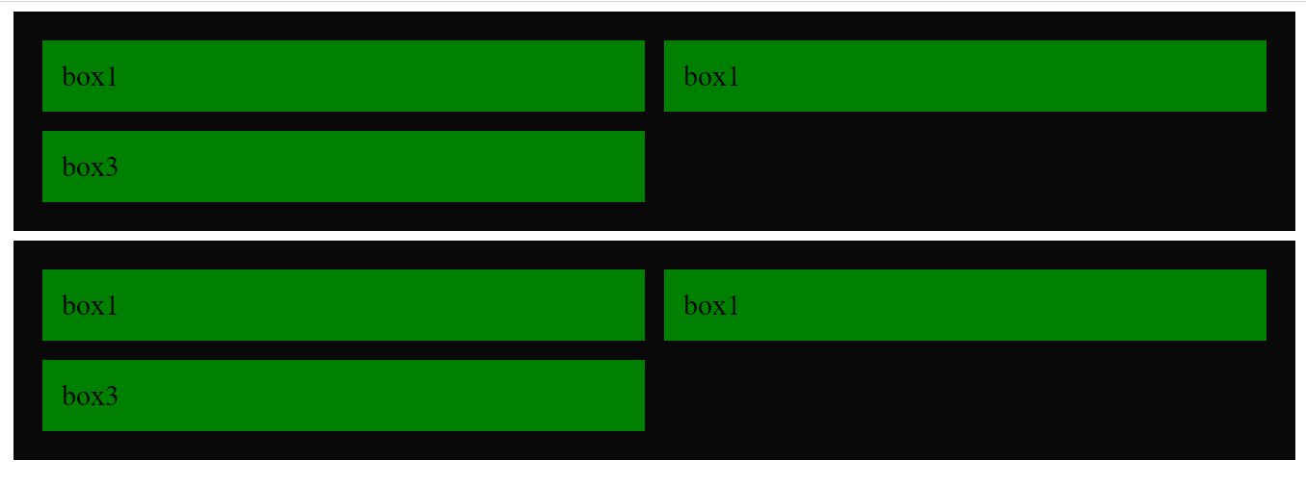
Grid

Slide 15
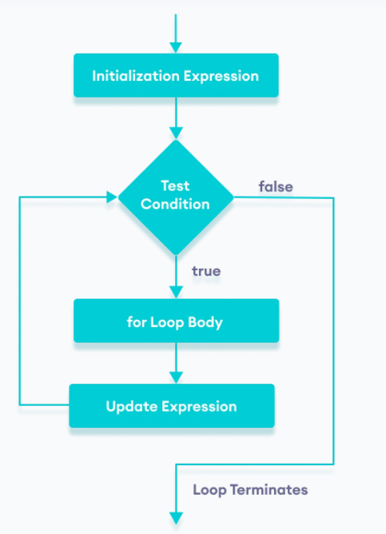
JavaScript Loops - for
The for loop requires following three parts.
Initializer: Initialize a counter variable to start with
Condition: specify a condition that must evaluate to true for next iteration
Iteration: increase or decrease counter
Syntax
for(initializer; condition; iteration)
{
// Code to be executed
}
Example
for (var i = 0; i < 5; i++)
{
console.log(i);
}
let n = 5;
// looping from i = 1 to 5
for (let i = 1; i <= n; i++) {
console.log(`I am learning JavaScript.`);
}

