Slide 1
Class component
Salman Ahmed G

Slide 2
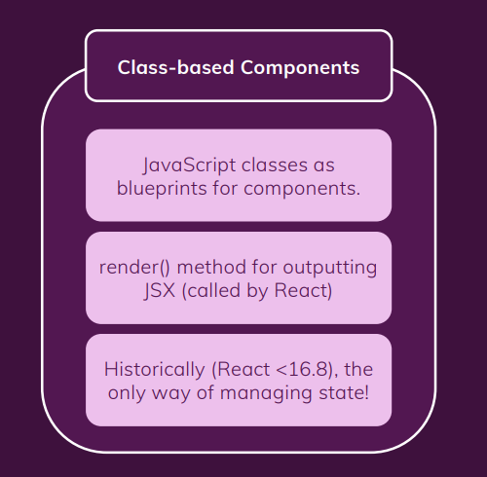
What is class component

Slide 3
Benefits of Class component
Below points highlight the benefits
Class components help in calling different methods at different time of DOM manipulation using lifecycle hooks
Class components help us to manage state

Slide 4
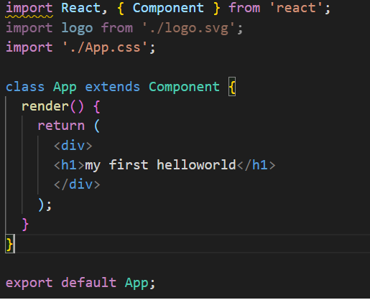
Class component
Class components need to extends to Component class of react
Class component should consists of render()method inside the class
Inside class component constructor() method is optional

Slide 5
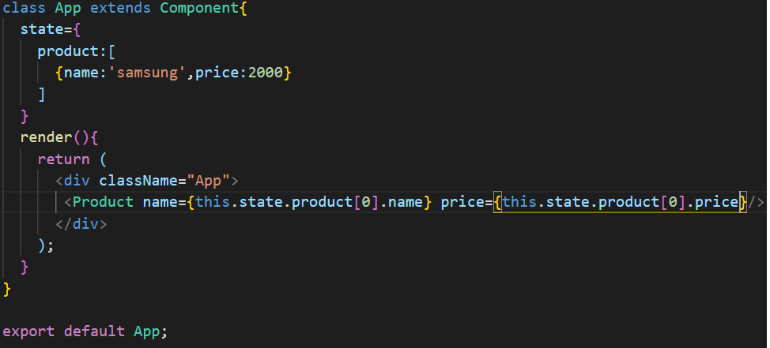
State in component class

Slide 6
State in component class
State can be declare in two ways:
State can be declare inside the constructor
State can be declare outside the constructor if constructor is optional
Whenever you declare state in class component always use keyword “state”
Whenever you want to access the state use “this.state”

Slide 7
Inside the constructor declaring the state:
Example:
constructor(){
this.state={
name:”salman”,
Address:”chennai”
}
}

Slide 8
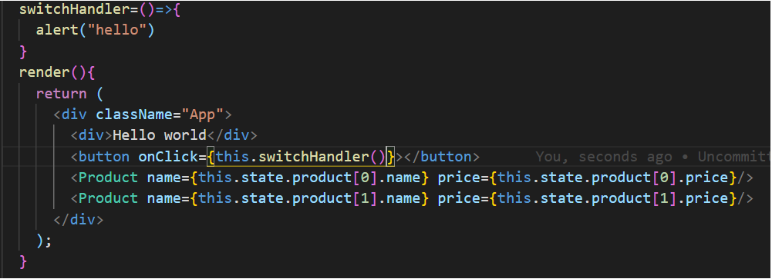
Handling events using state

Slide 9
Events handling
Events can be called from JSX using the this keyword with method name
Please don’t use method name with parenthesis inside the JSX because method will be called immediately
Always use arrow function to write methods inside the class components

Slide 10
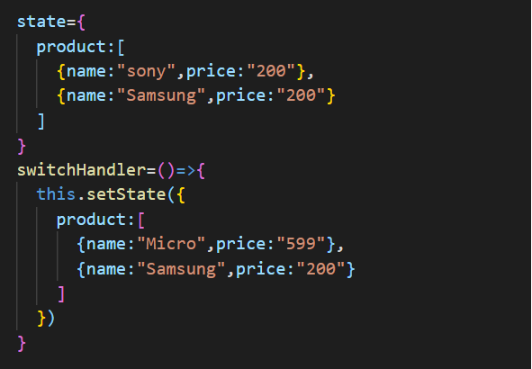
Manipulation of state

Slide 11
Manipulation of state
Changing state in class component always need setState() property from react components.
Inside the setState() which ever property you want to update then that particular data you can update it.
Other state data will remain as it is there will no change in data.

Slide 12
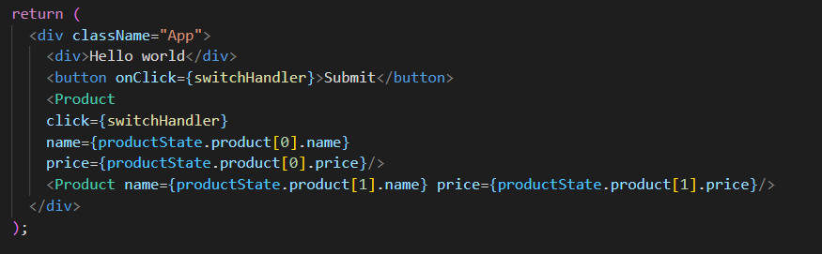
Passing method reference-1

Slide 13
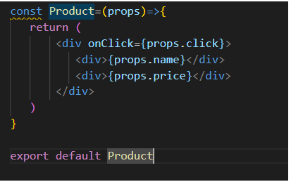
Passing method reference-2

Slide 14
Passing method reference-3
Calling method from child component to parent component while using method passing reference
Whenever events trigger from child component it will react to parent component via props.
Whatever methods is attached in props then particular method can be called.
We can pass a data from child to parent component using method reference
So flow of data will become bidirectional from parent to child and from child to parent component.

Slide 15
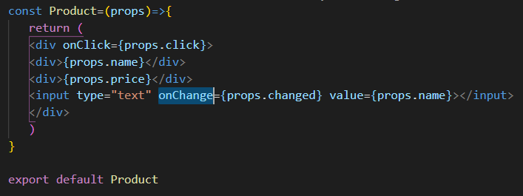
Two way binding in form - 1

Slide 16
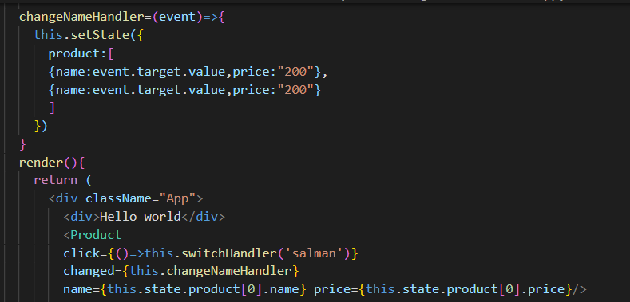
Two way binding form-2

Slide 17
Two way binding form-3
For two way binding inside the form tag we have to use value property and onChange() events inside the input,textarea,radio,checkbox,select tags.
Value property helps us to binding the existing value and updating value from state
onChange events help us to call setState to change the value of the state.
Value property use curly braces{} to bind the value inside the JSX
onChange() call event method inside the curly braces{}don’t use circle braces inside the function call otherwise it will call immediately

