Slide 1
Bootstrap 4
Salman Ahmed G

Slide 2
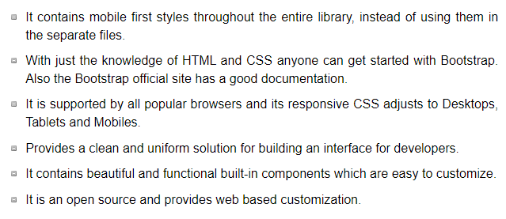
Use of bootstrap

Slide 3
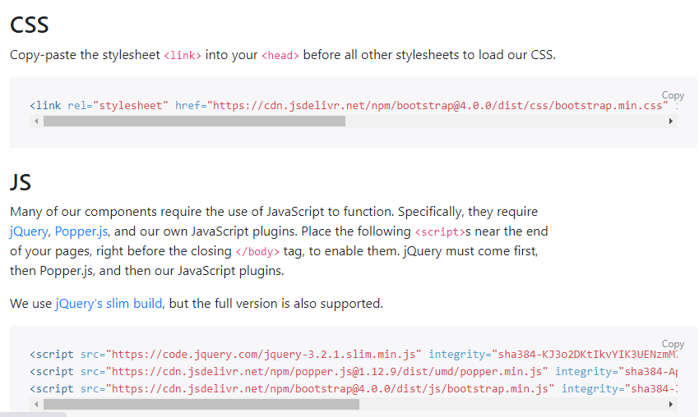
Environmental setup

Slide 4

Layout - container

Slide 5
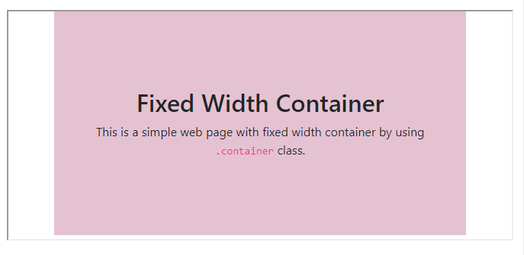
Layout container - example

Slide 6

Layout container-fluid

Slide 7
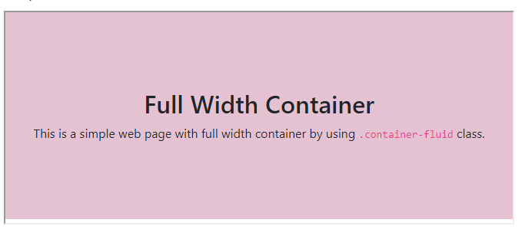
Layout container-fluid - example

Slide 8
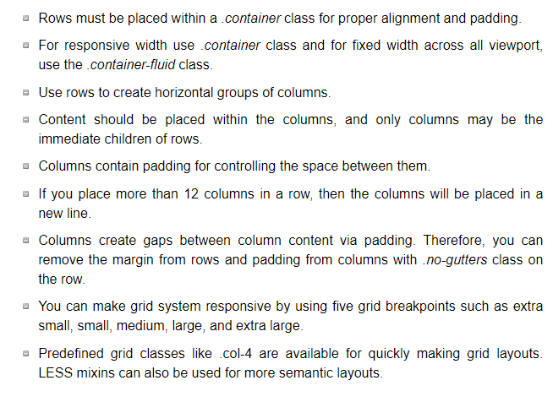
Grid system

Slide 9
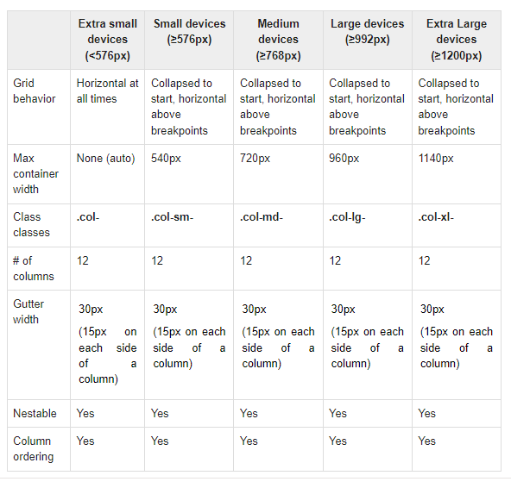
Grid system

Slide 10
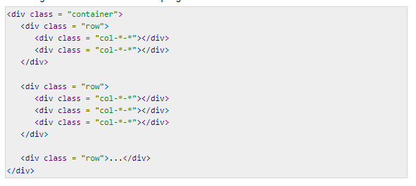
Grid basic structure

Slide 11

colors

Slide 12
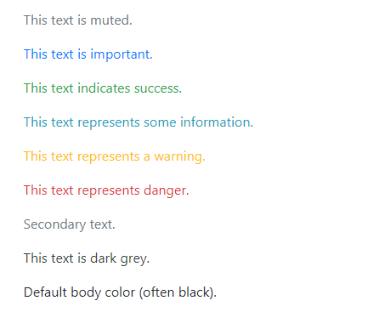
Colors output

Slide 13

button

Slide 14

Button output

Slide 15
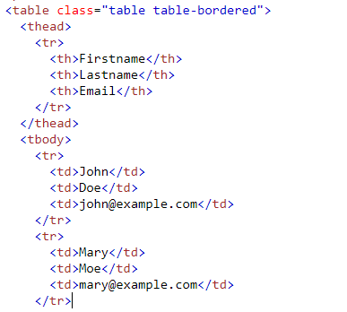
table

Slide 16

Table output

Slide 17
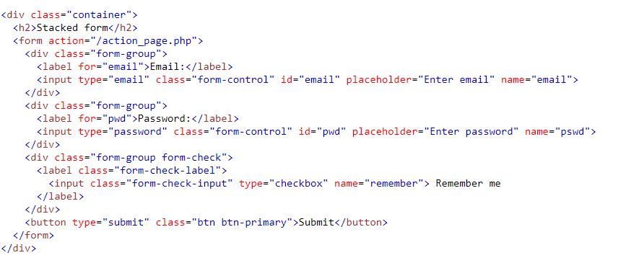
forms

Slide 18

Forms output

Slide 19

Modal example

Slide 20



Navbar example

