Slide 1
Testing
Salman Ahmed G

Slide 2
About testing
Testing is often seen as a tedious process. It's extra code you have to write, and in some cases, to be honest, it's not needed. But every developer should know at least the basics of testing. It increases confidence in the products they build, and for most companies, it's a requirement.
In the React world, there is an amazing library called the react-testing-library which helps you test your React Apps more efficiently. You use it with Jest.

Slide 3
basics
Some key things will be used a lot in this article, and understanding their role can help you with your understanding.
it or test: describes the test itself. It takes as parameters the name of the test and a function that holds the tests.
expect: the condition that the test needs to pass. It will compare the received parameter to a matcher.
a matcher: a function that is applied to the expected condition.
render: the method used to render a given component.
import React from 'react'

Slide 4
To run run test case:
npm test -- --coverage

Slide 5
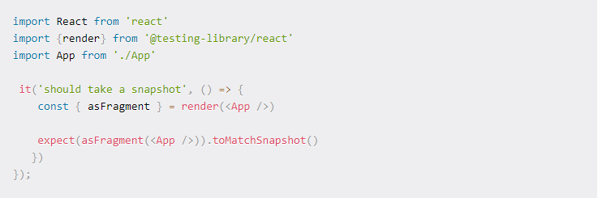
Example of unit testing

Slide 6
testing notes
As you can see, we describe the test with it, then, use render to display the App component and expect that asFragment(<App />) matches toMatchSnapshot() (the matcher provided by jest-dom).
By the way, the render method returns several methods we can use to test our features. We also used destructuring to get the method.

Slide 7
React testing library
The React Testing Library is a very light-weight package created by Kent C. Dodds. It's a replacement for Enzyme and provides light utility functions on top of react-dom and react-dom/test-utils.
The React Testing Library is a DOM testing library, which means that instead of dealing with instances of rendered React components, it handles DOM elements and how they behave in front of real users.
It's a great library, it's (relatively) easy to start using, and it encourages good testing practices. Note – you can also use it without Jest.

Slide 8
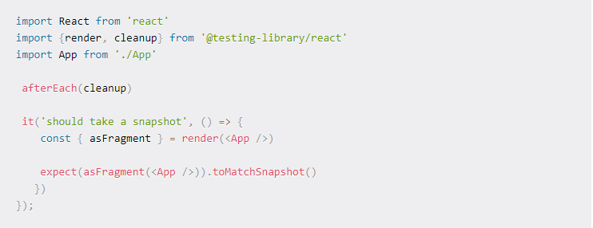
Example 1 – snapshot testing

Slide 9
Example 1 – snapshot testing notes
To take a snapshot, we first have to import render and cleanup. These two methods will be used a lot throughout this article.
render, as you might guess, helps to render a React component. And cleanup is passed as a parameter to afterEach to just clean up everything after each test to avoid memory leaks.
Next, we can render the App component with render and get back asFragment as a returned value from the method. And finally, make sure that the fragment of the App component matches the snapshot.
Now, to run the test, open your terminal and navigate to the root of the project and run the following command:

Slide 10
Command to run
npm run test
As a result, it will create a new folder __snapshots__ and a file App.test.js.snap in the src.
And if you make another change in App.js, the test will fail, because the snapshot will no longer match the condition. To make it passes, just press u to update it. And you'll have the updated snapshot in App.test.js.snap.

Slide 11
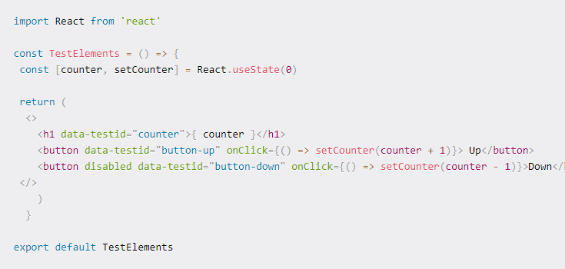
Example 2 : testing dom elements

Slide 12
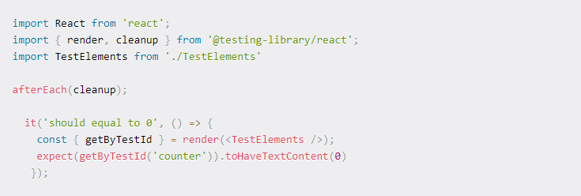
Example 2 : testing dom elements

Slide 13
Example 2: testing dom elements notes
As you can see, the syntax is quite similar to the previous test. The only difference is that we use getByTestId to select the necessary elements (remember the data-testid) and check if it passed the test. In others words, we check if the text content <h1 data-testid="counter">{ counter }</h1> is equal to 0.
Test if the buttons are enabled or disabled:

Slide 14
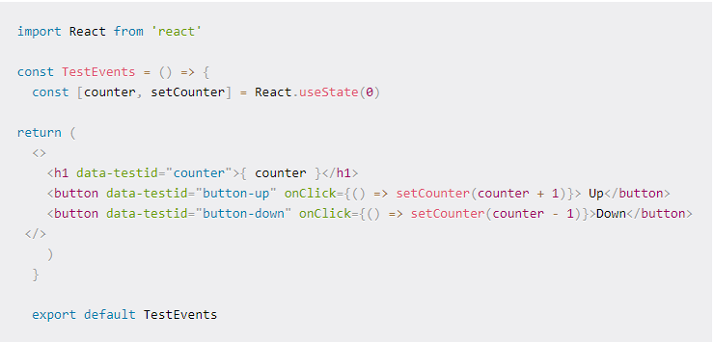
Example 3 – testing events

Slide 15
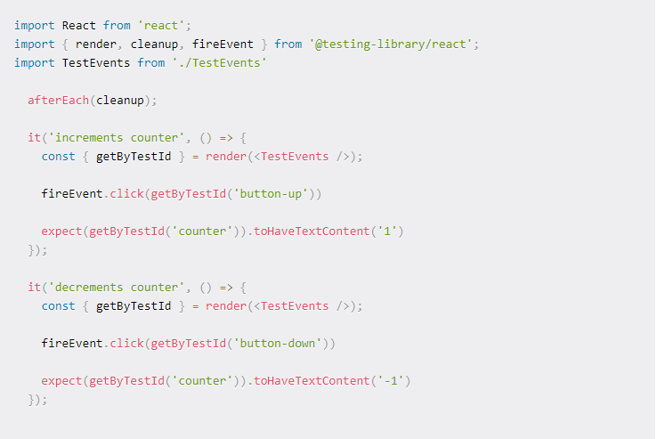
Example 3 – testing events

Slide 16
Example e – testing events notes
As you can see, these two tests are very similar except the expected text content.
The first test fires a click event with fireEvent.click() to check if the counter increments to 1 when the button is clicked.
And the second one checks if the counter decrements to -1 when the button is clicked.
fireEvent has several methods you can use to test events, so feel free to dive into the documentation to learn more.
Now that we know how to test events, let's move on and learn in the next section how to deal with asynchronous actions.

Slide 17
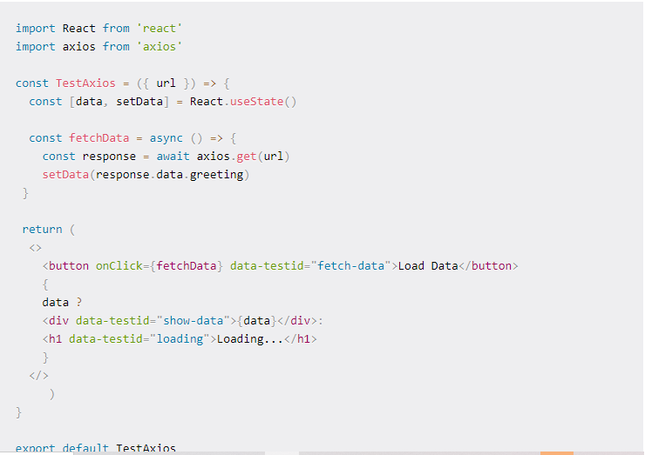
Example 4 – testing http request

Slide 18
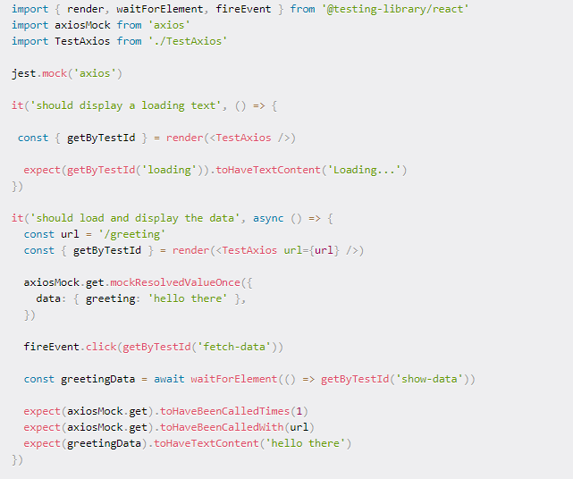
Example 4 : testing http request

Slide 19
Example 4:testing http request notes
This test case is a bit different because we have to deal with an HTTP request. And to do that, we have to mock an axios request with the help of jest.mock('axios').
Now, we can use axiosMock and apply a get() method to it. Finally we will use the Jest function mockResolvedValueOnce() to pass the mocked data as a parameter.
With that, now for the second test we can click to the button to fetch the data and use async/await to resolve it. And now we have to test 3 things:
If the HTTP request has been done correctly
If the HTTP request has been done with the url
If the data fetched matches the expectation.
And for the first test, we just check if the loading message is displayed when we have no data to show.

Slide 20
conclusion
The React Testing Library is a great package for testing React Apps. It gives us access to jest-dom matchers we can use to test our components more efficiently and with good practice

