Slide 1

HTML 5 - Training

Slide 2

HTML – Head Tag Containers
The Head Element
Title tag
Style tag
Link tag
Script tag
Meta tag

Slide 3
Structure of HTML continue..
The Head Element
The <head> element is a container for metadata and is placed between the <html> tag and the <body> tag.
HTML metadata is data about the HTML document.
Metadata typically define the document title, character set, styles, scripts, and other meta information.
The <title> Element
The <title> element defines the title of the document.
Defines a title in the browser toolbar
Provides a title for the page when it is added to favorites
Displays a title for the page in search engine-results

Slide 4
Structure of HTML continue..
The <meta> Element
The <meta> element is typically used to specify the character set, page description, keywords, author of the document, and viewport settings.
Define the character set used:
<meta charset="UTF-8">
Define a description of your web page:
<meta name="description" content=“Web Development Training">
Define the author of a page:
<meta name="author" content=“Gopi">
Setting the viewport to make your website look good on all devices:
<meta name="viewport" content="width=device-width, initial-scale=1.0">

Slide 5
HTML Body Tags
Heading Tags - <h1>, <h2>, <h3>, <h4>, <h5>, <h6> tags.
Paragraph Tag - <p> tag.
Horizontal ruler - <hr> tag.
Anchor(Link) Tag - <a> (anchor) tag.
List Tag - <ul> (unordered list), <ol> (ordered list) and <li> (list element) tags.
Image Tag - <img> tag
Divider, denoted using the <div> tag
Text span, denoted using the <span> tag

Slide 6
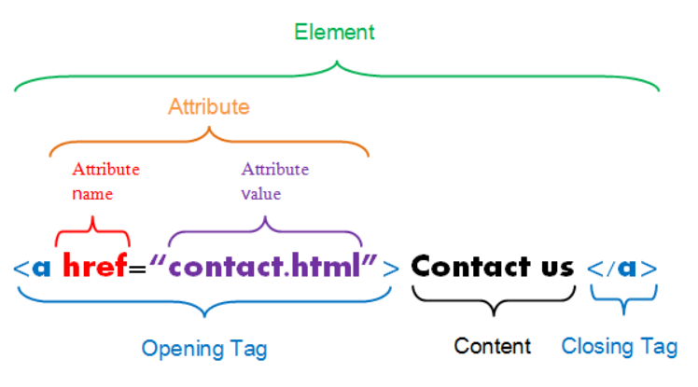
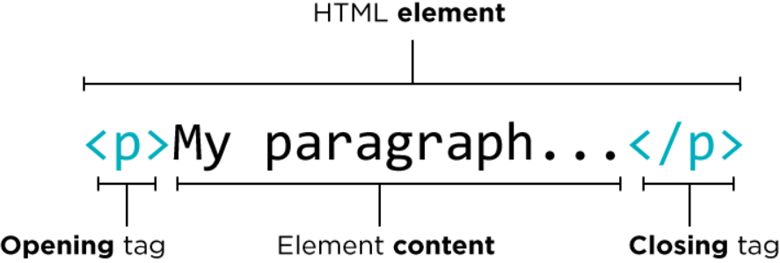
HTML Element, Tag & Attribute

Slide 7
HTML Elements
HTML Headings
HTML headings are defined with the <h1> to <h6> tags.
<h1> defines the most important heading. <h6> defines the least important heading.
HTML Paragraphs
HTML paragraphs are defined with the <p> tag.
<h1>This is heading 1</h1> <h2>This is heading 2</h2> <h3>This is heading 3</h3>
15hrs
<p>This is a paragraph.</p>
<p>This is another paragraph.</p>

