Slide 1
React JS
SALMAN AHMED G

Slide 2
What is React
React is a Javascript Library for building user interface.
React makes building complex interactive and reactive user interface simpler
Mobile apps and desktop apps feel very “reactive”:Things happen instantly you don’t wait for new page to load or actions to start.
Traditionally in web apps you click a link and wait for new page to load. you click a button and wait for some action to complete

Slide 3
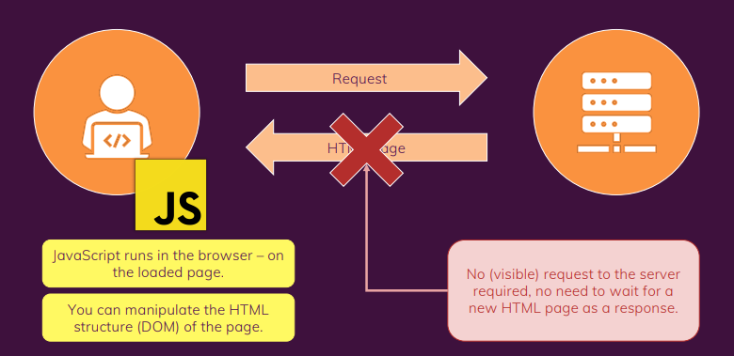
Javascript the Master

Slide 4
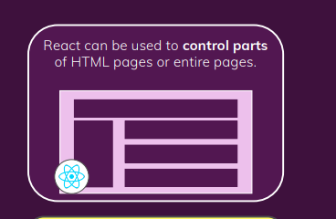
SPA-Single page Application

Slide 5
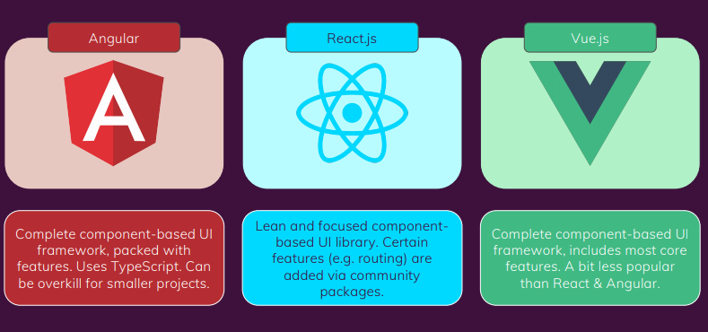
React.js Alternatives

Slide 6


React.js Component Approach

Slide 7
Component Approach
React is all about component
Because all user interfaces in the end are made up of components
Components benefits don’t repeat itself
Don’t do too many things in one and same function
Split big junks of code into smaller functions.

Slide 8
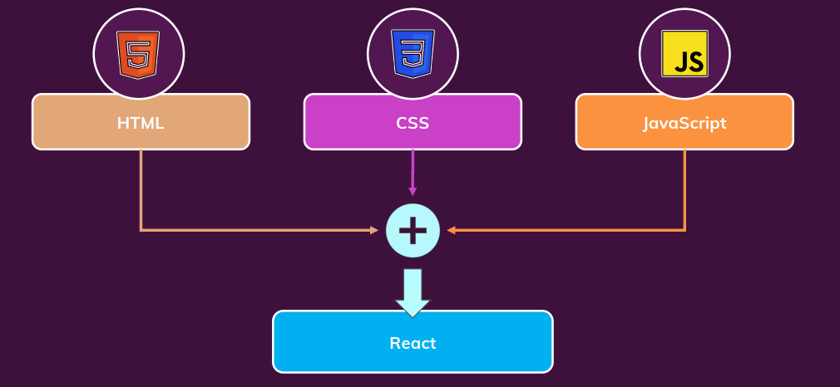
How Components is built

Slide 9
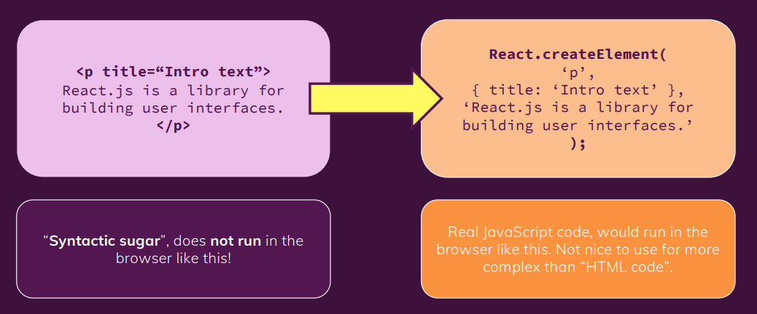
JSX – Html in javascript
JSX stands for Javascript XML

Slide 10
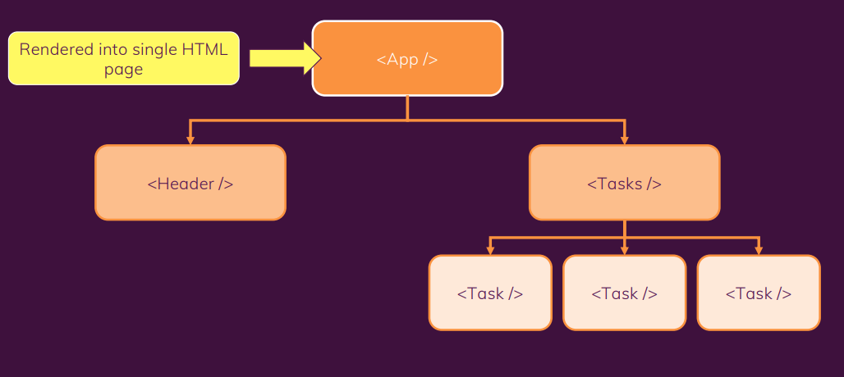
Component tree

Slide 11
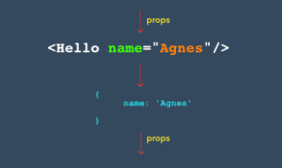
What is Props
Props are attribute of your custom html components.
Similar in HTML built in attributes like id,name,value
Props is passed from higher component to lower component or parent to child component

Slide 12
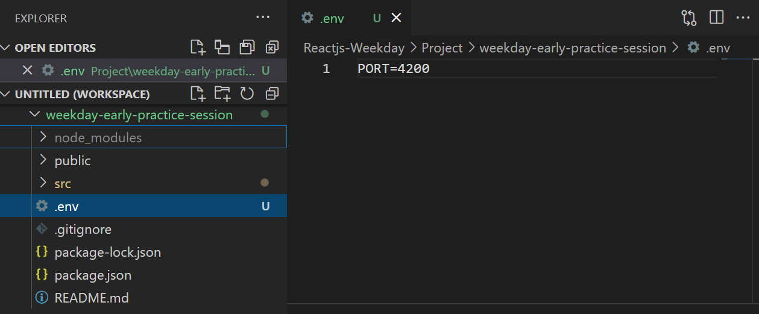
Changing default port

Slide 13
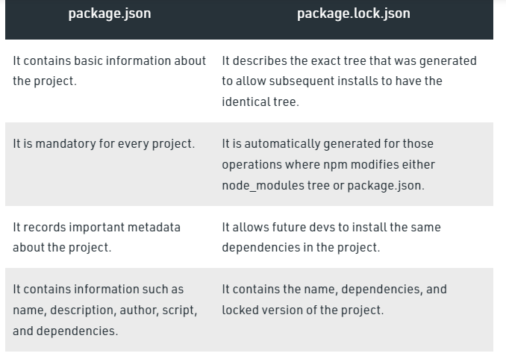
Package.json

Slide 14
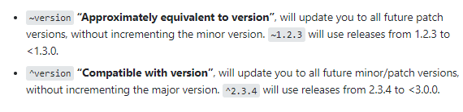
Version

