Slide 1
What is State in React
Salman Ahmed G

Slide 2
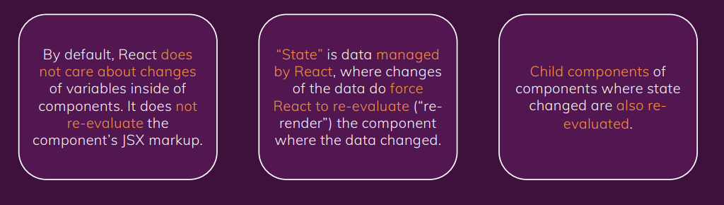
What is state

Slide 3
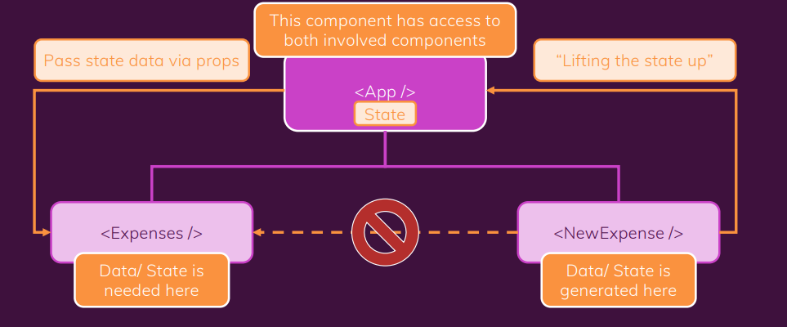
Lifting state up

Slide 4
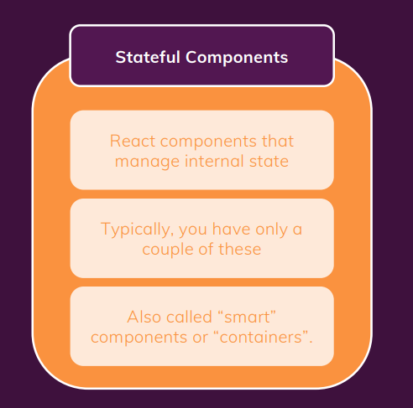
Statefull components

Slide 5
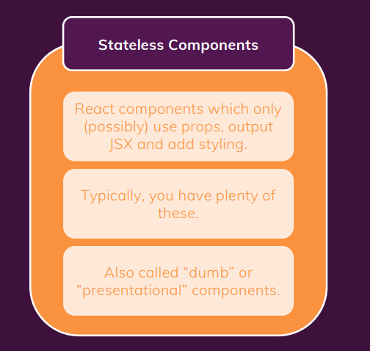
Stateless components

Slide 6
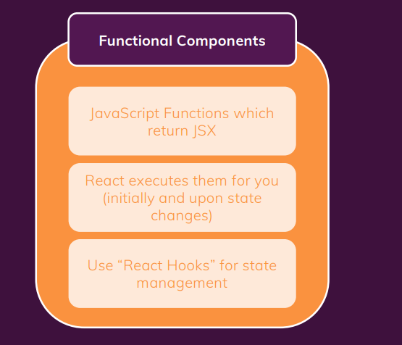
Type 1:Building components

Slide 7
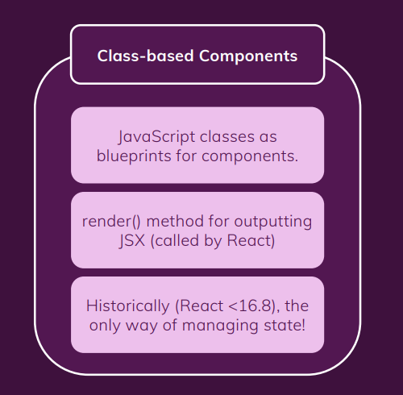
Type 2: building components

