Slide 1


HTML 5 - Training

Slide 2

Agenda
Web Introduction
Client-side Technologies overview
Application Architecture
HTML Introduction
HTML Elements deep dive
HTML Input Elements
HTML Element Specific Attributes
HTML Forms & its Attributes
www.credosystemz.com © Copyright 2021 | credosystemz | All Rights Reserved

Slide 3
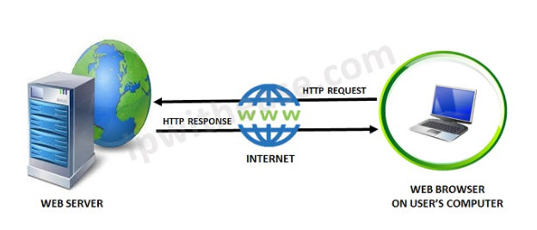
What is Web?
The Web is the common name for the World Wide Web (WWW)
The Web is just one of the ways that information is shared over the Internet.
The Web consisting of the pages that can be accessed by a Web browser such as Internet Explorer, Google Chrome, Mozilla Firefox
Web pages are formatted in a language called HTML.
The Web uses HTTP protocol to transmit data and share information.
www.credosystemz.com © Copyright 2021 | credosystemz | All Rights Reserved

Slide 4
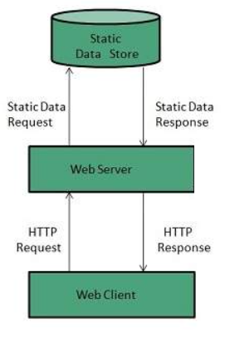
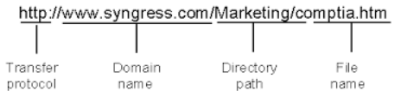
What is Web Server?
Web server is a computer where the web content is stored
Web server is used to host the web sites
When client sends request for a web page, the web server search for the requested page if requested page is found then it will send it to client with an HTTP response.
www.credosystemz.com © Copyright 2021 | credosystemz | All Rights Reserved

Slide 5
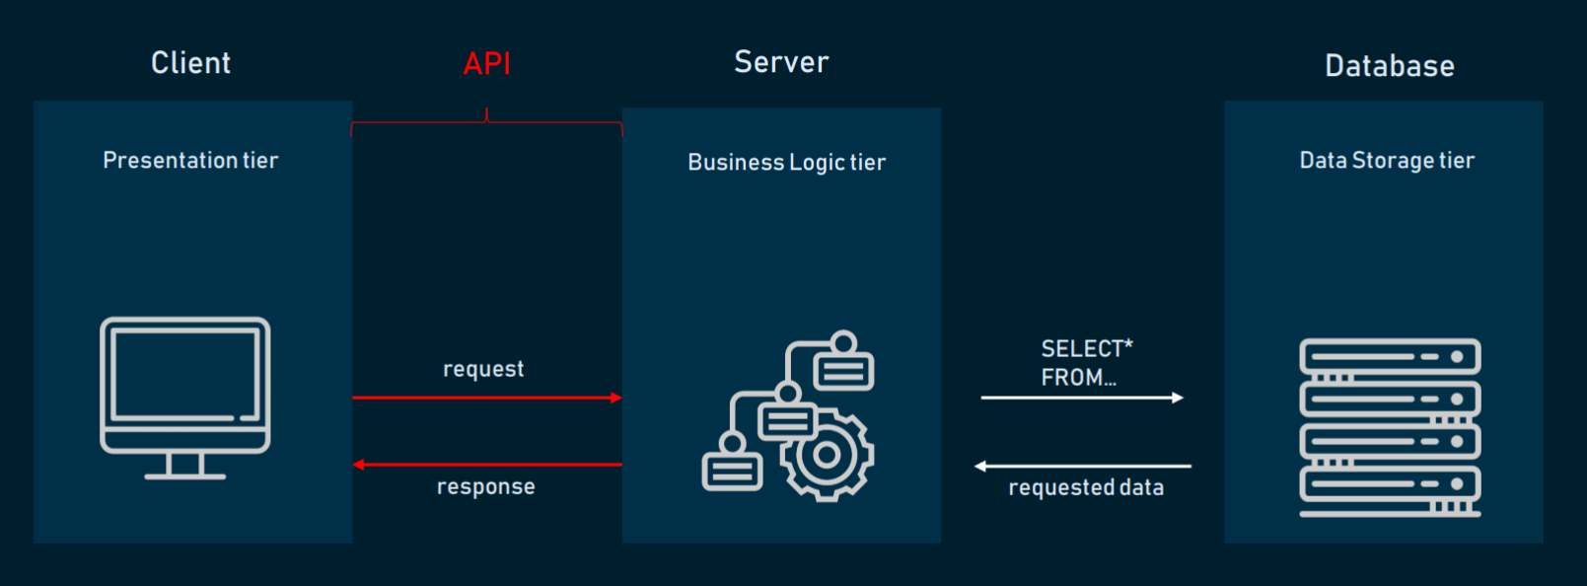
Application Architecture
HTML, CSS, JavaScript, Angular
www.credosystemz.com © Copyright 2021 | credosystemz | All Rights Reserved

Slide 6
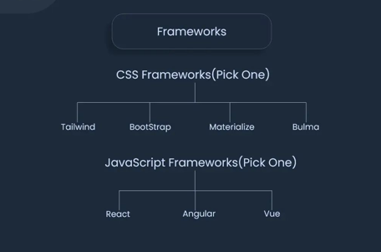
FRONTEND FRAMEWORKS

Slide 7
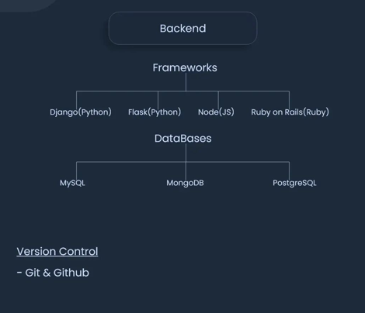
BACKEND FRAMEWORKS

Slide 8
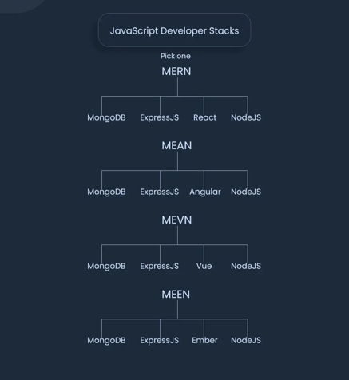
JAVASCRIPT FRAMEWORKS

Slide 9
What is HTML?
HTML (HyperText Markup Language) is the most basic building block of the Web.
HTML describes the structure of a Web page.
HTML consists of a series of elements.
HTML elements tell the browser how to display the content.
HTML elements are represented by tags.
HTML tags label pieces of content such as "heading", "paragraph", "table", and so on.
Browsers do not display the HTML tags, but use them to render the content of the page
www.credosystemz.com © Copyright 2021 | credosystemz | All Rights Reserved

Slide 10
What is Hypertext & Markup?
Hypertext is a text which references to other text.
Hypertext means machine readable text and Markup means to structure it in a specific format.
So, HTML is called hypertext markup language because it is a language that allows users to organize, improve the appearance of, and link text with data on the internet.
www.credosystemz.com © Copyright 2021 | credosystemz | All Rights Reserved

Slide 11
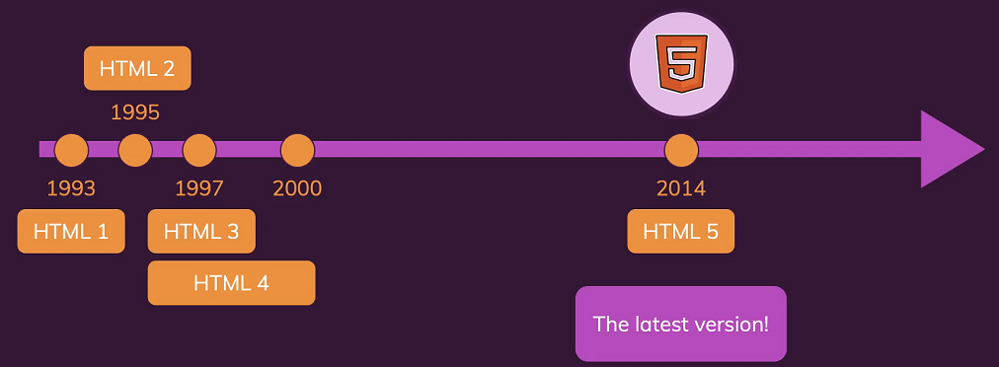
History of HTML
www.credosystemz.com © Copyright 2021 | credosystemz | All Rights Reserved

Slide 12
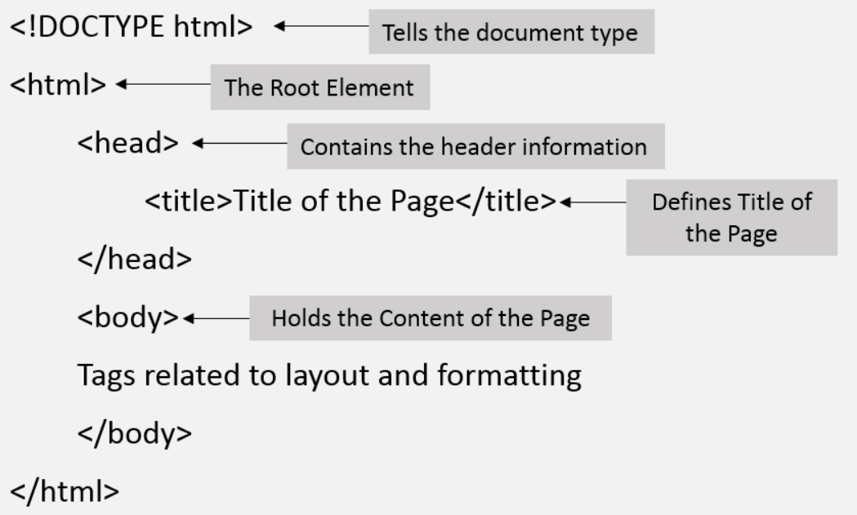
Structure of HTML
www.credosystemz.com © Copyright 2021 | credosystemz | All Rights Reserved

Slide 13
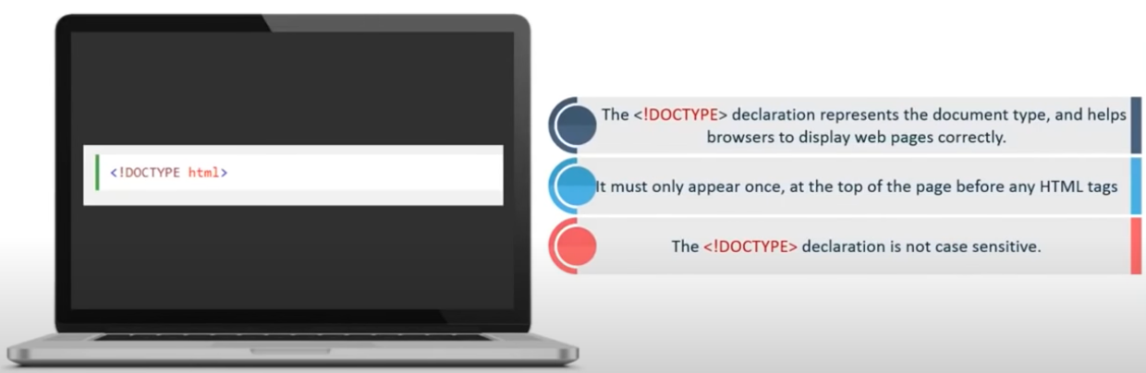
<!Doctype html> Declaration
www.credosystemz.com © Copyright 2021 | credosystemz | All Rights Reserved

Slide 14
HTML – Head Tag Containers
The Head Element
Title tag
Style tag
Link tag
Script tag
Meta tag
www.credosystemz.com © Copyright 2021 | credosystemz | All Rights Reserved

Slide 15
Structure of HTML continue..
The Head Element
The <head> element is a container for metadata and is placed between the <html> tag and the <body> tag.
HTML metadata is data about the HTML document.
Metadata typically define the document title, character set, styles, scripts, and other meta information.
The <title> Element
The <title> element defines the title of the document.
Defines a title in the browser toolbar
Provides a title for the page when it is added to favorites
Displays a title for the page in search engine-results
www.credosystemz.com © Copyright 2021 | credosystemz | All Rights Reserved

Slide 16
Structure of HTML continue..
The <meta> Element
The <meta> element is typically used to specify the character set, page description, keywords, author of the document, and viewport settings.
Define the character set used:
<meta charset="UTF-8">
Define a description of your web page:
<meta name="description" content=“Web Development Training">
Define the author of a page:
<meta name="author" content=“Gopi">
Setting the viewport to make your website look good on all devices:
<meta name="viewport" content="width=device-width, initial-scale=1.0">
www.credosystemz.com © Copyright 2021 | credosystemz | All Rights Reserved

Slide 17
HTML Body Tags
Heading Tags - <h1>, <h2>, <h3>, <h4>, <h5>, <h6> tags.
Paragraph Tag - <p> tag.
Horizontal ruler - <hr> tag.
Anchor(Link) Tag - <a> (anchor) tag.
List Tag - <ul> (unordered list), <ol> (ordered list) and <li> (list element) tags.
Image Tag - <img> tag
Divider, denoted using the <div> tag
Text span, denoted using the <span> tag
www.credosystemz.com © Copyright 2021 | credosystemz | All Rights Reserved

Slide 18
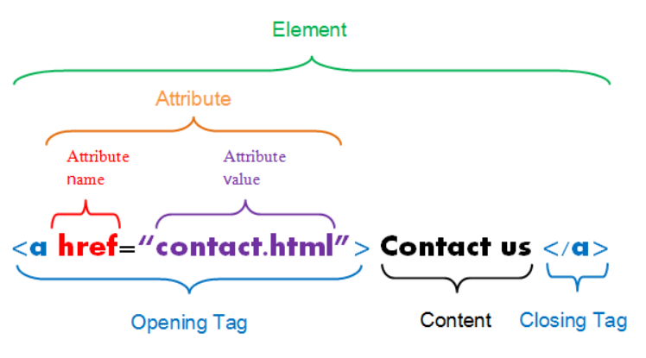
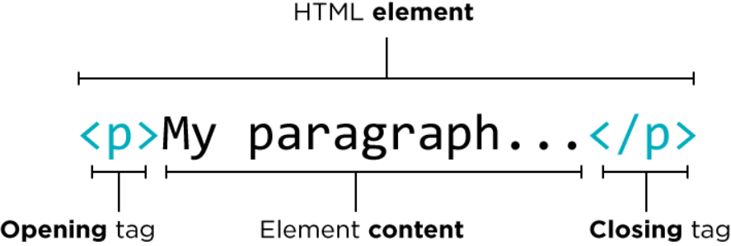
HTML Element, Tag & Attribute
www.credosystemz.com © Copyright 2021 | credosystemz | All Rights Reserved

Slide 19
HTML Elements
HTML Headings
HTML headings are defined with the <h1> to <h6> tags.
<h1> defines the most important heading. <h6> defines the least important heading.
HTML Paragraphs
HTML paragraphs are defined with the <p> tag.
<h1>This is heading 1</h1> <h2>This is heading 2</h2> <h3>This is heading 3</h3>
15hrs
<p>This is a paragraph.</p>
<p>This is another paragraph.</p>
www.credosystemz.com © Copyright 2021 | credosystemz | All Rights Reserved

Slide 20

HTML Elements continue..
HTML Links
Use the <a> element to define a link
Use the href attribute to define the link address
Use the target attribute to define where to open the linked document
Use the <img> element (inside <a>) to use an image as a link
HTML Images
Use the HTML <img> element to define an image.
Use the HTML src attribute to define the URL of the image.
Use the HTML alt attribute to define an alternate text for an image, if it cannot be displayed.
Use the HTML width and height attributes to define the size of the image
15hrs
<a href="https://www.credosystemz.com">This is a link</a>
<img src="credologo.jpg" alt="credosystemz.com" width="104" height="142">
www.credosystemz.com © Copyright 2021 | credosystemz | All Rights Reserved

Slide 21
HTML Elements continue..
HTML Lists
HTML lists are defined with the <ul> (unordered/bullet list) or the <ol> (ordered/numbered list) tag, followed by <li> tags (list items):
<ul> <li>Coffee</li> <li>Tea</li> <li>Milk</li> </ul>
<ol> <li>Coffee</li> <li>Tea</li> <li>Milk</li> </ol>
www.credosystemz.com © Copyright 2021 | credosystemz | All Rights Reserved

Slide 22
Main Categories of Elements and Attributes
The main categories of elements are mentioned below:
Block level elements :
<div>, <p>, <h1> to <h6>, <form>, <table> etc.,
Inline elements :
<img>, <a>, <span>, <input> etc.,
Attributes:
Attributes are something which give the additional information of the element.
Ex. name, width, height, alt, title, href, id, class, etc.,
www.credosystemz.com © Copyright 2021 | credosystemz | All Rights Reserved

Slide 23
HTML Block and Inline Elements
Every HTML element has a default display value, depending on what type of element it is.
There are two display values: block and inline.
Block-level Elements:
A block-level element always begins a new line on a web page.
It extends the full width of the available horizontal space of its parent element.
A block level element has a top and a bottom margin, whereas an inline element does not.
Eg: <div></div>
www.credosystemz.com © Copyright 2021 | credosystemz | All Rights Reserved

Slide 24
HTML Block and Inline Elements continue..
Inline Elements
An inline element does not start on a new line.
An inline element only takes up as much width as necessary.
Eg: <span></span>
Note: An inline element cannot contain a block-level element!
www.credosystemz.com © Copyright 2021 | credosystemz | All Rights Reserved

Slide 25
HTML Elements continue..
HTML <div> Tag
The <div> tag defines a division or a section in an HTML document.
The <div> element is often used as a container for other HTML elements
HTML <span> Tag
The <span> tag is used to group inline-elements in a document.
The <span> tag provides no visual change by itself.
The <span> tag provides a way to add a hook to a part of a text or a part of a document
<div style="background-color:lightblue"> <h3>This is a heading</h3> <p>This is a paragraph.</p> </div>
<p>My mother has <span style="color:blue">blue</span> eyes.</p>
www.credosystemz.com © Copyright 2021 | credosystemz | All Rights Reserved

Slide 26
Empty HTML Elements
HTML elements with no content are called empty elements.
Line Break Tag
<br> is an empty element without a closing tag (the <br> tag defines a line break).
<p>This is a <br /> paragraph with a line break.</p>
Horizontal Lines
Horizontal lines are used to visually break-up sections of a document.
<p>This is paragraph one and should be on top</p>
<hr />
<p>This is paragraph two and should be at bottom</p>
www.credosystemz.com © Copyright 2021 | credosystemz | All Rights Reserved

Slide 27
Formatting Elements
HTML <b> Tag
The <b> tag specifies bold text without any extra importance.
<p>This is normal text - <b>and this is bold text</b>.</p>
HTML <i> Tag
The content of the <i> tag is usually displayed in italic.
The <i> tag can be used to indicate a technical term, a phrase from another language, a thought, etc.
<p>He named his car <i>The lightning</i>, because it was very fast.</p>
www.credosystemz.com © Copyright 2021 | credosystemz | All Rights Reserved

Slide 28
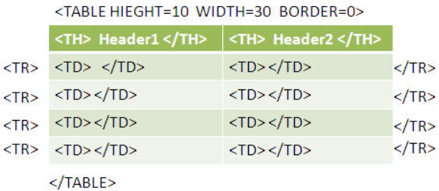
HTML Elements continue..
HTML <table> Tag
An HTML table consists of the <table> element and one or more <tr>, <th>, and <td> elements.
The <tr> element defines a table row, the <th> element defines a table header, and the <td> element defines a table cell.
<table> <tr> <th>Month</th> <th>Savings</th> </tr> <tr> <td>January</td> <td>$100</td> </tr> </table>
www.credosystemz.com © Copyright 2021 | credosystemz | All Rights Reserved

Slide 29
HTML Input Elements
Input element is used to get input from the users.
An input field can be of various types depending upon the attribute type.
The Input tag is an empty element which only contains attributes.
Most Freq used input element list:
<input type="button">
<input type="checkbox">
<input type="date">
<input type="email">
<input type="file">
<input type="hidden">
<input type="number">
<input type="password">
<input type="radio">
<input type="reset">
<input type="submit">
<input type="text">
www.credosystemz.com © Copyright 2021 | credosystemz | All Rights Reserved

Slide 30
HTML Input Elements continue..
Input Type Text:
Defines a single-line text input field
<input type="text" id="fname" name="fname">
Input Type Password:
The characters in a password field are masked (shown as asterisks or circles).
<input type=" password " id=“pwd" name=“pwd">
Input Type Submit:
It defines a button for submitting form data to a form-handler.
<input type="submit" value="Submit">
www.credosystemz.com © Copyright 2021 | credosystemz | All Rights Reserved

Slide 31
HTML Input Elements continue..
Input Type Reset:
<input type="reset"> defines a reset button that will reset all form values to their default values.
Input Type Radio:
<input type="radio"> defines a radio button. It allow user select ONLY ONE of a limited number of choices.
Input Type Checkbox:
<input type="checkbox"> defines a checkbox. It allow users select ZERO or MORE options of a limited number of choices.
Input Type Button:
<input type="button"> defines a button
www.credosystemz.com © Copyright 2021 | credosystemz | All Rights Reserved

Slide 32
HTML Input Elements continue..
Input Type Date:
<input type="date"> is used for input fields that should contain a date
Input Type Email:
<input type="email"> is used for input fields that should contain an e-mail address.
Some smartphones recognize the email type, and add ".com" to the keyboard to match email input.
Input Type File:
<input type="file"> defines a file-select field and a "Browse" button for file uploads.
Input Type Number:
<input type="number"> defines a numeric input field.
www.credosystemz.com © Copyright 2021 | credosystemz | All Rights Reserved

Slide 33
HTML Attributes
Attributes provide additional information about HTML elements.
All HTML elements can have attributes
Attributes are always specified in the start tag
Attributes usually come in name/value pairs like: name="value"
Types of Attributes in HTML:
There are Two different kinds of attributes are available in HTML,
Global Attributes
Element Specific Attributes
www.credosystemz.com © Copyright 2021 | credosystemz | All Rights Reserved

Slide 34
Global Attributes
Style Attribute:
The style attribute specifies an inline style for an element.
The style attribute will override any style set globally, e.g. styles specified in the <style> tag or in an external style sheet.
<p style="color:green">This is a paragraph.</p>
Id Attribute:
The id attribute specifies a unique id for an HTML element.
The id attribute is most used to point to a style in a style sheet, and by JavaScript (via the HTML DOM) to manipulate the element with the specific id.
<h1 id="myHeader">Hello World!</h1>
www.credosystemz.com © Copyright 2021 | credosystemz | All Rights Reserved

Slide 35
Global Attributes continue..
class Attribute:
The class attribute specifies one or more class names for an element.
<element class="classname">
title Attribute:
The title attribute specifies extra information about an element.
The information is most often shown as a tooltip text when the mouse moves over the element.
<p title="Angular Training">credosystemz.com</p>
www.credosystemz.com © Copyright 2021 | credosystemz | All Rights Reserved

Slide 36
Element Specific Attributes
Src Attribute:
The src attribute specifies the location (URL) of the external resource.
Attached in Image, Script, Audio, Video.
<img src="smiley.gif" alt="Smiley face">
Href Attribute:
For <a> element, the href attribute specifies the URL of the page the link goes to.
For <link> elements, the href attribute specifies the location (URL) of the external resource (most often a style sheet file).
<a href="https://www.credosystemz.com">Visit credosystemz</a>
<link rel="stylesheet" type="text/css" href="theme.css">
www.credosystemz.com © Copyright 2021 | credosystemz | All Rights Reserved

Slide 37
Element Specific Attributes continue..
Input Elements Attribute List:
value Attribute - <input type="text" id="fname" name="fname" value=“Ramesh">
readonly Attribute - <input type="text" id="fname" name="fname" value=“Ramesh“ readonly>
disabled Attribute - <input type="text" id="fname" name="fname" value=“Ramesh“ disabled>
maxlength Attribute - <input type="text" id=“mbl" name=“mobile" maxlength=“10">
placeholder Attribute - <input type="text" id="fname" name="fname" placeholder=“Enter First Name">
required Attribute - <input type="text" id="username" name="username" required>
autofocus Attribute - <input type="text" id="fname" name="fname" autofocus>
selected Attribute - <option value=“chn" selected>Chennai</option>
checked Attribute - <input type="checkbox" name=“run" value=“running" checked>
www.credosystemz.com © Copyright 2021 | credosystemz | All Rights Reserved

Slide 38
Element Specific Attributes continue..
Name Attribute:
The name attribute specifies a name for the element.
This name attribute can be used to reference the element in a JavaScript.
For form elements it is also used as a reference when the data is submitted.
Value Attribute:
For <button>, <input> and <option> elements, the value attribute specifies the initial value of the element. <input type="text" name="fname" value="John">
Disabled Attribute:
The disabled attribute is a Boolean attribute.
When present, it specifies that the element should be disabled.
A disabled element is unusable.
<button type="button" disabled>Click Me!</button>
www.credosystemz.com © Copyright 2021 | credosystemz | All Rights Reserved

Slide 39
Element Specific Attributes continue..
Checked Attribute:
The checked attribute is a boolean attribute.
When present, it specifies that an <input> element should be pre-selected (checked) when the page loads.
<input type="checkbox" name="vehicle" value="Car" checked>
Selected Attribute:
The selected attribute is a boolean attribute.
When present, it specifies that an option should be pre-selected when the page loads.
The pre-selected option will be displayed first in the drop-down list.
<select id=“cities"> <option value=“chn">Chennai</option> <option value=“blr">Bengaluru</option> <option value=“hyd" selected>Hyderabad</option> </select>
Readonly Attribute:
The readonly attribute is a boolean attribute.
When present, it specifies that an input field or textarea is read-only.
www.credosystemz.com © Copyright 2021 | credosystemz | All Rights Reserved

Slide 40
HTML Forms and its Attributes
An HTML form is used to collect user input.
The user input is most often sent to a server for processing.
The <form> element is a container for different types of input elements, such as: text fields, checkboxes, radio buttons, submit buttons, etc.
Form Attributes
Action
The action attribute defines the action to be performed when the form is submitted.
If the action attribute is omitted, the action is set to the current page.
Method
The method attribute specifies which HTTP method to be used when submitting the form.
The form-data can be sent as URL variables (with method="get") or as HTTP post transaction (with method="post").
The default HTTP method when submitting form data is GET.
www.credosystemz.com © Copyright 2021 | credosystemz | All Rights Reserved

Slide 41
HTML Forms and its Attributes continue..
GET:
Appends the form data to the URL, in name/value pairs.
NEVER use GET to send sensitive data! (the submitted form data is visible in the URL!).
The length of a URL is limited (2048 characters).
Useful for form submissions where a user wants to bookmark the result.
GET is good for non-secure data, like query strings in Google.
POST:
Appends the form data inside the body of the HTTP request (the submitted form data is not shown in the URL).
POST has no size limitations, and can be used to send large amounts of data.
Form submissions with POST cannot be bookmarked.
www.credosystemz.com © Copyright 2021 | credosystemz | All Rights Reserved

Slide 42
HTML Forms and its Attributes continue..
Novalidate:
The novalidate attribute is a boolean attribute.
When present, it specifies that the form-data (input) should not be validated when submitted.
Name:
The name attribute specifies the name of a form.
www.credosystemz.com © Copyright 2021 | credosystemz | All Rights Reserved

