Slide 1
Functional component
Salman Ahmed G

Slide 2
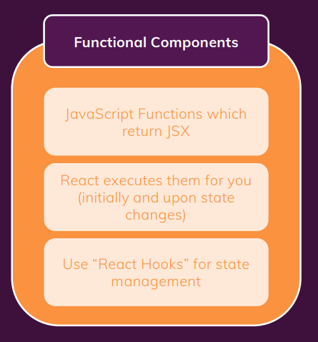
Functional component

Slide 3
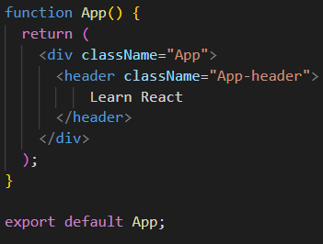
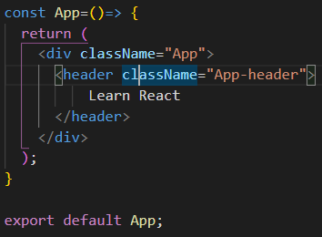
Creating functional component

Slide 4
Introduction to functional components
Functional components can be written in two ways using normal function and one is using arrow function
Maintaining state is not possible before React version 16.9
From React version 16.9 maintaining the state is possible via React Hooks
From React version 16.9 we can use lifecycle Hooks using useEffect() method.

Slide 5
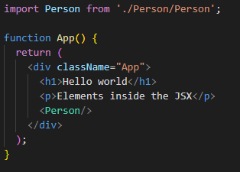
Importing functional component in some other component

Slide 6
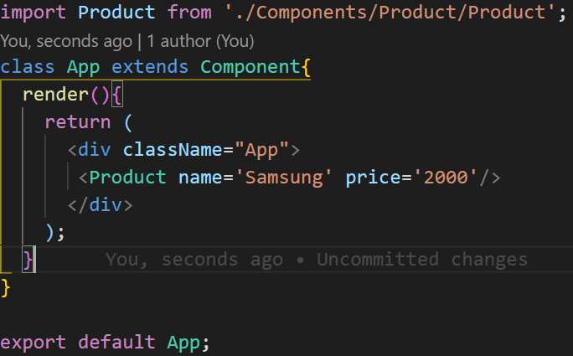
Passing props in functional component-1

Slide 7
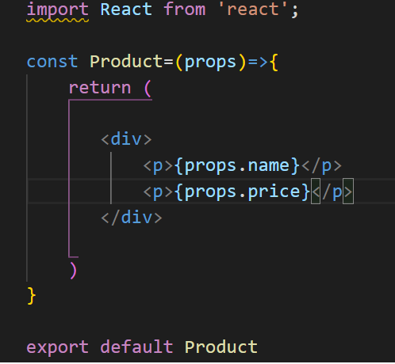
Passing props in functional component-2

Slide 8
Events in functional component
In normal JavaScript you will have events like onclick,onchange,onblur,onfocus,onsubmit.
In React you will have the the same events but onClick,onChange,onBlur,onFocus. The second letter in capital.
Syntax:
const switchHandler=()=>{
alert("hello")
}
<button onClick={switchHandlers}></button>

Slide 9
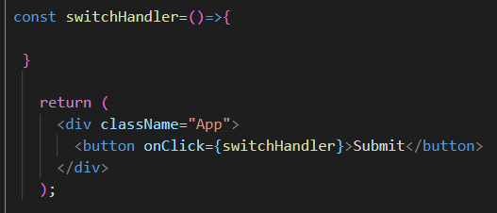
Example events in functional component

Slide 10
State in functional component
To use state in functional component we need to useState() property from React package.
In functional component you can have multiple state in one component
useState() property will return a array with two indexes.
First index will represent the get updated state details
Second index will represent updating the state details with existing one.

Slide 11
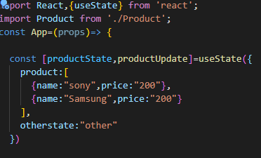
Single State in functional component-1

Slide 12
Single State in functional component-2
In Single state we have two properties
Product
Otherstate
If there is change happen in product property we need to copy the existing state of Otherstate property as well.

Slide 13
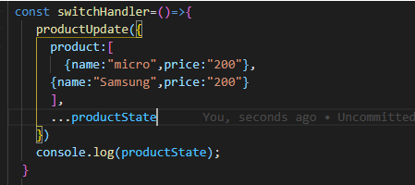
Single State in functional component-3

Slide 14
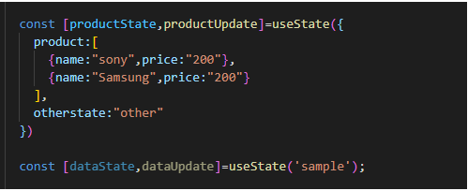
Multiple state in functional component-1

Slide 15
Multiple state in functional component-1
Important points
If you want to maintain multiple state in one component is possible.
We can use for complicated scenario where maintaining the multiple state is needed
If you change one state then other state will not get impacted both will have separate instance

Slide 16
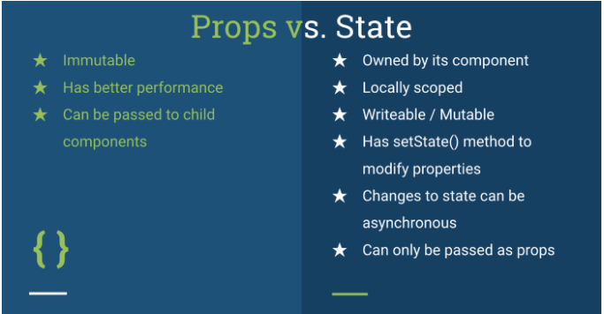
Statefull and stateless

Slide 17
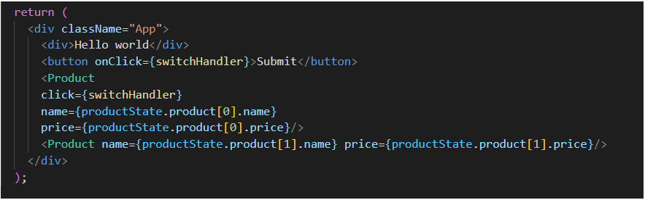
Passing method reference-1

Slide 18
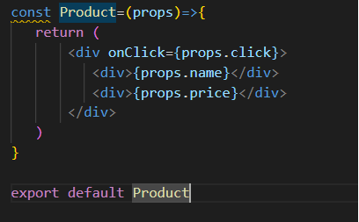
Passing method reference-2

Slide 19
Passing method reference-3
You can passing method from child component to parent component and you can invoke method in parent component
By using this approach you can communicate bidirection with parent and child component
One direction from parent to child using props
Other direction from child to parent using method reference

Slide 20
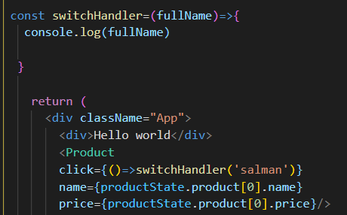
Passing values in method reference

Slide 21
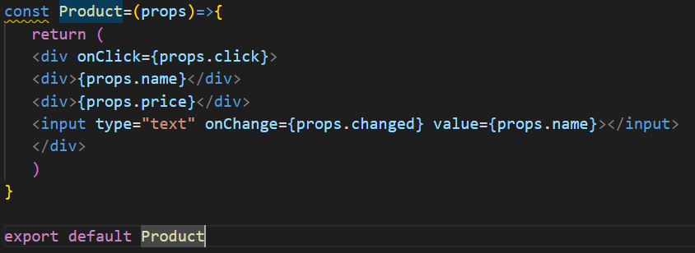
Two way binding in form -1

Slide 22
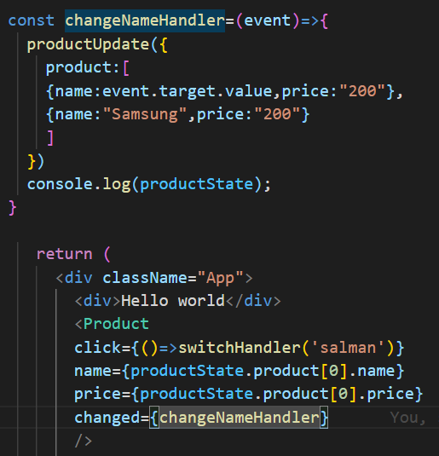
Two way binding form-2

Slide 23
Two way binding form-3
Two things is important for two binding binding:
value property is needed to binding the existing value and to show updated value from state
onChange() method is needed to send the updated state data to update state variable
value property should be binding to state variable
onChange ()method should consists of updating state function then only it will update in real DOM.

