Slide 1

HTML 5 - Training

Slide 2

Agenda
Web Introduction
Client-side Technologies overview
Application Architecture
HTML Introduction
HTML Elements deep dive
HTML Input Elements
HTML Element Specific Attributes
HTML Forms & its Attributes

Slide 3
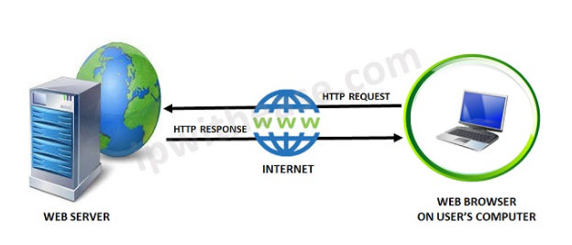
What is Web?
The Web is the common name for the World Wide Web (WWW)
The Web is just one of the ways that information is shared over the Internet.
The Web consisting of the pages that can be accessed by a Web browser such as Internet Explorer, Google Chrome, Mozilla Firefox
Web pages are formatted in a language called HTML.
The Web uses HTTP protocol to transmit data and share information.

Slide 4
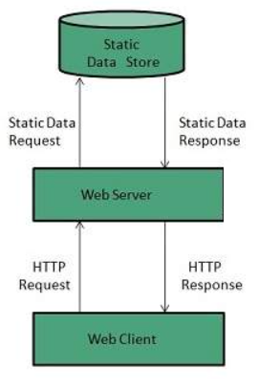
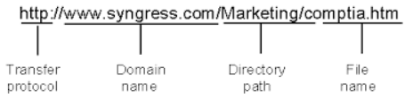
What is Web Server?
Web server is a computer where the web content is stored
Web server is used to host the web sites
When client sends request for a web page, the web server search for the requested page if requested page is found then it will send it to client with an HTTP response.

Slide 5
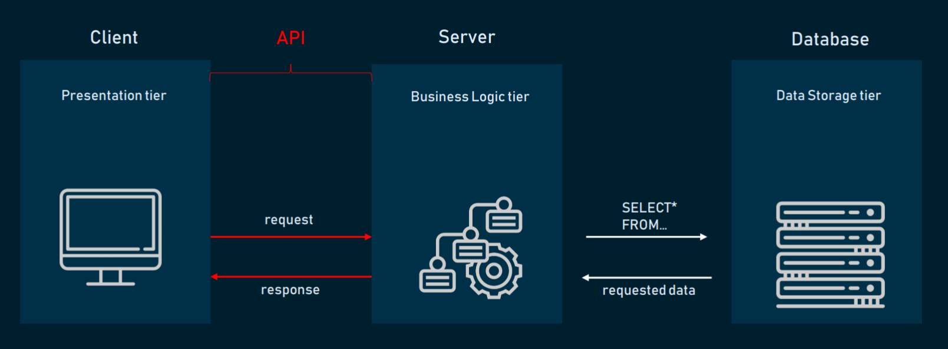
Application Architecture
HTML, CSS, JavaScript, Angular

