Slide 1

HTML 5 - Training

Slide 2
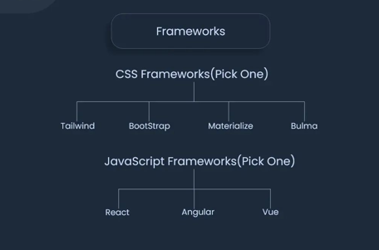
FRONTEND FRAMEWORKS

Slide 3
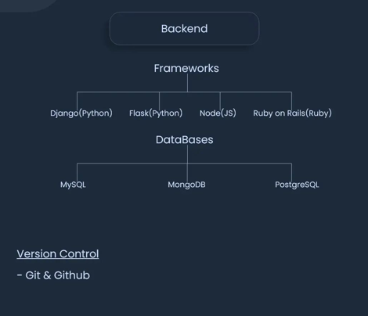
BACKEND FRAMEWORKS

Slide 4
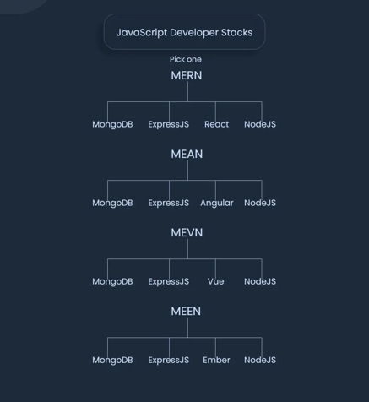
JAVASCRIPT FRAMEWORKS

Slide 5

What is HTML?
HTML (HyperText Markup Language) is the most basic building block of the Web.
HTML describes the structure of a Web page.
HTML consists of a series of elements.
HTML elements tell the browser how to display the content.
HTML elements are represented by tags.
HTML tags label pieces of content such as "heading", "paragraph", "table", and so on.
Browsers do not display the HTML tags, but use them to render the content of the page

Slide 6
What is Hypertext & Markup?
Hypertext is a text which references to other text.
Hypertext means machine readable text and Markup means to structure it in a specific format.
So, HTML is called hypertext markup language because it is a language that allows users to organize, improve the appearance of, and link text with data on the internet.

Slide 7
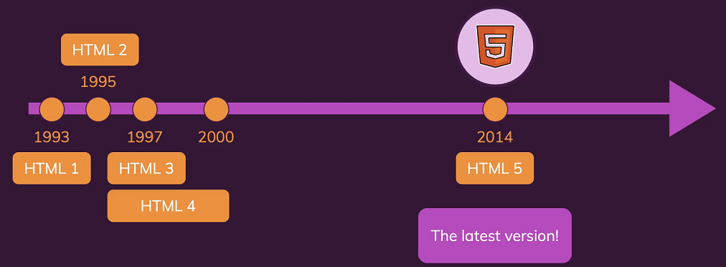
History of HTML

Slide 8
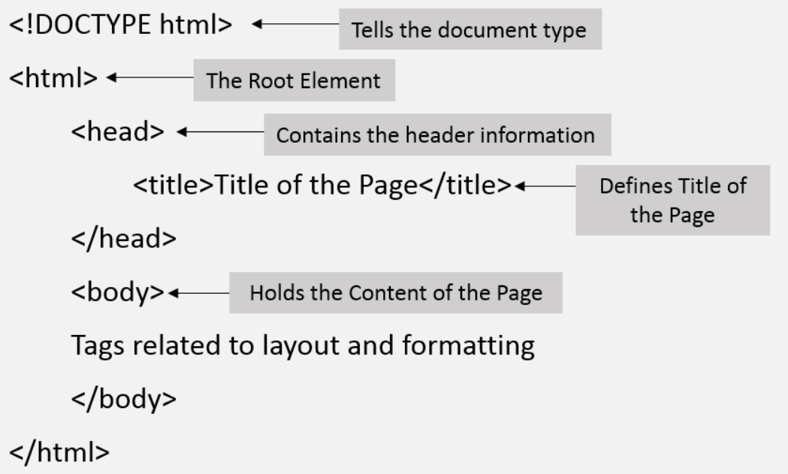
Structure of HTML

