Slide 1


CSS - Training

Slide 2

Agenda
CSS Introduction
CSS Syntax understanding
CSS Selectors
Different Ways of Applying CSS in HTML
CSS Properties – Deep Dive
Building Various Navigation List
Styling HTML Forms
www.credosystemz.com © Copyright 2021 | credosystemz | All Rights Reserved

Slide 3
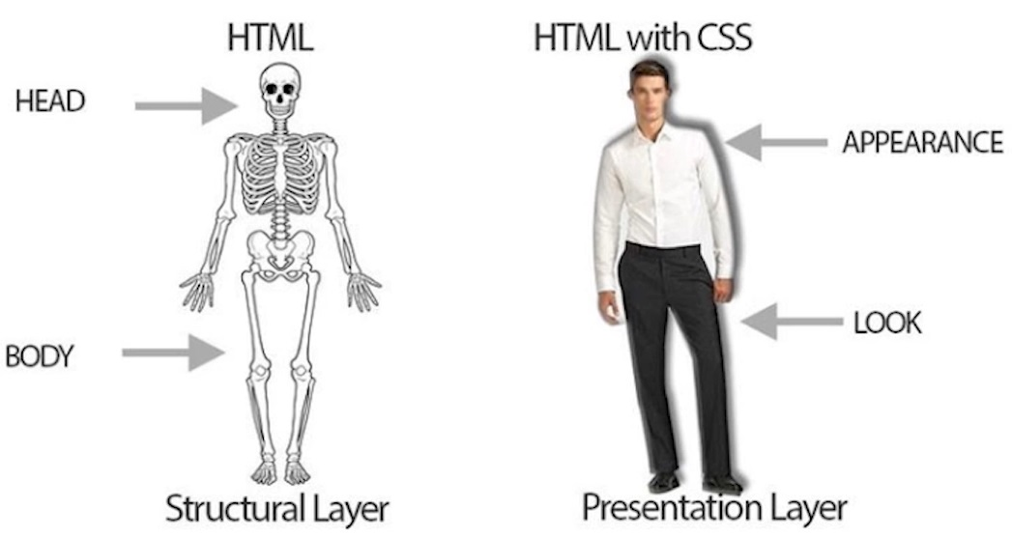
What is CSS?
CSS stands for Cascading Style Sheets.
It is used to style HTML documents to make it good looking.
Turn ordinary black & white page into colorful one.
Can make webpage as a Responsive one.
www.credosystemz.com © Copyright 2021 | credosystemz | All Rights Reserved

Slide 4
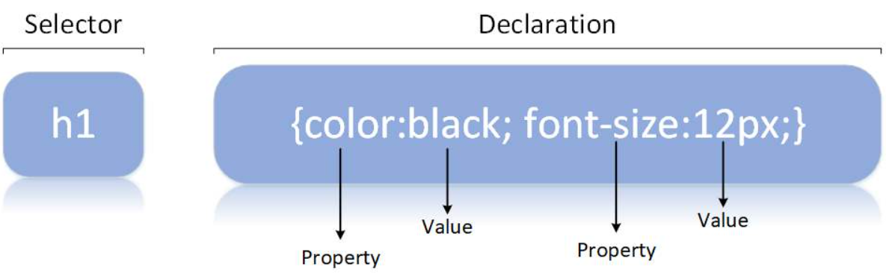
CSS Syntax
A CSS rule consists of a selector and a declaration block.
The selector points to the HTML element you want to style.
The declaration block contains one or more declarations separated by semicolons.
www.credosystemz.com © Copyright 2021 | credosystemz | All Rights Reserved

Slide 5
Different Ways of Adding CSS
There are three ways of inserting a style sheet:
External CSS (in the head section)
Internal CSS (in the head section)
Inline CSS (inside an HTML element)
External CSS :
With an external style sheet, you can change the look of an entire website by changing just one file
<!DOCTYPE html> <html> <head> <link rel="stylesheet" href="mystyle.css"> </head> <body> </body> </html>
www.credosystemz.com © Copyright 2021 | credosystemz | All Rights Reserved

Slide 6
Different Ways of Adding CSS
Intenal CSS :
An internal style sheet may be used if one single HTML page has a unique style.
The internal style is defined inside the <style> element, inside the head section.
<html> <head> <style> body { background-color: linen; } h1 { color: maroon; margin-left: 40px; } </style> </head> <body> <h1>This is a heading</h1> <p>This is a paragraph.</p> </body> </html>
www.credosystemz.com © Copyright 2021 | credosystemz | All Rights Reserved

Slide 7
Different Ways of Adding CSS
Inline CSS :
An inline style may be used to apply a unique style for a single element, to use inline styles, add the style attribute to the relevant element.
<!DOCTYPE html> <html> <body> <h1 style="color:blue;text-align:center;">This is a heading</h1> <p style="color:red;">This is a paragraph.</p> </body> </html>
www.credosystemz.com © Copyright 2021 | credosystemz | All Rights Reserved

Slide 8
CSS Selectors
A CSS selector selects the HTML element(s) which we want to style
Types of Selectors:
CSS element Selector
CSS id Selector
CSS class Selector
CSS Universal Selector
CSS Grouping Selector
www.credosystemz.com © Copyright 2021 | credosystemz | All Rights Reserved

Slide 9
CSS Selectors
CSS element Selector: - The element selector selects HTML elements based on the element name
CSS id Selector - id selector uses the id attribute of an HTML element to select a specific element
CSS class Selector - Class selector selects HTML elements with a specific class attribute
p { text-align: center;
color: red; }
#textBoxName{ text-align: center; color: red; }
.portal { text-align: center; color: black; }
www.credosystemz.com © Copyright 2021 | credosystemz | All Rights Reserved

Slide 10
CSS Selectors
CSS Universal Selector: - CSS rule below will affect every HTML element on the page
CSS Grouping Selector
* { text-align: center; color: blue; }
h1 { text-align: center; color: red; } h2 { text-align: center; color: red; } p { text-align: center; color: red; }
h1, h2, p { text-align: center; color: red; }
www.credosystemz.com © Copyright 2021 | credosystemz | All Rights Reserved

Slide 11
CSS Properties
Borders
Margins
Padding
Height and Width
Colors
Backgrounds
Fonts
Float
www.credosystemz.com © Copyright 2021 | credosystemz | All Rights Reserved

Slide 12
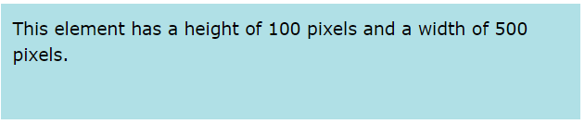
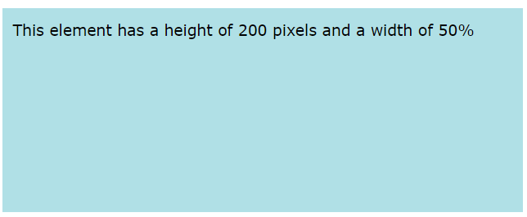
CSS Property – Height & Width
Height and Width - The CSS height and width properties are used to set the height and width of an element.
Individual Sides
div { height: 100px; width: 500px; background-color: powderblue; }
div { height: 200px; width: 50%; background-color: powderblue; }
www.credosystemz.com © Copyright 2021 | credosystemz | All Rights Reserved

Slide 13
CSS Property - Border
Borders - The CSS border properties allow you to specify the style, width, and color of an element's border
Border Style – dotted, dashed, solid, double -
Border Width -
Border Color –
Border Sides
Shorthand Border Property -
Rounded Borders -
p {border-style: solid;}
p {border-width: 5px;}
p {border-color: red;}
p { border-top-style: dotted; border-right-style: solid; border-bottom-style: dotted; border-left-style: solid; }
p {border: 5px solid red;}
p {border-radius: 5px;}
www.credosystemz.com © Copyright 2021 | credosystemz | All Rights Reserved

Slide 14
CSS Property - Padding
Padding - Padding is used to create space around an element's content, inside of any defined borders
Individual Sides
Shorthand Property -
div { padding-top: 50px; padding-right: 30px; padding-bottom: 50px; padding-left: 80px; }
p { padding: 25px 50px 75px 100px; }
div{padding: 25px 50px;}
div {padding: 25px;}
www.credosystemz.com © Copyright 2021 | credosystemz | All Rights Reserved

Slide 15
CSS Property - Margin
Margins - Margins are used to create space around elements, outside of any defined borders
Individual Sides
Shorthand Property -
auto Value - set the margin property to auto to horizontally center the element within its container
p { margin-top: 100px; margin-bottom: 100px; margin-right: 150px; margin-left: 80px; }
p {margin: 25px 50px 75px 100px;}
div { width: 300px; margin: auto; border: 1px solid red; }
www.credosystemz.com © Copyright 2021 | credosystemz | All Rights Reserved

Slide 16
CSS Property - Background
Backgrounds - CSS background properties are used to add background effects for elements.
background-color
Background Image
Background-repeat
Background Shorthand
div { background-color: lightblue; }
div {background-image: url("bgWallppr.jpg"); }
body { background-image: url("img_tree.png"); background-repeat: no-repeat;
Background-size:100px 200px;
Background-size:cover; }
div {background: #ffffff url("img_tree.png") no-repeat;}
www.credosystemz.com © Copyright 2021 | credosystemz | All Rights Reserved

Slide 17
CSS Properties
Colors - Colors are specified using predefined color names, or RGB, HEX, HSL, RGBA, HSLA values.
Text Color
Border Color
Background Color
Color Values - In CSS, colors can also be specified using RGB values, HEX values, HSL values:
<h1 style="color:blue;">Hello World</h1>
<h1 style="border:2px solid Tomato;">Hello World</h1>
<h1 style="background-color:DodgerBlue;">Hello World</h1>
Tomato
rgb(255, 99, 71)
#ff6347
hsl(9, 100%, 64%)
www.credosystemz.com © Copyright 2021 | credosystemz | All Rights Reserved

Slide 18
CSS Property - Fonts
Fonts
font-family
font-style
font-weight
font-size
p {font-family: "Times New Roman", Times, serif; }
p {font-style: italic;}
p {font-weight: bold;}
p {font-size: 14px;}
www.credosystemz.com © Copyright 2021 | credosystemz | All Rights Reserved

Slide 19
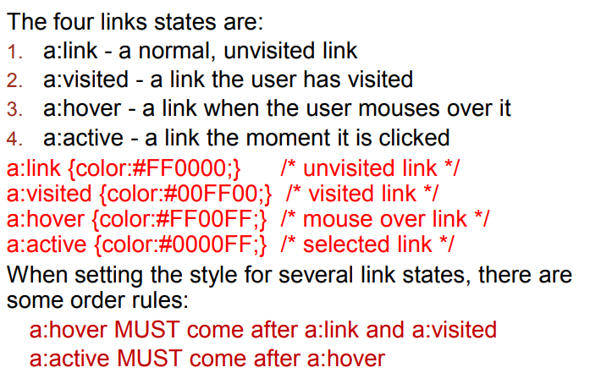
CSS Property – Link Properties
www.credosystemz.com © Copyright 2021 | credosystemz | All Rights Reserved

Slide 20
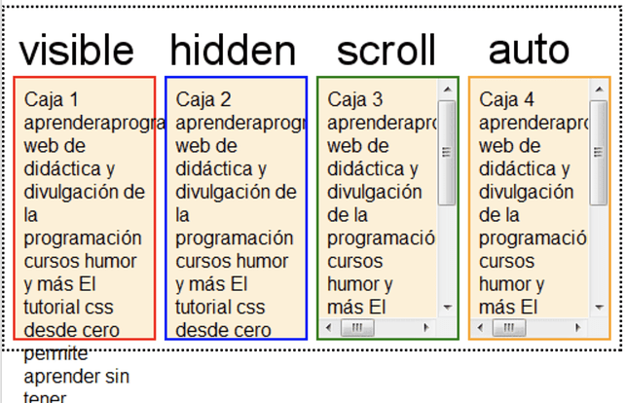
CSS Property - overflow

Slide 21
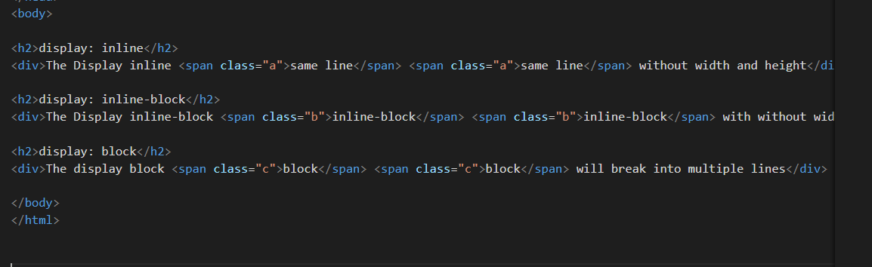
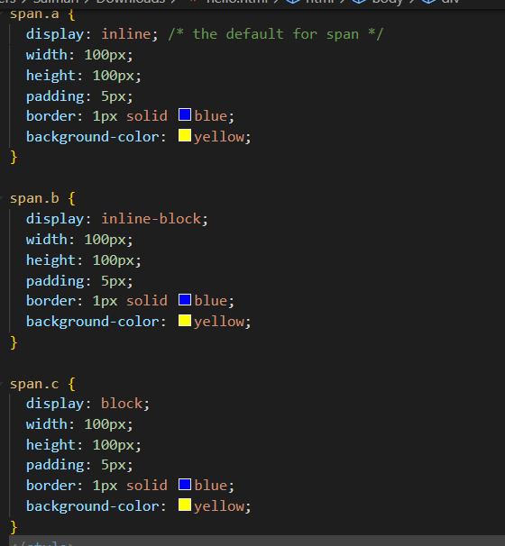
Display:inline,display:inline-block,display:block

Slide 22
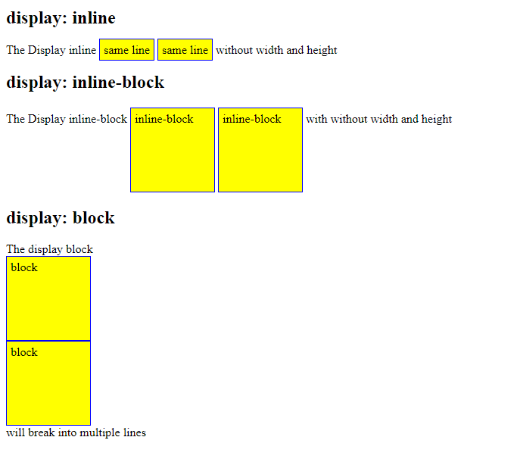
Display:inline,display:inline-block,display:block

Slide 23
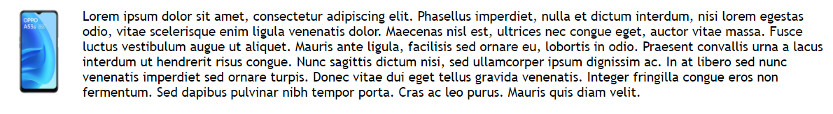
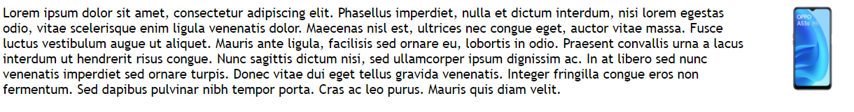
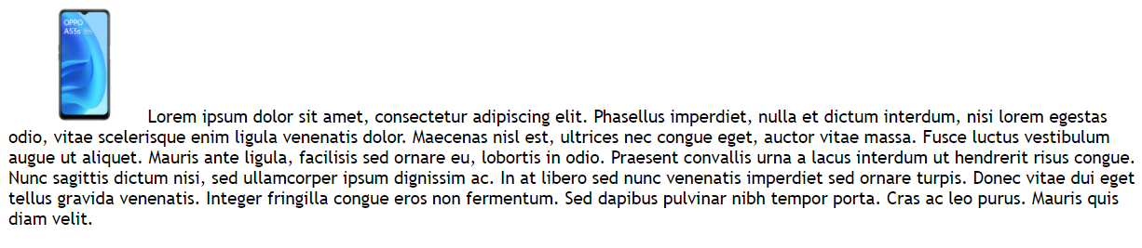

CSS Property - Float
Float - The CSS float property specifies how an element should float.
float: left
float: right
float: none
img {
float: left;
}
img { float: right; }
img { float: none; }
www.credosystemz.com © Copyright 2021 | credosystemz | All Rights Reserved

Slide 24


CSS – Navigation using List
Horizontal Navigation bar
ul {
list-style-type: none;
margin: 0;
padding: 0;
background-color: #E7E9EB;
}
li {
float: left;
}
li a {
display: block;
color: black;
text-align: center;
padding: 14px 16px;
text-decoration: none;
}
li a:hover {
background-color: #04AA6D;
}
.active {
background-color: #04AA6D;
}
<ul> <li><a class="active" href=“home.html">Home</a></li> <li><a href=“news.html">News</a></li> <li><a href="contact.html">Contact</a></li> <li><a href="about.html">About</a></li> </ul>
www.credosystemz.com © Copyright 2021 | credosystemz | All Rights Reserved

Slide 25
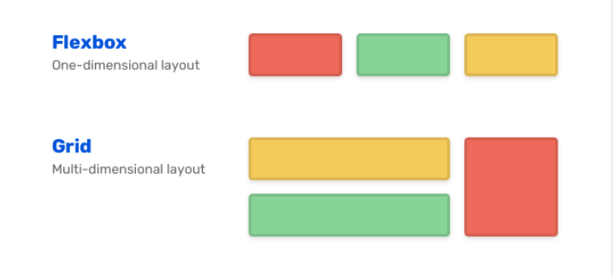
Flex box and grid

Slide 26
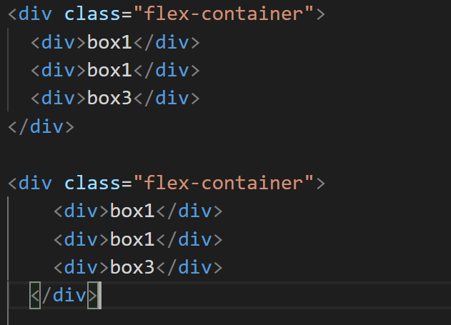
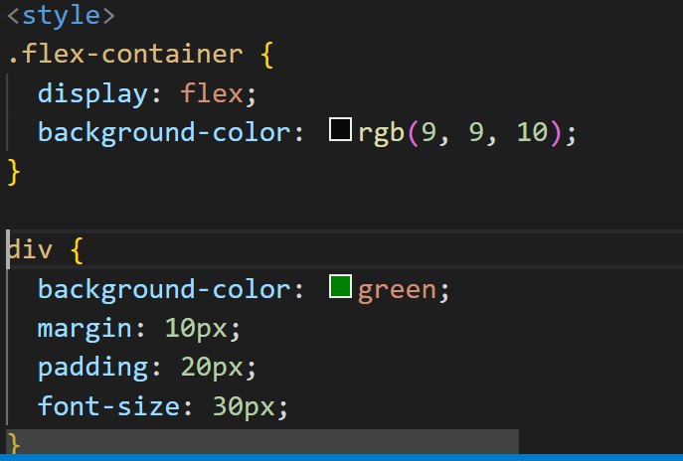
flexbox

Slide 27
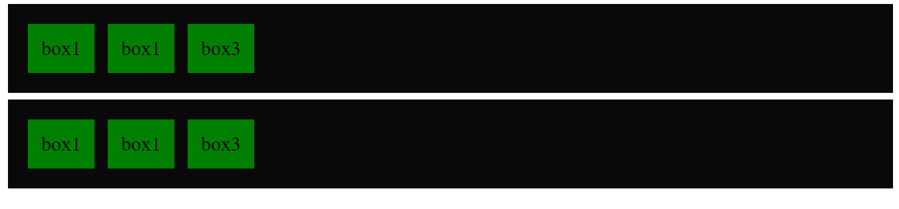
FlexBoX

Slide 28
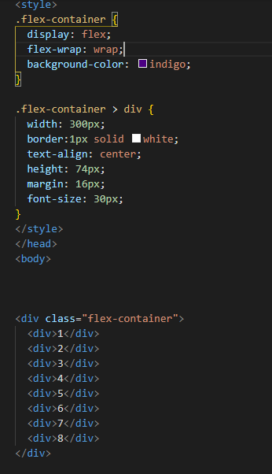
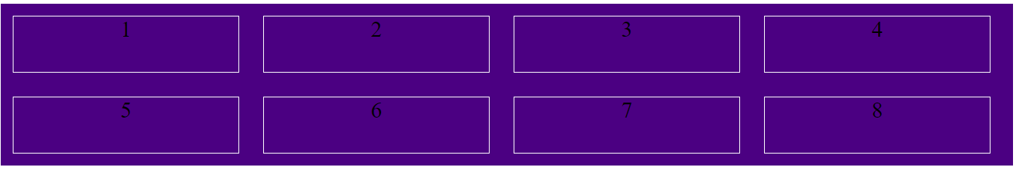
Flexbox

Slide 29
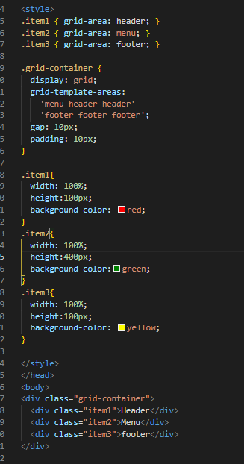
Grid layout 1

Slide 30
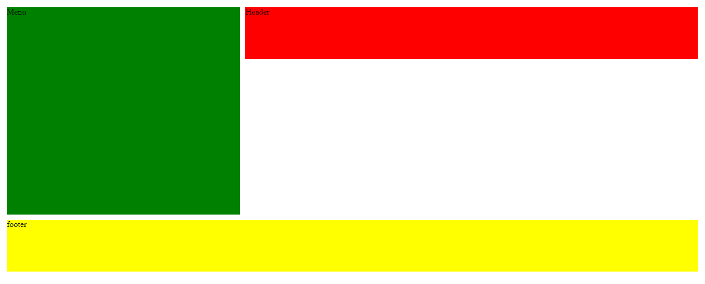
Output

Slide 31
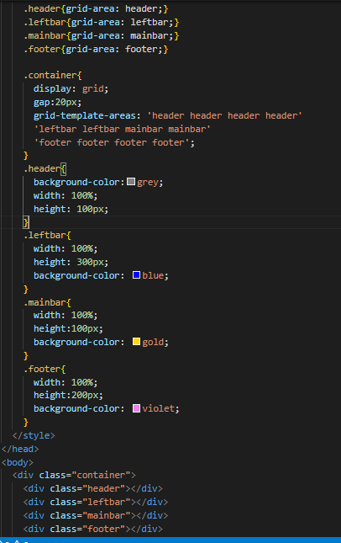
Grid Layout 2

Slide 32

Output

Slide 33
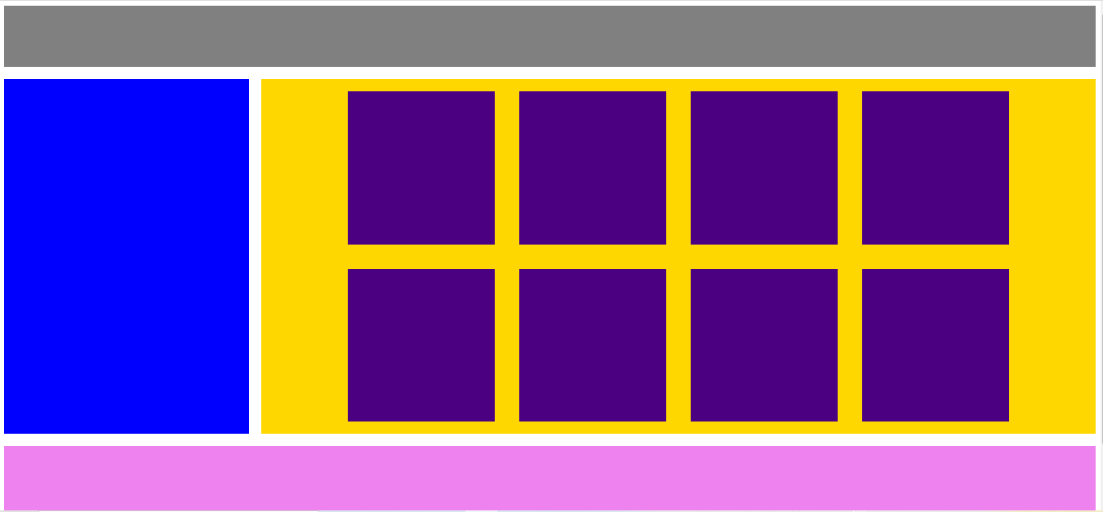
Flex+Grid

Slide 34
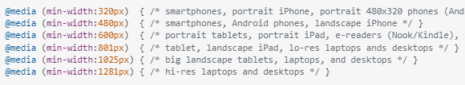
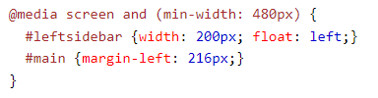
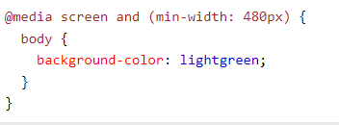
Media query

Slide 35
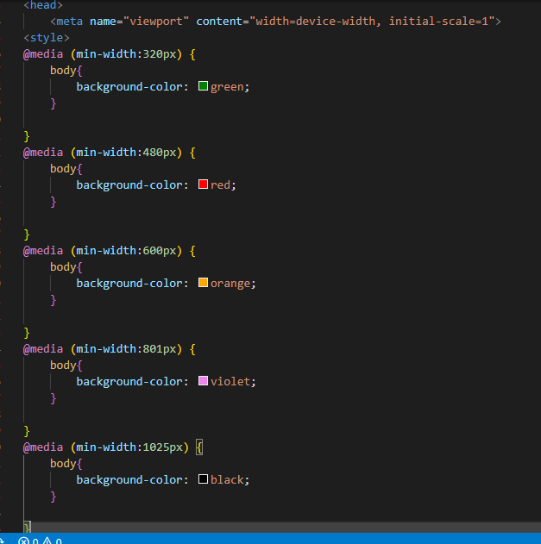
Media Query

Slide 36
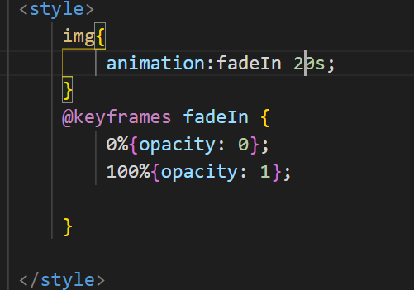
opacity
img {
opacity: 0.5;
}
h2.a { visibility: visible; } h2.b { visibility: hidden; }

Slide 37
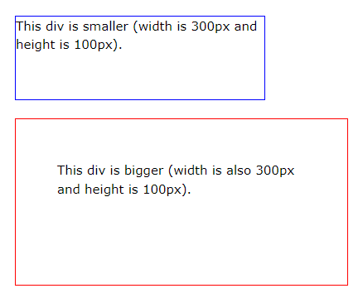
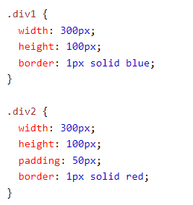
Box sizing – without border box

Slide 38
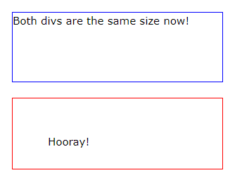
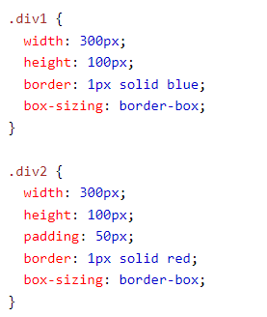
Box sizing – border-box

Slide 39
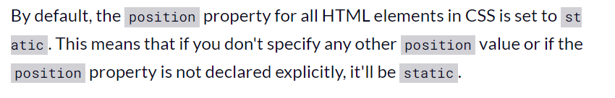
Position

Slide 40
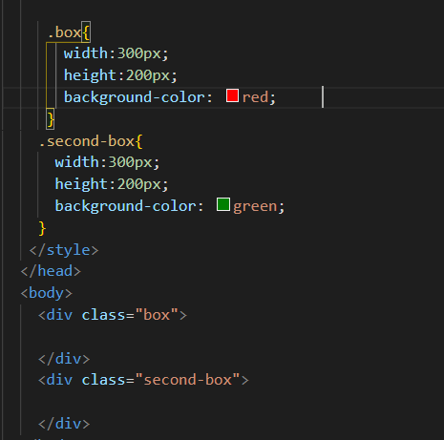

Default Position - static

Slide 41
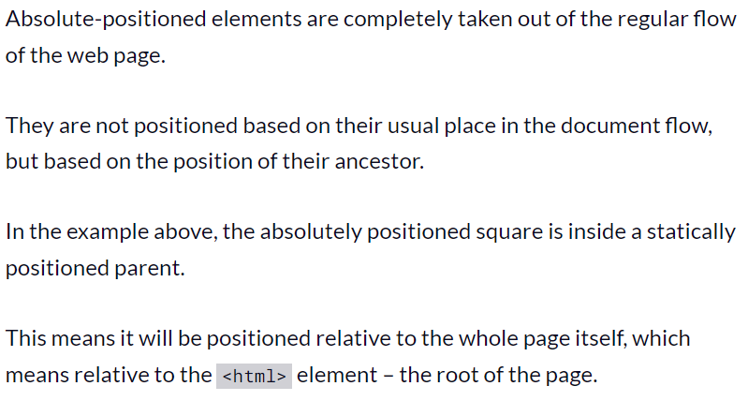
Position:absolute

Slide 42
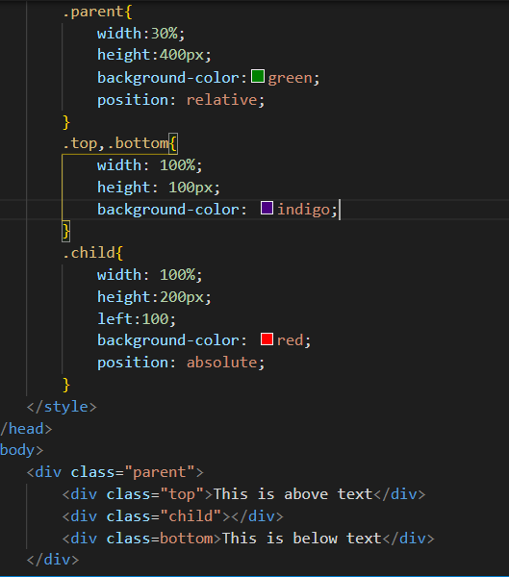
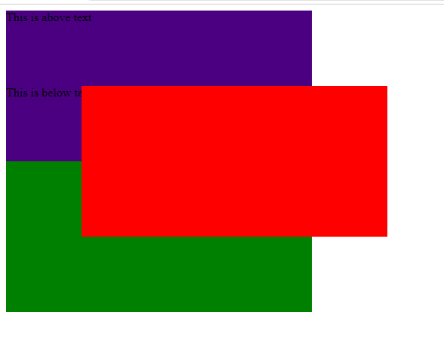
Position:absolute

Slide 43
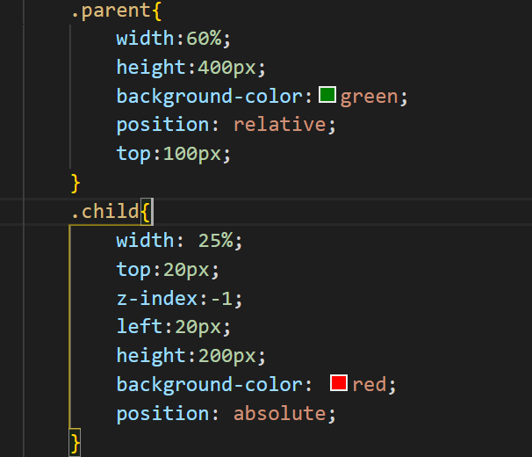

Z-index

Slide 44
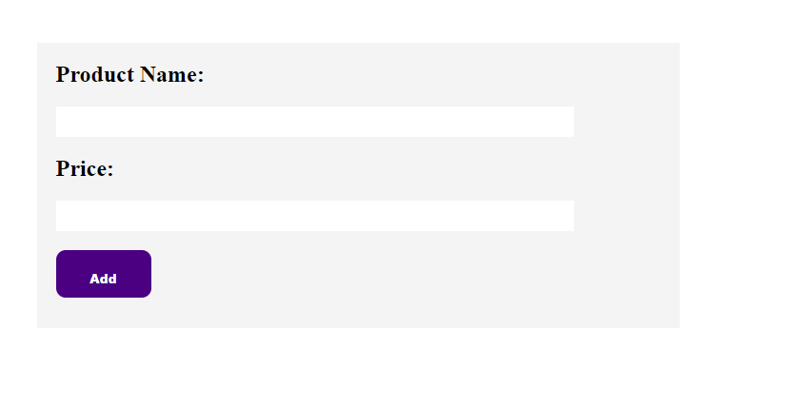
Form Design

