Slide 1
Project on Malignant Comments Classifier Project
Salman Pradhan
Submitted by

Slide 2
These are the approaches to solve this problem
1.Understand business problem
2.Scrapping data from flipkart.com using selenium
3.Data analysis
4.Data Cleaning
5.Data preprocessing
6.Model Building
7. Model Evaluation
8. Selecting the best model
9.Predict test.csv dataset

Slide 3
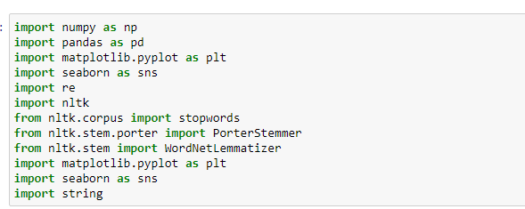
Importing Various Libraries
1.Numpy
2.Pandas
3.Matplotlib
4.Seaborn
5.Scikit_multilearn
6.re
7.Nltk

Slide 4
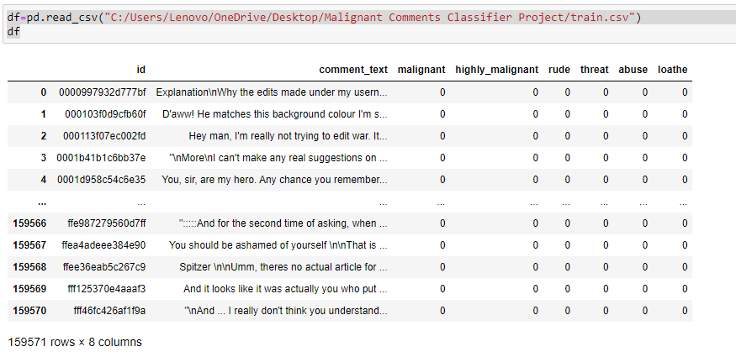
About Dataset
1.Loading dataset
2.Checking dimension
3.Checking columns
4.Checking column’s type
5.Checking Null values

Slide 5
From dataset we get information as:
Dataset has no null values.
Dataset has target 6 target variable so it is multilabel classification .

Slide 6
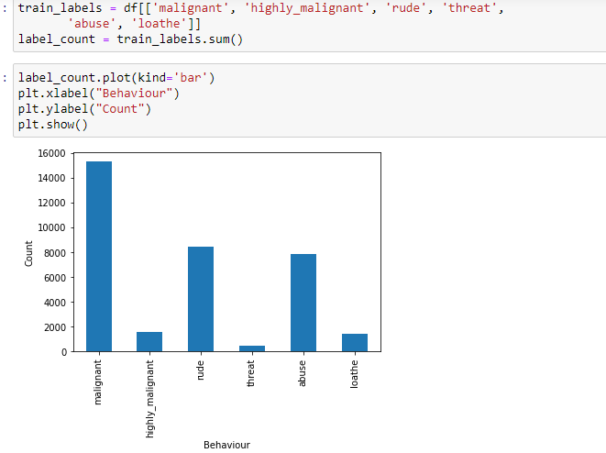
Data Analysis
Comment categories value count

Slide 7
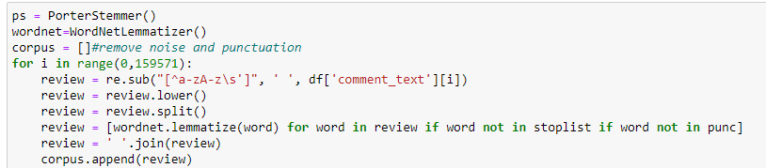
Data PreProcessing
1. First we have to remove all other words and symbols except alphates (a-z and A-Z).
2. We have to make all the words lower.
3. We have to split words from different sentences.
4. Then we have made a list named stoplist which contains all the repetation of words whose impact is neglisible while predicting the output.
5. We have to remove all the punctuations that present inside the sentence.
6. After removing all these unnecessary noise ,we have converted words to their base form by using WordnetLemmatizer.
7. Aproxmately 20000000 unnecessary words are removed.
8.We remove large sentence whose Length of words more than 400

Slide 8
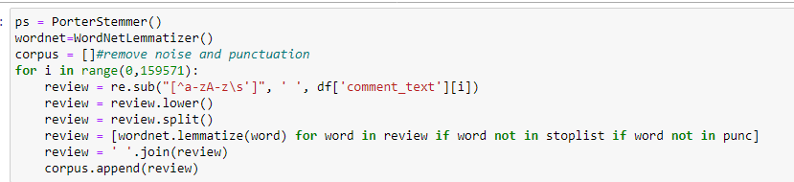
Data Cleaning

Slide 9
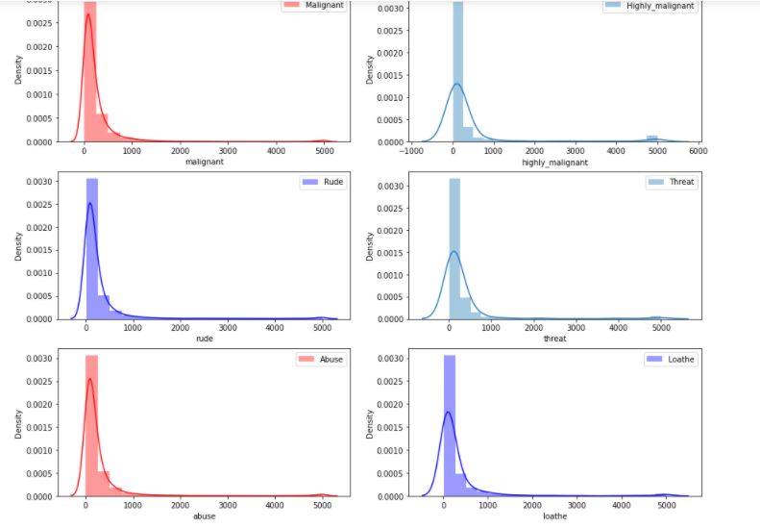
Distribution of length before cleaning

Slide 10
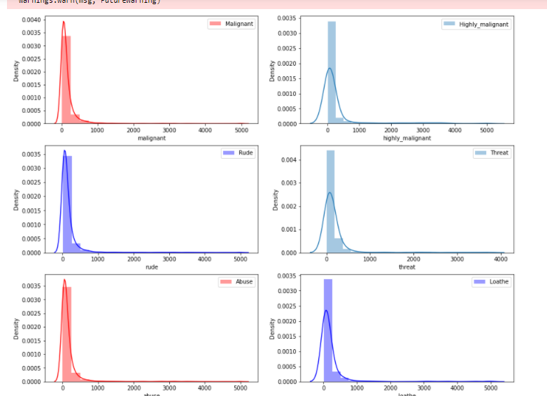
Distribution of length after cleaning

Slide 11
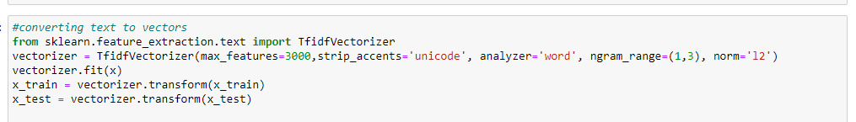
Convert text into vectors by tfidfvectorizer.

Slide 12
Model building
We have to divide dataset in 80% training and 20% for testing purpose.
We have to use different algorithms and check it’s accuracy.

Slide 13
Algorithms used for model building:
1. MLkNN
2. BinaryRelevance
3. ClassifierChain
4. LabelPowerset

Slide 14
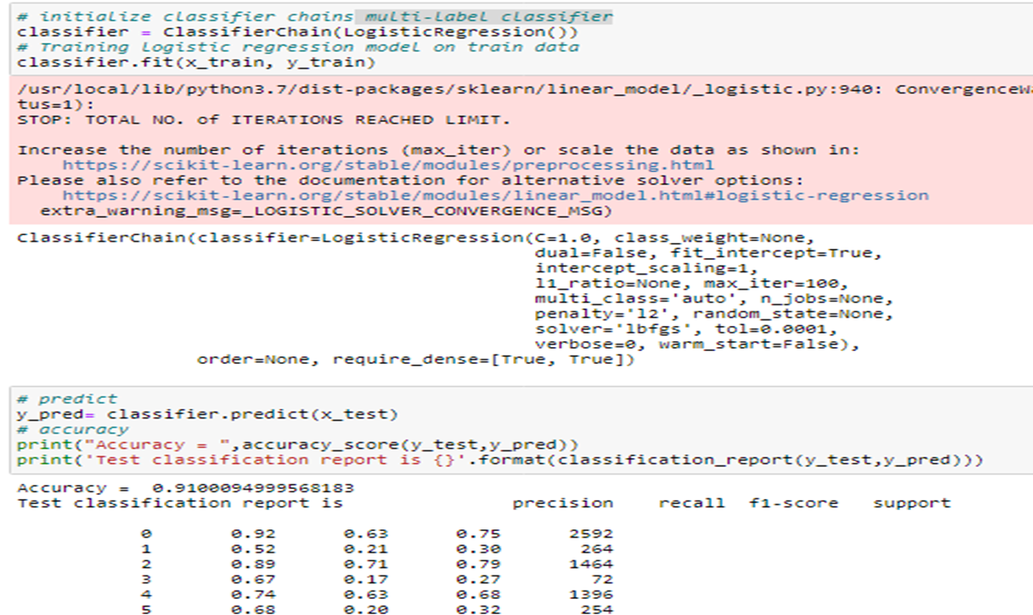
After using above algorithms we found that multilabel Classifier is the best model for the dataset.

Slide 15
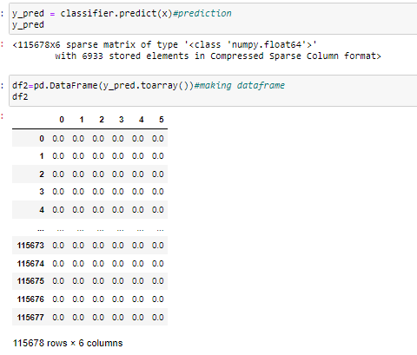
We got an accuracy score of 91%.
Then we preprocess our test dataset and make it ready for our model to predict.

Slide 16
Conclusion
1. First we load datasets Train.csv and Test .csv.
2. Then we preprocess data of both train.csv and test.csv by cleaning duplicates,noise and unnecessary words which are not helpful for this project
3. Then we convert text into vectors by using tfidfvectorizer as we know our ml model understands only integers.
4.We remove the rows whose length is more than 400.
5.Then we build our model.
5. We clearly see that accuracy score of multi-label classifierr is good compared to all other algorithms.
6. We confirm and conclude that this is the best model.we predict test.csv
7. We save the model by using joblib for future use.

