Slide 1

Identifying Gender Using Face Recognition Under the guidance of Mr.Muhammed Salman Shamsi Assistant Professor
BY
Shaikh Safiya Naaz
Mohd Salman Ansari
Shaikh Shafaque Naushad

Slide 2
Outline
Motivation
Face Detection
Haar cascade Classifier
Fisherface Method
Applications

Slide 3
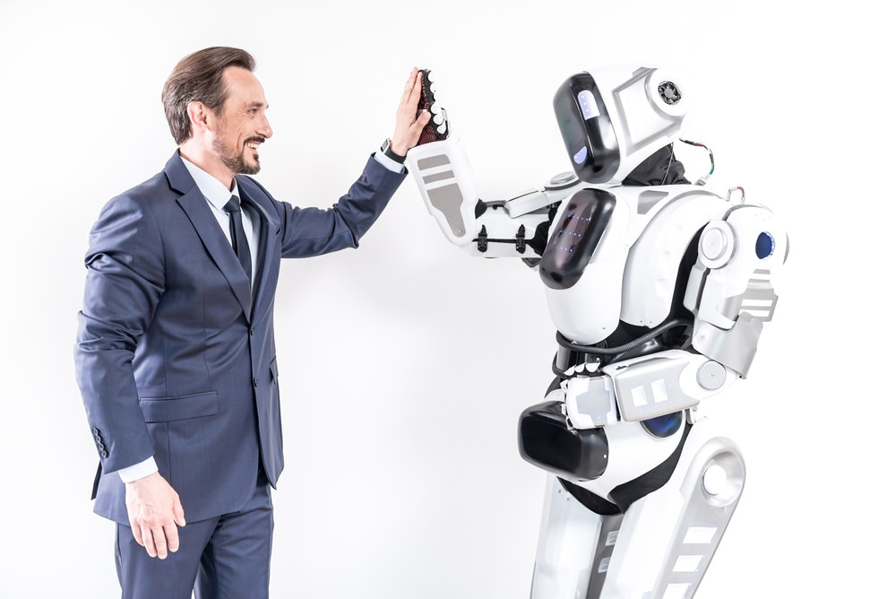
MOTIVATION
Current service robots require a smooth robot to user interaction.
In the ﬁeld of HCI , By successfully determining gender, the system can provide appropriate and customized services for users by adapting to them according to their gender.

Slide 4
Outline
Motivation
Face Detection
Haar cascade Classifier
Fisherface Method
Applications

Slide 5



Step 1. FACE DETECTION
Step 1.1
Create a Cascade Classifier it will contain the feature of the face
Step 1.3
OpenCV will read the image and the features file.
Step 1.2
Numpy Array
Display the image with a rectangular box
Search for the row and column values of the face numpy ndarray.

Slide 6
Outline
Motivation
Face Detection
Haar cascade Classifier
Fisherface Method
Applications

Slide 7

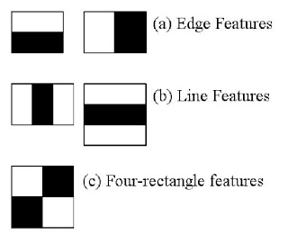
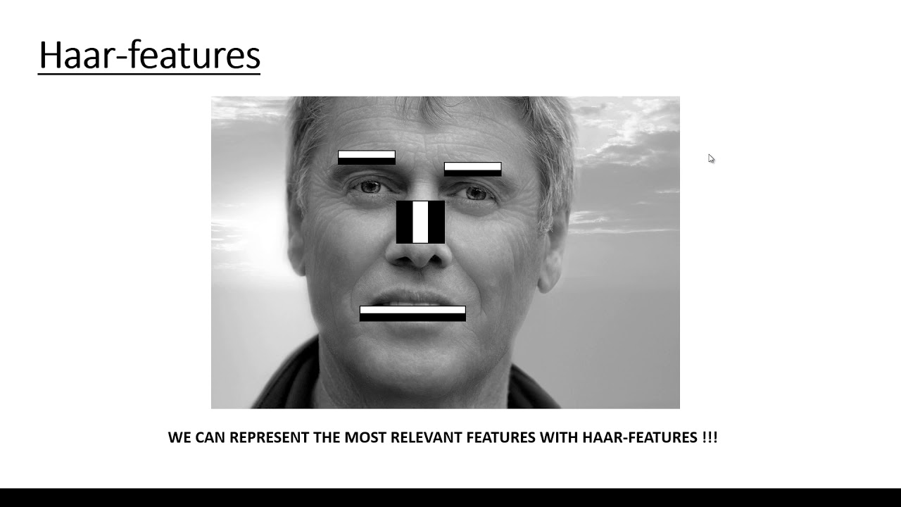
HAAR FEATURE BASED CASCADE CLASSIFIER.
HAAR-LIKE FEATURE

Slide 8
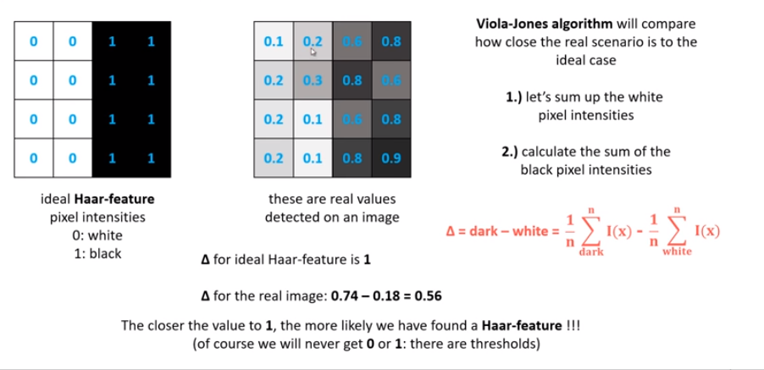

Slide 9
Outline
Motivation
Face Detection
Haar cascade Classifier
Fisherface Method
Applications

Slide 10


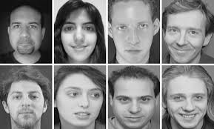
CROPPED
RGB TO GRAY
RESIZE
OUR PREVIOUS DATASET
OUR NEW DATASET
SPLIT DATASET INTO TRAINING DATA
AND PREDICTION DATA
TRAIN THE TRAINING DATA
USING FISHER FACE METHOD

Slide 11
Fisher Face Method
FisherFace method for classification uses LDA
Linear Discriminant analysis is very similar to the PCA approach.
PCA involves finding the components axes that maximize the variance of the entire data.
LDA involves finding the axes that maximize the separation between multiple classes

Slide 12
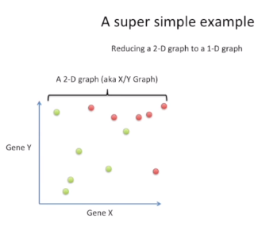
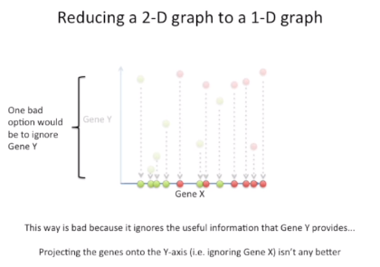

Slide 13
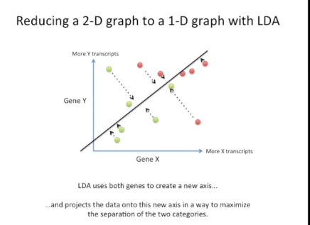
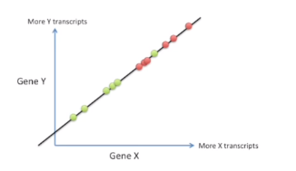

Slide 14
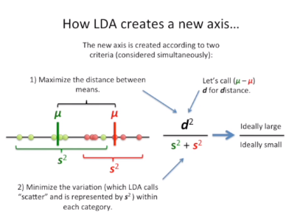

Slide 15
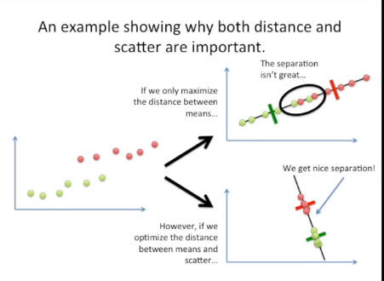

Slide 16
Outline
Motivation
Face Detection
Haar cascade Classifier
Fisherface Method
Applications

Slide 17
Applications
In the sale of product. You could customize ads in stores depending on the gender.
In the forensic field.
Gender classification can be helpful and useful for marketing in future.
It can be use to improve usability of devices, software or services

Slide 18
Outline
Motivation
Face Detection
Haar cascade Classifier
Fisherface Method
Applications

Slide 19
Conclusion
Gender recognition by face is consider one of the active research area of computer vision there are huge numbers of applications where gender recognition can be used in biometric, authentication, high-tech surveillance, security systems, criminology and augmented reality.
Also we can conclude that this is one method with some accuracy for classification, We can try many other methods with fine accuracy.

Slide 20


