Slide 1

Decentralized Auction Engine Using Hyperledger-Fabric Blockchain Framework
Project 2(E)
Submitted To: Submitted By:
Prof. Shrisha Rao Mayank Senani(MT2017067)
Sharad Mahajan(MT2017103)
Tarun Agrawal (MT2017127)

Slide 2
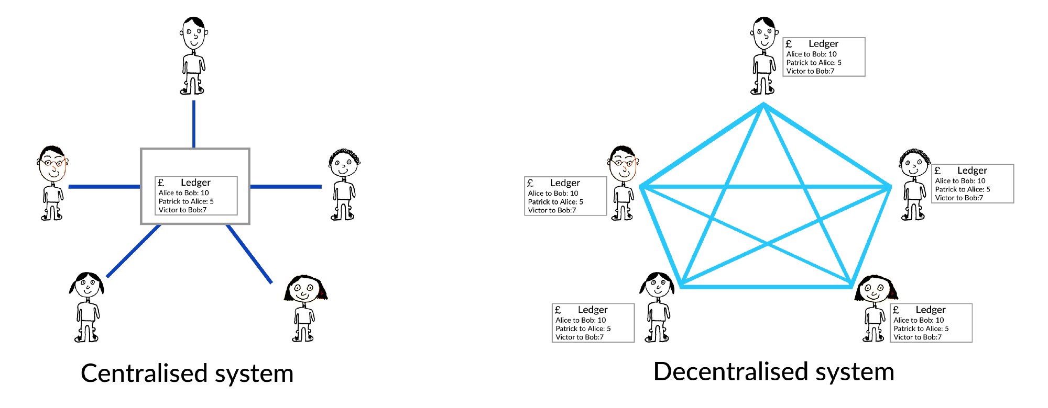
Centralised vs. Decentralised

Slide 3
BlockChain???
An Immutable, digital ledger. That is replicated among the participants.
Blockchain allows consumers and suppliers to connect directly, removing the need for a third party.
Blockchain can generate the trust in the organisation where parties don’t trust each other

Slide 4
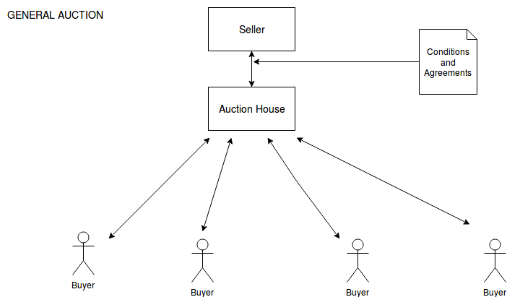
Current Scenario

Slide 5
Gap Analysis
Centralized system
Not Transparent : Bidders have to trust the auction houses.
Lack of common platforms : different auction house have their own platforms and own agreement conditions.
Expensive : A huge cost involved in carrying out a auction.
Flexibility:

Slide 6
Major Auctions
English Auction : an ascending sequential bid auction.
Reverse Auction: Role interchanged.
Dutch Auction : an descending sequential bid auction.
Kth Price Auction(sealed bid):

Slide 7
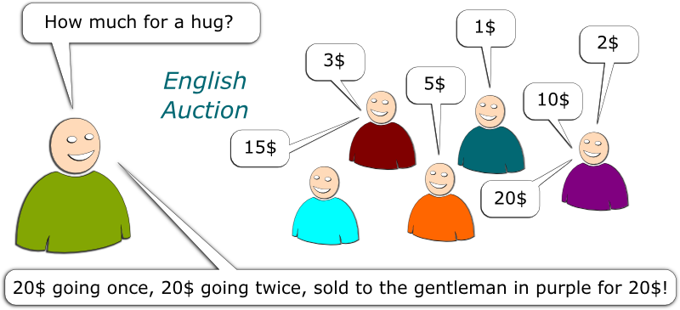
English Auction

Slide 8
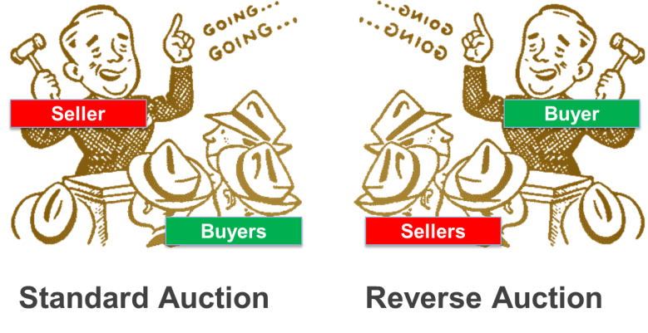
Reverse Auction

Slide 9
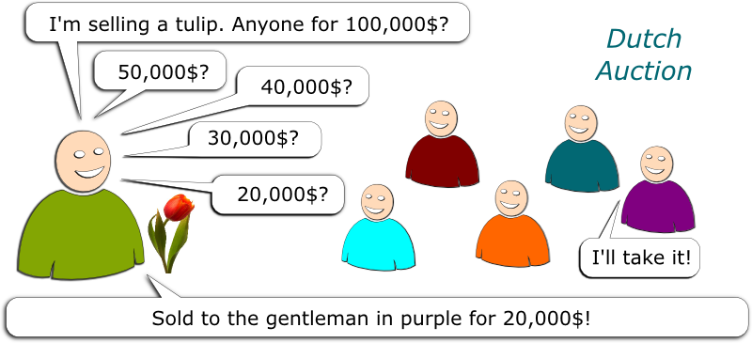
Dutch Auction

Slide 10
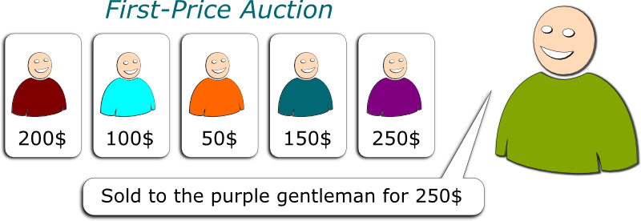
Kth_Price Auction(Sealed bid)

Slide 11
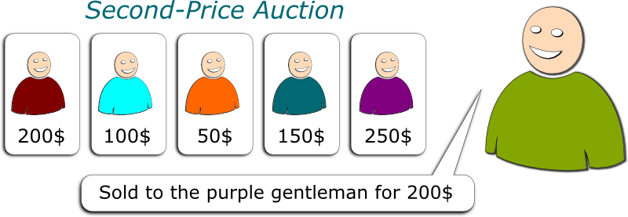
Kth_Price (Vickrey Auction)

Slide 12
Our Solution
1. decentralized platform : that enables everyone will be able to connect in order to sell, bid, organize an auction or offer a service to the ecosystem.
2. Scalable, reliable and transparent: each operation will be registered within the network in a way that is transparent, publicly verifiable and infeasible to falsify.
3. Interoperable: The bidder will be able to participate in numerous worldwide auctions– using just one interface.

Slide 13
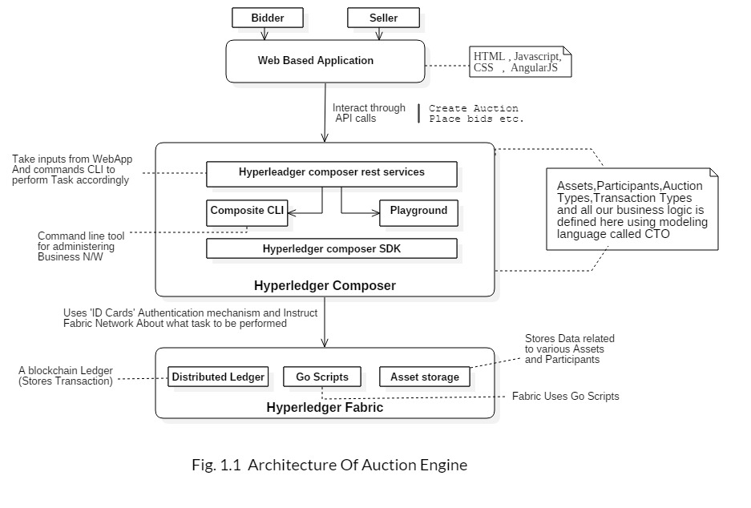
Architecture

Slide 14
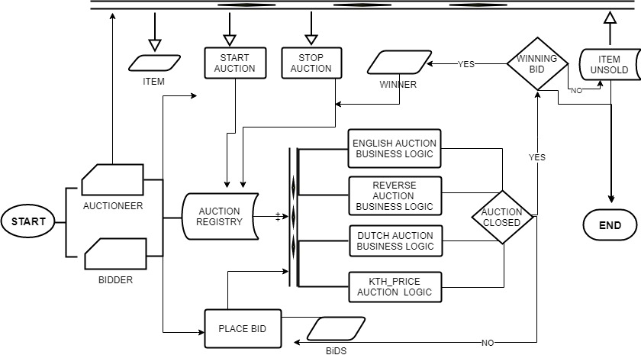
Flow Diagram

Slide 15
Future Plans
Want to make it open source.
Support More Types Of Auctions.
Should be able to create rules dynamically.

Slide 16

Thank You

