Slide 1

Decentralized Auction Engine Using Hyperledger-Fabric Blockchain Framework
Project 2(E)
Submitted To: Submitted By:
Professor: Shrisha Rao Mayank Senani(MT2017067)
Sharad Mahajan(MT2017103)
Tarun Agrawal (MT2017127)

Slide 2
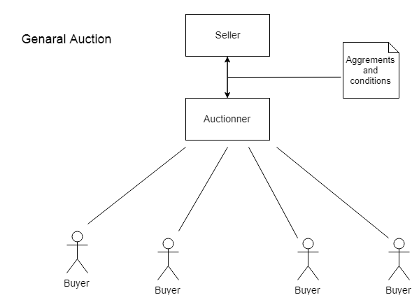
Today’s Auction

Slide 3
Limitations or Gap
1) All the online auction platforms that currently exist are based on one centralized operation.
2) They are not transparent- Bidders have no way to ensure the origin, authenticity and legitimacy of a higher bid. Only the organizer has this information.
3) They are not open - Every bidder must use the organizer’s platform for registration, authentication and bidding. So, as there are a huge number of auctions organizers worldwide, a bidder must register many times over. They must therefore manage many different accounts and learn how to use a new and different interface each time.
4) The ecosystem is very limited- Because no one standard exists, each organizer has developed its own bidder interfaces and tools and even most auction organizers don’t have mobile applications.
5) In contrast with the live auction there will be high organizational cost and maintenance cost with limited number of bidders.

Slide 4
Blockchain’s Solution

Slide 5
Major Auctions
English Auction(an ascending sequential bid auction)
Reverse Auction
Dutch Auction(an descending sequential bid auction)
Kth Price Auction(sealed bid) etc.

Slide 6
Kth_Price Auction

