Slide 1

Department of Computer Science and Engineering
(Cyber Security)
CS23533– Foundations of Artificial Intelligence
2026-2027
FORENSEQUENCE : AI-Powered Digital Forensics
Investigation System — MODEL REVIEW
Dr. S Bhuvana
Assistant Professor(SG)
KAVYA SRIRAM – 241901045
MOHAMED SALMAN - 241901055

Slide 2
Problem Statement and Motivation
Problem: Digital forensic investigations involve analyzing large volumes of evidence from multiple sources, making it difficult to identify suspicious activities quickly.
Importance: Delayed identification of suspicious activities affects investigators who need to examine evidence, understand incident sequences, and determine potential security threats.
Motivation: To develop FORENSEQUENCE, a rule-based AI forensic assistant that automates evidence analysis, derives explainable findings, calculates risk levels, and monitors new evidence in real time.

Slide 3
Objectives
Objectives
Analyze evidence from multiple sources.
Implement Rule-Based AI using Forward Chaining.
Calculate risk scores and reconstruct event timelines.
Enable real-time monitoring and PDF report generation.
Progress
Requirements and literature survey
System design and methodology
Implementation, testing and evaluation

Slide 4
Abstract
FORENSEQUENCE is an AI-based digital forensic assistant developed using Python to simplify digital evidence analysis. It analyzes logs, files, browser history, and email data to identify suspicious activities. Using a Rule-Based Expert System and Forward Chaining, it generates explainable findings, calculates risk scores, and creates event timelines. The system also supports forensic report generation, with live evidence monitoring planned to detect changes and trigger automatic re-analysis. FORENSEQUENCE aims to make digital forensic investigations faster, more organized, and easier to understand.

Slide 5
Literature Survey
S. No. | Author(s) & Year | Paper Title | Methodology / Algorithm | Limitations
1 | Dunsin et al. (2024) | AI in Digital Forensics | AI-based forensic techniques | Limited real-time investigation capabilities
2 | Alam & Demir (2024) | SIFT: Explainable AI in Cyber Forensics | Explainable forensic analysis | Focuses on file-fragment classification
3 | Russell & Norvig (2020) | Artificial Intelligence: A Modern Approach | Rule-based reasoning, logical inference | Requires predefined knowledge and rules

Slide 6
Literature Survey
S. No. | Author(s) & Year | Paper Title | Methodology / Algorithm | Limitations
4 | Hargreaves & Patterson (2012) | Automated Timeline Reconstruction | Event pattern analysis | Limited to pre-defined patterns
5 | Kang et al. (2013) | User Activity Reconstruction | Signature-based analysis | Depends on identifiable signatures

Slide 7
Research Gap/Existing System
1. Literature findings
Existing studies focus on individual forensic techniques, rule-based analysis, and timeline reconstruction.
2. Limitations
Limited integration of evidence sources and lack of continuous, automated analysis.
3. Refined research gap
Need to combine evidence analysis, explainable reasoning, risk scoring, and real-time monitoring in one system.
4. Progress toward the solution
FORENSEQUENCE integrates multi-source analysis, Forward Chaining, risk assessment, timelines, and live monitoring.

Slide 8
Proposed System
Evidence sources
Evidence Analyzer: Extracts forensic facts from multiple sources.
Knowledge Base: Stores IF–THEN rules.
Forward Chaining: Derives explainable findings from facts.
Risk & Timeline: Assesses risk and organizes events chronologically.
Live Monitoring: Detects evidence changes and triggers re-analysis.
Evidence analysis & fast extraction
Knowledge base + Forward chaining
Risk Assessment & Event Timeline
Forensic Report · PDF · Alerts

Slide 9
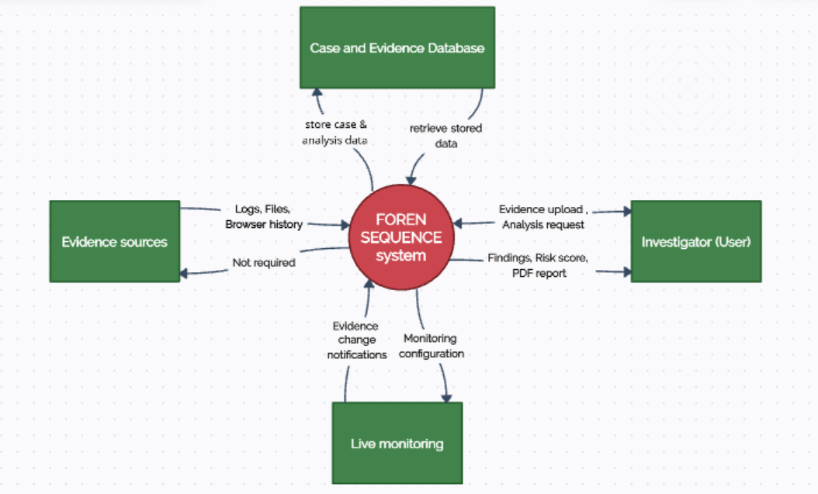
DFD Diagram – level 0

Slide 10
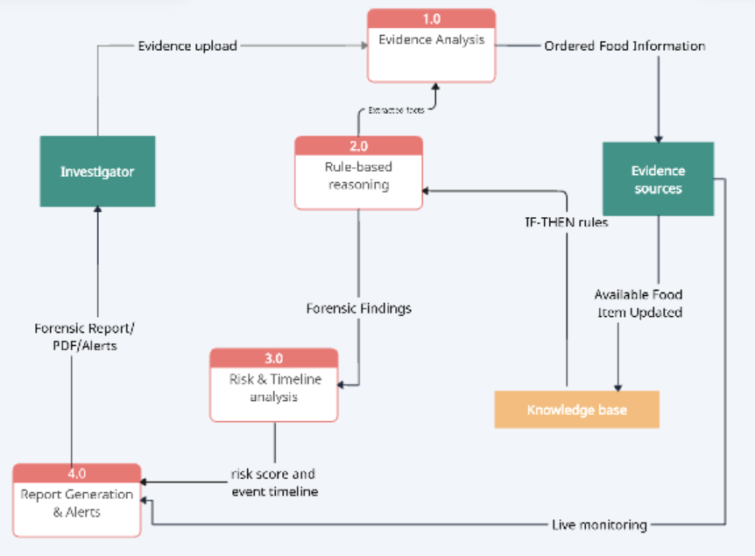
DFD Diagram – level 1

Slide 11
Methodology/Work Flow Diagram
Evidence collection - Logs · Files · Browser · Email
Pre-processing - Parse evidence · Extract facts
System Design - Architecture · Knowledge Base · Rules
Implementation - Forward Chaining · Risk · Timeline · Monitoring
Testing - Verify rules · Evidence analysis · Alerts
Evaluation & o/p - Assess findings · PDF Report · Risk Score

Slide 12
Tools and Technologies
Programming Language | Python
GUI | Tkinter + ttkbootstrap
DataBase | SQLite
AI Techniques | Rule-Based Expert System, Forward Chaining
Libraries | Pandas, watchdog, ReportLab
Justification: Python enables rapid development; Tkinter supports the desktop GUI; Pandas processes structured data; watchdog enables real-time monitoring; ReportLab generates PDF reports; SQLite stores case data locally.

Slide 13
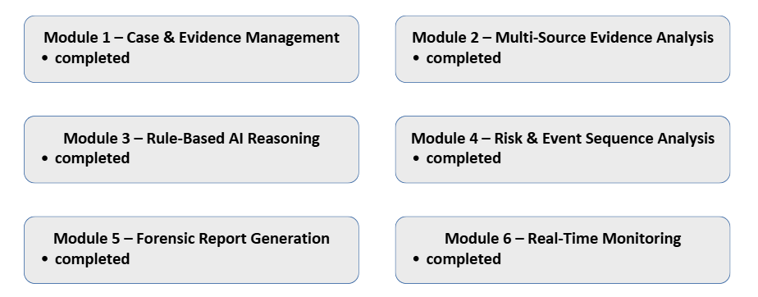
List of Modules

Slide 14
Module Description(For each Module separately)
Module 1: Case & Evidence Management — Completed
Purpose: Create cases and manage digital evidence.
Input: Case details and evidence files.
Output: Stored evidence and SHA-256 hashes.
Implementation: Case creation, file handling, and hashing.
Module 2: Multi-Source Evidence Analysis — Completed
Purpose: Analyze evidence from multiple sources.
Input: Logs, files, browser history, and email data.
Output: Extracted forensic facts.
Implementation: Evidence parsing and fact extraction.

Slide 15
Module Description(For each Module separately)
Module 3: Rule-Based AI Reasoning — Completed
Purpose: Identify suspicious activities through logical reasoning.
Input: Extracted facts and predefined rules.
Output: Forensic findings with explanations.
Implementation: IF–THEN rules and Forward Chaining.
Module 4: Risk & Event Sequence Analysis — Completed
Purpose: Assess risk and reconstruct event sequences.
Input: Forensic findings and event data.
Output: Risk score and chronological timeline.
Implementation: Weighted risk calculation and event ordering.

Slide 16
Module Description(For each Module separately)
Module 5: Forensic Report Generation — Completed
Purpose: Present investigation results in a structured format.
Input: Findings, risk scores, and timeline.
Output: Forensic report and PDF.
Implementation: Report formatting and PDF export.
Module 6: Risk & Event Sequence Analysis — Completed
Purpose: Detect changes in monitored evidence.
Input: Monitored evidence files and folders.
Output: Change alerts and re-analysis triggers.
Implementation: File-system monitoring using watchdog

Slide 17
Results & Discussion
Evidence analysis and rule-based findings completed.
Risk scoring and timeline generation completed.
Testing through functional test cases.
PDF reporting in progress; live monitoring pending.
Improvement: Automated, unified forensic analysis.

Slide 18
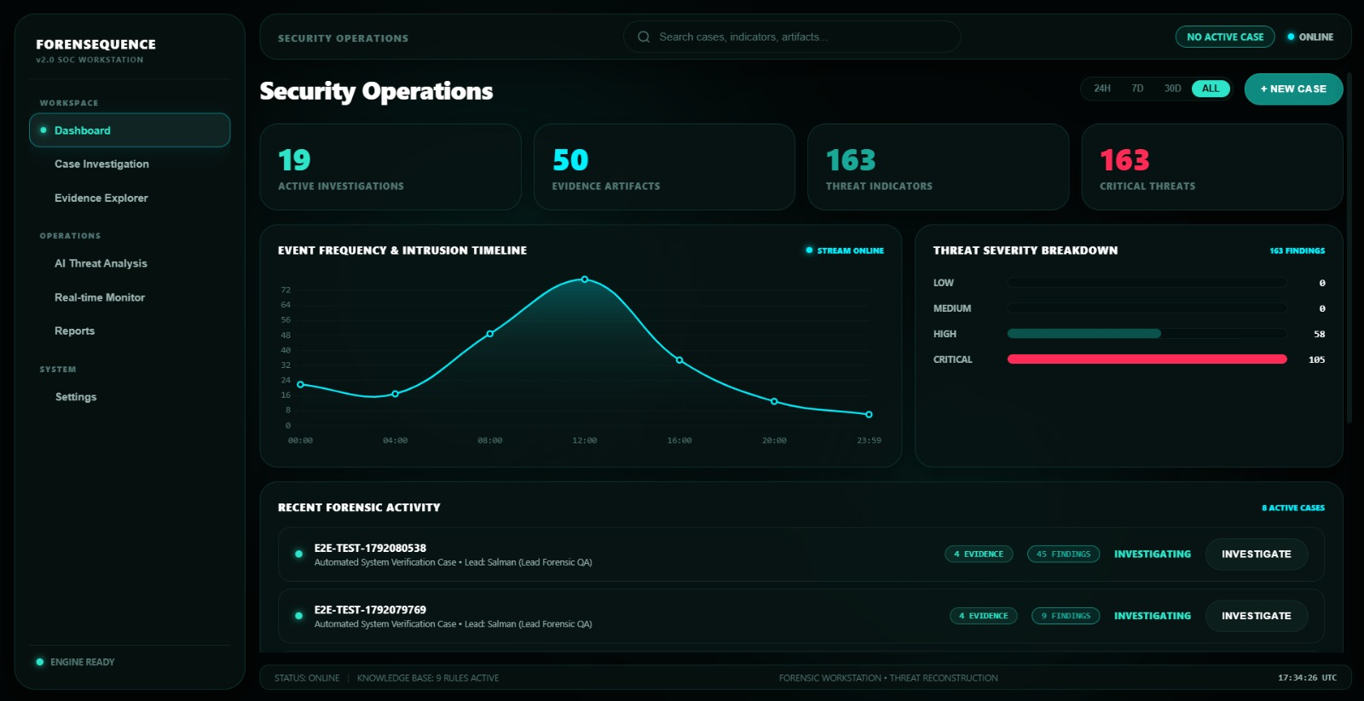
User Interface/ Screenshots
DASHBOARD

Slide 19
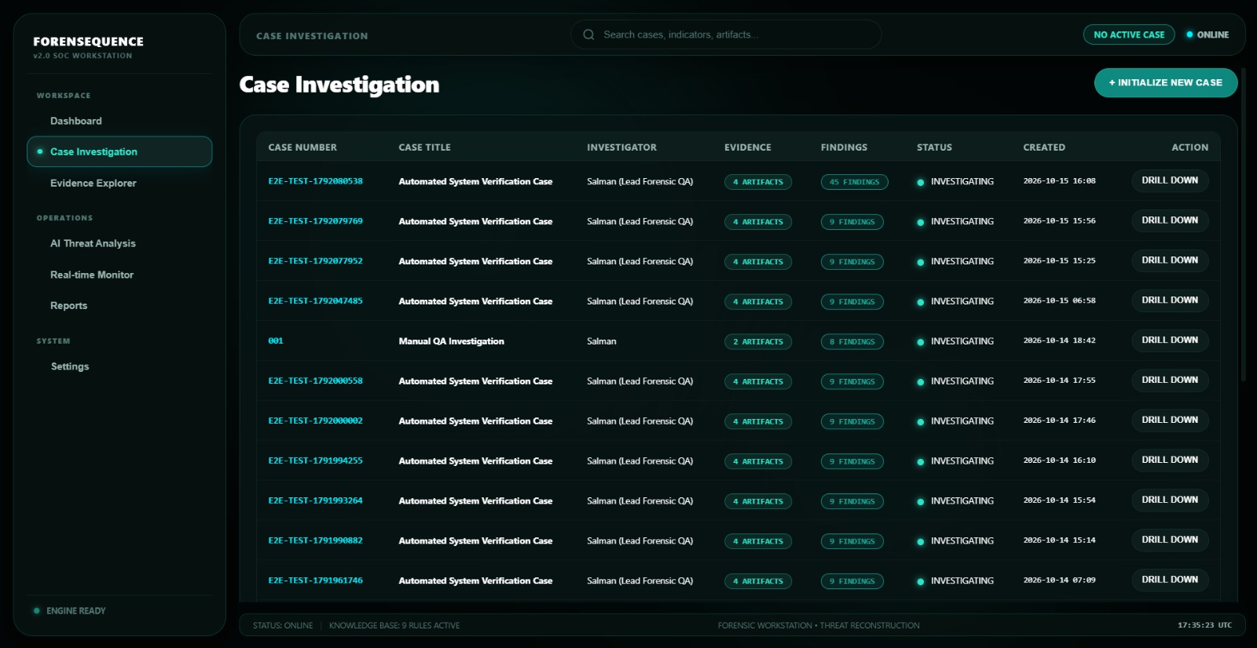
User Interface/ Screenshots
CASE INVESTIGATION TAB

Slide 20
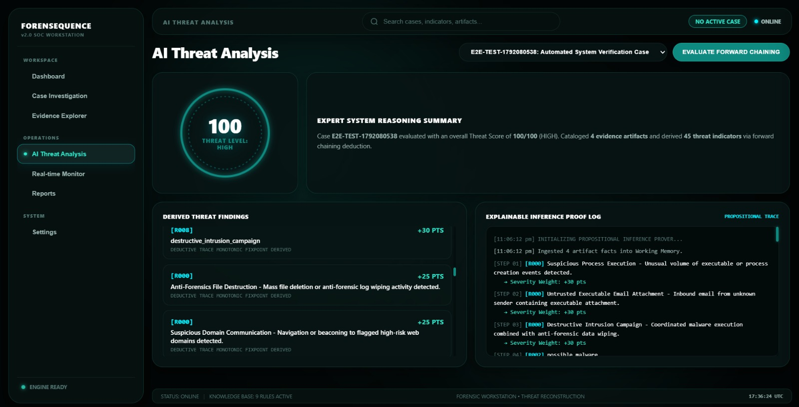
User Interface/ Screenshots
AI THREAT ANALYSIS TAB

Slide 21
Conclusion
FORENSEQUENCE automates digital evidence analysis using rule-based AI.
Forward Chaining enables explainable forensic findings.
Risk scoring and event timelines support investigation.
PDF reporting and real-time monitoring will enhance the system further.

Slide 22
Future Work
Implement live evidence monitoring with automatic re-analysis and real-time alerts.
Expand the rule base to detect more suspicious activities.
Support additional evidence sources and file formats.
Enhance PDF reports with clearer findings and event timelines.
Improve reliability through extensive testing and evaluation.

Slide 23
References
D. Dunsin et al. (2023) — Rule-Based Digital Forensics
S. Alam & A. K. Demir (2024) — SIFT: Explainable AI in Cyber Forensics
D. D. et al. (2024) — AI in Digital Forensic Investigation
S. Russell & P. Norvig — Artificial Intelligence: A Modern Approach
Python Software Foundation — Python Documentation
SQLite — SQLite Documentation

Slide 24
Thank You

