Slide 1


Department of Cyber Security
2026-2027- Odd Semester
III Year /V Sem
CS23533-FOUNDATIONS OF ARTIFICIAL INTELLIGENCE
Review 1– 09.09.2026
Rajalakshmi Engineering College,Department of Cyber Security

Slide 2
Introduction
2
FORENSEQUENCE : AI-Powered Digital Forensics
Investigation System
  Domain: Digital Forensics and Artificial Intelligence
  Analyzes evidence from logs, files/folders, browser history, and emails
  Uses Forward Chaining to reason over extracted facts and identify suspicious activities
  Provides risk scoring, event timeline reconstruction, and explainable findings
  Supports real-time evidence monitoring and automatically re-analyzes new activity
FORENSEQUENCE is a desktop-based AI-assisted digital forensic investigation system that helps investigators analyze digital evidence and derive forensic findings using a Rule-Based Expert System.
[Department] | Project Review – 1 | [Academic Year]

Slide 3


Problem Statement
3
CURRENT CHALLENGES AND PROBLEMS
PROPOSED NEED
  Forensic analysis involves large volumes of digital evidence
  Existing analysis is largely retrospective and manual
  Delays in identifying suspicious activities
  Evidence from multiple sources needs unified analysis
  Need for automated and explainable forensic reasoning
A unified forensic assistant that combines multi-source evidence analysis, rule-based reasoning, risk assessment, event sequencing, and real-time monitoring
[Department] | Project Review – 1 | [Academic Year]

Slide 4
Motivation
4
WHAT | HOW
Reduce manual investigation effort | automating repetitive forensic evidence analysis.
Enable faster identification of suspicious activity | automated rule-based analysis.
Apply classical AI techniques | Knowledge-Based Agents and Forward Chaining to digital forensics.
Provide explainable forensic findings | by showing the rules and facts behind each conclusion.
Support real-time investigation | by automatically analyzing new evidence as it appears.
[Department] | Project Review – 1 | [Academic Year]

Slide 5

Objectives
5
To collect and analyze digital evidence from multiple sources
To extract structured facts from forensic evidence
To implement Forward Chaining for rule-based forensic reasoning
To generate findings, risk scores, and event timelines
To enable real-time forensic monitoring that automatically analyzes newly added evidence and generates alerts and updated reports.
To perform risk and event analysis by calculating a risk score and reconstructing the chronological sequence of events.
[Department] | Project Review – 1 | [Academic Year]

Slide 6
Literature Survey
6
S.No. | Author & Year | Method / Technique | Key Findings | Limitations
1 | D. Dunsin et al., 2023 | Rule-Based System | Applies rule-based reasoning to digital forensic investigation | Scope is limited to rule-based analysis
2 | S. Alam, A. K. Demir, 2024 | Explainable AI (XAI), Forensic Analysis | Focuses on explainable AI for cyber-forensic analysis | Focus is primarily on explainability in forensic analysis
3 | D. D. et al., 2024 | Logical Reasoning, Forward Chaining | Uses logical reasoning and Forward Chaining for digital forensic investigation | Focuses on logical/rule-based reasoning
[Department] | Project Review – 1 | [Academic Year]

Slide 7



Existing System
7
Existing Approach
  Retrospective forensic analysis
  Evidence reviewed after an incident
Technologies / Techniques
  Digital forensic investigation tools
  Log and artifact analysis
  Timeline reconstruction
Advantages
  Detailed evidence examination
  Established forensic workflows
Limitations
  Manual and time-consuming
  Analysis is mainly after-the-fact
  Multiple evidence sources may require separate analysis
  Limited real-time detection and automated reasoning
EXISTING SYSTEM FLOW
Digital Evidence
Manual Analysis
Findings
Report
[Department] | Project Review – 1 | [Academic Year]

Slide 8

Proposed System
8
Proposed Approach
  AI-based digital forensic assistant
  Rule-Based Expert System using Forward Chaining
Key Features
  Multi-source evidence analysis
  Explainable rule-based findings
  Risk scoring + event timeline
  Real-time evidence monitoring
  Automated forensic report generation
Evidence
Fast Extraction
Knowledge Base
Forward Chaining
Findings
Expected Outcome
  Faster investigation
  Explainable findings
  Continuous evidence monitoring
  Structured forensic reports
Risk + Timeline
Report
[Department] | Project Review – 1 | [Academic Year]

Slide 9
System Architecture / Block Diagram
9
EVIDENCE SOURCES
EVIDENCE ANALYZERS
FAST EXTRACTION
KNOWLEDGE BASE + FORWARD CHAINING
FINDINGS
RISK SCORE
TIMELINE
REPORTS/ALERTS
[Department] | Project Review – 1 | [Academic Year]

Slide 10
Methodology
10
1. Evidence Collection
Logs | Files | Browser History | Email
2. Fast Extraction
Parse evidence → Extract structured facts
3. Knowledge Processing
Apply IF–THEN rules
4. Forward Chaining
Facts → Rule Matching → Findings
5. Risk & Timeline Analysis
Risk Score + Event Sequence
6. Output
Alerts + Forensic Report
[Department] | Project Review – 1 | [Academic Year]

Slide 11
Technologies Used
11
Programming Language | Python
GUI | Tkinter + ttkbootstrap
DataBase | SQLite
AI Techniques | Rule-Based Expert System, Forward Chaining
Libraries | Pandas, watchdog, ReportLab
[Department] | Project Review – 1 | [Academic Year]

Slide 12
Module Description
12
Module 1 – Case & Evidence Management
Case creation, evidence upload, SHA-256 hashing
Module 2 – Multi-Source Evidence Analysis
Logs, files/folders, browser history, email
Module 3 – Rule-Based AI Reasoning
Knowledge Base + Forward Chaining
Module 4 – Risk & Event Sequence Analysis
Risk scoring + event timeline
Module 5 – Forensic Report Generation
In-app report + PDF export
Module 6 – Real-Time Monitoring
Live evidence monitoring + automatic re-analysis + alerts
[Department] | Project Review – 1 | [Academic Year]

Slide 13
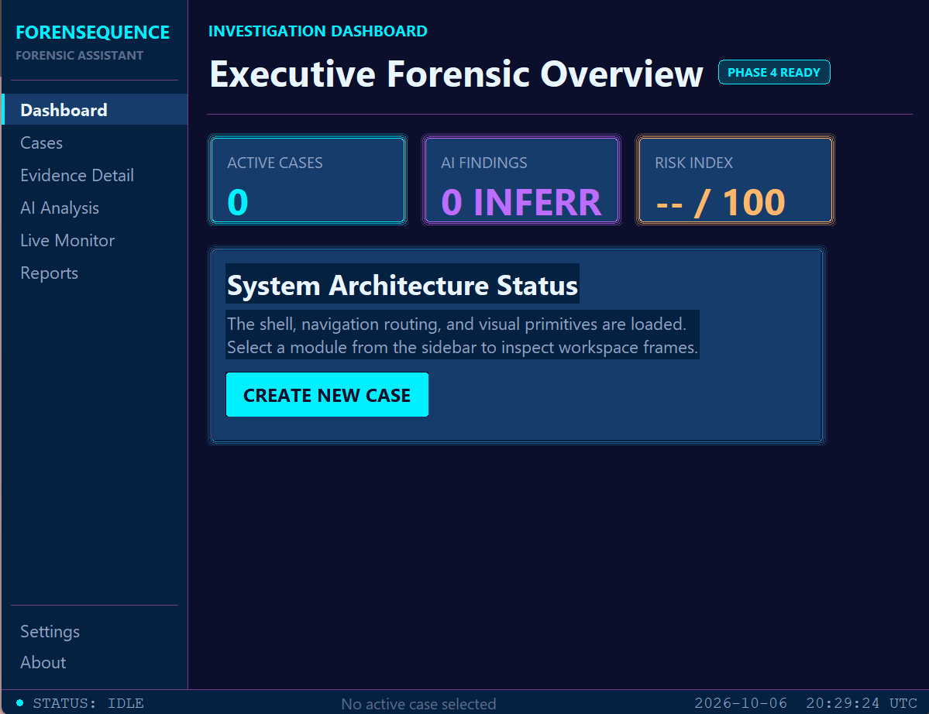
Preliminary / Expected Results
13
[Department] | Project Review – 1 | [Academic Year]

Slide 14
Project Schedule
14
Activity | Month 1 | Month 2 | Month 3 | Month 4
Literature Survey | ✓
Problem Identification | ✓
System Design |  | ✓
Implementation |  | ✓ | ✓
Testing & Evaluation |  |  | ✓
Documentation |  |  |  | ✓
[Department] | Project Review – 1 | [Academic Year]

Slide 15
Current Progress
15
✓ Literature survey completed
✓ Problem identification completed
✓ Requirement analysis / methodology finalized
☐ Implementation completed
☐ Testing completed
☐ Final evaluation completed
[Department] | Project Review – 1 | [Academic Year]

Slide 16
Future Work
16
Remaining Project Work
Complete core system implementation
Implement Forward Chaining and rule engine
Integrate real-time evidence monitoring
Test multi-source evidence analysis
Evaluate risk scoring and event reconstruction
Future Enhancements
Support additional forensic evidence sources and file formats
Extend the rule base with more forensic investigation scenarios
Improve visualization of evidence and event timelines
Explore advanced AI techniques for future forensic assistance
[Department] | Project Review – 1 | [Academic Year]

Slide 17
Conclusion
17
  FORENSEQUENCE applies AI-based rule reasoning to digital forensic investigation.
  Combines multi-source evidence analysis with Forward Chaining.
  Provides explainable findings, risk scoring, and event timeline reconstruction.
  Enables real-time monitoring and automatic re-analysis of new evidence.
  Aims to support investigators with faster, structured, and explainable forensic analysis.
[Department] | Project Review – 1 | [Academic Year]

Slide 18
References
18
  D. Dunsin et al. (2023) — Rule-Based Digital Forensics
  S. Alam & A. K. Demir (2024) — SIFT: Explainable AI in Cyber Forensics
  D. D. et al. (2024) — AI in Digital Forensic Investigation
  S. Russell & P. Norvig — Artificial Intelligence: A Modern Approach
  Python Software Foundation — Python Documentation
  SQLite — SQLite Documentation
[Department] | Project Review – 1 | [Academic Year]

