Slide 1

Department of Computer Science and Engineering
(Cyber Security)
CS23533– Foundations of Artificial Intelligence
2026-2027
FORENSEQUENCE : AI-Powered Digital Forensics
Investigation System — REVIEW 2
Dr. S Bhuvana
Assistant Professor(SG)
KAVYA SRIRAM – 241901045
MOHAMED SALMAN - 241901055

Slide 2
Problem Statement and Motivation
Problem: Digital forensic investigations involve analyzing large volumes of evidence from multiple sources, making it difficult to identify suspicious activities quickly.
Importance: Delayed identification of suspicious activities affects investigators who need to examine evidence, understand incident sequences, and determine potential security threats.
Motivation: To develop FORENSEQUENCE, a rule-based AI forensic assistant that automates evidence analysis, derives explainable findings, calculates risk levels, and monitors new evidence in real time.

Slide 3
Objectives
Objectives
Analyze evidence from multiple sources.
Implement Rule-Based AI using Forward Chaining.
Calculate risk scores and reconstruct event timelines.
Enable real-time monitoring and PDF report generation.
Progress
Requirements and literature survey
System design and methodology
Implementation, testing and evaluation

Slide 4
Project Progress Since Review 1
Finalized system architecture and module design.
Defined the rule base and Forward Chaining workflow.
Planned multi-source evidence analysis and risk assessment.
Finalized the real-time monitoring and report generation approach.
Current Status: Design finalized; implementation and testing in progress.

Slide 5
Literature Survey
S. No. | Author(s) & Year | Paper Title | Methodology / Algorithm | Limitations
1 | Dunsin et al. (2024) | AI in Digital Forensics | AI-based forensic techniques | Limited real-time investigation capabilities
2 | Alam & Demir (2024) | SIFT: Explainable AI in Cyber Forensics | Explainable forensic analysis | Focuses on file-fragment classification
3 | Russell & Norvig (2020) | Artificial Intelligence: A Modern Approach | Rule-based reasoning, logical inference | Requires predefined knowledge and rules

Slide 6
Literature Survey
S. No. | Author(s) & Year | Paper Title | Methodology / Algorithm | Limitations
4 | Hargreaves & Patterson (2012) | Automated Timeline Reconstruction | Event pattern analysis | Limited to pre-defined patterns
5 | Kang et al. (2013) | User Activity Reconstruction | Signature-based analysis | Depends on identifiable signatures

Slide 7
Research Gap and Project Response
1. Literature findings
Existing studies focus on individual forensic techniques, rule-based analysis, and timeline reconstruction.
2. Limitations
Limited integration of evidence sources and lack of continuous, automated analysis.
3. Refined research gap
Need to combine evidence analysis, explainable reasoning, risk scoring, and real-time monitoring in one system.
4. Progress toward the solution
FORENSEQUENCE integrates multi-source analysis, Forward Chaining, risk assessment, timelines, and live monitoring.

Slide 8
System Architecture / Proposed System
Evidence sources
Evidence Analyzer: Extracts forensic facts from multiple sources.
Knowledge Base: Stores IF–THEN rules.
Forward Chaining: Derives explainable findings from facts.
Risk & Timeline: Assesses risk and organizes events chronologically.
Live Monitoring: Detects evidence changes and triggers re-analysis.
Evidence analysis & fast extraction
Knowledge base + Forward chaining
Risk Assessment & Event Timeline
Forensic Report · PDF · Alerts

Slide 9
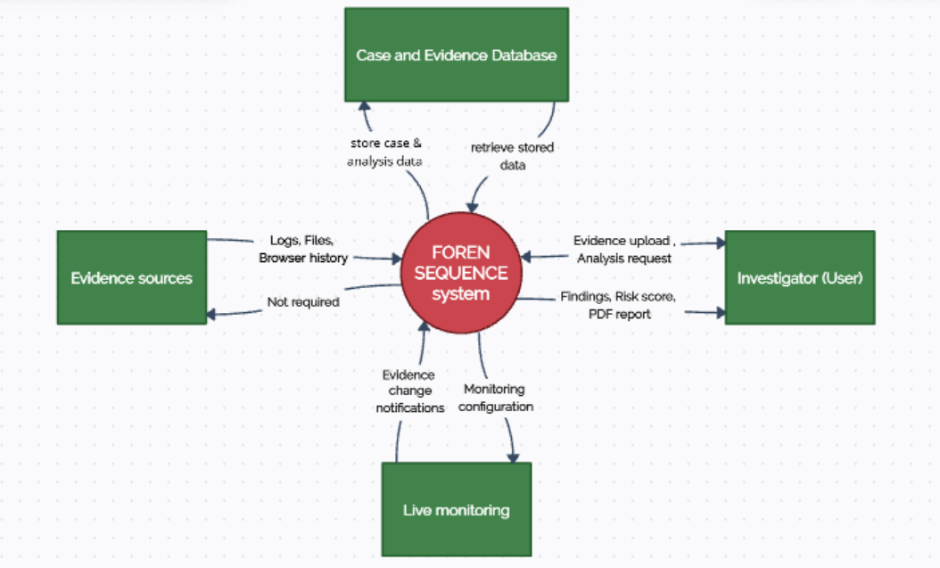
DFD Diagram – Level 0

Slide 10
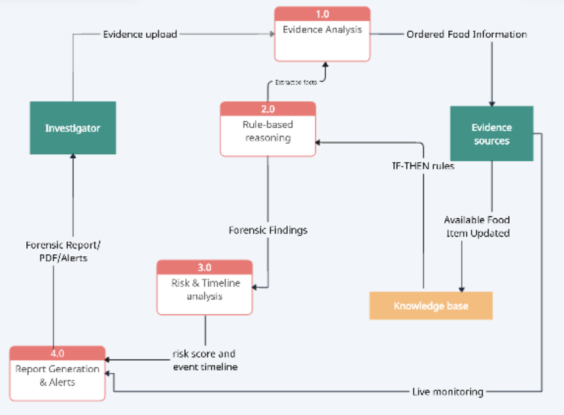
DFD Diagram – Level 1

Slide 11
Methodology / Workflow Diagram
Evidence collection - Logs · Files · Browser · Email
Pre-processing - Parse evidence · Extract facts
System Design - Architecture · Knowledge Base · Rules
Implementation - Forward Chaining · Risk · Timeline · Monitoring
Testing - Verify rules · Evidence analysis · Alerts
Evaluation & o/p - Assess findings · PDF Report · Risk Score

Slide 12
Tools and Technologies
Programming Language | Python
GUI | Tkinter + ttkbootstrap
DataBase | SQLite
AI Techniques | Rule-Based Expert System, Forward Chaining
Libraries | Pandas, watchdog, ReportLab
Justification: Python enables rapid development; Tkinter supports the desktop GUI; Pandas processes structured data; watchdog enables real-time monitoring; ReportLab generates PDF reports; SQLite stores case data locally.

Slide 13
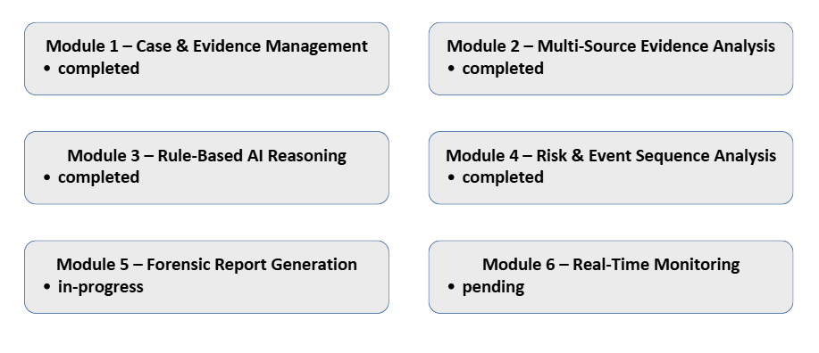
List of Modules

Slide 14
Module Implementation – Part 1
Module | Purpose/ input-output | Implementation Approach | Status
1. Case & Evidence Management | Case details, evidence → Stored evidence, SHA-256 hash | Case management, file handling, hashing | Completed
2. Multi-Source Evidence Analysis | Logs, files, browser, email → Extracted facts | Evidence parsing and fact extraction | Completed
3. Rule-Based AI Reasoning | Extracted facts, rules → Forensic findings | IF–THEN rules, Forward Chaining | Completed

Slide 15
Module Implementation – Part 2
Module | Purpose/ input-output | Implementation Approach | Status
4. Risk & Event Sequence Analysis | Findings, event data → Risk score, timeline | Risk calculation and event ordering | Completed
5. Forensic Report Generations | Findings, risk, timeline → Report, PDF | Report formatting and PDF export | In-progress
6. Real-Time Monitoring | Monitored evidence → Change alerts, re-analysis | File monitoring using watchdog | Pending

Slide 16
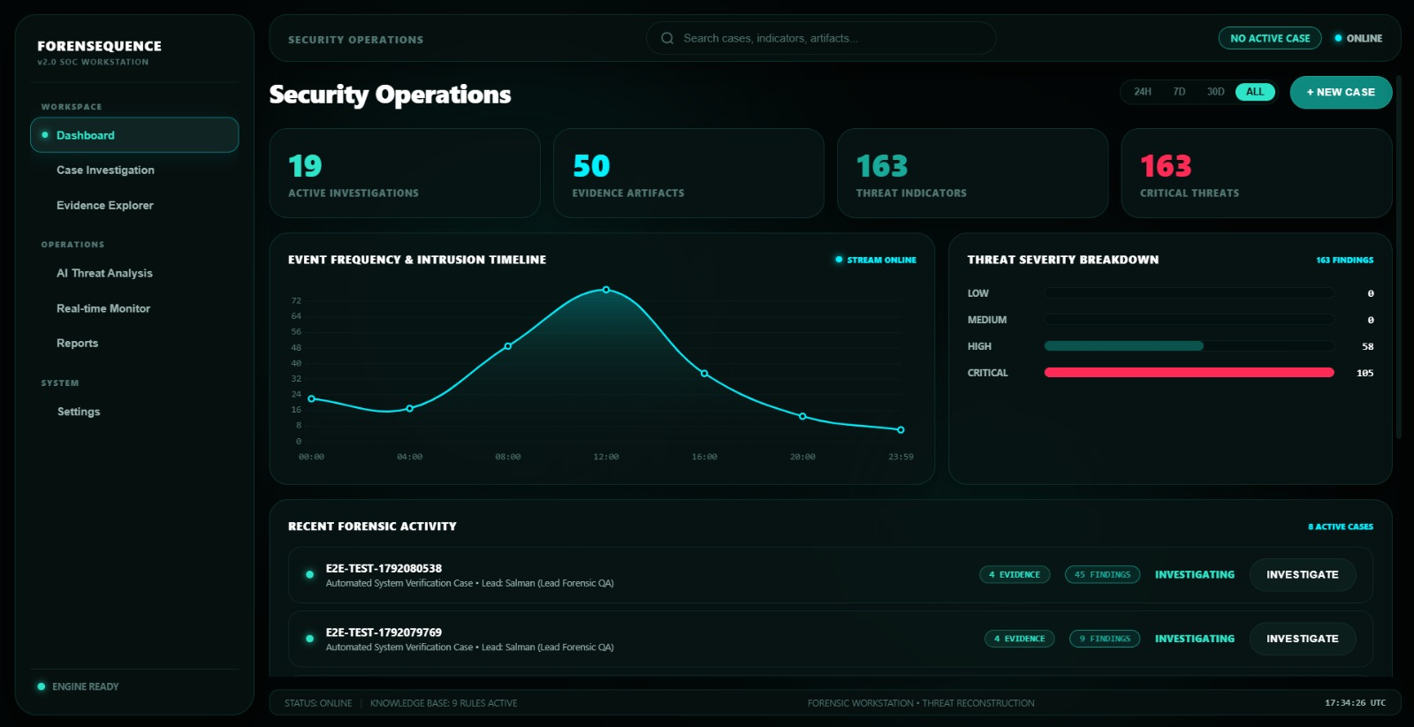
Preliminary Results and Discussion
DASHBOARD

Slide 17
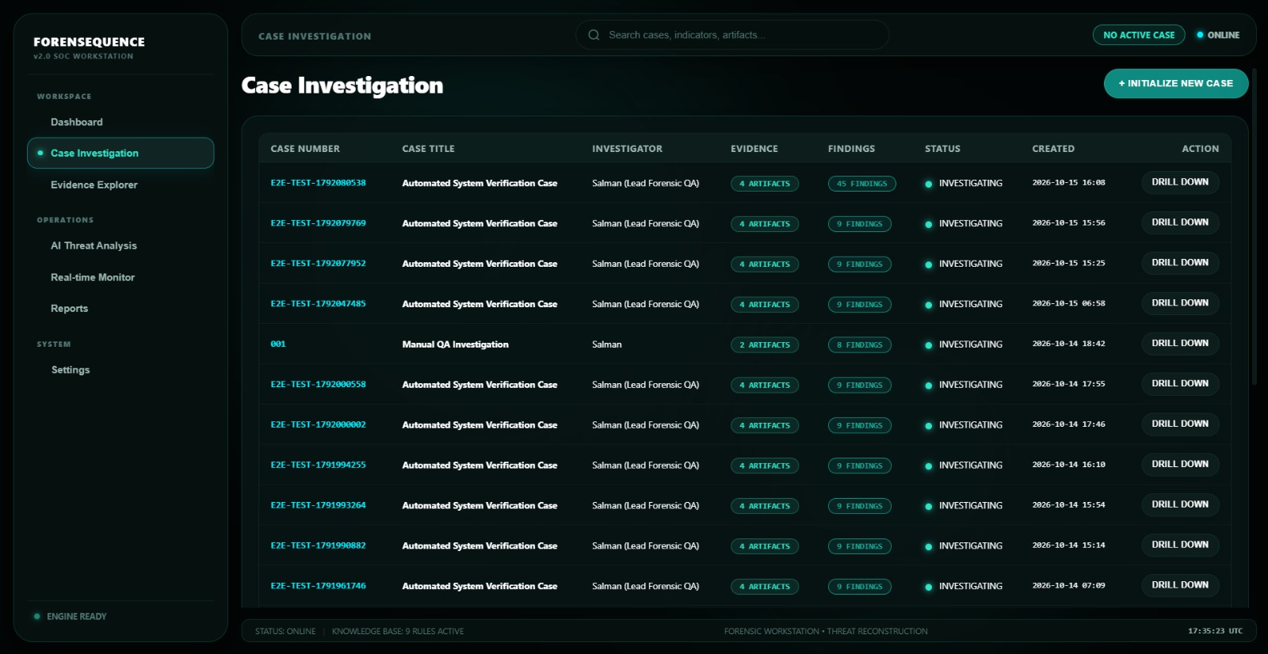
User Interface / Implementation Screenshots
CASE INVESTIGATION TAB

Slide 18
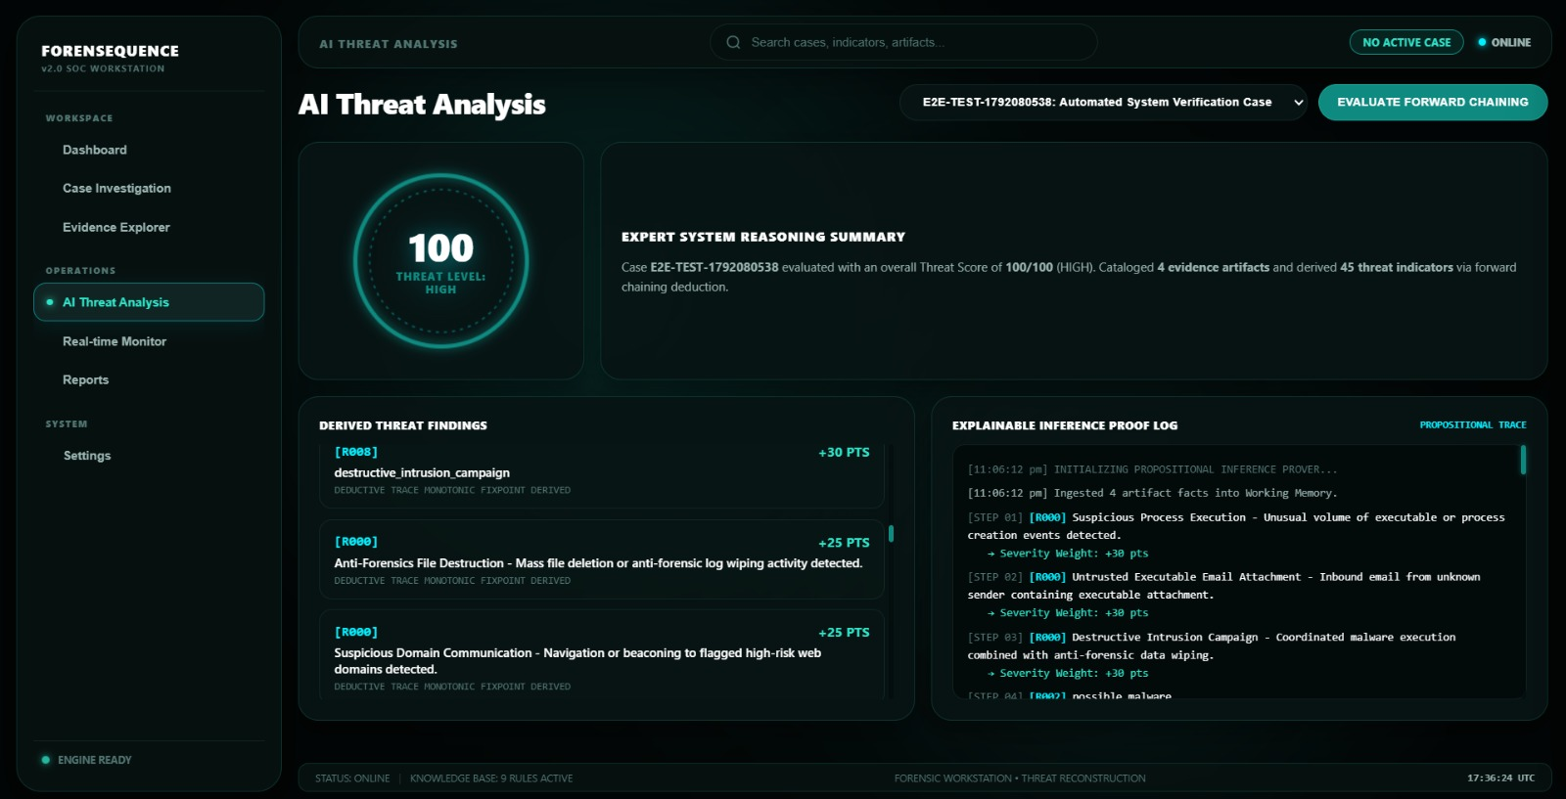
User Interface / Implementation Screenshots
AI THREAT ANALYSIS TAB

Slide 19
Challenges Faced and Solutions
Multi-Source Evidence Handling: Different evidence formats require different parsing methods. Solution: Use format-specific parsers for logs, files, and CSV data.
Rule-Based Reasoning: Findings depend on accurate fact extraction and rule matching. Solution: Use structured facts and predefined IF–THEN rules with Forward Chaining.
Risk Assessment: Combining multiple findings into a meaningful risk level can be challenging. Solution: Apply weighted risk scores and predefined risk levels.
Remaining Challenges: Complete PDF report generation, implement real-time monitoring, and test the integrated system.

Slide 20
Work Plan Until Final Review
Week 1 – Implementation
Complete PDF report generation.
Implement real-time evidence monitoring.
Week 2 – Integration & Testing
Integrate all modules.
Test evidence analysis, rules, risk scores, and alerts.
Week 3 – Evaluation & Documentation
Evaluate test results and fix errors.
Complete project report and documentation.
Week 4 – Final Preparation
Capture output screenshots.
Finalize PPT and prepare the demonstration.

Slide 21
References
D. Dunsin et al. (2023) — Rule-Based Digital Forensics
S. Alam & A. K. Demir (2024) — SIFT: Explainable AI in Cyber Forensics
D. D. et al. (2024) — AI in Digital Forensic Investigation
S. Russell & P. Norvig — Artificial Intelligence: A Modern Approach
Python Software Foundation — Python Documentation
SQLite — SQLite Documentation

Slide 22
Thank You

