Slide 1


INTERNET of THINGS

Slide 2
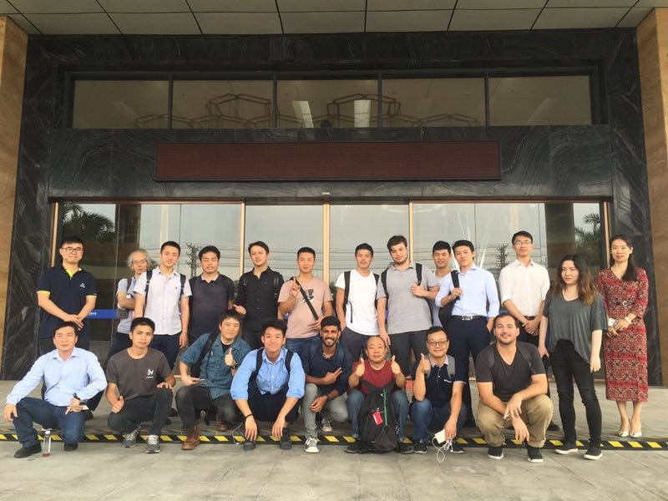

I am Salman Faris
KSUM Technology Innovation Fellow
Fab Academy Instructor at Fablab Kochi
Seeed Studio Ranger
Hackster.io Ambassador
You can find me at 0xsalfar

Slide 3

Internet of Things
‘’ Network of physical objects with embedded electronics , software ,
connectivity , and people to enable connectivity to exchange data , for intelligent application and services ”

Slide 4

What is relay ?

Slide 5


Slide 6
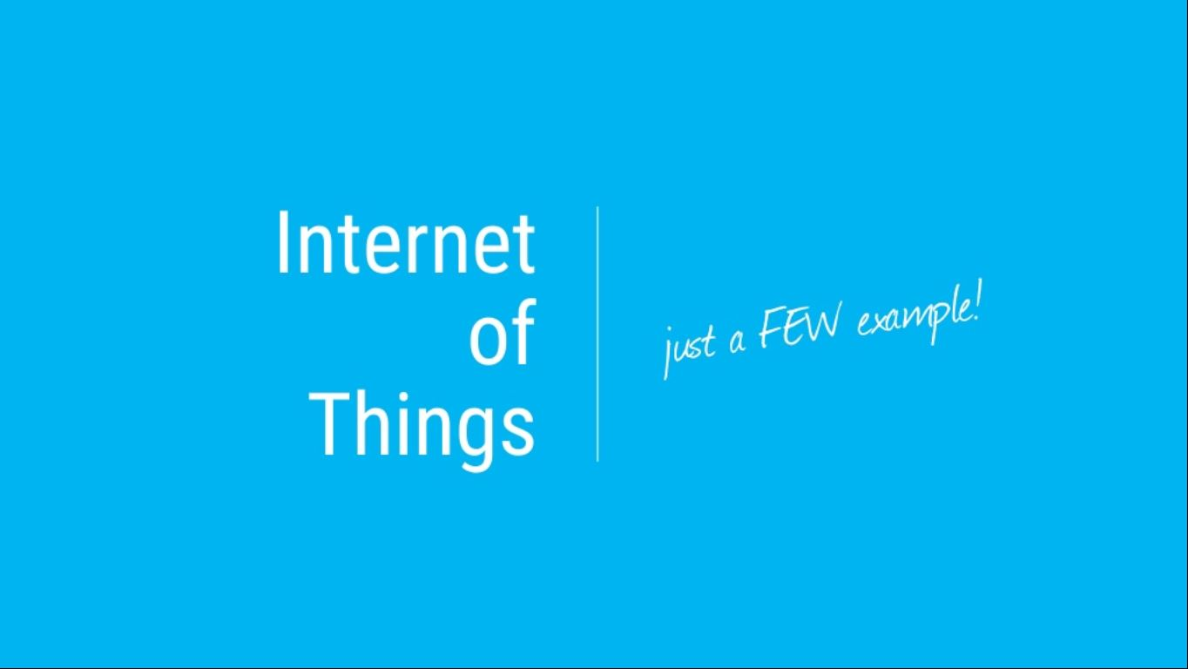

Slide 7


Slide 8
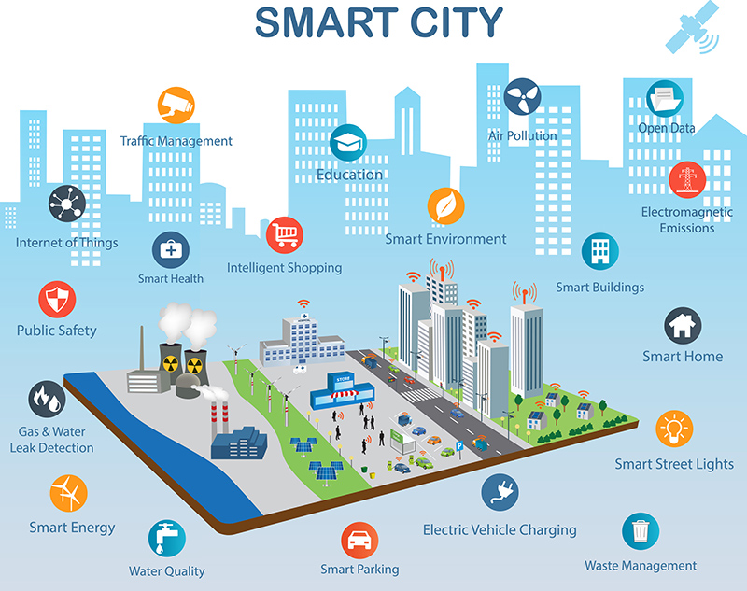

Slide 9
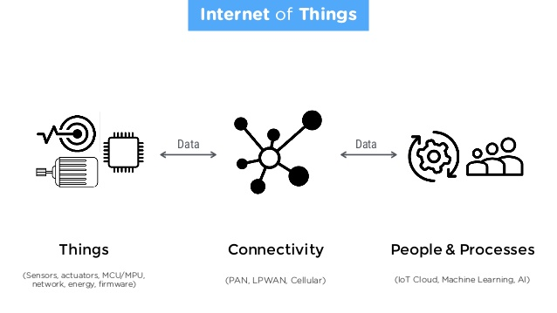

Slide 10
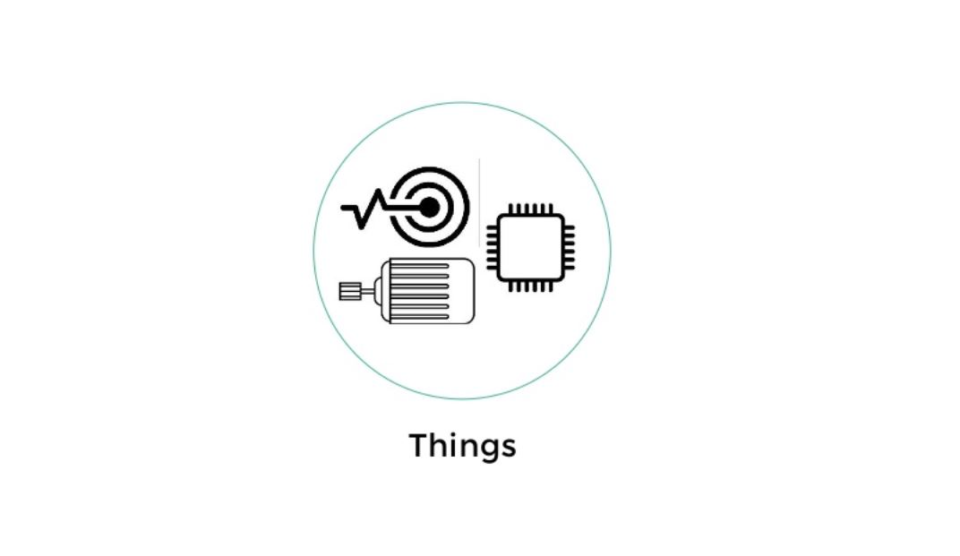

Slide 11
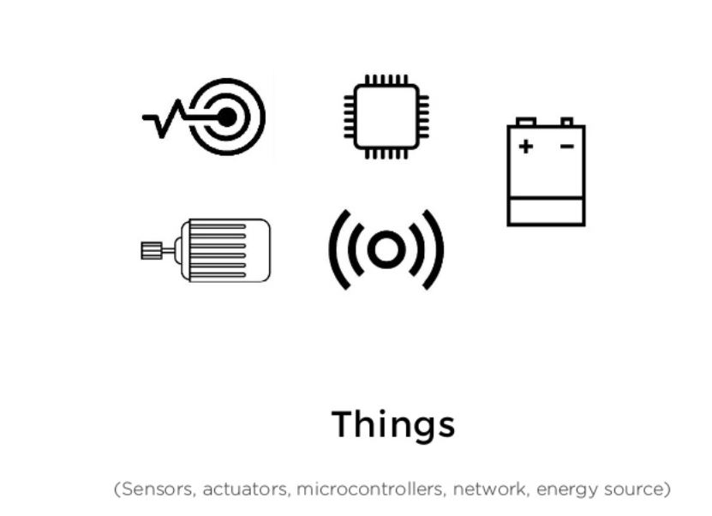

Slide 12
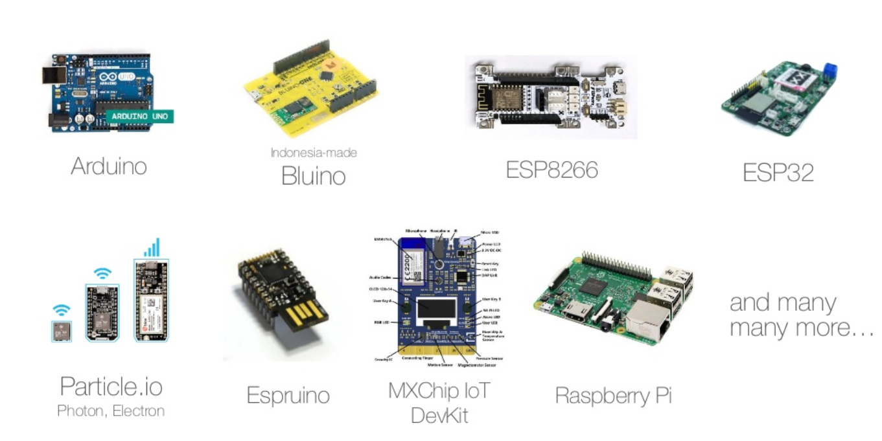

Slide 13
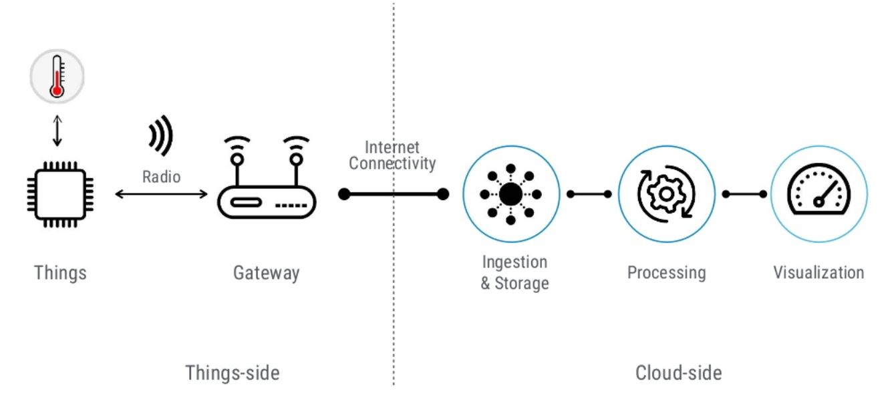
Architecture

Slide 14
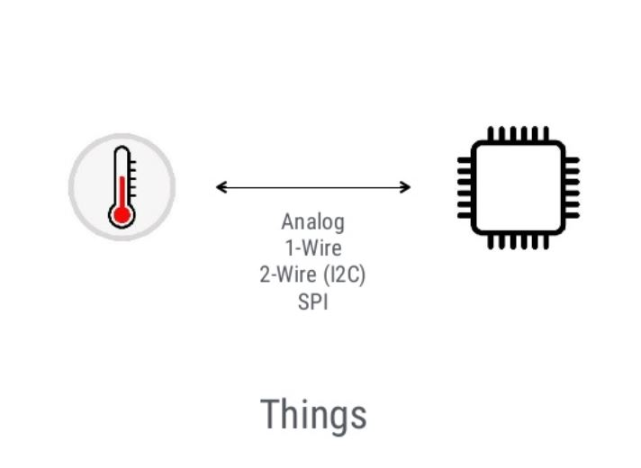

Slide 15
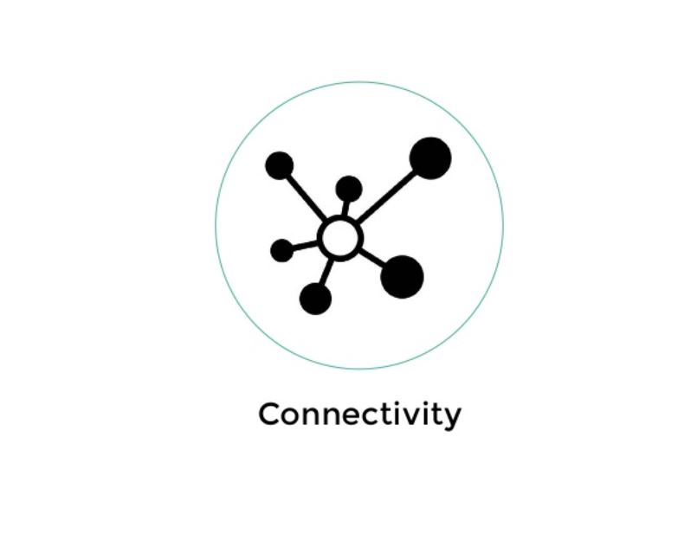

Slide 16
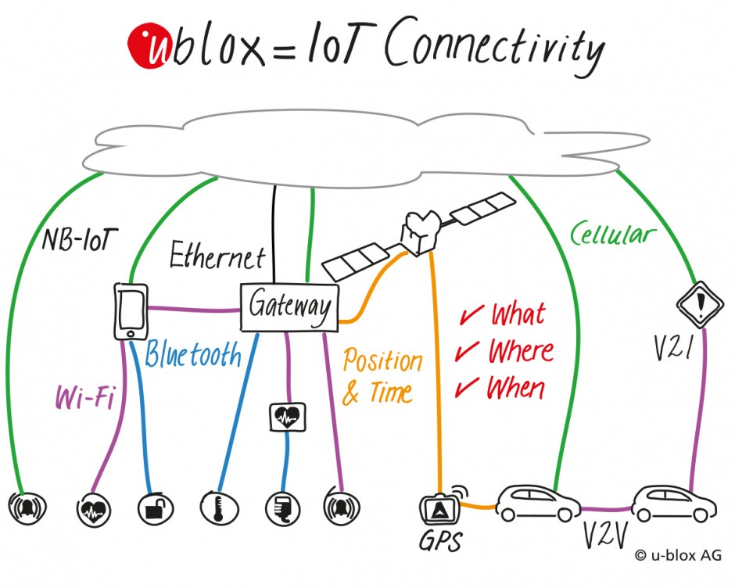

Slide 17
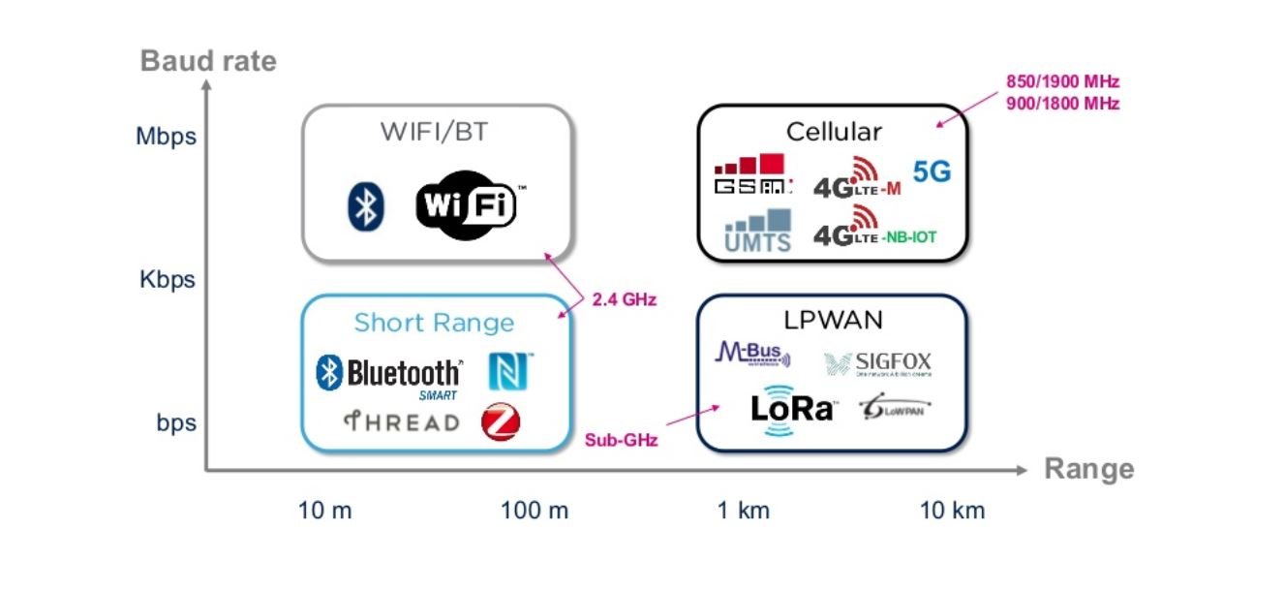

Slide 18
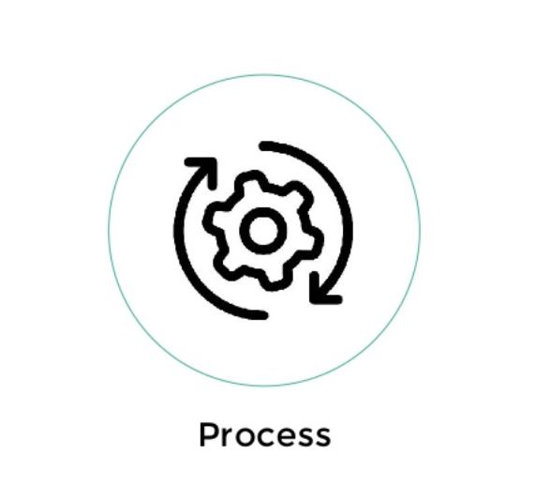

Slide 19
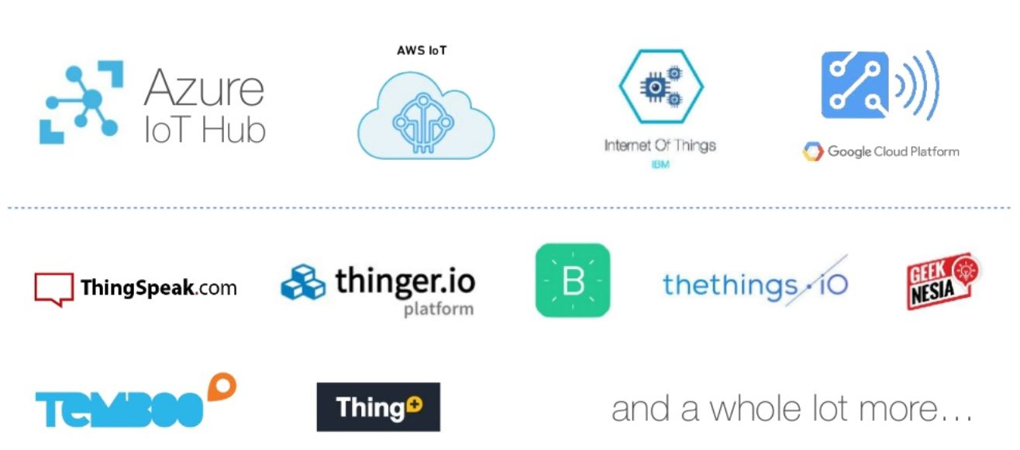
Cloud Platform

Slide 20
DEMO

Slide 21
Prerequisite
Internet connected Computer/laptop Installed Arduino IDE Installed
NodeMCU board manager
LED, LDR, DHT, Resistor , Jumper Wires , Breadboard
Mydevice Cayenne account.

Slide 22
Arduino
Arduino is an open-source platform used for building electronics projects. Arduino consists of both a physical programmable circuit board and a piece of software, or IDE (Integrated Development Environment) that runs on your computer, used to write and upload computer code to the physical board.

Slide 23
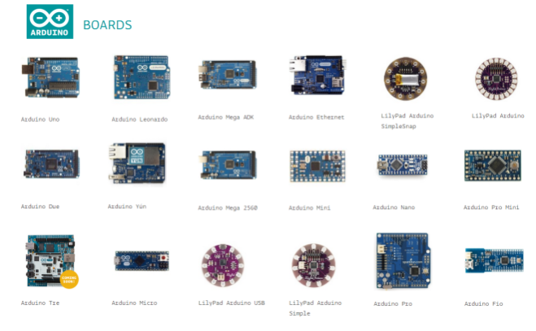

Slide 24
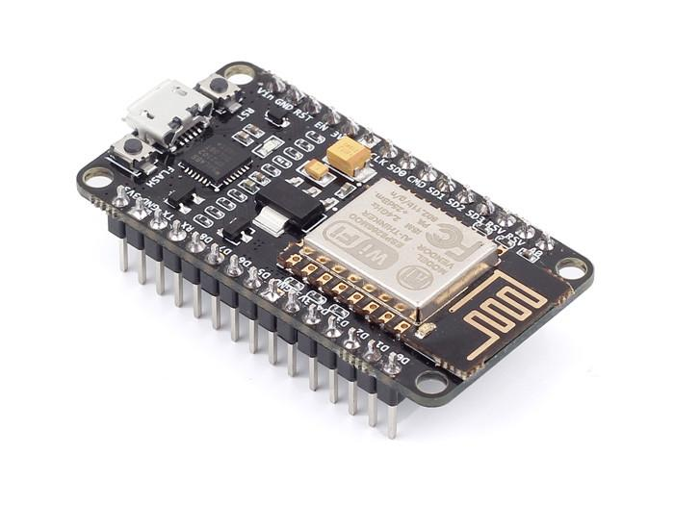
Node MCU
NodeMCU is an open source IoT platform.It includes firmware which runs on the ESP8266 WiFi SoC from Espressif Systems, and hardware which is based on the ESP-12 module.The term "NodeMCU" by default refers to the firmware rather than the development kits. The firmware uses the Lua scripting language.

Slide 25
cayenne
Cayenne is the world’s first drag and drop IoT project builder that empowers developers, designers and engineers to quickly prototype and share their connected device projects. Cayenne was designed to help users create Internet of Things prototypes and then bring them to production.
Cayenne Online Dashboard – Use customizable widgets to visualize data, set up rules, schedule events and more.

Slide 26
Let’s hack

