Slide 1
Project 1:
Stock Screener
FinTech Boot Camp - UofT SCS
Group 10
Salman Khaliq
Devesh Agarwal
Cam Gould
Eugenio Sanchez
Apr 20, 2022
Notes:
Hello everyone Thank you for taking the time tonight to let us share our work with you
Over the last couple weeks Salman, Devesh, Eugenio, and myself have created a stock screener to provide users insights into the most profitable portfolios that can be created using the individual stocks composing the S&P 500 index.

Slide 2
Motivation & Summary:
Description
Assumption
Scope
Provide user with portfolios with best returns.
Portfolios created
from calculations derived from the stocks historical data.
Focused on stocks in the S&P founded before 2011.
Notes:
Create a tool which will provide a user with portfolios to invest in with best expected returns compared to the returns of the S&P 500. The final portfolios are compared to the profits of the S&P index to determine the most profitable portfolio.
The portfolios were created using calculations derived from the stocks historical data pulled from yahoo finance. It is important to note that This implies implications that the stocks are expected to perform in the future similar to that in the past.
from the all 505 stocks making up the S&P 500, we are only analyzing companies founded in 2010 or earlier, resulting in a group of 443 companies. Their were also few days that all the stocks had null values and were dropped, leaving us with a full data set of stock information for each stock for the past 12 years.

Slide 3
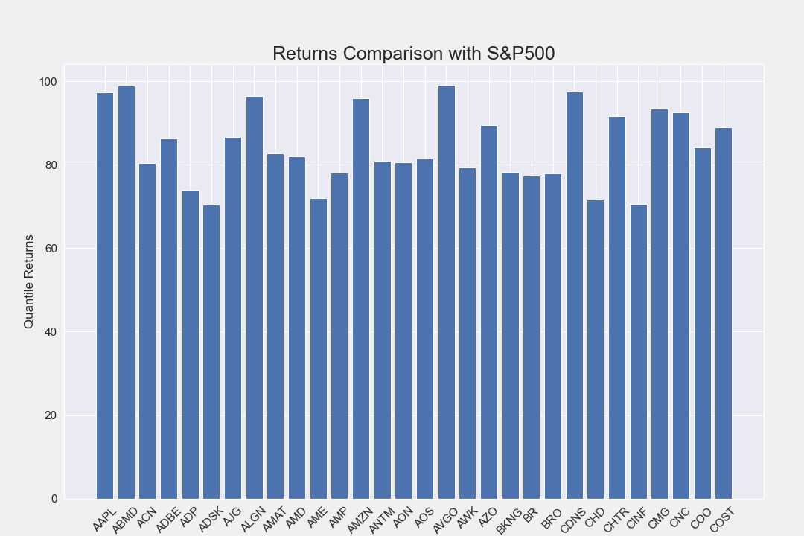
Initial Data Refinement
Started out with 443 stocks that are in the S&P 500 that were in market by the date 2010-01-01.
Of these stocks we compared each stocks returns over the S&P return.
We then took the top 70% quantile performers to analyze for creating the portfolios
Notes:
Primary data refinement to isolate the stocks with returns in the 70th percentile.
Started out with 443 stocks that are in the S&P that were founded before the year 2011.
From these stocks we compared each stocks returns over the S&P return over the exact same time period
This gave us a ratio of each stocks return over the S&Ps return as a whole
We then took the top 30% performers to analyze for creating the portfolios.
We now had a group of 133 companies to analyze allowing for faster and more accurate analysis in terms of profitability.
To dive deeper into our product, i will now pass along to Salman to discuss more about our process.

Slide 4
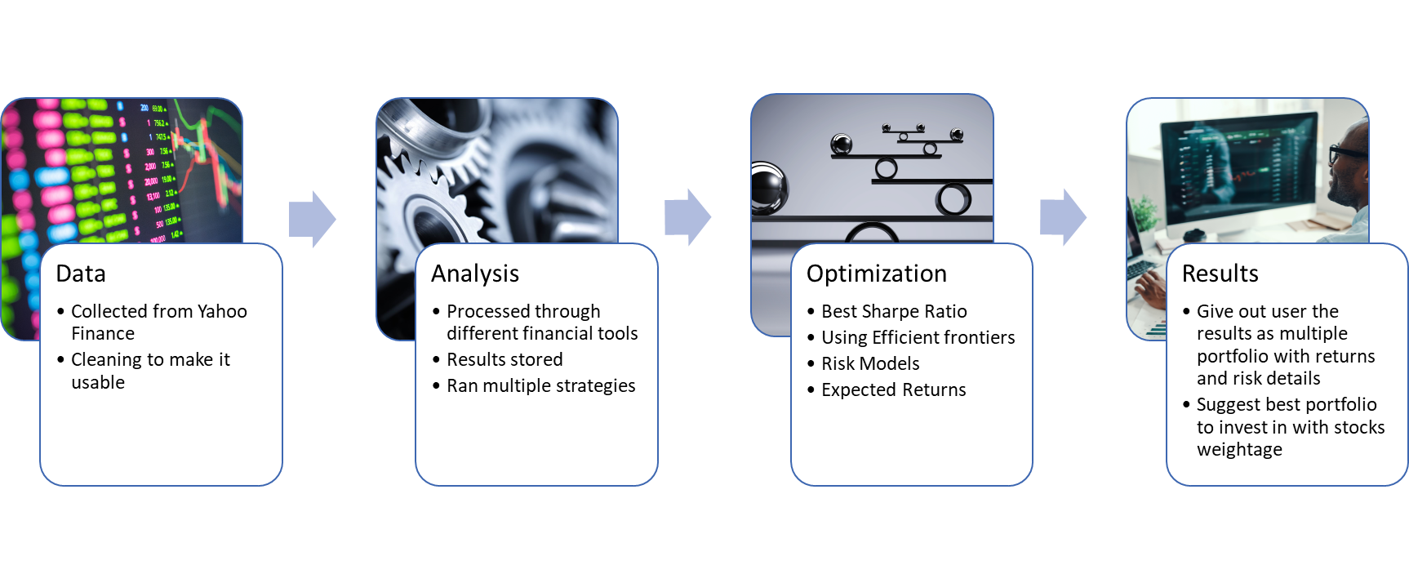
Product

Slide 5
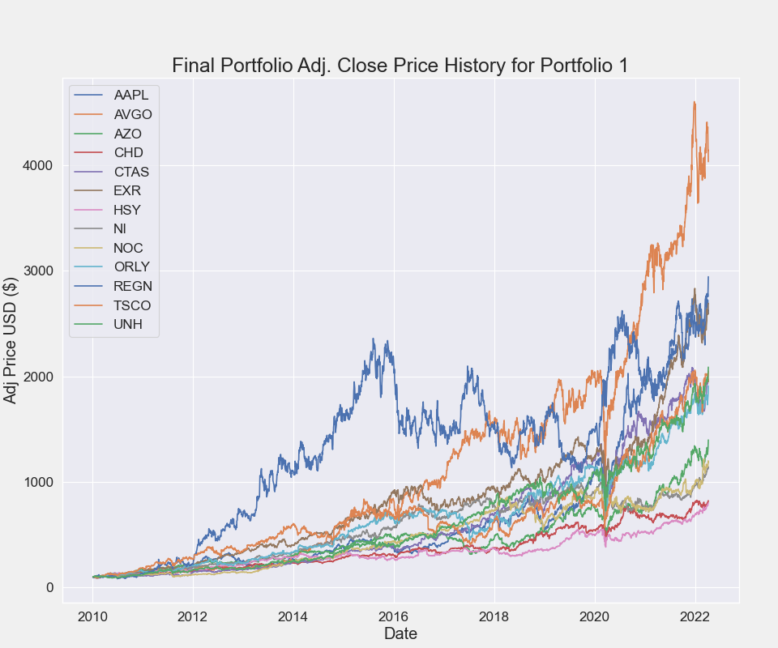
Optimized Portfolio One
Conditions:
Latest price > 150 Days Simple Moving Average > 200 Days Simple Moving Average
Price/Earning Ratio < 40
Notes:
First condition - latest price must be higher than the 150 day moving average and both must be higher than the 200 day moving average
Second condition - the price to earnings ratio must be less than forty
Of the 133 stocks in the condensed group, 30 stocks met both of these conditions.
The thirty stocks in this initial portfolio resulted in an expected annual return of 25.0%, annual volatility (or risk) of 16.0%, and an annual variance of 3.0%.
After optimizing the portofolio, we are left with a weighted distribution of 13 stocks.

Slide 6
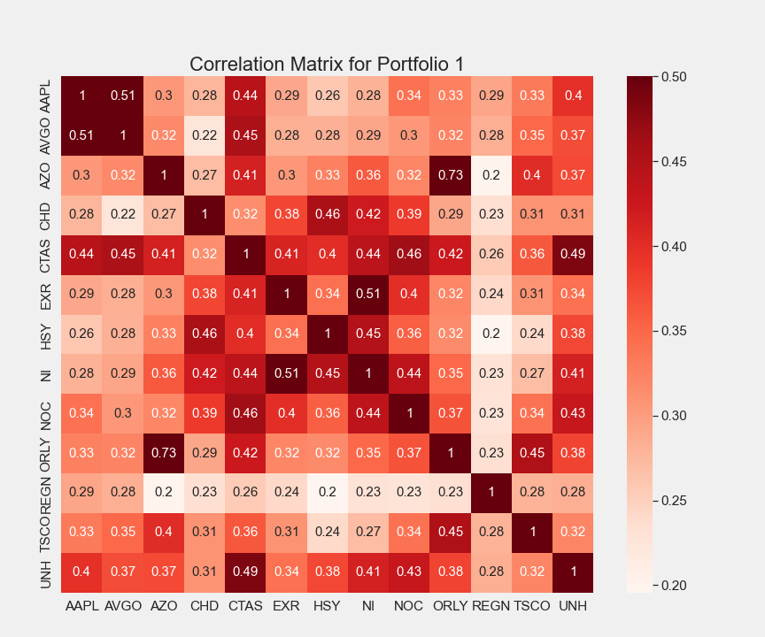
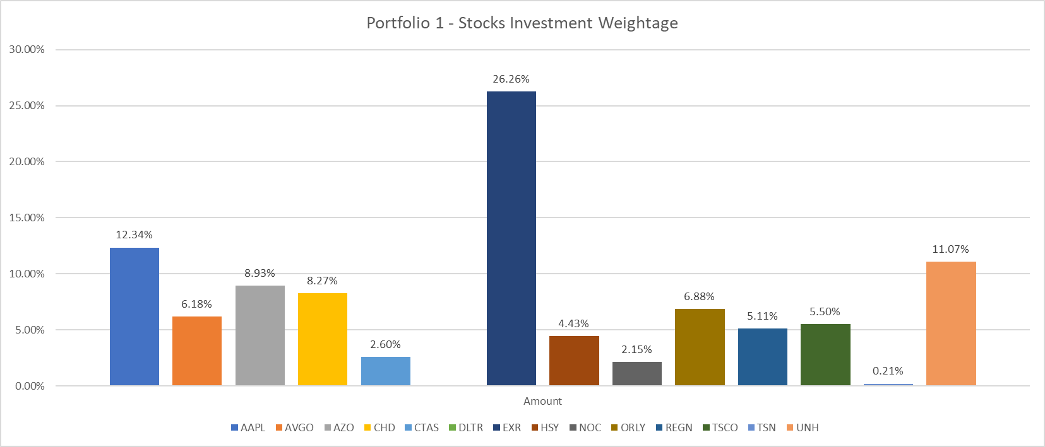
Optimized Portfolio One (Continued)...
Notes:
After optimizing the weights of the different stocks in the portfolio, we are left with specific holdings for each stocks.
With a sample investment of $15’000, we are left holding the above percentages in each stock.
The optimized portfolio resulted in an annual return of 28.0%, an annual volatility (or risk) of 16.9%, and a sharpe ratio of 1.54

Slide 7
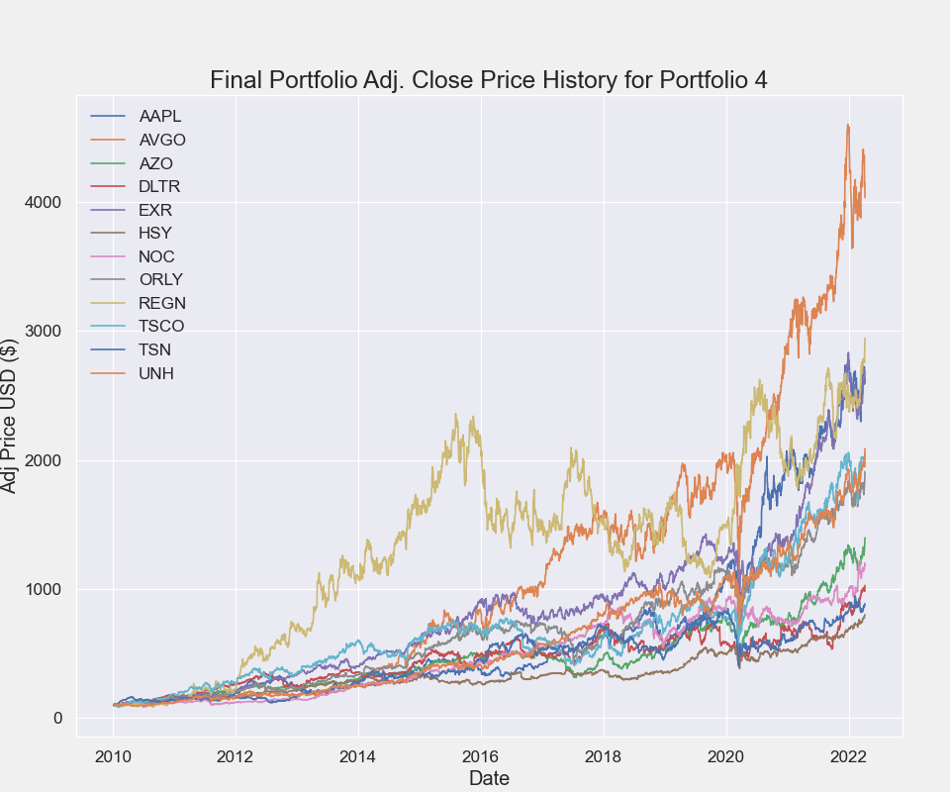
Optimized Portfolio Two
Conditions:
Latest_price > moving_average_150 and > moving_average_200
Latest_price >= (1.3 * low_52week)
Latest_price >= (0.75 * high_52week)
PE_ratio < 40
Notes:
First condition - latest price must be higher than the 150 day moving average and both must be higher than the 200 day moving average
Second condition - the latest price must be within 130% times the 52 week low and 75% times the 52 week high
Third condition - the PE ratio must be less than 40
Of the 133 stocks in the condensed group, 33 stocks met both of these conditions.
The thirty-three stocks in this initial portfolio resulted in an expected annual return of 25.0%, annual volatility (or risk) of 16.0%, and an annual variance of 3.0%.
After optimizing the portofolio, we are left with a weighted distribution of 12 stocks.

Slide 8
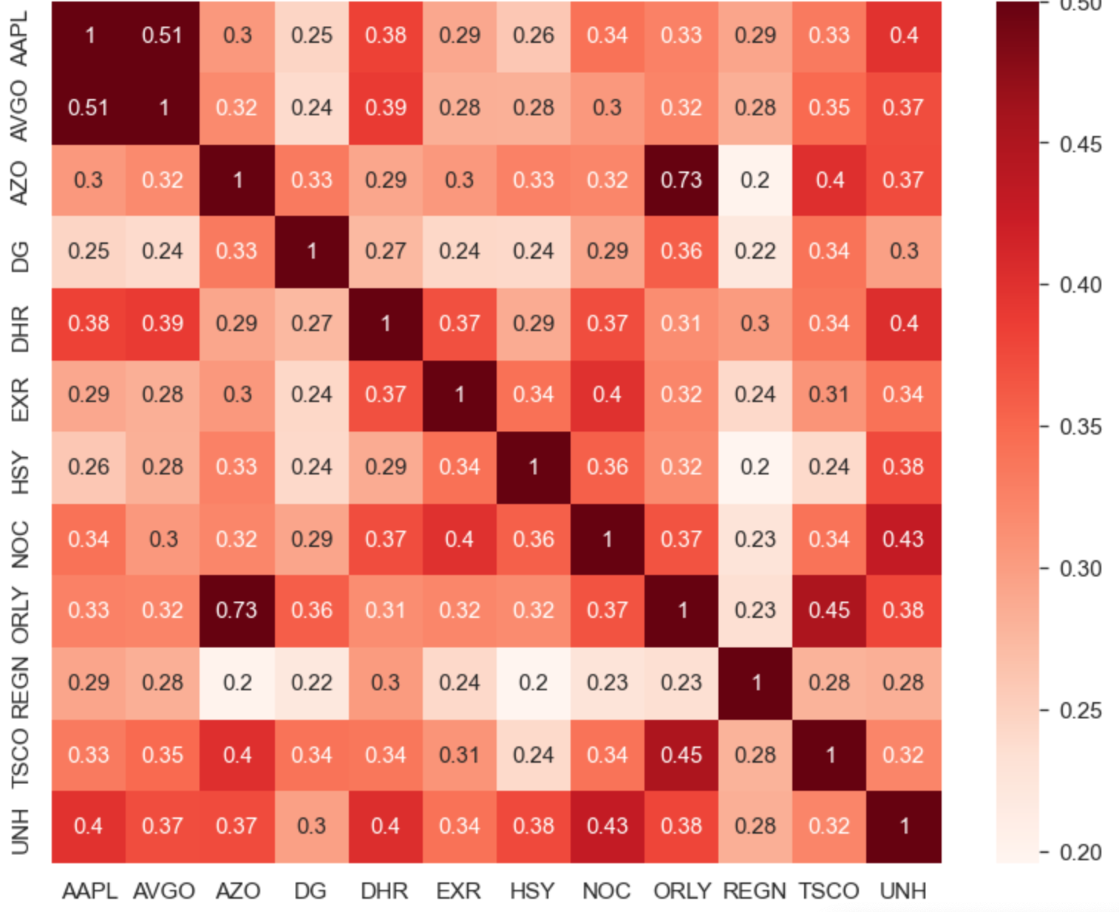
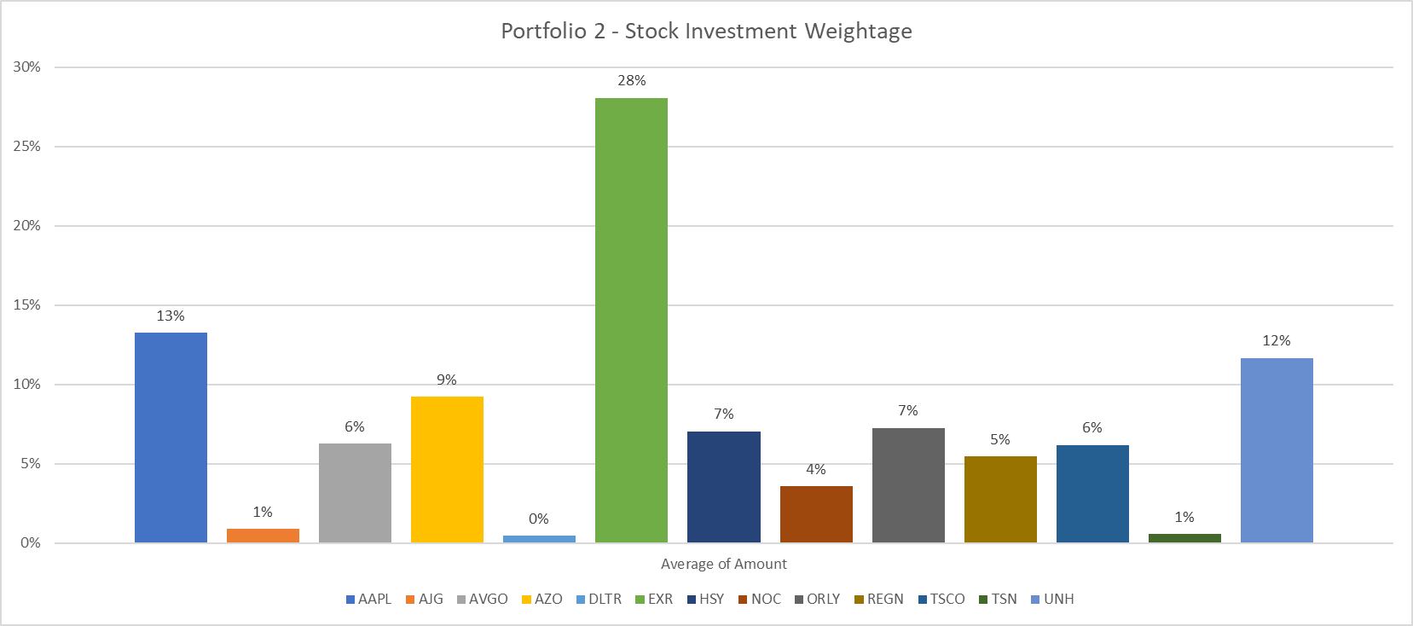
Optimized Portfolio Two (Continued)...
Conditions:
Latest_price > moving_average_150 > moving_average_200
Latest_price >= (1.3 * low_52week)
Latest_price >= (0.75 * high_52week)
PE_ratio < 40
Notes:
After optimizing the weights of the different stocks in the portfolio, we are left with specific holdings for each stocks.
With a sample investment of $15’000, we are left holding the above percentages in each stock.
The optimized portfolio resulted in an annual return of 28.0%, an annual volatility (or risk) of 16.8%, and a sharpe ratio of 1.54

Slide 9
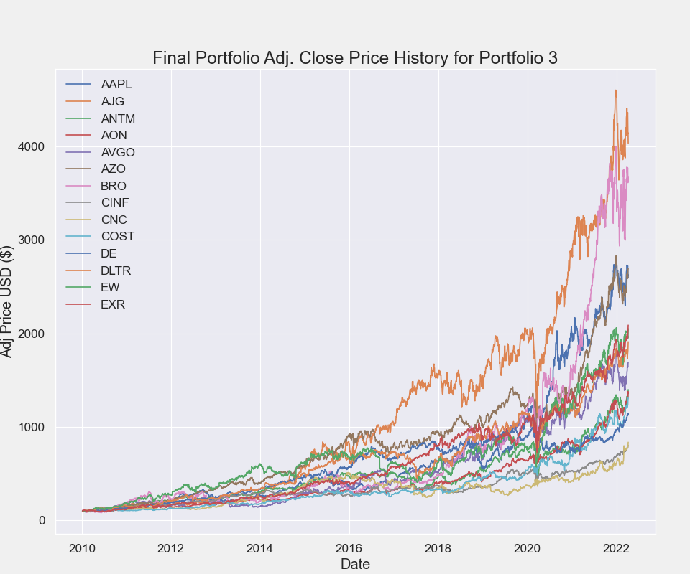
Optimized Portfolio Three
Conditions:
1- Latest_price >= (1.3 * low_52week)
2- Latest_price >= (0.75 * high_52week)
3- PE_ratio < 40
Notes:
First condition - the latest price must be within 130% times the 52 week low and 75% times the 52 week high
Second condition - the pe ratio must be less than 40
Of the 133 stocks in the condensed group, 24 stocks met both of these conditions.
The 24 stocks in this initial portfolio resulted in an expected annual return of 25.0%, annual volatility (or risk) of 16.0%, and an annual variance of 3.0%.
After optimizing the portofolio, we are left with a weighted distribution of 12 stocks.

Slide 10
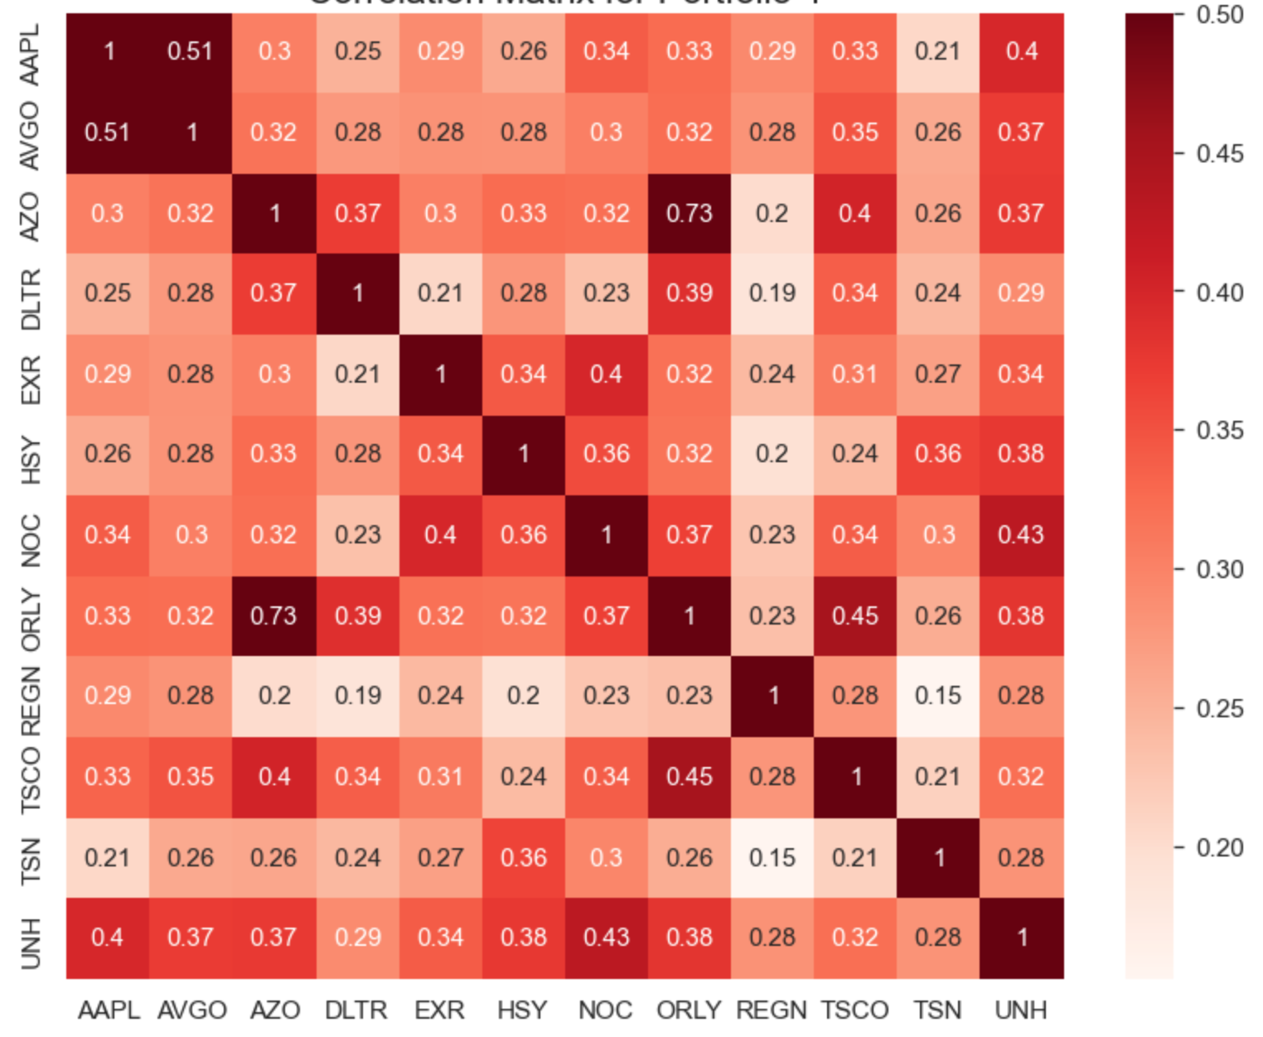
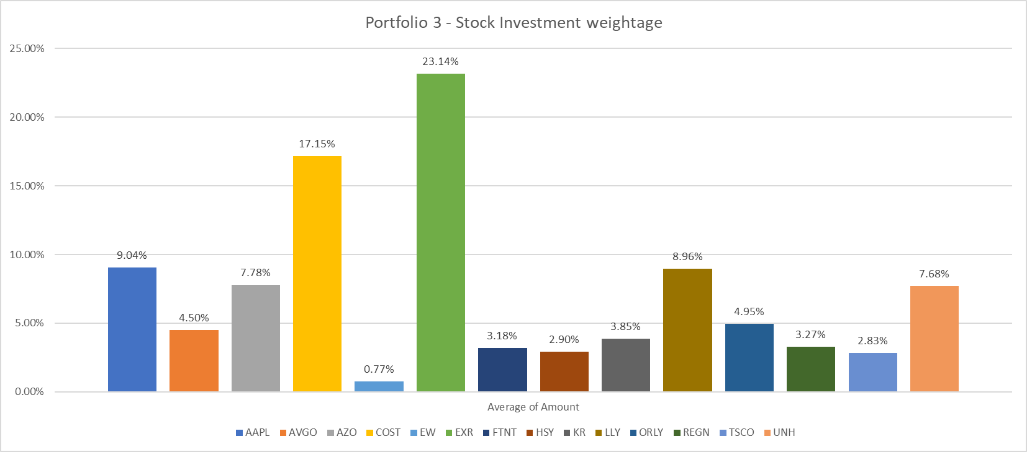
Optimized Portfolio Three (Continued)...
Conditions:
Latest_price >= (1.3 * low_52week)
Latest_price >= (0.75 * high_52week)
PE_ratio < 40
Notes:
After optimizing the weights of the different stocks in the portfolio, we are left with specific holdings for each stocks.
With a sample investment of $15’000, we are left holding the above percentages in each stock.
The optimized portfolio resulted in an annual return of 28.4%, an annual volatility (or risk) of 17.2%, and a sharpe ratio of 1.53

Slide 11
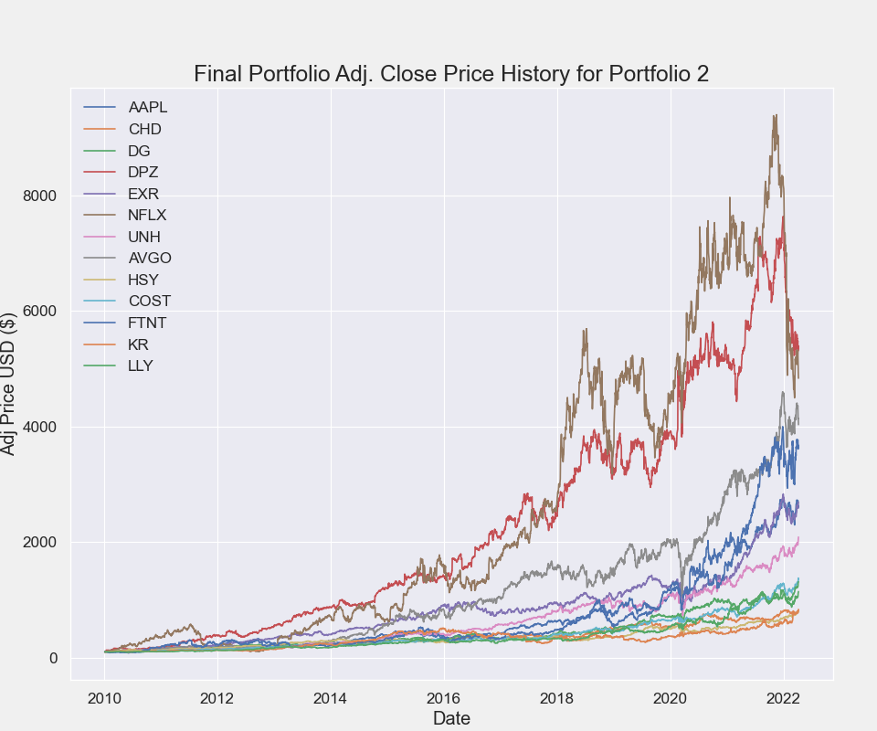
Optimized Portfolio Four
Conditions:
Latest Price > moving_average_150 > moving_average_200
Latest Price >= (1.3 * Low of 52 week)
Latest Price >= (0.75 * High of 52 week)
Notes:
First condition - the latest price must be within 130% times the 52 week low and 75% times the 52 week high
Second condition - latest price must be higher than the 150 day moving average and both must be higher than the 200 day moving average
Of the 133 stocks in the condensed group, 109 stocks met both of these conditions.
The hundred and nine stocks in this initial portfolio resulted in an expected annual return of 25.0%, annual volatility (or risk) of 17.0%, and an annual variance of 3.0%.
After optimizing the portofolio, we are left with a weighted distribution of 13 stocks.

Slide 12
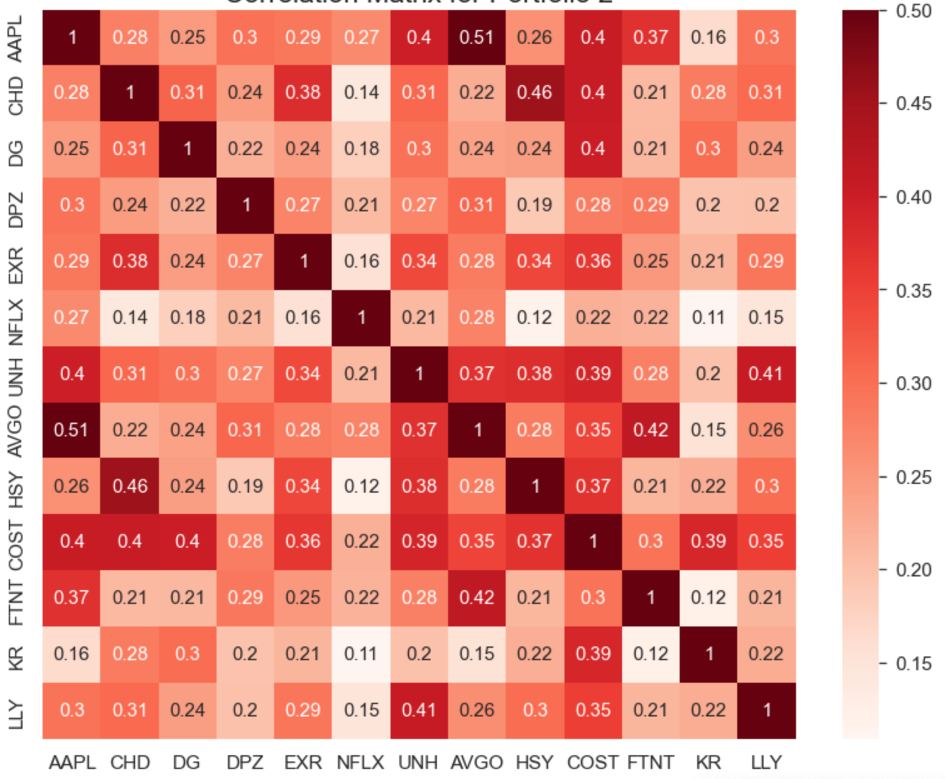
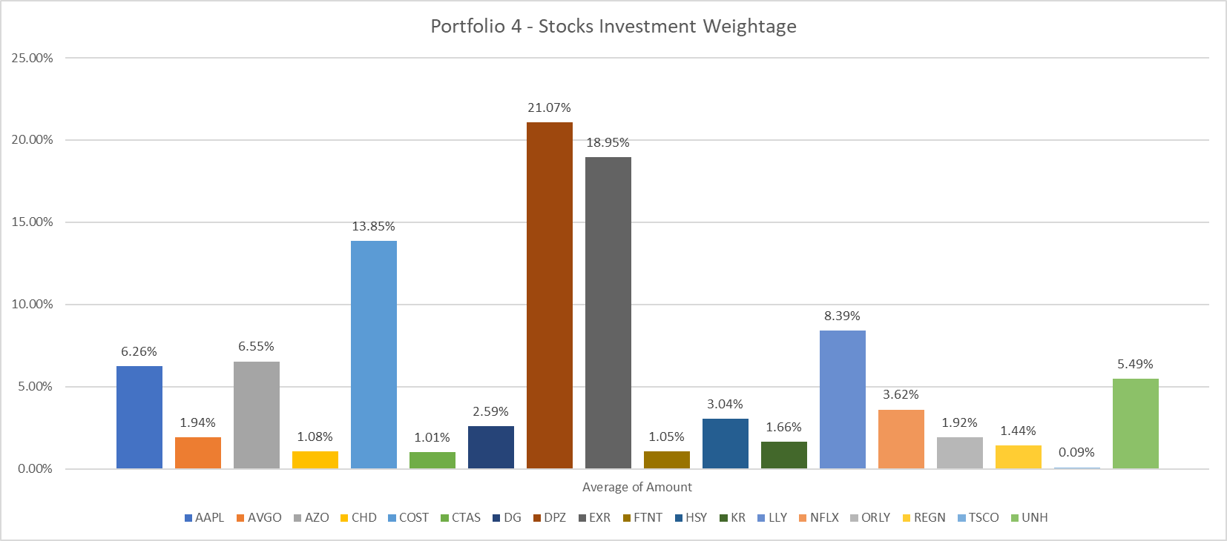
Optimized Portfolio Four (Continued)...
Conditions:
Notes:
After optimizing the weights of the different stocks in the portfolio, we are left with specific holdings for each stocks.
With a sample investment of $15’000, we are left holding the above percentages in each stock.
The optimized portfolio resulted in an annual return of 29.5%, an annual volatility (or risk) of 16.1%, and a sharpe ratio of 1.71

Slide 13
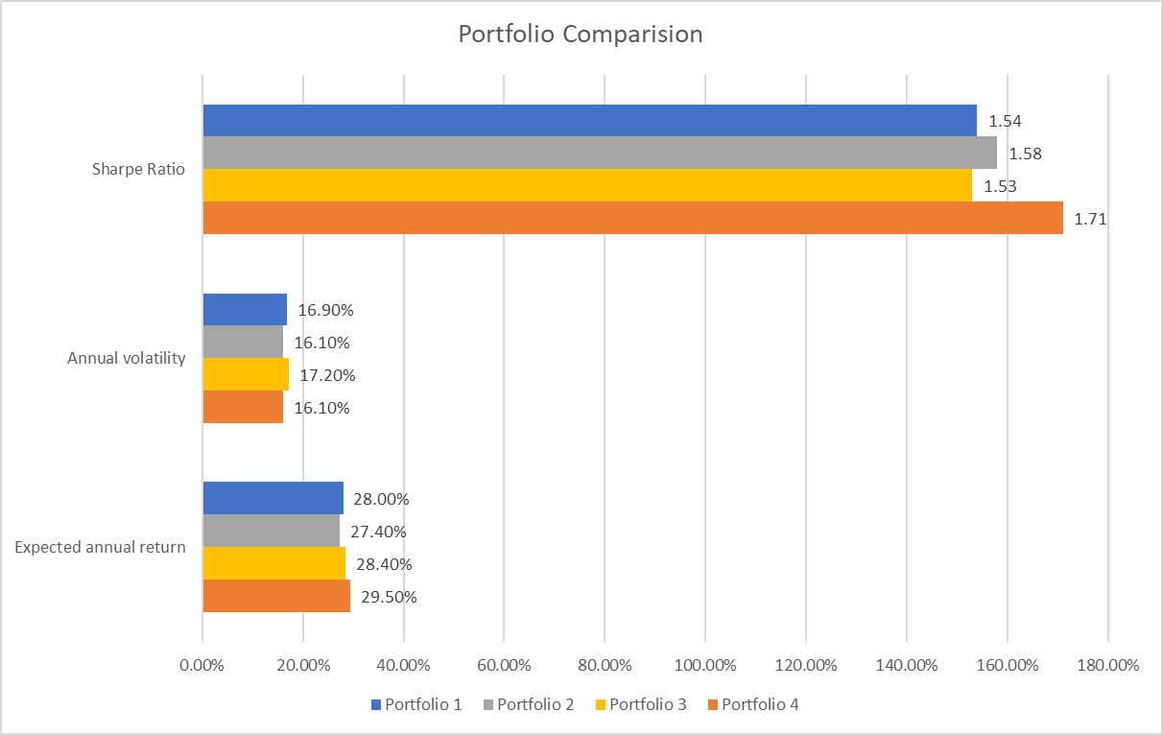
Portfolio Comparison

Slide 14
Questions

