Slide 1
Store Sales Prediction
Written By | Mohammad Salman
Document Version | 1.0
Last Revised Date | 26-11-2022

Slide 2
Objective:
Several bike/scooter ride sharing facilities (e.g., Bird, Capital Bikeshare, Citi Bike) have started up lately especially in metropolitan cities like San Francisco, New York, Chicago and Los Angeles, and one of the most important problem from a business point of view is to predict the bike demand on any particular day. While having excess bikes results in wastage of resource (both with respect to bike maintenance and the land/bike stand required for parking and security), having fewer bikes leads to revenue loss (ranging from a short term loss due to missing out on immediate customers to potential longer term loss due to loss in future customer base), Thus, having a estimate on the demands would enable efficient functioning of these companies.

Slide 3
Data Description
Given is the variable name, variable type, the measurement unit, and a brief description. The concrete compressive strength is the regression problem. The order of this listing corresponds to the order of numerals along the rows of the database.
datetime - hourly date + timestamp
season - 1 = spring, 2 = summer, 3 = fall, 4 = winter
holiday - whether the day is considered a holiday
workingday - whether the day is neither a weekend nor holiday
weather -
1: Clear, Few clouds, Partly cloudy, Partly cloudy
2: Mist + Cloudy, Mist + Broken clouds, Mist + Few clouds, Mist
3: Light Snow, Light Rain + Thunderstorm + Scattered clouds, Light Rain + Scattered clouds
4: Heavy Rain + Ice Pallets + Thunderstorm + Mist, Snow + Fog
temp - temperature in Celsius
atemp - "feels like" temperature in Celsius
humidity - relative humidity
windspeed - wind speed
casual - number of non-registered user rentals initiated
registered - number of registered user rentals initiated
count - number of total rentals

Slide 4
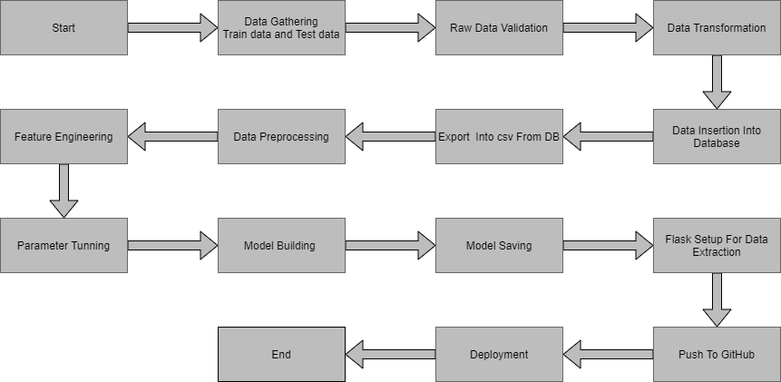
Architecture

Slide 5
Architecture Description
1. Data gathering:
Data source: https://www.google.com/url?q=https://archive.ics.uci.edu/ml/datasets/Bike%2BSharing%2BDataset&sa=D&source=apps-viewer-frontend&ust=1669523611018571&usg=AOvVaw2w2CNen9aLPM9FfBoI2J16&hl=enTrain and Test data are stored in .csv format.
2.Raw Data Validation:
After data is loaded, various types of validation is required before we proceed further for any operation. Validations like checking for zero standard deviation for all the columns, checking for complete missing values in any columns, etc. These are required because The attributes which contains these are of no use. It will not play role in contributing the sales of an item from respective outlets.
Like if any attribute is having zero standard deviation, it means that’s all the values are same, its mean is zero. Which indicate that either the sale is increase or decrease that attribute will remain the same. Similarly, if any attribute is having full missing values, then there is no use of taking that attribute into an account for operation. It’s unnecessary increasing the chances of dimensionality curse.
3. Data Transformation
Before sending the data into the database, data transformation is required so that data are converted into such form with which it can easily insert into the database.

Slide 6
4. Export into csv from database
From database both the train and test data set are exported into local system and stored into csv files. Now this csv file will be proceeded for further processing.
5. Data preprocessing
Season: Month column has a direct mapping with season (Winter: January to March, Summer: April to June, Fall: July to September and Spring: October to December). Hence we will drop season column
Holiday and 'day': workingday = weekday and not a holiday. Since we noticed that there were two kinds of bike rental behavoirs - during working days and not a working day, we will retain only the workingday column and drop 'day' and 'holiday' column
Workingday: After observing the bike rental trend, we propose to build 2 separate models for 1. if it is a working day, and 2. if it is a non-working day. Hence, we can separate out the data based on this column and drop the column
Weather: Split weather column to weather_1, weather_2 and weather 3 (recall that we had relabelled all the weather = 4 data points to weather = 3 due to its sparseness). Drop weather_3 since it is a function of the rest of the weather columns
Temp: temp and atemp are highly correlated. Hence retain only the temp column
Windspeed: Very poorly correlated with count. Hence drop this column
Casual and registered: These are individual components of our to be predicted column (count). Hence drop these columns
Month: Split month column to month_1, month_2, ..., month_12. Drop month_12 since it is a function of the rest of the month columns
Date: Intuitively, there is should be no dependency on date. Hence drop this column
Hour: Split hour column to hour_0, hour_1, ..., hour_23. Drop hour_23 since it is a function of the rest of the hour columns

Slide 7
7. Feature Engineering:
After preprocessing it was found that some of the attributes are not important to the item sales for the particular outlet. So those attributes are removed. Even one hot encoding is also performed to convert the categorical features into numerical features.
8. Parameter tunning:
Parameters are tunned using Randomized searchCV. Four algorithms are used in this problem, Linear Regression and Random Forest. The parameters of all these 2 algorithms are tunned and passed into the model.
9. Model building:
After doing all kinds of preprocessing operations mention above and performing scaling and hyper parameter tunning, data set is passed into all four models, Linear Regression, Gradient boost, Random Forest and XGBoost regressor. It was found that Gradient boost performs best with smallest RMSE value i.e. 587.0 and highest R2 score equals to 0.55. So ‘Gradient boost’ performed well in this problem.
10. Model saving:
Model is then saved using pickle library in. pkl format.

Slide 8
11 Flask setup for data extraction:
After saving the model, API building process started using Flask. Web application creation was created here. Whatever the data user will enter and then that data will be extraction by the model to predict the prediction of sales, this is performed in this stage.
12 Git Hub
Whole project directory will be pushed into GitHub repository.
13 Deployment:
Cloud environment was set up and project was deployed form GitHub into Heroku cloud platform.
App link- https://bike-new-share.herokuapp.com

Slide 9
Conclusion
In this project, we explored several factors that influenced bike rental count. Below is a quick summary of exploratory data analysis
· Working or Non-working Day We see 2 rental patterns across the day in bike rentals count - first for a Working Day where the rental count high at peak office hours (8am and 5pm) and the second for a Non-working day where rental count is more or less uniform across the day with a peak at around noon.
· Hour of the day: Bike rental count is mostly correlated with the time of the day. As indicated above, the count reaches a high point during peak hours on a working day and is mostly uniform during the day on a non-working day
· Casual and Registered Users: While most casual users are likely to be tourists whose rental count is high during non-working days, most registered users are most likely city natives whose rental count is high during working days
· Temperature: People generally prefer to bike at moderate to high temperatures. We see highest rental counts between 32 to 36 degrees Celsius
· Season: We see highest number bike rentals in Fall (July to September) and Summer (April to June) Seasons and the lowest in Spring (January to March) season
· Weather: As one would expect, we see highest number of bike rentals on a clear day and the lowest on a snowy or rainy day
· Humidity: With increasing humidity, we see decrease in the number of bike rental count.

Slide 10
Q & A:
Q1) What’s the source of data?
Ans. The data for training is provided by the client from:
https://www.google.com/url?q=https://archive.ics.uci.edu/ml/datasets/Bike%2BSharing%2BDataset&sa=D&source=apps-viewer-frontend&ust=1669523611018571&usg=AOvVaw2w2CNen9aLPM9FfBoI2J16&hl=en
Q 2) What was the type of data?
Ans. The data was the combination of numerical and Categorical values.
Q 3) What’s the complete flow you followed in this Project?
Ans. Refer the Architecture section for this.
Q 4) After the File validation what you do with incompatible file or files which didn’t pass the validation?
Ans. Files like these are moved to the Achieve Folder and a list of these files has been shared with the client and we removed the bad data folder.
Q 5) How logs are managed?
Ans. We are using different logs as per the steps that we follow in validation and modeling like validation log, database operation log, preprocessing log, model training log, etc..

Slide 11
Q 6) What techniques were you using for data pre-processing?
Removing unwanted attributes
Visualizing relation of independent variables with each other and output variables
Removing outliers
Cleaning data and imputing if null values are present.
Converting categorical data into numeric values.
Scaling the data
Q 7) How training was done or what models were used?
Before diving the data in training and validation set we performed clustering over fit to divide the data into clusters. As per cluster the training and validation data were divided. The scaling was performed over training and validation data
Algorithms like Linear regression and Random forest
Q 8) How Prediction was done?
Ans. The testing files are shared by the client. We pass its data to the best model which we have saved in pickle format and get the prediction.
Q 9) Where the model was deployed?
Ans. When the model is ready, we deploy it in Heroku platform. This model is an web application where user can enter the data and these data gets extracted in the backend and user gets the prediction result.

