Slide 1
DLBCSPJWD01 · PROJECT JAVA AND WEB DEVELOPMENT
Expense Tracker
Portfolio Part 1: Conception Phase
Name: [Surname, First Name]
Matriculation Number: [Matriculation Number]

Slide 2
Purpose
Most people lose track of where their money goes.
Small everyday spending, like coffee, transport, or snacks, adds up quickly, but it is rarely written down anywhere.
Bank apps show transactions, not categories, so spending patterns stay hidden.
Expense Tracker is a simple web app where a user logs an expense with an amount and a category, and instantly sees where their money is going.

Slide 3
Target User Group
Students and young professionals managing their own money for the first time.
People on a fixed monthly budget, such as students, interns, and early-career workers.
Comfortable using a phone or browser every day, but not looking for a full accounting tool.
Want something faster than a spreadsheet and simpler than a bank's built-in budgeting feature.

Slide 4
Benefits
See spending patterns the moment they happen, not at the end of the month.
Instant visibility: a live chart of spending by category, updated the moment an expense is added.
No friction: adding or removing an expense happens without reloading the page.
Better decisions: spotting an overspent category early is easier than reading a bank statement after the fact.

Slide 5
Technical Component Choices
A small, standard stack that fits the size of the app.
Front end (HTML, CSS, Vue.js): Vue handles the two dynamic interactions, adding or deleting an expense and redrawing the live chart, without a full page reload.
Back end (Laravel, PHP): handles requests from the front end, saves expenses, and returns category totals as JSON. Laravel's routing, Eloquent ORM, and migrations keep the data layer clean and easy to extend later.
Database (MySQL): stores each expense, its amount, category, and date, in a single table.
There is no external API. The app is self-contained, which the assignment allows.

Slide 6
Procedure
Backend first, then the two dynamic interactions, one at a time.
Step 1: build the database table with a migration, plus a basic Laravel route and controller that can save and list expenses.
Step 2: connect the front end to it with a form that adds an expense through AJAX, with no page reload.
Step 3: add the delete interaction the same way.
Step 4: add the live chart, fed by category totals calculated on the backend.
Step 5: test on desktop and mobile widths, and adjust the layout for responsiveness.

Slide 7
Development Overview
Every feature from the Phase 1 concept is built and working.
Public GitHub repository: github.com/salmanpatnee/Expense_Tracker
Built in six ordered stages: foundation, categories (backend and frontend), expenses (backend and frontend), and a final polish stage.
No automated test suite was written for this project. Manual test cases were run against every feature instead, documented on later slides, which the course guidelines allow.

Slide 8
Final Technical Stack
The stack stayed close to the Phase 1 plan, with a few additions.
Front end: Vue 3 single-file components bundled with Vite, Tailwind CSS v4 for styling, Chart.js with the vue-chartjs wrapper for the live chart, and Axios for calling the API.
Back end: Laravel 13 (PHP), using Eloquent for the data layer and Form Request classes for validation.
Database: MySQL, with a categories table and an expenses table linked by a restrict-on-delete foreign key.
Development environment: Laravel Herd.

Slide 9
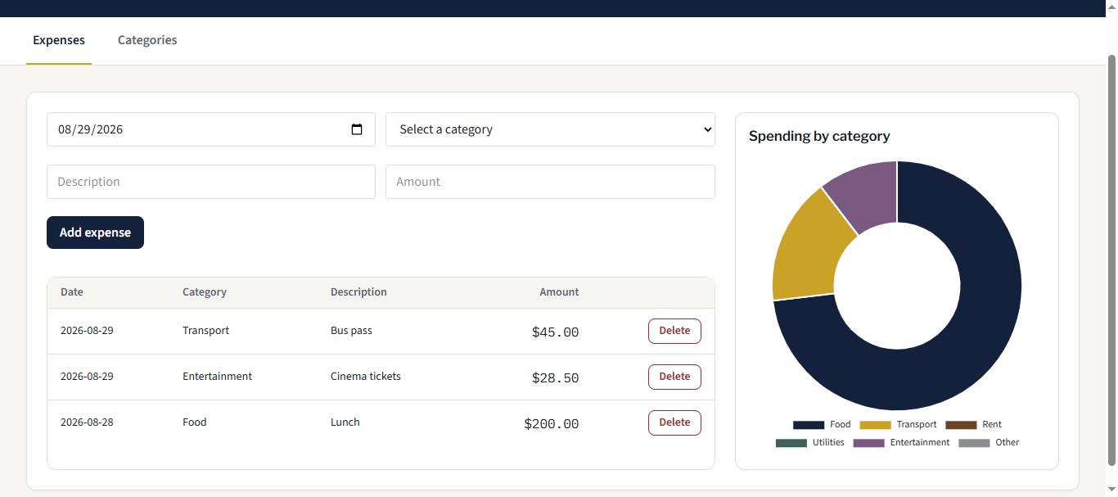
Screenshot: Expenses
Adding and deleting an expense updates the page instantly.
Add-expense form with date, category, description, and amount.
Expense table lists every entry with a delete action.
Doughnut chart on the right updates the moment an expense is added or removed.

Slide 10
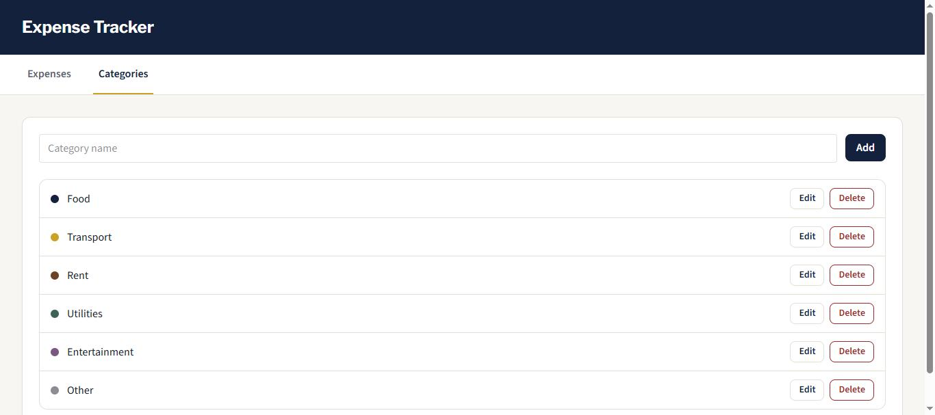
Screenshot: Categories
Categories are fully user-manageable, not a fixed list.
Add, rename, and delete a category, all without a page reload.
Each category shows a colour swatch that matches its slice in the expenses chart.

Slide 11
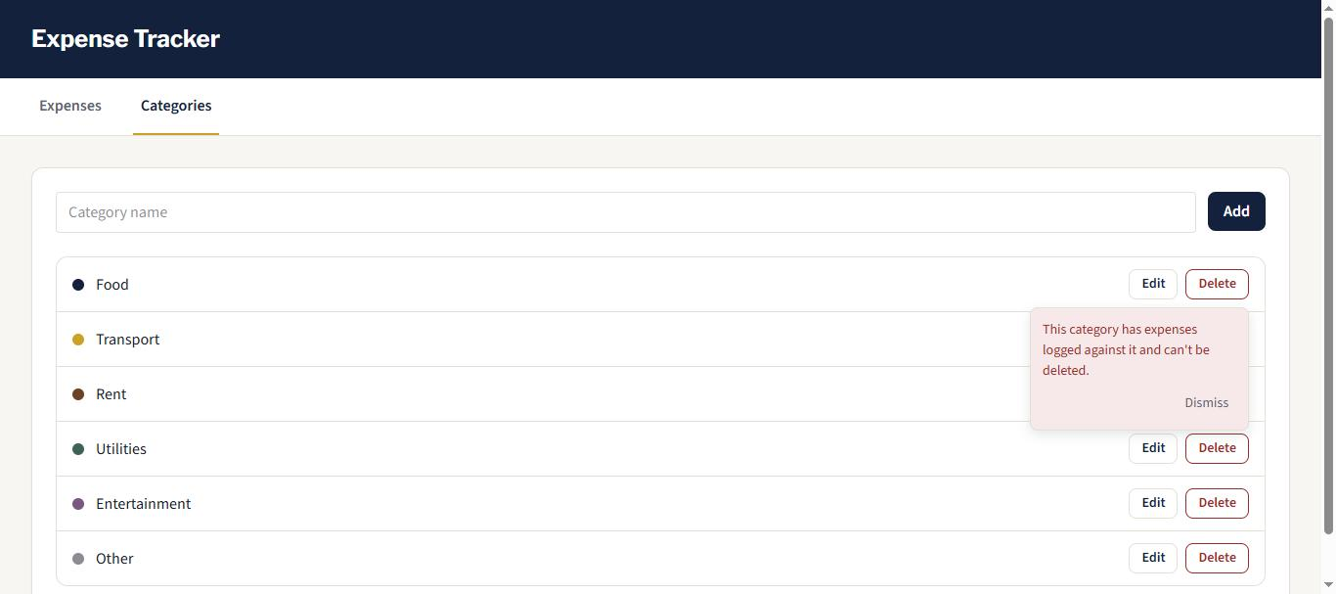
Screenshot: Delete Guard
A category still in use cannot be deleted.
Deleting "Food" is blocked because expenses are logged against it.
The backend catches the database's foreign-key restriction and returns a clear message instead of a raw error.

Slide 12
Changes Since Phase 1
Most of the plan held. A few things grew along the way.
Categories became a full CRUD module rather than a fixed list, kept consistent with how expenses work.
Added a delete guard so a category still in use cannot be removed. This was not anticipated in the original concept.
A written design-token system (colours, type, spacing) was defined and applied consistently across the app.
Expense amounts round to 2 decimals client-side, on top of the browser's own step validation.
A full responsiveness pass: the two-column expense layout stacks on mobile, and delete-confirmation popups reposition themselves near the bottom of a list.

Slide 13
Dynamic Interactions Implemented
Both required interactions are built and working end to end.
Add and delete without a page reload: Vue calls the Laravel JSON API through Axios for both expenses and categories. The list re-fetches and re-renders instantly.
Backend-aggregated totals rendered live: a dedicated endpoint sums expenses per category in SQL, and the chart redraws every time an expense is added or removed.

Slide 14
Test Cases: Categories
Manual test cases, run against the live app.
Test | Steps | Expected result
Add category | Enter a valid name, submit | Appears in the list instantly, no reload
Duplicate name | Submit a name that already exists | Rejected with an inline "already taken" message
Rename category | Edit an existing category, save | List updates instantly
Delete unused category | Delete a category with no expenses | Removed from the list instantly
Delete category in use | Delete a category that has expenses | Blocked, with a clear inline message

Slide 15
Test Cases: Expenses
Manual test cases, run against the live app.
Test | Steps | Expected result
Add expense | Enter valid date, category, description, amount | Appears in the table, chart updates instantly
Missing description | Submit with description left blank | Rejected with an inline "field is required" message
Zero / negative amount | Submit an amount of 0 or less | Rejected by validation
Over-precise decimal | Enter an amount like 12.999 | Blocked by the browser's step validation before it is sent
Delete expense | Click delete, confirm | Removed from the table, chart updates instantly
Empty state | View the app with zero expenses | "No expenses yet." and "No data yet." are shown

Slide 16
Screencast & What Is Next
A short recording shows the app in action.
Screencast to be embedded here. It demonstrates adding and deleting an expense, and the live chart updating without a page reload.
Next: Finalization phase
Package the project for submission: full source code and a zipped GitHub export.
Write the README with install and run instructions.
Write the "making of" abstract and lessons learned.

