Slide 1

Data Mining Project
The Islamia University of Bahawalpur
Department of Artificial Intelligence
Presented by
Salman Sarwar | F23BARIN1M01045
CardioPredict
Muhammad Nadeem | F23BARIN1M01025
Presented to
Intelligent Heart Disease
Risk Assessment
Ms. Marrium Aslam
Bachelor of Artificial Intelligence (2023-2027)

Slide 2



Introduction
#1 Killer
Shortage
Solution
Heart disease is the
leading cause of death worldwide
Not enough cardiologists
in many parts of the world
CardioPredict gives
doctors instant AI predictions
CardioPredict is a web app that lets doctors check patient heart disease risk instantly.

Slide 3

Dataset
UCI Cleveland Heart Disease Dataset
1,025
723
302
Original Rows
Duplicates Found
Unique Records Used
After cleaning, class balance was 54% vs 46% - no resampling needed.
Key Features (13 inputs + 1 target)
80% Train
241 rows
20% Test
61 rows
Age, Sex, Chest Pain Type
Resting BP, Cholesterol, Fasting Blood Sugar
Resting ECG, Max Heart Rate, Exercise Angina
ST Depression, Slope, Major Vessels, Thalassemia
Target: 0 = No Disease, 1 = Disease
Train / Test Split

Slide 4
Models Compared
5-Fold Cross Validation Recall
Model Results Summary
Model | Recall | F1
Log. Reg. | 87.86% | 80.00%
Dec. Tree | 82.99% | 71.43%
Rnd Forest | 88.45% | 81.25%
KNN | 85.98% | 75.00%
SVM | 86.57% | 84.38%
Random Forest selected: highest recall (88.45%) with lowest variance (4.81%)

Slide 5
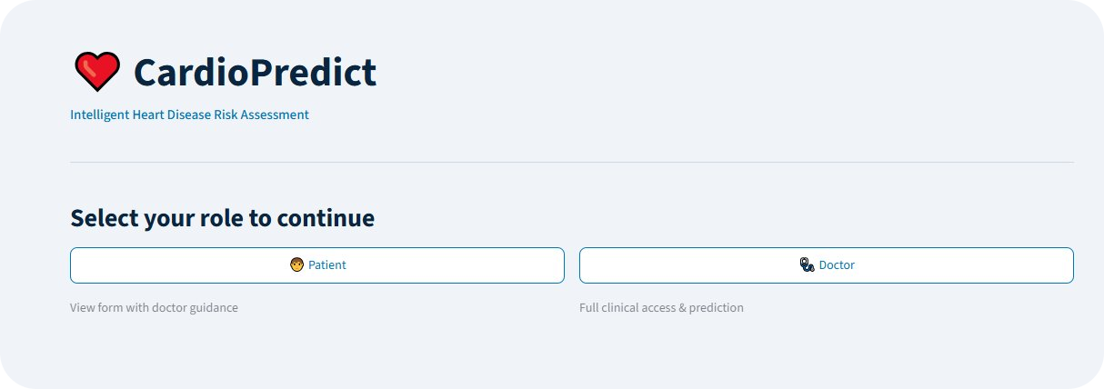


Results
80.33%
74.29%
89.66%
81.25%
Accuracy
Precision
Recall
F1 Score
Cross Validation Recall: 88.45% | Std Dev: 4.81% (5-fold)
No Heart Disease Detected
Heart Disease Risk Detected
Doctor / Patient role-based access.
All results include clinical disclaimer.

Slide 6




Conclusion
Right Model
Clinical Tool
Random Forest gave the best recall (88.45%) with consistent cross validation results.
Doctors can use CardioPredict directly without any technical background.
Limitation
Built With
Only 302 unique records after cleaning. A larger dataset would improve reliability.
Python, Streamlit, Scikit-learn, Random Forest deployed as a web application.
Salman Sarwar | Muhammad Nadeem | Bachelor of AI | IUB Bahawalpur

