Slide 1

Estimating Contagion Rates in Kickstarter Twitter Cliques
Davon Woodard/MD Salman Ahmed CS 6604 Fall 2017

Slide 2
Outline
Introduction and Initial Motivation
Data Collection
Assumptions
Simple Contagion
Model
Results
Complex Contagion
Model
Results
Challenges
Conclusion

Slide 3
Introduction
Crowdfunding has emerged as a popular community-based, micro-financing model for entrepreneurs, artists, and activists alike to bring their respective dreams into fruition.
Successful campaigns, those which meet their financial goals, bring with them not only the financial utility for the creator, but also social utility for the backers.

Slide 4
Motivation
Initial: Can the prediction power of Twitter data be extended by complementing static data with the model of social media exposure curves (stickiness and persistence) presented by Romero^{[1]}, et. al coupled with the use of censored data presented by Li, et. al^{[2]}?
Secondary: Given a set of assumptions, can the rate of spread of Kickstarter campaigns in a Twitter network be estimated using simple contagion and complex contagion models?

Slide 5
Data Collection
Crowdfunding dataset
From Chandan K. Reddy’s Team
Twitter dataset
Using Twitter public API & GetOldTweets-python¹)
Modifying the APIs of GetOldTweets-python to meet our needs
1. https://github.com/Jefferson-Henrique/GetOldTweets-python

Slide 6
Dataset Characteristics
Crowdfunding dataset¹ – 18k total records
Each record corresponds a project
Contains project id, name, URL, duration, goal amount, pledged amount, …
Twitter dataset² – 162k total records
Each record corresponds to a tweet
Contains the text, user, date of tweet, tweet link, retweet, etc.
1 & 2. You can get the two datasets on http://people.cs.vt.edu/ahmedms/cs6604.html
Notes:
Project Id,Name,Url,Url,Currency,Top Category,Category,Creator,Location,Updates,Comments,Rewards,Goal,Pledged,Backers,Start,End,Duration in Days,Facebook Connected,Facebook Friends,Facebook Shares,Has Video,Latitude,Longitude,Start Timestamp (UTC),End Timestamp (UTC),Creator Bio,Creator Website,Creator - # Projects Created,Creator - # Projects Backed,# Videos,# Images,# Words (Description),# Words (Risks and Challenges),# FAQs
project_id, project_name, username, date, retweets, favorites, text, geo, mentions, hashtags, id, permalink

Slide 7
Relevancy [Crowdfunding dataset x Twitter dataset]
Out of 18k projects, 10k projects have tweets
Out of the 10k, 4k projects have enough tweets to take part in the model develop

Slide 8
Assumptions
Our crawling program retrieves only the information about tweets.
Twitter user network as a clique
Total nodes of the Twitter user network is twice the unique Twitter users

Slide 9
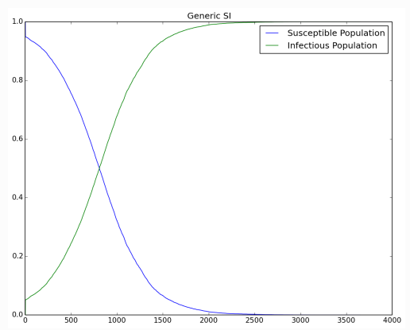
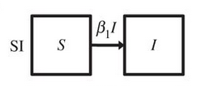
Model – Simple Contagion
^{[4]}

Slide 10
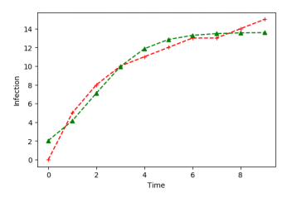

Model – Simple Contagion
Β_{(successful)} = .0092
Β_{(failed)} = .0120

Slide 11
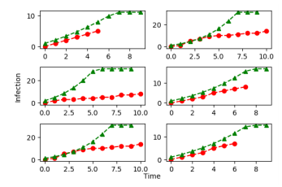

Results– Simple Contagion
Variance:
Assumptions
Network Structure

Slide 12
Model - Complex Contagion [Concept of Exposure Curve]
1
2
1
2
After one day
5
3
5
3
4
4
Day 1
Day 2
P(k) = 2/4
Where k = 1
E_{k} = {2, 3, 4, 5}
I_{k} = {4, 5}

Slide 13
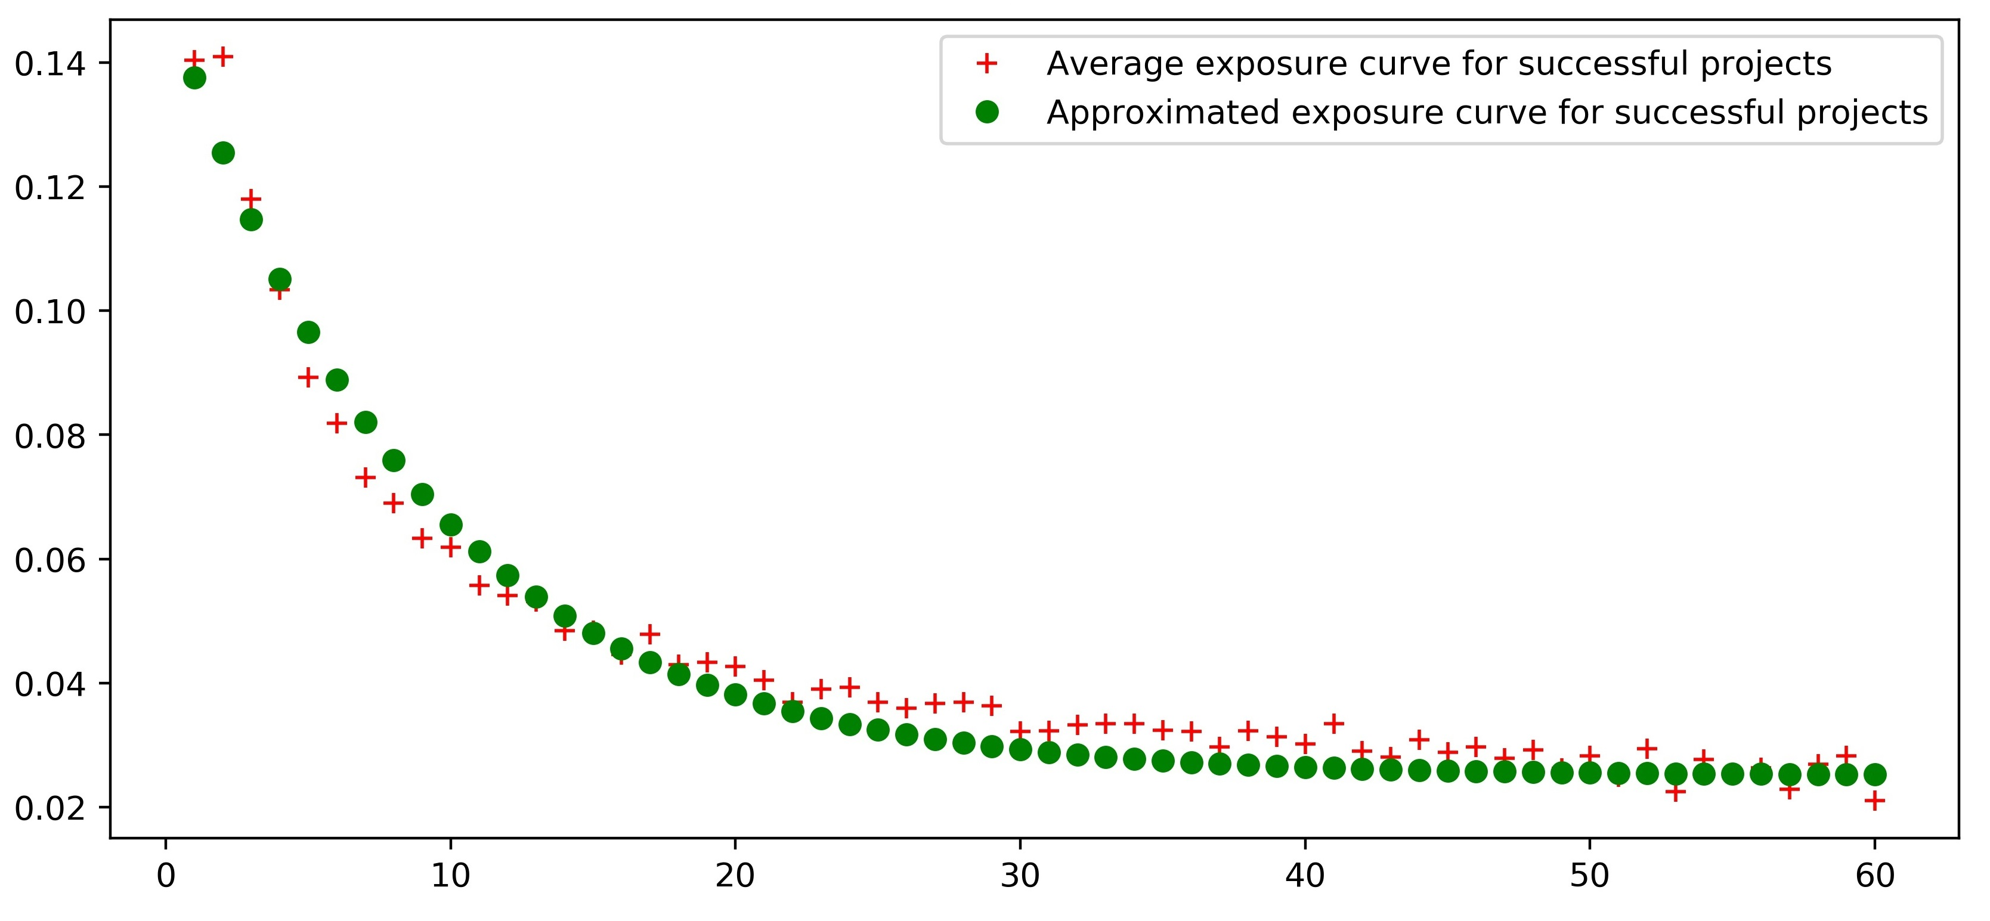
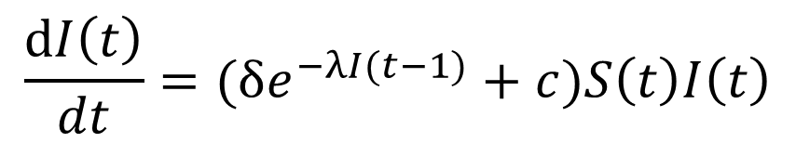
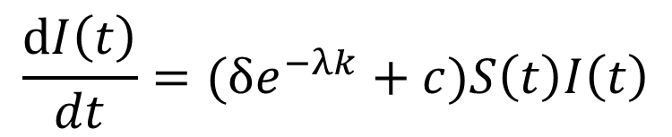
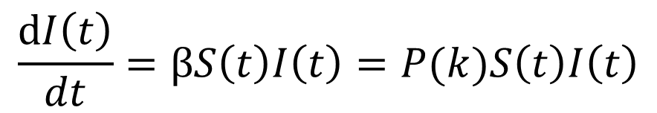

Exposure Curve
λ = 0.11360768
$$P\left(k\right)=δe^{−λk}+c$$
$$\frac{dI\left(t\right)}{dt}=βS\left(t\right)I\left(t\right)=P(k)S\left(t\right)I\left(t\right)$$
P(k)
$$\frac{dI\left(t\right)}{dt}=(δe^{−λk}+c)S\left(t\right)I\left(t\right)$$
$$\frac{dI\left(t\right)}{dt}=(δe^{−λI(t−1)}+c)S\left(t\right)I\left(t\right)$$
K
Notes:
0.12637707

Slide 14
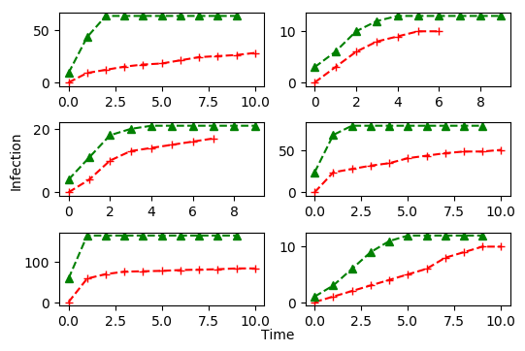
Results - Complex Contagion [Actual vs. Prediction]
A big approximation error
Inadequate twitter data
Poor assumptions

Slide 15
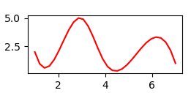
Challenges
Heading wrong direction until the last moment
Thinking the output as the input to our models
Inadequate associated Twitter data
Poor assumptions
tweets
week

Slide 16
Conclusion
Assumptions are critical
Model should fit the dataset available
With additional Network Information additional research on information diffusion of Kickstarter campaigns help guide marketing efforts

Slide 17
References
Romero, et. al . “Differences in the Mechanics of Information Diffusion Across Topics: Idioms, Political Hashtags, and Complex Contagion on Twitter”
Yan Li, Vineeth Rakesh, and Chandan K. Reddy. 2016. Project Success Prediction in Crowdfunding Environments.
Prakash, Aditya. “Epidemics: Probabilistic Models”, Lecture, 9/25/17, VT
https://institutefordiseasemodeling.github.io/Documentation/general/generic-tutorial7SI.html

