Slide 1
Image Forgery Detection
Using Dual-Branch CNN with Error Level Analysis
Salman Zaman · Muhammad Usama Alam · Muhammad Zafar Khan
Project Coordinator: Sajid Majeed
NED University of Engineering and Technology
Post Graduate Diploma in Generative AI · Deep Learning
June 2026
NED University of Engineering & Technology · PG Diploma in Generative AI · Deep Learning
1 / 11

Slide 2
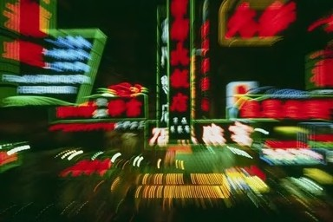
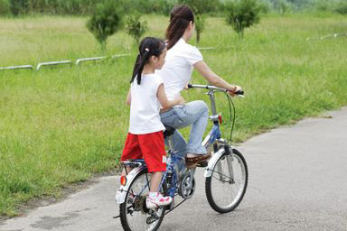
The Problem — Image Forgery
Why does it matter?
What is Image Forgery?
Splicing — pasting content from another image
Copy-Move — duplicating regions within an image
Inpainting — removing/replacing objects
Real-World Impact:
Fake news & misinformation spread
Tampered legal & forensic evidence
Manipulated medical scans
Academic fraud & document forgery
AUTHENTIC
FORGED
Can you tell the difference?
Traditional visual inspection often fails. Automated forensic analysis is essential.
NED University of Engineering & Technology · PG Diploma in Generative AI · Deep Learning
2 / 11

Slide 3
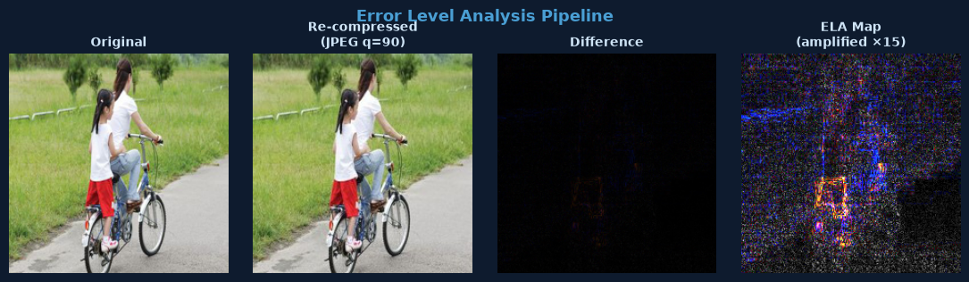
Error Level Analysis (ELA)
The core forensic technique powering our model
How it works
The forensic insight
1 Re-save image as JPEG (quality = 90)
2 Compute pixel-wise difference
3 Amplify by 15× (brightness enhance)
4 Encode result as JPEG bytes
5 Decode via tf.image for consistent resize
Original regions: uniform, low ELA residual
Tampered regions: high ELA — re-saved at
a different quality than the background
Bright patches in ELA map = manipulation
The model learns to read this map
NED University of Engineering & Technology · PG Diploma in Generative AI · Deep Learning
3 / 11

Slide 4
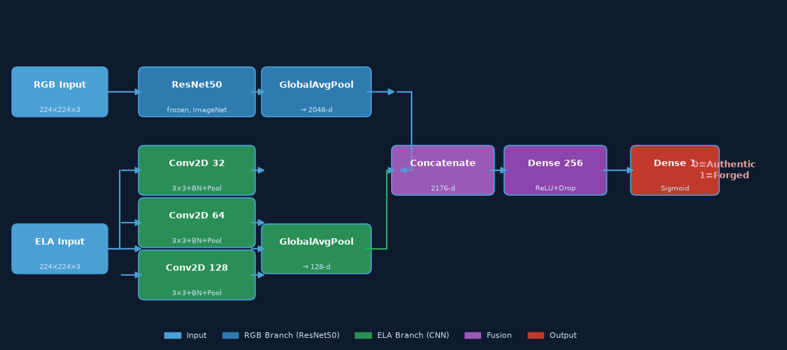
Model Architecture — Dual-Branch CNN (M3)
Two complementary views fused into one powerful classifier
RGB Branch
ELA Branch
Fusion Head
Total
ResNet50 frozen ~23.5M params
Custom 3-block CNN ~650K trainable params
Dense(256)+Dropout → Binary output
~24.2M params ELA branch is dominant
NED University of Engineering & Technology · PG Diploma in Generative AI · Deep Learning
4 / 11

Slide 5
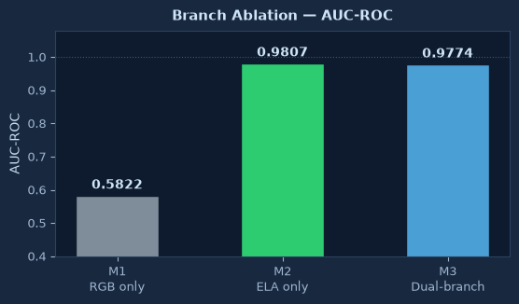
Ablation Study — Why ELA Matters
Isolating the contribution of each branch
Key Findings
M1 — RGB only
AUC 0.58 ≈ random guess
M2 — ELA only
AUC 0.98 near-perfect
M3 — Dual
AUC 0.97 best overall
The model is fundamentally ELA-driven. ResNet50 provides complementary texture context but does not dominate.
NED University of Engineering & Technology · PG Diploma in Generative AI · Deep Learning
5 / 11

Slide 6
Dataset & Training
CASIA v2 — the standard benchmark for image forgery detection
7,492
5,124
12,616
70/15/15
Authentic images
Tampered images
Total images
Train/Val/Test split
Hyperparameters
Data Integrity
Optimizer
Adam (lr = 0.001)
Stratified split (SEED = 42)
Donor & tampered image pairs are kept
in the same split to prevent leakage
CASIA naming convention parsed to
extract source IDs before splitting
CASIA v2 contains splicing and
copy-move forgeries across diverse
categories: animals, architecture,
nature, people, and more.
Loss
Binary Cross-Entropy
Batch size
32
Input size
224 × 224 × 3
ELA quality
JPEG quality = 90
ELA amplification
15× brightness
Framework
TensorFlow 2.20 / Keras
Platform
Google Colab (GPU)
NED University of Engineering & Technology · PG Diploma in Generative AI · Deep Learning
6 / 11

Slide 7
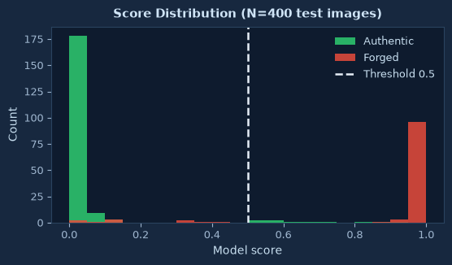
Results & Evaluation Metrics
Evaluated on 400 stratified CASIA v2 test images (261 authentic / 139 forged)
0.9774
~92%
0.50
~8%
AUC-ROC
Test Accuracy
Decision Threshold
Error Rate
Confusion Matrix
Pred: Auth
Pred: Forged
True: Auth
236
25
True: Forged
11
128
• True Positives: 128 forged correctly detected
• True Negatives: 236 authentic correctly passed
• False Positives: 25 authentic flagged as forged
• False Negatives: 11 forged missed
NED University of Engineering & Technology · PG Diploma in Generative AI · Deep Learning
7 / 11

Slide 8
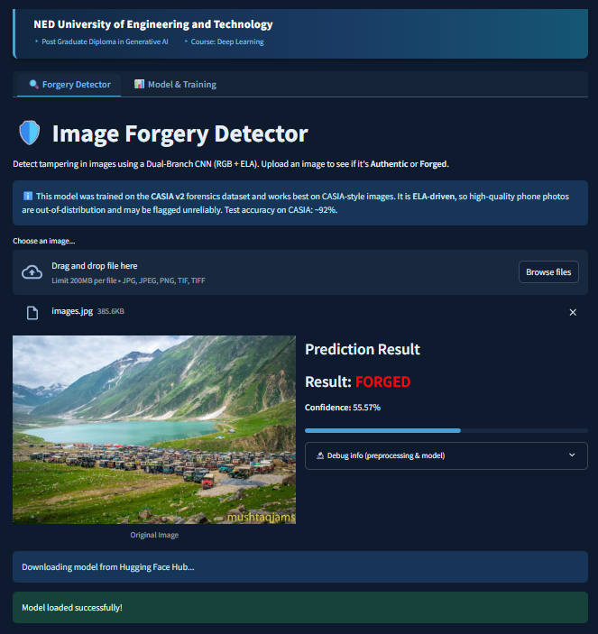
Live Demo — Upload & Prediction (1/2)
huggingface.co/spaces/deep-learning/image-forgery-detector-v2
How to use the app
1 Open the Forgery Detector tab
2 Upload any JPG / PNG / TIFF
3 App computes ELA in real-time
4 Model predicts in < 2 seconds
Result categories:
FORGED — score > 0.55
UNCERTAIN — 0.45 – 0.55
AUTHENTIC — score < 0.45
Confidence score shown below
the result badge.
NED University of Engineering & Technology · PG Diploma in Generative AI · Deep Learning
8 / 11

Slide 9
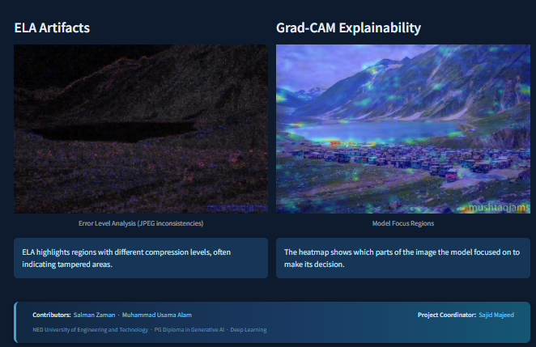
Live Demo — Explainability (2/2)
ELA Artifacts and Grad-CAM heatmap for every prediction
Explainability features
ELA Artifacts panel:
Shows JPEG compression residuals
Bright patches = tampered regions
Uniform areas = untouched pixels
Grad-CAM Heatmap:
Gradient-weighted activation map
Red/yellow = high model attention
Overlaid on original image
Derived from last Conv2D layer
Both panels update instantly
for every uploaded image.
NED University of Engineering & Technology · PG Diploma in Generative AI · Deep Learning
9 / 11

Slide 10
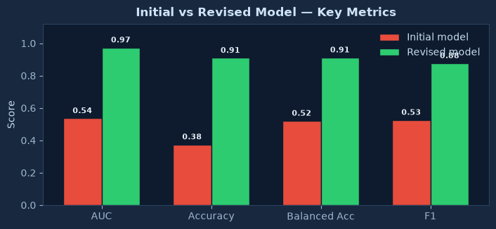
Model Improvement — Initial vs Revised
The journey from a broken prototype to a validated forensic classifier
Initial Model
• M3_best.keras (19 layers)
• Internal Rescaling layer
• Buggy multiply-ELA pipeline
• AUC = 0.54 (near-random)
• Predicts FORGED for everything
Revised Model
• M3_best_v2.h5 (191 layers)
• No internal norm (correct /255)
• Brightness-ELA + JPEG roundtrip
• AUC = 0.974 (validated)
• 92% accuracy on CASIA test split
Root cause identified & fixed
ELA multiply attenuation → brightness amplification · PIL bicubic resize → tf.image bilinear · Missing JPEG roundtrip · RGB [0,255] → /255 normalization
NED University of Engineering & Technology · PG Diploma in Generative AI · Deep Learning
10 / 11

Slide 11
Conclusion & Future Work
Summary, limitations, and next steps
What We Achieved
Known Limitations
• Dual-branch CNN (RGB + ELA) trained on CASIA v2
• AUC-ROC: 0.974 on held-out test set
• Test accuracy: ~92% (threshold = 0.5)
• Grad-CAM explainability integrated
• Deployed on Hugging Face Spaces
• Comprehensive preprocessing pipeline
• matching the exact training conditions
• Ablation study confirming ELA dominance
• Model comparison documentation
• Phone photos are out-of-distribution
• (ELA residuals are large everywhere)
• CASIA-specific forgery types only
• ResNet50 backbone fully frozen
• No deepfake / GAN detection
Future Work
• Fine-tune ResNet50 top layers
• Train on diverse, larger datasets
• Add GAN / deepfake detection branch
• Real-time video frame analysis
• Uncertainty quantification output
• Mobile-optimised lightweight model
NED University of Engineering & Technology · PG Diploma in Generative AI · Deep Learning
11 / 11

