Slide 1

PTB-STS-001 | MONTH 10 OF 24
Project Health & Status Report
Pole Trust Bank | AI Banking Transformation
Reporting Period
Overall RAG Status
Month 10 of 24
AMBER — LAGGING
Reported To
Project Sponsor & Executive Steering Committee

Slide 2
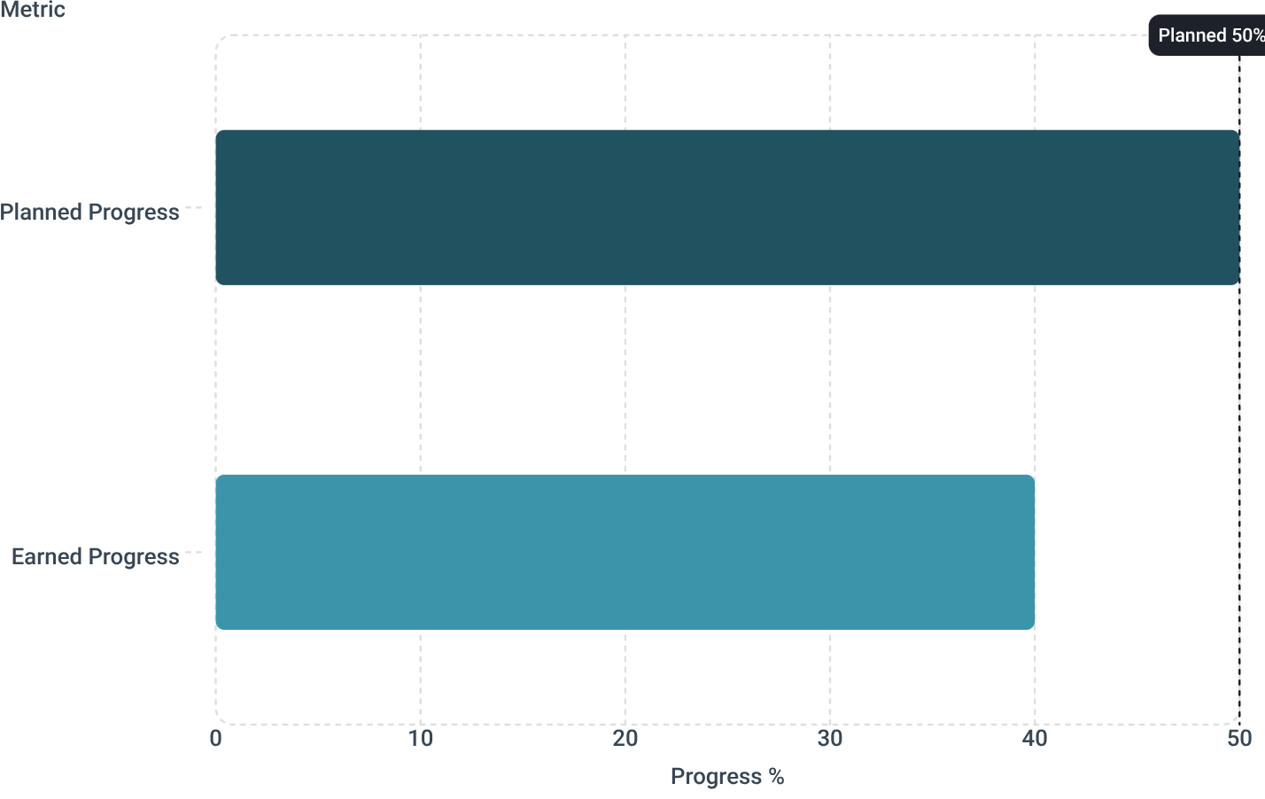

EXECUTIVE DASHBOARD
At a Glance — Month 10 of 24
Four EVM indicators define the project's Month 10 health. Schedule and cost performance are in the red zone. Two amber signals require immediate Sponsor attention.
40%
0.80
Progress Earned
Schedule Index
Planned: 50% | 10% gap on critical path
SPI = 0.80 | SV = −10% | 10% behind critical path
0.89
$11.5M
Cost Index
CAPEX Budget
CPI = 0.89 | CV = −12% | 12% over phase budget
TCO: $27.5M | DEC-02 funding pending
The 10% Gap — Stated Plainly
Planned: 50%. Earned: 40%. The 10% shortfall is a schedule variance that compounds across the zero-slack critical path. Every week of delay flows one-for-one to the D7 completion date.
Bad news stated plainly. Sponsor decisions fund recovery.

Slide 3
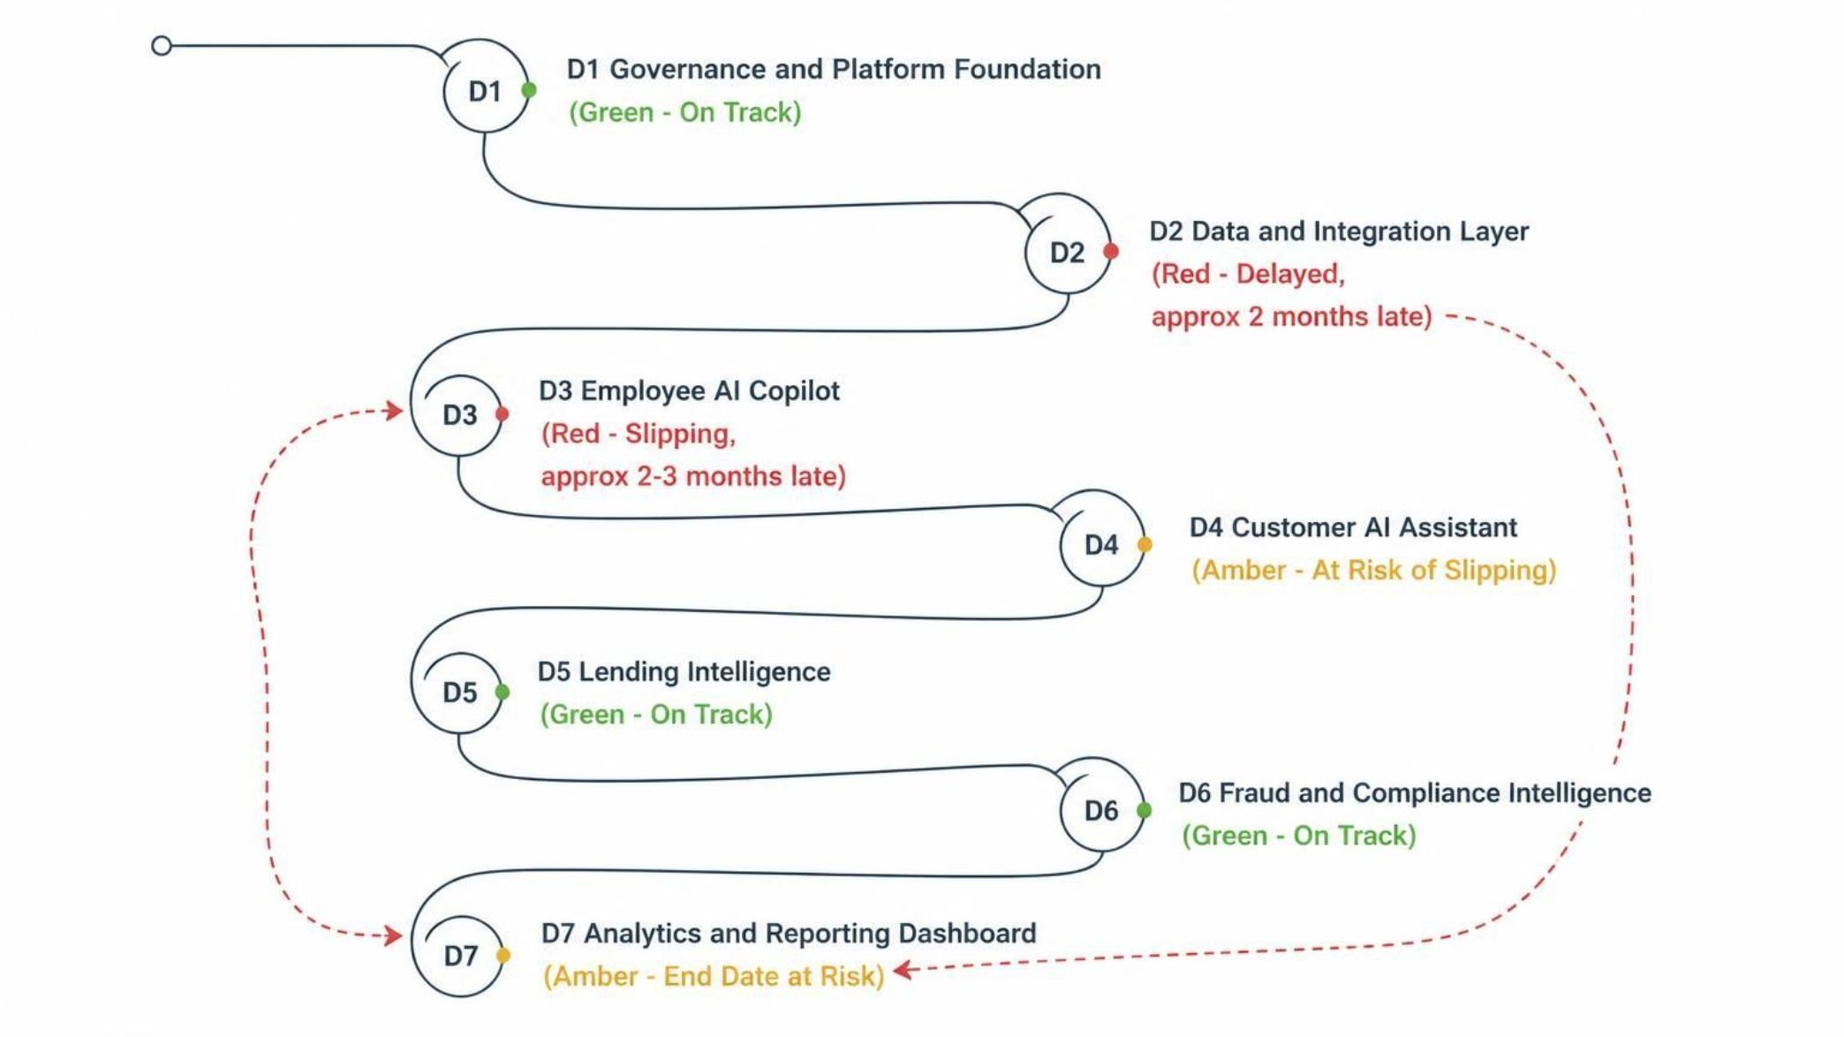
SCOPE & ROADMAP
Project Scope — 7 Deliverables, 48 Work Packages, 24 Months
Seven sequential deliverables (D1–D7) form a zero-slack critical path. D2 and D3 carry active delays — each week of slippage flows one-for-one to D7. No float exists on this chain.
Critical Path Warning
D1 to D7 = Zero-slack critical path. Every D2 slip flows one-for-one to D7.
D2 and D3 delays have already consumed the schedule float.
No recovery is possible without Sponsor-approved intervention.
Scope & Budget Reference
Scope Document: PTB-SCOPE-001
CAPEX Envelope: USD 11.5M
Total Cost of Ownership: USD 27.5M
Work Packages: 48 across 7 deliverables
Program Duration: 24 months

Slide 4
MILESTONE TRACKER
Milestone Tracker — What's On Track, What's Not
Five gate milestones define the program's critical path. M0 and M1 are approved and closed. M2 and M3 are red — delayed by approximately 2 to 3 months. M4 is amber and at risk of slipping if D2/D3 recovery does not accelerate immediately.
M0 — Schedule Baseline Approved
1
Baseline formally approved. Schedule governance active.
2
M1 — Charter & Funding Gate (End M02)
Charter signed. Funding gate cleared. Program authorized.
M2 — Foundation Accepted / D2 (End M04)
3
Data & vendor gaps not resolved in time. Foundation acceptance delayed.
4
M3 — Copilot Pilot Live / D3 (End M07)
D2 delay cascaded to D3. Copilot pilot launch pushed back.
M4 — Customer Assistant Pilot / D4 (End M11)
5
Contingent on D2/D3 recovery. Slippage risk is active.
Root Cause
Recovery Action
Late D2 start — data gaps and vendor onboarding not resolved in time. D3 is single-threaded with no parallel path. Slip flows 1-for-1 on the zero-slack critical path.
Crash D2/D3 schedules. Parallelize activities. Enforce COTS-First sourcing. Accelerate specialist staffing. Rebaseline via CR-002 with Sponsor approval.

Slide 5
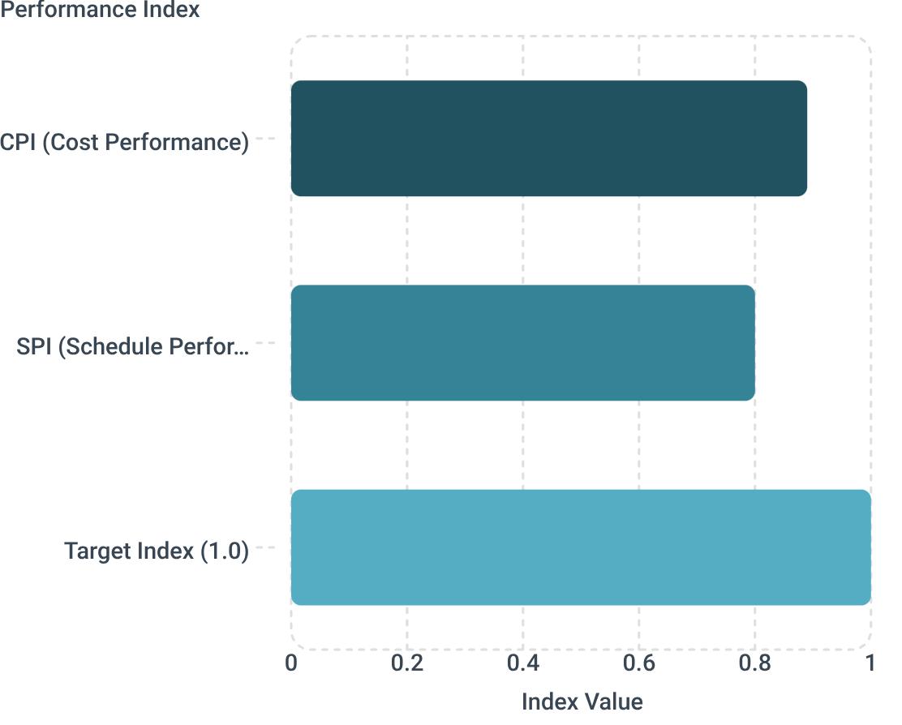
COST & EVM PERFORMANCE
Budget Performance — Earned Value Management Deep Dive
Month 10 EVM data confirms cost pressure. CPI at 0.89 means the project receives 89 cents of earned value per dollar spent. CV at −12% confirms a USD 1.38M cost overrun against phase budget. Contingency is being consumed faster than planned.
Cost Variance (CV)
Cost Performance Index
−12% | EV minus AC is negative | Over budget by phase
CPI = 0.89 | Getting 89 cents per dollar spent
Contingency Status
Early-burn flag active | Consumed faster than planned
Root Cause — Cost Pressure
Recovery Actions — Cost Control
Heavier D2/D3 specialist effort than planned. Extended vendor procurement windows. Early contingency draw. All variances remain within the USD 11.5M CAPEX / USD 27.5M TCO envelope — but trajectory requires intervention.
DEC-02 funding release to unlock phase budget
CR-002 rebaseline to reset EVM baselines
COTS-First sourcing to reduce specialist dependency
Weekly CPI tracking with CFO, Sponsor, PM, Finance, PMO

Slide 6


RISK REGISTER
Risks & Issues — What's Fired, What's Rising
Five active risks span the program. Two are red and require immediate action. Three are amber and under active monitoring. Every risk has an owner, an action, and a decision route to the Sponsor.
RED — Integration Failure (D2) — FIRED
RED — Vendor / Platform Slip — RISING
AMBER — Staff / Capacity Gap — RISING
API and data profiling gaps threaten D2 delivery. Front-load profiling activities. Decision deadline: DEC-10. Owner: Tech Lead | Action Owner: Data Architect
Platform vendor delays compound D2 schedule risk. Early sourcing required. Sponsor decision needed: DEC-07. Owner: Procurement | Action Owner: Vendor Manager
Specialist AI and data roles remain unfilled. Role appointments required by DEC-05 / DEC-06. Owner: HR Partner | Action Owner: Project Manager
AMBER — Hallucination / Model Risk — MONITORING
AMBER — Regulatory Concern — MONITORING
LLM output accuracy risk in Copilot and Customer Assistant. Retrieval controls and pilot gates active. Owner: AI Quality Lead | Action Owner: Model Governance Team
AI compliance evidence requirements evolving. Compliance evidence pack due: DEC-09. Owner: Compliance Officer | Action Owner: Legal & Compliance
Every risk has an owner, an action, and a decision route to the Sponsor.

Slide 7
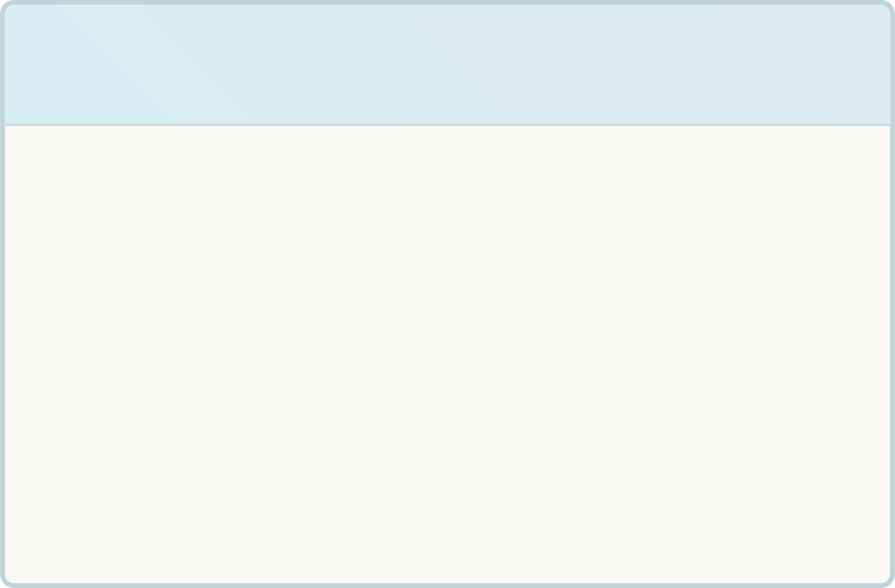

SPONSOR DECISIONS REQUIRED
Sponsor Decisions Required — Three Calls, One Board Meeting
Three Sponsor decisions are required to authorize recovery. Each has a defined decision reference, an owner, and a deadline. No scope is added — funding and rebaseline authority flow through CR-002.
1
2
3
DEC-01 — Record Effective Start Date
DEC-02 — Release Phase Funding
DEC-03 — Delegate PM Authority to Salman Zaman
Release phase funding to unlock D2/D3 recovery. Implemented via CR-002 / PTB-CHG-001. Contingency draw and specialist staffing depend on this release.
Formally record the program's effective start date. Baseline for all EVM calculations depends on this authorization.
Formally delegate Program Manager authority to Salman Zaman. Recovery execution requires clear, authorized leadership.
Funding & rebaseline authority flows through CR-002 — the CCB-approved change-control firewall. No scope is added. Funding + rebaseline only. Baseline moves only through an approved CR.

