Slide 1

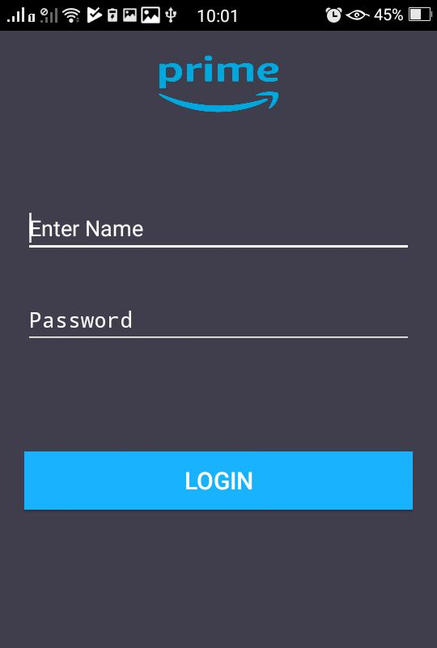
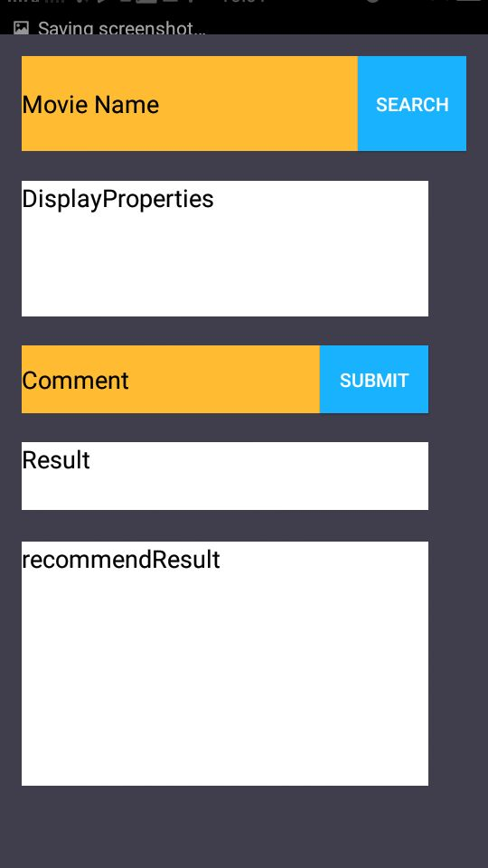
Android Authentication Server
ADB Server
Mobile App Client
User Authentication
Android Java SDK
Related Movies Recommendation
Sentimental Analysis
Login Successful
Classified Movies
NB Classification Algorithm
Response
Request
Amazon Prime Videos
Application Form
Movie Details Retrival

Slide 2
Android Authentication Server
ADB Server
Mobile App Client
User Authentication
Android Java SDK
Related Movies Recommendation
Sentimental Analysis
Login Successful
Classified Movies
NB Classification Algorithm
Response
Request
Amazon Prime Videos
Application Form
Movie Details Retrival

