Slide 1

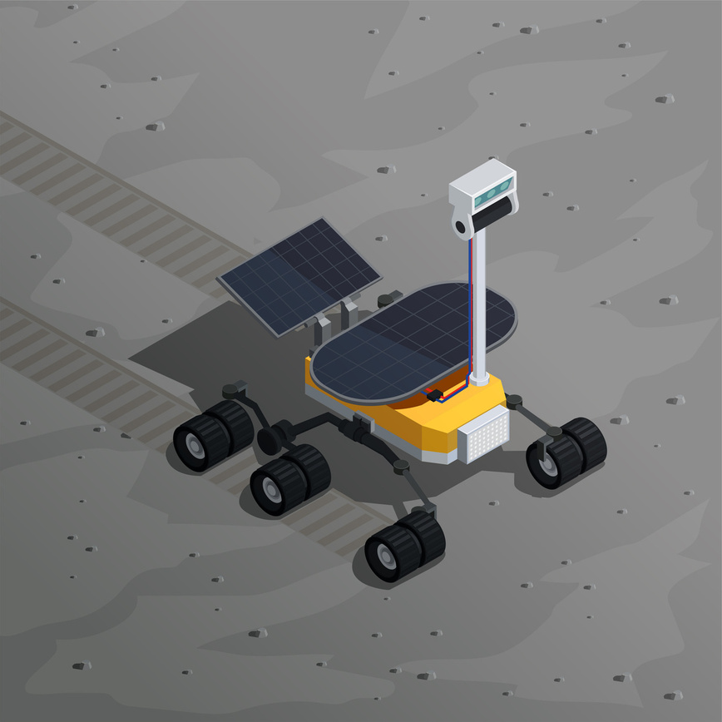

Path Planning Algorithm for Mobile Robots in Unknown Environments
Salma Sahab (22-cp-60)
Attia Batool (22-cp-79)
Supervised by: Dr. Usman Rauf

Slide 2
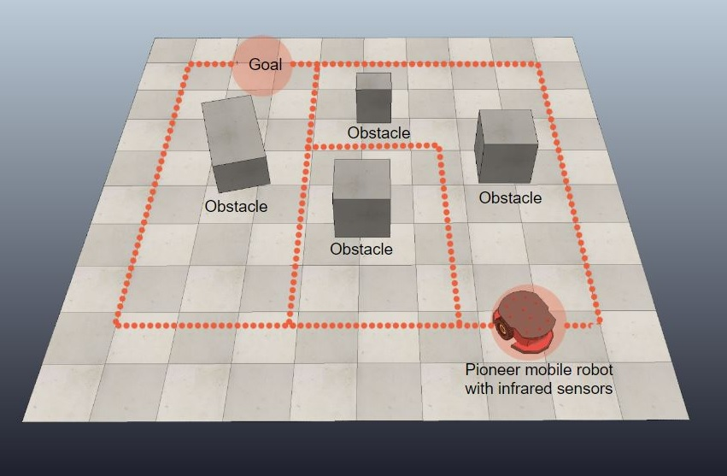
Problem Statement
Mobile robots face challenges when moving in unknown and changing environments where obstacles appear unexpectedly. Some existing path planning algorithms often fail to find safe and efficient routes in real time, especially when the surroundings are not already mapped.

Slide 3
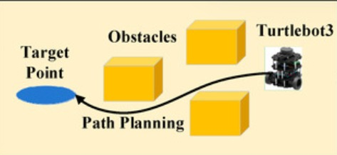
Aim of Project
To develop a hybrid path planning system that allows a mobile robot to navigate safely and efficiently in unknown environments using real time sensor data.

Slide 4
01
Develop a differential drive mobile robot equipped with onboard sensors (RPLidar A1 and MPU6050) for real-time mapping using SLAM
02
Enable autonomous navigation in unknown environments by integrating the Nav2 stack for path planning and obstacle avoidance.
Objectives
03
Perform real time obstacle detection using RPLidar A1 .
04
Establish wireless communication via ROS 2 over WiFi for real time monitoring and teleoperation.
Evaluate system performance using metrics such as mapping accuracy, path planning success rate, and obstacle avoidance reliability.
05

Slide 5
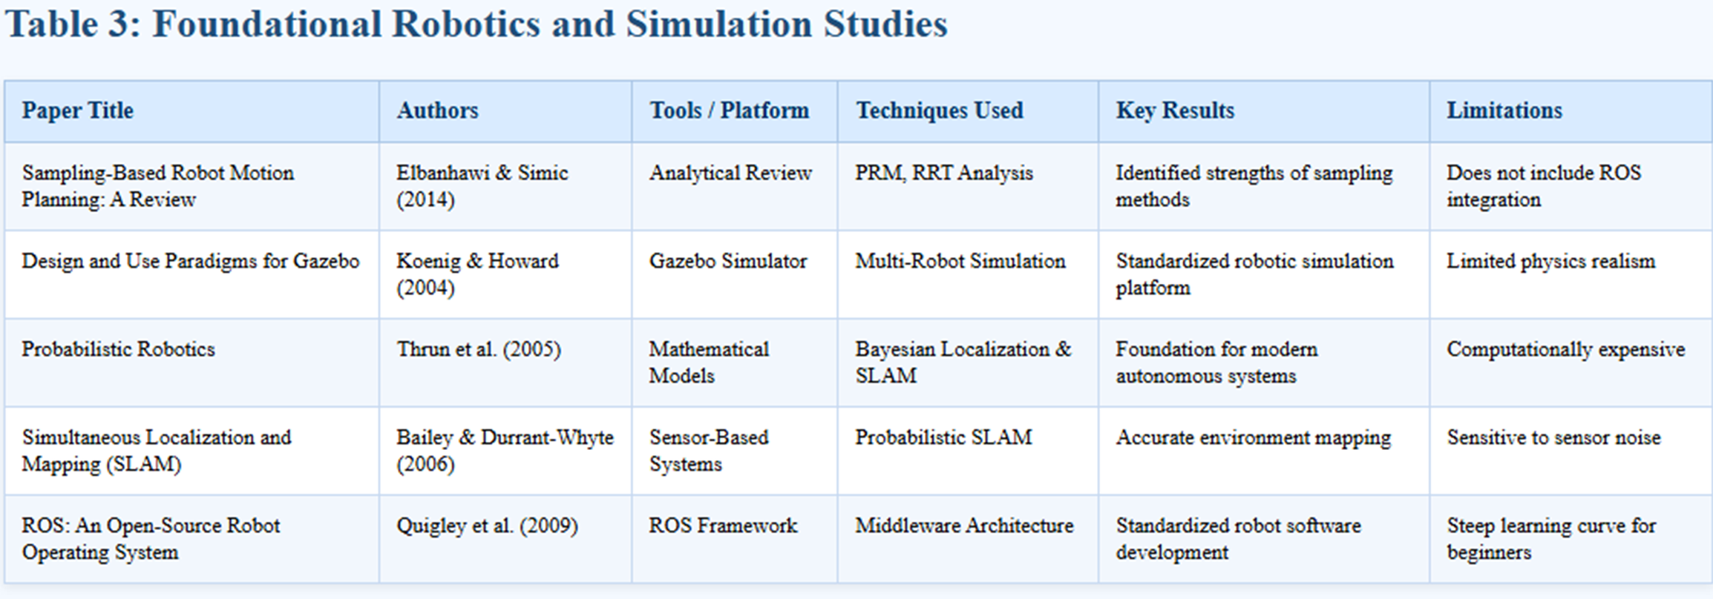
Literature Review

Slide 6
SOFTWARE & SIMULATION TOOLS
Operating System: Ubuntu 22.04
Middleware: ROS2 Humble
Simulator: Gazebo
Visualization Tool: RViz2
SLAM Package: SLAM Toolbox
Navigation Framework: Nav2 Stack
Programming Language: Python
Storage: microSD Card

Slide 7
HARDWARE REQUIRED
Main Controller: Raspberry Pi 3 (1 GB)
Motor Driver: TB6612FNG
Mobile Base: DIY 2WD robot chassis with DC geared motors and incremental encoders
LiDAR Sensor: RPLIDAR A1
IMU Sensor: MPU6050
Seconday Controller: Arduino Uno
Power Supply

Slide 8
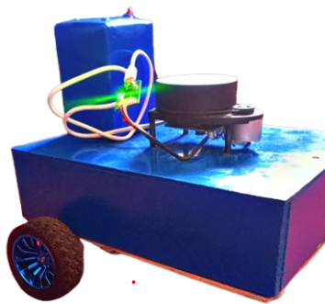
PROTOTYPE
Figure 1:Assembled autonomous mobile robot with RPLIDAR A1 sensor

Slide 9
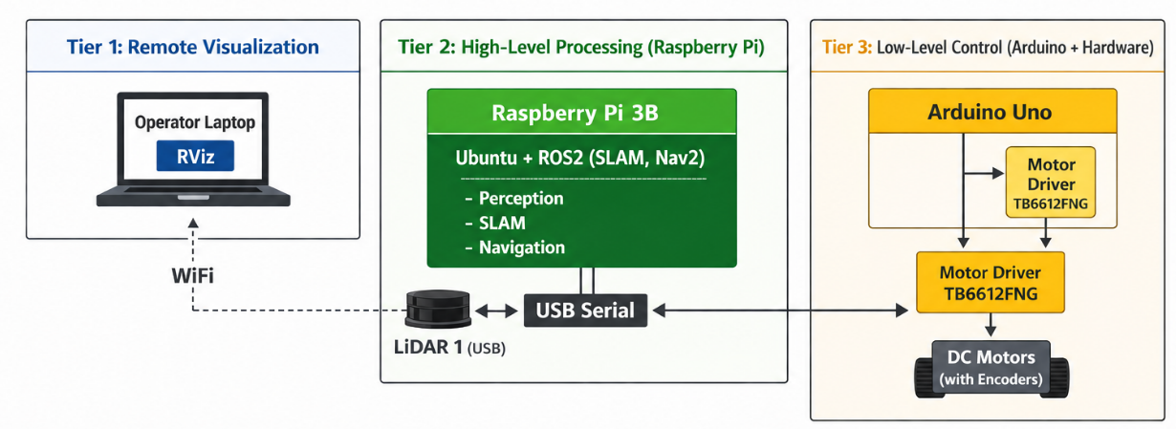
SYSTEM ARCHITECTURE
Figure 2: Three tier system architecture of the autonomous mobile robot

Slide 10
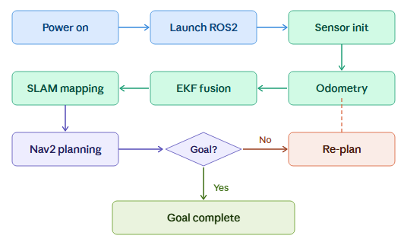
METHODOLOGY
Figure 3: End-to-end operational workflow from power-on to goal completion

Slide 11
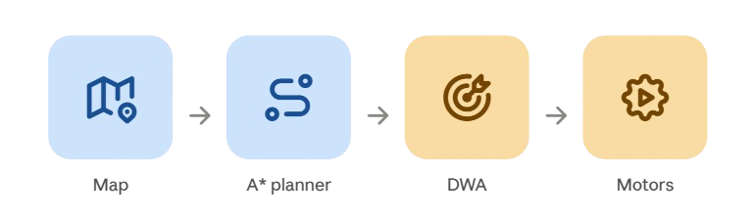
Algorithm Overview
(A* + DWA)
Global path planned once using the map (A*)
Local path adjusted continuously in real time to dodge obstacles (DWA)
Final output sent as velocity commands to the motors

Slide 12
LIMITATIONS
Limited RAM (1GB, Pi 3): slows SLAM map updates and leaves little headroom for other processes
No dynamic obstacle handling: system reacts to obstacles present at scan time, doesn't track or predict moving objects
Indoor only testing: validated in a single lab environment (~5m × 8m); not tested outdoors or in larger/more complex spaces
LiDAR only perception: camera is mounted but not yet used for navigation decisions
Battery dependent performance: motor response varies slightly as LiPo charge drops

Slide 13
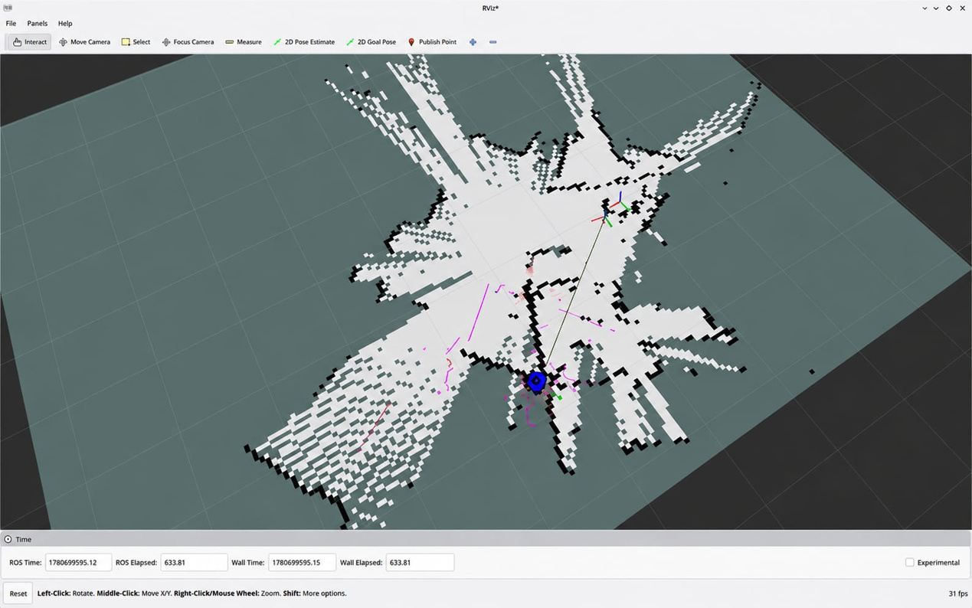
SLAM Mapping — Live Environment Map
Occupancy grid map built in real time using LiDAR + SLAM Toolbox
Blue marker shows the robot's estimated pose within the map
White cells represent free (navigable) space; black cells represent detected obstacles/walls
Magenta trace shows the path travelled by the robot during exploration
Map generated through manual teleoperation of the robot around the test environment

Slide 14
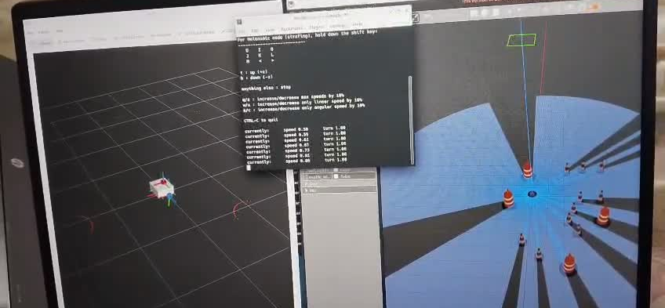
RESULTS

Slide 15







Monthly Timeline
FIRST MILESTONE
SECOND MILESTONE
THIRD MILESTONE
FOURTH MILESTONE
FIFTH MILESTONE
SIXTH MILESTONE
SEVENTH MILESTONE
Research
Software
Algorithm
Simulation
Hardware
Implementation
Completion
Literature review of existing path planning techniques.
Finalize problem statement and project objectives.
Select simulation platforms and software tools.
Study ROS2 environment and path planning frameworks.
Develop path planning algorithm for mobile robots.
Test algorithm in static and dynamic environments
Implement algorithm in simulated unknown environments.
Analyze and validate results using ROS2.
Finalize hardware components and specifications.
Purchase sensors, controller, motors, and chassis.
Assemble mobile robot hardware.
Integrate software with hardware and implement path planning.
Test robot in real unknown environments.
Evaluate performance and complete final documentation.
september
october
november
december
January/Feburary
March/April
May/June

Slide 16


SUSTAINABLE DEVELOPMENT GOAL(S)
SDG 09
SDG 11
Industry, Innovation and Infrastructure
Sustainable Cities and Communities

Slide 17
Conclusion
The project successfully focuses on developing a hybrid path planning approach for mobile robots in unknown environments. By combining multiple existing algorithms and using real-time sensor data, the system aims to enable autonomous navigation, obstacle avoidance, and adaptive decision making. This work lays the foundation for creating intelligent robotic systems capable of exploring complex indoor and outdoor environments safely and efficiently.

Slide 18
Future Work
Implement the system on an advanced robot platform for large scale testing.
Improve dynamic obstacle detection using deep learning or AI based mapping.
Enhance real time decision making with improved sensor fusion and optimization.
Extend the system for outdoor and multi robot coordination scenarios.

Slide 19
REFERENCES
S. Thrun, W. Burgard, and D. Fox, Probabilistic Robotics. MIT Press, 2005.
T. Bailey and H. Durrant-Whyte, "Simultaneous localization and mapping (SLAM): Part I," IEEE Robotics & Automation Magazine, 2006.
M. Quigley et al., "ROS: An open-source Robot Operating System," in ICRA Workshop on Open Source Software, 2009.
N. Koenig and A. Howard, "Design and use paradigms for Gazebo, an open-source multi-robot simulator," in IEEE/RSJ IROS, 2004.
D. Fox, W. Burgard, and S. Thrun, "The dynamic window approach to collision avoidance," IEEE Robotics & Automation Magazine, 1997.

Slide 20
THANK YOU!

