Slide 1
PROJECT TITLE: Secure Data Hiding in Image Using Steganography
CAPSTONE PROJECT
Presented By: Shaik Salma
Student Name : Shaik Salma
College Name & Department : Vignan’s Nirula Institute of Technology and Science for Women - Computer Science Engineering (CSE)

Slide 2
OUTLINE
Problem Statement
Technology used
Wow factor
End users
Result
Conclusion
Git-hub Link
Future scope

Slide 3
Problem Statement
With the rise of digital communication, ensuring data security has become a critical challenge.
Traditional encryption methods attract attention, making sensitive data vulnerable to attacks.
Steganography offers a covert approach by embedding data within images, but existing methods face security risks, low capacity, and distortion issues.
This project aims to develop a secure and efficient image steganography technique that enhances data hiding capacity while maintaining image quality and resisting steganalysis.

Slide 4
Technology used
Programming Language:
Python: A high-level, versatile programming language widely used for cryptography, steganography, and security applications due to its extensive library support and ease of implementation.
Libraries Used:
OpenCV (cv2): Open Source Computer Vision Library (OpenCV) is used for image processing tasks. In this project, it is used to read an image, manipulate pixel values to embed a secret message, and save the modified image.
OS (Operating System Library): Provides functionalities to interact with the operating system. Used in this project to open the generated encrypted image automatically
Platform Used:
Windows: The script includes a system command (os.system("start encryptedImage.jpg")) that is specific to Windows, which automatically opens the encrypted image.

Slide 5
Wow factors
Stealthy Data Hiding:
Unlike encryption, which signals the presence of hidden data, steganography makes the message invisible within an image, preventing unwanted attention.
Password-Protected Security:
The secret message can only be decrypted with the correct password, adding an extra layer of security against unauthorized access.
Minimal Image Distortion:
The technique subtly modifies pixel values, ensuring the image looks unchanged to the human eye while securely embedding data.
Lightweight & Fast Processing:
Simple pixel manipulation ensures quick encryption and decryption without requiring high computational power, making it efficient and practical.

Slide 6
End users
Cybersecurity Professionals:
Used for secure communication, data protection, and preventing unauthorized access to sensitive information.
Government & Military Agencies:
Useful for covert operations, secure intelligence sharing, and protecting classified information.
Forensic Experts & Law Enforcement:
Assists in embedding hidden watermarks or evidence in images for secure digital forensics and crime investigations.
Corporate & Financial Institutions:
Ensures secure transmission of confidential business data and protects trade secrets from cyber threats.
Everyday Users Concerned About Privacy:
Helps individuals hide personal or sensitive data in images to prevent unauthorized access or cyber threats.

Slide 7
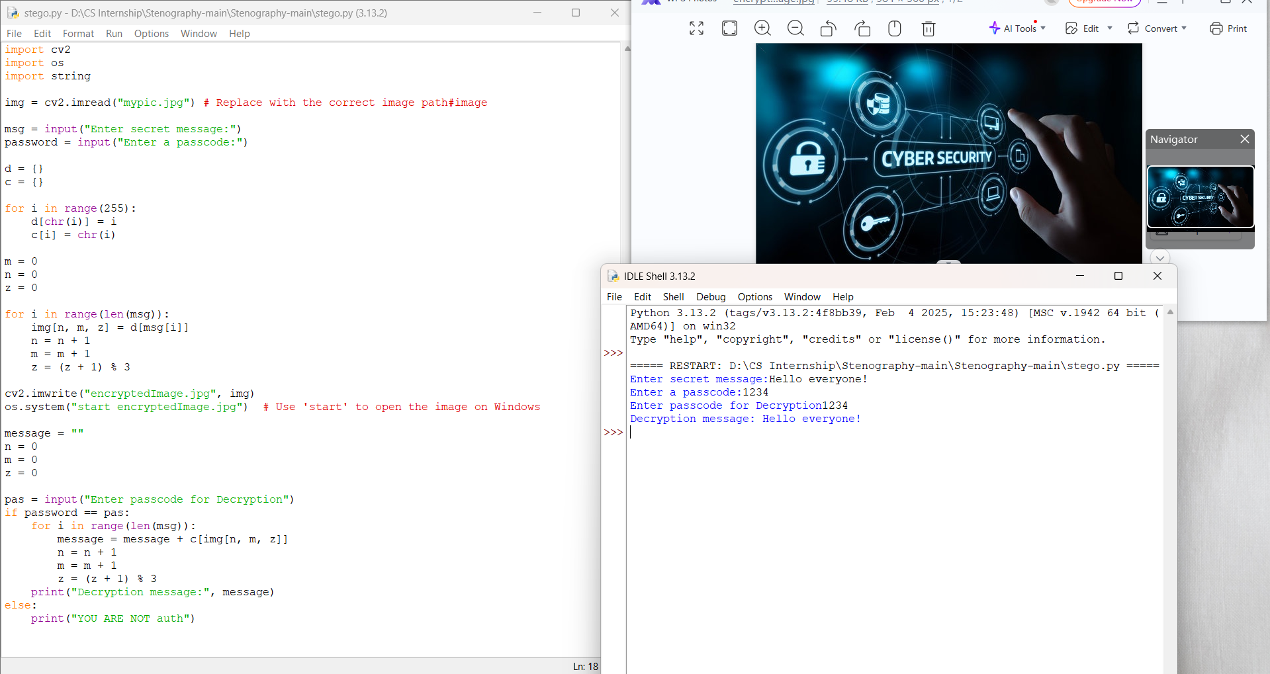
Results

Slide 8
Conclusion
This project effectively addresses the limitations of traditional encryption methods, which often attract attention and make sensitive data vulnerable to attacks.
By utilizing image steganography, it enables secure and covert data transmission without altering the visual integrity of the image.
The proposed technique enhances data hiding capacity while maintaining image quality and resisting detection through steganalysis.
With its applications in cybersecurity, law enforcement, and secure communication, this project provides a practical and efficient solution for safeguarding sensitive information in the digital age.

Slide 9
GitHub Link
https://github.com/salmashaik45/Steganography-Project.git

Slide 10
Future scope(optional)
Enhanced Security with Encryption:
Integrating strong encryption algorithms (AES, RSA) before embedding to ensure multi-layered security.
Resistance Against Steganalysis :
Developing techniques to make hidden data undetectable by AI-driven and modern steganalysis tools.
Audio & Video Steganography:
Expanding the project to hide data within audio and video files for broader applications in secure communication.
Real-Time Steganography Applications:
Implementing the technique in secure messaging, digital watermarking, and authentication systems for real-world use.

Slide 11
THANK YOU

