Slide 1

Diabetes Readmission Prediction
Sheik Basha
1760B37

Slide 2
Introduction
Readmission Rate
A hospitalization that occurs within 30 days after a discharge.
Why Is Readmission Important ?
Reduce cost of care and medical disputes.
Improve patients’ safety and health.

Slide 3
Methodology/ Process
Problem Statement
Business Outlook
Data Pre-mining
Data Processing
Perform Analysis
Model Building
Evaluation
Accuracy comparison
Variable Selection
Conclusion

Slide 4
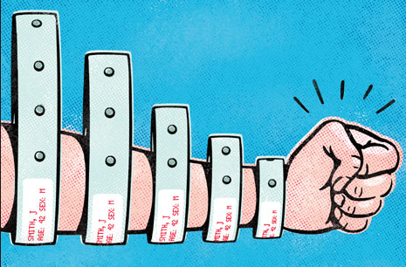
Problem Statement
Identify the major factors that contribute to hospital readmissions.
Goal : To make effective prediction on readmissions which will enable hospitals to identify and target patients at the higher risk.

Slide 5
Data Pre-mining
Data Pre-processing
Feature Engineering
Variable Extraction

Slide 6
Data Pre-processing
Dataset was given with 34650 records and 45 variables out of which one is target variable.
Categorize Diagnosis into 18 groups.
Re-categorize Age group.
Drop variables which has more than 50% of null
Values.

Slide 7

Feature Engineering
A new Feature have been extracted based on the existing variables.
Days _Spent : No. of days spent in hospital

Slide 8

Variable Extraction
By using the chisq test between
the various extracted variables and
the target variables, could able to
find the most useful variables.
Remove irrelevant variables (EX: patient ID)

Slide 9
Data Insights

Slide 10
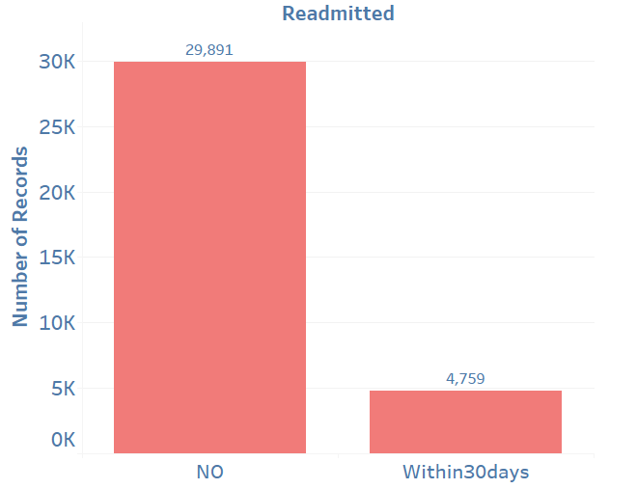
Target Variable Data Distribution
Smote has been used to oversample the minority
class data.

Slide 11

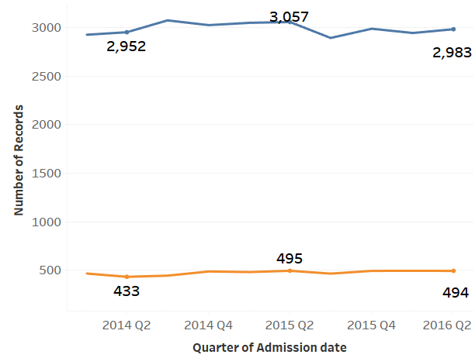
No. of Patient Records Trend

Slide 12
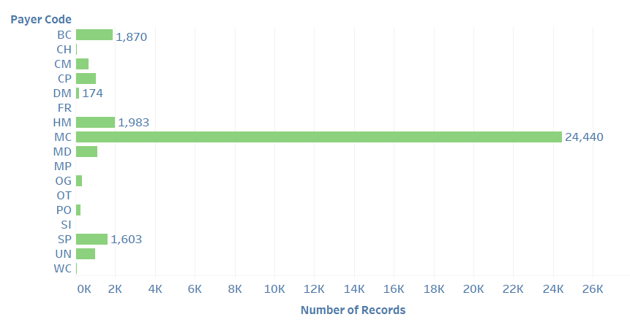
No. of Records Significantly varying with Payer

Slide 13

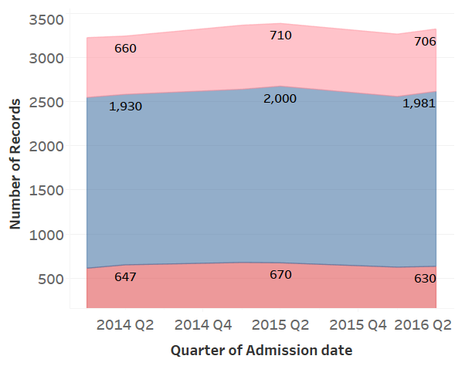
Admission Type Trend
Admission Type

Slide 14
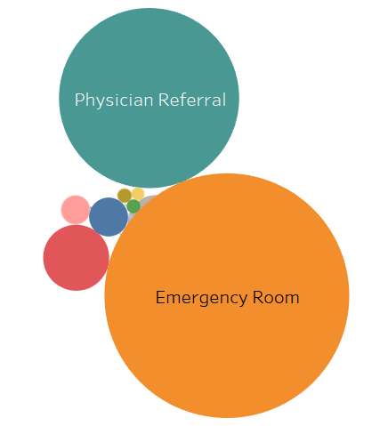
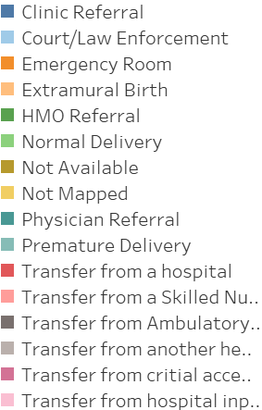
Admission Sources

Slide 15
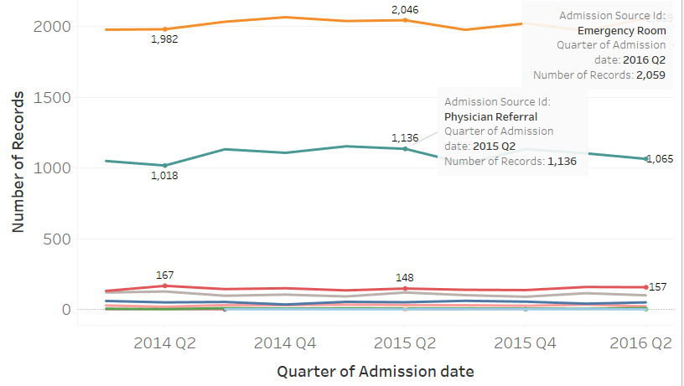
Admission Source Trend
Admission Source

Slide 16

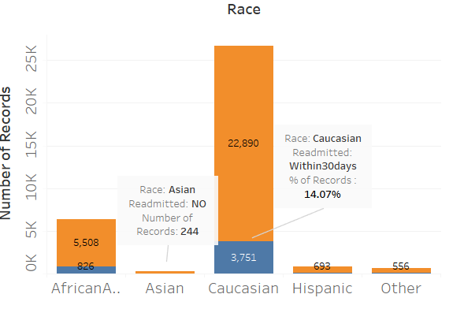
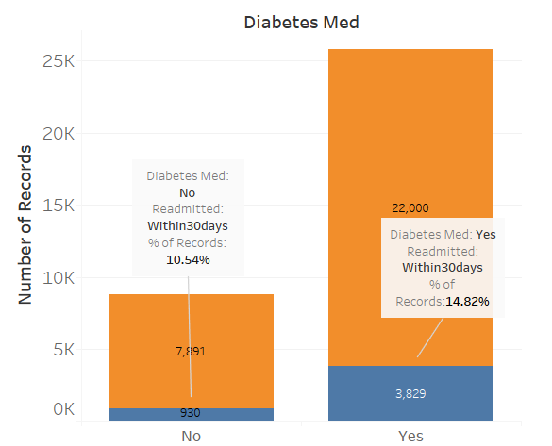
No. of Patients readmitted Vs Race
No. of Patients readmitted who were on Diabetes Medicine

Slide 17

Model Building

Slide 18
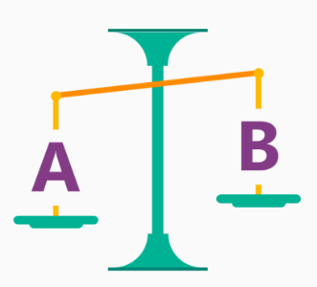
Model Building Methods
Classification
Decision Tree
Bagged CART
Logistic Regression

Slide 19


Decision Trees
Easy to interpret.
Useful in Data exploration.
Less data cleaning required.
Model Performance:

Slide 20
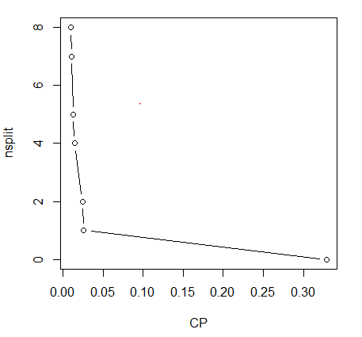
Decision Tree..
Variables actually used in tree construction:
A1Cresult
discharge_disposition_id
max_glu_serum
num_diagnoses
num_lab_procedures
race

Slide 21


Bagged CART
Reduce the variance of our predictions.
There are various implementations of bagging models Random forest is one of them.
Model Performance using “treebag” :

Slide 22
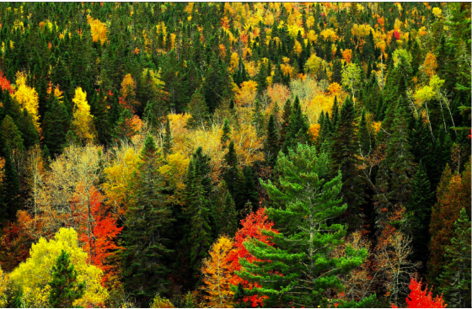
Random Forest
Handle large data set with higher dimensionality.
Identify most significant variables i.e. the model outputs
Importance of variable.
The sub-trees are learned so that the resulting predictions from all of the subtrees have less correlation.

Slide 23
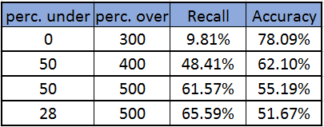
Random Forest ..
By considering more than one decision tree and then doing a majority voting, random forests helped in being more robust predictive representations than trees.
Model Performance :

Slide 24
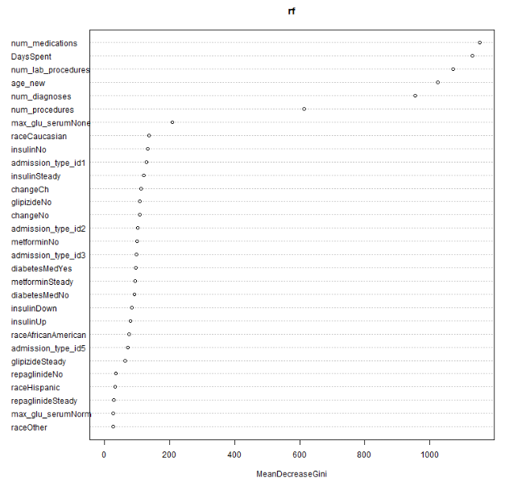
Important Variable Plot

Slide 25
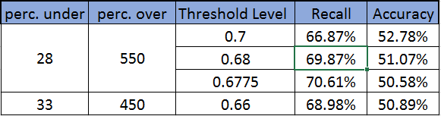
Logistic Regression
Have probability for reference.
The threshold value determines whether the probability value should be assigned to True or False.
Model Performance :

Slide 26
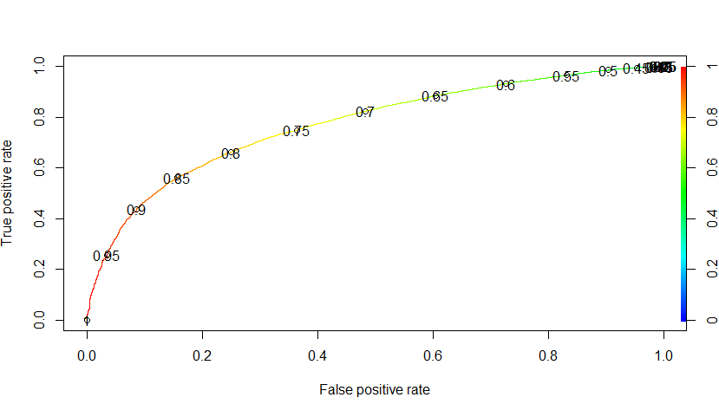
ROC Curve
AUC = 77.12%

Slide 27
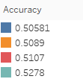
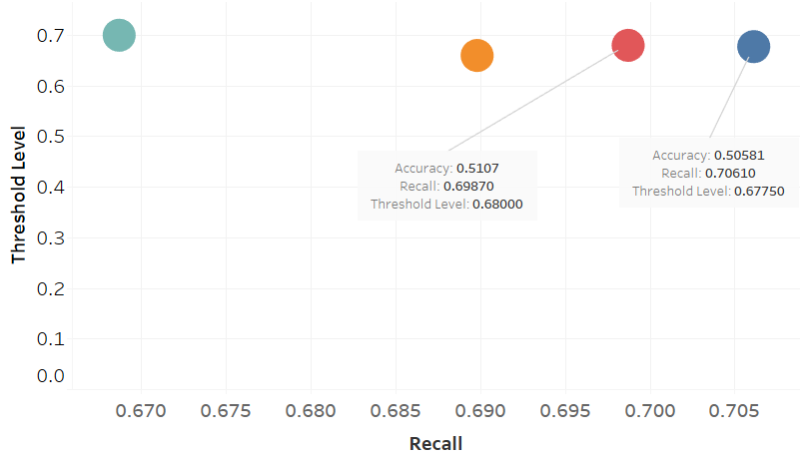
Threshold Level Vs Recall & Accuracy

Slide 28
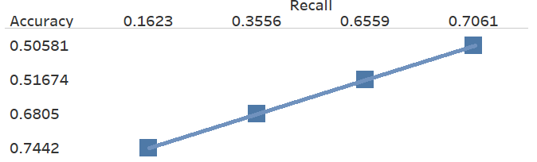

Model Performance

Slide 29
Conclusion
The readmission groups are related to admission source, admission type, discharge disposition and number of inpatient visits.
Instead of tracking all attributes, hospitals are suggested to focus on number of patient’s inpatient visits, admission source, admission type, discharge disposition.
Hospitals are advised to concern not only inpatient treatment but also continuing care after discharge.

Slide 30


