Slide 1
Project – Bazinga!
Detecting Sarcasm one tweet at a time
Team –
Vinodh Krishnan
Vivek Nabhi

Slide 2
Introduction
Sarcasm in NLP
Product Review Summarization
Brand monitoring
Dialogue systems
Sentiment analysis.
Why is it a challenge ?
Primarily a verbal function.
Non trivial to humans.

Slide 3
Baseline Method
Basic Idea: Sarcasm as Contrast between a Positive Sentiment and Negative Situation – Riloff et al. (2013)
Method
Bootstrapping
SVM Classifier
Baseline Results
Precision - 0.62
Recall – 0.44
F-measure – 0.51

Slide 4
What we did
Implemented the baseline method and achieved similar accuracies.
SVM Classifier –
Punctuation Features
Syntax Features(Sentence Length, Stop Words, @Mentions)
10 fold Cross Validation for RBF Kernel hyper parameters
Bootstrapping Improvements –
Lemmatization
Emphasis on Trigrams and custom rules for trigrams
Higher n-grams in case of predicative sentences
World Knowledge (new implementation)

Slide 5
Flowchart
Get data from Twitter
Bootstrapping
SVM
World Knowledge
Get negative ngrams after positive seed word
Extract unigrams bigrams
Get ngrams immediately after positive words from the test set
Extract Syntactic, Punctuation and Twitter based features
Score it and take top 20 ngrams
Pass to Google Search api and obtain the top 5 blog post results
Extract positive words that occur immediately before the negative ngrams
Bootstrap until
no change
Pass features to SVM classifier
Run Sentiment analysis on them and return the average sentiment
Extract positive predicate phrases using copular verbs and negative ngrams
If negative, classify the tweet as sarcastic

Slide 6
Our Data
Training data pulled from twitter using their API’s –
Positive Instances – Tweets with #sarcasm or #sarcastic tags (3920)
Negative Instances – All the other tweets (19933)
Filtered based on language and Retweets
Test Data –
Gold Standard data obtained from Prof. Ellen Riloff
1727 negative and 505 positive tweets annotated by 3 experts
IAA values around 0.80

Slide 7
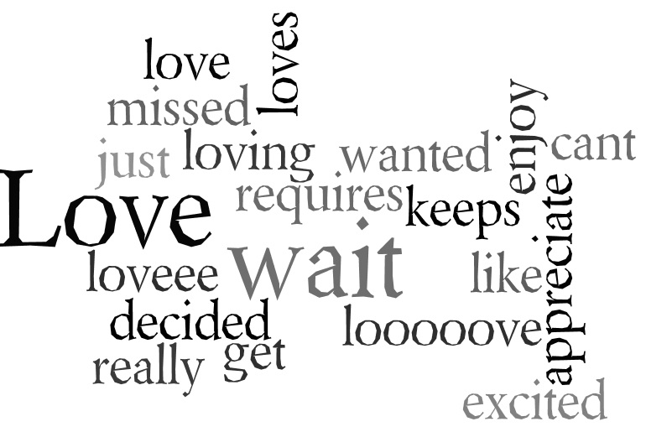
Experiments
Positive Word Wordle –

Slide 8
Bootstrapping Experiments
Precision Values

Slide 9
SVM Experiments
Type of Features | Recall | Precision | F Measure
Baseline(Riloff et al) | 0.39 | 0.64 | 0.48
Unigrams + Bigrams + Cross validated | 0.39 | 0.59 | 0.47
+Syntactic +Punctuation | 0.42 | 0.58 | 0.49
+Sentence Length | 0.52 | 0.58 | 0.55

Slide 10
Final Results
Method | Recall | Precision | F Measure
Hybrid (Riloff et al.) | 0.44 | 0.62 | 0.51
Hybrid (Our Implementation) | 0.57 | 0.57 | 0.57
+ World Knowledge | 0.56 | 0.57 | 0.56

Slide 11
Results Analysis
Lemmatization and trigram improve recall for bootstrapping
Sentence Length is the best feature for SVM classifier
World Knowledge does not improve the existing classifiers.
This may be because:
Small size of data sample
Filtering of extracted phrases may be required

Slide 12


Evaluation Metric
Implement Baseline Method (Riloff et al.)
Achieve > 44% recall on the Test set provided
Achieve > 62% precision on the Test set provided
Achieve > 51% F measure on the Test set provided

