Slide 1
Smart Legal Assistant: AI Powered Legal Documentation Assistant
PIP2001 Capstone Project
Review-1
Batch Number:
Under the Supervision of,
Prof. Ankita Bhaumik
School of Computer Science and Engineering
Presidency University
Roll Number | Student Name
20221LSD0007 | Salmondavid F Potagoli
20211CSD0128 | Guddattu Ravith Kumar
20211CSD0046 | Abhishek Shivlal Rathod
Name of the Program:Computer Science Of Engineering (Data Science)
Name of the HoD: Dr. Saira Bhanu Atham
Name of the Program Project Coordinator: Dr. Manjula H M
Name of the School Project Coordinators: Dr. Sampath A K /Mr. Md Ziaur Rahman

Slide 2
Introduction
Smart Legal Assistant is an innovative legal technology solution built using modern software architecture, designed to streamline legal workflows for legal professionals. It leverages cutting-edge AI to enhance legal document analysis, optimizing information extraction and comprehension. The platform uses intelligent algorithms to analyze legal documents and tasks, ensuring that key clauses, concepts, and insights align with users' needs. By integrating AI-driven document analysis, Smart Legal Assistant improves the efficiency and accuracy of legal work, making legal processes faster, smarter, and more effective for all parties involved.

Slide 3
Literature Review
The increasing demand for efficient legal workflows has led to significant advancements in legal technology solutions. Traditional methods of legal document analysis have evolved, incorporating artificial intelligence (AI) and machine learning techniques to improve the understanding and processing of legal information. This review examines the relevant literature that forms the foundation for the development of Smart Legal Assistant, a legal technology solution that combines modern software architecture with AI-driven legal document analysis.

Slide 4
Literature Review Cont’d
Evolution of Legal Document Analysis and Legal Technology
AI and Machine Learning in Legal Text Processing
AI for Legal Document Analysis and Information Extraction
Modern Software Architecture and Web Development for Legal Applications
Impact of AI-Driven Legal Document Analysis on Legal Workflows

Slide 5
Existing method Drawback
Time-Consuming Manual Legal Document Review
Lack of Comprehensive Understanding in Legal Text Analysis
Inefficient Information Extraction from Legal Documents
Manual Effort Required for Legal Document Summarization and Analysis
Potential for Inconsistency and Subjectivity in Legal Analysis
Slow and Inefficient Legal Workflows

Slide 6
Proposed Method
AI-Driven Contextual Legal Document Analysis
Personalized Legal Information Retrieval Using Machine Learning
Advanced Legal Document Parsing with AI
AI-Powered Legal Text Analysis and Summarization Tools for Legal Professionals
Bias Mitigation Using AI in Legal Document Review (e.g., ensuring objective analysis)
Automated and Streamlined Legal Workflows
Scalable and Responsive Modern Software Architecture
Real-Time Analytics and Reporting on Document Processing and Insights

Slide 7
Objectives
Enhance Accuracy in Legal Document Analysis and Information Extraction
Streamline Legal Workflows
Provide Personalized Legal Information Retrieval and Task Assistance
Optimize Legal Documents for AI-Driven Analysis and Processing
Support Scalability and High Performance for Legal Data Handling
Improve User Experience and Engagement with Legal Technology
Reduce Time and Costs Associated with Legal Document Analysis and Tasks

Slide 8
Methodology/Modules
The development of Smart Legal Assistant follows a structured methodology that integrates cutting-edge technologies like AI and machine learning, built upon a modern software architecture. The platform is designed to address key limitations of traditional legal workflows and enhance the efficiency and accuracy of legal tasks for legal professionals

Slide 9
Methodology/Modules
Requirement Analysis and Problem Definition in Legal Workflows
System Architecture Design (Modern Software Architecture)
AI and Machine Learning Integration for Legal Text Processing
Development of AI-Powered Legal Document Analysis and Summarization Tools
Automation of Legal Workflows and Tasks
User Interface and Experience (UI/UX) Development for Legal Professionals
Testing and Quality Assurance for Legal Technology
Deployment and Continuous Improvement of the Smart Legal Assistant

Slide 10
Software Used
The Smart Legal Assistant platform is designed using a modern software architecture to ensure scalability, high performance, and efficient handling of legal data. This architecture integrates AI components for legal document parsing, information extraction, summarization, and task automation.
Frontend Layer: User Interface Technology Used: [Specify your frontend technology, e.g., React.js, if applicable]
Backend Layer: Application Logic and API Technology Used: [Specify your backend technology, e.g., Python (Flask/Django), Node.js (Express.js), etc.]

Slide 11
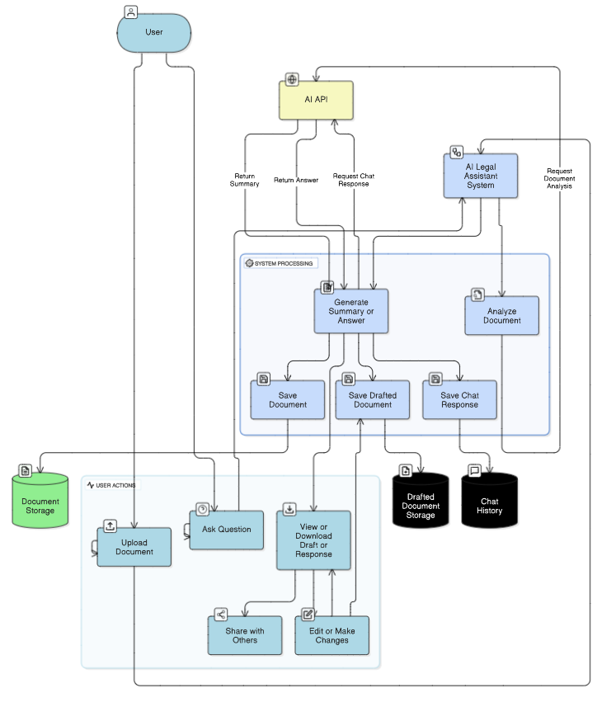
Architecture

Slide 12
Timeline of Project
Task | Week 1 | Week 2 | Week 3 | Week 4 | Week 5 | Week 6 | Week 7
Planning and Strategy Development | ✓ | ✓
Software Architecture and Design |  |  | ✓
Backend Development |  |  | ✓ | ✗
Frontend Development |  |  |  | ✗
Testing and Quality Assurance |  |  |  |  | ✗
User Acceptance Testing |  |  |  |  | ✗
Continuous Improvement |  |  |  |  |  | ✗ | ✗

Slide 13
Expected Outcomes
Enhanced Accuracy in Legal Document Analysis and Information Extraction
Improved Efficiency in Legal Workflows and Task Completion
Streamlined Legal Document Review and Processing for Legal Professionals
Reduced Inconsistencies and Subjectivity in Legal Analysis
Increased Legal Professional Engagement and Satisfaction with Technology
Higher Efficiency Rates for Legal Document Processing and Task Automation
Reduced Time Spent on Manual Legal Tasks

Slide 14
Conclusion
The Smart Legal Assistant, powered by modern software architecture and AI-driven legal document analysis, represents a transformative solution for modern legal workflow challenges. By integrating AI into legal processes, the platform not only enhances the accuracy and efficiency of legal document analysis but also empowers legal professionals with tools to better understand and process complex legal information. This benefits legal professionals, who can streamline their tasks and gain deeper insights, and the legal system overall, which can become more efficient and accessible. In conclusion, Smart Legal Assistant creates a win-win scenario in the legal space by leveraging cutting-edge technology to streamline legal workflows, reduce inconsistencies, and improve the quality of legal analysis, ultimately leading to more successful and efficient legal outcomes.

Slide 15
Github Link
https://github.com/salmondavidp/8_CSD_23

Slide 16
References
P. Jain et al., “Automating Legal Document Analysis for Indian Judiciary,” Indian Journal of AI and Law, vol. 5, no. 1, pp. 23-47, 2021. (India-specific AI challenges)
A. Gupta and R. Patel, “NLP for Indian Legal Texts: A Survey,” in Proc. ICAILLI*, New Delhi, 2022, pp. 112-125. (Indian legal NLP)
N. Singh and P. Chatterjee, “Legal-IND: A Pre-trained Model for Indian Legal Documents,” arXiv:2205.12345, 2022. (India-focused BERT)
M. Henderson et al., “Efficient Legal Document Summarization with Transformers,” Artificial Intelligence and Law, vol. 30, no. 3, pp. 387–412, 2022. (Summarization techniques)
L. Chalkidis et al., “LEGAL-BERT: The Muppets Straight Out of Law School,” in Proc. EMNLP, 2020, pp. 2898–2904. (Pre-trained legal NLP models)
K. Reddy and M. Sharma, “Automated Contract Generation for Indian Businesses,” in Proc. Computational Law, Singapore, 2021, pp. 56-67. (Drafting tools for India)
Supreme Court of India, “E-Committee Report on AI in Judiciary,” 2022. (Policy framework)

Slide 17
Thank You

