Slide 1

VIRTUAL ASSISTANT(“JARVIS”) USING PYTHON
:SUBMITTED BY:
Asma.Z.Hangal 333cs17001
Sahil.J.Myageri 333cs17019
Nausheen.M.Kanavi 333cs18016
Sakshi.P.Balabadri 333cs18019

Slide 2
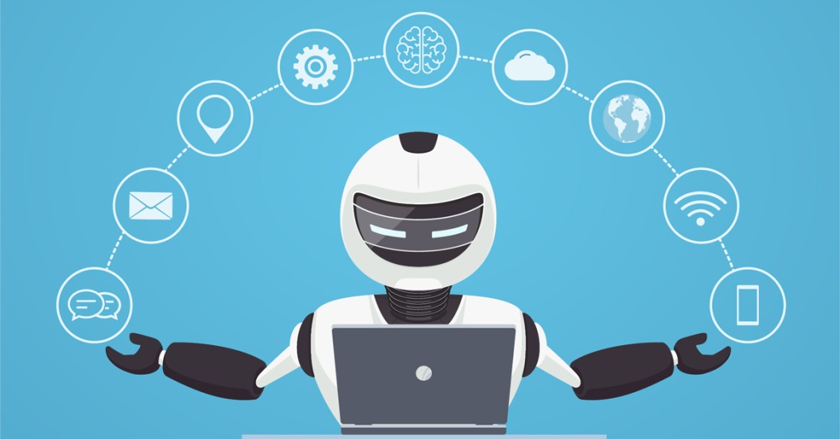
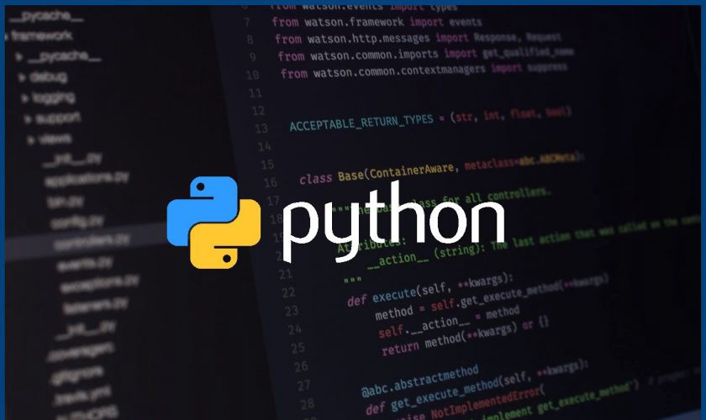
CONTENT :
Introduction.
Overview.
Features.
How it works?
Advantages.
Disadvantages.
Future Of Bluetooth.
Conclusion.

Slide 3
INTRODUCTION:-
This Software aims at developing a personal assistant for python-based systems.
The main purpose of the software is to perform the tasks of the user at certain commands, provided in either of the ways, speech or text.
It will ease most of the work of the user as a complete task can be done on a single command.
Jarvis draws its inspiration from Virtual assistants like Cortana for Windows ,Siri for iOS and Google Assistant for Android. Users can interact with the assistant through voice commands.

Slide 4
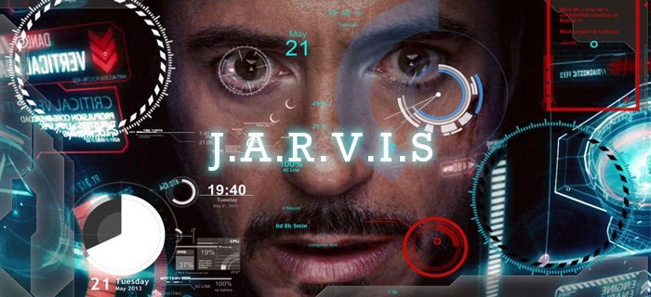
What is JARVIS?
It is commonly reimagined as “Just a rather very intelligent system”, (J.A.R.V.I.S.). Currently, the project aims to provide the Windows Users with a Virtual Assistant that would not only aid in their daily routine tasks like searching the web, extracting weather data, vocabulary help and many others but also help in automation of various activities.

Slide 5
Features:-
The implemented voice assistant can perform the following task it can:-
Open YouTube, Gmail, Google chrome.
Predict current time, take a photo, search Wikipedia to abstract required data.
Conversing(i.e.conversation) with user.
Capturing Photo.
Answering complex questions.
Solving Math's equations.
Meanings of Words.
Predict weather in different cities, get top headline news from Times of India and can answer computational and geographical questions too.

Slide 6
How it works?
As we know Python is a suitable language for script writers and developers. The query for the assistant can be manipulated as per the user’s need. Speech Recognition is the process of converting audio into text .This is commonly used in voice assistants like Alexa,Siri,etc. Python provides an API called Speech Recognition to allow us to convert audio into text for further processing.

Slide 7
PACKAGES REQUIRED:
speech recognition: Converts the speech to text.
pyttsx3: It’s a text to speech conversion library in python.
wikipedia: This package in python extracts data’s required from Wikipedia.
ecapture: This module is used to capture images from your camera.
datetime : This is an inbuilt module in python and it works on date and time.
time: The time module helps us to display time.
web browser : This is an in-built package in python. It extracts data from the web.
subprocess: This is a standard library use to process various system commands like to log off or to restart your PC.
json: The json module is used for storing and exchanging data.
request: The request module is used to send all types of HTTP request. Its accepts URL as parameters and gives access to the given URL’S.
wolfram alpha: Wolfram Alpha is an API which can compute expert-level answers using Wolfram’s algorithms, knowledge base and AI technology.

Slide 8

ADVANTAGES:
Easy to use .
Can work with variety of commands.
Custom commands.
Helpful for disabled i.e. accessibility Option for Visually impaired.
Artificial intelligent.

Slide 9
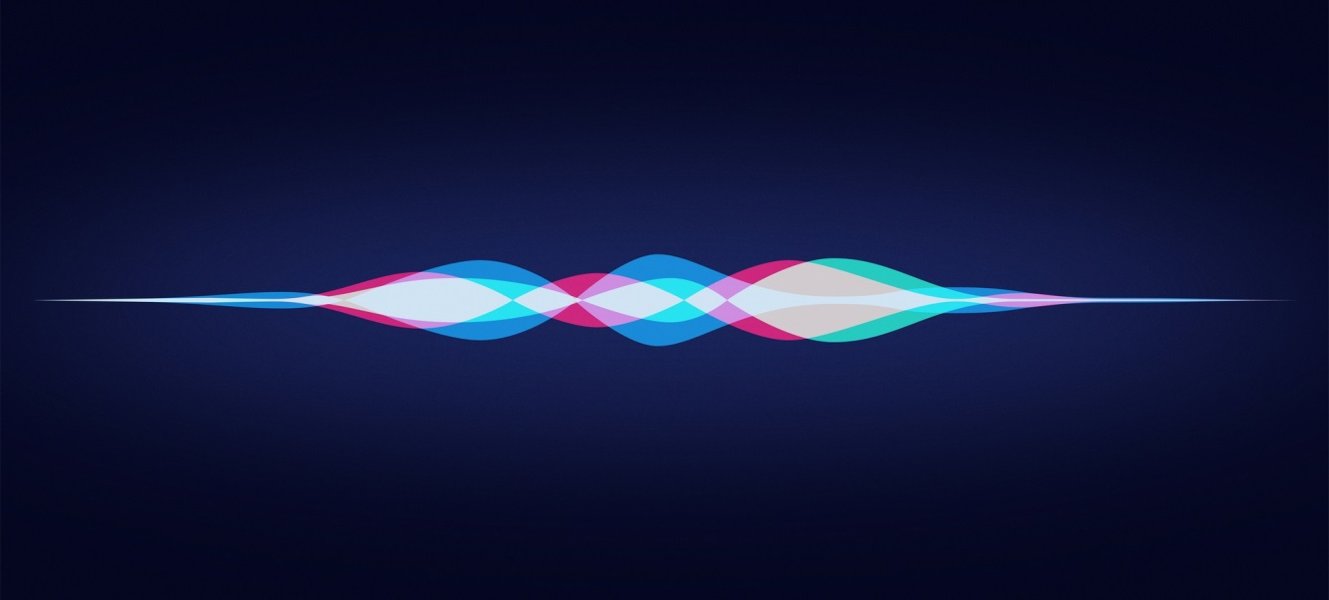
DISADVANTAGES:
Free of charge .
Easy to use .
It may not work in Noisy Environment.
Limited Language support.
Voice recognition isn’t perfect. That sometimes you should repeat the sentence/tasks.
It is an weak AI that it can only execute and perform quest designed by the user.

Slide 10
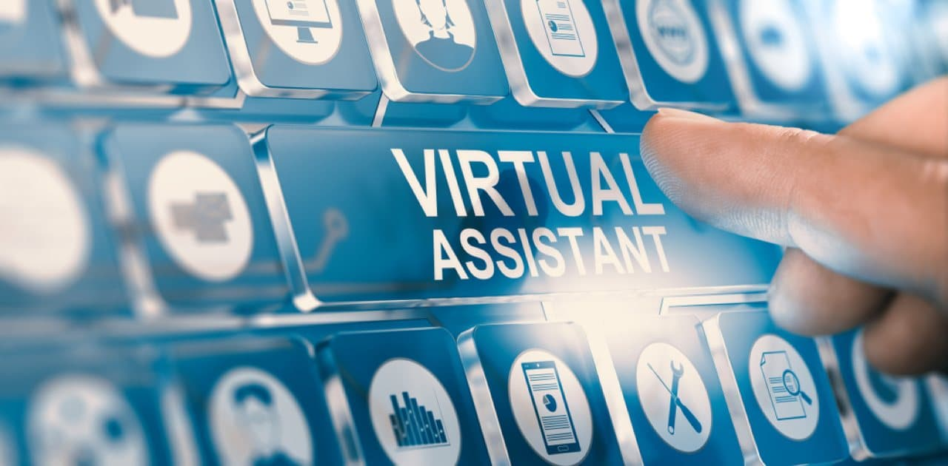
Conclusion!
Jarvis is a digital and virtual assistant with artificial intelligence.
It is very flexible and useful technology.
It provides a better interface to deal with it.
It eases most of the tasks of the user like searching the Web, Retrieving Weather Forecast details, Vocabulary help.

Slide 11
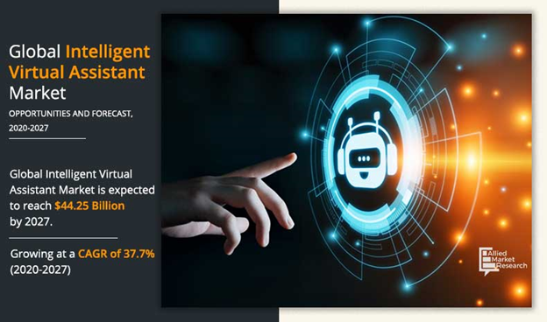
REFERENCES:
https://www.geeksforgeeks.org/.
https://www.analyticsvidhya.com/blog/
https://www.skyfilabs.com/project-ideas/jarvis-personal-assistant-using-python
https://codewithharry.com/videos/python-tutorials-for-absolute-beginners-120
https://github.com/nihal111/J.A.R.V.I.S
www.google.com
https://en.wikipedia.org/wiki/Wikipedia

Slide 12
THE END

