Slide 1

Caching long lasting queries
Laszlo Forro @ thinkproject.com

Slide 2
Serve It Fresh and if we are not Fast fast enough – Cache It
Rules of caching on the back end:
Do not cache
Cache is last resort, so try not to cache
Before caching consider if there is better data model or architecture

Slide 3
Side note
User
Application
Some DB
E(universe)
Those applications
Our DB
- the database and the user are separated
- the entities are how the application developers imagine it
- cognitive gap
Gavin Powell: Beginning Database Design, Wiley, 2006,
Ch.2.: Database Modelling in the Workspace

Slide 4
Serve It Fresh and Fast
It: what is the use pattern of the data we need to serve?
- Can we say that the most recently used?
- Can we say that the most frequently used?
- Or neither of those above?

Slide 5
Serve It Fresh and Fast
It : what is the identity of the data we serve regarding the data source?
- Can be identified simply
- Or a product of function like any aggregate (sum, count, aggregate average ), max, min
- Or can’t be identified, eg. a result of a DISTINCT

Slide 6
Serve It Fresh and Fast
Fresh : what is the allowed difference of the data we serve and the data source?
- Do we have to serve the latest and greatest for everyone
- Or we can let the user trigger an action for himself?
- What latency can we permit?

Slide 7
Serve It Fresh and Fast
Fast : which system component is identified as ‘slow’?
- Where should the optimization take place?
- Can a change in the architecture/data model result in better optimization ?
- What is the implication of Cache Invalidation requirements ?
(change ratio, cache complexity)

Slide 8
Serve It From Cache
Persistence (I/O)
OS
File system
Caching in shared_buffer
Clock-sweep using access counter
to release memory
Managing inserts and updates
Low level on blocks / tuples
Most Frequently Used/
Most Recently Used
It is about all access to the database,
not only that we consider user relevant.
shared_buffer
Process
If we need cache, it is already not sufficient...
See the excellent chapter on PostgreSQL buffer management.
See also PostgreSQL memory components @severalnines: Architecture and Tuning of Memory in PostgreSQL Databases
See also the Cache replacement policies page on the Wikipedia.

Slide 9

Serve It From Cache
Incremental View Maintenance
A materialized views represent a result set of a query.
On change try to add only the change instead of replaying the query.
Assumption:
- the change can be propagated, because there are entities that can be identified as changed
- the change propagation is cheaper than replaying the query
- factors: change ratio, algorithmic efficiency of view delegation

Slide 10
Serve It From Cache
Incremental View Maintenance
A very simple example:
1. Let’s say a view is V = A «θ B
2. Change in A means a V diff table: Vδ = Aδ «θ B
3. Add the changes of Vδ to V using some Update Propagation Query

Slide 11
Serve It From Cache
Incremental View Maintenance
UPQ for INSERT can be V ∪ Vδ or V – Vδ on DELETE,
(V – Vδ) ∪ Vδ on UPDATE generally speaking.

Slide 12
Serve It From Cache
IVM – Self Maintainable View
id
- there is a relation in the View and Update/Delete definition
that makes possible to Update/Delete the View without replaying
the whole query
- Inserts must be still evaluated

Slide 13
Serve It From Cache
IVM – Self Maintainable View
The very simple example
V = A «θ B → Vδ = Aδ «θ B → Update V with Vδ
would look like
1. V = A «a.id = b.aid B
2. Then when updating Aa1..aN , V can also be updated on the same ID references
id
Eg.: Katsis et al. : Utilizing IDs to AccelerateIncremental View Maintenance

Slide 14
Serve It From Cache
IVM – Self Maintainable View
A possible algorithm for PostgreSQL:
- on change of an entity in table A check
1. if there is a dependent MV view on A and if yes,
2. check if that view has a column corresponding to A.id
- make an UPDATE … RETURNING A.id on A
- UPDATE the view with the NEW values by A.id
- might still need to parse a good amount of SQL
- eg. A.id = B.aid (foreign key)
- SELECT A.id as foo
Etc.
id

Slide 15
Serve It From Cache
IVM – Self Maintainable View
Yugo Nagata: Incremental View Maintenance,
presented at 2018 PgConf EU, Lissabon.
Implemented as an experimental PostgreSQL fork.
oid
- The problem to identify entities is solved by using the OIDs
- Use a mapping table between the OIDs of the source table tuples and the View tuples for each tuple

Slide 16
Serve It From Cache
Incremental View Maintenance
- for a generic solution we need to identify an Update Propagation Query
- it grows more and more complex as more and more tables are involved
- needs efficient algorithm for DISTINCT, aggregate
, min-max etc. functions
- how can it be efficiently implemented?
Database Query Optimization problem!
UPQ
For the generic theory and the query optimizations see the thesis of Dimitra Vista:
Optimizing Incremental View Maintenance Expressions in Relational Databases, Toronto, 1996.

Slide 17
Serve It From Cache
Incremental View Maintenance
The approaches above
- create a Deltas table:
that needs maintenance
- need some IDs to identify the changed entities:
that is not always available for the whole View Definition
- apply the changes via some automated method
- track parallel changes...
Leads to a complex query optimization problem.
Δ?

Slide 18
Serve It From Cache
A Logical Decoding Based Solution
- listener on logical decoding socket filtering the stream
- change distributor forwards the data to workers (domain filtering and semantics)
- the worker output is the cached data structure
Blagoj Atanasovski: Use Logical Decoding to build your own application cache, Presented at PgConf EU 2018, Lissabon

Slide 19
Serve It From Cache
A Logical Decoding Based Solution
Advantages:
- Consistency and invalidation is trivial
- No complex update query problem
- Application developer friendly
Blagoj Atanasovski: Use Logical Decoding to build your own application cache, Presented at PgConf EU 2018, Lissabon

Slide 20
Serve It From Cache
Our scenario:
- dynamically generated complex queries
- the identity of the entities depend on the query and not DB relatios
- the use case does not define hot data
- the only correlation is: the bigger a result set the more INSERTS
- no DELETE
- must be always Fresh
- max 1 sec user wait is ok.

Slide 21
Serve It From Cache
Incremental View Maintenance
A different angle: a change TS is always incremental.
Let A have an attribute, t, that acts as a ‘last_changed’ TS.
T0: Let’s say a view is V = A «θ B
Save T0 as metadata for the View update TS.
T1: Update A as usual, but the t = T1 for each element of Aδ
T1: Update V: V ← ( σ(t > T0)A) «θ B, using T0 from the View metadata table.
Save T1 as metadata for the View update TS.
Δt

Slide 22
Serve It From Cache
Incremental View Maintenance
To identify an entity to Update, a Unique key is needed on the V table.
INSERT – UPDATE implementation: UPSERT.
If there is a key violation, it means that the entity already exists in the V table,
so it needs UPDATE.
What the client must provide:
- some way to recognize the condition for TS check in the V query
- the Unique key for the V table
Δt

Slide 23
Serve It From Cache
query_cache : non self maintaining view with deferred update
What we have not solved / did not want to solve
/ avoided to solve / couldn’t solve / did not even think of to solve:
- a generic solution for the Update Propagation Query, instead
we let the Query Optimizer of the Database to do the job.
- heruistics: the user must provide the Unique key.
- DELETION: it must be implemented as a change.
- optimization for aggregates
- …
Δt

Slide 24
Serve It From Cache
query_cache : non self maintaining view with deferred update
T
TODOs:
- implement DELETE
- implement AGGREGATE, MIN/MAX, COUNT, AVG etc. cache
- rethink of the API
- some automatism (eg. if outer query has DISTINCT that can act as Unique key)
- possibly make it more generic

Slide 25
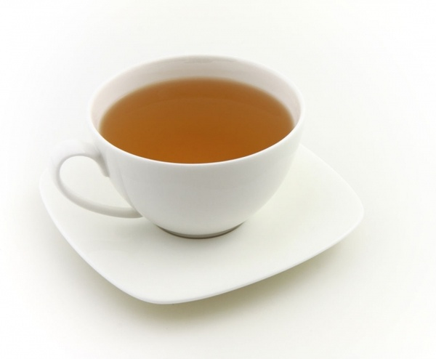
Thank you !
query_cache@thinkproject github

