Slide 1
Cs1231S tutorial #6
Functions
(AY2025/26 Semester 1)
Adapted from Prof Aaron Tan’s slides

Slide 2
Learning objectives of this tutorial
Functions
ranges of functions
equality of functions
composition of functions
surjectivity, injectivity and bijectivity
inverse functions
setwise images and setwise preimages

Slide 3



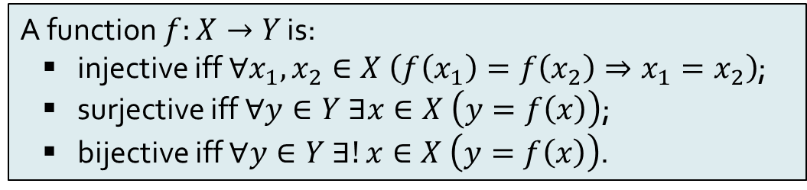








Recap: Definitions
A function$f:X→Y$ is:
injective iff $∀x_{1},x_{2}∈X \left(f\left(x_{1}\right)=f\left(x_{2}\right)⇒x_{1}=x_{2}\right)$;
surjective iff $∀y∈Y ∃x∈X \left(y=f\left(x\right)\right)$;
bijective iff $∀y∈Y ∃!x∈X \left(y=f\left(x\right)\right)$.
(Injective) Informally, every element in the codomain must have at most one arrow going into it.
(Surjective) Informally, every element in the codomain must have at least one arrow going into it.
(Bijective) Informally, every element in the codomain must have exactly one arrow going into it.
$$∧$$
$$≡$$
$$X$$
$$R_{4}$$
$$Y$$
$$X$$
$$R_{5}$$
$$Y$$
$$X$$
$$R_{6}$$
$$Y$$
Injective
Not injective
Injective
Not surjective
Surjective
Surjective
Bijective

Slide 4
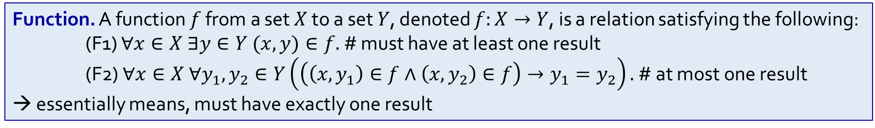
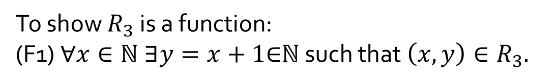

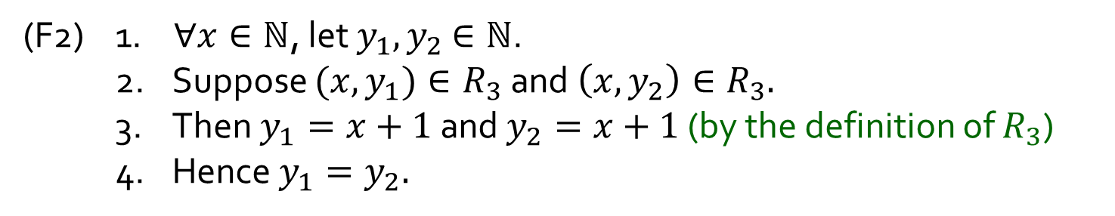
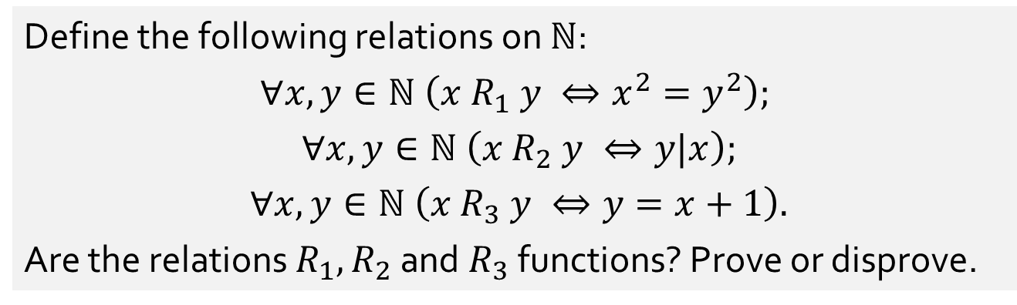
Q1.
Define the following relations on $ℕ$:
$$∀x,y∈ℕ \left(x R_{1} y ⇔x^{2}=y^{2}\right);$$
$∀x,y∈ℕ \left(x R_{2} y ⇔y|x\right);$
$∀x,y∈ℕ \left(x R_{3} y ⇔y=x+1\right).$
Are the relations $R_{1}{,R}_{2}$ and $R_{3}$ functions? Prove or disprove.
Yes
No
$$(6 R_{2} 2)∧(6 R_{2} 3)$$
Yes
To show $R_{3}$ is a function:
(F1) $∀x∈ℕ ∃y=x+1\text{∈}\text{ℕ}$ such that $\left(x,y\right)∈R_{3}.$
(F2) 1. $∀x∈ℕ$, let $y_{1},y_{2}$ $∈ℕ$.
2. Suppose $(x,y_{1})∈R_{3}$ and $\left(x,y_{2}\right)∈R_{3}.$
3. Then $y_{1}=x+1$ and $y_{2}=x+1$ (by the definition of $R_{3}$)
Hence $y_{1}=y_{2}.$
Function. A function $f$ from a set $X$ to a set $Y$, denoted $f:X→Y$, is a relation satisfying the following: (F1) $∀x∈X ∃y∈Y (x,y)∈f.$ # must have at least one result
(F2) $∀x∈X ∀y_{1},y_{2}∈Y\left(\left(\left(x,y_{1}\right)∈f∧\left(x,y_{2}\right)∈f\right)→y_{1}=y_{2}\right).$ # at most one result → essentially means, must have exactly one result

Slide 5

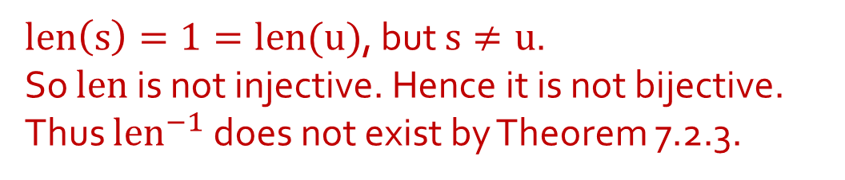

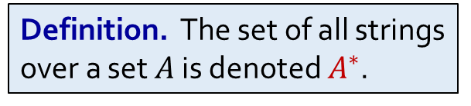
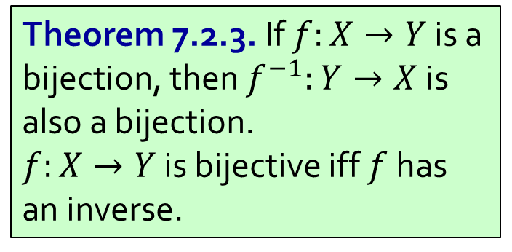
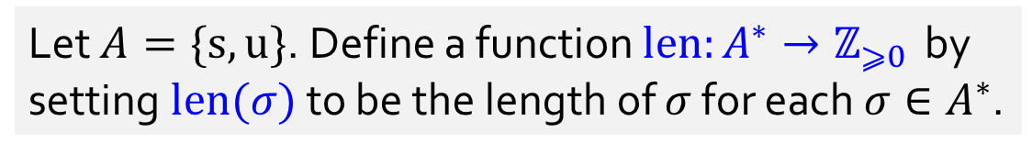
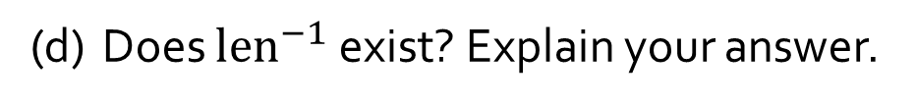


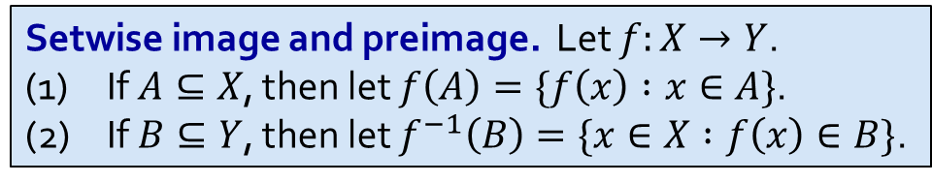
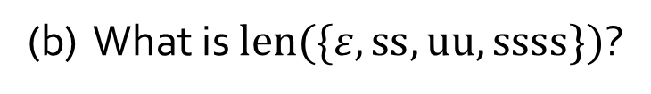

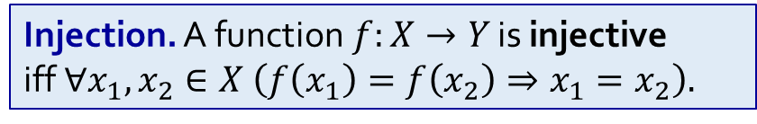
Q2.
Let $A=\{s,u\}$. Define a function $len:A^{∗}→ℤ_{⩾0 }$ by setting $len(σ)$ to be the length of $σ$ for each $σ∈A^{∗}$.
Definition. The set of all strings over a set $A$ is denoted $A^{∗}$.
$$3$$
(a) What is $len(suu)$?
(b) What is $len(\{ε,ss,uu,ssss\})$?
$$\{0,2,4\}$$
(c) What is ${len}^{−1}(\{3\})$?
$$\{sss,ssu,sus, uss,suu,usu,uus,uuu\}$$
(d) Does ${len}^{−1}$ exist? Explain your answer.
No.
$len\left(s\right)=1=len(u)$, but $s≠u$.
So $len$ is not injective. Hence it is not bijective.
Thus $len^{−1}$ does not exist by Theorem 7.2.3.
Theorem 7.2.3. If $f:X→Y$ is a bijection, then $f^{−1}:Y→X$ is also a bijection.
$f:X→Y$ is bijective iff $f$ has an inverse.
Setwise image and preimage. Let $f:X→Y$.
(1) If $A⊆X$, then let $f\left(A\right)=\{f\left(x\right) :x∈A\}$.
(2) If $B⊆Y$, then let $f^{−1}\left(B\right)=\{x∈X :f\left(x\right)∈B\}$.
Injection. A function$f:X→Y$ is injective
iff $∀x_{1},x_{2}∈X \left(f\left(x_{1}\right)=f\left(x_{2}\right)⇒x_{1}=x_{2}\right).$

Slide 6
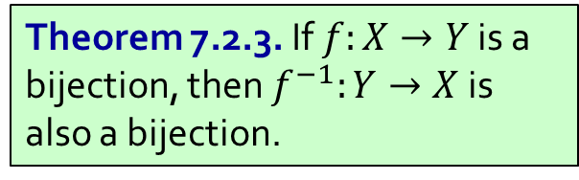
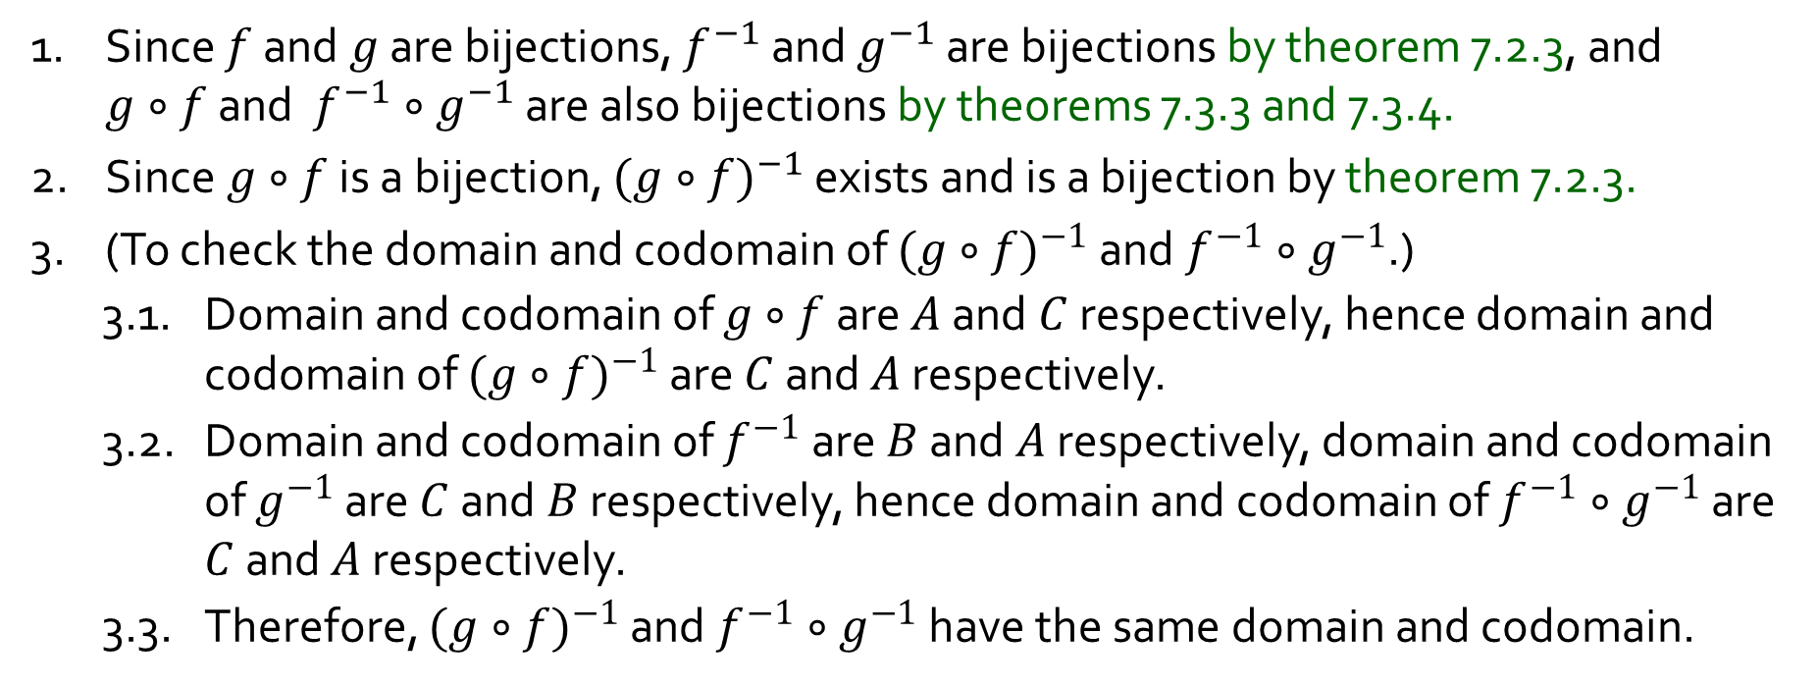
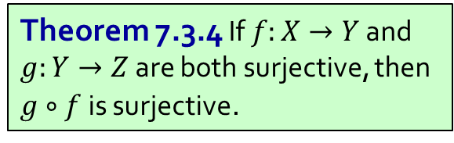
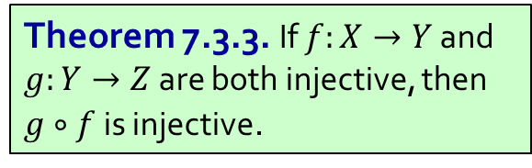
Q3.
Given any two bijections $f:A→B$ and $g:B→C$, prove ${(g∘f)}^{−1}=f^{−1}∘g^{−1}$.
1. Since $f$ and $g$ are bijections, $f^{−1}$ and $g^{−1}$ are bijections by theorem 7.2.3, and $g∘f$ and $f^{−1}∘g^{−1}$ are also bijections by theorems 7.3.3 and 7.3.4.
2. Since$g∘f$ is a bijection, ${(g∘f)}^{−1}$ exists and is a bijection by theorem 7.2.3.
(To check the domain and codomain of ${(g∘f)}^{−1}$ and $f^{−1}∘g^{−1}$.)
3.1. Domain and codomain of $g∘f$ are $A$ and $C$ respectively, hence domain and codomain of ${(g∘f)}^{−1}$ are $C$ and $A$ respectively.
3.2. Domain and codomain of $f^{−1}$ are $B$ and $A$ respectively, domain and codomain of $g^{−1}$ are $C$ and $B$ respectively, hence domain and codomain of $f^{−1}∘g^{−1}$ are $C$ and $A$ respectively.
3.3. Therefore, ${(g∘f)}^{−1}$ and $f^{−1}∘g^{−1}$ have the same domain and codomain.
Theorem 7.2.3. If $f:X→Y$ is a bijection, then $f^{−1}:Y→X$ is also a bijection.
Theorem 7.3.3. If $f:X→Y$ and $g:Y→Z$ are both injective, then $g∘f$ is injective.
Theorem 7.3.4 If $f:X→Y$ and $g:Y→Z$ are both surjective, then $g∘f$ is surjective.

Slide 7
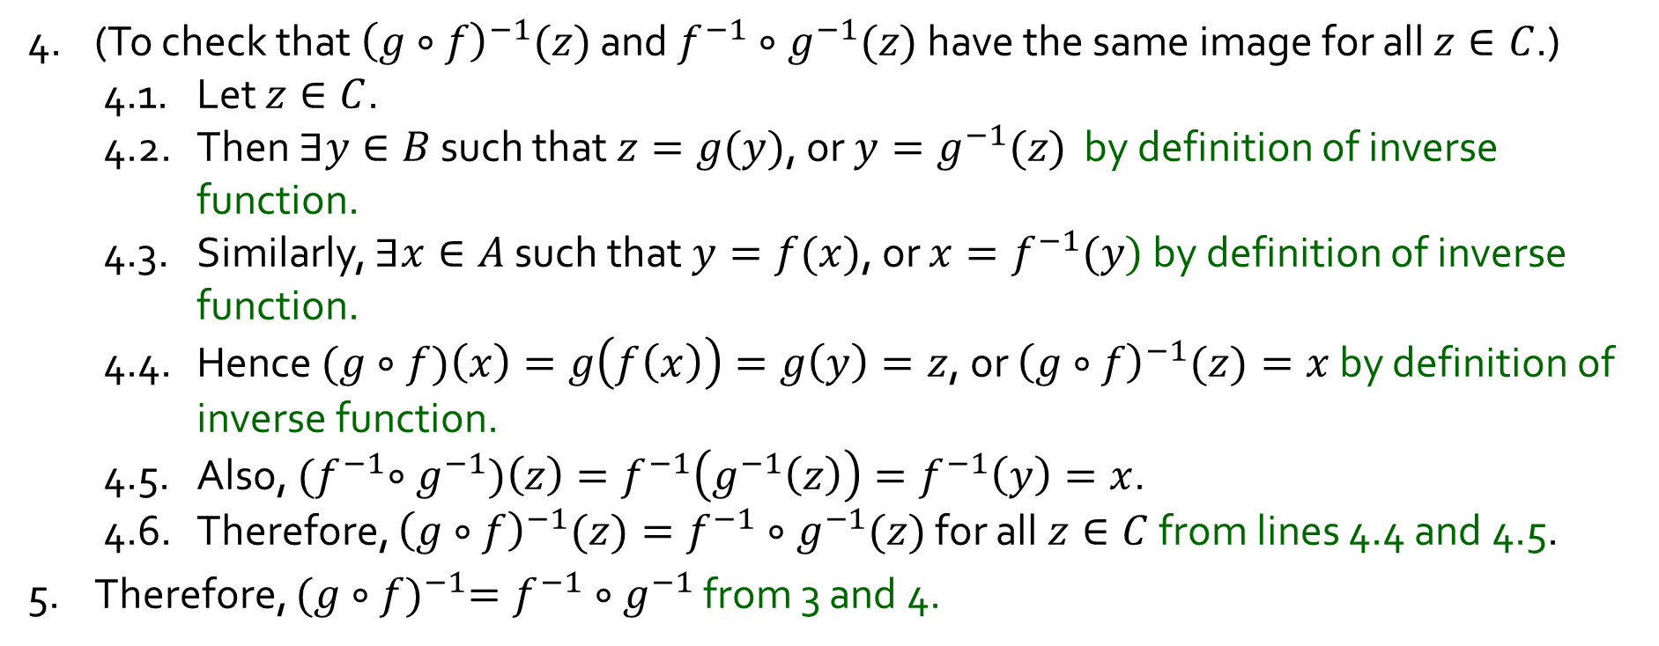


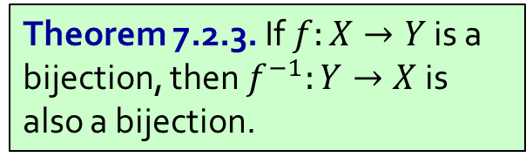
Q3.
Given any two bijections $f:A→B$ and $g:B→C$, prove ${(g∘f)}^{−1}=f^{−1}∘g^{−1}$.
4. (To check that ${\left(g∘f\right)}^{−1}(z)$ and $f^{−1}∘g^{−1}(z)$ have the same image for all $z∈C$.)
4.1. Let $z∈C$.
4.2. Then $∃y∈B$ such that $z=g(y)$, or $y=g^{−1}(z)$ by definition of inverse function.
4.3. Similarly, $∃x∈A$ such that $y=f(x)$, or $x=f^{−1}(y)$ by definition of inverse function.
4.4. Hence $(g∘f)\left(x\right)=g\left(f\left(x\right)\right)=g\left(y\right)=z$, or ${\left(g∘f\right)}^{−1}(z)=x$ by definition of inverse function.
4.5. Also, ${(f}^{−1}∘g^{−1})\left(z\right)=f^{−1}\left(g^{−1}\left(z\right)\right)=f^{−1}\left(y\right)=x$.
4.6. Therefore, ${\left(g∘f\right)}^{−1}(z)=f^{−1}∘g^{−1}(z)$ for all$z∈C$ from lines 4.4 and 4.5.
5. Therefore, ${(g∘f)}^{−1}=f^{−1}∘g^{−1}$ from 3 and 4.
Theorem 7.2.3. If $f:X→Y$ is a bijection, then $f^{−1}:Y→X$ is also a bijection.
Theorem 7.3.3. If $f:X→Y$ and $g:Y→Z$ are both injective, then $g∘f$ is injective.
Theorem 7.3.4 If $f:X→Y$ and $g:Y→Z$ are both surjective, then $g∘f$ is surjective.

Slide 8
Q3.
Given any two bijections $f:A→B$ and $g:B→C$, prove ${(g∘f)}^{−1}=f^{−1}∘g^{−1}$.
It is rare for you to need to write out proofs as lengthy as above.
(but not impossible)
However, the learning point here is, when proving function equality:
Ensure same domain & codomain
Let x be an element of domain in F1
Get results of F1(x) = y
Show that F2(x) = y also
Thus, F1 = F2.
Observe that we are being a bit more loose here.

Slide 9


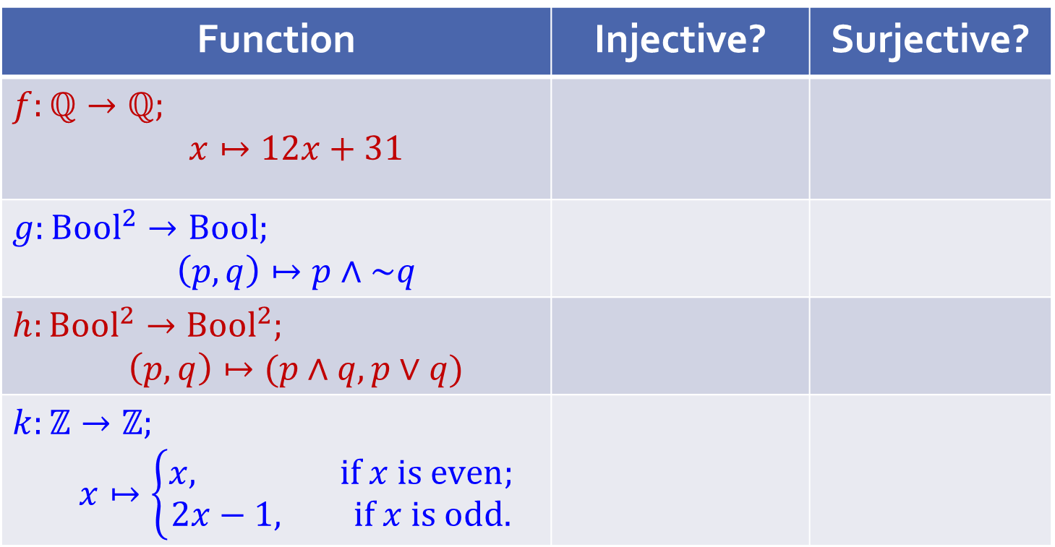
Q4.
Is the function injective? Surjective? Prove. If it is bijective, find the inverse function. Here denote by Bool the set {true; false}.
Quick check before we go into the details:
Function | Injective? | Surjective?
$$f:ℚ→ℚ;$$ $$x↦12x+31$$
$$g:Bool^{2}→Bool;$$ $$\left(p,q\right)↦p∧\sim q$$
$$h:Bool^{2}→Bool^{2};$$ $$\left(p,q\right)↦(p∧q,p∨q)$$
$$k:ℤ→ℤ;$$ $$x↦\left\{\begin{aligned}x, if x is even; \\ 2x−1, if x is odd.\end{aligned}\right.$$
Notes:
Tutors: Ask students what their answers are.

Slide 10
Q4.
What does the previous table show?
A function can be
injective but not surjective;
surjective but not injective;
injective and surjective (i.e. bijective); or
neither injective nor surjective.
All four cases are possible!

Slide 11
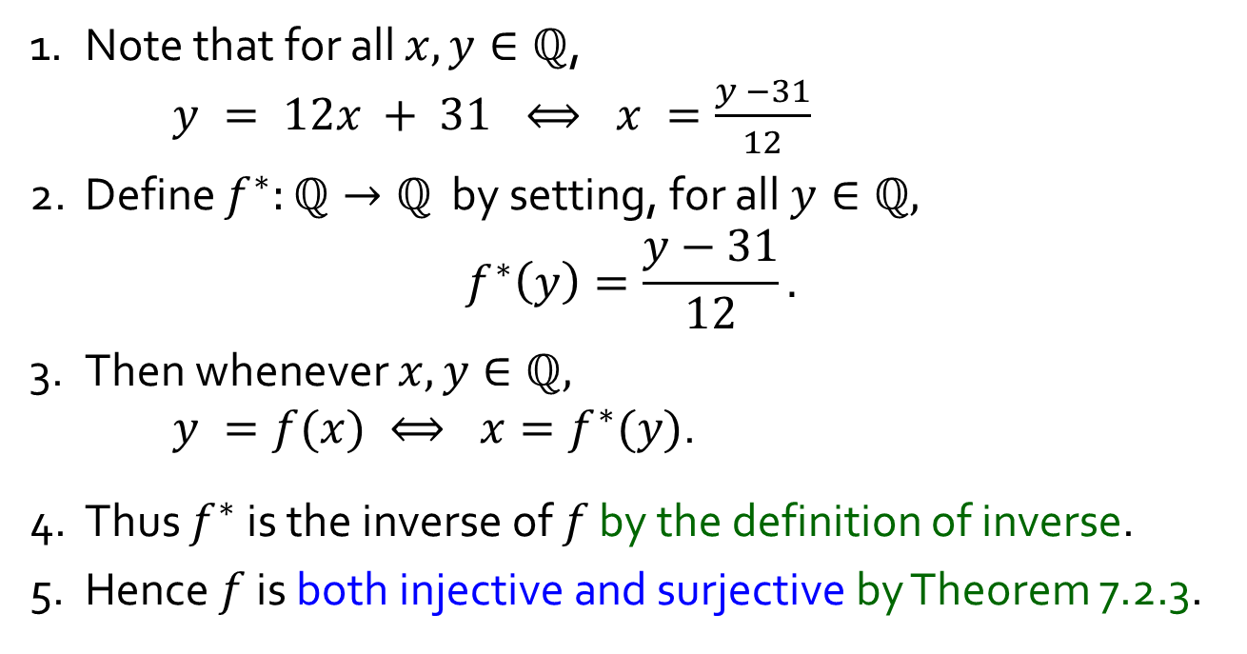
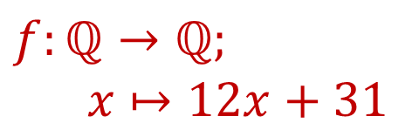
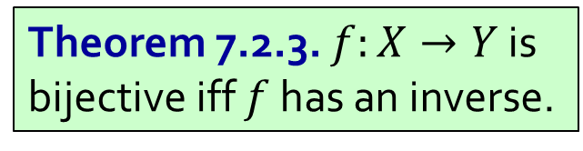
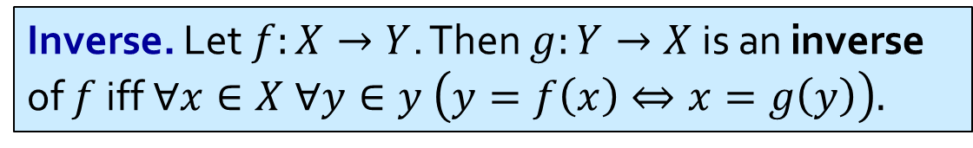
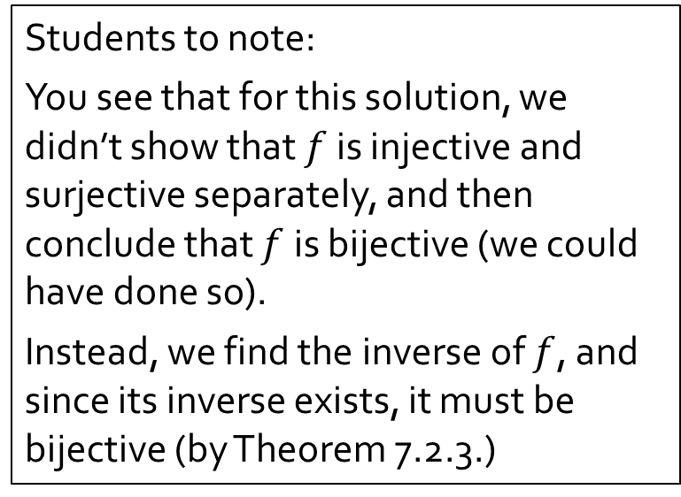
Q4a.
$$f:ℚ→ℚ;$$
$$x↦12x+31$$
Both Injective and Surjective
Students to note:
You see that for this solution, we didn’t show that $f$ is injective and surjective separately, and then conclude that $f$ is bijective (we could have done so).
Instead, we find the inverse of $f$, and since its inverse exists, it must be bijective (by Theorem 7.2.3.)
1. Note that for all $x,y∈ℚ$,
$y = 12x + 31 ⟺ x =\frac{y −31}{12}$
2. Define $f^{∗}:ℚ→ℚ$ by setting, for all $y∈ℚ,$ $$f^{∗}\left(y\right)=\frac{y−31}{12}.$$
3. Then whenever $x,y∈ℚ,$
$y =f(x) ⟺ x=f^{∗}(y)$.
4. Thus $f^{∗}$ is the inverse of $f$ by the definition of inverse.
5. Hence $f$ is both injective and surjective by Theorem 7.2.3.
Inverse. Let $f:X→Y$. Then $g:Y→X$ is an inverse of $f$ iff $∀x∈X ∀y∈y \left(y=f\left(x\right)⇔x=g\left(y\right)\right).$
Theorem 7.2.3. $f:X→Y$ is bijective iff $f$ has an inverse.

Slide 12
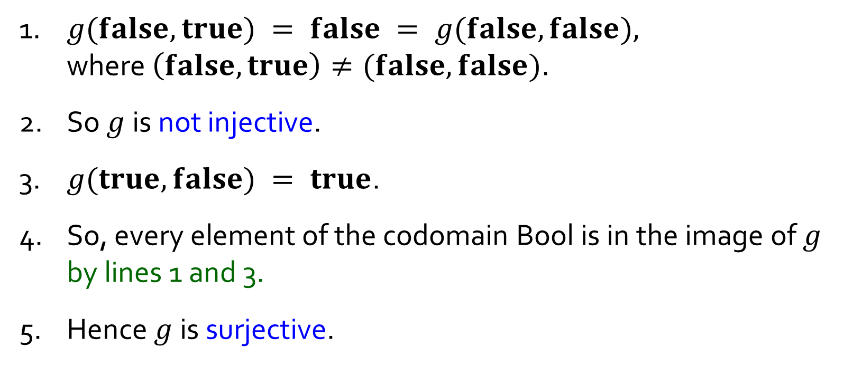
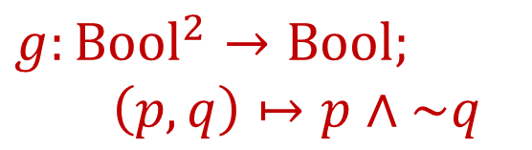
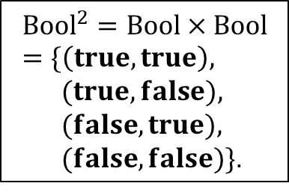
Q4b.
$$g:Bool^{2}→Bool;$$
$$\left(p,q\right)↦p∧\sim q$$
Not Injective But Surjective
$${Bool}^{2}=Bool×Bool=\{\left(true,true\right),$$
$(true,false),$
$(false,true),$
$(false,false)\}$.
1. $g(false,true) = false = g(false,false),$
where $\left(false,true\right)≠(false,false)$.
2. So $g$ is not injective.
3. $g(true, false) = true$.
4. So, every element of the codomain Bool is in the image of $g$ by lines 1 and 3.
5. Hence $g$is surjective.

Slide 13
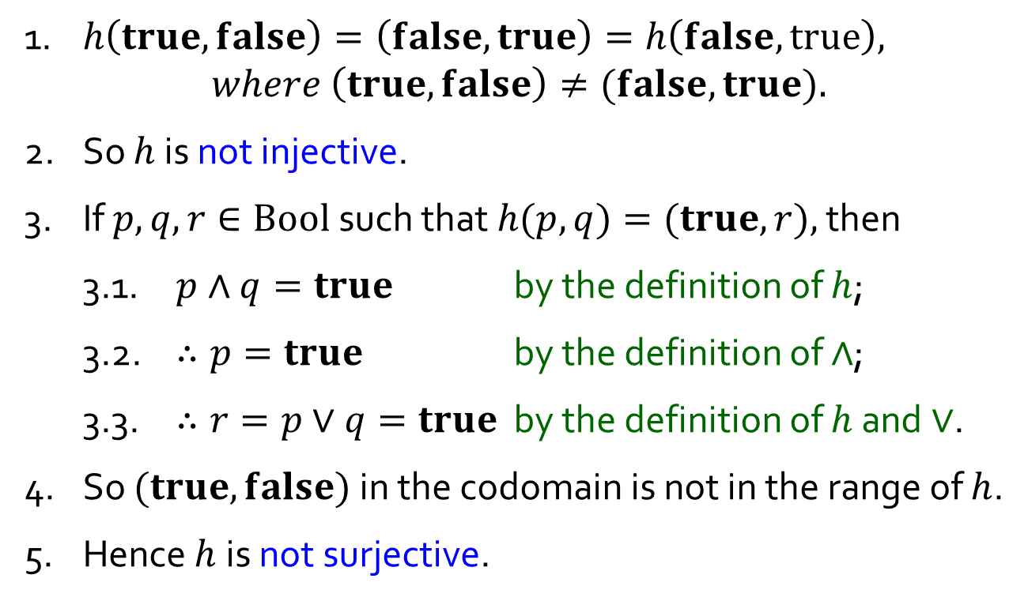
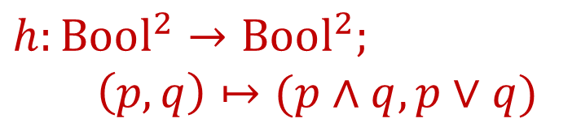
Q4c.
$$h:Bool^{2}→Bool^{2};$$
$$\left(p,q\right)↦(p∧q,p∨q)$$
Not Injective, Not Surjective
$${Bool}^{2}=Bool×Bool=\{\left(true,true\right),$$
$(true,false),$
$(false,true),$
$(false,false)\}$.
1. $h\left(true,false\right)=\left(false,true\right)=h\left(false, true\right),$
$$where \left(true, false\right)≠(false, true).$$
2. So $h$ is not injective.
3. If $p,q,r∈Bool$such that $h(p,q)=(true,r),$ then
3.1. $p∧q=true$ by the definition of $h$;
3.2. $∴p=true$ by the definition of $∧$;
3.3. $∴r=p∨q=true$ by the definition of $h$ and $∨$.
4. So $(true,false)$ in the codomain is not in the range of $h$.
5. Hence $h$is not surjective.

Slide 14



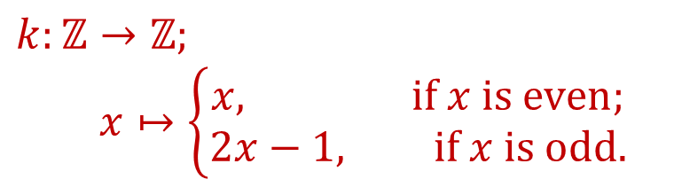



Q4d.
Assumption 1 (Lecture #1).
Every integer is even or odd, but not both.
$$k:ℤ→ℤ;$$
$$x↦\left\{\begin{aligned}x, if x is even; \\ 2x−1, if x is odd.\end{aligned}\right.$$
Injective, Not Surjective
$x$is odd
$6$ –
$4$ –
$2$ –
$x$is even
$$−6$$ | $$−4$$ | $$−2$$
| | | | |
– $−2$
– $−4$
– $−6$
| | | | | | |
 | $$2$$ | $$4$$ | $$6$$

Slide 15
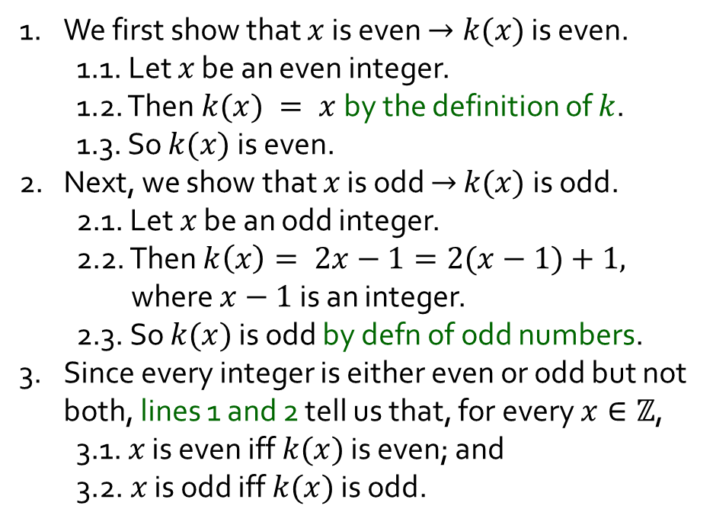
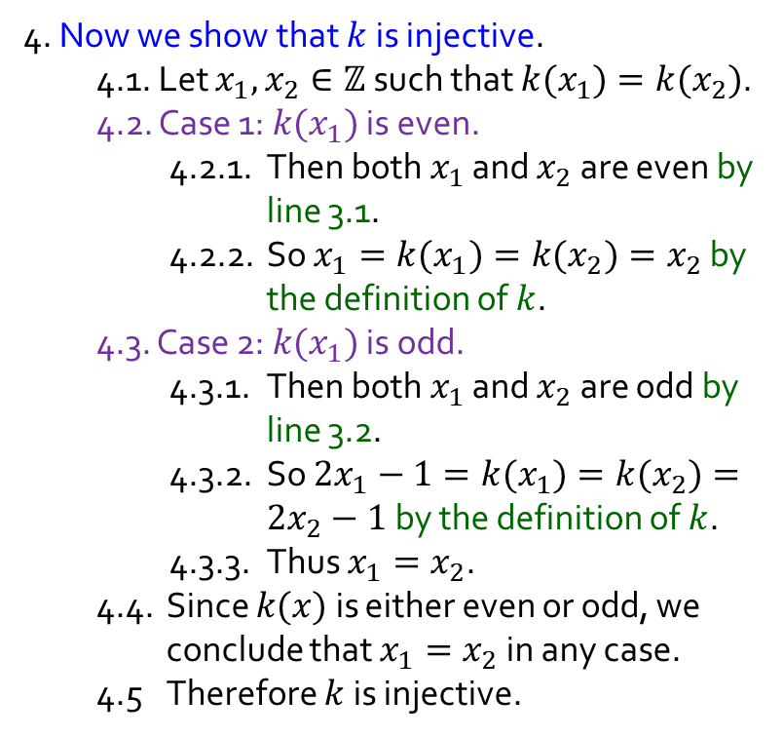
Q4d.
Assumption 1 (Lecture #1).
Every integer is even or odd, but not both.
$$k:ℤ→ℤ;$$
$$x↦\left\{\begin{aligned}x, if x is even; \\ 2x−1, if x is odd.\end{aligned}\right.$$
Injective, Not Surjective
4. Now we show that $k$ is injective.
4.1. Let $x_{1},x_{2}∈ℤ$such that $k(x_{1})=k(x_{2})$.
4.2. Case 1: $k(x_{1})$ is even.
4.2.1. Then both $x_{1}$ and $x_{2}$are even by line 3.1.
4.2.2. So $x_{1}=k(x_{1})=k(x_{2})=x_{2}$ by the definition of $k$.
4.3. Case 2: $k(x_{1})$ is odd.
4.3.1. Then both $x_{1}$ and $x_{2}$are odd by line 3.2.
4.3.2. So $2x_{1}−1=k(x_{1})=k(x_{2})=2x_{2}−1$ by the definition of $k$.
4.3.3. Thus $x_{1}=x_{2}$.
4.4. Since $k(x)$ is either even or odd, we conclude that $x_{1}=x_{2}$ in any case.
4.5 Therefore $k$ is injective.
1. We first show that $x$ is even $→k(x)$ is even.
1.1. Let $x$ be an even integer.
1.2. Then $k(x) = x$by the definition of $k$.
1.3. So $k(x)$ is even.
2. Next, we show that $x$ is odd $→$ $k(x)$is odd.
2.1. Let $x$ be an odd integer.
2.2. Then $k\left(x\right)= 2x−1=2(x−1)+1,$ where $x−1$is an integer.
2.3. So $k(x)$ is odd by defn of odd numbers.
3. Since every integer is either even or odd but not both, lines 1 and 2 tell us that, for every $x∈ℤ$,
3.1. $x$ is even iff $k(x)$ is even; and
3.2. $x$ is odd iff $k(x)$ is odd.
When function involves cases, try to draw useful insights between input and result.
Continued …

Slide 16
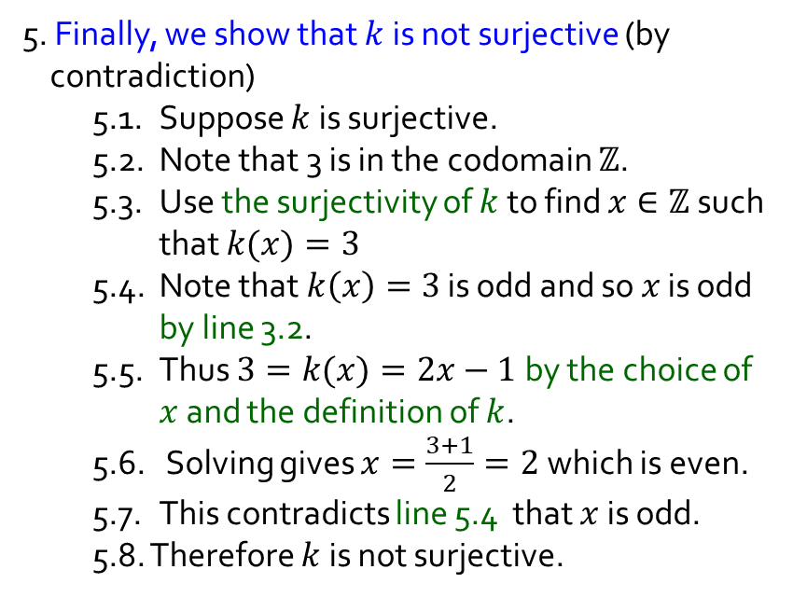

Q4d.
Assumption 1 (Lecture #1).
Every integer is even or odd, but not both.
$$k:ℤ→ℤ;$$
$$x↦\left\{\begin{aligned}x, if x is even; \\ 2x−1, if x is odd.\end{aligned}\right.$$
Injective, Not Surjective
5. Finally, we show that $k$ is not surjective (by contradiction)
5.1. Suppose $k$ is surjective.
5.2. Note that 3 is in the codomain $ℤ$.
5.3. Use the surjectivity of $k$ to find $x∈ℤ$ such that $k(x)=3$
5.4. Note that $k\left(x\right)=3$ is odd and so $x$ is odd by line 3.2.
5.5. Thus $3=k(x)=2x−1$ by the choice of $x$ and the definition of $k$.
5.6. Solving gives $x=\frac{3+1}{2}=2$ which is even.
5.7. This contradicts line 5.4 that $x$ is odd.
5.8. Therefore $k$ is not surjective.
4. Now we show that $k$ is injective.
4.1. Let $x_{1},x_{2}∈ℤ$such that $k(x_{1})=k(x_{2})$.
4.2. Case 1: $k(x_{1})$ is even.
4.2.1. Then both $x_{1}$ and $x_{2}$are even by line 3.1.
4.2.2. So$x_{1}=k(x_{1})=k(x_{2})=x_{2}$ by the definition of $k$.
4.3. Case 2: $k(x_{1})$ is odd.
4.3.1. Then both $x_{1}$ and $x_{2}$are odd by line 3.2.
4.3.2. So $2x_{1}−1=k(x_{1})=k(x_{2})=2x_{2}−1$ by the definition of $k$.
4.3.3. Thus $x_{1}=x_{2}$.
4.4. Since $k(x)$ is either even or odd, we conclude that $x_{1}=x_{2}$ in any case.
4.5 Therefore $k$ is injective.

Slide 17
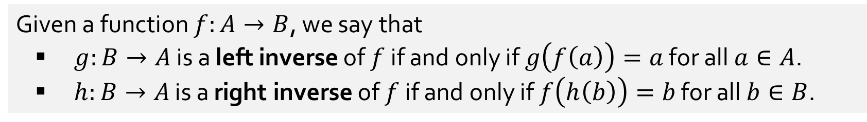




Q5.
[AY2022/23 Sem2 Exam Questions]
Given a function $f:A→B$, we say that
▪ $g:B→A$ is a left inverse of $f$ if and only if $g\left(f\left(a\right)\right)=a$ for all $a∈A$.
▪ $h:B→A$ is a right inverse of $f$ if and only if $f\left(h\left(b\right)\right)=b$ for all $b∈B$.
(a) Which of the 4 functions given in question 4 have a left inverse?
$$f$$
$$k$$
(b) Which of the 4 functions given in question 4 have a right inverse?
$$f$$
$$g$$
(c) Which of the following statements are true?
(i) If a function has a left inverse, then it has a right inverse.
(ii) If a function has a right inverse, then it has a left inverse.
Neither is true.
A function is injective if and only if it has a left inverse.
A function is surjective if and only if it has a right inverse.
Notes:
Diagram of this
Injenctive = at most one arrow coming in
If more, then you cannot decide who to go back to for the inverse
Surjective = at least one arrow coming in
If no arrow, then cannot even define who to start with.

Slide 18

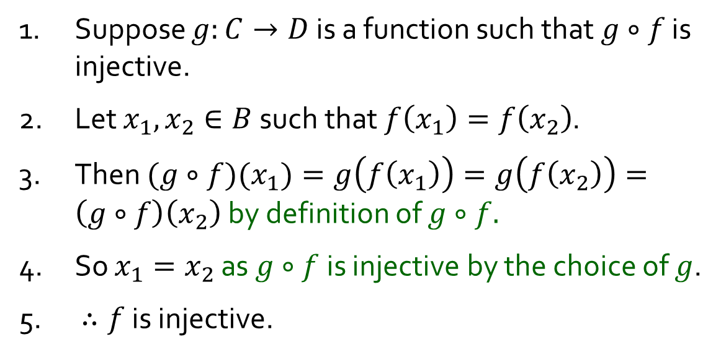



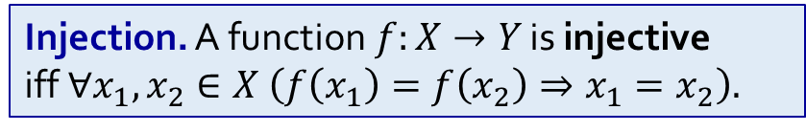


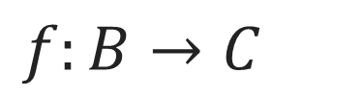

Q6.
$f:B→C$
Suppose we have a function $g$ with domain $C$ such that $g∘f$ is injective. Show that $f$is injective$.$
1. Suppose $g:C→D$ is a function such that $g∘f$ is injective.
2. Let $x_{1},x_{2}∈B$such that $f\left(x_{1}\right)=f\left(x_{2}\right)$.
3. Then $(g∘f)(x_{1})=g\left(f\left(x_{1}\right)\right)=g\left(f\left(x_{2}\right)\right)=\left(g∘f\right)\left(x_{2}\right)$ by definition of $g∘f.$
4. So $x_{1}=x_{2}$ as $g∘f$ is injective by the choice of $g$.
5. $∴f$ is injective.
$$B$$
$$C$$
$$D$$
$$f$$
$$g$$
$$g∘f$$
Injection. A function$f:X→Y$ is injective
iff $∀x_{1},x_{2}∈X \left(f\left(x_{1}\right)=f\left(x_{2}\right)⇒x_{1}=x_{2}\right).$

Slide 19
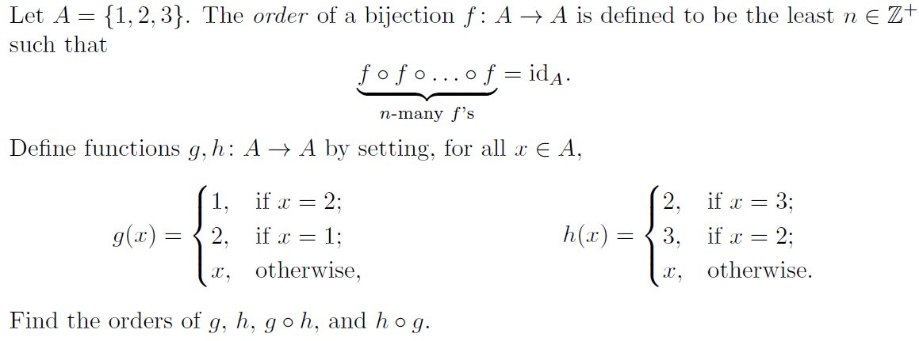


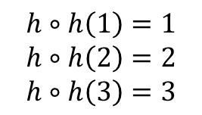







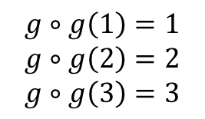



Q7.
$$A$$
$$g$$
$$A$$
$$g$$
$$A$$
$$A$$
$$h$$
$$A$$
$$h$$
$$A$$
1
2
3
1
2
3
1
2
3
$$g∘g\left(1\right)=1$$
$$g∘g\left(2\right)=2$$
$$g∘g\left(3\right)=3$$
1
2
3
1
2
3
1
2
3
$$h∘h\left(1\right)=1$$
$$h∘h\left(2\right)=2$$
$$h∘h\left(3\right)=3$$
$∴$ order of $g$ = 2
$∴$ order of $h$ = 2

Slide 20
















Q7.
Is $\left(g∘h\right)∘\left(g∘h\right)={id}_{A}$?
Is $\left(g∘h\right)∘\left(g∘h\right)∘\left(g∘h\right)={id}_{A}$?
$$A$$
$$h$$
$$A$$
$$g$$
$$A$$
$$A$$
$$A$$
$$A$$
$$A$$
1
2
3
1
2
3
1
2
3
1
2
3
1
2
3
1
2
3
1
2
3
$$≡$$
$$g∘h$$
$$g∘h$$
$$g∘h$$
$$g∘h$$

Slide 21










Q7.
Is $\left(h∘g\right)∘\left(h∘g\right)={id}_{A}$?
Is $\left(h∘g\right)∘\left(h∘g\right)∘\left(h∘g\right)={id}_{A}$?
$$A$$
$$g$$
$$A$$
$$h$$
$$A$$
$$A$$
$$A$$
$$A$$
$$A$$
1
2
3
1
2
3
1
2
3
1
2
3
1
2
3
1
2
3
1
2
3
$$≡$$
$$h∘g$$
$$h∘g$$
$$h∘g$$
$$h∘g$$

Slide 22

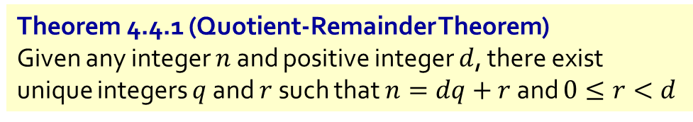
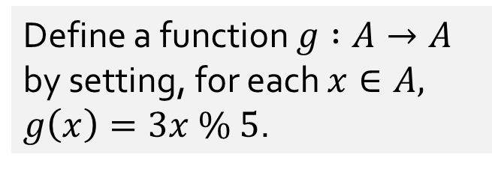
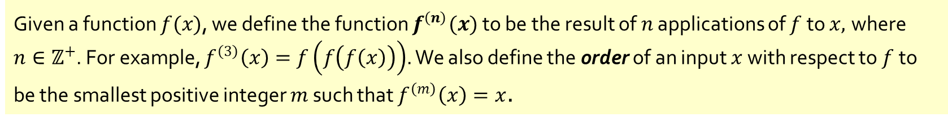

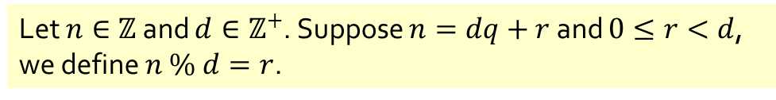
Q8.
[AY2023/24 Sem2 Exam Questions]
Theorem 4.4.1 (Quotient-Remainder Theorem)
Given any integer $n$ and positive integer $d$, there exist unique integers $q$ and $r$ such that $n=dq+r$ and $0≤r<d$
Define a function $g :A→A$ by setting, for each $x∈A,$ $g\left(x\right)=3x \% 5$.
Let $n∈ℤ$ and $d∈ℤ^{+}$. Suppose $n=dq+r$ and $0≤r<d$, we define $n \% d=r$.
(a) What is $g^{\left(3\right)}\left(21\right)$?
$$g^{\left(3\right)}\left(21\right)=g^{\left(2\right)}\left(3\right)=g\left(4\right)=2$$
(b) What is the order of 3 with respect to the function $g$?
$${g^{\left(4\right)}\left(3\right)=g}^{\left(3\right)}\left(4\right)=g^{\left(2\right)}\left(2\right)=g\left(1\right)=3$$
$$\text{Therefore}\text{, }\text{order} \text{of}\text{ 3 }\text{is}\text{ 4.}$$
Given a function $f(x)$, we define the function $f^{\left(n\right)}(x)$ to be the result of $n$ applications of $f$ to $x,$ where $n∈ℤ^{+}$. For example, $f^{\left(3\right)}\left(x\right)=f\left(f\left(f\left(x\right)\right)\right)$. We also define the order of an input $x$ with respect to $f$to be the smallest positive integer $m$ such that $f^{\left(m\right)}\left(x\right)=x$.

Slide 23

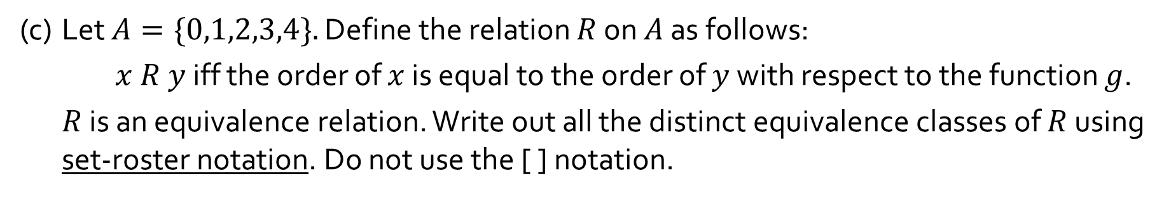
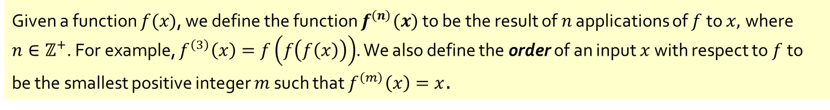

Q8.
[AY2023/24 Sem2 Exam Questions]
Theorem 4.4.1 (Quotient-Remainder Theorem)
Given any integer $n$ and positive integer $d$, there exist unique integers $q$ and $r$ such that $n=dq+r$ and $0≤r<d$
Define a function $g :A→A$ by setting, for each $x∈A,$ $g\left(x\right)=3x \% 5$.
Let $n∈ℤ$ and $d∈ℤ^{+}$. Suppose $n=dq+r$ and $0≤r<d$, we define $n \% d=r$.
(c) Let $A=\{0,1,2,3,4\}.$ Define the relation $R$ on $A$ as follows:
$x R y$ iff the order of $x$ is equal to the order of $y$ with respect to the function $g$.
$R$ is an equivalence relation. Write out all the distinct equivalence classes of $R$ using set-roster notation. Do not use the [ ] notation.
$$\{0\} \text{and} \{1,2,3,4\}\text{.}$$
Given a function $f(x)$, we define the function $f^{\left(n\right)}(x)$ to be the result of $n$ applications of $f$ to $x,$ where $n∈ℤ^{+}$. For example, $f^{\left(3\right)}\left(x\right)=f\left(f\left(f\left(x\right)\right)\right)$. We also define the order of an input $x$ with respect to $f$to be the smallest positive integer $m$ such that $f^{\left(m\right)}\left(x\right)=x$.

Slide 24
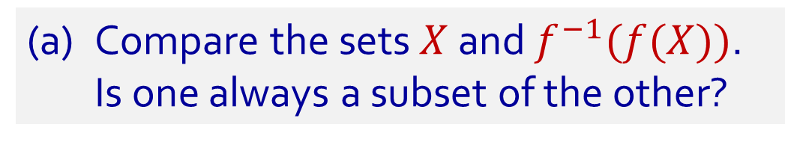
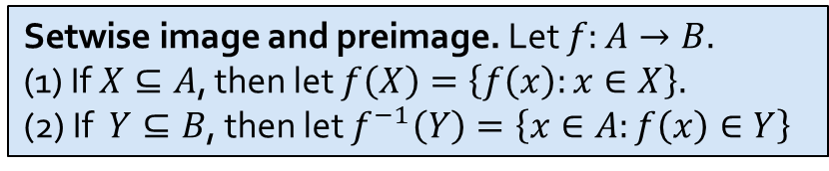
Q9.
Let $f:A→B$ be a function. Let $X⊆A$ and $Y⊆B$.
(a) Compare the sets $X$ and $f^{−1}(f(X))$.
Is one always a subset of the other?
Is the function bijective?
No! Setwise image and preimage does not imply anything about the function!
The notation is indeed ambiguous between setwise image/preimage and inverse of normal function.
Setwise image and preimage. Let $f:A→B.$
(1) If $X⊆A$, then let $f\left(X\right)=\left\{f\left(x\right):x∈X\right\}.$
(2) If $Y⊆B$, then let $f^{−1}\left(Y\right)=\left\{x∈A:f\left(x\right)∈Y\right\}$
24

Slide 25












Q9.
Let $f:A→B$ be a function. Let $X⊆A$ and $Y⊆B$.
(a) Compare the sets $X$ and $f^{−1}(f(X))$.
Is one always a subset of the other?
$$A$$
$$f$$
$$B$$
$$f^{−1}\left(f\left(X\right)\right)$$
Is $X⊆f^{−1}(f(X))$ always true?
Yes
$$f(X)$$
1. Let $x∈X.$
2. Then $f\left(x\right)∈f\left(X\right)$ by the definition of $f\left(X\right).$
3. So $x∈f^{−1}(f(X))$ by the definition of $f^{−1}(f(X))$ .
$$X$$
Is$f^{−1}(f(X))⊆X$ always true?
No
1. Consider $f:\left\{−1, 1\right\}→\{0\}$ where $f(−1)=0=f(1)$, and $X=\{1\}$.
2. Note $f\left(X\right)=\left\{f\left(1\right)\right\}=\left\{0\right\}.$
3. Since $f\left(−1\right)=0,$ we know $−1∈f^{−1}\left(\left\{0\right\}\right)=f^{−1}\left(f\left(X\right)\right).$
4. As $−1∉\left\{1\right\}=X,$ we deduce that $f^{−1}\left(f\left(X\right)\right)⊈X.$
Setwise image and preimage. Let $f:A→B.$
(1) If $X⊆A$, then let $f\left(X\right)=\left\{f\left(x\right):x∈X\right\}.$
(2) If $Y⊆B$, then let $f^{−1}\left(Y\right)=\left\{x∈A:f\left(x\right)∈Y\right\}$
25
Notes:
Case when function is not injenctive = more than one arrow coming into an element.

Slide 26












Q9.
Let $f:A→B$ be a function. Let $X⊆A$ and $Y⊆B$.
(b) Compare the sets $Y$ and $f(f^{−1}(Y))$.
Is one always a subset of the other?
$$A$$
$$f$$
$$B$$
Is $f(f^{−1}(Y))⊆Y$ always true?
Yes
$f^{−1}(Y$)
$$f\left(f^{−1}\left(Y\right)\right)$$
Take any $y∈f(f^{−1}\left(Y\right)).$
2. There is some $x∈f^{−1}\left(Y\right)$ s.t. $y=f\left(x\right)$ by the def^{n} of $f\left(f^{−1}\left(Y\right)\right)$.
3. As $x∈f^{−1}\left(Y\right),$ we get $y′∈Y$ which makes $y′=f(x)$.
4. Since $f$ is a function, $y=f\left(x\right)=y^{′}∈Y$.
$$Y$$
Is $Y⊆f(f^{−1}(Y))$ always true?
No
1. Consider $f:\{0\}→\left\{−1, 1\right\}$ where $f\left(0\right)=1$, and $Y=\{−1\}$.
2. Note that no $x∈\left\{0\right\}$ makes $f\left(X\right)=−1.$
3. So $f^{−1}\left(Y\right)=∅$ by the definition of $f^{−1}\left(Y\right).$
4. This entails $f\left(f^{−1}\left(Y\right)\right)=∅⊉\left\{−1\right\}=Y$ by the definition of $f(f^{−1}\left(Y\right))$.
Setwise image and preimage. Let $f:A→B.$
(1) If $X⊆A$, then let $f\left(X\right)=\left\{f\left(x\right):x∈X\right\}.$
(2) If $Y⊆B$, then let $f^{−1}\left(Y\right)=\left\{x∈A:f\left(x\right)∈Y\right\}$
26
Notes:
Case where not surjective = one element in codomain does not have an arrow into it.

Slide 27


Q10(+)
Consider the equivalence relation $∼$ on $ℚ$ defined by
$$∀x,y∈ℚ ( x∼y ⇔ x−y∈ℤ ).$$
Define addition on $ℚ/\sim$ by setting, for all $\left[x\right],\left[y\right]∈ℚ/\sim$,
$$\left[x\right]+\left[y\right]=\left[x+y\right].$$

Slide 28

Q10(+)
Consider the equivalence relation $∼$ on $ℚ$ defined by
$$∀x,y∈ℚ ( x∼y ⇔ x−y∈ℤ ).$$
Define addition on $ℚ/\sim$ by setting, for all $\left[x\right],\left[y\right]∈ℚ/\sim$,
$$\left[x\right]+\left[y\right]=\left[x+y\right].$$
Is $+$ well defined on $ℚ/\sim$?
In other words, is it true that, according to this definition, for all $\left[x_{1}\right],\left[y_{1}\right],\left[x_{2}\right],\left[y_{2}\right]∈ℚ/\sim$,
$$\left[x_{1}\right]=\left[x_{2}\right]∧\left[y_{1}\right]=\left[y_{2}\right] ⇒ \left[x_{1}\right]+\left[y_{1}\right]=\left[x_{2}\right]+\left[y_{2}\right]?$$
Consider $A=\left\{…,−\frac{8}{3},−\frac{5}{3},−\frac{2}{3},\frac{1}{3},\frac{4}{3},\frac{7}{3},\frac{10}{3},…\right\}$ and $B=\left\{…,−\frac{13}{5},−\frac{8}{5},−\frac{3}{5},\frac{2}{5},\frac{7}{5},\frac{12}{5},\frac{17}{5},…\right\}$.
Note $A,B∈ℚ/\sim$. What is $A+B$?
Since $A=\left[\frac{1}{3}\right]$ and $B=\left[\frac{2}{5}\right]$, the definition above tells us $A+B=\left[\frac{1}{3}\right]+\left[\frac{2}{5}\right]=\left[\frac{1}{3}+\frac{2}{5}\right]=\left[\frac{11}{15}\right].$
$$=$$
Since $A=\left[\frac{4}{3}\right]$ and $B=\left[\frac{7}{5}\right]$, the definition above tells us $A+B=\left[\frac{4}{3}\right]+\left[\frac{7}{5}\right]=\left[\frac{4}{3}+\frac{7}{5}\right]=\left[\frac{41}{15}\right].$
28

Slide 29

Q10(+)
Consider the equivalence relation $∼$ on $ℚ$ defined by
$$∀x,y∈ℚ ( x∼y ⇔ x−y∈ℤ ).$$
Define addition on $ℚ/\sim$ by setting, for all $\left[x\right],\left[y\right]∈ℚ/\sim$,
$$\left[x\right]+\left[y\right]=\left[x+y\right].$$
Yes!
Is $+$ well defined on $ℚ/\sim$?
In other words, is it true that, according to this definition, for all $\left[x_{1}\right],\left[y_{1}\right],\left[x_{2}\right],\left[y_{2}\right]∈ℚ/\sim$,
$$\left[x_{1}\right]=\left[x_{2}\right]∧\left[y_{1}\right]=\left[y_{2}\right] ⇒ \left[x_{1}\right]+\left[y_{1}\right]=\left[x_{2}\right]+\left[y_{2}\right]?$$
1. Let $\left[x_{1}\right],\left[y_{1}\right],\left[x_{2}\right],\left[y_{2}\right]∈ℚ/\sim$ such that $\left[x_{1}\right]=[x_{2}]$ and $\left[y_{1}\right]=\left[y_{2}\right]$.
2. So $x_{1}∼x_{2}$ and $y_{1}∼y_{2}$ by Lemma Rel.1.
3. Use the definition of $∼$ to find $k,ℓ∈ℤ$ such that $x_{1}−x_{2}=k$ and $y_{1}−y_{2}=ℓ$.
4. Note $\left(x_{1}+y_{1}\right)−\left(x_{2}+y_{2}\right)=\left(x_{1}−x_{2}\right)+\left(y_{1}−y_{2}\right)=k+ℓ∈ℤ$ as $ℤ$ is closed under $+$.
5. So $x_{1}+y_{1}∼x_{2}+y_{2}$ by the definition of $\sim$.
6. Hence $\left[x_{1}\right]+\left[y_{1}\right]=\left[x_{1}+y_{1}\right]=\left[x_{2}+y_{2}\right]=\left[x_{2}\right]+\left[y_{2}\right]$ by Lemma Rel.1.
Lemma Rel.1. The following are equivalent: (i) $x∼y$; (ii) $\left[x\right]=\left[y\right]$; (iii) $\left[x\right]∩\left[y\right]≠∅$.
29

Slide 30


Q10(⋅)
Consider the equivalence relation $∼$ on $ℚ$ defined by
$$∀x,y∈ℚ ( x∼y ⇔ x−y∈ℤ ).$$
Define addition on $ℚ/\sim$ by setting, for all $\left[x\right],\left[y\right]∈ℚ/\sim$,
$$\left[x\right]∙\left[y\right]=\left[x∙y\right].$$
No!
Is $⋅$ well defined on $ℚ/\sim$?
In other words, is it true that, according to this definition, for all $\left[x_{1}\right],\left[y_{1}\right],\left[x_{2}\right],\left[y_{2}\right]∈ℚ/\sim$,
$$\left[x_{1}\right]=\left[x_{2}\right]∧\left[y_{1}\right]=\left[y_{2}\right] ⇒ \left[x_{1}\right]⋅\left[y_{1}\right]=\left[x_{2}\right]⋅\left[y_{2}\right]?$$
So $\left[\frac{1}{2}\right]=\left[\frac{−1}{2}\right]$ by Lemma Rel.1.
So $\left[\frac{1}{4}\right]≠\left[\frac{−1}{4}\right]$ by Lemma Rel.1.
1. Note that $\frac{1}{2}−\frac{−1}{2}=1∈ℤ$. This implies $\frac{1}{2}∼\frac{−1}{2}$. So $\left[\frac{1}{2}\right]=\left[\frac{−1}{2}\right]$ by Lemma 6.3.4.
2. Note also $\frac{1}{4}−\frac{−1}{4}=\frac{1}{2}∉ℤ$. This implies $\frac{1}{4}≁\frac{−1}{4}$. So $\left[\frac{1}{4}\right]≠\left[\frac{−1}{4}\right]$ by Lemma 6.3.4.
3. Therefore, according to the definition of $⋅$ on $ℚ/\sim$ above,
$$\left[\frac{1}{2}\right]⋅\left[\frac{1}{2}\right]=\left[\frac{1}{2}⋅\frac{1}{2}\right]=\left[\frac{1}{4}\right]≠\left[\frac{−1}{4}\right]=\left[\frac{1}{2}⋅\frac{−1}{2}\right]=\left[\frac{1}{2}\right]⋅\left[\frac{−1}{2}\right].$$
This implies $\frac{1}{2}∼\frac{−1}{2}$. $\left[\frac{1}{2}\right]$
This implies $\frac{1}{4}≁\frac{−1}{4}$. $\left[\frac{1}{2}\right]$
$$\left[\frac{1}{2}⋅\frac{1}{2}\right]$$
$$=\left[\frac{1}{4}\right]$$
$$\left[\frac{−1}{4}\right]=$$
$$\left[\frac{1}{2}⋅\frac{−1}{2}\right]$$
$$≠$$
Lemma Rel.1. The following are equivalent: (i) $x∼y$; (ii) $\left[x\right]=\left[y\right]$; (iii) $\left[x\right]∩\left[y\right]≠∅$.
30

Slide 31
End of Tutorial 6
Good luck for your midterms!

