Slide 1
Cs1231S tutorial #7
Mathematical Induction and Recursion
(AY2025/26 Semester 1)
Based on slides by Prof Aaron Tan

Slide 2
Learning objectives of this tutorial
Understanding Mathematical Induction (MI)
Using MI and Strong MI in proofs
Recursive definition of a sequence
Recursive definition of a set
Using structural induction over recursively defined sets

Slide 3
Try out the discussion questions!
Good practice for writing full-fledged induction proofs

Slide 4
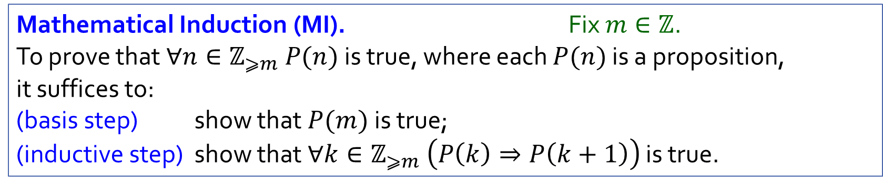
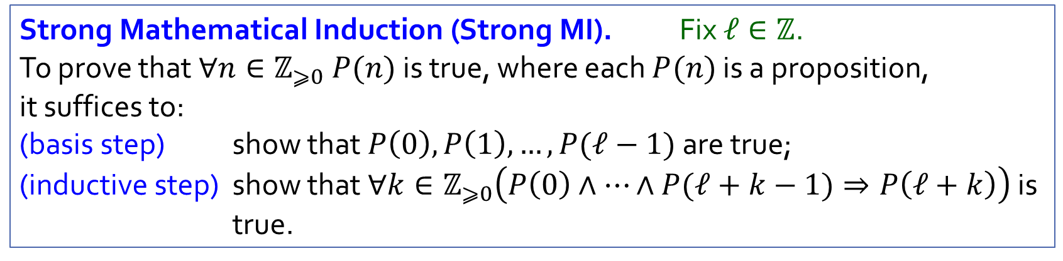
Recap
Mathematical Induction (MI). Fix $m∈ℤ$.
To prove that $∀n∈ℤ_{⩾m} P(n)$ is true, where each $P(n)$ is a proposition, it suffices to:
(basis step) show that $P(m)$ is true;
(inductive step) show that $∀k∈ℤ_{⩾m} \left(P\left(k\right)⇒P\left(k+1\right)\right)$ is true.
Strong Mathematical Induction (Strong MI). Fix $ℓ∈ℤ$.
To prove that $∀n∈ℤ_{⩾0} P(n)$ is true, where each $P(n)$ is a proposition, it suffices to:
(basis step) show that $P\left(0\right),P\left(1\right),…,P(ℓ−1)$ are true;
(inductive step) show that $∀k∈ℤ_{⩾0}\left(P\left(0\right)∧⋯∧P(ℓ+k−1)⇒P\left(ℓ+k\right)\right)$ is true.

Slide 5
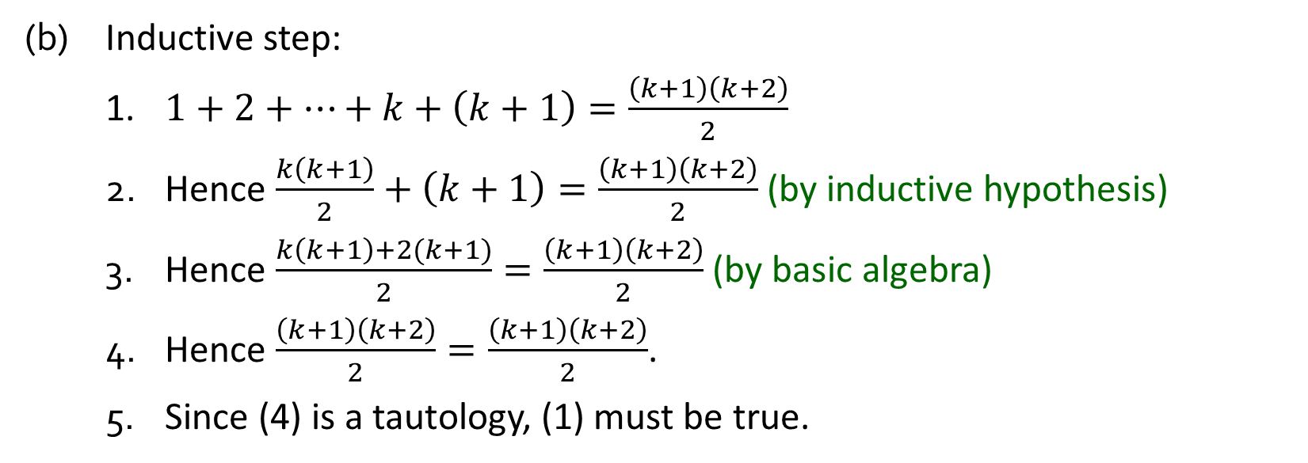
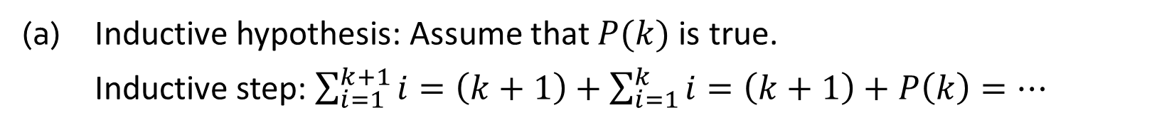
Q1.
Common mistakes
(a) Inductive hypothesis: Assume that $P(k)$ is true.
Inductive step: $\sum_{i=1}^{k+1}{i}=\left(k+1\right)+\sum_{i=1}^{k}{i}=\left(k+1\right)+P\left(k\right)=⋯$
P(k) is a predicate, not a function!
P(k) is always either true or false.
(b) Inductive step:
1. $1+2+⋯+k+\left(k+1\right)=\frac{\left(k+1\right)\left(k+2\right)}{2}$
2. Hence $\frac{k\left(k+1\right)}{2}+\left(k+1\right)=\frac{\left(k+1\right)\left(k+2\right)}{2}$ (by inductive hypothesis)
3. Hence $\frac{k\left(k+1\right)+2(k+1)}{2}=\frac{\left(k+1\right)\left(k+2\right)}{2}$ (by basic algebra)
4. Hence $\frac{\left(k+1\right)\left(k+2\right)}{2}=\frac{\left(k+1\right)\left(k+2\right)}{2}$.
5. Since (4) is a tautology, (1) must be true.
Show P(k) → P(k+1). This is really proving the other way round.

Slide 6
Q1.
Common mistakes
(c) Inductive hypothesis: Assume that $P(k)$ is true for all $k∈ℤ^{+}$.
You have basically just assumed the solution.
What’s left to prove?

Slide 7


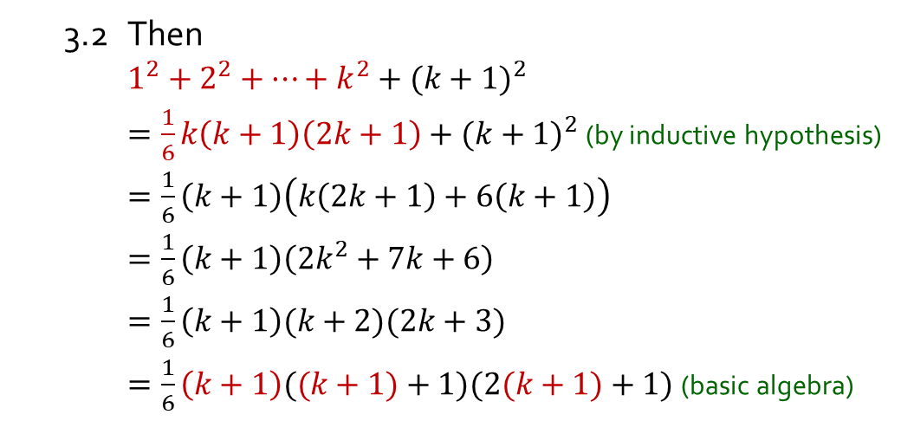
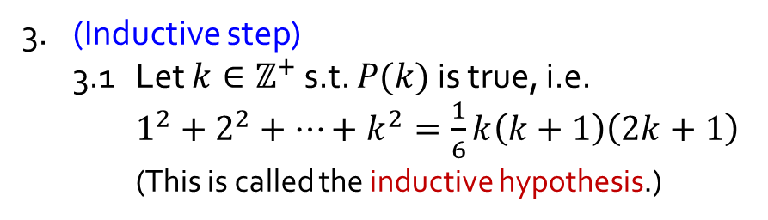
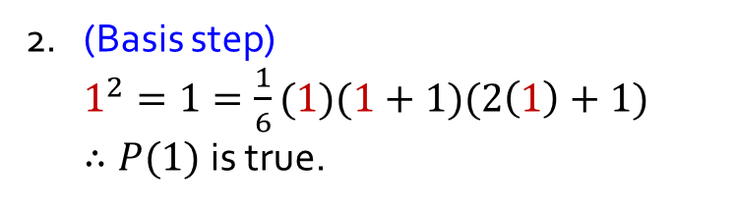

Q2.
Prove: $∀n∈ℤ^{+}, 1^{2}+2^{2}+⋯+n^{2}=\frac{1}{6}n(n+1)(2n+1)$.
1. (Define $P(n)$) For each $n∈ℤ^{+}$, let $P\left(n\right) \text{be}\text{ “}1^{2}+2^{2}+⋯+n^{2}=\frac{1}{6}n\left(n+1\right)\left(2n+1\right)\text{”.}$
2. (Basis step)
$1^{2}=1=\frac{1}{6}(1)(1+1)(2\left(1\right)+1)$
$∴P(1)$is true.
(Aim: to show that $P(k+1)$ is true.)
3.2 Then
$1^{2}+2^{2}+⋯+k^{2}+{(k+1)}^{2}$
$=\frac{1}{6}k\left(k+1\right)\left(2k+1\right)+{(k+1)}^{2}$ (by inductive hypothesis)
$=\frac{1}{6}\left(k+1\right)\left(k\left(2k+1\right)+6\left(k+1\right)\right)$
$=\frac{1}{6}\left(k+1\right)\left(2k^{2}+7k+6\right)$
$=\frac{1}{6}\left(k+1\right)(k+2)(2k+3)$
$=\frac{1}{6}\left(k+1\right)((k+1)+1)(2(k+1)+1)$ (basic algebra)
3. (Inductive step)
3.1 Let $k∈ℤ^{+}$ s.t. $P(k)$is true, i.e.
$1^{2}+2^{2}+⋯+k^{2}=\frac{1}{6}k\left(k+1\right)\left(2k+1\right)$
(This is called the inductive hypothesis.)
3.3 Therefore $P(k+1)$ is true.
4. Hence, $∀n∈ℤ^{+} P(n)$ is true by MI.

Slide 8


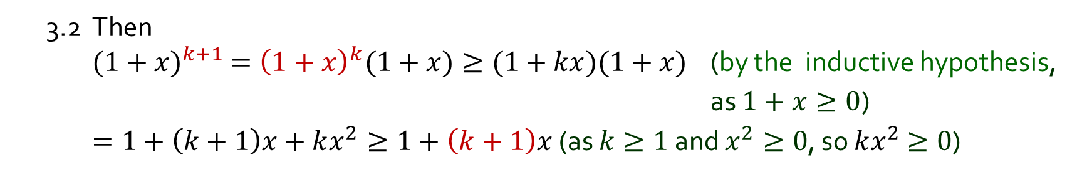
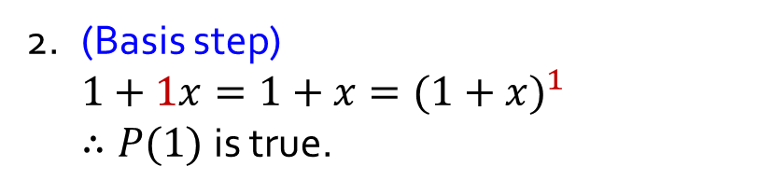
Q3.
Let $x∈ℝ_{≥−1}$. Prove: $∀n∈ℤ^{+}, 1+nx≤{(1+x)}^{n}.$
1. (Define $P(n)$) $∀n∈ℤ^{+}$, let $P\left(n\right) \text{be}\text{ “}\left(1+nx≤{(1+x)}^{n}\right)\text{”}$.
2. (Basis step)
$1+1x=1+x={(1+x)}^{1}$
$∴P(1)$is true.
3. (Inductive step)
3.1 Let $k∈ℤ^{+}$ s.t. $P(k)$is true, i.e.$1+kx≤{(1+x)}^{k}$ (inductive hypothesis)
Aim: To show $P(k+1)$ is true, i.e., $1+\left(k+1\right)x≤{(1+x)}^{k+1}$
3.2 Then
${(1+x)}^{k+1} ={\left(1+x\right)}^{k}(1+x)≥(1+kx)(1+x)$ (by the inductive hypothesis,
as $1+x≥0$)
$=1+\left(k+1\right)x+kx^{2}≥1+\left(k+1\right)x$ (as $k≥1$ and $x^{2}≥0$, so $kx^{2}$ $≥0$)
3.3 Therefore $P(k+1)$ is true.
4. Hence, $∀n∈ℤ^{+} P(n)$ is true by MI.

Slide 9

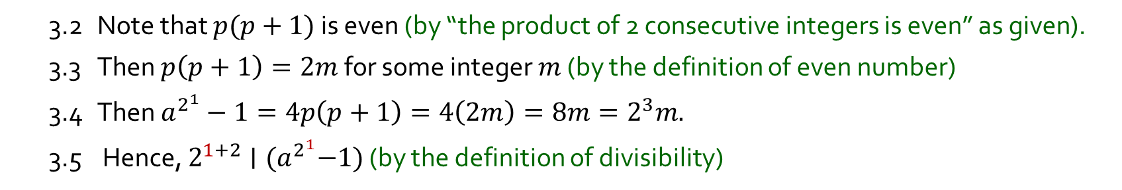
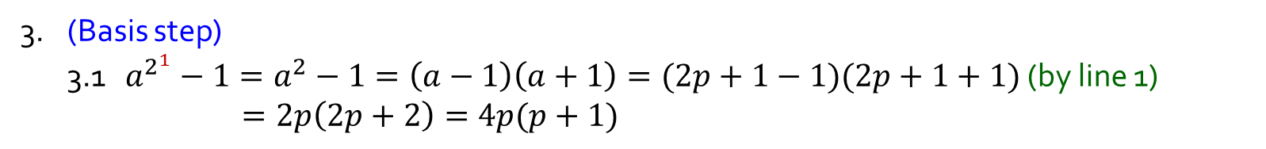
Q4.
Let $a$ be an odd integer. Prove: $∀n∈ℤ^{+}, 2^{n+2} | (a^{2^{n}}−1).$
1. $a = 2p+1$for some integer $p$ (by the definition of odd integers)
Fact. The product of two consecutive integers is even.
2. (Define $P(n)$) $∀n∈ℤ^{+}$, let $P\left(n\right)≡2^{n+2} | (a^{2^{n}}−1).$
3. (Basis step)
3.1 $a^{2^{1}}−1=a^{2}−1=\left(a−1\right)\left(a+1\right)=(2p+1−1)(2p+1+1)$ (by line 1) $=2p\left(2p+2\right)=4p(p+1)$
3.2 Note that $p(p+1)$ is even (by “the product of 2 consecutive integers is even” as given).
3.3 Then $p\left(p+1\right)=2m$ for some integer $m$ (by the definition of even number)
3.4 Then $a^{2^{1}}−1=4p\left(p+1\right)=4\left(2m\right)=8m=2^{3}m.$
3.5 Hence, $2^{1+2}∣{(a}^{2^{1}}−1)$ (by the definition of divisibility)
3.6 Therefore, $P(1)$ is true.
$$d∣n ⇔ ∃k∈ℤ \left(n=dk\right).$$

Slide 10
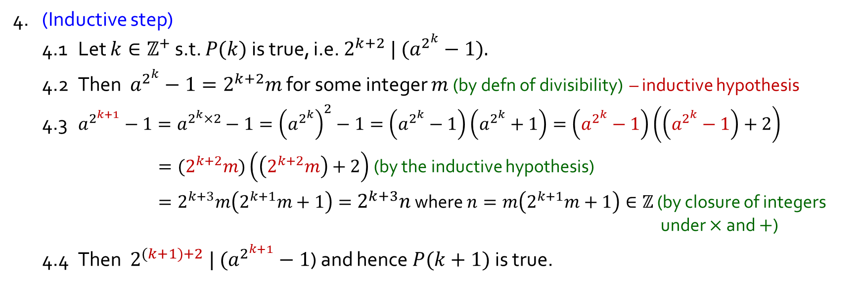
Q4.
Let $a$ be an odd integer. Prove: $∀n∈ℤ^{+}, 2^{n+2} | (a^{2^{n}}−1).$
1. $a = 2p+1$for some integer $p$ (by defn of odd integers)
2. (Define $P(n)$) $∀n∈ℤ^{+}$, let $P\left(n\right)≡2^{n+2} | (a^{2^{n}}−1).$
3. (Basis step) … $P(1)$ is true.
4. (Inductive step)
4.1 Let $k∈ℤ^{+}$ s.t. $P(k)$ is true, i.e. $2^{k+2} | (a^{2^{k}}−1).$
4.2 Then $a^{2^{k}}−1=2^{k+2}m$ for some integer $m$ (by defn of divisibility) – inductive hypothesis
4.3 $a^{2^{k+1}}−1=a^{2^{k}×2}−1={\left(a^{2^{k}}\right)}^{2}−1=\left(a^{2^{k}}−1\right)\left(a^{2^{k}}+1\right)=\left(a^{2^{k}}−1\right)\left(\left(a^{2^{k}}−1\right)+2\right)$
$={(2}^{k+2}m)\left(\left(2^{k+2}m\right)+2\right)$ (by the inductive hypothesis)
$=2^{k+3}m\left(2^{k+1}m+1\right)=2^{k+3}n$ where $n=m\left(2^{k+1}m+1\right)∈ℤ$ (by closure of integers under $×$ and $+$)
4.4 Then $2^{(k+1)+2} | (a^{2^{k+1}}−1$) and hence $P(k+1)$is true.
5. Hence, , $∀n∈ℤ^{+} P(n)$ is true by MI.
$$d∣n ⇔ ∃k∈ℤ \left(n=dk\right).$$

Slide 11

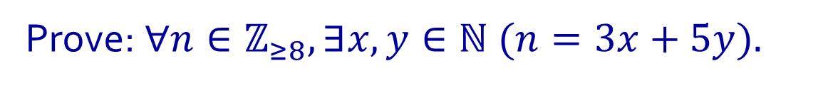
Q5.
Prove: $∀n∈ℤ_{≥8}, ∃x,y∈ℕ (n=3x+5y).$
Possible Approach:
1) Listing first few $n$, we have
8 = 3(1) + 5(1)
9 = 3(3) + 5(0)
10 = 3(0) + 5(2)
11 = 3(2) + 5(1)
12 = 3(4) +5(0)
13 = 3(1) + 5(2)
14 = 3(3) + 5(1)
…
2) Finding a pattern
For successive integers $n$
Split the inductive step into two cases ($y > 0$ or $y = 0$)
Case 1: $y > 0$
$y$ to decrease by 1; $x$ to increase by 2
Case 2: $y = 0$
$y$ to increase by 2; $x$ to decrease by 3
+2
-1
-3
+2
+2
-1
+2
-1
-3
+2
+2
-1

Slide 12



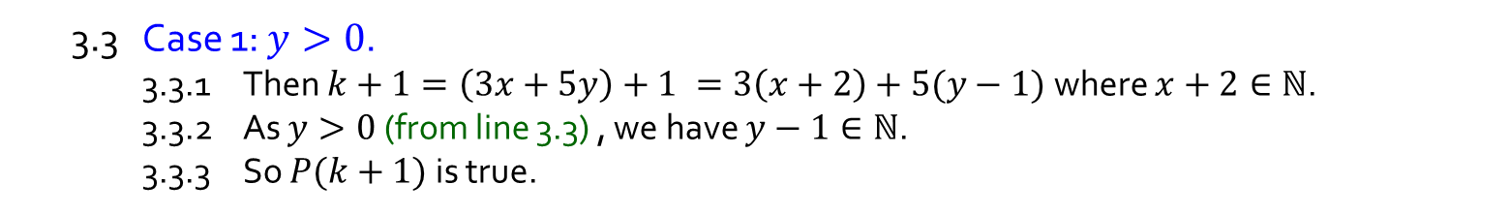
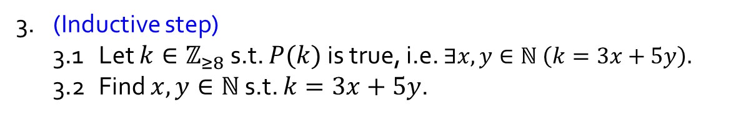
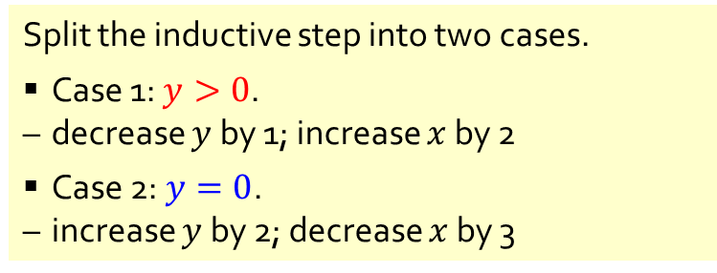
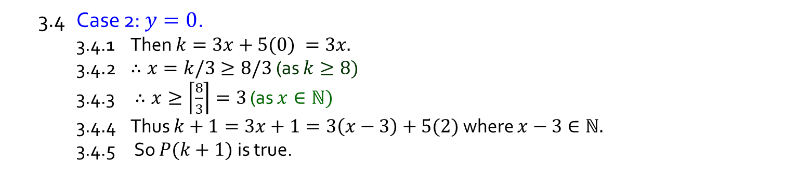
Q5.
Prove: $∀n∈ℤ_{≥8}, ∃x,y∈ℕ (n=3x+5y).$
1. (Define $P(n)$) $∀n∈ℤ_{≥8}$, let $P\left(n\right)≡∃x,y∈ℕ (n=3x+5y).$
2. (Basis step) $P(8)$is true as $8=3(1)+5(1).$
3. (Inductive step)
3.1 Let $k∈ℤ_{≥8}$ s.t. $P(k)$is true, i.e. $∃x,y∈ℕ \left(k=3x+5y\right).$
3.2 Find $x,y∈ℕ$ s.t. $k=3x+5y$.
This is important. Why?
3.3 Case 1: $y>0$.
3.3.1 Then $k+1=\left(3x+5y\right)+1 =3\left(x+2\right)+5(y−1)$ where $x+2∈ℕ$.
3.3.2 As $y>0$ (from line 3.3) , we have $y−1∈ℕ\text{.}$
3.3.3 So $P(k+1)$ is true.
Split the inductive step into two cases.
Case 1: $y>0$.
decrease $y$ by 1; increase $x$ by 2
Case 2: $y=0$.
increase $y$ by 2; decrease $x$ by 3
3.4 Case 2: $y=0$.
3.4.1 Then $k=3x+5(0) =3x.$
3.4.2 $∴x=k/3≥8/3$ (as $k≥8)$
3.4.3 $∴x≥\left\lceil \frac{8}{3}\right\rceil =3$ (as $x∈ℕ)$
3.4.4 Thus $k+1=3x+1=3\left(x−3\right)+5(2)$ where $x−3∈ℕ.$
3.4.5 So $P(k+1)$ is true.
This is important too.
3.5 Thus $P(k+1)$ is true for all case.
4. Hence, $∀n∈ℤ_{≥8} P(n)$ is true by MI.

Slide 13
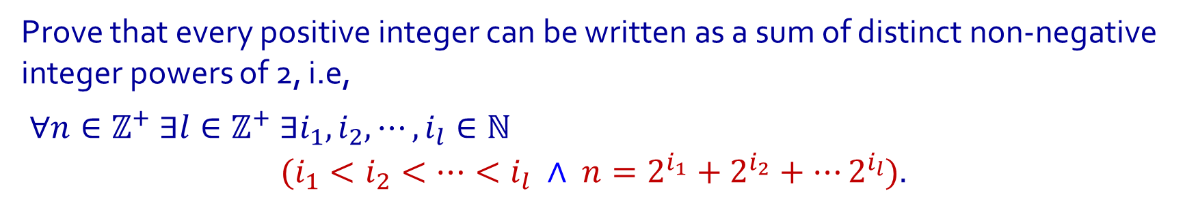
Q6.
Prove that every positive integer can be written as a sum of distinct non-negative integer powers of 2, i.e,
$∀n∈ℤ^{+} ∃l∈ℤ^{+} ∃i_{1},i_{2}, ⋯,i_{l}∈ℕ$
$$(i_{1}<i_{2}<⋯<i_{l} ∧ {n=2}^{i_{1}}+2^{i_{2}}+⋯2^{i_{l}}).$$
Examples:
Binary representation
$$123=1+2+8+16+32+64$$
$=2^{0}+2^{1}+2^{3}+2^{4}+2^{5}+2^{6}$
$$123={1111011}_{2}$$
$$1717=1+4+16+32+128+512+1024$$
$=2^{0}+{2^{2}+2}^{4}+2^{5}+2^{7}+2^{9}+2^{10}$
$$1717={11010110101}_{2}$$
$$776=8+256+512$$
$=2^{3}+2^{8}+2^{9}$
$$776={1100001000}_{2}$$

Slide 14
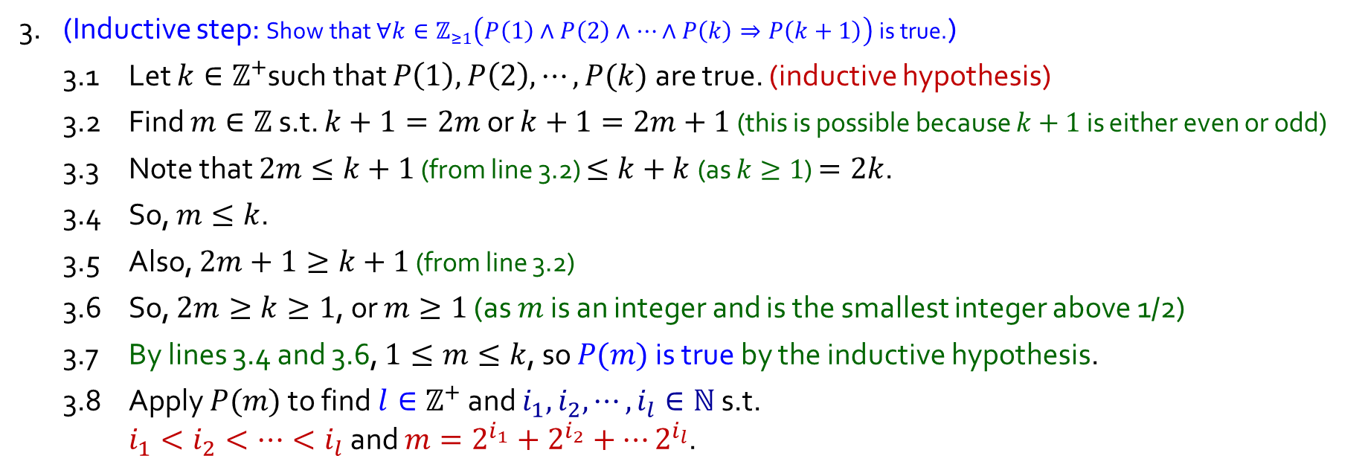
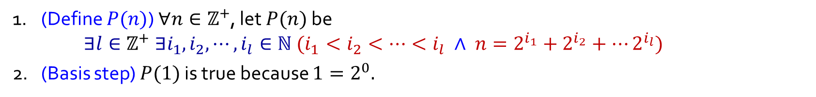
Q6.
Using Strong MI
1. (Define $P(n)$) $∀n∈ℤ^{+}$, let $P(n)$ be $∃l∈ℤ^{+} ∃i_{1},i_{2}, ⋯,i_{l}∈ℕ (i_{1}<i_{2}<⋯<i_{l} ∧ {n=2}^{i_{1}}+2^{i_{2}}+⋯2^{i_{l}})$
2. (Basis step) $P(1)$ is true because $1=2^{0}.$
3. (Inductive step: Show that $∀k∈ℤ_{≥1}\left(P\left(1\right)∧P\left(2\right)∧⋯∧P\left(k\right)⇒P\left(k+1\right)\right)$ is true.)
3.1 Let $k∈ℤ^{+}$such that $P\left(1\right),P\left(2\right),⋯,P(k)$are true. (inductive hypothesis)
3.2 Find $m∈ℤ$ s.t. $k+1=2m$ or $k+1=2m+1$ (this is possible because $k+1$ is either even or odd)
3.3 Note that $2m≤k+1$ (from line 3.2) $≤k+k$ (as $k≥1$) $=2k$.
3.4 So, $m≤k$.
3.5 Also, $2m+1≥k+1$ (from line 3.2)
3.6 So, $2m≥k≥1$, or $m≥1$ (as $m$ is an integer and is the smallest integer above 1/2)
3.7 By lines 3.4 and 3.6, $1≤m≤k$, so $P(m)$ is true by the inductive hypothesis.
3.8 Apply $P(m)$ to find $l∈ℤ^{+}$ and $i_{1},i_{2}, ⋯,i_{l}∈ℕ$ s.t. $i_{1}<i_{2}<⋯<i_{l}$ and ${m=2}^{i_{1}}+2^{i_{2}}+⋯2^{i_{l}}$.

Slide 15
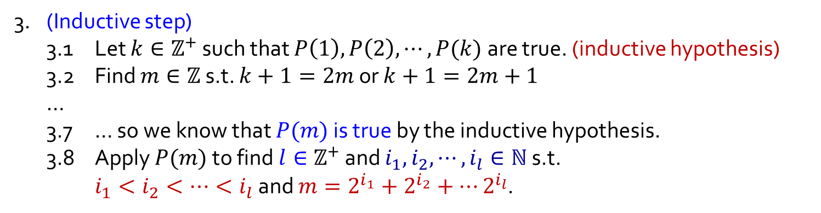
Q6.
3. (Inductive step)
3.1 Let $k∈ℤ^{+}$ such that $P\left(1\right),P\left(2\right),⋯,P(k)$are true. (inductive hypothesis)
3.2 Find $m∈ℤ$ s.t. $k+1=2m$ or $k+1=2m+1$
…
3.7 … so we know that $P(m)$ is true by the inductive hypothesis.
3.8 Apply $P(m)$ to find $l∈ℤ^{+}$ and $i_{1},i_{2}, ⋯,i_{l}∈ℕ$ s.t. $i_{1}<i_{2}<⋯<i_{l}$ and ${m=2}^{i_{1}}+2^{i_{2}}+⋯2^{i_{l}}$.
Using Strong MI
3.9 Case 1$: k+1 = 2m$.
3.10 Case 2$: k+1 = 2m+1$.
3.9.1 $k+1= 2m$ $=2(2^{i_{1}}+2^{i_{2}}+⋯+2^{i_{l}})$ (by the choice of $i_{1},⋯,i_{l}$) $=2^{i_{1}+1}+2^{i_{2}+1}+⋯+2^{i_{l}+1}$.
3.9.2 Also, $i_{1}+1<i_{2}+1<⋯<i_{l}+1$ (as $i_{1}<i_{2}<⋯<i_{l}$)
3.9.3 So, $P(k+1)$ is true.
3.10.1 $k+1= 2m+1$ $=2\left(2^{i_{1}}+2^{i_{2}}+⋯+2^{i_{l}}\right)+1$ (by the choice of $i_{1},⋯,i_{l}$) $=2^{0}+2^{i_{1}+1}+2^{i_{2}+1}+⋯+2^{i_{l}+1}$.
3.10.2 Also, ${0<i}_{1}+1<i_{2}+1<⋯<i_{l}+1$ (as $0≤i_{1}<i_{2}<⋯<i_{l}$)
3.10.3 So, $P(k+1)$ is true.
3.11 Thus $P(k+1)$ is true in all cases.
4. Hence, $∀n∈ℤ^{+} P(n)$ is true by Strong MI.

Slide 16
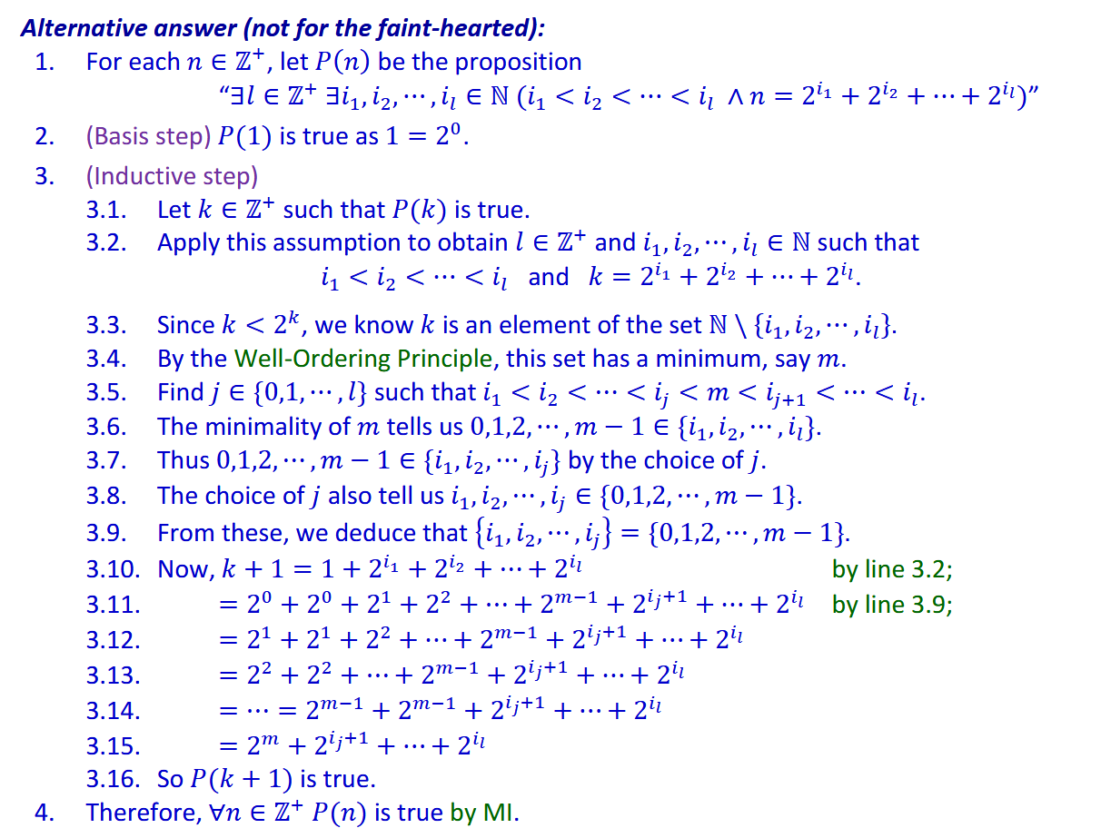
Q6.
Using Strong MI

Slide 17
Break

Slide 18
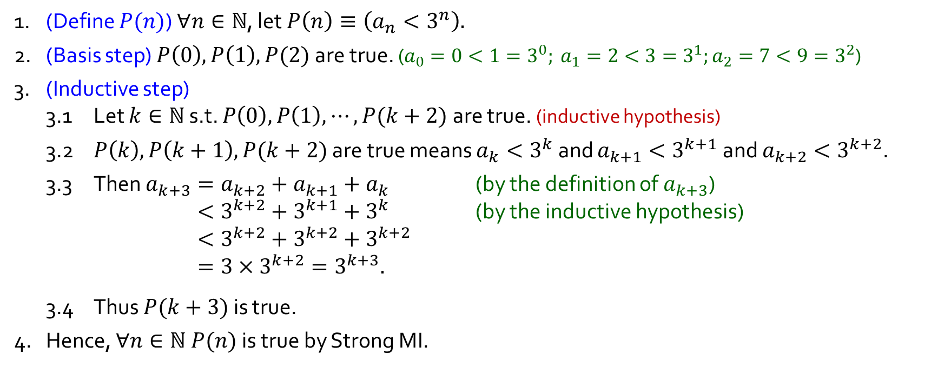
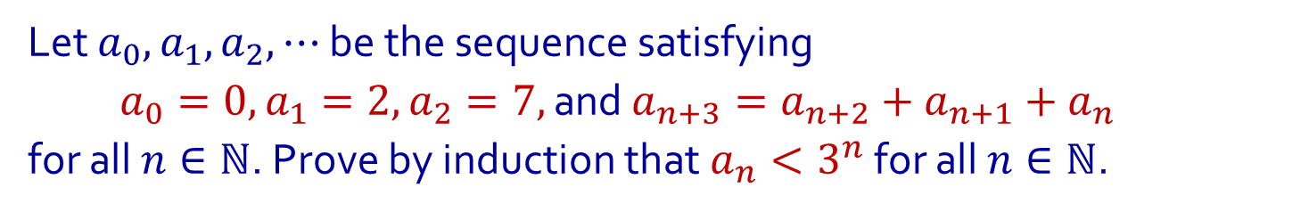
Q7.
Using Strong MI
Let $a_{0},a_{1},a_{2},⋯$ be the sequence satisfying
$a_{0}=0, a_{1}=2, a_{2}=7,$ and $a_{n+3}=a_{n+2}+a_{n+1}+a_{n}$
for all $n∈ℕ$. Prove by induction that $a_{n}<3^{n}$ for all $n∈ℕ$.
1. (Define $P(n)$) $∀n∈ℕ$, let $P\left(n\right)≡\left(a_{n}<3^{n}\right).$
2. (Basis step) $P\left(0\right),P\left(1\right),P(2)$ are true. ($a_{0}=0<1=3^{0}; a_{1}=2<3=3^{1};a_{2}=7<9=3^{2}$)
3. (Inductive step)
3.1 Let $k∈ℕ$ s.t. $P\left(0\right),P\left(1\right),⋯,P(k+2)$ are true. (inductive hypothesis)
3.2 $P\left(k\right),P\left(k+1\right),P(k+2)$ are true means $a_{k}<3^{k}$ and $a_{k+1}<3^{k+1}$ and $a_{k+2}<3^{k+2}$.
3.3 Then $a_{k+3}=a_{k+2}+a_{k+1}+a_{k}$ (by the definition of $a_{k+3}$) $<3^{k+2}+3^{k+1}+3^{k}$ (by the inductive hypothesis) $<3^{k+2}+3^{k+2}+3^{k+2}$ $=3×3^{k+2}=3^{k+3}.$
3.4 Thus $P(k+3)$ is true.
4. Hence, $∀n∈ℕ P(n)$ is true by Strong MI.

Slide 19
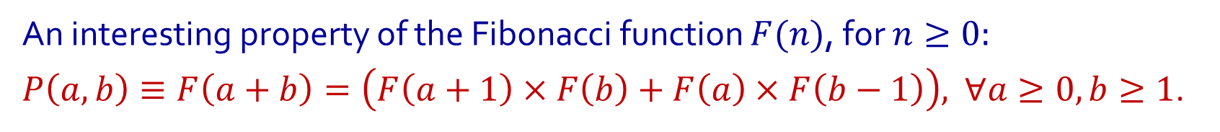
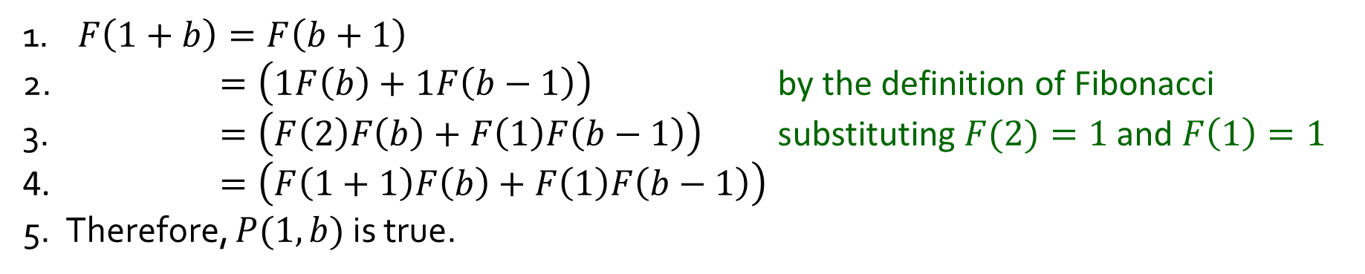
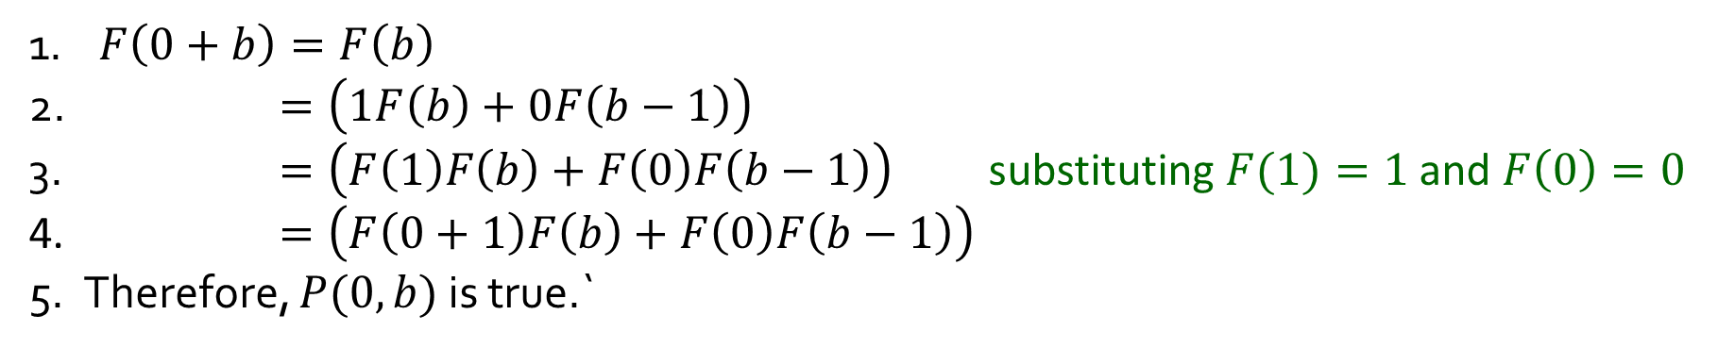
Q8.
Using Strong MI
An interesting property of the Fibonacci function $F(n)$, for $n≥0:$
$P\left(a,b\right)≡F\left(a+b\right)=\left(F\left(a+1\right)×F\left(b\right)+F\left(a\right)×F\left(b−1\right)\right),$ $∀a≥0,b≥1$.
(a) Prove the basis steps $P(0,b)$ and $P(1,b)$ for all $b≥1$.
1. $F\left(0+b\right)=F\left(b\right)$
2. $=\left(1F\left(b\right)+0F\left(b−1\right)\right)$
3. $=\left(F\left(1\right)F\left(b\right)+F\left(0\right)F\left(b−1\right)\right)$ substituting $F(1)=1$and $F\left(0\right)=0$
4. $=\left(F\left(0+1\right)F\left(b\right)+F\left(0\right)F\left(b−1\right)\right)$
5. Therefore, $P(0,b)$ is true.`
1. $F\left(1+b\right)=F\left(b+1\right)$
2. $=\left(1F\left(b\right)+1F\left(b−1\right)\right)$ by the definition of Fibonacci
3. $=\left(F\left(2\right)F\left(b\right)+F\left(1\right)F\left(b−1\right)\right)$ substituting $F(2)=1$and $F\left(1\right)=1$
4. $=\left(F\left(1+1\right)F\left(b\right)+F\left(1\right)F\left(b−1\right)\right)$
5. Therefore, $P(1,b)$ is true.

Slide 20
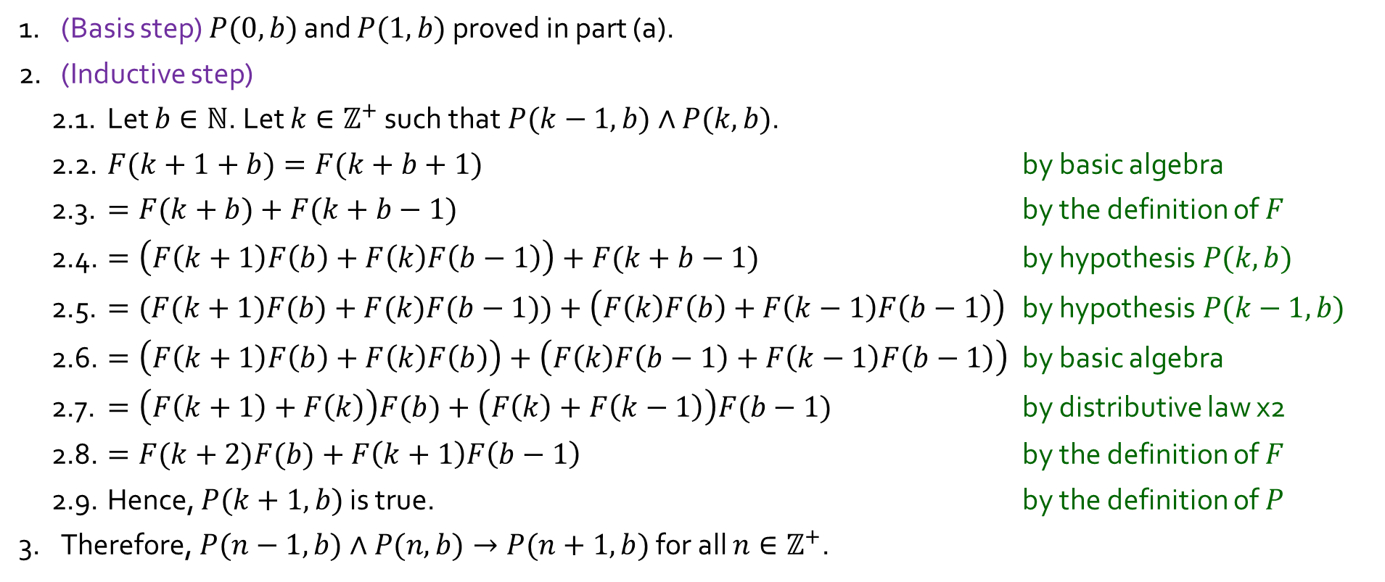
Q8.
An interesting property of the Fibonacci function $F(n)$, for $n≥0:$
$P\left(a,b\right)≡F\left(a+b\right)=\left(F\left(a+1\right)×F\left(b\right)+F\left(a\right)×F\left(b−1\right)\right),$ $∀a≥0,b≥1$.
Let $b∈ℕ$. Prove: $P(n−1,b)∧P(n,b)→P(n+1,b)$ for all $n∈ℤ^{+}$.
1. (Basis step) $P(0,b)$ and $P(1,b)$ proved in part (a).
2. (Inductive step)
2.1. Let $b∈ℕ$. Let $k∈ℤ^{+}$ such that$P(k−1,b)∧P(k,b)$.
2.2. $F(k+1+b)=F(k+b+1)$ by basic algebra
2.3. $=F(k+b)+F(k+b−1)$ by the definition of $F$
2.4. $=\left(F\left(k+1\right)F\left(b\right)+F\left(k\right)F\left(b−1\right)\right)+F(k+b−1)$ by hypothesis$P(k,b)$
2.5. $=(F(k+1)F(b)+F(k)F(b−1))+\left(F\left(k\right)F\left(b\right)+F\left(k−1\right)F\left(b−1\right)\right)$ by hypothesis$P(k−1,b)$
2.6. $=\left(F\left(k+1\right)F\left(b\right)+F\left(k\right)F\left(b\right)\right)+\left(F\left(k\right)F\left(b−1\right)+F\left(k−1\right)F\left(b−1\right)\right)$ by basic algebra
2.7. $=\left(F\left(k+1\right)+F\left(k\right)\right)F(b)+\left(F\left(k\right)+F\left(k−1\right)\right)F(b−1)$ by distributive law x2
2.8. $=F(k+2)F(b)+F\left(k+1\right)F\left(b−1\right)$ by the definition of $F$
2.9. Hence, $P(k+1,b)$ is true. by the definition of $P$
3. Therefore, $P(n−1,b)∧P(n,b)→P(n+1,b)$ for all $n∈ℤ^{+}$.

Slide 21
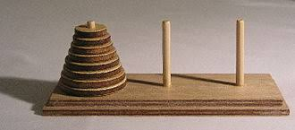
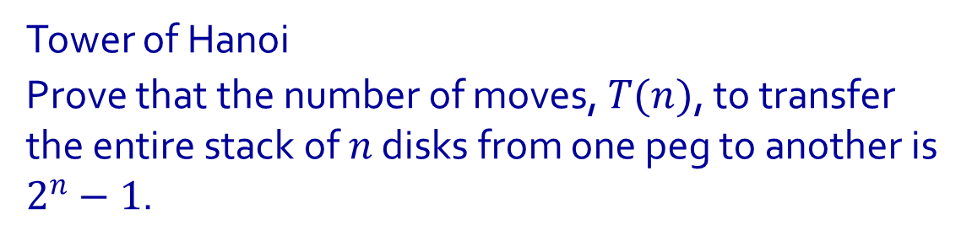
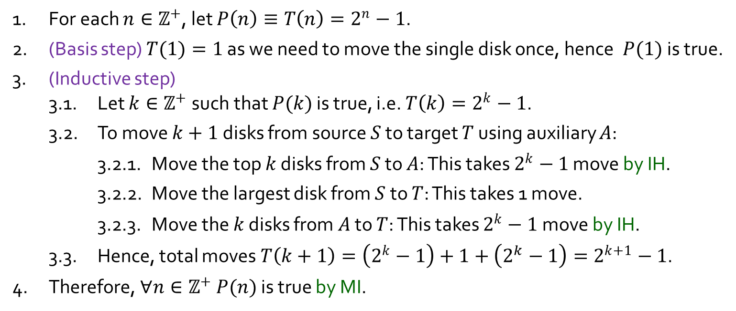
Q9.
Tower of Hanoi
Prove that the number of moves, $T(n)$, to transfer the entire stack of $n$ disks from one peg to another is $2^{n}−1$.
1. For each $n∈ℤ^{+}$, let $P\left(n\right)≡T\left(n\right)=2^{n}−1$.
2. (Basis step) $T(1)=1$ as we need to move the single disk once, hence$P(1)$ is true.
3. (Inductive step)
3.1. Let $k∈ℤ^{+}$such that $P(k)$ is true, i.e. $T\left(k\right)=2^{k}−1$.
3.2. To move $k+1$ disks from source $S$ to target $T$ using auxiliary $A$:
3.2.1. Move the top $k$ disks from $S$ to $A$: This takes $2^{k}−1$ move by IH.
3.2.2. Move the largest disk from $S$ to $T$: This takes 1 move.
3.2.3. Move the $k$ disks from $A$ to $T$: This takes $2^{k}−1$ move by IH.
3.3. Hence, total moves $T\left(k+1\right)=\left(2^{k}−1\right)+1+\left(2^{k}−1\right)=2^{k+1}−1$.
4. Therefore, $∀n∈ℤ^{+} P(n)$ is true by MI.

Slide 22

Q9.
Tower of Hanoi
Prove that the number of moves, $T(n)$, to transfer the entire stack of $n$ disks from one peg to another is $2^{n}−1$.
Actually, you’ve just somewhat defined the optimal solution. There is more nuance to be had here given the space ‘availability’ after each step from 3.2.1 – 3.2.2, but it is omitted here, and its correctness is relatively trivial to prove nonetheless.
The learning point here is how to use MI more than to solve the problem.
Maybe you’ll re-encounter this in CS2040S?

Slide 23


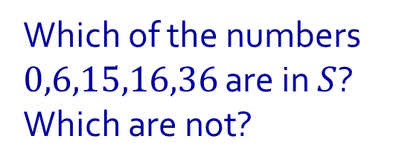



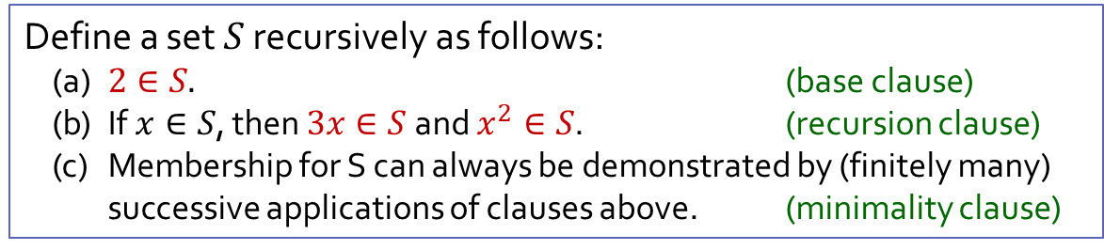









Q10.
Define a set $S$ recursively as follows:
(a) $2∈S.$ (base clause)
(b) If $x∈S$, then $3x∈S$ and $x^{2}∈S$. (recursion clause)
(c) Membership for S can always be demonstrated by (finitely many) successive applications of clauses above. (minimality clause)
Which of the numbers $0,6,15,16,36$ are in $S$? Which are not?
18
$$3x$$
$$3x$$
$$x^{2}$$
6
$$x^{2}$$
36
$$3x$$
$$3x$$
$$x^{2}$$
2
$$x^{2}$$
12
$$3x$$
4
$$3x$$
$$x^{2}$$
$$x^{2}$$
16
$$3x$$
$$x^{2}$$

Slide 24


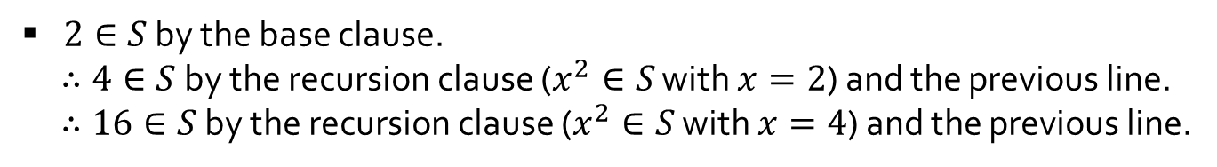
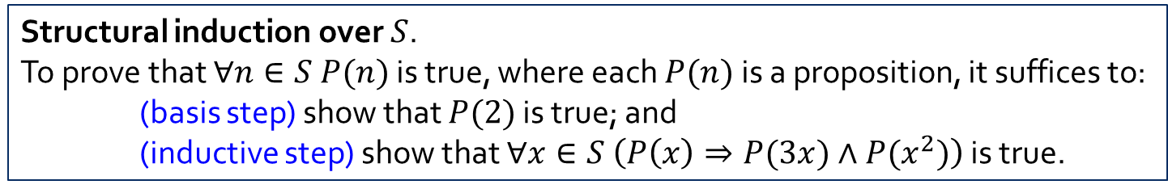
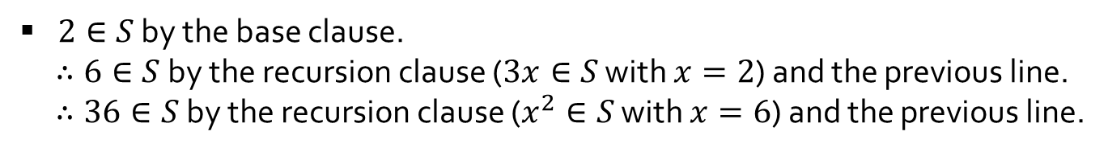
Q10.
Define a set $S$ recursively as follows:
(a) $2∈S.$ (base clause)
(b) If $x∈S$, then $3x∈S$ and $x^{2}∈S$. (recursion clause)
(c) Membership for S can always be demonstrated by (finitely many) successive applications of clauses above. (minimality clause)
Which of the numbers $0,6,15,16,36$ are in $S$? Which are not?
Structural induction over $S$.
To prove that $∀n∈S P(n)$ is true, where each $P(n)$is a proposition, it suffices to:
(basis step) show that $P(2)$ is true; and
(inductive step) show that $∀x∈S \left(P\left(x\right)⇒P(3x)∧P(x^{2})\right)$ is true.
$$x$$ | $$x∈S$$
0
6
15
16
36
We know $0∉S$ because all $x∈S$ satisfy $x≥2$, as one can show by structural induction over $S$.
$2∈S$ by the base clause.
$∴6∈S$ by the recursion clause ($3x∈S$ with $x=2$) and the previous line.
$∴36∈S$ by the recursion clause ($x^{2}∈S$ with $x=6$) and the previous line.
$2∈S$ by the base clause.
$∴4∈S$ by the recursion clause ($x^{2}∈S$ with $x=2$) and the previous line.
$∴16∈S$ by the recursion clause ($x^{2}∈S$ with $x=4$) and the previous line.
We know $15∉S$ because no $x∈S$ is odd, as one can show by structural induction over $S$.

Slide 25
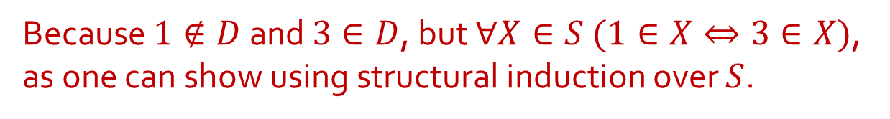


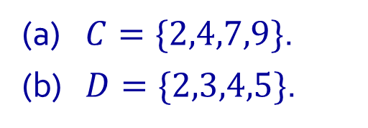
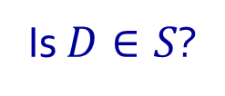




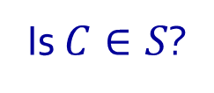


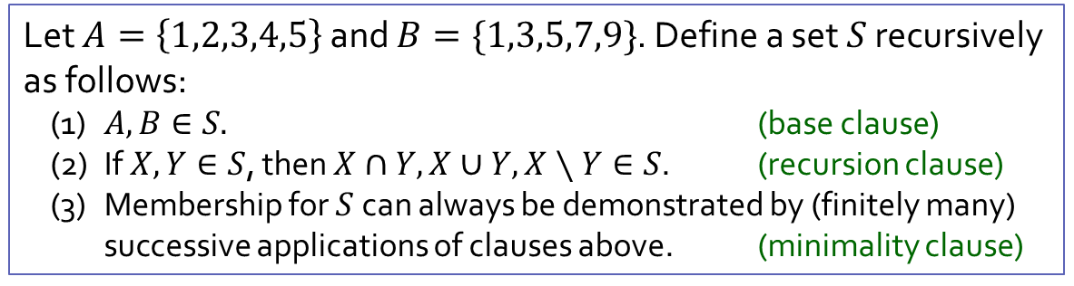
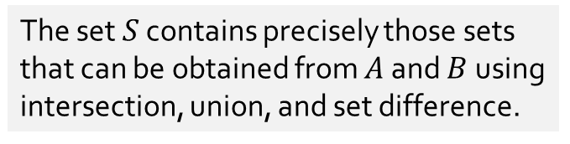
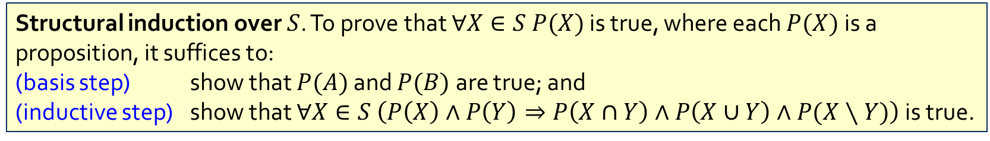

Q11.
(a) $C=\{2,4,7,9\}$.
(b) $D=\{2,3,4,5\}$.
Let $A=\left\{1,2,3,4,5\right\}$ and $B=\{1,3,5,7,9\}$. Define a set $S$ recursively as follows:
(1) $A,B∈S.$ (base clause)
(2) If $X,Y∈S$, then $X∩Y,X∪Y,X∖Y∈S$. (recursion clause)
(3) Membership for $S$ can always be demonstrated by (finitely many) successive applications of clauses above. (minimality clause)
The set $S$ contains precisely those sets that can be obtained from $A$ and $B$ using intersection, union, and set difference.
Structural induction over $S$. To prove that $∀X∈S P(X)$ is true, where each $P(X)$is a proposition, it suffices to:
(basis step) show that $P(A)$ and $P(B)$ are true; and
(inductive step) show that $∀X∈S \left(P\left(X\right)∧P\left(Y\right)⇒P\left(X∩Y\right)∧P\left(X∪Y\right)∧P(X∖Y)\right)$ is true.
Is $C∈S$?
Yes!
$$A$$
$$2$$
$$1$$
$$7$$
Why?
Because $C=\left(A∖B\right)∪(B∖A)$.
$$3$$
$$5$$
$$9$$
$$4$$
Is $D∈S$?
No!
$$B$$
Why?
Because $1∉D$ and $3∈D$, but $∀X∈S (1∈X⇔3∈X)$, as one can show using structural induction over $S$.

Slide 26


Q11.
(a) $C=\{2,4,7,9\}$.
(b) $D=\{2,3,4,5\}$.
Let $A=\left\{1,2,3,4,5\right\}$ and $B=\{1,3,5,7,9\}$. Define a set $S$ recursively as follows:
(1) $A,B∈S.$ (base clause)
(2) If $X,Y∈S$, then $X∩Y,X∪Y,X∖Y∈S$. (recursion clause)
(3) Membership for $S$ can always be demonstrated by (finitely many) successive applications of clauses above. (minimality clause)
How to show that D is not in S by structural induction?
Need to show that for all X in S, either 1 & 3 is in X, or neither are in X.
Can be reworded as P(X) = ∀𝑋 ∈ 𝑆 (1 ∈ 𝑋 ⇔ 3 ∈ 𝑋).
Process is similar.
Write basis step.
Assume P(X), P(Y) are true. Show P(X union Y) & P(X intersect Y) are also true.
By induction, you’ve shown that for all X in S, P(X) is true!

Slide 27
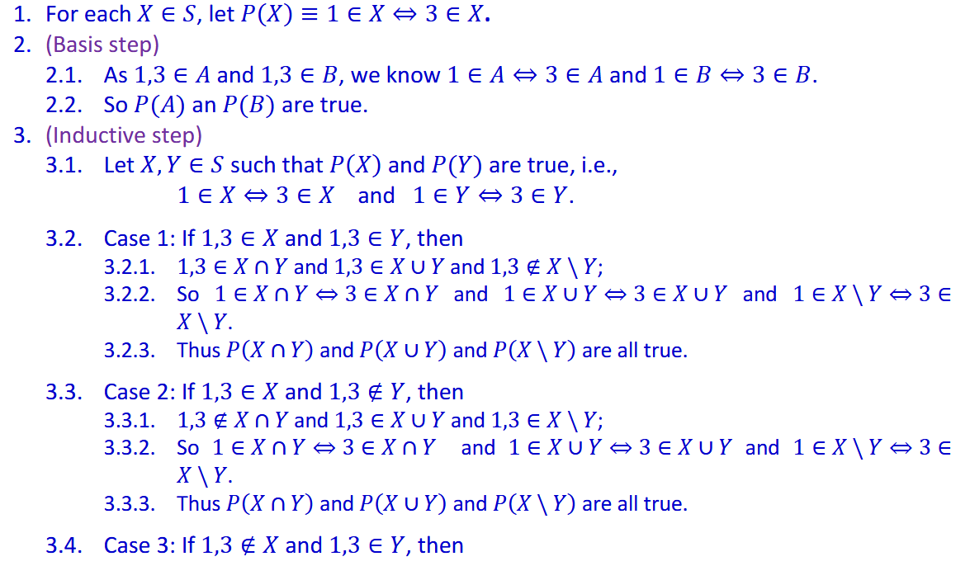
Q11.
(a) $C=\{2,4,7,9\}$.
(b) $D=\{2,3,4,5\}$.
Let $A=\left\{1,2,3,4,5\right\}$ and $B=\{1,3,5,7,9\}$. Define a set $S$ recursively as follows:
(1) $A,B∈S.$ (base clause)
(2) If $X,Y∈S$, then $X∩Y,X∪Y,X∖Y∈S$. (recursion clause)
(3) Membership for $S$ can always be demonstrated by (finitely many) successive applications of clauses above. (minimality clause)

Slide 28
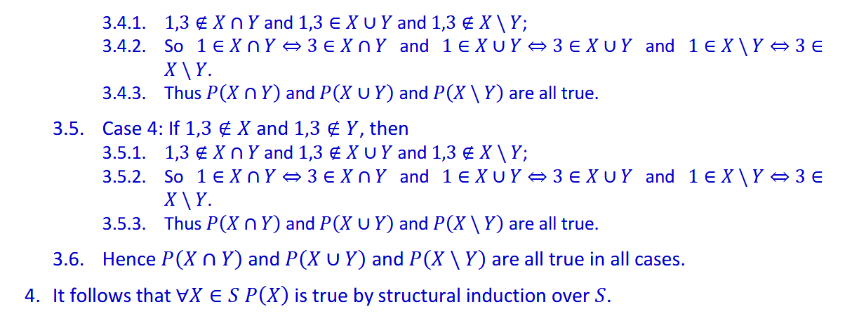
Q11.
(a) $C=\{2,4,7,9\}$.
(b) $D=\{2,3,4,5\}$.
Let $A=\left\{1,2,3,4,5\right\}$ and $B=\{1,3,5,7,9\}$. Define a set $S$ recursively as follows:
(1) $A,B∈S.$ (base clause)
(2) If $X,Y∈S$, then $X∩Y,X∪Y,X∖Y∈S$. (recursion clause)
(3) Membership for $S$ can always be demonstrated by (finitely many) successive applications of clauses above. (minimality clause)

Slide 29
End of Tutorial 7

