Slide 1
Cs1231S tutorial #8
Cardinality and Revision

Slide 2
Learning objectives of this tutorial
Cardinality
relationship between bijections and cardinality
Cantor’s definition of same-cardinality
the notion of countability
techniques to show a set is countable
techniques to show a set is uncountable

Slide 3
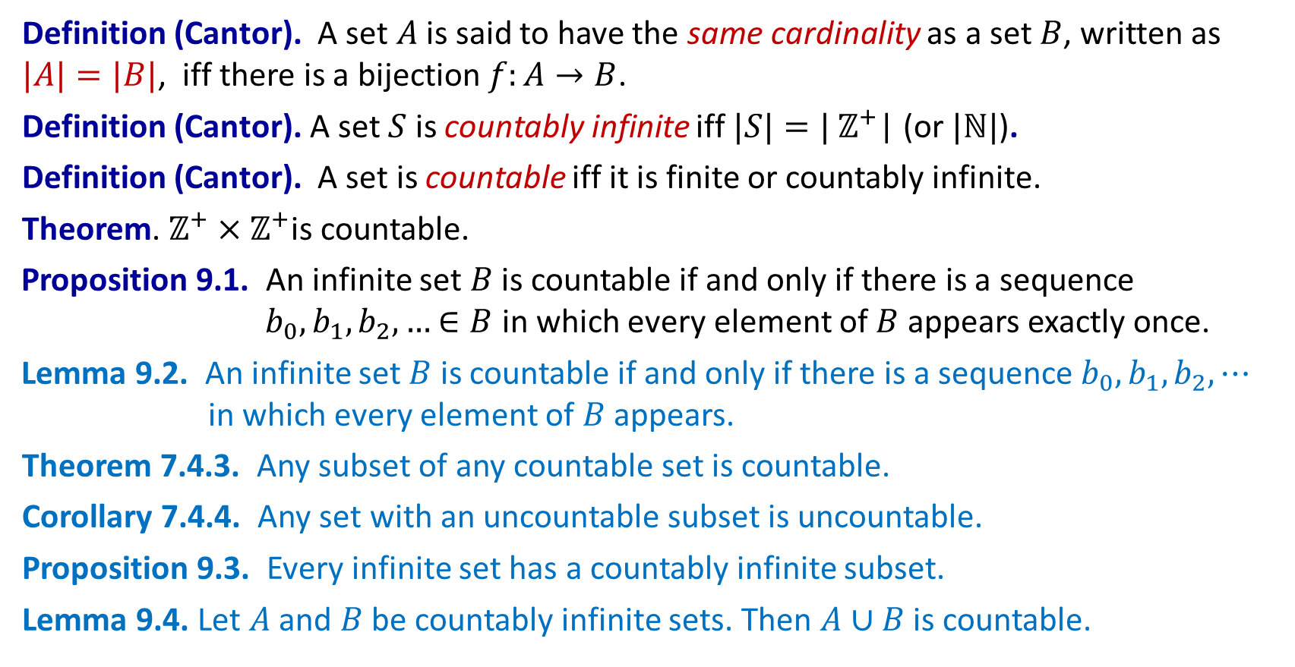
Quick summary
Definition (Cantor). A set $A$ is said to have the same cardinality as a set $B$, written as $|A|=|B|$, iff there is a bijection $f:A→B$.
Definition (Cantor). A set $S$ is countably infinite iff $|S|=|$ $ℤ^{+}$| (or $|ℕ|$).
Definition (Cantor). A set is countable iff it is finite or countably infinite.
Theorem. $ℤ^{+}×ℤ^{+}$is countable.
Proposition 9.1. An infinite set $B$ is countable if and only if there is a sequence $b_{0},b_{1},b_{2},…$ $∈B$ in which every element of $B$ appears exactly once.
Lemma 9.2. An infinite set $B$ is countable if and only if there is a sequence $b_{0},b_{1},b_{2},⋯$ in which every element of $B$ appears.
Theorem 7.4.3. Any subset of any countable set is countable.
Corollary 7.4.4. Any set with an uncountable subset is uncountable.
Proposition 9.3. Every infinite set has a countably infinite subset.
Lemma 9.4. Let $A$ and $B$ be countably infinite sets. Then $A∪B$ is countable.

Slide 4
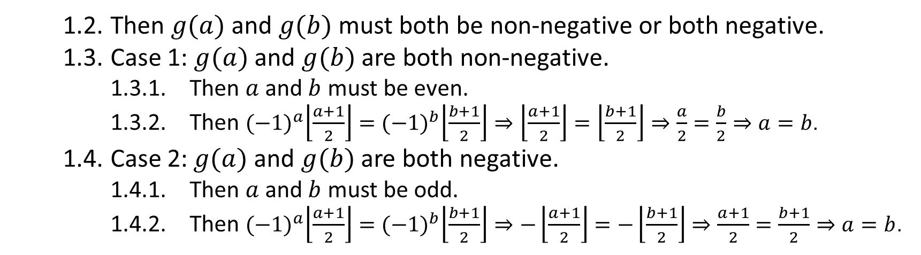
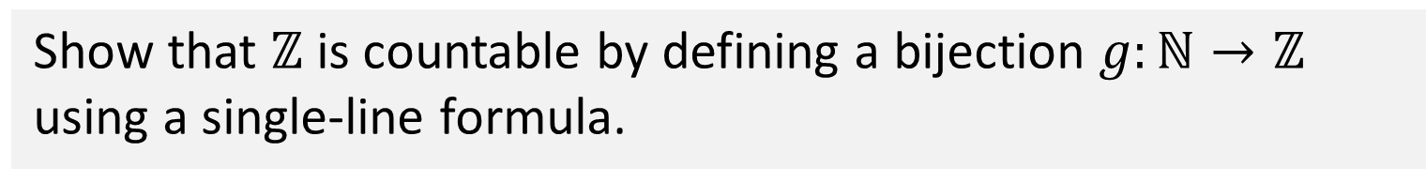
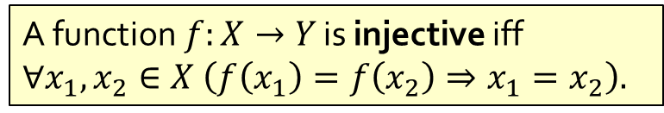
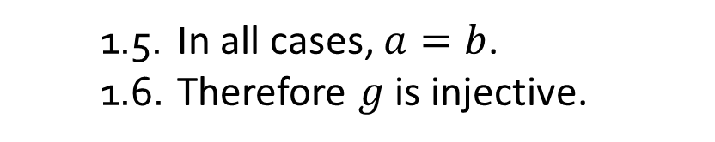
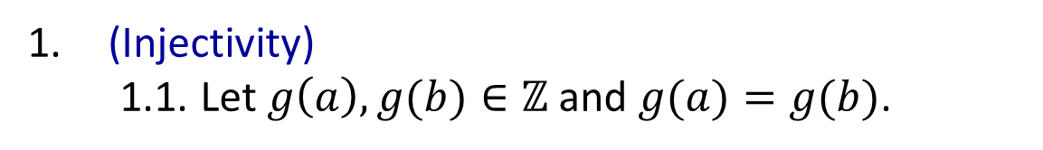
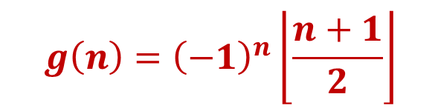
Q1.
Show that $ℤ$ is countable by defining a bijection $g:ℕ→ℤ$ using a single-line formula.
$$g\left(n\right)={\left(−1\right)}^{n}\left\lfloor \frac{n+1}{2}\right\rfloor$$
1. (Injectivity)
1.1. Let $g\left(a\right),g(b)∈ℤ$ and $g(a)=g(b)$.
A function$f:X→Y$ is injective iff
$$∀x_{1},x_{2}∈X \left(f\left(x_{1}\right)=f\left(x_{2}\right)⇒x_{1}=x_{2}\right).$$
1.2. Then $g(a)$ and $g(b)$ must both be non-negative or both negative.
1.3. Case 1: $g(a)$ and $g(b)$ are both non-negative.
1.3.1. Then $a$ and $b$ must be even.
1.3.2. Then ${(−1)}^{a}\left\lfloor \frac{a+1}{2}\right\rfloor ={(−1)}^{b}\left\lfloor \frac{b+1}{2}\right\rfloor ⇒\left\lfloor \frac{a+1}{2}\right\rfloor =\left\lfloor \frac{b+1}{2}\right\rfloor ⇒\frac{a}{2}=\frac{b}{2}⇒a=b$.
1.4. Case 2: $g(a)$ and $g(b)$ are both negative.
1.4.1. Then $a$ and $b$ must be odd.
1.4.2. Then ${(−1)}^{a}\left\lfloor \frac{a+1}{2}\right\rfloor ={(−1)}^{b}\left\lfloor \frac{b+1}{2}\right\rfloor ⇒−\left\lfloor \frac{a+1}{2}\right\rfloor =−\left\lfloor \frac{b+1}{2}\right\rfloor ⇒\frac{a+1}{2}=\frac{b+1}{2}⇒a=b$.
1.5. In all cases, $a=b$.
1.6. Therefore $g$ is injective.
Notes:
Alternative answers:
n / 2 if even, - (n+1)/2 if odd
Or define inverse from Z to N (should be relatively easy, only need to show that odd -> negative, even -> non-negative)
If greater than 0, 2z
If less or equal to 0, -2z-1
Intutition: map!
0 -> 0
1 -> -1
2 -> -1
3 -> 2
4 -> -2

Slide 5
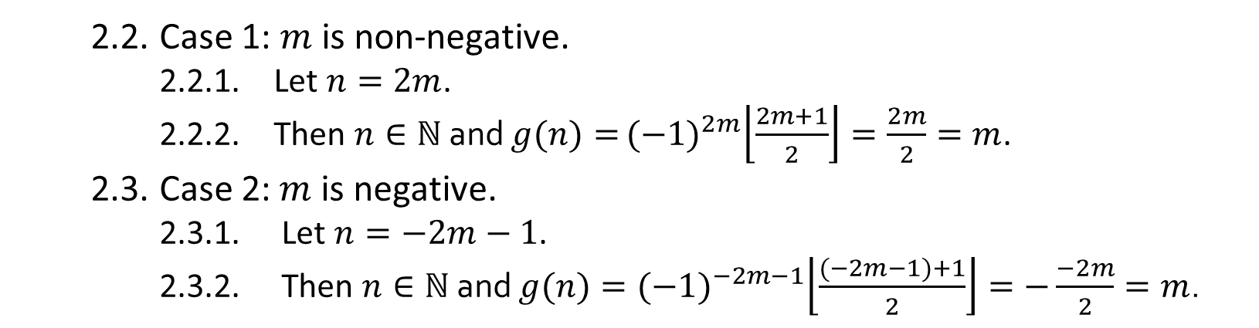
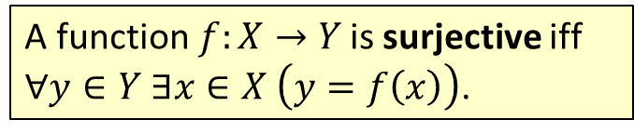

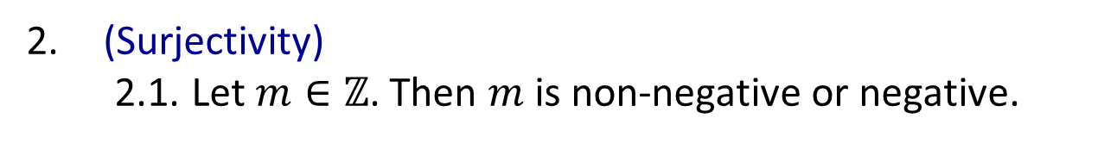
Q1.
Show that $ℤ$ is countable by defining a bijection $g:ℕ→ℤ$ using a single-line formula.
$$g\left(n\right)={\left(−1\right)}^{n}\left\lfloor \frac{n+1}{2}\right\rfloor$$
A function$f:X→Y$ is surjective iff
$∀y∈Y ∃x∈X \left(y=f\left(x\right)\right)$.
2. (Surjectivity)
2.1. Let $m∈ℤ$. Then $m$ is non-negative or negative.
2.2. Case 1: $m$ is non-negative.
2.2.1. Let $n=2m$.
2.2.2. Then $n∈ℕ$ and $g(n)=$ ${(−1)}^{2m}\left\lfloor \frac{2m+1}{2}\right\rfloor =\frac{2m}{2}=m$.
2.3. Case 2: $m$ is negative.
2.3.1. Let $n=−2m−1$.
2.3.2. Then $n∈ℕ$ and $g(n)={(−1)}^{−2m−1}\left\lfloor \frac{(−2m−1)+1}{2}\right\rfloor =−\frac{−2m}{2}=m$.
2.4. In all cases, there exists $n∈ℕ$ such that $g(n)=m$.
2.5. Therefore $g$ is surjective.
3. Therefore $g$ is a bijection from $ℕ$ to $ℤ$.

Slide 6
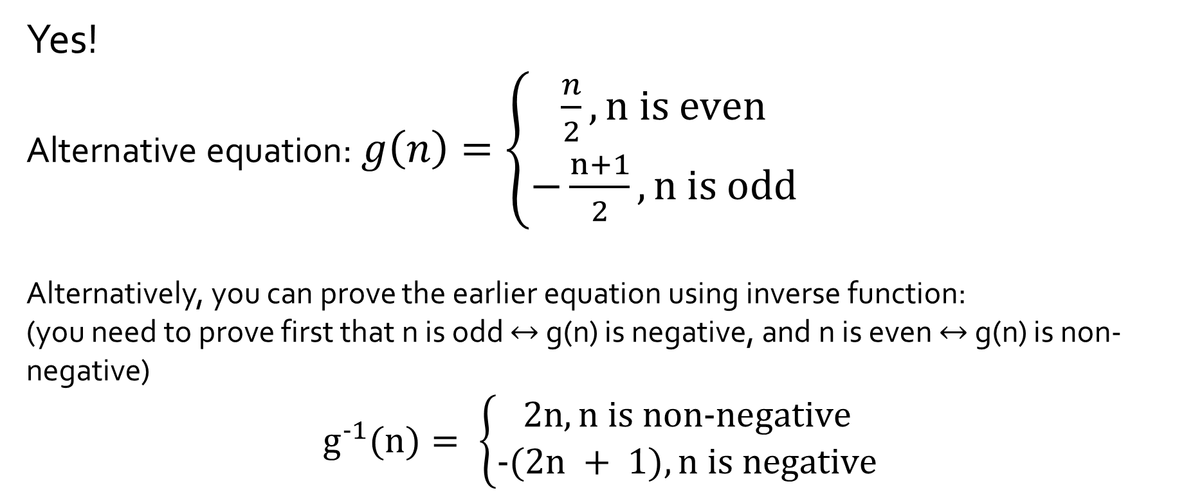

Q1.
Show that $ℤ$ is countable by defining a bijection $g:ℕ→ℤ$ using a single-line formula.
Are there alternative solutions?
Yes!
Alternative equation: $g\left(n\right)=\left\{\begin{aligned}\frac{n}{2},\text{n} \text{is} \text{even} \\ −\frac{n+1}{2}, \text{n} \text{is} odd\end{aligned}\right.$
Alternatively, you can prove the earlier equation using inverse function:
(you need to prove first that n is odd $↔$ g(n) is negative, and n is even $↔$ g(n) is non-negative)
$$g^{−1}(n)= \left\{\begin{aligned}2n, \text{n} \text{is} \text{non}\text{−}\text{negative} \\ −(2n + 1), \text{n} \text{is} \text{negative}\end{aligned}\right.$$

Slide 7
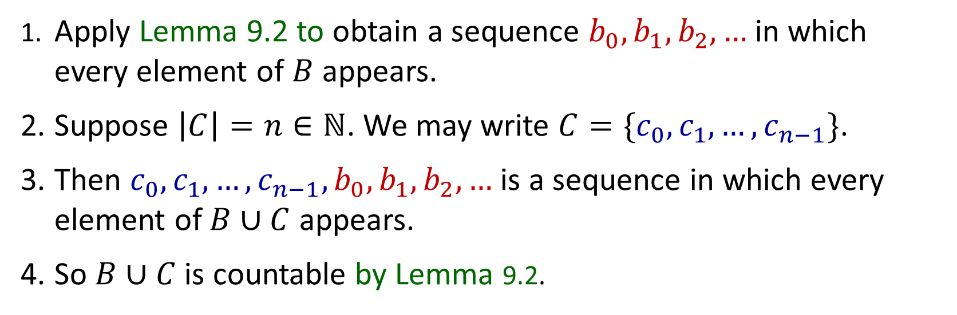
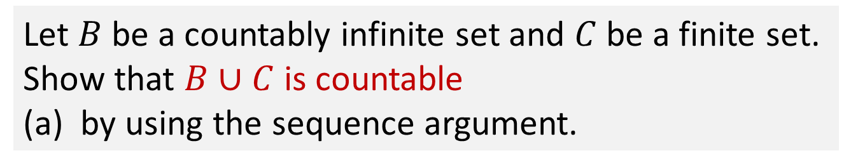
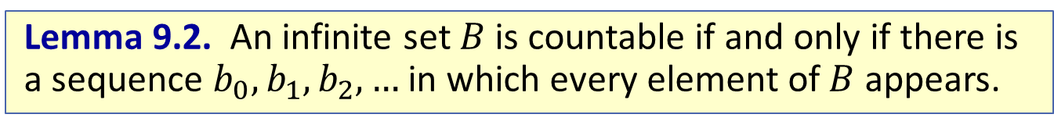
Q2.
Let $B$ be a countably infinite set and $C$ be a finite set. Show that $B∪C$ is countable
(a) by using the sequence argument.
1. Apply Lemma 9.2 to obtain a sequence $b_{0},b_{1},b_{2},…$ in which every element of $B$ appears.
2. Suppose $\left|C\right|=n∈ℕ$. We may write $C=\{c_{0},c_{1},…,c_{n−1}\}$.
3. Then $c_{0},c_{1},…,c_{n−1},b_{0},b_{1},b_{2},…$ is a sequence in which every element of $B∪C$ appears.
4. So $B∪C$ is countable by Lemma 9.2.
Lemma 9.2. An infinite set $B$ is countable if and only if there is a sequence $b_{0},b_{1},b_{2},…$ in which every element of $B$ appears.

Slide 8
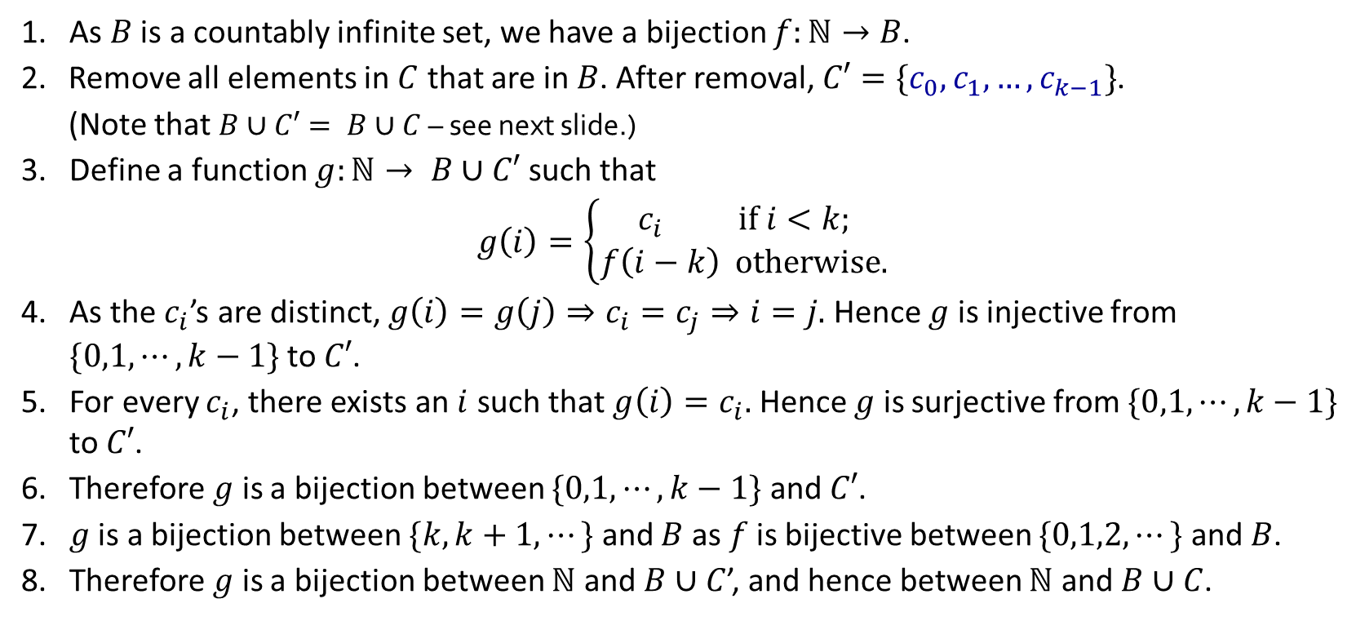
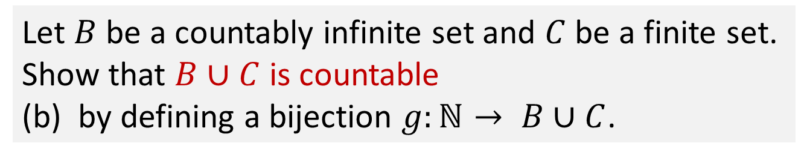
Q2.
Let $B$ be a countably infinite set and $C$ be a finite set. Show that $B∪C$ is countable
(b) by defining a bijection $g:ℕ→ B∪C$.
1. As $B$ is a countably infinite set, we have a bijection $f:ℕ→B$.
Remove all elements in $C$ that are in $B$. After removal, $C′=\{c_{0},c_{1},…,c_{k−1}\}$.
(Note that $B∪C′= B∪C$ – see next slide.)
3. Define a function $g:ℕ→ B∪C′$ such that
$$g\left(i\right)=\left\{\begin{aligned}c_{i} if i<k; \\ f\left(i−k\right) otherwise.\end{aligned}\right.$$
4. As the $c_{i}$’s are distinct, $g\left(i\right)=g\left(j\right)⇒c_{i}=c_{j}⇒i=j.$ Hence $g$ is injective from $\{0,1,⋯,k−1\}$ to $C′$.
5. For every $c_{i}$, there exists an $i$ such that $g\left(i\right)=c_{i}.$ Hence $g$ is surjective from $\{0,1,⋯,k−1\}$ to $C′$.
6. Therefore $g$ is a bijection between $\{0,1,⋯,k−1\}$ and $C′$.
7. $g$ is a bijection between $\{k,k+1,⋯\}$ and $B$ as $f$ is bijective between $\{0,1,2,⋯\}$ and $B$.
8. Therefore $g$ is a bijection between $ℕ$ and $B∪C$’, and hence between $ℕ$ and $B∪C$.

Slide 9
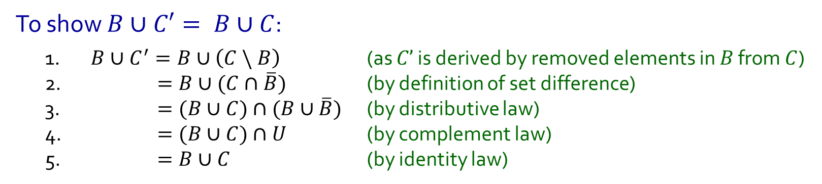
Q2.
Let $B$ be a countably infinite set and $C$ be a finite set. Show that $B∪C$ is countable
(b) by defining a bijection $g:ℕ→ B∪C$.
To show $B∪C′= B∪C$:
1. $B∪C^{′}=B∪\left(C \backslash B\right)$ (as $C’$ is derived by removed elements in $B$ from $C$)
2. $=B∪(C∩\overline{B})$ (by definition of set difference)
3. $=(B∪C)∩(B∪\overline{B})$ (by distributive law)
4. $=(B∪C)∩U$ (by complement law)
5. $=B∪C$ (by identity law)

Slide 10
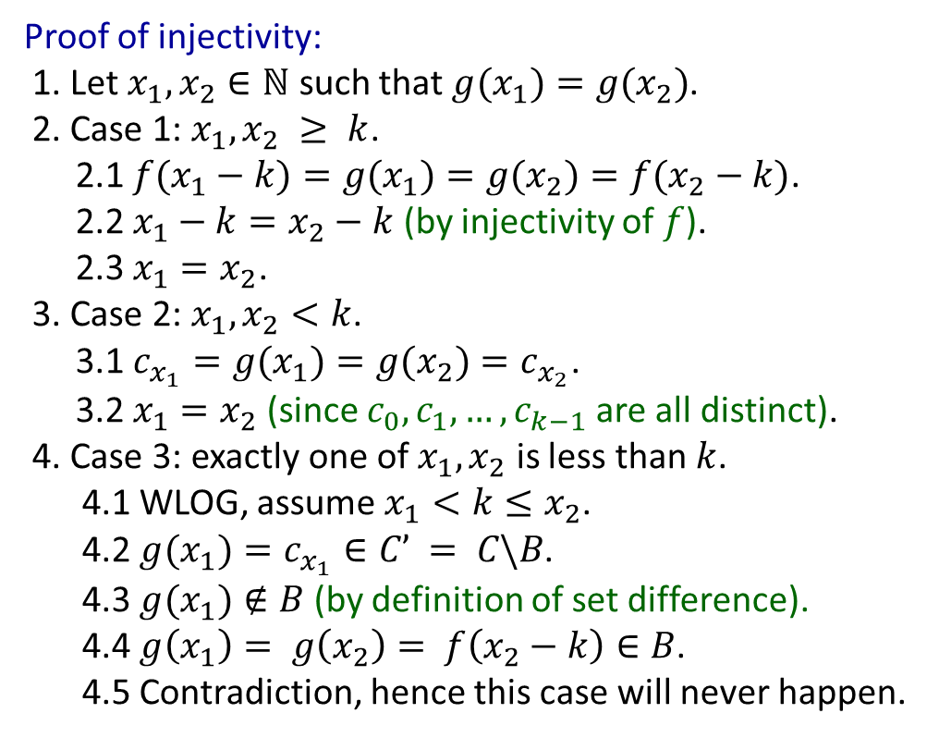
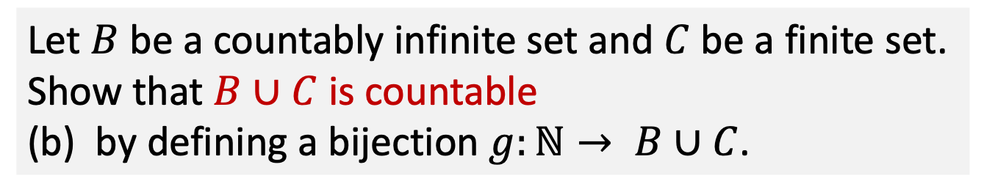

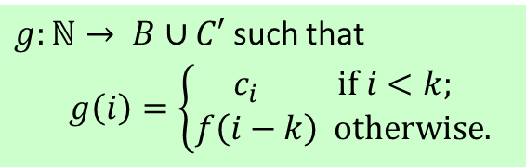
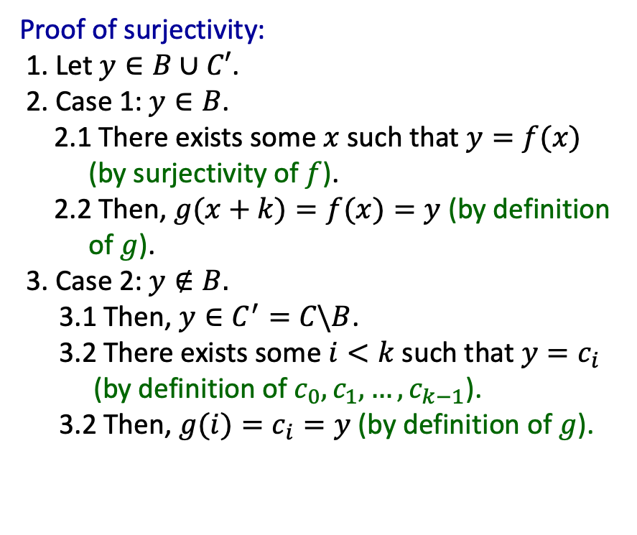
Q2.
Let $B$ be a countably infinite set and $C$ be a finite set. Show that $B∪C$ is countable
(b) by defining a bijection $g:ℕ→ B∪C$.
$g:ℕ→ B∪C′$ such that
$$g\left(i\right)=\left\{\begin{aligned}c_{i} if i<k; \\ f\left(i−k\right) otherwise.\end{aligned}\right.$$
Proof of injectivity:
1. Let $x_{1}, x_{2}∈ℕ$ such that $g(x_{1})=g(x_{2})$.
2. Case 1: $x_{1}, x_{2} ≥ k$.
2.1 $f(x_{1}−k)=g(x_{1})=g(x_{2})=f(x_{2}−k)$.
2.2 $x_{1}−k=x_{2}−k$(by injectivity of $f$).
2.3 $x_{1}=x_{2}$.
3. Case 2: $x_{1}, x_{2}<k$.
3.1 $c_{x_{1}}=g(x_{1})=g(x_{2})=c_{x_{2}}$.
3.2 $x_{1}=x_{2}$(since $c_{0}, c_{1}, …, c_{k−1}$ are all distinct).
4. Case 3: exactly one of $x_{1}, x_{2}$ is less than $k$.
4.1 WLOG, assume $x_{1}<k≤x_{2}$.
4.2 $g(x_{1})=c_{x_{1}}∈C’ = C\backslash B$.
4.3 $g(x_{1})∉B$ (by definition of set difference).
4.4 $g\left(x_{1}\right)= g\left(x_{2}\right)= f\left(x_{2}−k\right)∈B$.
4.5 Contradiction, hence this case will never happen.
Proof of surjectivity:
1. Let $y∈B∪C′$.
2. Case 1: $y∈B$.
2.1 There exists some $x$ such that $y=f(x)$ (by surjectivity of $f$).
2.2 Then, $g(x+k)=f(x)=y$ (by definition of $g$).
3. Case 2: $y∉B.$
3.1 Then, $y∈C^{′}=C\backslash B$.
3.2 There exists some $i<k$ such that $y=c_{i}$ (by definition of $c_{0}, c_{1}, …, c_{k−1}$).
3.2 Then, $g(i)=c_{i}=y$ (by definition of $g$).
To show $g$ is a bijection.

Slide 11

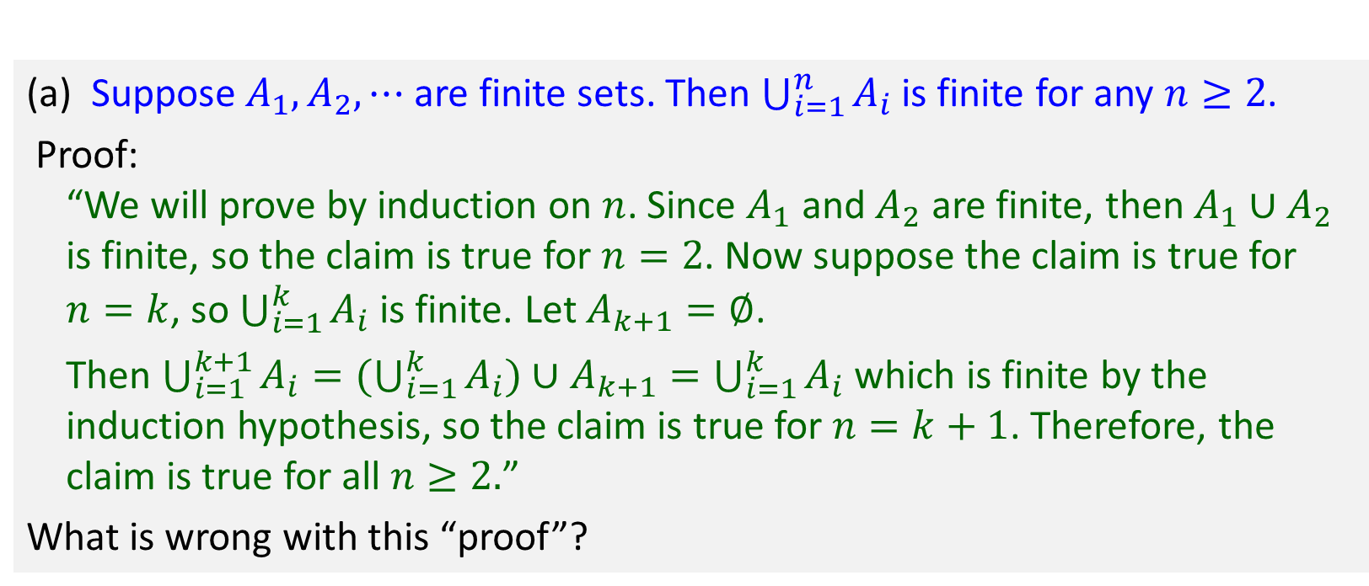
Q3.
(a) Suppose $A_{1},A_{2},⋯$ are finite sets. Then $\bigcup_{i=1}^{n}{A_{i}}$ is finite for any $n≥2$.
Proof:
“We will prove by induction on $n$. Since $A_{1}$ and $A_{2}$ are finite, then $A_{1}{∪A}_{2}$ is finite, so the claim is true for $n=2$. Now suppose the claim is true for $n=k$, so $\bigcup_{i=1}^{k}{A_{i}}$ is finite. Let $A_{k+1}=∅$.
Then $\bigcup_{i=1}^{k+1}{A_{i}=(\bigcup_{i=1}^{k}{A_{i})∪A_{k+1}}=\bigcup_{i=1}^{k}{A_{i}}}$ which is finite by the induction hypothesis, so the claim is true for $n=k+1$. Therefore, the claim is true for all $n≥2.$”
What is wrong with this “proof”?
There is an implicit universal quantification on $A_{1},A_{2},⋯$, i.e. we have to prove the claim is true for all possible $A_{1},A_{2},⋯$, so we cannot just consider the special case $A_{k+1}=∅$.

Slide 12
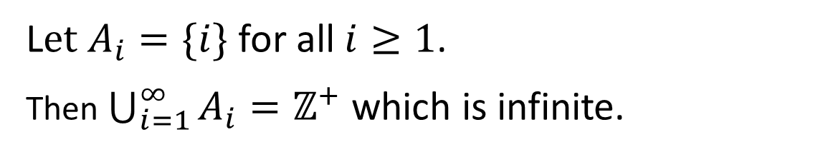
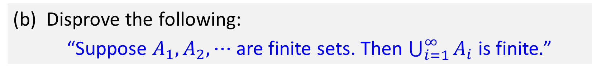
Q3.
(b) Disprove the following:
“Suppose $A_{1},A_{2},⋯$ are finite sets. Then $\bigcup_{i=1}^{∞}{A_{i}}$ is finite$.$”
L$et A_{i}=\{i\}$ for all $i≥1$.
Then $\bigcup_{i=1}^{∞}{A_{i}}=ℤ^{+}$ which is infinite.

Slide 13
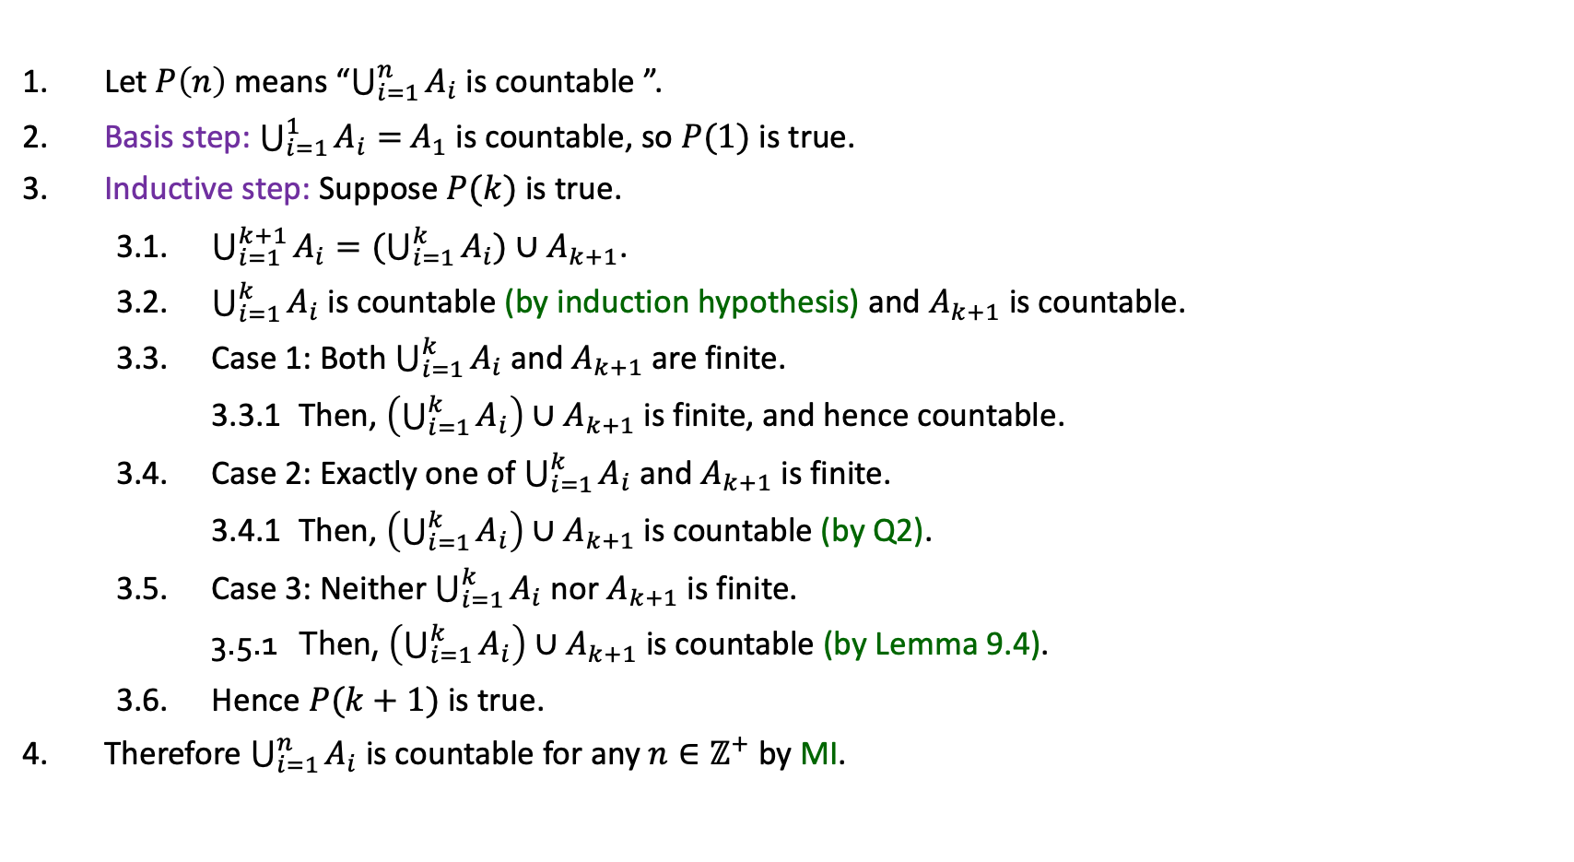
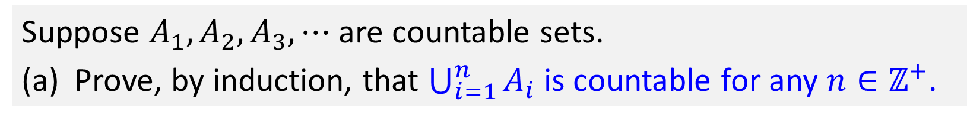
Q4.
Suppose $A_{1},A_{2},A_{3},⋯$ are countable sets.
(a) Prove, by induction, that $\bigcup_{i=1}^{n}{A_{i}}$ is countable for any $n∈ℤ^{+}$.
1. Let $P\left(n\right)$ means “$\bigcup_{i=1}^{n}{A_{i}}$ is countable ”.
2. Basis step: $\bigcup_{i=1}^{1}{A_{i}}=$ $A_{1}$ is countable, so $P(1)$ is true.
3. Inductive step: Suppose $P(k)$ is true.
3.1. $\bigcup_{i=1}^{k+1}{A_{i}}=(\bigcup_{i=1}^{k}{A_{i}})∪A_{k+1}$.
3.2. $\bigcup_{i=1}^{k}{A_{i}}$ is countable (by induction hypothesis) and $A_{k+1}$ is countable.
3.3. Case 1: Both $\bigcup_{i=1}^{k}{A_{i}}$ and $A_{k+1}$ are finite.
3.3.1 Then, $\left(\bigcup_{i=1}^{k}{A_{i}}\right)∪A_{k+1}$ is finite, and hence countable.
3.4. Case 2: Exactly one of $\bigcup_{i=1}^{k}{A_{i}}$ and $A_{k+1}$ is finite.
3.4.1 Then, $\left(\bigcup_{i=1}^{k}{A_{i}}\right)∪A_{k+1}$ is countable (by Q2).
3.5. Case 3: Neither $\bigcup_{i=1}^{k}{A_{i}}$ nor $A_{k+1}$ is finite.
3.5.1 Then, $\left(\bigcup_{i=1}^{k}{A_{i}}\right)∪A_{k+1}$ is countable (by Lemma 9.4).
3.6. Hence $P(k+1)$ is true.
4. Therefore $\bigcup_{i=1}^{n}{A_{i}}$ is countable for any $n∈ℤ^{+}$ by MI.
Lemma 9.4. Let $A$ and $B$ be countably infinite sets. Then $A∪B$ is countable.

Slide 14
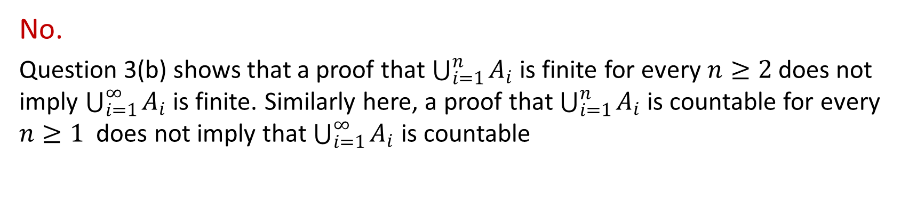
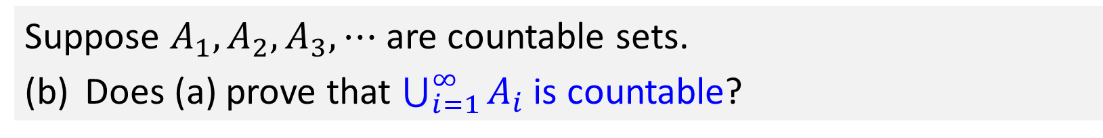

Q4.
Suppose $A_{1},A_{2},A_{3},⋯$ are countable sets.
(b) Does (a) prove that $\bigcup_{i=1}^{∞}{A_{i}}$ is countable?
No.
Question 3(b) shows that a proof that $\bigcup_{i=1}^{n}{A_{i}}$ is finite for every $n≥2$ does not imply $\bigcup_{i=1}^{∞}{A_{i}}$ is finite. Similarly here, a proof that $\bigcup_{i=1}^{n}{A_{i}}$ is countable for every $n≥1$ does not imply that $\bigcup_{i=1}^{∞}{A_{i}}$ is countable
Note that $\bigcup_{i=1}^{∞}{A_{i}}$ is indeed countable, just that it cannot be proved using the approach in part (a). We will prove it in the next question.

Slide 15








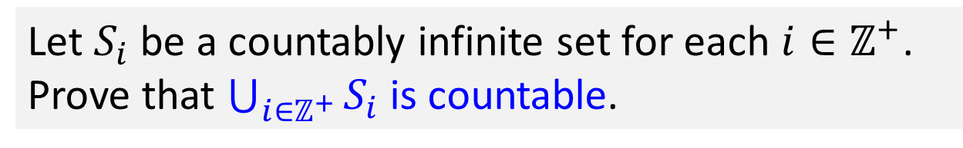

























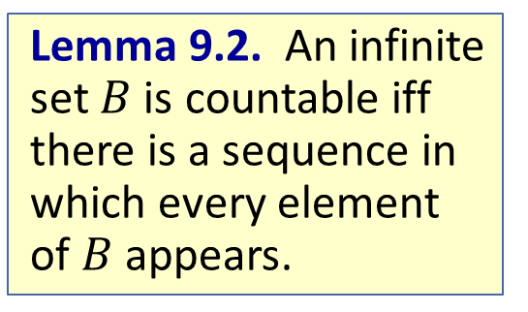







Q5.
Let $S_{i}$ be a countably infinite set for each $i∈ℤ^{+}$. Prove that $\bigcup_{i∈ℤ^{+}}{S_{i}}$ is countable.
Lemma 9.2. An infinite set $B$ is countable iff there is a sequence in which every element of $B$ appears.
$$⋮$$
$$⋮$$
$$⋮$$
$$⋮$$
$$⋮$$
$$⋮$$
$$⋮$$
$$⋮$$
$$S_{4}$$
$$b_{4,1},$$
$$b_{4,2},$$
$$b_{4,3},$$
$$b_{4,4},$$
$$b_{4,5},$$
$$b_{4,6},$$
$$…$$
$$S_{3}$$
$$b_{3,1},$$
$$b_{3,2},$$
$$b_{3,3},$$
$$b_{3,4},$$
$$b_{3,5},$$
$$b_{3,6},$$
$$…$$
$$S_{2}$$
$$b_{2,1},$$
$$b_{2,2},$$
$$b_{2,3},$$
$$b_{2,4},$$
$$b_{2,5},$$
$$b_{2,6},$$
$$…$$
$$S_{1}$$
$$b_{1,1},$$
$$b_{1,2},$$
$$b_{1,3},$$
$$b_{1,4},$$
$$b_{1,5},$$
$$b_{1,6},$$
$$…$$

Slide 16
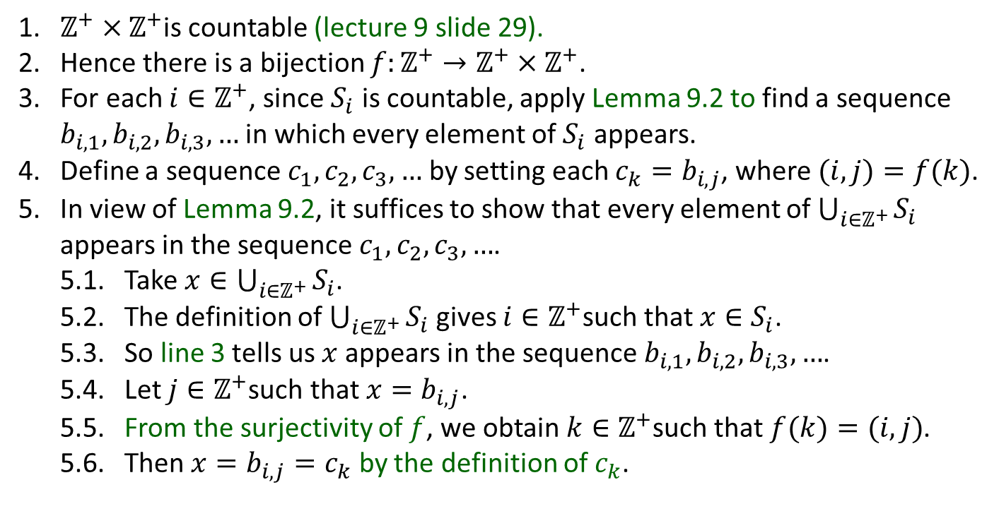

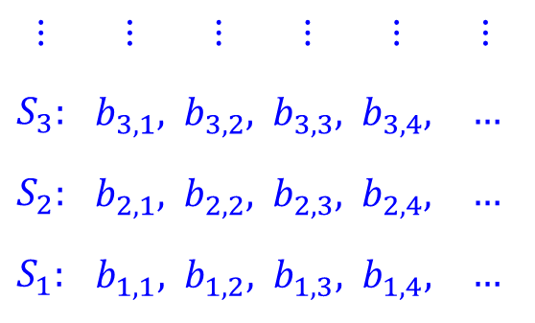
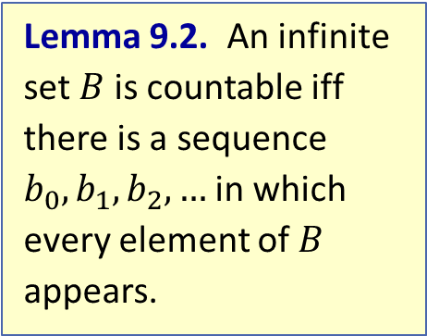
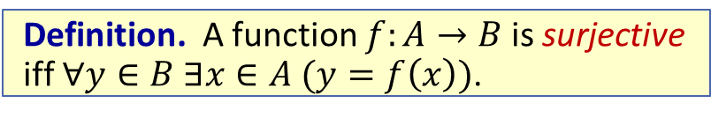
Q5.
Let $S_{i}$ be a countably infinite set for each $i∈ℤ^{+}$. Prove that $\bigcup_{i∈ℤ^{+}}{S_{i}}$ is countable.
Lemma 9.2. An infinite set $B$ is countable iff there is a sequence $b_{0},b_{1},b_{2},…$ in which every element of $B$ appears.
1. $ℤ^{+}×ℤ^{+}$is countable (lecture 9 slide 29).
2. Hence there is a bijection $f:ℤ^{+}→ℤ^{+}×ℤ^{+}$.
3. For each $i∈ℤ^{+}$, since $S_{i}$ is countable, apply Lemma 9.2 to find a sequence $b_{i,1}, b_{i,2}, b_{i,3}, …$ in which every element of $S_{i}$ appears.
4. Define a sequence $c_{1},c_{2},c_{3},…$ by setting each $c_{k}=b_{i,j}$, where $(i, j)=f(k)$.
5. In view of Lemma 9.2, it suffices to show that every element of $\bigcup_{i∈ℤ^{+}}{S_{i}}$ appears in the sequence $c_{1},c_{2},c_{3},…$.
5.1. Take $x∈\bigcup_{i∈ℤ^{+}}{S_{i}}$.
5.2. The definition of $\bigcup_{i∈ℤ^{+}}{S_{i}}$ gives $i∈ℤ^{+}$such that $x∈S_{i}$.
5.3. So line 3 tells us $x$ appears in the sequence $b_{i,1}, b_{i,2}, b_{i,3}, …$.
5.4. Let $j∈ℤ^{+}$such that $x=b_{i,j}$.
5.5. From the surjectivity of $f$, we obtain $k∈ℤ^{+}$such that $f(k)=(i, j)$.
5.6. Then $x=b_{i,j}=c_{k}$ by the definition of $c_{k}$.
$$⋮$$ | $$⋮$$ | $$⋮$$ | $$⋮$$ | $$⋮$$ | $$⋮$$
$$S_{3}:$$ | $$b_{3,1},$$ | $$b_{3,2},$$ | $$b_{3,3},$$ | $$b_{3,4},$$ | $$…$$
$$S_{2}:$$ | $$b_{2,1},$$ | $$b_{2,2},$$ | $$b_{2,3},$$ | $$b_{2,4},$$ | $$…$$
$$S_{1}:$$ | $$b_{1,1},$$ | $$b_{1,2},$$ | $$b_{1,3},$$ | $$b_{1,4},$$ | $$…$$
Definition. A function $f:A→B$ is surjective iff $∀y∈B ∃x∈A (y=f\left(x\right))$.

Slide 17

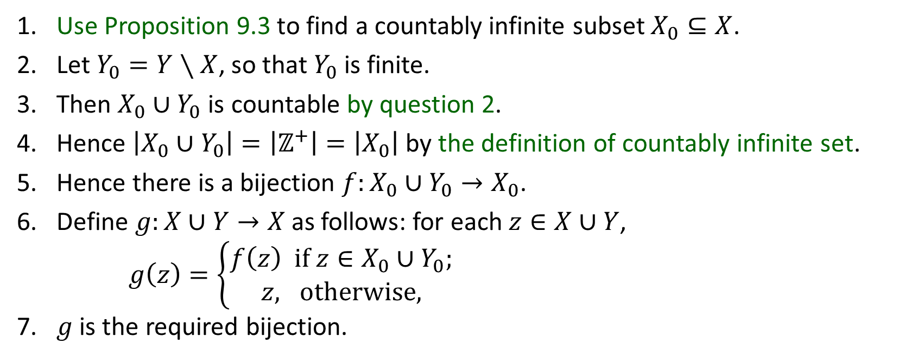

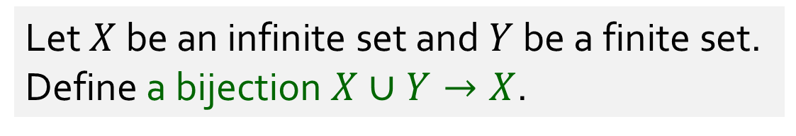


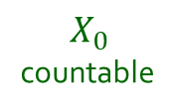

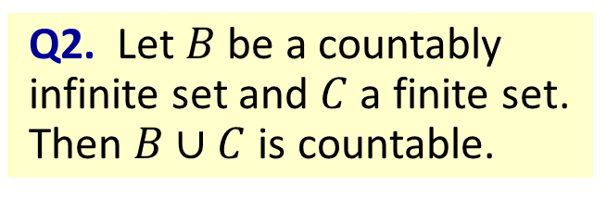

Q6.
Let $X$ be an infinite set and $Y$ be a finite set. Define a bijection $X∪Y→X$.
Q2. Let $B$ be a countably infinite set and $C$ a finite set. Then $B∪C$ is countable.
1. Use Proposition 9.3 to find a countably infinite subset $X_{0}⊆X$.
2. Let $Y_{0}=Y∖X$, so that $Y_{0}$ is finite.
3. Then $X_{0}∪Y_{0}$ is countable by question 2.
4. Hence $\left|X_{0}∪Y_{0}\right|=\left|ℤ^{+}\right|=\left|X_{0}\right|$ by the definition of countably infinite set.
5. Hence there is a bijection $f:X_{0}∪Y_{0}→X_{0}$.
6. Define $g:X∪Y→X$ as follows: for each $z∈X∪Y$,
$g\left(z\right)=\left\{\begin{aligned}f\left(z\right) if z∈X_{0}∪Y_{0}; \\ &z, otherwise,\end{aligned}\right.$
7. $g$ is the required bijection.
$X$ infinite
$$X$$
$$X_{0}$$
countable
$$X_{0}$$
$Y$ finite
$$f$$
Proposition 9.3. Every infinite set has a countably infinite subset.
$$Y_{0}$$

Slide 18
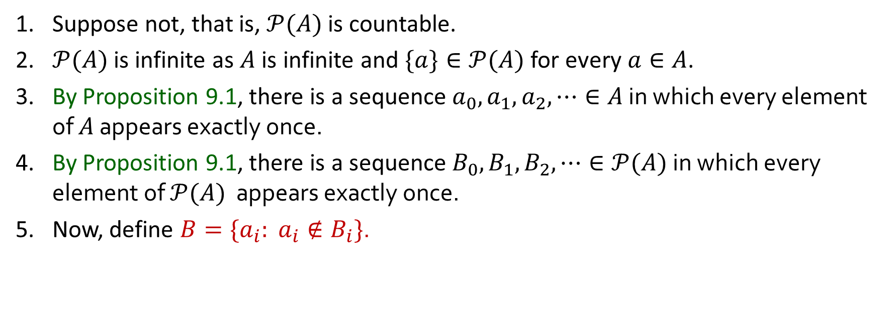
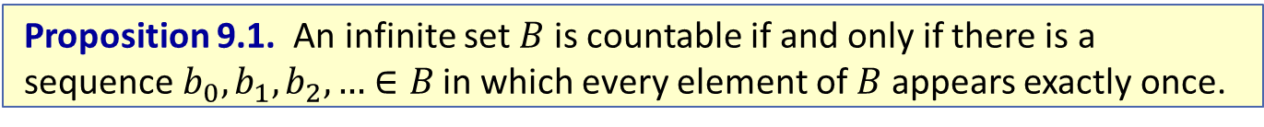
Q7.
Let $A$ be a countably infinite set. Prove that $𝒫(A)$ is uncountable.
1. Suppose not, that is, $𝒫(A)$ is countable.
2. $𝒫(A)$ is infinite as $A$ is infinite and $\{a\}∈𝒫(A)$ for every $a∈A$.
3. By Proposition 9.1, there is a sequence $a_{0},a_{1},a_{2},⋯∈A$ in which every element of $A$ appears exactly once.
4. By Proposition 9.1, there is a sequence $B_{0},B_{1},B_{2},⋯∈𝒫(A)$ in which every element of $𝒫(A)$ appears exactly once.
5. Now, define $B=\{a_{i}: a_{i}∉B_{i}\}$.
Proposition 9.1. An infinite set $B$ is countable if and only if there is a sequence $b_{0},b_{1},b_{2},…$ $∈B$ in which every element of $B$ appears exactly once.

Slide 19
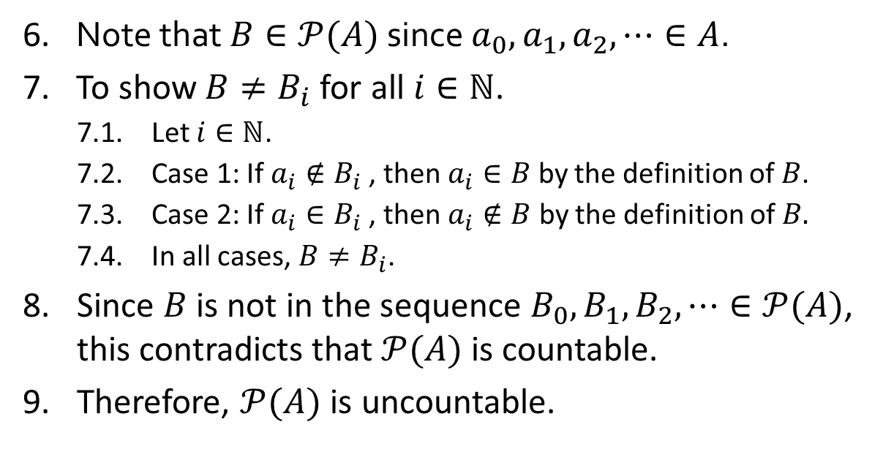
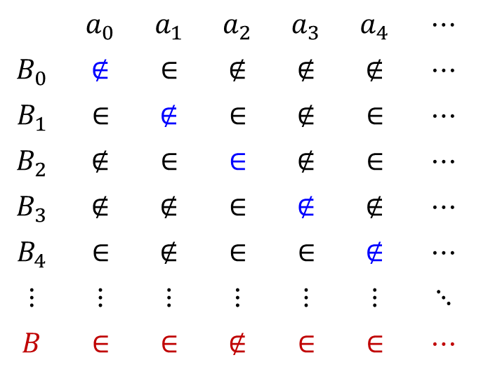
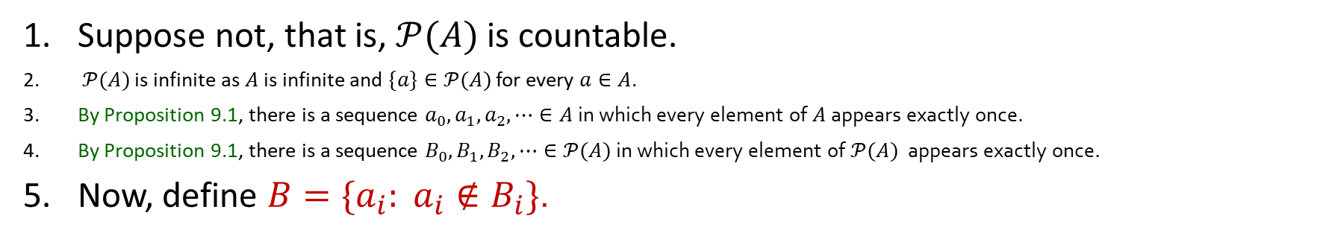
Q7.
Let $A$ be a countably infinite set. Prove that $𝒫(A)$ is uncountable.
1. Suppose not, that is, $𝒫(A)$ is countable.
2. $𝒫(A)$ is infinite as $A$ is infinite and $\{a\}∈𝒫(A)$ for every $a∈A$.
3. By Proposition 9.1, there is a sequence $a_{0},a_{1},a_{2},⋯∈A$ in which every element of $A$ appears exactly once.
4. By Proposition 9.1, there is a sequence $B_{0},B_{1},B_{2},⋯∈𝒫(A)$ in which every element of $𝒫(A)$ appears exactly once.
5. Now, define $B=\{a_{i}: a_{i}∉B_{i}\}$.
 | $$a_{0}$$ | $$a_{1}$$ | $$a_{2}$$ | $$a_{3}$$ | $$a_{4}$$ | $$⋯$$
$$B_{0}$$ | $$∉$$ | $$∈$$ | $$∉$$ | $$∉$$ | $$∉$$ | $$⋯$$
$$B_{1}$$ | $$∈$$ | $$∉$$ | $$∈$$ | $$∉$$ | $$∈$$ | $$⋯$$
$$B_{2}$$ | $$∉$$ | $$∈$$ | $$∈$$ | $$∉$$ | $$∈$$ | $$⋯$$
$$B_{3}$$ | $$∉$$ | $$∉$$ | $$∈$$ | $$∉$$ | $$∉$$ | $$⋯$$
$$B_{4}$$ | $$∈$$ | $$∉$$ | $$∈$$ | $$∈$$ | $$∉$$ | $$⋯$$
$$⋮$$ | $$⋮$$ | $$⋮$$ | $$⋮$$ | $$⋮$$ | $$⋮$$ | $$⋱$$
$$B$$ | $$∈$$ | $$∈$$ | $$∉$$ | $$∈$$ | $$∈$$ | $$⋯$$
6. Note that $B∈𝒫(A)$ since $a_{0},a_{1},a_{2},⋯∈A$.
7. To show $B≠B_{i}$for all $i∈ℕ$.
7.1. Let $i∈ℕ$.
7.2. Case 1: If $a_{i}∉B_{i}$, then $a_{i}∈B$ by the definition of $B$.
7.3. Case 2: If $a_{i}∈B_{i}$, then $a_{i}∉B$ by the definition of $B.$
7.4. In all cases, $B≠B_{i}$.
8. Since $B$ is not in the sequence $B_{0},B_{1},B_{2},⋯∈𝒫(A)$, this contradicts that $𝒫(A)$ is countable.
9. Therefore, $𝒫(A)$ is uncountable.
Notes:
- Harder diagonalisation technique application

Slide 20
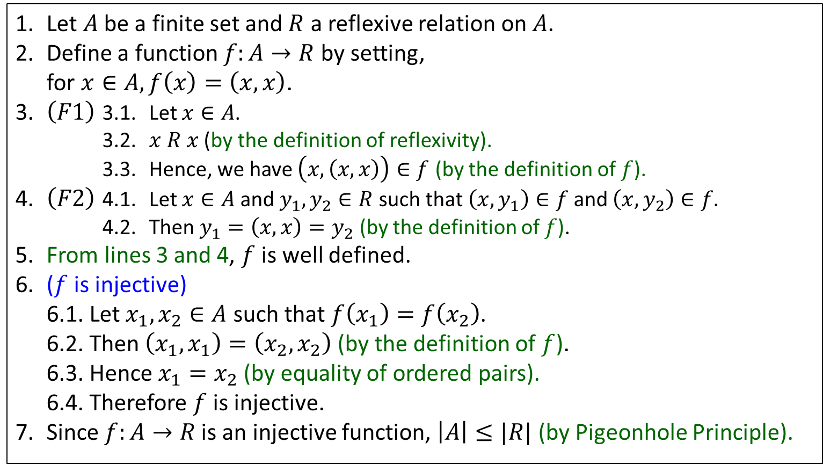
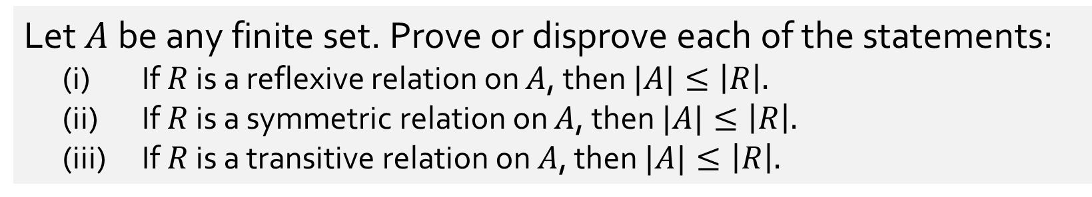
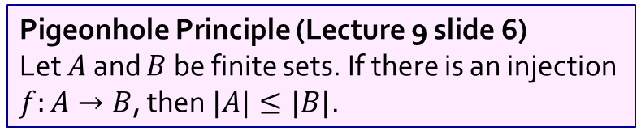
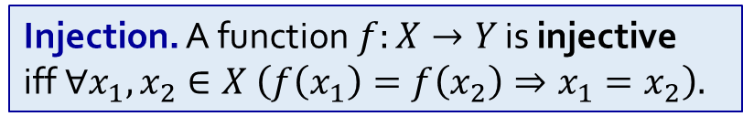
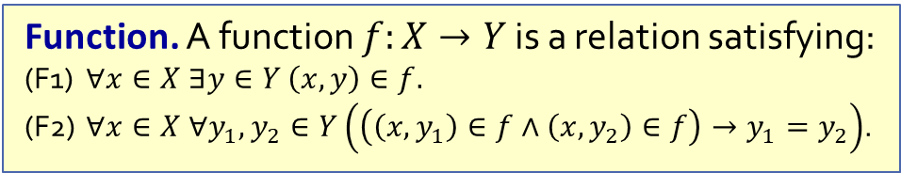
Q8.
Let $A$ be any finite set. Prove or disprove each of the statements:
(i) If $R$ is a reflexive relation on $A$, then $|A|≤\left|R\right|.$
(ii) If $R$ is a symmetric relation on $A$, then $|A|≤\left|R\right|.$
(iii) If $R$ is a transitive relation on $A$, then $|A|≤\left|R\right|.$
True
False
1. Let $A$ be a finite set and $R$ a reflexive relation on $A$.
2. Define a function $f:A→R$ by setting,
for $x∈A, f\left(x\right)=\left(x, x\right)$.
3. $\left(F1\right)$ 3.1. Let $x∈A$.
3.2. $x R x$ (by the definition of reflexivity).
3.3. Hence, we have $\left(x, \left(x, x\right)\right)∈f$ (by the definition of $f$).
4. $\left(F2\right)$ 4.1. Let $x∈A$ and $y_{1},y_{2}∈R$ such that $\left(x, y_{1}\right)∈f$ and $\left(x, y_{2}\right)∈f$.
4.2. Then $y_{1}=\left(x, x\right)=y_{2}$ (by the definition of $f$).
5. From lines 3 and 4, $f$ is well defined.
6. ($f$ is injective)
6.1. Let $x_{1},x_{2}∈A$ such that $f\left(x_{1}\right)=f\left(x_{2}\right)$.
6.2. Then $\left(x_{1},x_{1}\right)=\left(x_{2},x_{2}\right)$ (by the definition of $f$).
6.3. Hence $x_{1}=x_{2}$ (by equality of ordered pairs).
6.4. Therefore $f$ is injective.
7. Since $f:A→R$ is an injective function, $\left|A\right|≤|R|$ (by Pigeonhole Principle).
False
Function. A function $f:X→Y$ is a relation satisfying:
(F1) $∀x∈X ∃y∈Y \left(x,y\right)∈f.$
(F2) $∀x∈X ∀y_{1},y_{2}∈Y\left(\left(\left(x,y_{1}\right)∈f∧\left(x,y_{2}\right)∈f\right)→y_{1}=y_{2}\right)$.
Injection. A function$f:X→Y$ is injective
iff $∀x_{1},x_{2}∈X \left(f\left(x_{1}\right)=f\left(x_{2}\right)⇒x_{1}=x_{2}\right).$
Pigeonhole Principle (Lecture 9 slide 6)
Let $A$ and $B$ be finite sets. If there is an injection $f:A→B$, then $|A|≤|B|$.

Slide 21
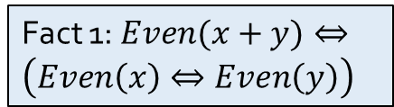
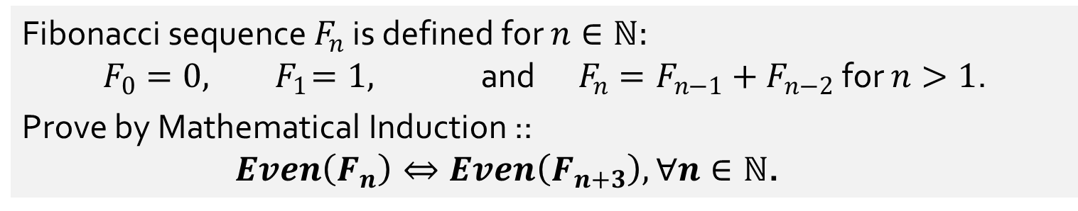

Q9.
Fibonacci sequence $F_{n}$ is defined for $n∈ℕ:$
$$F_{0}=0, { F}_{1}=1, \text{and} F_{n}=F_{n−1}+F_{n−2} \text{for} n>1\text{.}$$
Prove by Mathematical Induction ::
$Even\left(F_{n}\right)⇔Even\left(F_{n+3}\right),$ $∀n∈ℕ$.
Fact 1: $Even(x+y)⇔\left(Even\left(x\right)⇔Even\left(y\right)\right)$
1. For each $n∈ℕ$, let $P(n)≡\left(Even\left(F_{n}\right)⇔Even\left(F_{n+3}\right)\right)$.
2. (Basis step)
2.1. $F_{2}=F_{1}+F_{0}=1+0=1;F_{3}=F_{2}+F_{1}=1+1=2;$ $F_{4}=F_{3}+F_{2}=2+1=3$ (by defn of Fibonacci seq)
2.2. $P\left(0\right)≡(Even(F_{0})⇔Even(F_{3}))≡(Even(0)⇔Even(2))$ is true.
3. (Inductive step)
3.1. Let $k∈ℕ$ such that $P\left(0\right)∧P\left(1\right)∧…∧P\left(k\right)$ is true.
3.2. Case 1: $k=0$.
3.2.1. Then $P\left(1\right)≡(Even(F_{1})⇔Even(F_{4}))≡(Even(1)⇔Even(3))$ is true (by step 2.1).
3.3. Case 2: $k≥1$.
3.3.1. $Even\left(F_{k+1}\right)⇔Even\left(F_{k}+F_{k−1}\right)$ (by definition of Fibonacci sequence)
3.3.2. $⇔$ $\left(Even\left(F_{k})⇔{Even(F}_{k−1}\right)\right)$ (by Fact 1)
3.3.3. $⇔$ $\left(Even\left(F_{k+3})⇔{Even(F}_{k+2}\right)\right)$ (by IH: $P(k)$ and $P(k−1)$ are true)
3.3.4. $⇔$ $Even\left(F_{k+3}+F_{k+2}\right)$ (by Fact 1)
3.3.5. $⇔$ $Even\left(F_{k+4}\right)$ (by definition of Fibonacci sequence)
3.4. Thus $P(k+1)$ is true.
4. Therefore, $∀ n∈ℕ P(n)$ is true by Strong Mathematical Induction.

Slide 22



Q10.
(a) Let $\sim$ be an equivalence relation on $X$ and let $g :X→Y$ be a function such that $g\left(a\right)=g(b)⇔a\sim b$ $∀a,b∈X$.
Prove or disprove the following statement:
The following function $f$ is well-defined:
$f :X/\sim →Y$ given by the formula $f\left(\left[x\right]\right)=g\left(x\right) ∀x∈X$.
True
1. Given $f\left(\left[x\right]\right)=g\left(x\right) ∀x∈X$.
2. Let $[x]∈X/\sim$ be an arbitrary equivalence class of $\sim$ for some $x∈X$.
3. Since $g$ is a function, this shows the existence of an image of $\left[x\right]$ (i.e. $g(x)$) under $f$.
4. (Next, to show that the image of $[x]$ under $f$ is unique) Suppose $f\left(\left[x\right]\right)=g(x)$ and $f\left(\left[x′\right]\right)=g(x′)$ are such that $\left[x\right]=[x^{′}]$.
5. Since $\left[x\right]=[x^{′}]$, we have $x\sim x′$ (by Lemma Rel.1 Equivalence Classes)
6. Hence $g(x)=g(x’)$ (by definition of $g$)
7. Hence the image of $[x]$ is unique.
8. Since the image of $[x]$exists and is unique for every $[x]∈X/\sim$ , the function $f$ is well-defined.
Lemma Rel.1 Equivalence Classes: Let $\sim$ be an equivalence relation on a set $A$.
The following are equivalent for all $x,y∈A$.
(i) $x\sim y;$ (ii) $\left[x\right]=\left[y\right];$ (iii) $\left[x\right]∩[y]≠∅$.

Slide 23




Q10.
(b) If the function $f$ in part (a) above is well-defined, prove or disprove whether function $f$ is injective or not injective.
(a) Let $\sim$ be an equivalence relation on $X$ and let $g :X→Y$ be a function such that $g\left(a\right)=g(b)⇔a\sim b$ $∀a,b∈X$.
Prove or disprove the following statement:
The following function $f$ is well-defined:
$f :X/\sim →Y$ given by the formula $f\left(\left[x\right]\right)=g\left(x\right) ∀x∈X$.
1. Suppose $f\left(\left[x\right]\right)=f(\left[x^{′}\right])$.
2. Then $g\left(x\right)=g(x^{′})$ (by definition of $f$)
3. Then $x\sim x′$ (by definition of $g$)
4. Then $\left[x\right]=[x^{′}]$ (by Lemma Rel.1 Equivalence Classes)
5. Hence $f$ is injective (by definition of injection)
Injection. A function$f:X→Y$ is injective
iff $∀x_{1},x_{2}∈X \left(f\left(x_{1}\right)=f\left(x_{2}\right)⇒x_{1}=x_{2}\right).$
Lemma Rel.1 Equivalence Classes: Let $\sim$ be an equivalence relation on a set $A$.
The following are equivalent for all $x,y∈A$.
(i) $x\sim y;$ (ii) $\left[x\right]=\left[y\right];$ (iii) $\left[x\right]∩[y]≠∅$.

Slide 24



Q10.
(c) Given the following bijections $f$ and $g$ on the set $A=\{1,2,3,4\}$,
$f=\{\left(1,2\right), \left(2,4\right), \left(3,1\right), \left(4,3\right)\}$;
$g=\{\left(1,4\right), \left(2,1\right), \left(3,2\right), (4,3)$}.
Find the order of $f$, $g$ and ${(f}^{−1}∘g)$.
4
Order of $f$:
Order of $g$:
Order of${(f}^{−1}∘g)$:
4
3
$$f∘f∘f∘f\left(1\right)=f\left(f\left(f\left(f\left(1\right)\right)\right)\right)=f\left(f\left(f\left(2\right)\right)\right)=f\left(f\left(4\right)\right)=f\left(3\right)=1$$
$$f∘f∘f∘f\left(2\right)=f\left(f\left(f\left(f\left(2\right)\right)\right)\right)=f\left(f\left(f\left(4\right)\right)\right)=f\left(f\left(3\right)\right)=f\left(1\right)=2$$
$$f∘f∘f∘f\left(3\right)=f\left(f\left(f\left(f\left(3\right)\right)\right)\right)=f\left(f\left(f\left(1\right)\right)\right)=f\left(f\left(2\right)\right)=f\left(4\right)=3$$
$$f∘f∘f∘f\left(4\right)=f\left(f\left(f\left(f\left(4\right)\right)\right)\right)=f\left(f\left(f\left(3\right)\right)\right)=f\left(f\left(1\right)\right)=f\left(2\right)=4$$
The order of a a bijection $f:A→A$ is the smallest $n∈ℤ^{+}$ such that
$$f∘f∘⋯∘f={id}_{A}.$$
$n$-many $f$’s

Slide 25
Q10.
(c) Given the following bijections $f$ and $g$ on the set $A=\{1,2,3,4\}$,
$f=\{\left(1,2\right), \left(2,4\right), \left(3,1\right), \left(4,3\right)\}$;
$g=\{\left(1,4\right), \left(2,1\right), \left(3,2\right), (4,3)$}.
Find the order of $f$, $g$ and ${(f}^{−1}∘g)$.
4
Order of $f$:
Order of $g$:
Order of${(f}^{−1}∘g)$:
4
3
$$g∘g∘g∘g\left(1\right)=g\left(g\left(g\left(g\left(1\right)\right)\right)\right)=g\left(g\left(g\left(4\right)\right)\right)=g\left(g\left(3\right)\right)=g\left(2\right)=1$$
$$g∘g∘g∘g\left(2\right)=g\left(g\left(g\left(g\left(2\right)\right)\right)\right)=g\left(g\left(g\left(1\right)\right)\right)=g\left(g\left(4\right)\right)=g\left(3\right)=2$$
$$g∘g∘g∘g\left(3\right)=g\left(g\left(g\left(g\left(3\right)\right)\right)\right)=g\left(g\left(g\left(2\right)\right)\right)=g\left(g\left(1\right)\right)=g\left(4\right)=3$$
$$g∘g∘g∘g\left(4\right)=g\left(g\left(g\left(g\left(4\right)\right)\right)\right)=g\left(g\left(g\left(3\right)\right)\right)=g\left(g\left(2\right)\right)=g\left(1\right)=4$$
The order of a a bijection $f:A→A$ is the smallest $n∈ℤ^{+}$ such that
$$f∘f∘⋯∘f={id}_{A}.$$
$n$-many $f$’s

Slide 26

Q10.
(c) Given the following bijections $f$ and $g$ on the set $A=\{1,2,3,4\}$,
$f=\{\left(1,2\right), \left(2,4\right), \left(3,1\right), \left(4,3\right)\}$;
$g=\{\left(1,4\right), \left(2,1\right), \left(3,2\right), (4,3)$}.
Find the order of $f$, $g$ and ${(f}^{−1}∘g)$.
4
Order of $f$:
Order of $g$:
Order of${(f}^{−1}∘g)$:
4
3
Let $k\left(x\right)=f^{−1}∘g\left(x\right)=f^{−1}\left(g\left(x\right)\right)$.
$k\left(1\right)=f^{−1}∘g\left(1\right)=f^{−1}\left(g\left(1\right)\right)=f^{−1}\left(4\right)=2$.
$k\left(2\right)=f^{−1}∘g\left(2\right)=f^{−1}\left(g\left(2\right)\right)=f^{−1}\left(1\right)=3$.
$k\left(3\right)=f^{−1}∘g\left(3\right)=f^{−1}\left(g\left(3\right)\right)=f^{−1}\left(2\right)=1$.
$k\left(4\right)=f^{−1}∘g\left(4\right)=f^{−1}\left(g\left(4\right)\right)=f^{−1}\left(3\right)=4$.
$$k∘k∘k\left(1\right)=k\left(k\left(k\left(1\right)\right)\right)=k\left(k\left(2\right)\right)=k\left(3\right)=1$$
$$k∘k∘k\left(2\right)=k\left(k\left(k\left(2\right)\right)\right)=k\left(k\left(3\right)\right)=k\left(1\right)=2$$
$$k∘k∘k\left(3\right)=k\left(k\left(k\left(3\right)\right)\right)=k\left(k\left(1\right)\right)=k\left(2\right)=3$$
$$k∘k∘k\left(4\right)=k\left(k\left(k\left(4\right)\right)\right)=k\left(k\left(4\right)\right)=k\left(4\right)=4$$

Slide 27
End of Tutorial 8
Assignment 2 due on 3 November!

