Slide 1
Cs1231S tutorial #9
Counting & Probability I
Adapted from Prof Aaron Tan’s slides

Slide 2
Learning objectives of this tutorial
Counting
Applying multiplication rule, addition rule, difference rule and the inclusion/exclusion rule.
Applying permutation.
Learning about circular permutation.
Solving problems using the Pigeonhole Principle.
Applying combination.

Slide 3
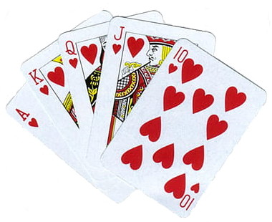




Q1.
You draw a sequence of 5 cards from a deck of cards. How many sequences have at least one picture card if
(a) you draw the cards with replacement?
Number of 5-card sequences =
$${52}^{5}$$
Number of 5-card sequences with no picture card =
$${40}^{5}$$
Number of 5-card sequences with at least one picture card =
$${52}^{5}−{40}^{5}$$
$$=277.804,032.$$
by Theorem 9.3.2 (difference rule)

Slide 4




Q1.
You draw a sequence of 5 cards from a deck of cards. How many sequences have at least one picture card if
(b) you draw the cards without replacement?
Number of 5-card sequences =
$$P(52,5)$$
Number of 5-card sequences with no picture card =
$$P(40,5)$$
Number of 5-card sequences with at least one picture card =
$$P\left(52,5\right)−P(40,5)$$
$$=232,914,240.$$
by Theorem 9.3.2 (difference rule)

Slide 5
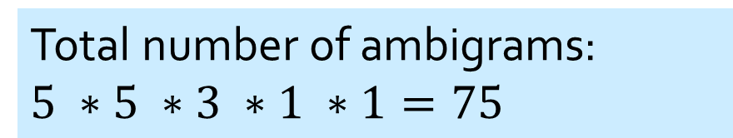
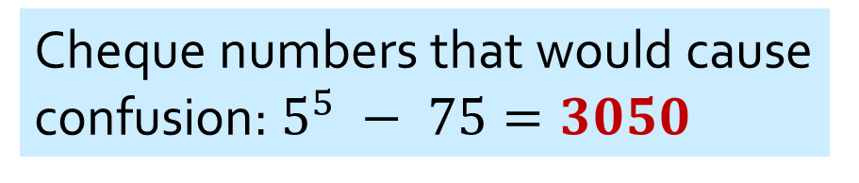
Q2.
Numbers that can be read both ways:
0 I 6 8 9
Total number of 5-digit cheque numbers that can be read both ways ${5 ∗5 ∗5 ∗5 ∗5= 5}^{5}$
But there are some ambigrams!
I689I
8I0I8
Multiplication Rule
Total number of ambigrams:
$$5 ∗5 ∗3 ∗1 ∗1=75$$
5 ways
3 ways (0, I, 8)
I way
5 ways
I way
Cheque numbers that would cause confusion: $5^{5} − 75=3050$
Difference Rule

Slide 6
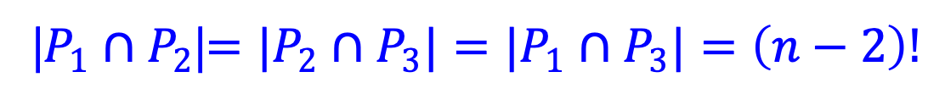
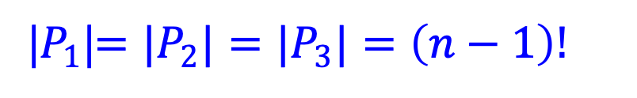
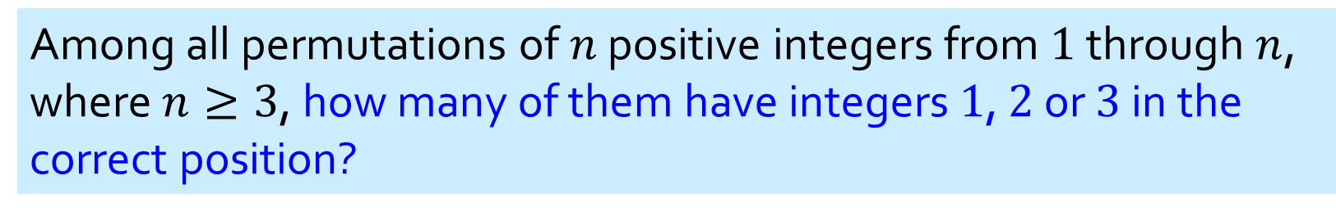


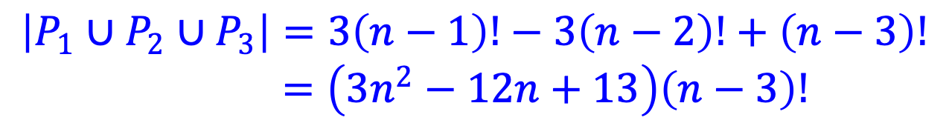

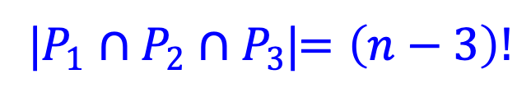
Q3.
Among all permutations of $n$ positive integers from $1$ through $n$, where $n≥3$, how many of them have integers $1$, $2$ or $3$ in the correct position?
Theorem 9.3.3 Inclusion/Exclusion Rule
Let $P_{k}$ be the permutations with integer $k$ in the correct position.
What is ${|P}_{1}|$? ${|P}_{2}|$? ${|P}_{3}|$?
|$P_{1}$|$=|P_{2}|=|P_{3}|=\left(n−1\right)!$
What is ${|P}_{1}∩P_{2}$|? ${|P}_{2}∩P_{3}|$? ${|P_{1}∩P}_{3}|$?
|$P_{1}∩P_{2}$|$=|P_{2}∩P_{3}|=|P_{1}∩P_{3}|=\left(n−2\right)!$
What is ${|P}_{1}∩P_{2}{∩P}_{3}$|?
|$P_{1}∩P_{2}∩P_{3}$|$=\left(n−3\right)!$
By the inclusion/exclusion rule (theorem 9.3.3),
$$\left|P_{1}∪P_{2}∪P_{3}\right|=3\left(n−1\right)!−3\left(n−2\right)!+\left(n−3\right)!$$
$=\left(3n^{2}−12n+13\right)\left(n−3\right)!$

Slide 7





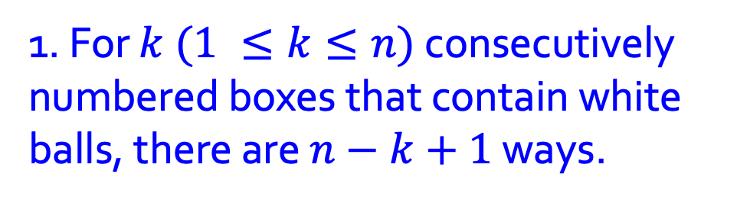

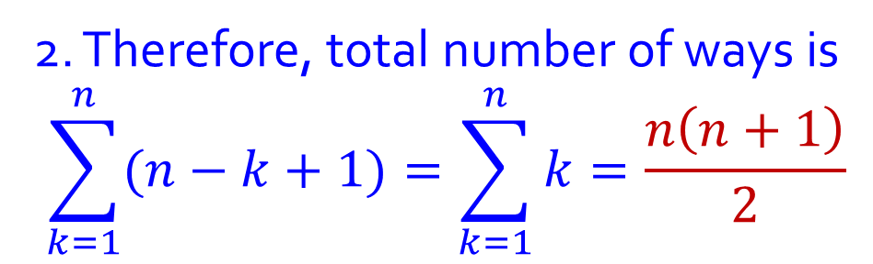


Q4.
Given n boxes numbered 1 to n, each box to be filled with a white ball or a blue ball. At least one box contains a white ball and boxes containing white balls must be consecutively numbered.
What is the total number of ways this can be done?
Case $1$: A white ball in a box.
$$n$$
Case $2$: White balls in $2$ consecutive boxes.
$$n−1$$
Case $3$: White balls in $3$ consecutive boxes.
$$n−2$$
:
Case $n$: White balls in $n$ consecutive boxes.
$$1$$
What rule to apply?
Addition rule.
1. For $k (1 ≤k≤n)$ consecutively numbered boxes that contain white balls, there are $n−k+1$ ways.
2. Therefore, total number of ways is
$$\sum_{k=1}^{n}{(n−k+1)}=\sum_{k=1}^{n}{k}=\frac{n\left(n+1\right)}{2}$$

Slide 8



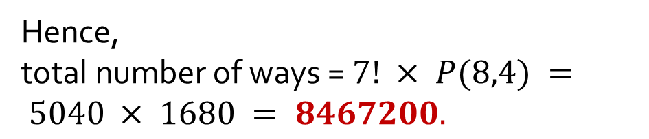
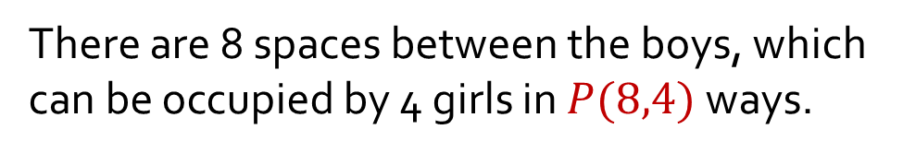
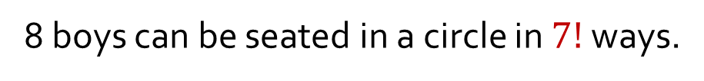

Q5.
(a) In how many ways can 8 boys and 4 girls sit around a circular table, so that no two girls sit together?
We sit the boys first, then sit each girl in between the boys so that no two girls will sit together.
8 boys can be seated in a circle in $7!$ ways.
There are 8 spaces between the boys, which can be occupied by 4 girls in $P(8,4)$ways.
Hence,
total number of ways = $7! × P(8,4) = 5040 × 1680 = 8467200.$

Slide 9
Q5.
(b) In how many ways can 6 people sit around a circular table, but Eric would not sit next to Freddy?
There are 5! = 120 ways for 6 people to sit around a circular table.
Eric
There are 2 × 4! = 48 ways for Eric and Freddy to sit together.
Therefore, the answer is 120 – 48 = 72 ways.
Freddy

Slide 10
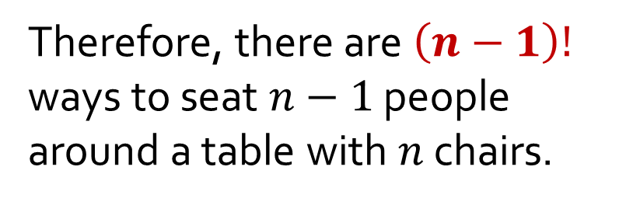
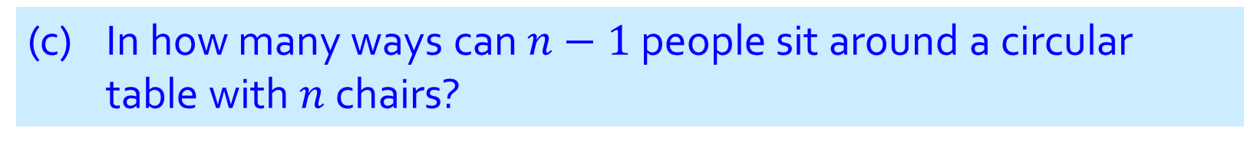
Q5.
(c) In how many ways can $n−1$ people sit around a circular table with $n$ chairs?
Treat the empty chair as just another person.
Therefore, there are $\left(n−1\right)!$ ways to seat $n−1$ people around a table with $n$ chairs.

Slide 11


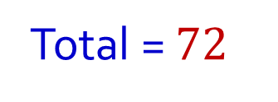
Q6.
You want to lay the letter tiles of these four words “I”, “CAN”, “DO”, “IT” in a circular arrangement. The letters in the groups “CAN”, “DO” and “IT” must be kept together in each group, but the letters within each group may be arranged in any order within that group. Also, no two similar letters should be placed next to each other. In how many ways can this be done?
Two cases:
T
I
Case 1: When “I” and “IT” are opposite.
I
C
$$2×3!×2!×2!=48$$
O
A
D
N
Case 2: When “I” and “IT” are adjacent.
A
N
Must be “ITI”. “CAN” and “DO” can be swapped:
$$2×3!×2!=24$$
I
C
T
I
Total = $72$
O
D

Slide 12


Q7.
Select 5 persons from 7 men and 6 women to form a committee with at least 3 men.
(a) In how many ways can you form the committee?
3 men, 2 women;
4 men, 1 woman;
5 men.
$$\left({7 \atop 3}\right)×\left({6 \atop 2}\right)$$
$$\left({7 \atop 4}\right)×\left({6 \atop 1}\right)$$
$$\left({7 \atop 5}\right)$$
$$+$$
$$+$$
$$35×15$$
$$+$$
$$35×6$$
$$+$$
$$21$$
$$=756$$

Slide 13

Q7.
Select 5 persons from 7 men and 6 women to form a committee with at least 3 men.
(b) If you randomly choose five persons to form the committee, what is the probability that you will get a committee with at least three men? Give your answer correct to 4 significant figures.
Number of outcomes in sample space: $\left({13 \atop 5}\right)=1287.$
From part (a), #ways to form a committee with at least 3 men $=756.$
Probability $=\frac{756}{1287}=58.74\%.$
(Do you know what 4 significant figures mean?)

Slide 14
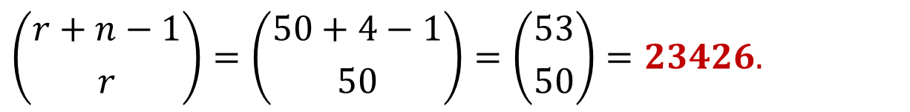
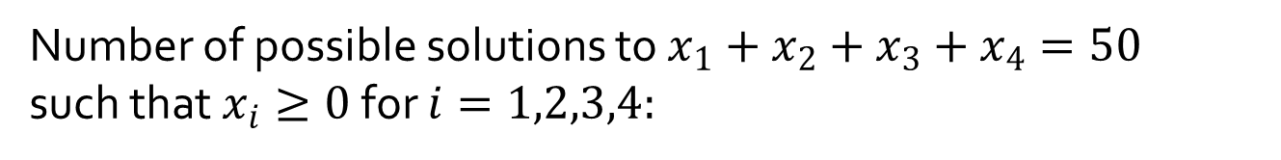

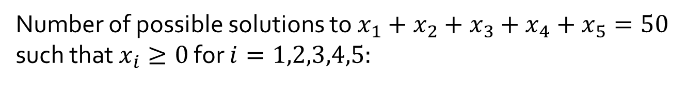
Q8.
You have $50,000 that you can use for investment. You are recommended 4 properties to invest in. Each investment must be in multiples of $1000.
(a) How many different investment strategies are possible if you invest $50,000 in total?
Number of possible solutions to $x_{1}+x_{2}+x_{3}+x_{4}=50$ such that $x_{i}≥0$ for $i=1,2,3,4:$
$$\left({r+n−1 \atop r}\right)=\left({50+4−1 \atop 50}\right)=\left({53 \atop 50}\right)=23426.$$
(b) How many different investment strategies are possible if you need not invest the entire amount of $50,000?
Number of possible solutions to $x_{1}+x_{2}+x_{3}+x_{4}+x_{5}=50$ such that $x_{i}≥0$ for $i=1,2,3,4,5:$
$$\left({r+n−1 \atop r}\right)=\left({50+5−1 \atop 50}\right)=\left({54 \atop 50}\right)=316251.$$

Slide 15
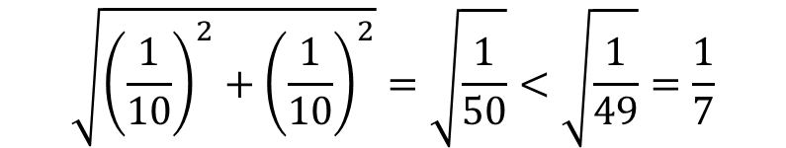
Q9.
Prove that if you randomly put 51 points inside a unit square, there are always 3 points that can be covered by a circle of radius 1/7.
1. Divide the unit square into 25 equal smaller squares of side 1/5 each.
2. Now, at least one of these small squares would contain at least 3 points. (Why?)
3. Now, the circle circumvented around the small square with the 3 points inside also contains these 3 points as it has radius
$$\sqrt{{\left(\frac{1}{10}\right)}^{2}+{\left(\frac{1}{10}\right)}^{2}}=\sqrt{\frac{1}{50}}<\sqrt{\frac{1}{49}}=\frac{1}{7}$$

Slide 16

Q9.
Prove that if you randomly put 51 points inside a unit square, there are always 3 points that can be covered by a circle of radius 1/7.
1. Divide the unit square into 16 equal smaller squares of side 1/4 each.
WRONG ANSWER!
(Why?)
2. Now, at least one of these small squares would contain at least 3 points. (Why?)
3. Now, the area of a small square is 1/16=0.0625, which is smaller than the area of a circle of radius 1/7 which is 0.0641.
Although the area of the small square < area of the circle, the radius of the smallest circle that covers the small square completely is
$$\sqrt{{\left(\frac{1}{8}\right)}^{2}+{\left(\frac{1}{8}\right)}^{2}}=\sqrt{\frac{1}{32}}>\frac{1}{7}$$

Slide 17
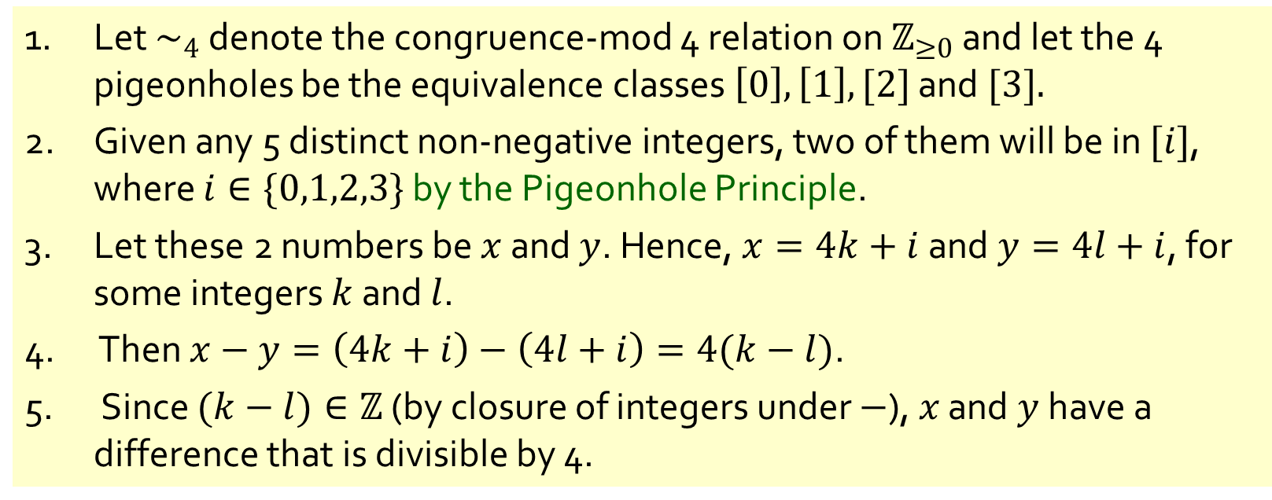
Q10.
Show that given any 5 distinct non-negative integers, two of them have a difference that is divisible by 4.
1. Let $\sim _{4}$ denote the congruence-mod 4 relation on $ℤ_{≥0}$ and let the 4 pigeonholes be the equivalence classes $\left[0\right],\left[1\right],[2]$ and $[3].$
2. Given any 5 distinct non-negative integers, two of them will be in $[i]$, where $i∈\{0,1,2,3\}$ by the Pigeonhole Principle.
3. Let these 2 numbers be $x$ and $y$. Hence, $x=4k+i$ and $y=4l+i$, for some integers $k$ and $l$.
4. Then $x−y=\left(4k+i\right)−\left(4l+i\right)=4(k−l)$.
5. Since $(k−l)∈ℤ$ (by closure of integers under $−$), $x$ and $y$ have a difference that is divisible by 4.

Slide 18
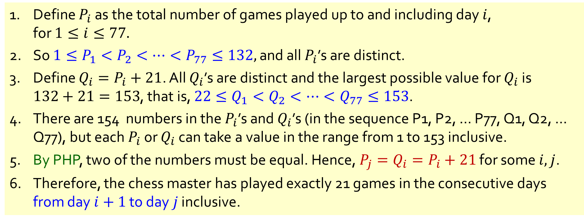
Q11.
A chess master who has 11 weeks to prepare for a tournament decides to play at least one game every day, but in order not to tire herself, she decides not to play more than 12 games during any one week. Show that there exists a succession of consecutive days during which the chess master will have played exactly 21 games.
1. Define $P_{i}$ as the total number of games played up to and including day $i$, for $1≤i≤77.$
2. So $1≤P_{1}<P_{2}<⋯<P_{77}≤132,$ and all $P_{i}$’s are distinct.
3. Define $Q_{i}=P_{i}+21$. All $Q_{i}$’s are distinct and the largest possible value for $Q_{i}$ is $132+21=153$, that is, $22≤Q_{1}<Q_{2}<⋯<Q_{77}≤153$.
4. There are 154 numbers in the $P_{i}$’s and $Q_{i}$’s (in the sequence P1, P2, … P77, Q1, Q2, … Q77), but each $P_{i}$ or $Q_{i}$ can take a value in the range from 1 to 153 inclusive.
5. By PHP, two of the numbers must be equal. Hence, $P_{j}=Q_{i}=P_{i}+21$ for some $i,j$.
6. Therefore, the chess master has played exactly 21 games in the consecutive days from day $i+1$ to day $j$ inclusive.

Slide 19
End of Tutorial 9
Assignment 2 due on 3 November

Slide 20
Notes for Assignment 2:
Don’t forget to still write out everything rigorously, especially MI questions.
Follow the usual format exactly, otherwise you may miss marks.
Lots of the questions are true/false questions -> proving whether they are true/false.
As you can expect, you will lose a *lot* of marks if you choose the wrong answer, so double check.
(Of course, the bulk of the marks will still be in the proof, so randomly guessing is not useful)
Don’t just rely on common sense, research and verify.

