Slide 1
Cs1231S tutorial #10
Counting 2 & Graphs 1

Slide 2
Learning objectives of this tutorial
Counting
Using Combinations.
Applying Binomial Theorem.
Calculating Expected Value.
Using Conditional Probability and Bayes’ Theorem.
Counting number of reflexive and symmetric relations.
Graphs
Matrix representation and counting #walks.
Non-isomorphic graphs.
Dominating set.
Graphs and pigeonhole principle.

Slide 3
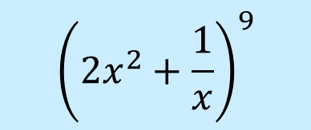

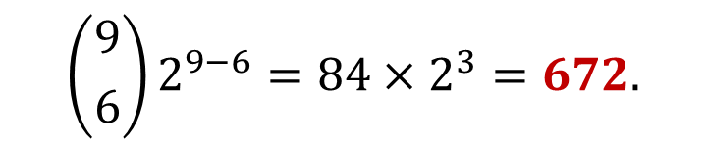
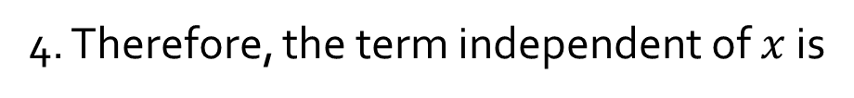
Q1.
Find the term independent of $x$ in the expansion of
$${\left(2x^{2}+\frac{1}{x}\right)}^{9}$$
Recall the Binomial Theorem:
$${\left(a+b\right)}^{n}=a^{n}+\left({n \atop 1}\right)a^{n−1}b^{1}+\left({n \atop 2}\right)a^{n−2}b^{2}+⋯+\left({n \atop n−1}\right)a^{1}b^{n−1}+b^{n}$$
1. We have $a=2x^{2},b=\frac{1}{x},n=9.$
2. The general term in the expansion of ${(a+b)}^{2}$ is given by:
$$\left({n \atop r}\right)a^{n−r}b^{r}=\left({9 \atop r}\right){(2x^{2})}^{9−r}{\left(\frac{1}{x}\right)}^{r}=\left({9 \atop r}\right)2^{9−r}x^{18−2r}x^{−r}=\left({9 \atop r}\right)2^{9−r}x^{18−3r}$$
3. For this term to be independent of $x$, we must have $18−3r=0,$ or $r=6$.
4. Therefore, the term independent of $x$ is
$$\left({9 \atop 6}\right)2^{9−6}=84×2^{3}=672.$$

Slide 4


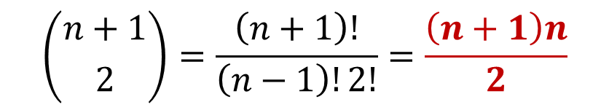

Q2.
Given n boxes numbered 1 to n, each box to be filled with a white ball or a blue ball. At least one box contains a white ball and boxes containing white balls must be consecutively numbered.
What is the total number of ways this can be done?
$$\sum_{k=1}^{n}{k}=\frac{n\left(n+1\right)}{2}$$
X
X
X
X
…
X
X
1 2 3 … n
The task is similar to choose $2$ out of the $n+1$ crosses to mark the start and end of the consecutively numbered boxes that contain the white balls.
$$\left({n+1 \atop 2}\right)=\frac{\left(n+1\right)!}{\left(n−1\right)!2!}=\frac{\left(n+1\right)n}{2}$$

Slide 5
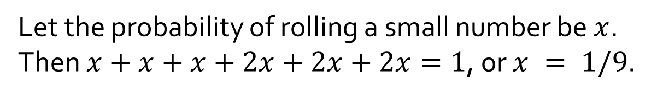
Q3.
[AY2020/21 Semester 2 Exam Question]
On a die there are 6 numbers. We call 4, 5, 6 the big numbers and 1, 2, 3 the small numbers. Given a loaded die in which the probability of rolling any fixed big number is twice the probability of rolling any fixed small number,
(i) What is the probability of rolling a 6?
(i)
Let the probability of rolling a small number be $x$.
Then $x+x+x+2x+2x+2x=1$, or $x = 1/9$.
Therefore, probability of rolling a 6 = $2/9$.

Slide 6
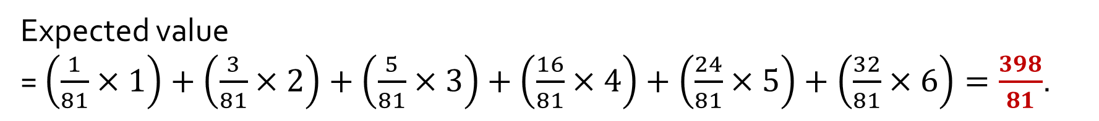
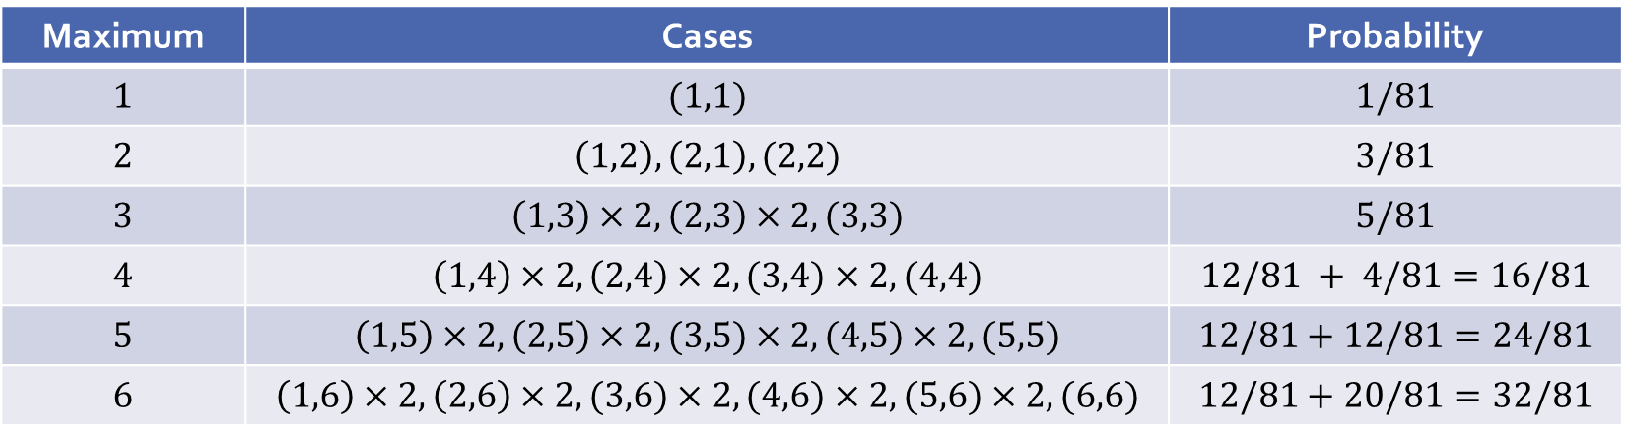
Q3.
On a die there are 6 numbers. We call 4, 5, 6 the big numbers and 1, 2, 3 the small numbers. Given a loaded die in which the probability of rolling any fixed big number is twice the probability of rolling any fixed small number,
(ii) If two such loaded dice are rolled, what is the expected value of the maximum of the two dice?
(ii)
Maximum | Cases | Probability
$$1$$ | $$(1,1)$$ | $$1/81$$
$$2$$ | $$\left(1,2\right),\left(2,1\right),(2,2)$$ | $$3/81$$
$$3$$ | $$\left(1,3\right)×2,\left(2,3\right)×2,(3,3)$$ | $$5/81$$
$$4$$ | $$\left(1,4\right)×2,\left(2,4\right)×2,(3,4)×2,(4,4)$$ | $$12/81 + 4/81=16/81$$
$$5$$ | $$\left(1,5\right)×2,\left(2,5\right)×2,(3,5)×2,(4,5)×2,(5,5)$$ | $$12/81+12/81=24/81$$
$$6$$ | $$\left(1,6\right)×2,\left(2,6\right)×2,(3,6)×2,(4,6)×2,(5,6)×2,(6,6)$$ | $$12/81+20/81=32/81$$
Expected value
= $\left(\frac{1}{81}×1\right)+\left(\frac{3}{81}×2\right)+\left(\frac{5}{81}×3\right)+\left(\frac{16}{81}×4\right)+\left(\frac{24}{81}×5\right)+\left(\frac{32}{81}×6\right)=\frac{398}{81}$.

Slide 7
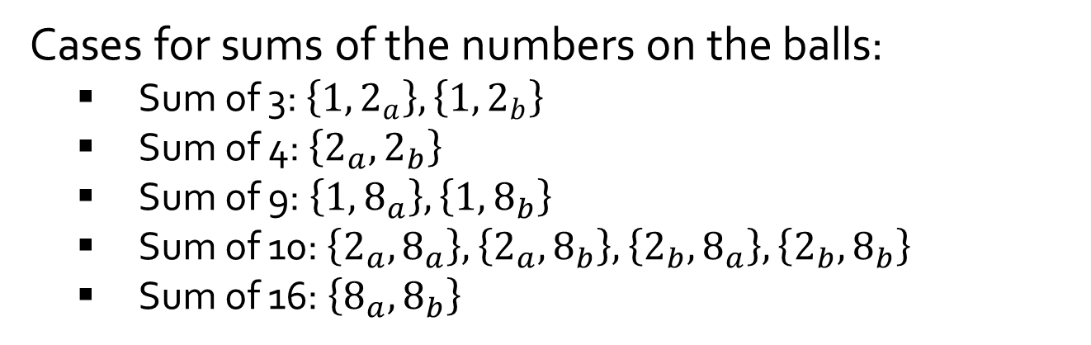
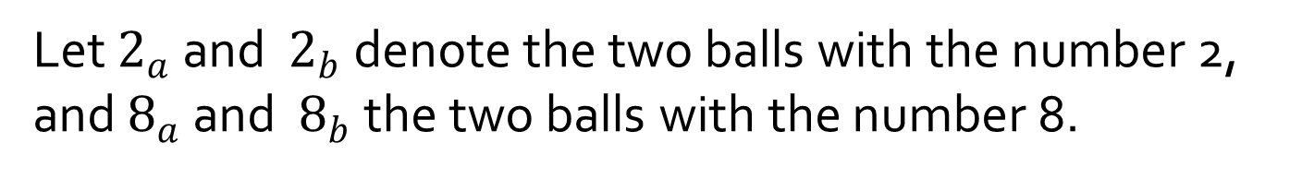

Q4.
An urn contains five balls numbered 1, 2, 2, 8 and 8. If a person selects a set of two balls at random, what is the expected value of the sum of the numbers on the balls?
Let $2_{a}$ and $2_{b}$ denote the two balls with the number 2, and $8_{a}$ and $8_{b}$ the two balls with the number 8.
Cases for sums of the numbers on the balls:
Sum of 3: $\left\{1,2_{a}\right\}, \left\{1,2_{b}\right\}$
Sum of 4: $\left\{2_{a},2_{b}\right\}$
Sum of 9: $\left\{1,8_{a}\right\}, \left\{1,8_{b}\right\}$
Sum of 10: $\left\{2_{a},8_{a}\right\}, \left\{2_{a},8_{b}\right\},\left\{2_{b},8_{a}\right\}, \left\{2_{b},8_{b}\right\}$
Sum of 16: $\left\{8_{a},8_{b}\right\}$
Expected sum
$=3∙\left(\frac{2}{10}\right)+$ $4∙\left(\frac{1}{10}\right)+9∙\left(\frac{2}{10}\right)+$ $10∙\left(\frac{4}{10}\right)+16∙\left(\frac{1}{10}\right)$
$$=8.4$$

Slide 8

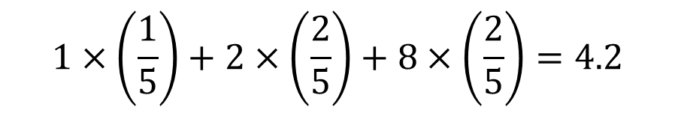
Q4.
An urn contains five balls numbered 1, 2, 2, 8 and 8. If a person selects a set of two balls at random, what is the expected value of the sum of the numbers on the balls?
Alternatively, compute the expected value of the number when one ball is picked:
$$1×\left(\frac{1}{5}\right)+2×\left(\frac{2}{5}\right)+8×\left(\frac{2}{5}\right)=4.2$$
Apply linearity of expected value:
$$2×4.2=8.4$$

Slide 9
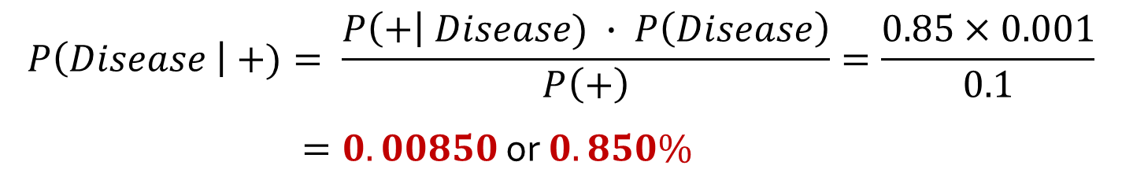
Q5.
[AY2021/22 Semester 2 Exam Question]
A rare disease broke out in a city with a prevalence of 0.1%, that is, it affects 1 out of every 1000 persons. A quick test kit has been developed that has a sensitivity of 85%, which is the probability that a person with the rare disease is tested positive. Among those who took the test, 10% of the time it came out positive. Write your answers correct to 3 significant figures.
(a) Divoc has shown symptoms of the disease. Should he be tested positive, what is the probability that he actually has the disease?
$$P(Disease) = 0.001; P(+|Disease) = 0.85; P(+) = 0.1.$$
$$P\left(Disease \right| +)= \frac{P\left(+\right| Disease) ∙ P\left(Disease\right)}{P\left(+\right)}=\frac{0.85×0.001}{0.1}$$
$=0.00850$ or $0.850\%$

Slide 10
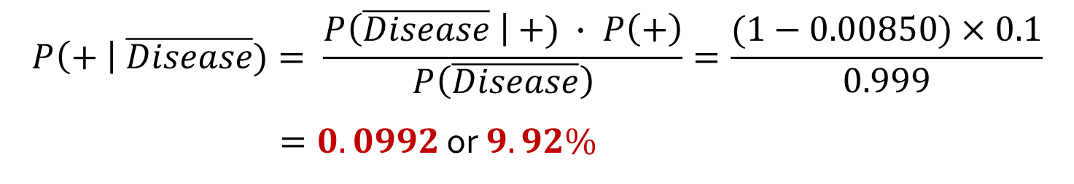
Q5.
[AY2021/22 Semester 2 Exam Question]
A rare disease broke out in a city with a prevalence of 0.1%, that is, it affects 1 out of every 1000 persons. A quick test kit has been developed that has a sensitivity of 85%, which is the probability that a person with the rare disease is tested positive. Among those who took the test, 10% of the time it came out positive. Write your answers correct to 3 significant figures.
(b) What is the probability of a false positive result, that is, a person does not have the disease but is tested positive?
$$P(Disease) = 0.001; P(+|Disease) = 0.85; P(+) = 0.1.$$
$$P\left(+ \right| \overline{Disease})= \frac{P\left(\overline{Disease} \right| +) ∙ P\left(+\right)}{P\left(\overline{Disease}\right)}=\frac{(1−0.00850)×0.1}{0.999}$$
$=0.0992$ or $9.92\%$

Slide 11
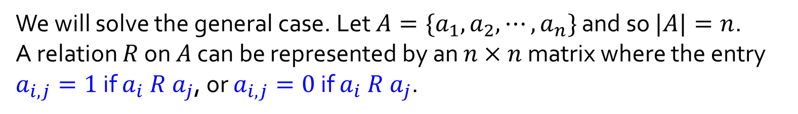
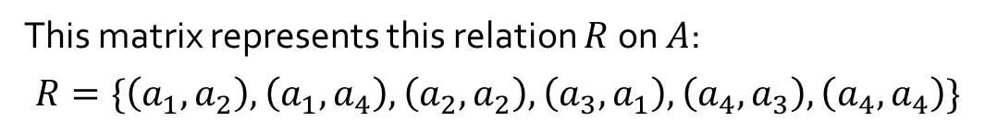
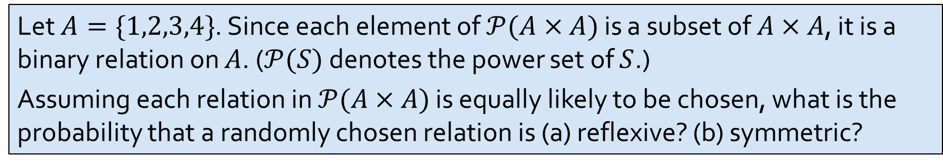


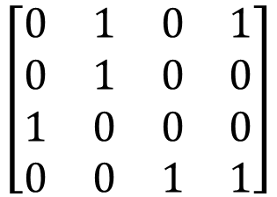
Q6.
Let $A=\{1,2,3,4\}$. Since each element of $𝒫(A×A)$ is a subset of $A×A$, it is a binary relation on $A$. ($𝒫(S)$ denotes the power set of $S$.)
Assuming each relation in $𝒫(A×A)$ is equally likely to be chosen, what is the probability that a randomly chosen relation is (a) reflexive? (b) symmetric?
We will solve the general case. Let $A=\{a_{1},a_{2},⋯,a_{n}\}$ and so $|A|=n$.
A relation $R$ on $A$ can be represented by an $n×n$ matrix where the entry $a_{i,j}=1$ if $a_{i} R a_{j}$, or $a_{i,j}=0$ if $a_{i} R a_{j}$.
Example:
$$a_{1}{ a}_{2} a_{3} a_{4}$$
$$a_{1}$$
$$a_{2}$$
$$a_{3}$$
$$a_{4}$$
$$\left[\begin{matrix}0 & 1 & 0 & 1 \\ 0 & 1 & 0 & 0 \\ 1 & 0 & 0 & 0 \\ 0 & 0 & 1 & 1\end{matrix}\right]$$
This matrix represents this relation $R$ on $A$:
$$R=\{\left(a_{1},a_{2}\right),\left(a_{1},a_{4}\right),\left(a_{2},a_{2}\right),\left(a_{3},a_{1}\right),\left(a_{4},a_{3}\right),\left(a_{4},a_{4}\right)\}$$

Slide 12
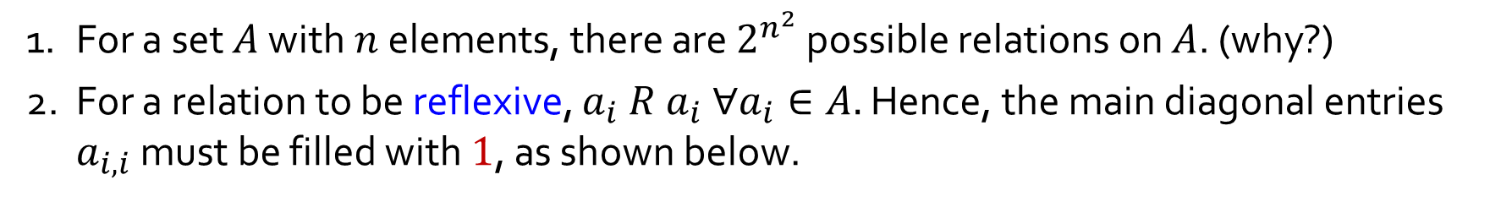
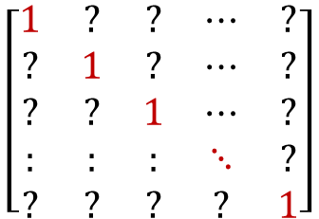
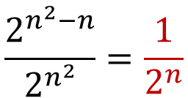
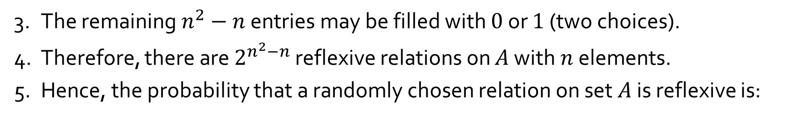
Q6.
(a) Reflexive relations
1. For a set $A$ with $n$ elements, there are $2^{n^{2}}$ possible relations on $A$. (why?)
2. For a relation to be reflexive, $a_{i} R a_{i} ∀a_{i}∈A.$ Hence, the main diagonal entries $a_{i,i}$ must be filled with $1$, as shown below.
$$\left[\begin{matrix}1 & ? & ? & ⋯ & ? \\ ? & 1 & ? & ⋯ & ? \\ ? & ? & 1 & ⋯ & ? \\ : & : & : & ⋱ & ? \\ ? & ? & ? & ? & 1\end{matrix}\right]$$
3. The remaining $n^{2}−n$ entries may be filled with $0$ or $1$ (two choices).
4. Therefore, there are $2^{n^{2}−n}$ reflexive relations on $A$ with $n$ elements.
5. Hence, the probability that a randomly chosen relation on set $A$ is reflexive is:
$$\frac{2^{n^{2}−n}}{2^{n^{2}}}=\frac{1}{2^{n}}$$
In particular, when $n=4$, the probability is $\frac{1}{2^{4}}$ or $\frac{1}{16}.$

Slide 13
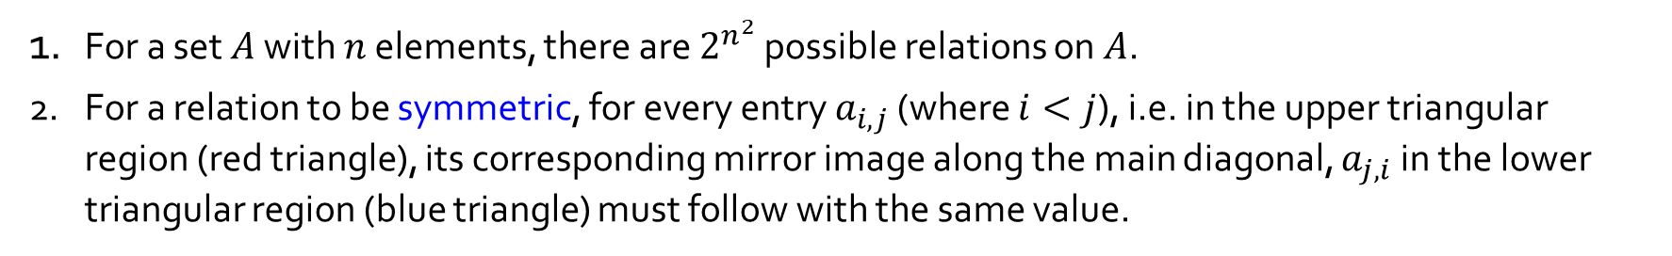


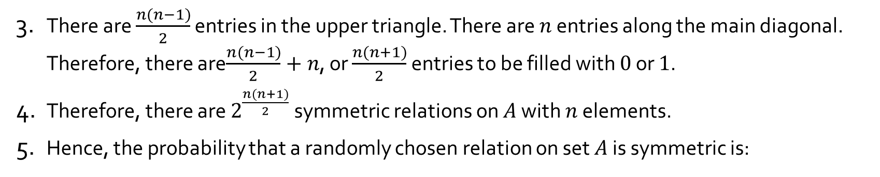
Q6.
(b) Symmetric relations
1. For a set $A$ with $n$ elements, there are $2^{n^{2}}$ possible relations on $A$.
2. For a relation to be symmetric, for every entry $a_{i,j}$ (where $i<j$), i.e. in the upper triangular region (red triangle), its corresponding mirror image along the main diagonal, $a_{j,i}$ in the lower triangular region (blue triangle) must follow with the same value.
$$\left[\begin{matrix}? & ? & ? & ⋯ & ? \\ ? & ? & ? & ⋯ & ? \\ ? & ? & ? & ⋯ & ? \\ : & : & : & ⋱ & ? \\ ? & ? & ? & ? & ?\end{matrix}\right]$$
3. There are $\frac{n(n−1)}{2}$ entries in the upper triangle. There are $n$ entries along the main diagonal. Therefore, there are$\frac{n(n−1)}{2}+n$, or $\frac{n(n+1)}{2}$ entries to be filled with $0$ or $1$.
4. Therefore, there are $2^{\frac{n(n+1)}{2}}$ symmetric relations on $A$ with $n$ elements.
5. Hence, the probability that a randomly chosen relation on set $A$ is symmetric is:
$$\frac{2^{\frac{n(n+1)}{2}}}{2^{n^{2}}}=\frac{1}{2^{\frac{n^{2}−n}{2}}}$$
In particular, when $n=4$, the probability is $\frac{1}{2^{6}}$ or $\frac{1}{64}.$

Slide 14
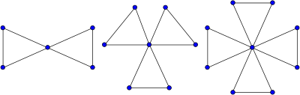
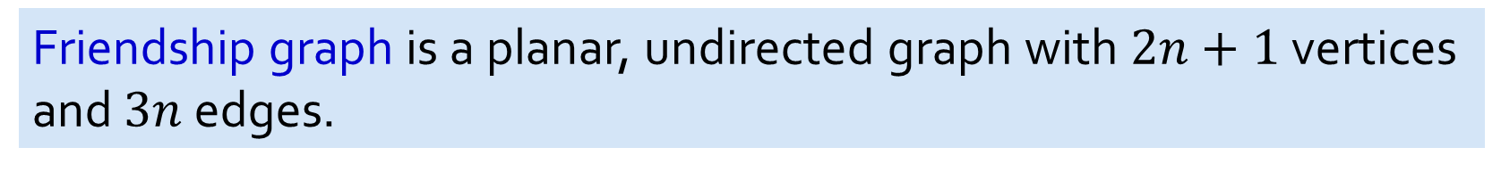



Q7.
Friendship graph is a planar, undirected graph with $2n+1$ vertices and $3n$ edges.
$$F_{2}$$
$$F_{3}$$
$$F_{4}$$
Yes
Is the friendship graph Eulerian?
Is the friendship graph Hamiltonian?
No
Notes:
Every vertex has a positive even degree. -> Eulerian
Eulerian graph = has eulerian circuit = everyedge exactly once, every vertex at least once
Hamiltonian = every edge at least once, every vertex exactly once, except for first and lat
Euler = positive even degree for every vertex and connected

Slide 15
Q8.
How many non-isomorphic undirected graphs with two vertices and two edges are there? Draw them.
4
Notes:
Smple = no parallel edges or loops

Slide 16
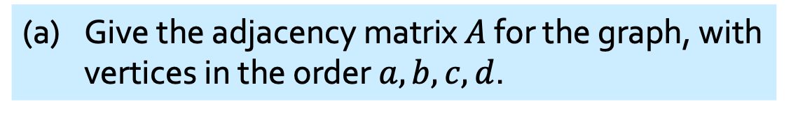
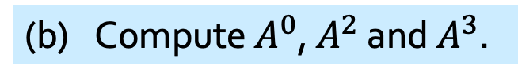
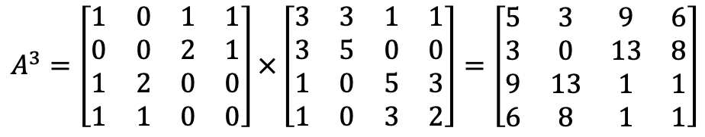
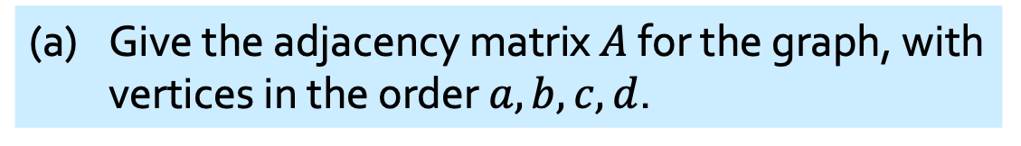

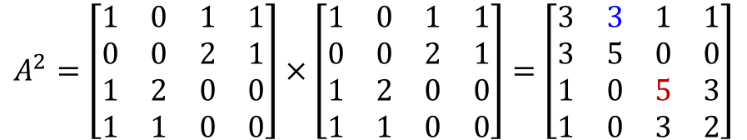
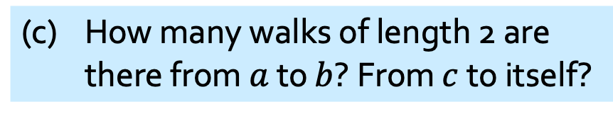
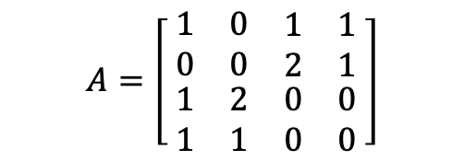
Q9.
(a) Give the adjacency matrix $A$ for the graph, with vertices in the order $a,b,c,d$.
Given this graph
(a) Give the adjacency matrix $A$ for the graph, with vertices in the order $a,b,c,d$.
a
b
(b) Compute $A^{0}$, $A^{2}$ and $A^{3}$.
$$A^{0}=I_{4}$$
e₂
e₃
e₆
e₅
$$A=\left[ \begin{matrix}\begin{matrix}1 & 0 \\ 0 & 0\end{matrix} & \begin{matrix}1 & 1 \\ 2 & 1\end{matrix} \\ \begin{matrix}1 & 2 \\ 1 & 1\end{matrix} & \begin{matrix}0 & 0 \\ 0 & 0\end{matrix}\end{matrix} \right]$$
$$A^{2}=\left[\begin{matrix}1 & 0 & 1 & 1 \\ 0 & 0 & 2 & 1 \\ 1 & 2 & 0 & 0 \\ 1 & 1 & 0 & 0\end{matrix}\right]×\left[\begin{matrix}1 & 0 & 1 & 1 \\ 0 & 0 & 2 & 1 \\ 1 & 2 & 0 & 0 \\ 1 & 1 & 0 & 0\end{matrix}\right]=\left[\begin{matrix}3 & 3 & 1 & 1 \\ 3 & 5 & 0 & 0 \\ 1 & 0 & 5 & 3 \\ 1 & 0 & 3 & 2\end{matrix}\right]$$
e₁
e₄
d
c
$$A^{3}=\left[\begin{matrix}1 & 0 & 1 & 1 \\ 0 & 0 & 2 & 1 \\ 1 & 2 & 0 & 0 \\ 1 & 1 & 0 & 0\end{matrix}\right]×\left[\begin{matrix}3 & 3 & 1 & 1 \\ 3 & 5 & 0 & 0 \\ 1 & 0 & 5 & 3 \\ 1 & 0 & 3 & 2\end{matrix}\right]=\left[\begin{matrix}5 & 3 & 9 & 6 \\ 3 & 0 & 13 & 8 \\ 9 & 13 & 1 & 1 \\ 6 & 8 & 1 & 1\end{matrix}\right]$$
(c) How many walks of length 2 are there from $a$ to $b$? From $c$ to itself?
3 walks from $a$ to $b$: $〈a→c\underset{→}{e_{5}} b〉$, $〈a→c\underset{→}{e_{6}} b〉$, $〈a→d→b〉$.
5 walks from $c$ to $c$: $〈c→a→c〉, 〈c \underset{→}{e_{5}} b \underset{→}{e_{5}} c〉, 〈c \underset{→}{e_{5}} b \underset{→}{e_{6}} c〉, 〈c \underset{→}{e_{6}} b \underset{→}{e_{5}} c〉, 〈c \underset{→}{e_{6}} b \underset{→}{e_{6}} c〉$.

Slide 17
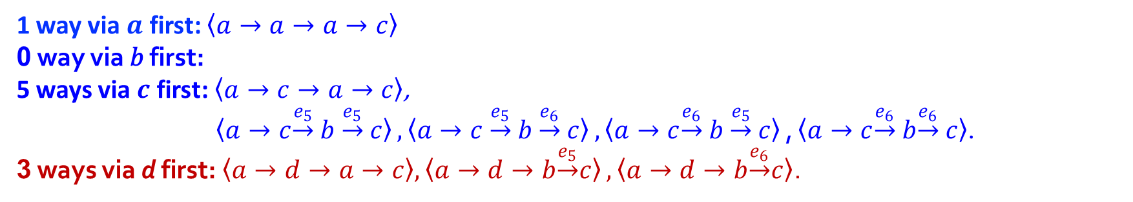
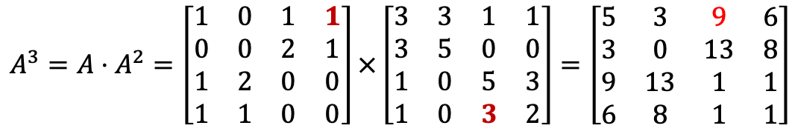
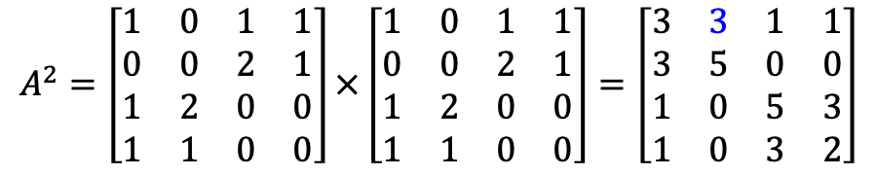
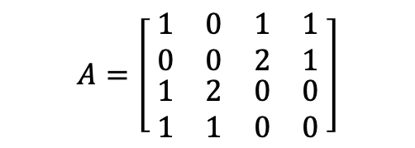


Q9.
a
b
e₂
e₃
$$A=\left[ \begin{matrix}\begin{matrix}1 & 0 \\ 0 & 0\end{matrix} & \begin{matrix}1 & 1 \\ 2 & 1\end{matrix} \\ \begin{matrix}1 & 2 \\ 1 & 1\end{matrix} & \begin{matrix}0 & 0 \\ 0 & 0\end{matrix}\end{matrix} \right]$$
$$A^{2}=\left[\begin{matrix}1 & 0 & 1 & 1 \\ 0 & 0 & 2 & 1 \\ 1 & 2 & 0 & 0 \\ 1 & 1 & 0 & 0\end{matrix}\right]×\left[\begin{matrix}1 & 0 & 1 & 1 \\ 0 & 0 & 2 & 1 \\ 1 & 2 & 0 & 0 \\ 1 & 1 & 0 & 0\end{matrix}\right]=\left[\begin{matrix}3 & 3 & 1 & 1 \\ 3 & 5 & 0 & 0 \\ 1 & 0 & 5 & 3 \\ 1 & 0 & 3 & 2\end{matrix}\right]$$
e₅
e₆
e₁
e₄
d
c
$$A^{3}=A⋅A^{2}=\left[\begin{matrix}1 & 0 & 1 & 1 \\ 0 & 0 & 2 & 1 \\ 1 & 2 & 0 & 0 \\ 1 & 1 & 0 & 0\end{matrix}\right]×\left[\begin{matrix}3 & 3 & 1 & 1 \\ 3 & 5 & 0 & 0 \\ 1 & 0 & 5 & 3 \\ 1 & 0 & 3 & 2\end{matrix}\right]=\left[\begin{matrix}5 & 3 & 9 & 6 \\ 3 & 0 & 13 & 8 \\ 9 & 13 & 1 & 1 \\ 6 & 8 & 1 & 1\end{matrix}\right]$$
(d) How many walks of length 3 are there from $a$ to $c$?
from $A_{xc}^{2}$ in $A^{2}$
9 walks of length 3 from $a$ to $c$:
from $A_{ax}^{1}$ in $A^{1}$
1 way via $a$ first: $〈a→a→a→c〉$
0 way via 𝑏 first:
5 ways via $c$ first: $〈a→c→a→c〉$,
$〈a→c\underset{→}{e_{5}} b \underset{→}{e_{5}} c〉,〈a→c \underset{→}{e_{5}} b \underset{→}{e_{6}} c〉,〈a→c\underset{→}{e_{6}} b \underset{→}{e_{5}} c〉\text{,}〈a→c\underset{→}{e_{6}} b\underset{→}{e_{6}} c〉$.
3 ways via d first:$〈a→d→a→c〉, 〈a→d→b\underset{→}{e_{5}}c〉, 〈a→d→b\underset{→}{e_{6}}c〉$.
1 edge
2 edges
a
x
c
Notes:
To Tutors: Illustrate with x=d
Try to show with GC

Slide 18
Q9.
https://www.youtube.com/watch?v=t01FFRMr_KI
How to do matrix multiplication in GC
Notes:
To Tutors: Illustrate with x=d
Try to show with GC

Slide 19
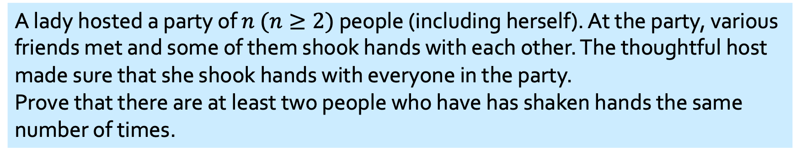
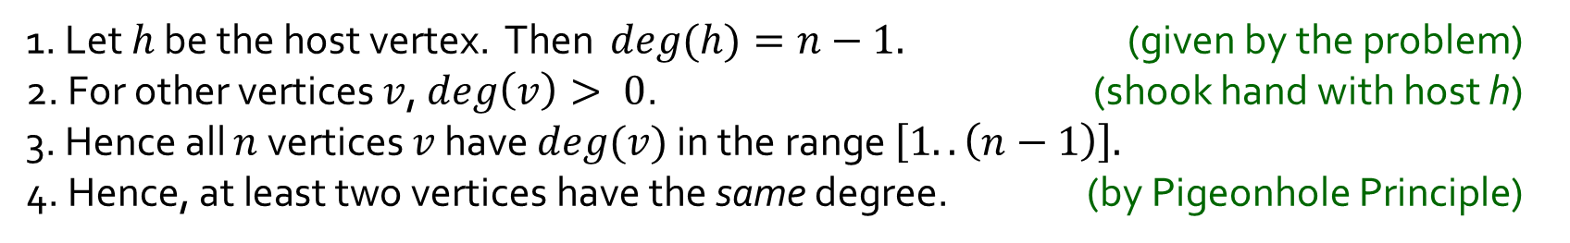
Q10.
A lady hosted a party of $n$ $(n≥2)$ people (including herself). At the party, various friends met and some of them shook hands with each other. The thoughtful host made sure that she shook hands with everyone in the party.
Prove that there are at least two people who have has shaken hands the same number of times.
Model this with a graph $G=(V,E$) where each person is a vertex in $V$, and there is an undirected edge {$x,y\}∈E$ whenever $x$ and $y$ shook hand at the party.
1. Let $h$ be the host vertex. Then $deg(h)=n−1.$ (given by the problem)
2. For other vertices $v$, $deg\left(v\right)> 0$. (shook hand with host h)
3. Hence all $n$ vertices $v$ have $deg(v)$ in the range $\left[1..\left(n−1\right)\right].$
4. Hence, at least two vertices have the same degree. (by Pigeonhole Principle)
Hence, at least two people has the same number of handshakes.
Notes:
N -1 + at least 1 x (N-1) = 2N-2. For n>=2, this is greater than N. Thus by PHP, at least two verts have same degree.

Slide 20
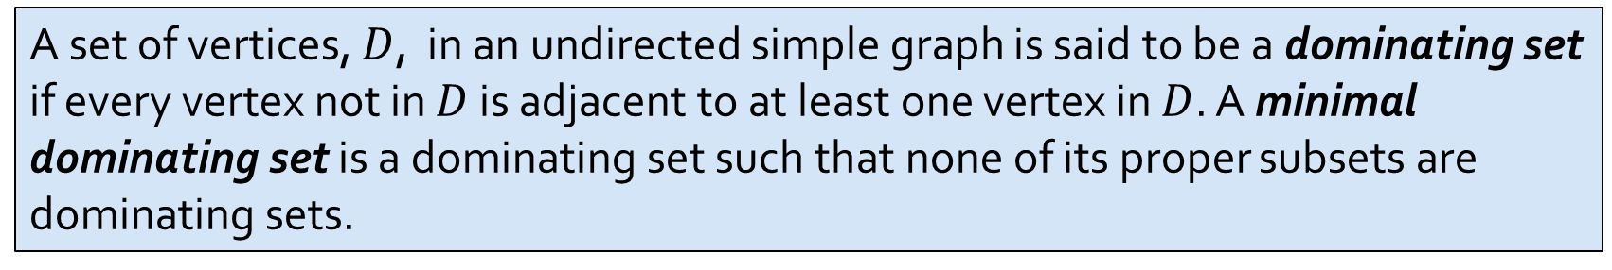
Q11.
A set of vertices, $D$, in an undirected simple graph is said to be a dominating set if every vertex not in $D$ is adjacent to at least one vertex in $D$. A minimal dominating set is a dominating set such that none of its proper subsets are dominating sets.
(a) Draw two non-isomorphic simple graphs with four vertices that have minimal dominating sets of size one. Highlight the vertices in the minimal dominating set in your graphs.

Slide 21
Q11.
A set of vertices, $D$, in an undirected simple graph is said to be a dominating set if every vertex not in $D$ is adjacent to at least one vertex in $D$. A minimal dominating set is a dominating set such that none of its proper subsets are dominating sets.
(b) Draw two non-isomorphic simple graphs with four vertices that have minimal dominating sets of size three. Highlight the vertices in the minimal dominating set in your graphs.

Slide 22


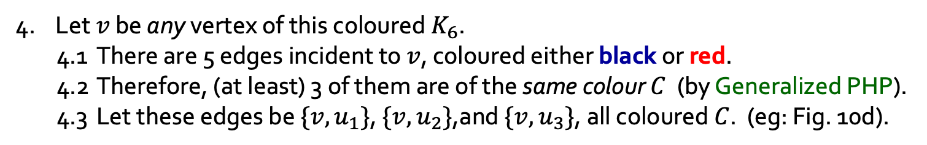

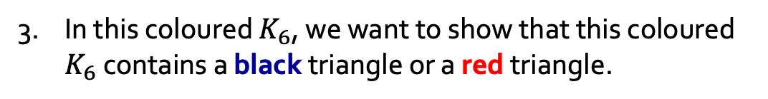



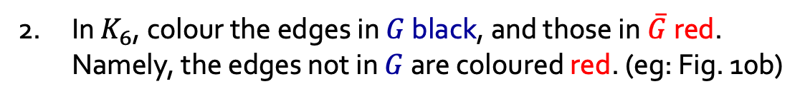



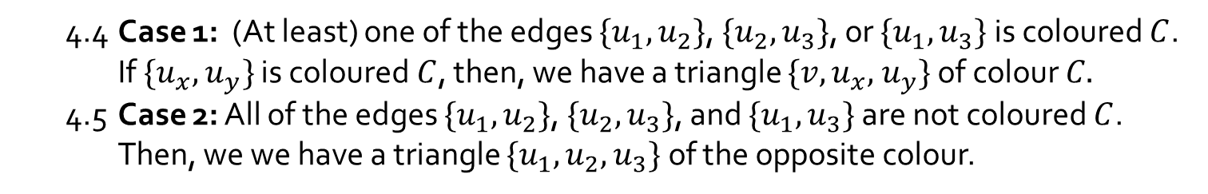

Q12.
Let $G$ be a simple graph with 6 vertices. Prove that $G$ or its complementary graph $\overline{G}$ contains a triangle (cycle of length 3).
1. Consider any simple graph $G$ on 6 vertices. (eg: Fig 10a)
In $K_{6}$, colour the edges in $G$ black, and those in$\overline{G}$ red. Namely, the edges not in $G$ are coloured red. (eg: Fig. 10b)
3. In this coloured $K_{6}$, we want to show that this coloured $K_{6}$ contains a black triangle or a red triangle.
Graph $G$
Coloured $K_{6}$
$$u_{1}$$
4. Let $v$ be any vertex of this coloured $K_{6}$.
4.1 There are 5 edges incident to $v$, coloured either black or red.
4.2 Therefore, (at least) 3 of them are of the same colour $C$ (by Generalized PHP).
4.3 Let these edges be ${\{v,u}_{1}\}$, $\{v,u_{2}\}$,and $\{v,u_{3}\}$, all coloured $C$. (eg: Fig. 10d).
$$u_{2}$$
$$v$$
$u_{3}$u
Figure 10d
4.4 Case 1: (At least) one of the edges ${\{u}_{1},u_{2}\}$, ${\{u}_{2},u_{3}\}$, or ${\{u}_{1},u_{3}\}$ is coloured $C$.
If $\{u_{x},$ $u_{y}\}$ is coloured $C$, then, we have a triangle $\{v,u_{x},$ $u_{y}\}$ of colour $C.$
4.5 Case 2: All of the edges ${\{u}_{1},u_{2}\}$, ${\{u}_{2},u_{3}\}$, and ${\{u}_{1},u_{3}\}$ are not coloured $C$.
Then, we we have a triangle $\{u_{1},u_{2},$ $u_{3}\}$ of the opposite colour.
$$u_{1}$$
$$u_{2}$$
5. In all cases, there is a triangle of the same colour.
$$v$$
$u_{3}$u
Figure 10e

Slide 23
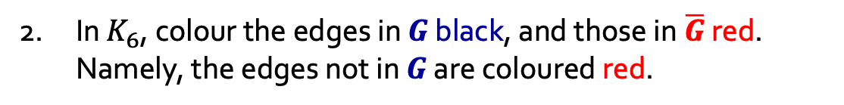

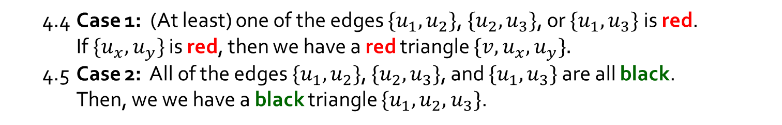
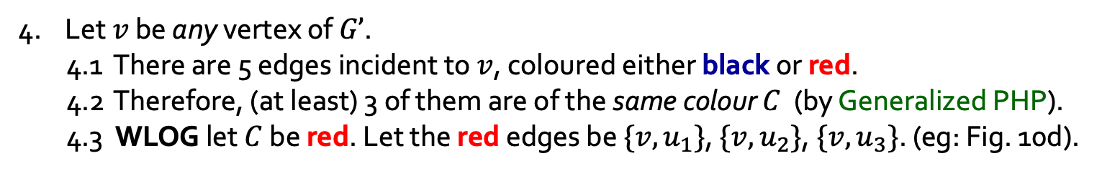
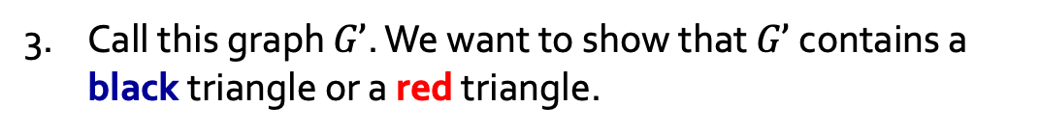
Q12.
Variant using WLOG
Prove that for any simple graph $G$ with 6 vertices, $G$ or its complementary graph $\overline{G}$ contains a triangle.
1. Consider any simple graph $G$ on 6 vertices.
In $K_{6}$, colour the edges in $G$ black, and those in$\overline{G}$ red. Namely, the edges not in $G$ are coloured red.
3. Call this graph $G’$. We want to show that $G’$contains a black triangle or a red triangle.
Graph $G$
Coloured $K_{6}$
$$u_{1}$$
4. Let $v$ be any vertex of $G’$.
4.1 There are 5 edges incident to $v$, coloured either black or red.
4.2 Therefore, (at least) 3 of them are of the same colour $C$ (by Generalized PHP).
4.3 WLOG let $C$ be red. Let the red edges be ${\{v,u}_{1}\}$, $\{v,u_{2}\}$, $\{v,u_{3}\}$. (eg: Fig. 10d).
$$u_{2}$$
$$v$$
$u_{3}$u
Figure 10d
4.4 Case 1: (At least) one of the edges ${\{u}_{1},u_{2}\}$, ${\{u}_{2},u_{3}\}$, or ${\{u}_{1},u_{3}\}$ is red.
If $\{u_{x},$ $u_{y}\}$ is red, then we have a red triangle $\{v,u_{x},$ $u_{y}\}.$
4.5 Case 2: All of the edges ${\{u}_{1},u_{2}\}$, ${\{u}_{2},u_{3}\}$, and ${\{u}_{1},u_{3}\}$ are all black.
Then, we we have a black triangle $\{u_{1},u_{2},$ $u_{3}\}$.
$$u_{1}$$
$$u_{2}$$
5. In all cases, there is a triangle of the same colour.
Optional DIY: WLOG let $C$ be black.
$$v$$
$u_{3}$u
Figure 10e

Slide 24
THE END

