Slide 1
CS1231S Tutorial #1
Propositional Logic and Proofs
(AY2025/26 Semester 1) – 11B
Based on Prof Aaron’s slides

Slide 2

Introduction
Gary A.M.
@salmonkarp
Y2 CS
Took CS1231S in 2024/2025 S1
nuSTUDIOS & The Ridge

Slide 3
More introductions! (while I take attendance)

Slide 4

Telegram Group
https://t.me/+AZarueRYPVRkMmE9

Slide 5
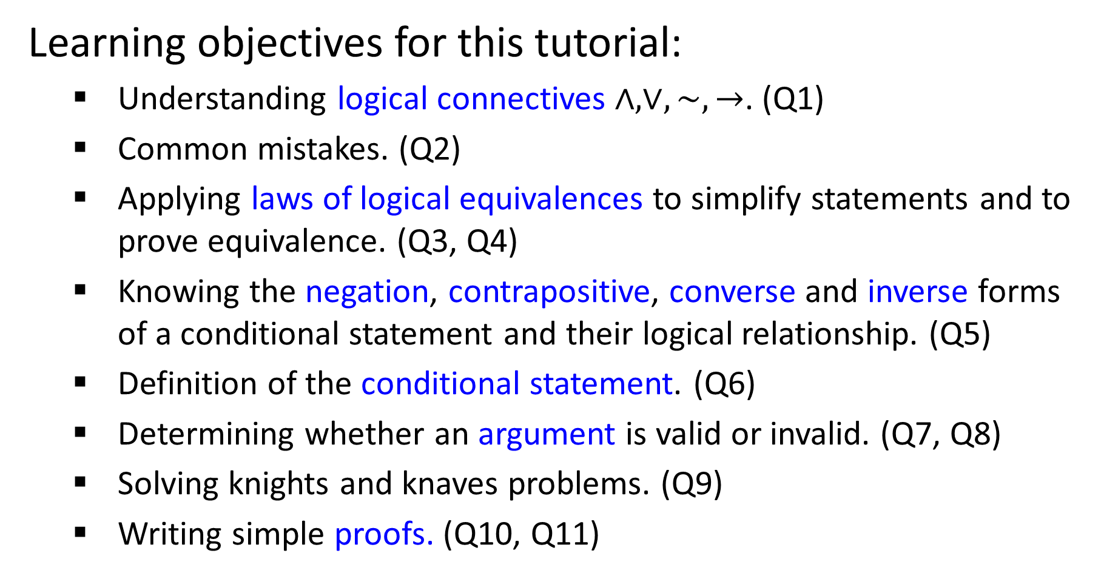
Learning objectives for this tutorial:
Understanding logical connectives $∧,∨,\sim ,→$. (Q1)
Common mistakes. (Q2)
Applying laws of logical equivalences to simplify statements and to prove equivalence. (Q3, Q4)
Knowing the negation, contrapositive, converse and inverse forms of a conditional statement and their logical relationship. (Q5)
Definition of the conditional statement. (Q6)
Determining whether an argument is valid or invalid. (Q7, Q8)
Solving knights and knaves problems. (Q9)
Writing simple proofs. (Q10, Q11)

Slide 6

Q1a
$p≡$ “I use the umbrella”.
$q≡$ “It rains”.
Propositional statement
I use the umbrella if it rains.
$$q→p$$
I use the umbrella only if it rains.
$$p→q$$

Slide 7
Q1b
I use the umbrella if it rains.
necessary
“I use the umbrella” is a ______________ condition for “it rains”.
sufficient
“It rains” is a _____________ condition for “I use the umbrella”.

Slide 8
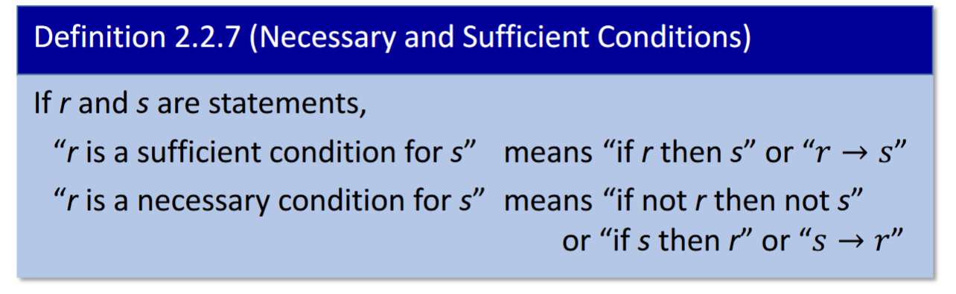

Slide 9
Q1c/d
$p≡$ “I use the umbrella”.
$q≡$ “It rains”.
$$(q→p)$$
$$∧$$
$$(p→q)$$
$$≡$$
$$(p↔q)$$
I use the umbrella if and only if it rains.
necessary and sufficient
“I use the umbrella” is a ____________________ condition for “it rains”.
Notes:
3

Slide 10
Q2
(a) $a∧\sim \left(b∧c\right)≡a∧\sim b∨\sim c$ by De Morgan’s law
is ambiguous!
$a∧\sim \left(b∧c\right)≡a∧(\sim b∨\sim c)$ by De Morgan’s law
(b) $\sim \left(x∨y\right)∨z≡\sim x∧\sim y∨z$ by De Morgan’s law
is ambiguous!
$\sim \left(x∨y\right)∨z≡(\sim x∧\sim y)∨z$ by De Morgan’s law
Notes:
Use example of false and false or true

Slide 11
For now till midterm test, follow this table and do not skip steps in your answers.
Theorem 2.1.1 Logical Equivalences
1 | Commutative laws | p ∧ q ≡ q ∧ p | p ∨ q ≡ q ∨ p
2 | Associative laws | p ∧ q ∧ r ≡ (p ∧ q) ∧ r ≡ p ∧ (q ∧ r) | p ∨ q ∨ r ≡ (p ∨ q) ∨ r ≡ p ∨ (q ∨ r)
3 | Distributive laws | p ∧ (q ∨ r) ≡ (p ∧ q) ∨ (p ∧ r) | p ∨ (q ∧ r) ≡ (p ∨ q) ∧ (p ∨ r)
4 | Identity laws | p ∧ true ≡ p | p ∨ false ≡ p
5 | Negation laws | p ∨ ~p ≡ true | p ∧ ~p ≡ false
6 | Double negative law | ~(~p) ≡ p
7 | Idempotent laws | p ∧ p ≡ p | p ∨ p ≡ p
8 | Universal bound laws | p ∨ true ≡ true | p ∧ false ≡ false
9 | De Morgan’s laws | ~(p ∧ q) ≡ ~p ∨ ~q | ~(p ∨ q) ≡ ~p ∧ ~q
10 | Absorption laws | p ∨ (p ∧ q) ≡ p | p ∧ (p ∨ q) ≡ p
11 | Negation of true and false | ~true ≡ false | ~false ≡ true
Implication law is NOT part of Theorem 2.1.1.
Notes:
Take note here: - order of brackets in distributive
True and false in identity
Order in engation law
True and false in UB law
Order of bracket in absorption
Strict due to: making sure you have a solid grasp on these basic laws + far easier clarity for marking
Reminder that implication law is NOT part of Theorem 2.1.1

Slide 12

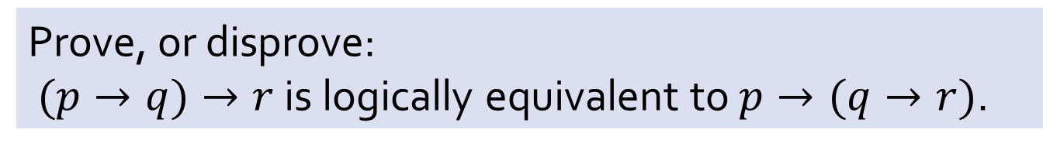
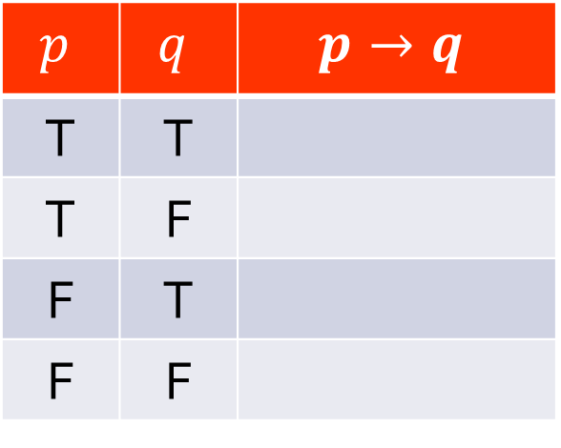

Q4
Prove, or disprove:
$(p→q)→r$ is logically equivalent to $p→(q→r)$.
Definition of conditional statement $p→q$:
$$p$$ | $$q$$ | $$p→q$$
T | T
T | F
F | T
F | F
T
F
T
T

Slide 13











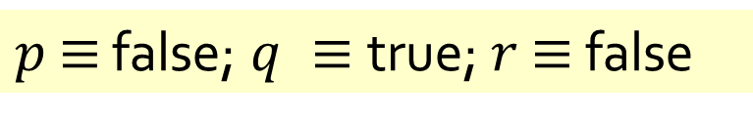




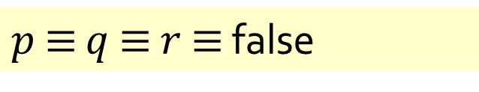

Q4
Prove, or disprove:
$(p→q)→r$ is logically equivalent to $p→(q→r)$.
True or false?
If false, what do you need?
What counterexample can you give?
$p$ $≡$ false; $q ≡$true; $r$ $≡$ false
$p$ $≡$ $q$ $≡$ $r$ $≡$ false
$$(p→q)→r$$
$$(p→q)→r$$
$$≡(F→T)→F$$
$$≡(F→F)→F$$
$$≡T→F$$
$$≡F$$
Any of these two counterexamples suffices.
$$≡T→F$$
$$≡F$$
$$p→(q→r)$$
$$p→(q→r)$$
$$≡F→(T→F)$$
$$≡F→(F→F)$$
Note: Do not follow these examples for proof-writing. This is just a quick sketch.
$$≡F→F$$
$$≡T$$
$$≡F→T$$
$$≡T$$
Notes:
Note that if you have a counterexample; you can just stop at the counter example.
If you want to prove that it is true, you need to prove it for ALL cases (aka draw the truth table)

Slide 14
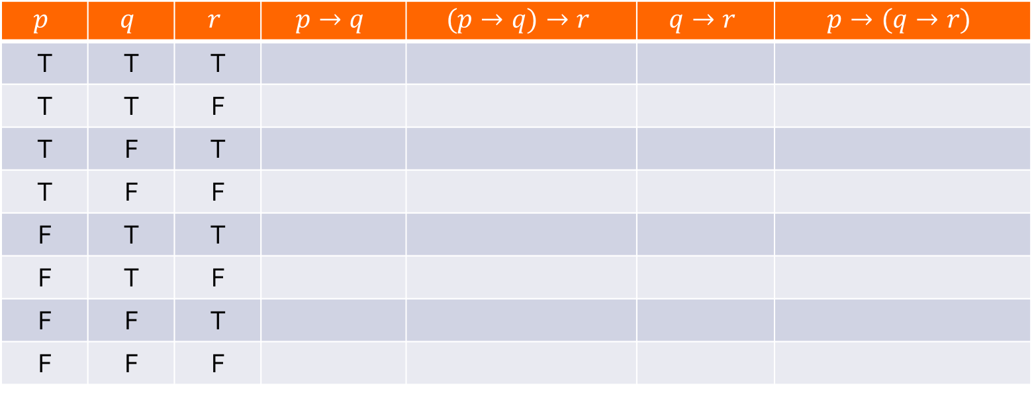
Q4
Prove, or disprove:
$(p→q)→r$ is logically equivalent to $p→(q→r)$.
If you do not know if it is true or false, you may have to draw the truth table to find out:
$$p$$ | $$q$$ | $$r$$ | $$p→q$$ | $$(p→q)→r$$ | $$q→r$$ | $$p→(q→r)$$
T | T | T
T | T | F
T | F | T
T | F | F
F | T | T
F | T | F
F | F | T
F | F | F
T
T
F
F
T
T
T
T
T
F
T
T
T
F
T
F
T
F
T
T
T
F
T
T
T
F
T
T
T
T
T
T

Slide 15
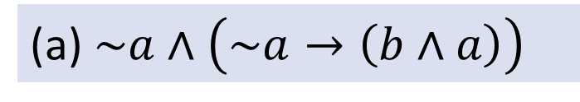
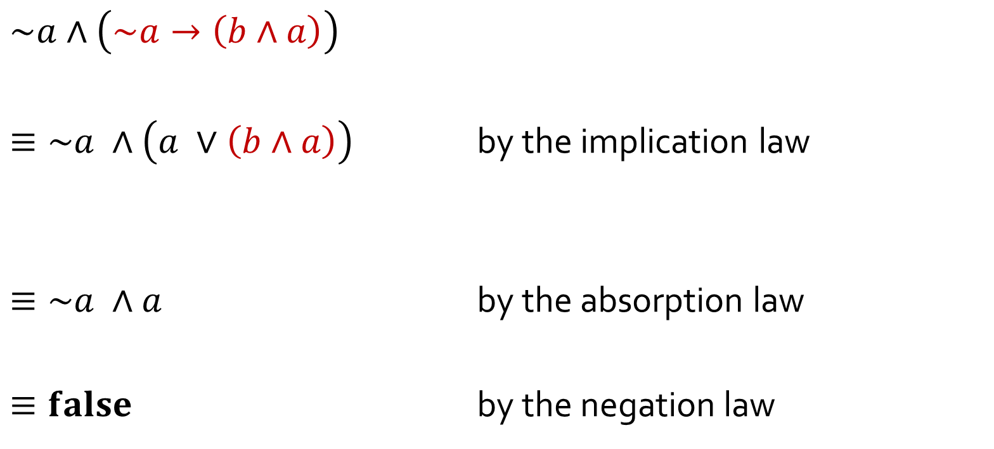
Q3
(a) $\sim a∧\left(\sim a→\left(b∧a\right)\right)$
$$\sim a∧\left(\sim a→\left(b∧a\right)\right)$$
$≡\sim a ∧\left(a ∨\left(b∧a\right)\right)$ by the implication law
$≡\sim a ∧a$ by the absorption law
$≡false$ by the negation law
$≡\sim a ∧\left(\sim (\sim a) ∨\left(b∧a\right)\right)$ by the implication law
double negative law
$≡\sim a ∧\left(a ∨\left(a∧b\right)\right)$ by the commutative law
$≡a∧\sim a$ by the commutative law
Notes:
GET SOMEONE TO WRITE ON BOARD.

Slide 16
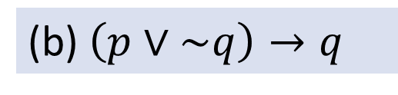
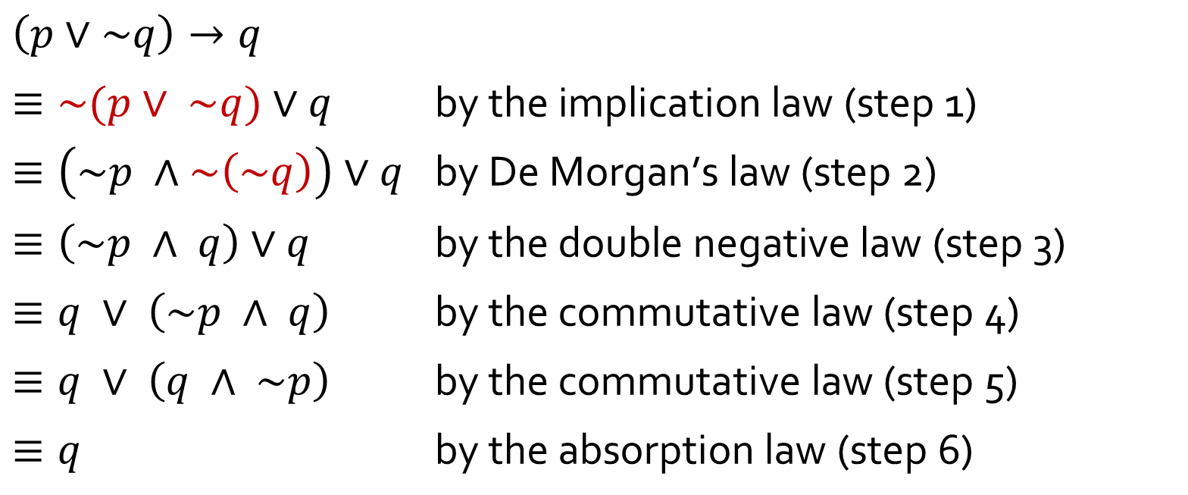
Q3
(b) $\left(p∨\sim q\right)→q$
$$\left(p∨\sim q\right)→q$$
$≡\sim (p∨ \sim q)∨q$ $\text{by} \text{the} \text{implication} \text{law}\text{ (}\text{step}\text{ 1)}$
$≡\left(\sim p ∧\sim \left(\sim q\right)\right)∨q$ $\text{by} \text{De} \text{Morgan}\text{’}\text{s} \text{law}\text{ (}\text{step}\text{ 2)}$
$≡\left(\sim p ∧ q\right)∨q$ $\text{by} \text{the} \text{double} \text{negative} \text{law}\text{ (}\text{step}\text{ 3)}$
$≡q ∨ \left(\sim p ∧ q\right)$ $\text{by} \text{the} \text{commutative} \text{law}\text{ (}\text{step}\text{ 4)}$
$≡q ∨ \left(q ∧ \sim p\right)$ $\text{by} \text{the} \text{commutative} \text{law}\text{ (}\text{step}\text{ 5)}$
$≡q$ $\text{by} \text{the} \text{absorption} \text{law}\text{ (}\text{step}\text{ 6)}$

Slide 17

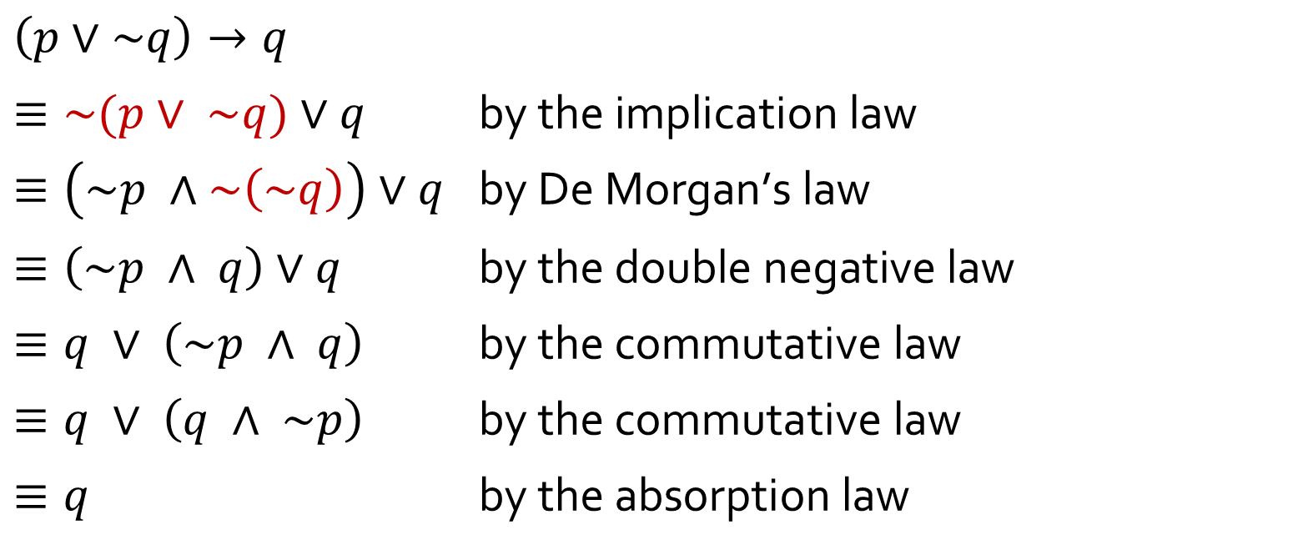
Q3
(b) $\left(p∨\sim q\right)→q$
You may combine two simple steps into one line, by citing the laws applied. Try not to combine more than 2 steps into one line or it may confuse your readers.
$$\left(p∨\sim q\right)→q$$
$≡\sim (p∨ \sim q)∨q$ $\text{by} \text{the} \text{implication} \text{law}$
$≡\left(\sim p ∧\sim \left(\sim q\right)\right)∨q$ $\text{by} \text{De} \text{Morgan}\text{’}\text{s} \text{law}$
$≡\left(\sim p ∧ q\right)∨q$ $\text{by} \text{the} \text{double} \text{negative} \text{law}$
$≡q ∨ \left(\sim p ∧ q\right)$ $\text{by} \text{the} \text{commutative} \text{law}$
$≡q ∨ \left(q ∧ \sim p\right)$ $\text{by} \text{the} \text{commutative} \text{law}$
$≡q$ $\text{by} \text{the} \text{absorption} \text{law}$
twice
Notes:
Special case of allowing double of the same line

Slide 18
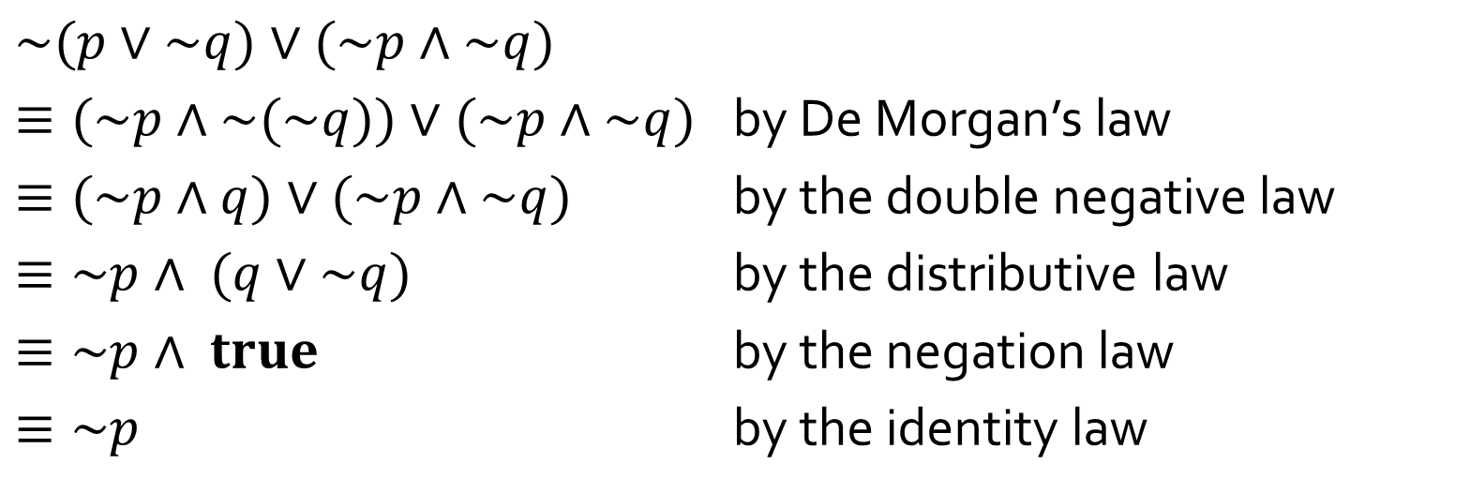
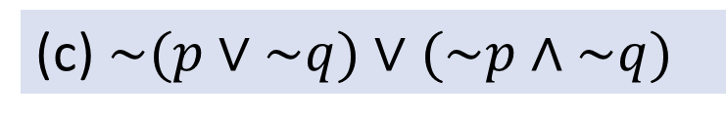
Q3
(c)$\sim (p∨\sim q)∨(\sim p∧\sim q)$
$$\sim (p∨\sim q)∨(\sim p∧\sim q)$$
$≡(\sim p∧\sim (\sim q))∨(\sim p∧\sim q)$ by De Morgan’s law
$≡(\sim p∧q)∨(\sim p∧\sim q)$ by the double negative law
$≡\sim p∧ (q∨\sim q)$ by the distributive law
$≡\sim p∧ true$ by the negation law
$≡\sim p$ by the identity law

Slide 19
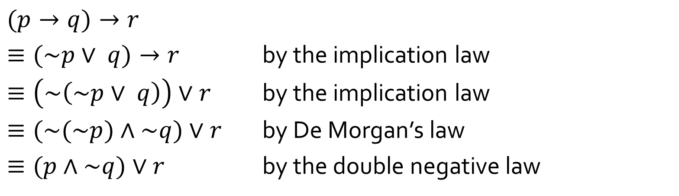
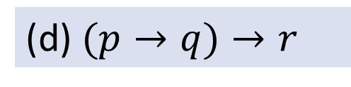
Q3
(d)$(p→q)→r$
$$(p→q)→r$$
$≡(\sim p∨ q)→r$ by the implication law
$≡\left(\sim \left(\sim p∨ q\right)\right)∨r$ by the implication law
$≡(\sim (\sim p)∧\sim q)∨r$ by De Morgan’s law
$≡(p∧\sim q)∨r$ by the double negative law

Slide 20
Q5
Given the conditional statement “If $12x−7=29$, then $x=3$”.
Negation:
$12x−7=29$ and $x≠3$.
Contrapositive:
If $x≠3,$ then $12x−7≠29$.
Converse:
If $x=3,\text{then} 12x−7=29$.
Inverse:
If $12x−7≠29,\text{then} x≠3$.
Is the given conditional statement true?
Yes.
Is the converse true?
Yes.
In general, possible for converse to be true but inverse false?
No.

Slide 21
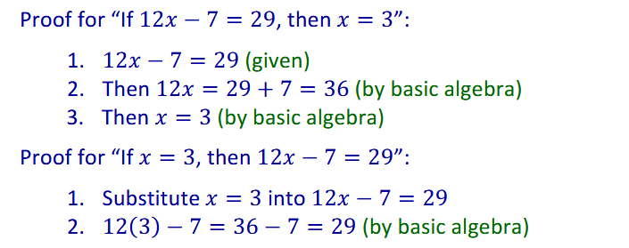

Q5
Given the conditional statement “If $12x−7=29$, then $x=3$”.
Note: Converse is logically equivalent to the inverse.
Converse of $p→q$: $q→p$
Inverse of $p→q$: $\sim p→\sim q≡q→p$ (by contraposition)

Slide 22
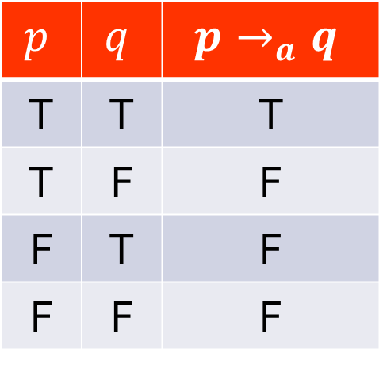
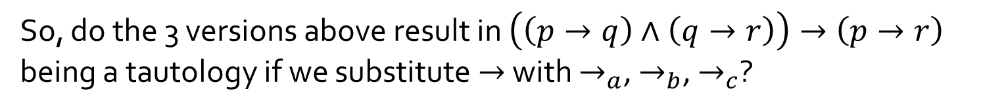

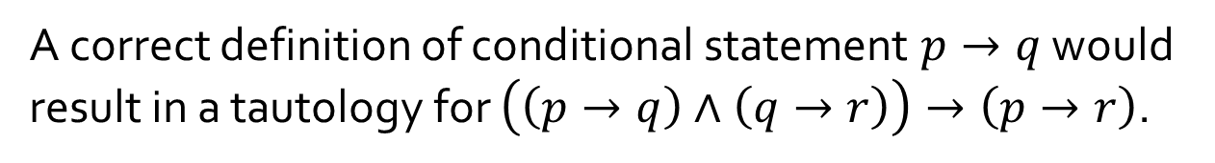

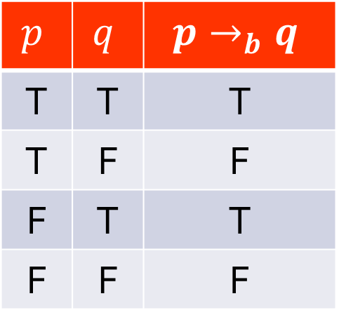
Q6
$$\left(\left(p→q\right)∧\left(q→r\right)\right)→\left(p→r\right)$$
$$p$$ | $$q$$ | $$p→_{a}q$$
T | T | T
T | F | F
F | T | F
F | F | F
$$p$$ | $$q$$ | $$p→_{b}q$$
T | T | T
T | F | F
F | T | T
F | F | F
$$p$$ | $$q$$ | $$p→_{c}q$$
T | T | T
T | F | F
F | T | F
F | F | T
A correct definition of conditional statement $p→q$ would result in a tautology for $\left(\left(p→q\right)∧\left(q→r\right)\right)→\left(p→r\right)$.
So, do the 3 versions above result in $\left(\left(p→q\right)∧\left(q→r\right)\right)→\left(p→r\right)$
being a tautology if we substitute $→$ with $→_{a}$, $→_{b}$, $→_{c}$?

Slide 23
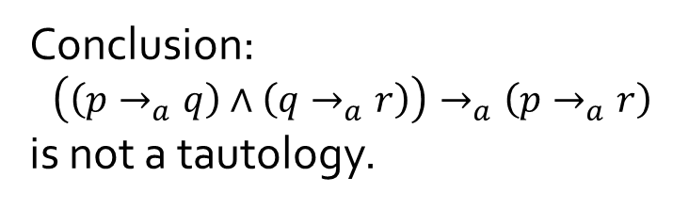
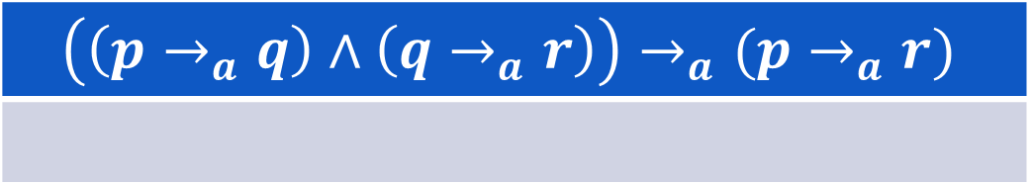
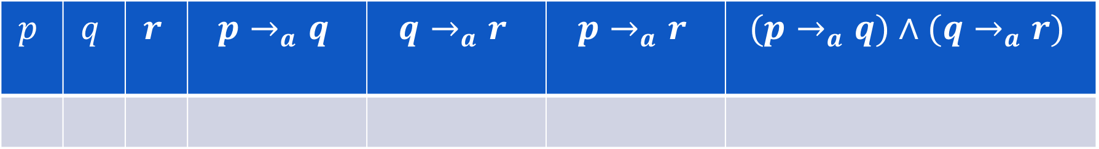
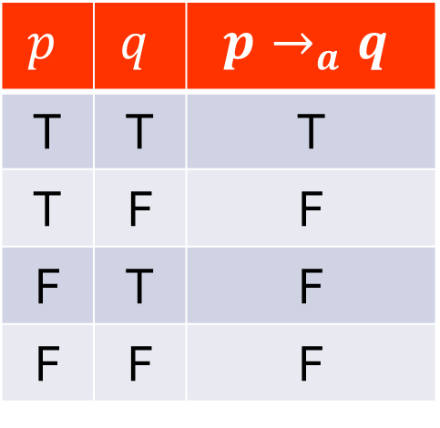
Q6
$$\left(\left(p→q\right)∧\left(q→r\right)\right)→\left(p→r\right)$$
$$p$$ | $$q$$ | $$p→_{a}q$$
T | T | T
T | F | F
F | T | F
F | F | F
$$p$$ | $$q$$ | $$r$$ | $$p→_{a}q$$ | $$q→_{a}r$$ | $$p→_{a}r$$ | $$(p→_{a}q)∧(q→_{a}r)$$
T
T
F
T
F
F
F
Conclusion:
$$\left(\left(p→_{a}q\right)∧\left(q→_{a}r\right)\right)→_{a}\left(p→_{a}r\right)$$
is not a tautology.
$$\left(\left(p→_{a}q\right)∧\left(q→_{a}r\right)\right)→_{a}(p→_{a}r)$$
F
Notes:
To ‘show’ that a imply operation is not a tautology, remember that a -> b is same as ~a or b.
Hence, we need to show that both ~a and b is NOT true.
Aka, we need to show that a is false, while b is true.
From here, we can find that p must be

Slide 24
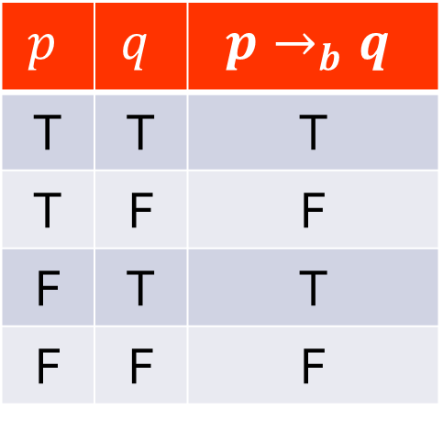
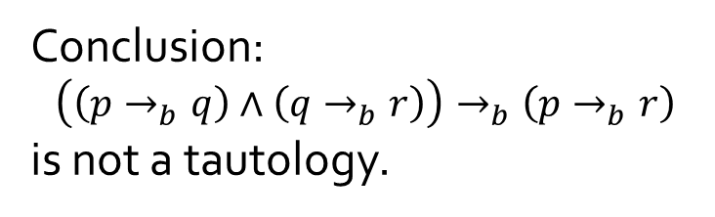
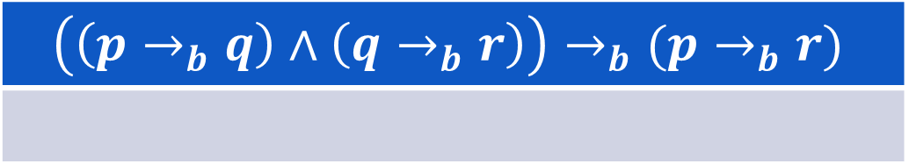
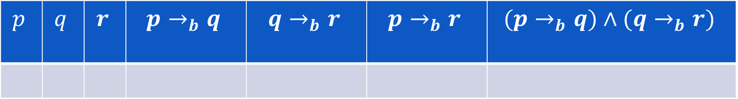
Q6
$$\left(\left(p→q\right)∧\left(q→r\right)\right)→\left(p→r\right)$$
$$p$$ | $$q$$ | $$p→_{b}q$$
T | T | T
T | F | F
F | T | T
F | F | F
$$p$$ | $$q$$ | $$r$$ | $$p→_{b}q$$ | $$q→_{b}r$$ | $$p→_{b}r$$ | $$(p→_{b}q)∧(q→_{b}r)$$
T
T
F
T
F
F
F
Conclusion:
$$\left(\left(p→_{b}q\right)∧\left(q→_{b}r\right)\right)→_{b}\left(p→_{b}r\right)$$
is not a tautology.
$$\left(\left(p→_{b}q\right)∧\left(q→_{b}r\right)\right)→_{b}(p→_{b}r)$$
F

Slide 25
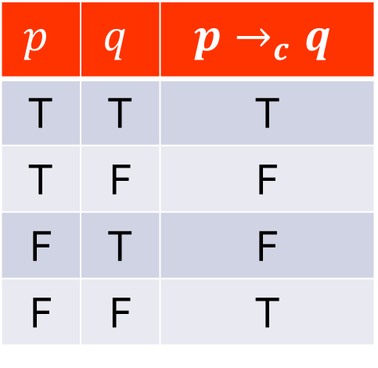
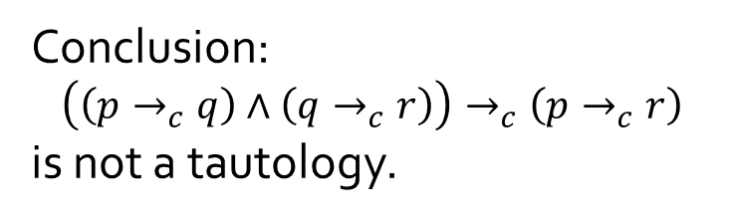
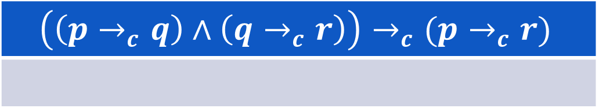
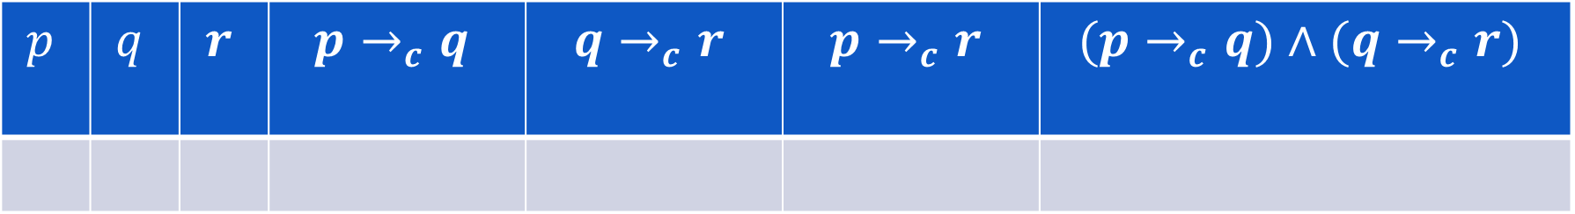
Q6
$$\left(\left(p→q\right)∧\left(q→r\right)\right)→\left(p→r\right)$$
$$p$$ | $$q$$ | $$p→_{c}q$$
T | T | T
T | F | F
F | T | F
F | F | T
$$p$$ | $$q$$ | $$r$$ | $$p→_{c}q$$ | $$q→_{c}r$$ | $$p→_{c}r$$ | $$(p→_{c}q)∧(q→_{c}r)$$
F
T
F
F
F
T
F
Conclusion:
$$\left(\left(p→_{c}q\right)∧\left(q→_{c}r\right)\right)→_{c}\left(p→_{c}r\right)$$
is not a tautology.
$$\left(\left(p→_{c}q\right)∧\left(q→_{c}r\right)\right)→_{c}(p→_{c}r)$$
F

Slide 26
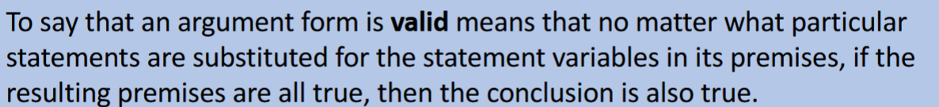
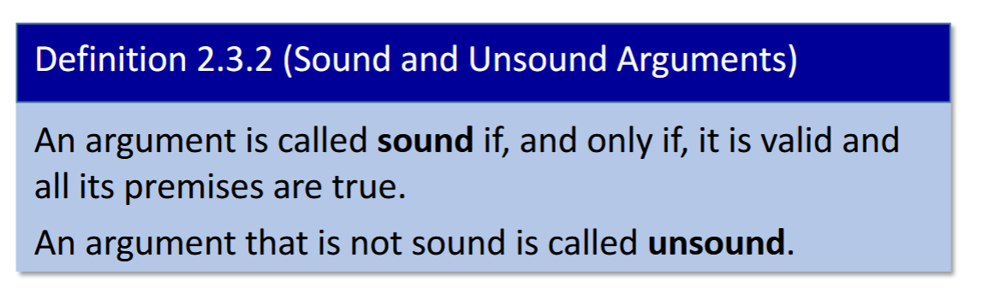
Arguments: Valid vs. Sound

Slide 27
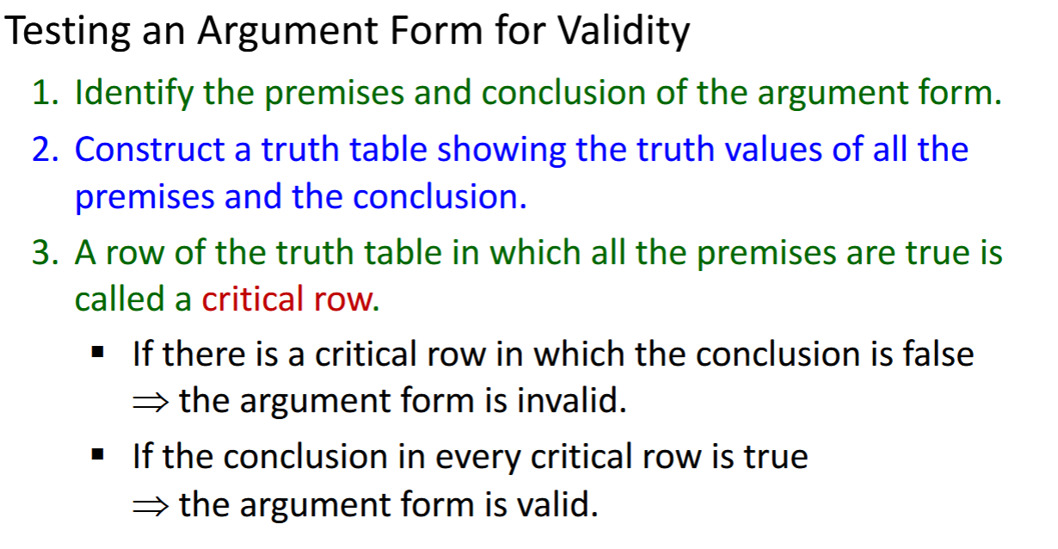
Arguments: Valid vs. Sound
Or, deduce through rules of inference.

Slide 28
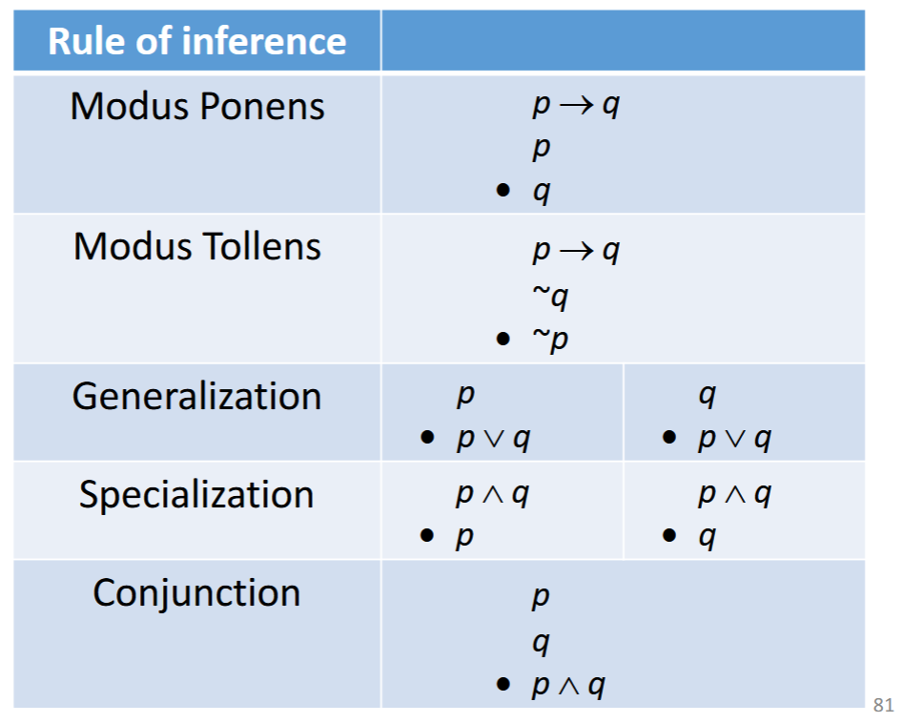
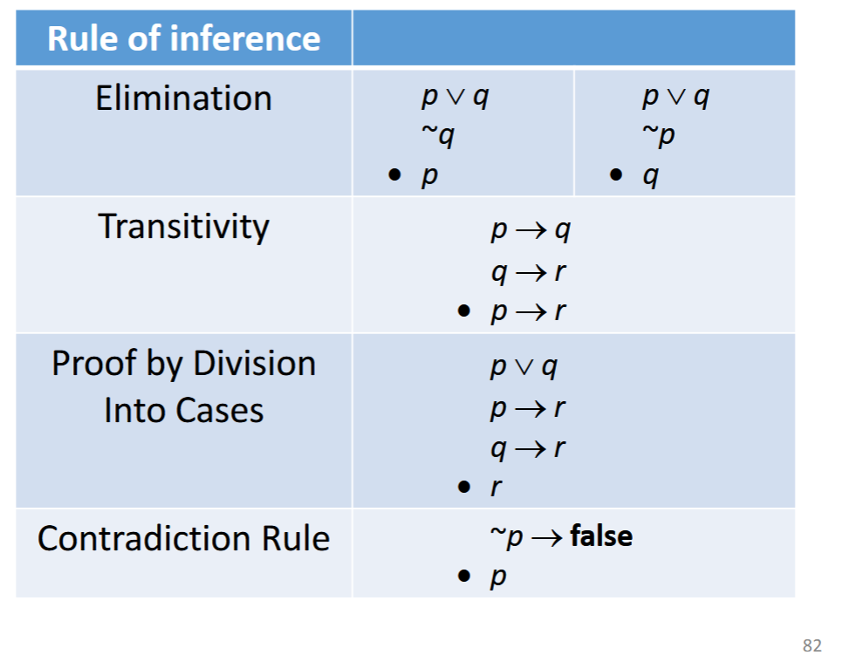
Rules of Inference

Slide 29
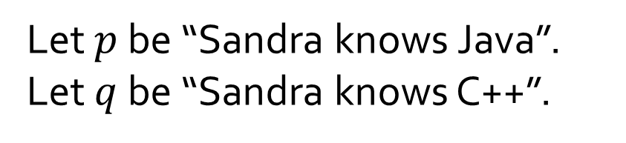
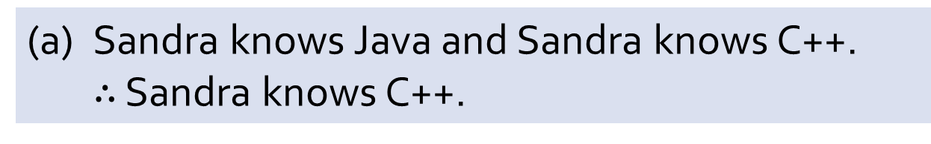
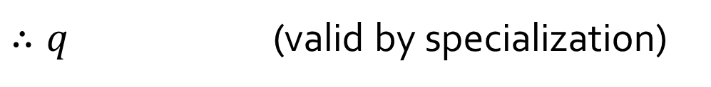
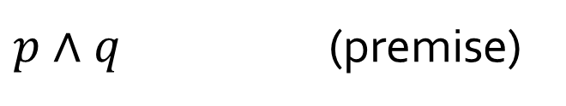
Q7
(a) Sandra knows Java and Sandra knows C++.
$∴$ Sandra knows C++.
Let $p$ be “Sandra knows Java”.
Let $q$ be “Sandra knows C++”.
$p∧q$ (premise)
$∴q$ (valid by specialization)

Slide 30
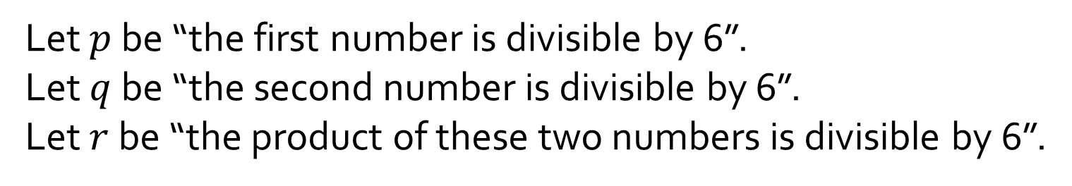
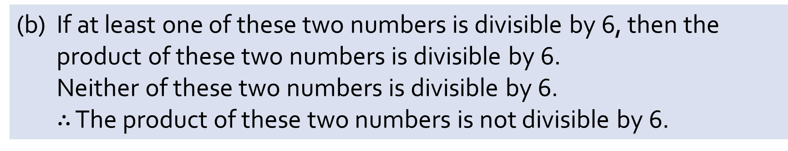
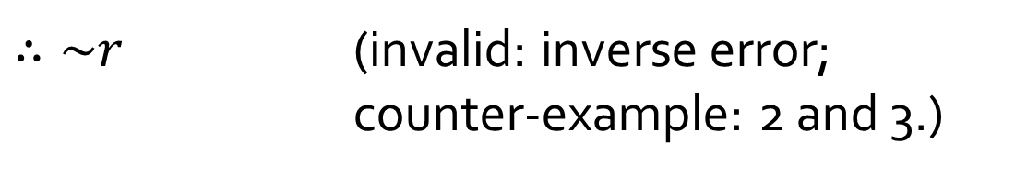
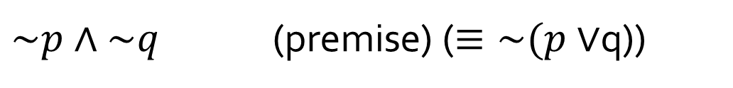
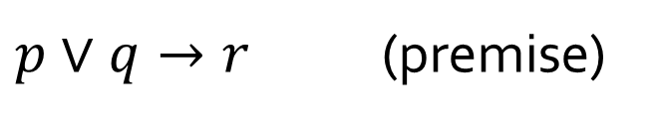
Q7
(b) If at least one of these two numbers is divisible by 6, then the product of these two numbers is divisible by 6.
Neither of these two numbers is divisible by 6.
$∴$ The product of these two numbers is not divisible by 6.
Let $p$ be “the first number is divisible by 6”.
Let $q$ be “the second number is divisible by 6”.
Let $r$ be “the product of these two numbers is divisible by 6”.
$p∨q→r$ (premise)
$\sim p∧\sim q$ (premise) ($≡\sim (p∨$q))
$∴\sim r$ (invalid: inverse error;
counter-example: 2 and 3.)

Slide 31
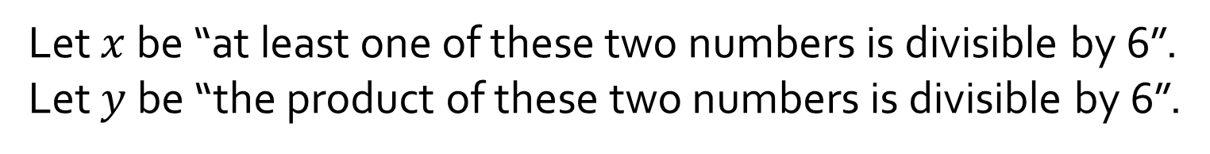
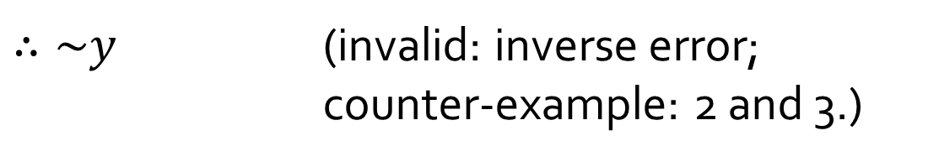
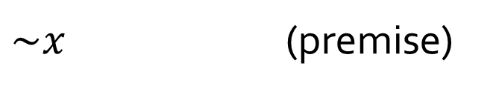

Q7
(b) If at least one of these two numbers is divisible by 6, then the product of these two numbers is divisible by 6.
Neither of these two numbers is divisible by 6.
$∴$ The product of these two numbers is not divisible by 6.
Let’s discuss this version:
Let $x$ be “at least one of these two numbers is divisible by 6”.
Let $y$ be “the product of these two numbers is divisible by 6”.
$x→y$ (premise)
Which version is better?
$\sim x$ (premise)
$∴\sim y$ (invalid: inverse error;
counter-example: 2 and 3.)

Slide 32





Q7
(c) If there are as many rational numbers as there are irrational numbers, then the set of all irrational numbers is infinite.
The set of all irrational numbers is infinite.
$∴$ There are as many rational numbers as there are irrational numbers.
Let $p$ be “there are as many rational numbers as there are irrational numbers”.
Let $q$ be “the set of all irrational numbers is infinite”.
$p→q$ (premise)
$q$ (premise)
$∴p$ (invalid: converse error.)

Slide 33




Q7
(d) If I get a Christmas bonus, I’ll buy a stereo.
If I sell my motorcycle, I’ll buy a stereo.
$∴$ If I get a Christmas bonus or I sell my motorcycle, I’ll buy a stereo.
Let $p$ be “I get a Christmas bonus”.
Let $q$ be “I sell my motorcycle”.
Let $r$ be “I’ll buy a stereo”.
Many students cite Proof by Division into Cases (Lecture #2 slide 66). This is NOT proof by division into cases.
$p→r$ (premise)
$q→r$ (premise)
$(p→r)∧(q→r)$ (conjunction premises)
How do you fill in the gap?
$(\sim p∨r)∧(\sim q∨r)$ (implication law)
$(\sim p∧\sim q)∨r$ (distributive law)
$\sim (p∨q)∨r$ (De Morgan’s law)
Note that for brevity, some steps are skipped. See answer document for the complete answer.
$∴(p∨q)→r$ (implication law)

Slide 34




Q8
(a) Given the following argument:
$$p∨\left(q∧r\right)$$
$$\sim p$$
$$∴q∧r$$
Without actually drawing the truth table, determine the values of $p$, $q$ and $r$ in the critical row(s) of the truth table.
$$p≡false$$
$$q≡true$$
$$r≡true$$
$$q∧r≡true$$
Is the argument valid?
Yes

Slide 35


Q8
(b) Give a counterexample to show that the following argument is invalid:
$$p∨\left(q∧r\right)$$
$$\sim (p∧q)$$
$$∴r$$
$$p≡true$$
$$q≡false$$
$$r≡false$$

Slide 36



Q8
(c) Determine whether the following argument is valid or invalid.
If I go to the beach, I will take my shades or my sunscreen.
I am taking my shades but not my sunscreen.
Therefore, I will go to the beach.
Let $p$ be “I go to the beach”;
$q$ be “I take my shades”;
$r$ be “I take my sunscreen”.
$$p→q∨r$$
$$q∧\sim r$$
$$∴p$$
Critical row: $p≡false; q≡true; r≡false.$
Conclusion: false.
Argument is invalid.

Slide 37


Q8
(c)
$$p$$ | $$q$$ | $$r$$ | $$\sim r$$ | $$q∨r$$ | $$p→(q∨r)$$ | $$q∧\sim r$$ | $$p$$
T | T | T | F | T | T | F | T
T | T | F | T | T | T | T | T
T | F | T | F | T | T | F | T
T | F | F | T | F | F | F | T
F | T | T | F | T | T | F | F
F | T | F | T | T | T | T | F
F | F | T | F | T | T | F | F
F | F | F | T | F | T | F | F
$$p→q∧r$$
$$q∧\sim r$$
$$∴p$$

Slide 38


Q8
(d) Determine whether the following argument is valid or invalid.
I will buy a new goat or a used Yugo.
If I buy both a new goat and a used Yugo, I will need a loan.
I bought a used Yugo but I don’t need a loan.
Therefore, I didn’t buy a new goat.
$$p∨q$$
$$(p∧q)→r$$
$$q∧\sim r$$
$$∴\sim p$$
Let $p$ be “I buy a new goat”;
$q$ be “I buy a used Yugo”;
$r$ be “I need a loan”.
Critical row: $p≡false; q≡true; r≡false.$
Conclusion: true.
Argument is valid.

Slide 39


Q8
(d)
$$p$$ | $$q$$ | $$r$$ | $$\sim r$$ | $$p∧q$$ | $$p∨q$$ | $$(p∧q)→r$$ | $$q∧\sim r$$ | $$\sim p$$
T | T | T | F | T | T | T | F | F
T | T | F | T | T | T | F | T | F
T | F | T | F | F | T | T | F | F
T | F | F | T | F | T | T | F | F
F | T | T | F | F | T | T | F | T
F | T | F | T | F | T | T | T | T
F | F | T | F | F | F | T | F | T
F | F | F | T | F | F | T | F | T
$$p∨q$$
$$(p∧q)→r$$
$$q∧\sim r$$
$$∴\sim p$$

Slide 40

Q10
Prove:
The product of any two odd integers is an odd integer.
Direct proof:
1. Take any two odd integers $n,m$.
2. Then $n=2k+1$ and $m=2p+1$, for $k,p∈ℤ$ (by definition of odd integers)
Hence $nm=\left(2k+1\right)\left(2p+1\right)$
$=\left(2k\left(2p+1\right)\right)+\left(2p+1\right)$
$=\left(4kp+2k\right)+(2p+1)$
$=2\left(2kp+k+p\right)+1$ (by basic algebra)
4. Let $q=2kp+k+p$ which is an integer (by closure of integers under $+$ and $×$).
5. Then $nm=2q+1$ which is odd (by definition of odd integers)
6. Therefore, the product of any two odd integers is an odd integer.
Give justification
Notes:
“closure” is an important property and should not be left out.
To tutors: Definitions of even and odd integers are given in lecture (lect #1 slide 27)

Slide 41


Q11
Let $n$ be an integer. Then $n^{2}$ is odd if and only if $n$ is odd.
(a) Smart’s attempt:
Proof (by contradiction)
1. Suppose $n$ is an even integer.
2. Then $∃k∈ℤ$ s.t. $n=2k$.
Squaring both sides, we get $n^{2}={(2k)}^{2}=4k^{2}=2(2k^{2}).$
4. Since $k$ is an integer, so is $2k^{2}$.
5. Hence $n^{2}=2p$, with $p=2k^{2}∈ℤ$.
6. Therefore, $n^{2}$ is even.
7. So, if $n$ is even, then $n^{2}$ is even, which is the same as saying, if $n^{2}$ is odd, then $n$ is odd.
8. Therefore, $n^{2}$ is odd if and only if $n$ is odd.
Missing justifications.
?
(by definition of even integers)
(by closure of integers under $×$)
(by definition of even integers)
Prove only one direction.
Notes:
Say a statement you want to show is false.
You must suppose an alternate statement first.
Then, follow the logical steps until you find that said alternate statement cannot be true.
Thus, it must be that another statement contrary to that is true.

Slide 42

Q11
Let $n$ be an integer. Then $n^{2}$ is odd if and only if $n$ is odd.
(b) Write your own proof.
Proof:
1. ($⇒$) Proving the contraposition of “if $n^{2}$ is odd, then $n$ is odd”.
1.1. Suppose $n$ is even.
1.2. Then $∃k∈ℤ$ s.t. $n=2k$. (by definition of even integers)
1.3. Squaring both sides, we get $n^{2}={(2k)}^{2}=4k^{2}=2(2k^{2}).$ (by basic algebra)
1.4. Hence $n^{2}=2p$, with $p=2k^{2}∈ℤ$. (by closure of integers under $×$)
1.5. Therefore, $n^{2}$ is even. (by definition of even integers)
1.6. This proves that if $n^{2}$ is odd, then $n$ is odd.
2. ($⇐$) If $n$ is odd, then $n×n=n^{2}$ is odd. (by question 10)
3. Therefore, $n^{2}$ is odd if and only if $n$ is odd. (by lines 1.6 and 2)

Slide 43


Q9
(a) Two natives A and B:
A says: Both of us are knights.
B says: A is a knave.
Tempting to say “Contradiction” right after 1.4. However, this is not valid because contradiction requires $p∧\sim p$, but ‘knave’ is not the negation of ‘knight’.
Hence 1.5 is required before we arrive at the contradiction in 1.6.
Proof (by contradiction):
1. If A is a knight, then:
1.1 What A says is true. (by definition of knight)
1.2 ∴ B is a knight too. (that’s what A says)
1.3 ∴ What B says is true. (by definition of knight)
1.4 ∴ A is a knave. (that’s what B says)
1.5 ∴ A is not a knight. (since A is either a knight or a knave, but not both)
1.6 ∴ Contradiction to 1.
2. ∴ A is not a knight.
3. ∴ A is a knave. (since A is either a knight or a knave, but not both)
4. ∴ What B says is true.
5. ∴ B cannot be a knave. (as B has said something true)
6. ∴ B is a knight. (as there are only knights and knaves)
7. Conclusion: A is a knave and B is a knight.

Slide 44
Q9
(b) Two natives C and D:
C says: D is a knave.
D says: C is a knave.
How many knights and knaves are there?
Proof (by division in cases):
1. If C is a knight, then:
1.1 What C says is true. (by definition of knight)
1.2 ∴ D is a knave. (that’s what C says)
2. If C is not a knight, then:
2.1 Then C is a knave. (one is either a knight or a knave)
2.2 ∴ what C says is false. (by definition of knave)
2.3 ∴ D is not a knave. (C says D is a knave, but what C says is false)
2.4 ∴ D is a knight. (one is either a knight or a knave)
3. Conclusion: in both cases, there is one knight and one knave.
This is actually a rather ‘incomplete’ proof. While the conclusions are correct, we never check on whether each configuration is consistent or not.
In general, don’t forget to check again whether what C/D says is possible *after* you’ve deduced their identities.

Slide 45
This is actually a rather ‘incomplete’ proof. While the conclusions are correct, we never check on whether each configuration is consistent or not.
In general, don’t forget to check again whether what C/D says is possible *after* you’ve deduced their identities.
For more details, try to solve this instead to see why checking consistency is important.
C: "D is a knight."
D: "Exactly one of us is a knight.“
Prove that there are 0 knights.

Slide 46

Tutorial answers will be uploaded on Canvas at the end of the week.
If you still have any doubts, please post on QnA.

