Slide 1
CS1231S Tutorial #2
Predicate Logic and Proofs
(AY2025/26 Semester 1) – T11B
Adapted from Prof Aaron Tan’s slides

Slide 2
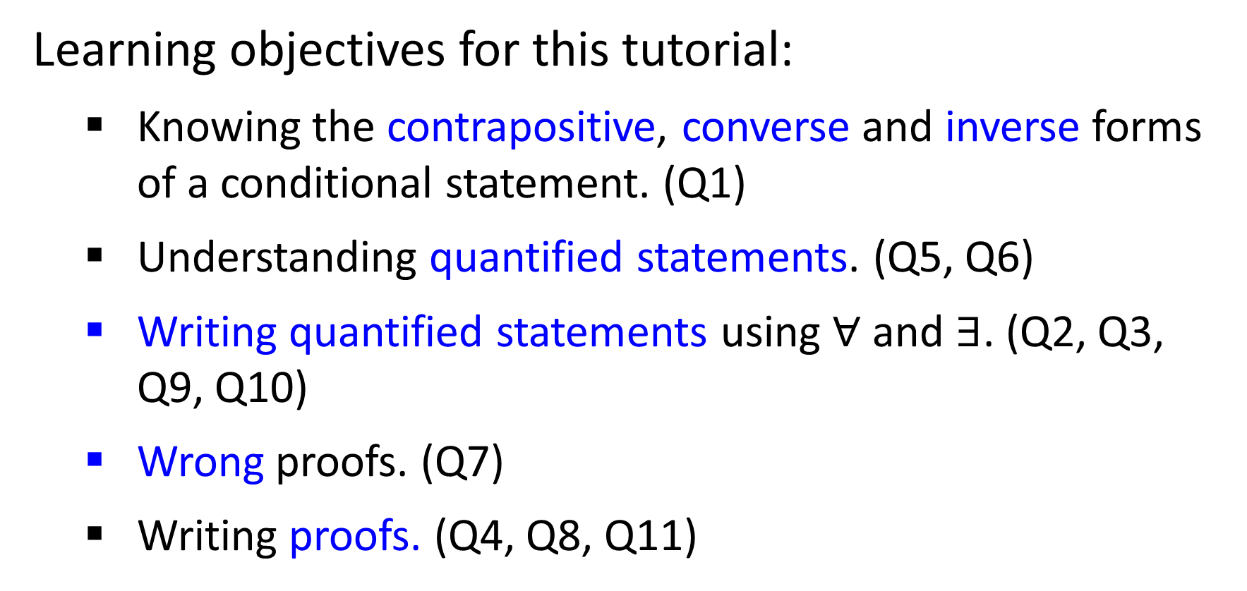
Learning objectives for this tutorial:
Knowing the contrapositive, converse and inverse forms of a conditional statement. (Q1)
Understanding quantified statements. (Q5, Q6)
Writing quantified statements using $∀$and $∃$. (Q2, Q3, Q9, Q10)
Wrong proofs. (Q7)
Writing proofs. (Q4, Q8, Q11)

Slide 3


Quick Pointers
Common mistakes:
Using commas instead of conjunction / disjunction / etc.
Predicates as ‘functions’: Loves(x, Reindeer(y)) is non-sensical!

Slide 4




Q1
Converse, inverse and contrapositive.
Quick recap:
Conditional statement:
$$p →q$$
Converse:
$$q →p$$
Inverse:
$$\sim p →\sim q$$
Contrapositive:
$$\sim q →\sim p$$
Reminder: Converse is equivalent to the inverse

Slide 5
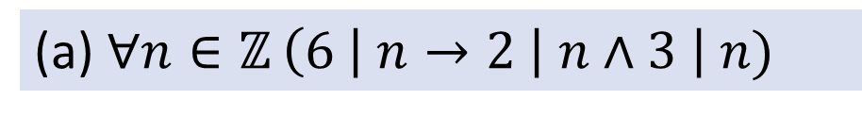
Q1
Converse, inverse and contrapositive.
Are they true or false?
(a) $∀n∈ℤ$ $\left(6 \right| n→2 \left| n∧3 \right| n)$
True
True
Converse:
$$∀n∈ℤ \left(2 \right| n ∧3 | n→6 | n)$$
$$∀n∈ℤ (6∤n→2∤n∨3∤n)$$
Inverse:
True
Contrapositive:
$$∀n∈ℤ (2∤n∨3∤n→6∤n)$$
True

Slide 6
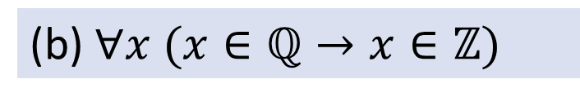
Q1
Converse, inverse and contrapositive.
Are they true or false?
(b) $∀x (x∈ℚ→x∈ℤ)$
False
True
Converse:
$$∀x (x∈ℤ→x∈ℚ)$$
$$∀x (x∉ℚ→x∉ℤ)$$
Inverse:
True
$$∀x (x∉ℤ→x∉ℚ)$$
Contrapositive:
False
Counterexample for original statement and contrapositive?
$$x=0.5, 1.5, etc.$$

Slide 7
Q1
Converse, inverse and contrapositive.
Are they true or false?
(c) $∀p,q∈ℤ \left(Even\left(p\right)∧Even\left(q\right)→Even\left(p+q\right)\right)$.
True
Converse:
$$∀p,q∈ℤ \left(Even\left(p+q\right)→Even\left(p\right)∧Even\left(q\right)\right).$$
False
Inverse:
$$∀p,q∈ℤ \left(\sim Even\left(p\right)∨\sim Even\left(q\right)→\sim Even\left(p+q\right)\right)\text{.}$$
False
Contrapositive:
$$∀p,q∈ℤ \left(\sim Even\left(p+q\right)→\sim Even\left(p\right)∨\sim Even\left(q\right)\right).$$
True
Counterexample for converse and inverse?
$$p=1, q=3, etc.$$

Slide 8

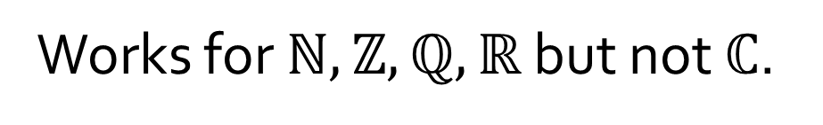
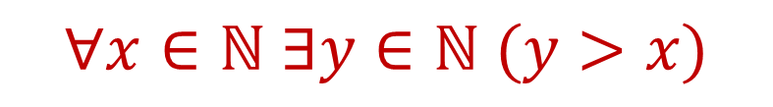
Q2
(a) There is no biggest number, i.e. no matter how big a number is, there is always another number that is bigger.
What about this?
$$∃x∈ℕ ∀y∈ℕ (y>x)$$
Answer:
$$∀x∈ℕ ∃y∈ℕ (y>x)$$
Works for $ℕ,ℤ,ℚ,ℝ$ but not $ℂ$.
Slightly clearer sentence form:
For all numbers, there is a number that is bigger than said number.

Slide 9

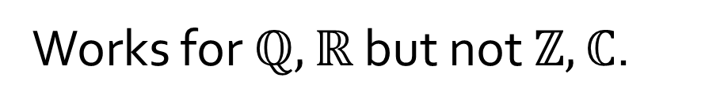
Q2
(b) Given any two distinct numbers, you can always find another number between them.
Answer:
$$∀x∈ℚ ∀y∈ℚ \left(x<y→∃z∈ℚ \left(x<z\right)∧\left(z<y\right)\right)\text{.}$$
May shorten to $∀x,y∈ℚ$
Works for $ℚ,ℝ$ but not $ℤ,ℂ$.
Observe that we need to specify x < y. If not, our statement is false.

Slide 10
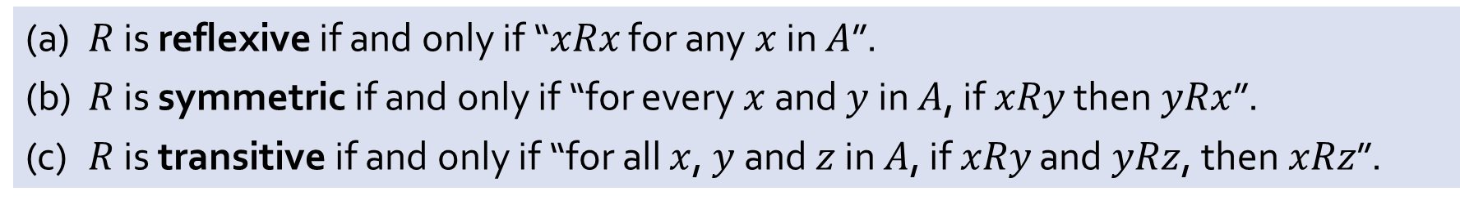


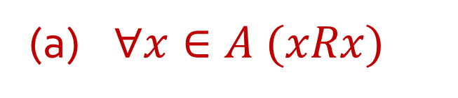
Q3
(a) $R$ is reflexive if and only if “$xRx$ for any $x$ in $A$”.
(b) $R$ is symmetric if and only if “for every $x$ and $y$ in $A$, if $xRy$ then$yRx$”.
(c) $R$ is transitive if and only if “for all $x$, $y$ and $z$ in $A$, if $xRy$ and$yRz$, then$xRz$”.
(a) $∀x∈A (xRx)$
(b) $∀x,y∈A (xRy→yRx)$
(c) $∀x,y,z∈A (xRy∧yRz→xRz)$
Sneak peak for later topics!

Slide 11
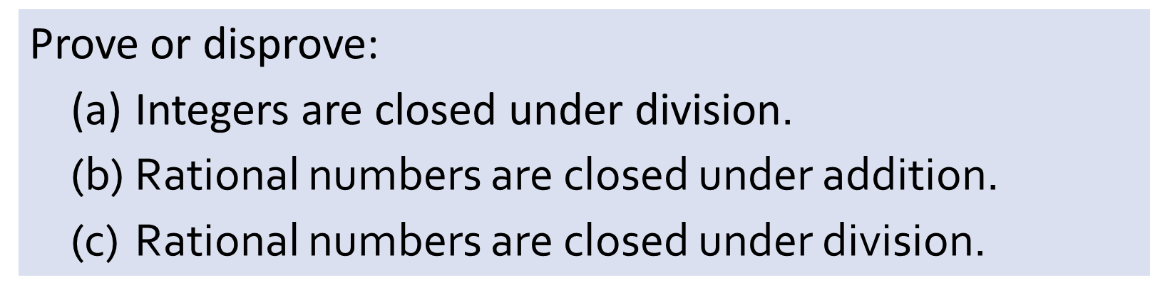
Q4
Prove or disprove:
(a) Integers are closed under division$\text{.}$
(b) Rational numbers are closed under addition.
(c) Rational numbers are closed under division.
Counterexample for (a)?
Counterexample for (c)?

Slide 12
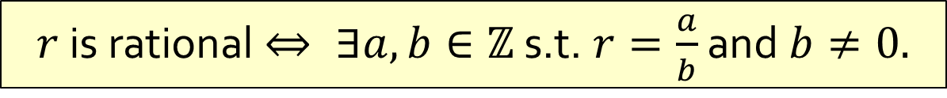
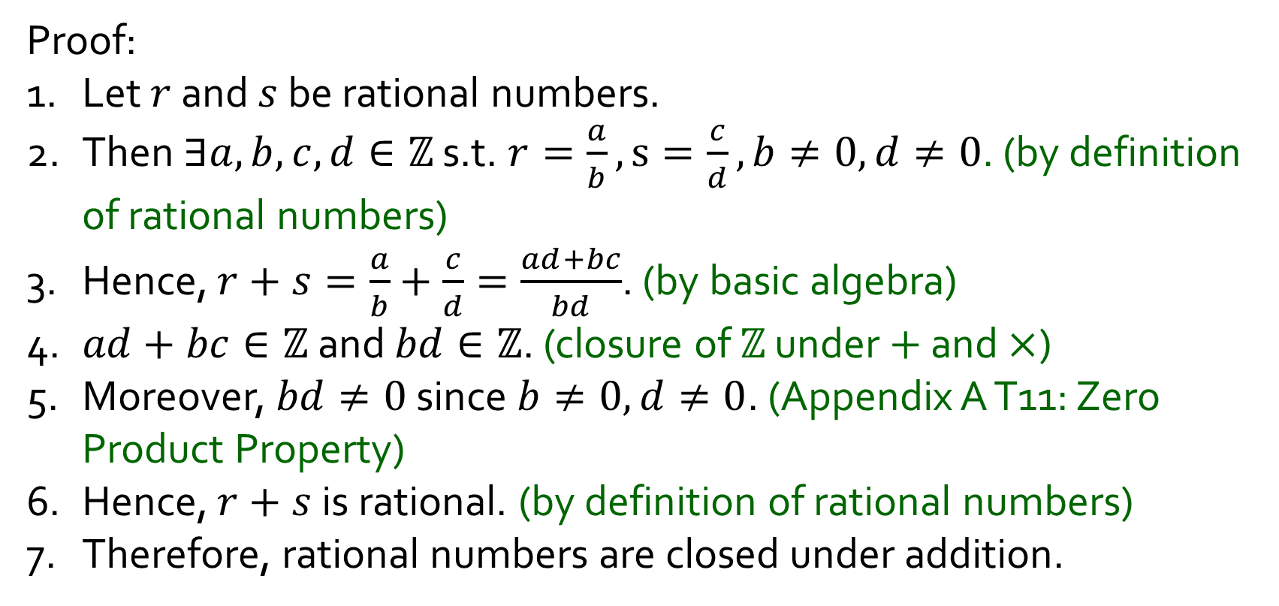
Q4
Prove: (b) Rational number are closed under addition.
Proof:
1. Let $r$ and $s$ be rational numbers.
2. Then $∃a,b,c,d∈ℤ$ s.t. $r=\frac{a}{b},s=\frac{c}{d},b≠0,d≠0$. (by definition of rational numbers)
3. Hence, $r+s=\frac{a}{b}+\frac{c}{d}=\frac{ad+bc}{bd}$. (by basic algebra)
4. $ad+bc∈ℤ$ and $bd∈ℤ$. (closure of $ℤ$ under $+$ and $×$)
5. Moreover, $bd≠0$ since $b≠0,d≠0$. (Appendix A T11: Zero Product Property)
6. Hence, $r+s$ is rational. (by definition of rational numbers)
7. Therefore, rational numbers are closed under addition.
$r$ is rational $⇔ ∃a,b∈ℤ$ s.t. $r=\frac{a}{b}$ and $b≠0.$

Slide 13
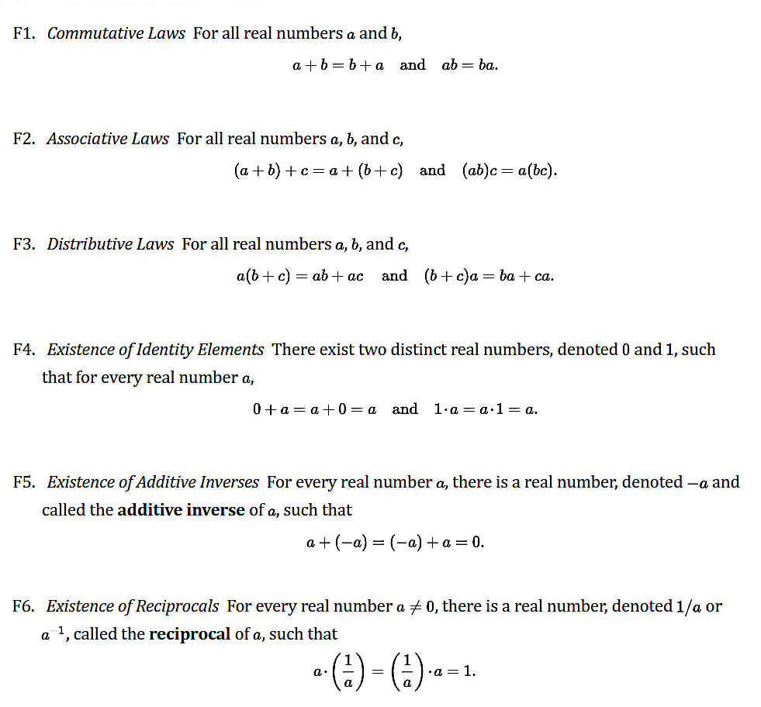
Appendix 1
While these are rarely explicitly tested in exam, they will be useful for scoring maximum marks in Assignments.
When in doubt, just include the law.

Slide 14
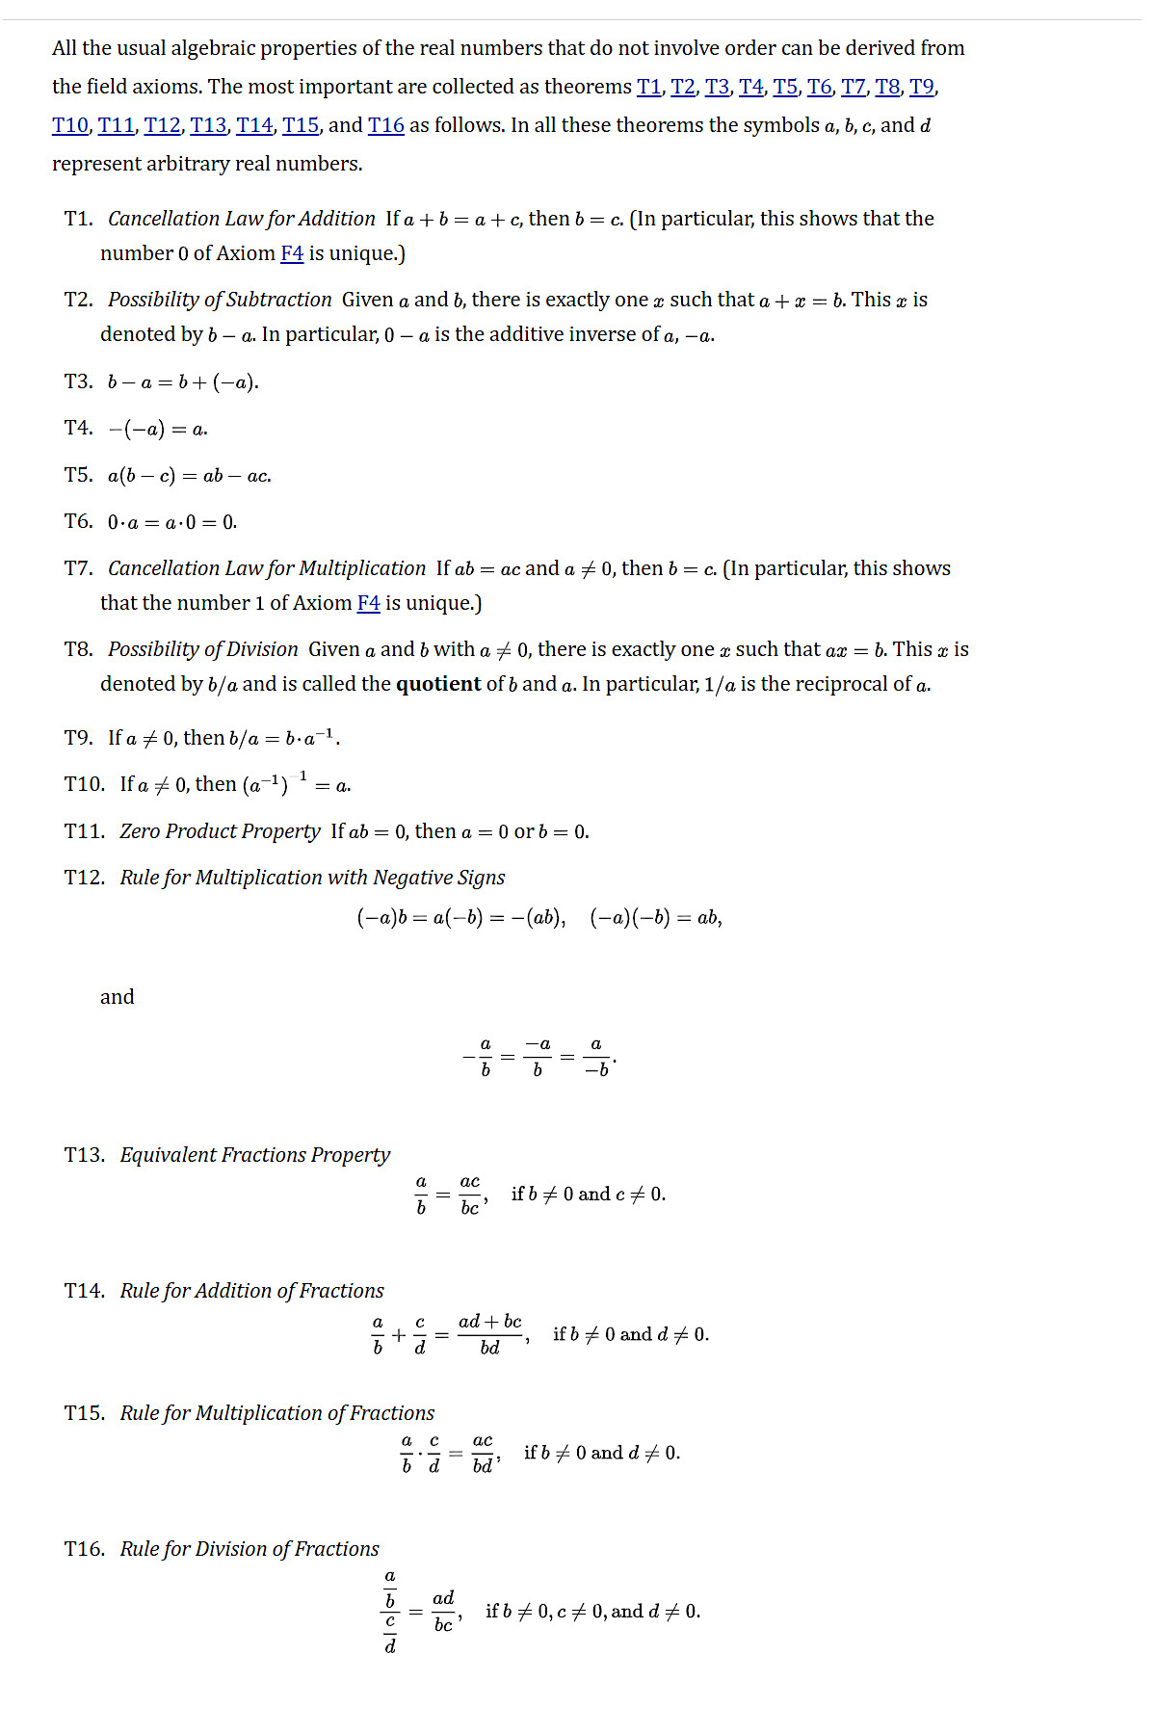



Appendix 2

Slide 15
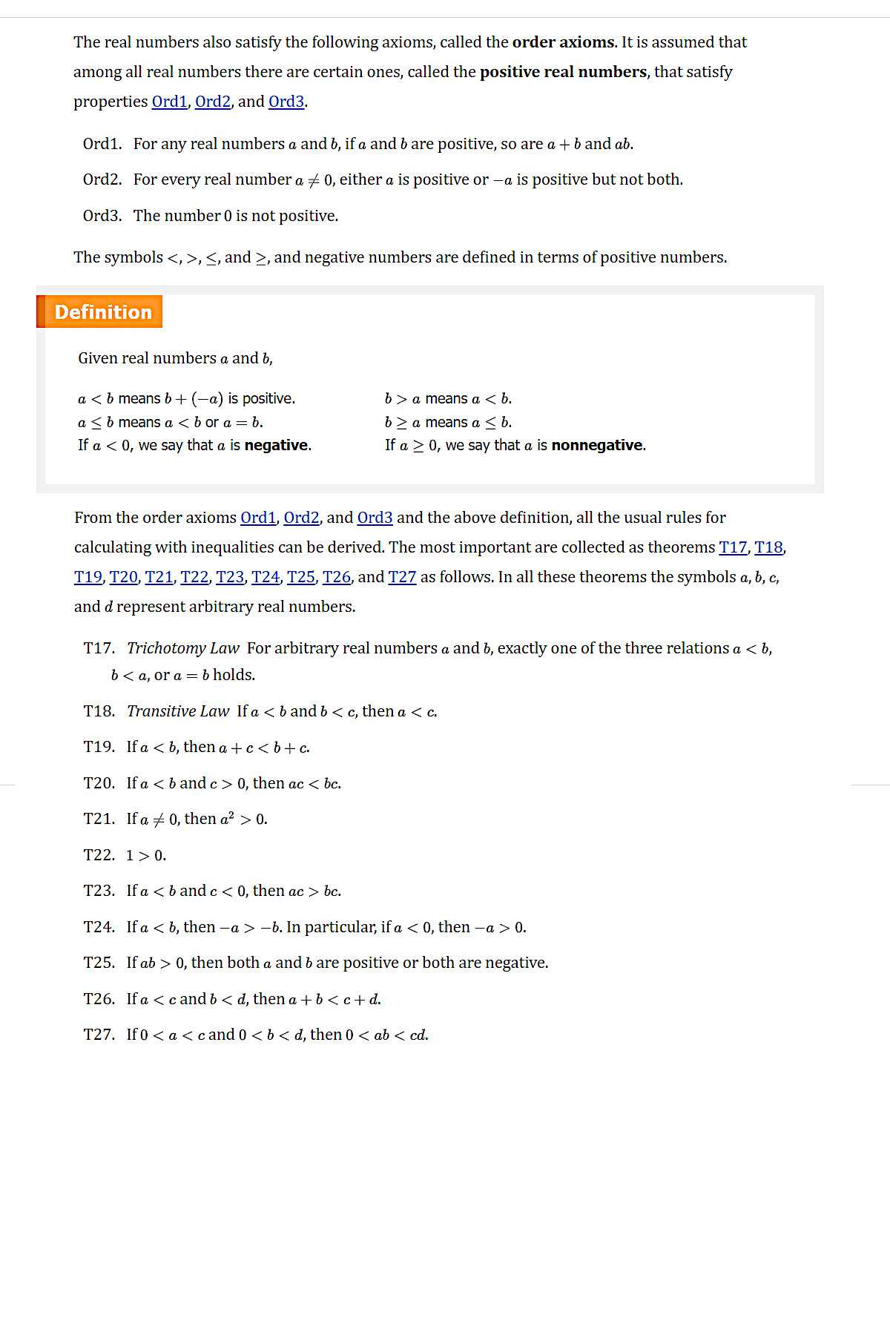













Appendix 3

Slide 16
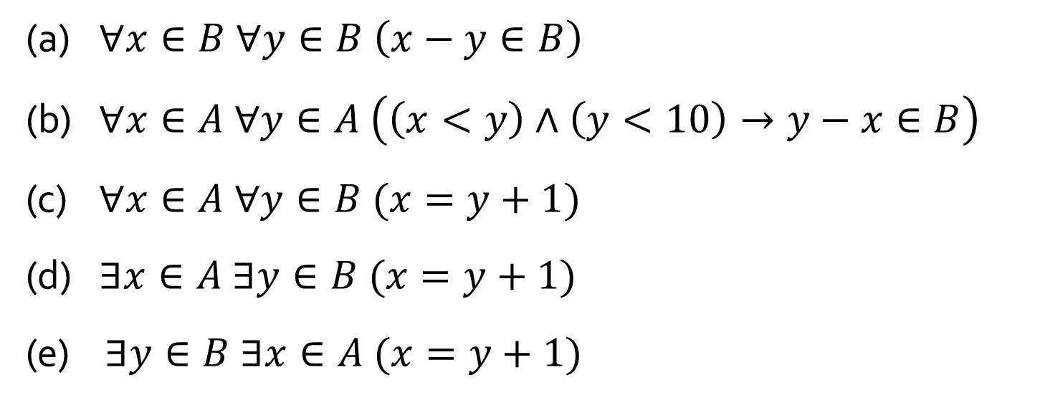
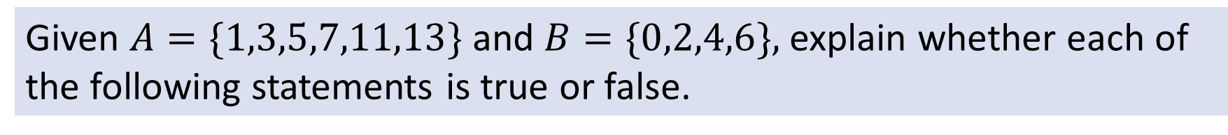
Q5
Given $A=\{1,3,5,7,11,13\}$and $B=\{0,2,4,6\},$explain whether each of the following statements is true or false.
(a) $∀x∈B ∀y∈B \left(x−y∈B\right)$
(b) $∀x∈A ∀y∈A \left(\left(x<y\right)∧\left(y<10\right)→y−x∈B\right)$
(c) $∀x∈A ∀y∈B (x=y+1)$
(d) $∃x∈A ∃y∈B (x=y+1)$
(e) $∃y∈B ∃x∈A (x=y+1)$
False
True
False
True
True
Note: (d) and (e) are equivalent.

Slide 17
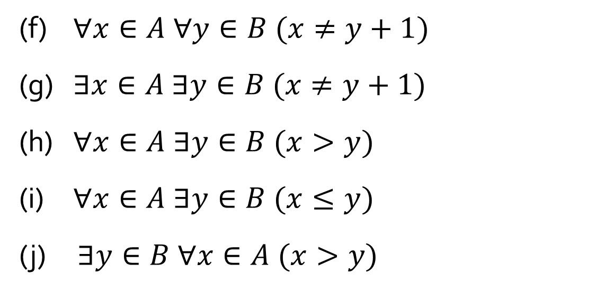
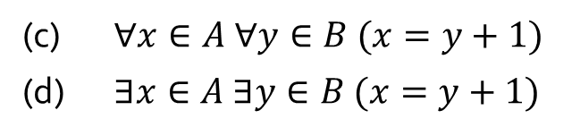
Q5
Given $A=\{1,3,5,7,11,13\}$and $B=\{0,2,4,6\},$explain whether each of the following statements is true or false.
(f) $∀x∈A ∀y∈B (x≠y+1)$
(g) $∃x∈A ∃y∈B (x≠y+1)$
(h) $∀x∈A ∃y∈B (x>y)$
(i) $∀x∈A ∃y∈B (x≤y)$
(j) $∃y∈B ∀x∈A (x>y)$
False
True
True
False
True
Note: (f) is the negation of (d); (g) is the negation of (c).
(c) $∀x∈A ∀y∈B (x=y+1)$
(d) $∃x∈A ∃y∈B (x=y+1)$

Slide 18
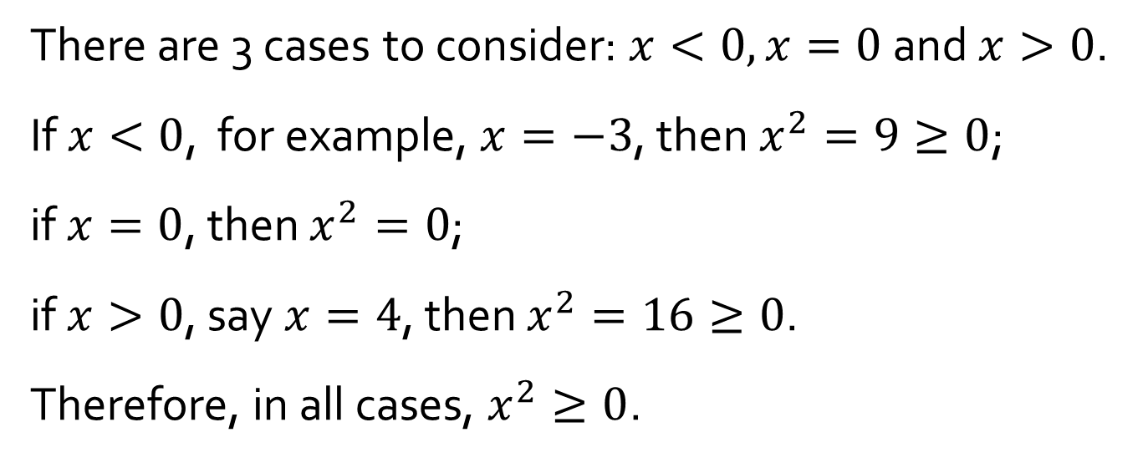
Q7
(a) Proof for: $∀x∈ℝ (x^{2}≥0)$. What is wrong with this “proof”?
There are 3 cases to consider: $x<0,x=0$ and $x>0$.
If $x<0$, for example, $x=−3$, then $x^{2}=9≥0$;
if $x=0$, then $x^{2}=0$;
if $x>0$, say $x=4$, then $x^{2}=16≥0$.
Therefore, in all cases, $x^{2}≥0$.
(b) Use the same logic in (a) to prove: $∀x∈ℝ (x^{3}=x)$.

Slide 19
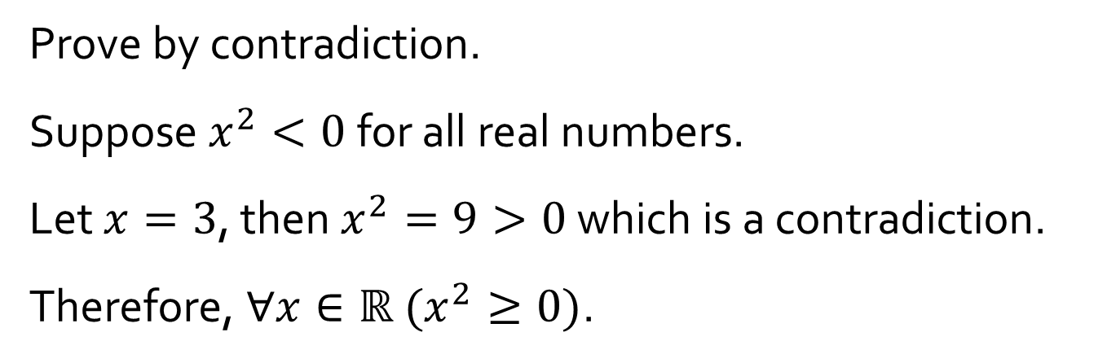
Q7
(c) Proof for: $∀x∈ℝ (x^{2}≥0)$. What is wrong with this “proof”?
Prove by contradiction.
Suppose $x^{2}<0$ for all real numbers.
Let $x=3$, then $x^{2}=9>0$ which is a contradiction.
Therefore, $∀x∈ℝ (x^{2}≥0)$.
(d) Use the same logic in (c) to prove: $∀x∈ℝ (x^{3}=x)$.

Slide 20
5-min Break

Slide 21
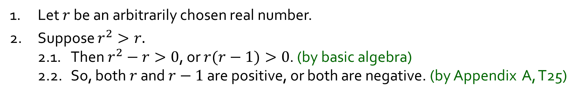
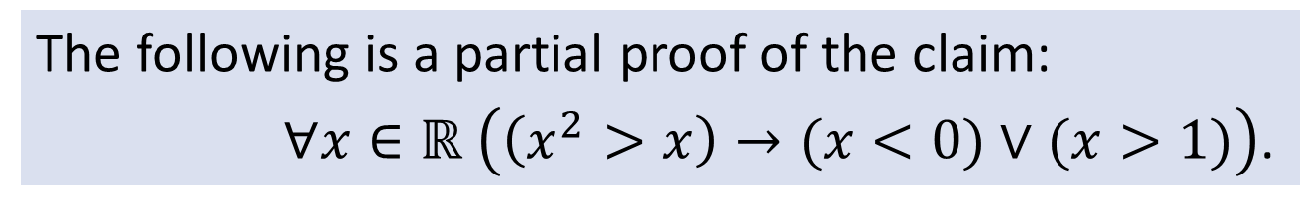
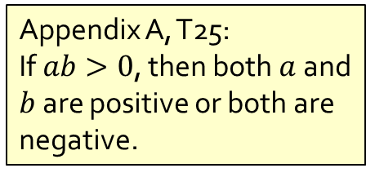
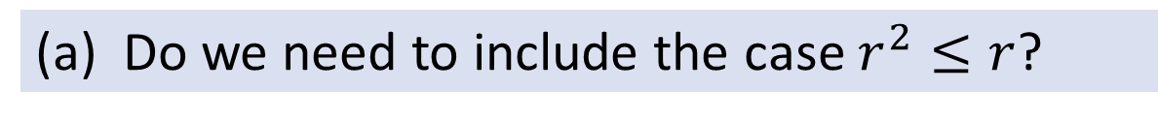
Q8
The following is a partial proof of the claim:
$∀x∈ℝ \left(\left(x^{2}>x\right)→(x<0)∨(x>1)\right)$.
Appendix A, T25:
If $ab>0$, then both $a$ and $b$ are positive or both are negative.
1. Let $r$ be an arbitrarily chosen real number.
2. Suppose $r^{2}>r.$
2.1. Then $r^{2}−r>0$, or $r(r−1)>0$. (by basic algebra)
2.2. So, both $r$ and $r−1$ are positive, or both are negative. (by Appendix A, T25)
(a) Do we need to include the case $r^{2}≤r$?
No. A conditional statement is true (true by default/vacuously true) when its hypotheses is false.
3. Therefore, $∀x∈ℝ \left(\left(x^{2}>x\right)→\left(x<0\right)∨\left(x>1\right)\right).$

Slide 22
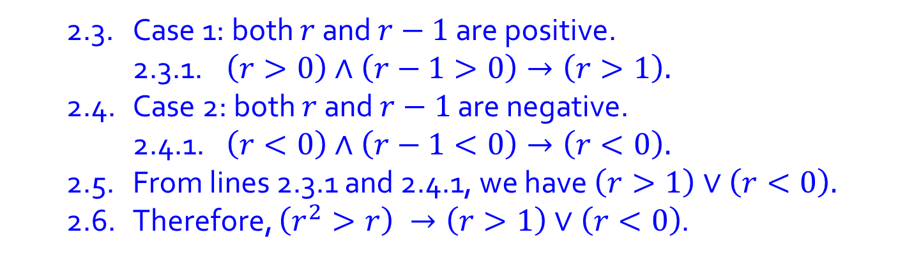
Q8
The following is a partial proof of the claim:
$∀x∈ℝ \left(\left(x^{2}>x\right)→(x<0)∨(x>1)\right)$.
(b) Complete the proof.
1. Let $r$ be an arbitrarily chosen real number.
2. Suppose $r^{2}>r.$
2.1. Then $r^{2}−r>0$, or $r(r−1)>0$. (by basic algebra)
2.2. So, both $r$ and $r−1$ are positive, or both are negative. (by Appendix A, T25)
2.3. Case 1: both $r$ and $r−1$ are positive.
2.3.1. $\left(r>0\right)∧\left(r−1>0\right)→\left(r>1\right).$
2.4. Case 2: both $r$ and $r−1$ are negative.
2.4.1. $\left(r<0\right)∧\left(r−1<0\right)→\left(r<0\right).$
2.5. From lines 2.3.1 and 2.4.1, we have $\left(r>1\right)∨\left(r<0\right).$
2.6. Therefore, $\left(r^{2}>r\right) →\left(r>1\right)∨\left(r<0\right)$.
3. Therefore, $∀x∈ℝ \left(\left(x^{2}>x\right)→\left(x<0\right)∨\left(x>1\right)\right).$

Slide 23
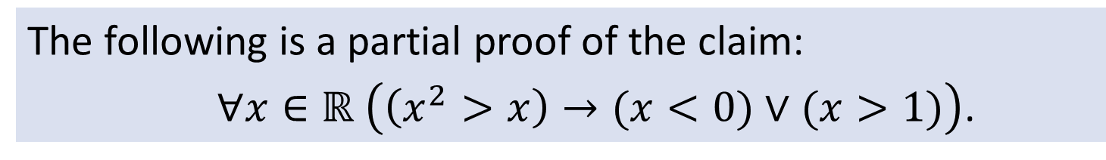
Q8
The following is a partial proof of the claim:
$∀x∈ℝ \left(\left(x^{2}>x\right)→(x<0)∨(x>1)\right)$.
1. Let $r$ be an arbitrarily chosen real number.
2. Suppose $r^{2}>r.$
2.1. Then $r^{2}−r>0$, or $r(r−1)>0$. (by basic algebra)
2.2. So, both $r$ and $r−1$ are positive, or both are negative. (by Appendix A, T25)
3. Therefore, $∀x∈ℝ \left(\left(x^{2}>x\right)→\left(x<0\right)∨\left(x>1\right)\right).$
(c) Step 3 is an application of universal generalization. Explain what it means.

Slide 24
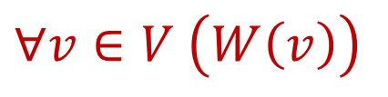
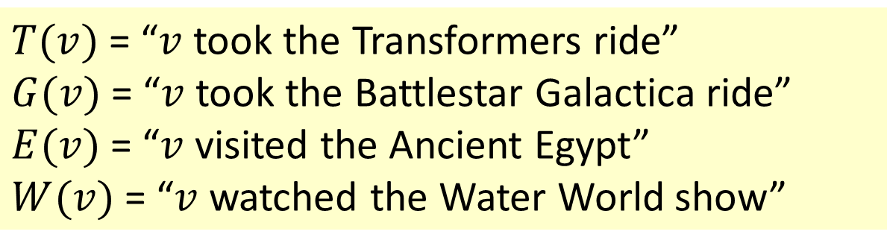
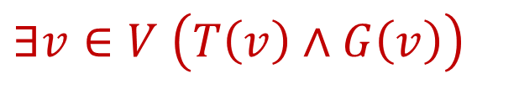
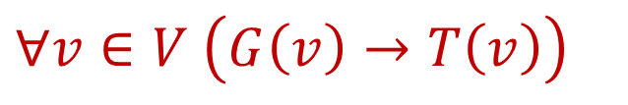
Q9
$T(v)$= “$v$ took the Transformers ride”
$G(v)$= “$v$ took the Battlestar Galactica ride”
$E(v)$= “$v$ visited the Ancient Egypt”
$W(v)$= “$v$ watched the Water World show”
(a) Every visitor watched the Water World show.
$$∀v∈V \left(W\left(v\right)\right)$$
(b) Every visitor who took the Battlestar Galactica ride also took the Transformers ride.
$$∀v∈V \left(G\left(v\right)→T\left(v\right)\right)$$
(c) There is a visitor who took both the Transformers ride and the Battlestar Galactica ride.
$$∃v∈V \left(T\left(v\right)∧G\left(v\right)\right)$$

Slide 25
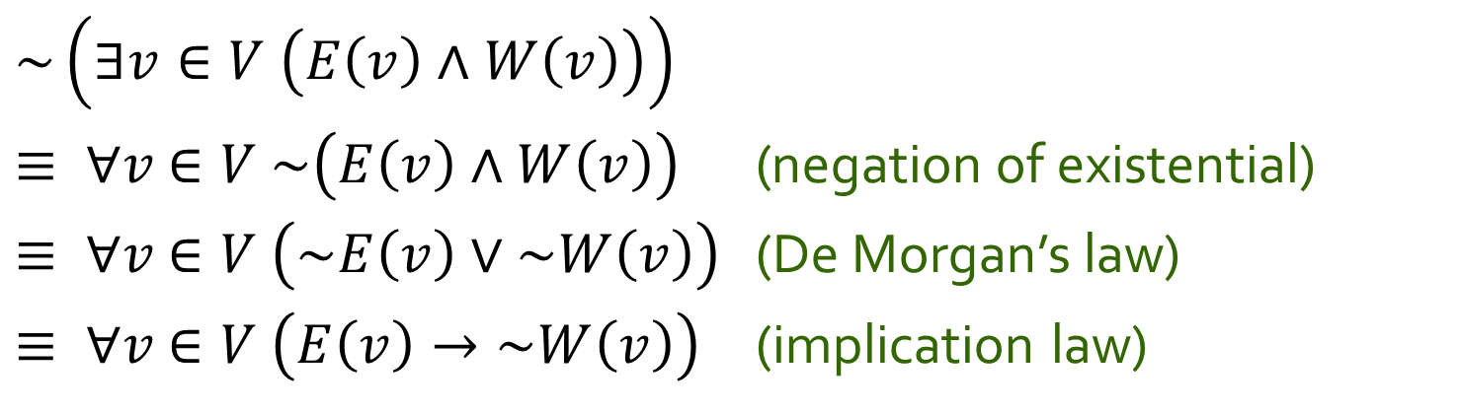
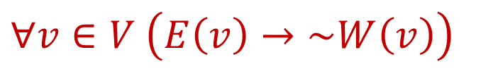
Q9
(d) No visitor who visited the Ancient Egypt watched the Water World show.
$$∀v∈V \left(E\left(v\right)→\sim W\left(v\right)\right)$$
Equivalently,
~(there is a visitor who visited the Ancient Egypt and watched the Water World show).
$$\sim \left(∃v∈V \left(E\left(v\right)∧W\left(v\right)\right)\right)$$
$≡ ∀v$ $∈V \sim \left(E\left(v\right)∧W\left(v\right)\right)$ (negation of existential)
$≡ ∀v$ $∈V \left(\sim E\left(v\right)∨\sim W\left(v\right)\right)$ (De Morgan’s law)
$≡ ∀v$ $∈V \left(E\left(v\right)→\sim W\left(v\right)\right)$ (implication law)

Slide 26
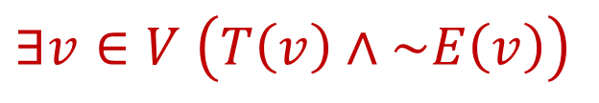

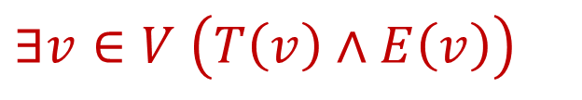
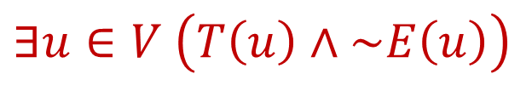
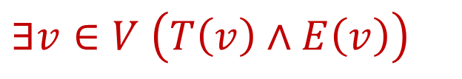

Q9
(e) Some visitors who took the Transformers ride also visited the Ancient Egypt but some (who took the Transformers ride) did not (visit the Ancient Egypt).
$$∃v∈V \left(T\left(v\right)∧E\left(v\right)\right)$$
$$∧$$
$$∃v∈V \left(T\left(v\right)∧\sim E\left(v\right)\right)$$
Any issue?
$$∃v∈V \left(T\left(v\right)∧E\left(v\right)\right)$$
$$∧$$
$$∃u∈V \left(T\left(u\right)∧\sim E\left(u\right)\right)$$

Slide 27
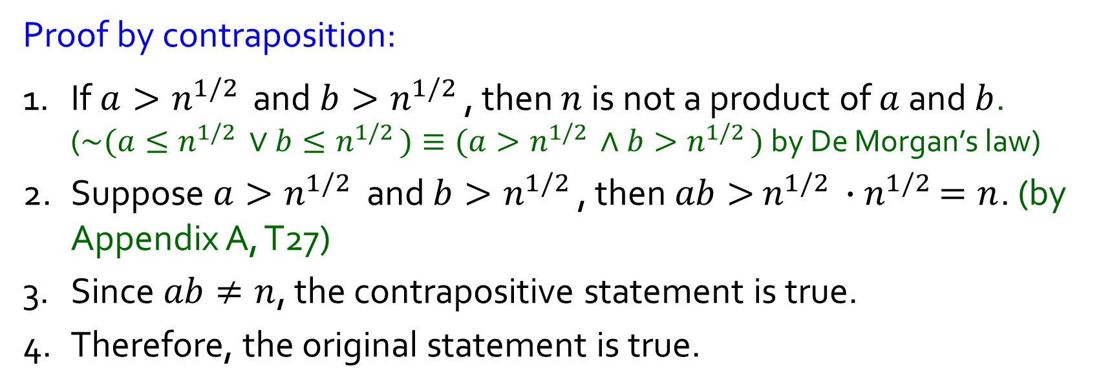
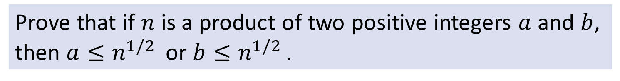

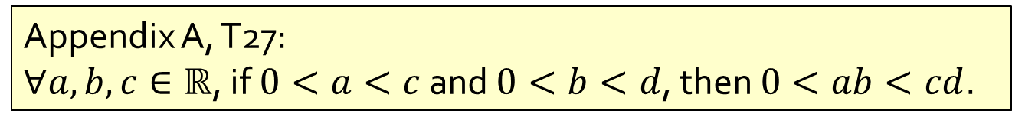
Q11
Prove that if $n$ is a product of two positive integers $a$ and $b$, then $a≤n^{1/2 }$ or $b≤n^{1/2 }$.
$$p→q≡\sim q→\sim p$$
Proof by contraposition:
1. If $a>n^{1/2 }$ and $b>n^{1/2 }$, then $n$ is not a product of $a$ and $b$. ($\sim (a≤n^{1/2 }∨b≤n^{1/2 })≡(a>n^{1/2 }∧b>n^{1/2 })$ by De Morgan’s law)
2. Suppose $a>n^{1/2 }$ and $b>n^{1/2 }$, then $ab>$ $n^{1/2 }{∙n}^{1/2 }=n$. (by Appendix A, T27)
3. Since $ab≠n$, the contrapositive statement is true.
4. Therefore, the original statement is true.
Appendix A, T27:
$∀a,b,c∈ℝ$, if $0<a<c$ and $0<b<d$, then $0<ab<cd$.

Slide 28

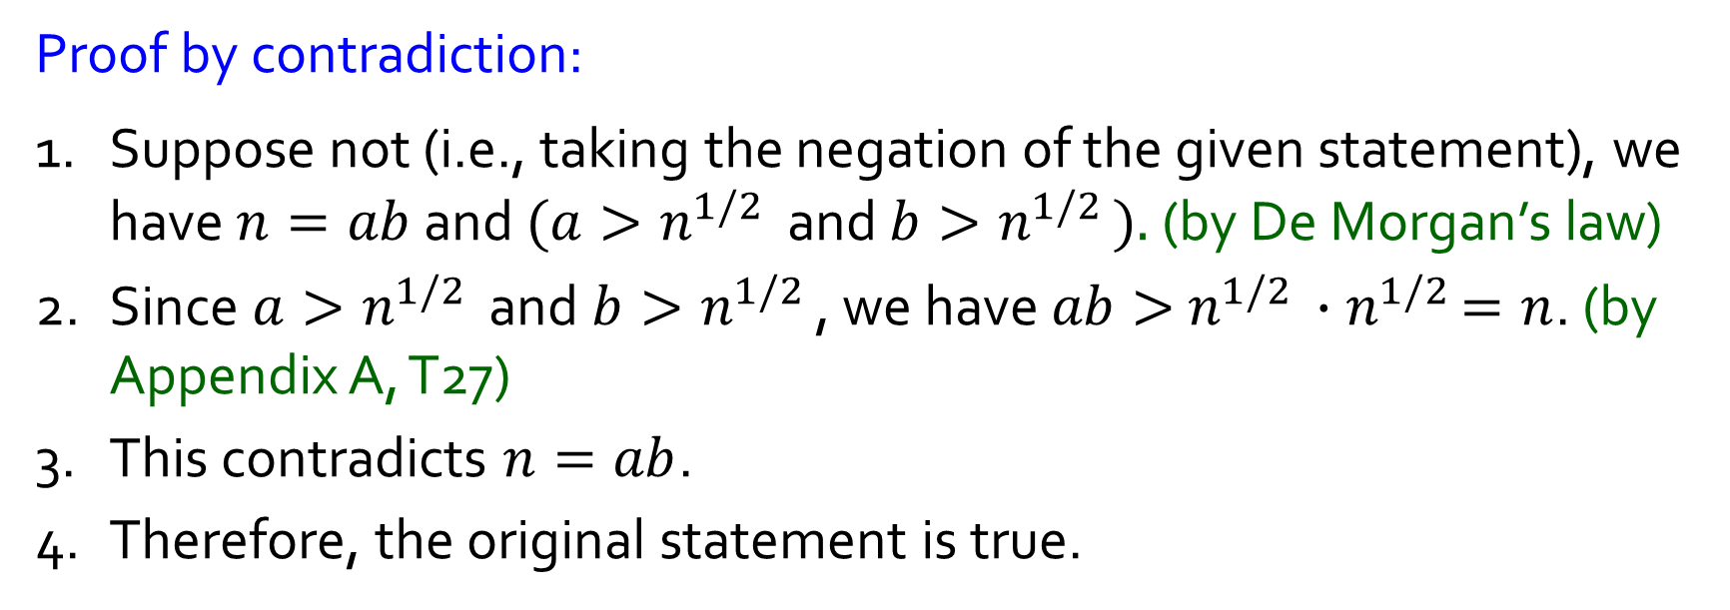
Q11
Prove that if $n$ is a product of two positive integers $a$ and $b$, then $a≤n^{1/2 }$ or $b≤n^{1/2 }$.
$$\sim (p→q)≡p∧\sim q$$
Proof by contradiction:
1. Suppose not (i.e., taking the negation of the given statement), we have $n=ab$ and $(a>n^{1/2 }$ and $b>n^{1/2 }).$ (by De Morgan’s law)
2. Since $a>n^{1/2 }$ and $b>n^{1/2 }$, we have $ab>$ $n^{1/2 }{∙n}^{1/2 }=n$. (by Appendix A, T27)
3. This contradicts $n=ab$.
4. Therefore, the original statement is true.
Appendix A, T27:
$∀a,b,c∈ℝ$, if $0<a<c$ and $0<b<d$, then $0<ab<cd$.

Slide 29

Q11
Prove that if $n$ is a product of two positive integers $a$ and $b$, then $a≤n^{1/2 }$ or $b≤n^{1/2 }$.
Other proofs welcome!

Slide 30
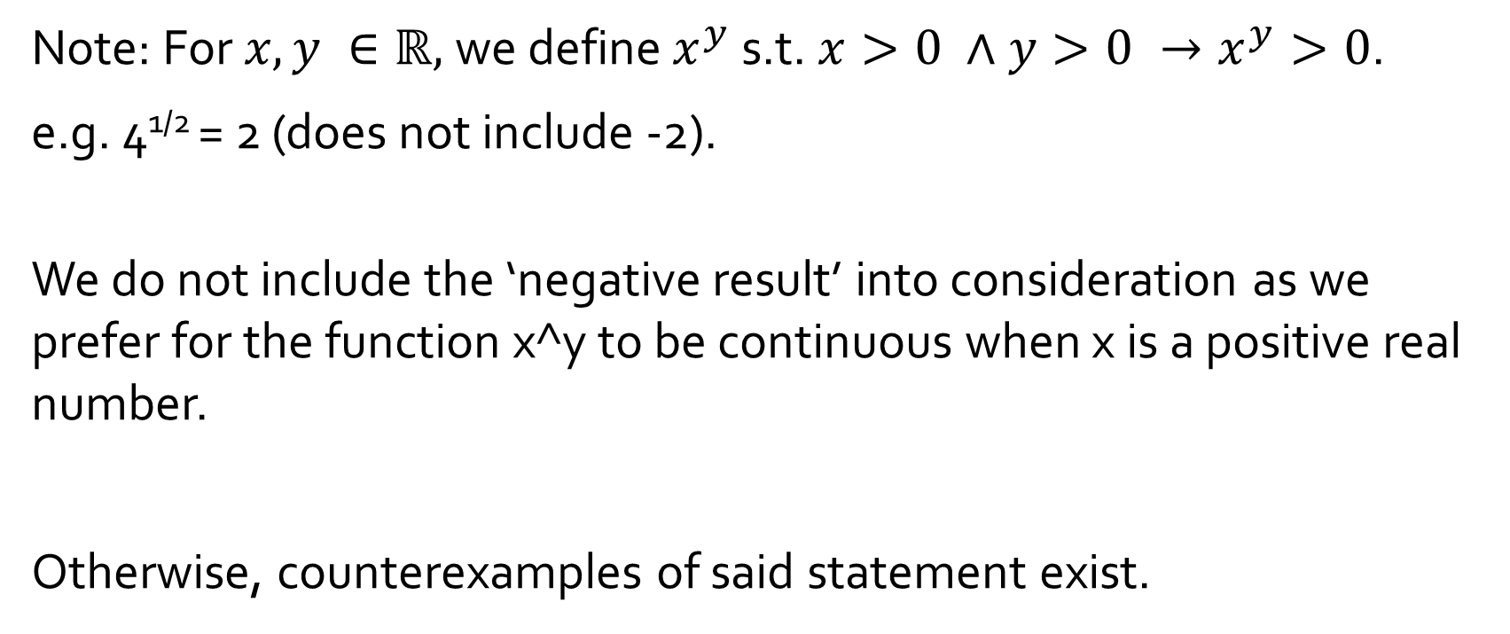
Q11
Prove that if $n$ is a product of two positive integers $a$ and $b$, then $a≤n^{1/2 }$ or $b≤n^{1/2 }$.
Note: For $x,y ∈ℝ,$we define $x^{y}$ s.t. $x>0 ∧y>0 →x^{y}>0$.
e.g. 4^{1/2} = 2 (does not include -2).
We do not include the ‘negative result’ into consideration as we prefer for the function x^y to be continuous when x is a positive real number.
Otherwise, counterexamples of said statement exist.

Slide 31
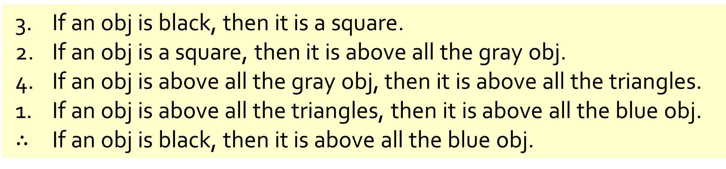
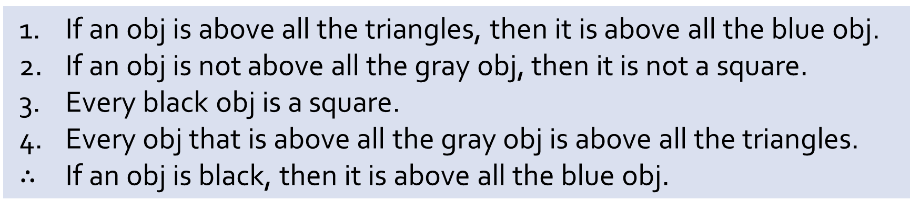
Q10
If an obj is above all the triangles, then it is above all the blue obj.
If an obj is not above all the gray obj, then it is not a square.
Every black obj is a square.
Every obj that is above all the gray obj is above all the triangles.
$∴$ If an obj is black, then it is above all the blue obj.
(a) Reorder the premises to show that the conclusion follows as a valid consequence from the premises by applying universal transitivity.
3. If an obj is black, then it is a square.
2. If an obj is a square, then it is above all the gray obj.
4. If an obj is above all the gray obj, then it is above all the triangles.
1. If an obj is above all the triangles, then it is above all the blue obj.
$∴$ If an obj is black, then it is above all the blue obj.

Slide 32
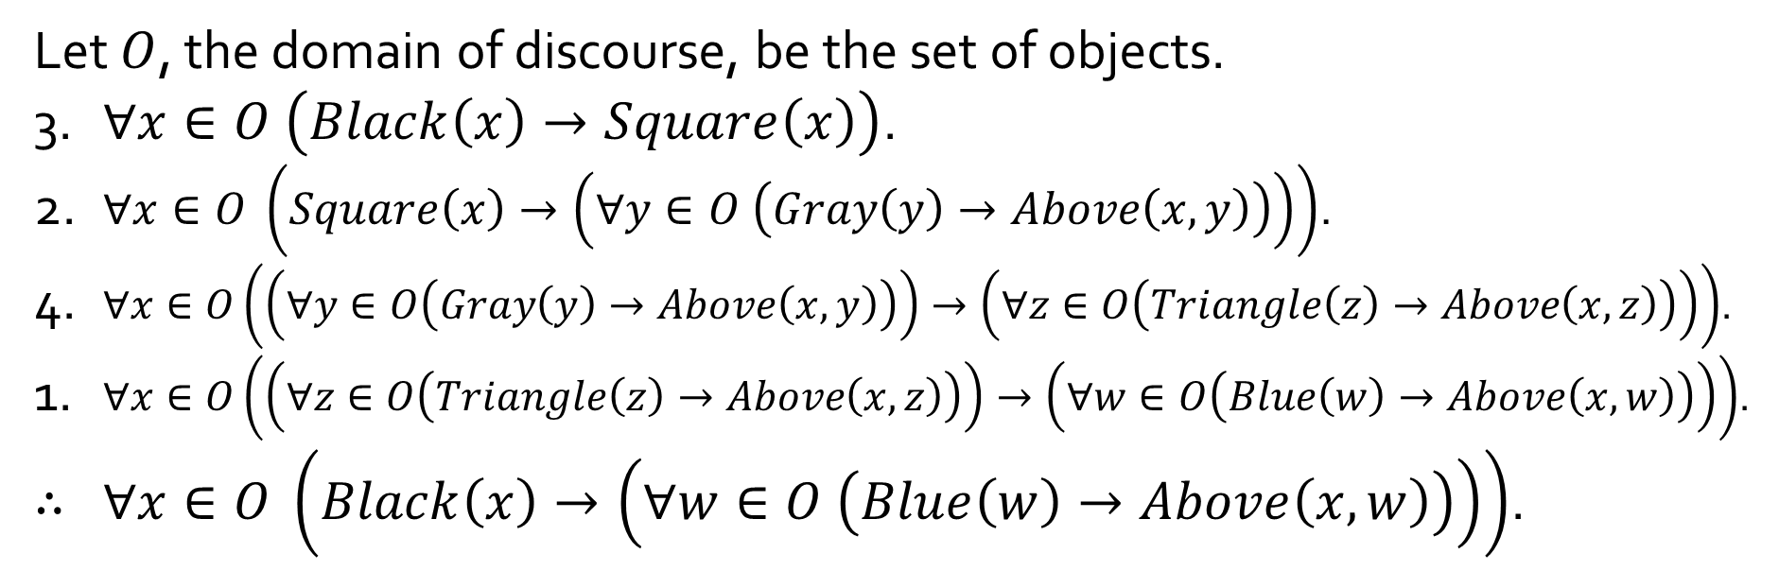
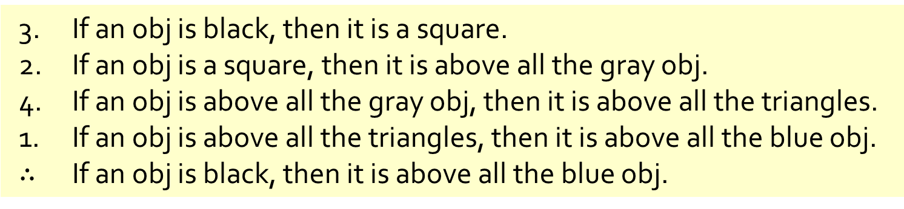
Q10
3. If an obj is black, then it is a square.
2. If an obj is a square, then it is above all the gray obj.
4. If an obj is above all the gray obj, then it is above all the triangles.
1. If an obj is above all the triangles, then it is above all the blue obj.
$∴$ If an obj is black, then it is above all the blue obj.
(b) Rewrite your answer in (a) using predicates and quantified statements.
Let $O$, the domain of discourse, be the set of objects.
3. $∀x∈O \left(Black\left(x\right)→Square\left(x\right)\right)$.
2. $∀x∈O \left(Square\left(x\right)→\left(∀y∈O \left(Gray\left(y\right)→Above\left(x,y\right)\right)\right)\right)$.
4. $∀x∈O\left(\left(∀y∈O\left(Gray\left(y\right)→Above\left(x,y\right)\right)\right)→\left(∀z∈O\left(Triangle\left(z\right)→Above\left(x,z\right)\right)\right)\right)$.
1. $∀x∈O\left(\left(∀z∈O\left(Triangle\left(z\right)→Above\left(x,z\right)\right)\right)→\left(∀w∈O\left(Blue\left(w\right)→Above\left(x,w\right)\right)\right)\right)$.
$∴$ $∀x∈O \left(Black\left(x\right)→\left(∀w∈O \left(Blue\left(w\right)→Above\left(x,w\right)\right)\right)\right)$.

Slide 33
Q6
(a) Some title is read by all the female readers.
False;
None of the titles is read by all 3 female readers.

Slide 34
Q6
(b) Every reader reads some title in every genre.
False;
Ms Dueet doesn’t read any Fantasy title.

Slide 35
Q6
(c) Some reader reads all titles of some genre.
True;
Ms Dueet reads all Mystery titles.

Slide 36
Q6
(d) There is some genre for which some reader does not read any of its titles.
True;
None of the Fantasy titles is read by Ms Dueet/Mr Fandi.

Slide 37
THE END

