Slide 1
Cs1231S tutorial #3
Sets
Adapted from Prof Aaron Tan’s slides

Slide 2
Learning objectives of this tutorial
Sets
Roster, set-builder, replacement notation
Membership, subset, set equality
Power sets, Cartesian products
Set operations
Partition of a set
Proving using set identities and element method

Slide 3
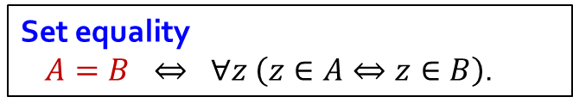
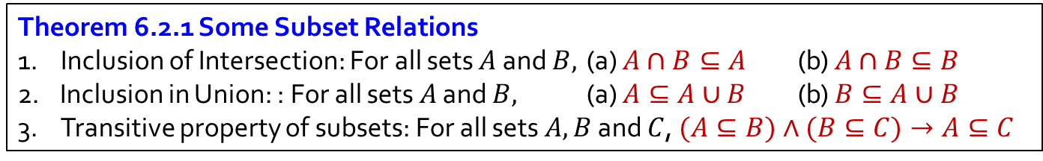
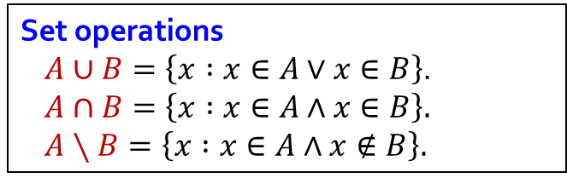
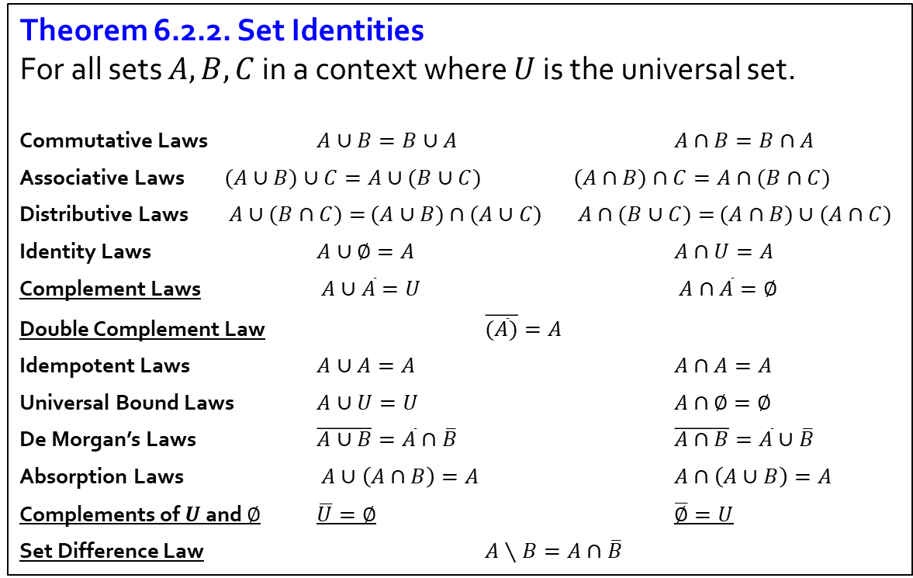
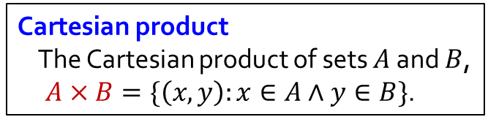
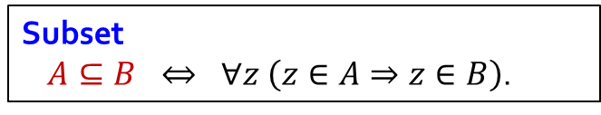
Sets
Theorem 6.2.2. Set Identities
For all sets $A,B,C$ in a context where $U$ is the universal set.
Commutative Laws $A∪B=B∪A$ $A∩B=B∩A$
Associative Laws $(A∪B)∪C=A∪(B∪C)$ $(A∩B)∩C=A∩(B∩C)$
Distributive Laws $A∪(B∩C)=$ $(A∪B)$ $∩$ $(A∪C)$ $A∩(B∪C)=$ $(A∩B)∪(A∩C)$
Identity Laws $A∪∅=A$ $A∩U=A$
Complement Laws $A∪\overline{A}=U$ $A∩\overline{A}=∅$
Double Complement Law $\overline{(\overline{A})}=A$
Idempotent Laws $A∪A=A$ $A∩A=A$
Universal Bound Laws $A∪U=U$ $A∩∅=∅$
De Morgan’s Laws $\overline{A∪B}=\overline{A}∩\overline{B}$ $\overline{A∩B}=\overline{A}∪\overline{B}$
Absorption Laws $A∪\left(A∩B\right)=A$ $A∩\left(A∪B\right)=A$
Complements of $U$ and $∅$ $\overline{U}=∅$ $\overline{∅}=U$
Set Difference Law $A∖B=A∩\overline{B}$
Set equality
$A=B ⇔ ∀z \left(z∈A⇔z∈B\right)$.
Subset
$A⊆B ⇔ ∀z \left(z∈A⇒z∈B\right)$.
Cartesian product
The Cartesian product of sets $A$ and $B$,
$A×B=\{\left(x,y\right):x∈A∧y∈B\}$.
Set operations
$A∪B=\left\{x :x∈A∨x∈B\right\}$.
$A∩B=\left\{x :x∈A∧x∈B\right\}.$
$A∖B=\left\{x :x∈A∧x∉B\right\}.$
Theorem 6.2.1 Some Subset Relations
1. Inclusion of Intersection: For all sets $A$ and $B,$ (a) $A∩B⊆A$ (b) $A∩B⊆B$
Inclusion in Union: : For all sets $A$ and $B,$ (a) $A⊆A∪B$ (b) $B⊆A∪B$
3. Transitive property of subsets: For all sets $A,B$ and $C$, $(A⊆B)∧(B⊆C)→A⊆C$

Slide 4








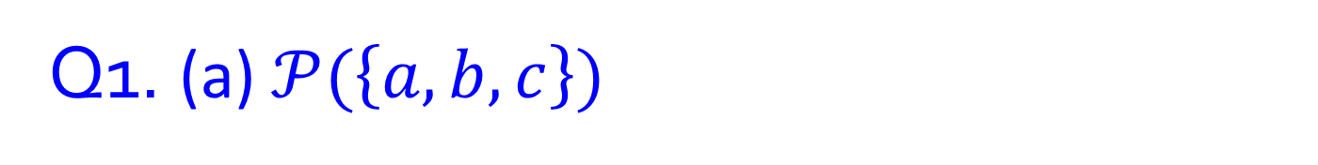












Q1. (a) $𝒫(\left\{a,b,c\right\})$
a
b
c
$$∅$$
$$\{a\}$$
$$\{b\}$$
$$\{c\}$$
a
b
c
a
b
a
b
a
b
$$𝒫\left(\left\{a,b,c\right\}\right)=$$
c
c
c
$$\{$$
$$∅$$
$$\{a\}$$
$$\{b\}$$
$$\{c\}$$
,
,
,
,
$$\{a,b\}$$
$$\{a,c\}$$
$$\{b,c\}$$
$$\{a,b,c\}$$
$$\{a,b\}$$
$$\{a,c\}$$
$$\{b,c\}$$
,
,
,
$$\{a,b,c\}$$
$$\}$$

Slide 5



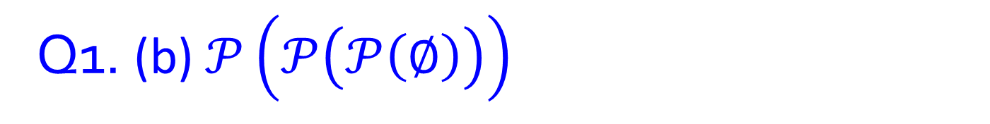

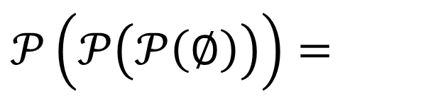
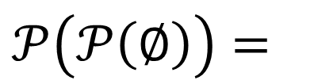
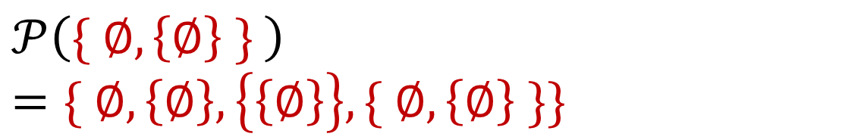
Q1. (b) $𝒫\left(𝒫\left(𝒫\left(∅\right)\right)\right)$
$$𝒫\left(∅\right)=$$
$$\{∅\}$$
$$𝒫\left(𝒫\left(∅\right)\right)=$$
$$𝒫\left(\{∅\}\right)=$$
$$\{ ∅, \left\{∅\right\} \}$$
$$𝒫\left(𝒫\left(𝒫\left(∅\right)\right)\right)=$$
$$𝒫\left(\{ ∅, \left\{∅\right\} \} \right)=\{ ∅, \left\{∅\right\},\left\{\left\{∅\right\}\right\},\{ ∅, \left\{∅\right\} \}\}$$

Slide 6
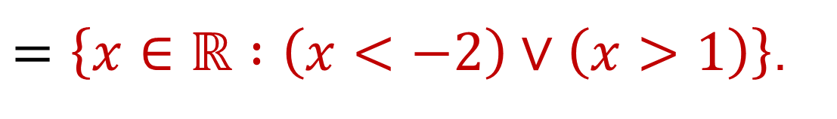
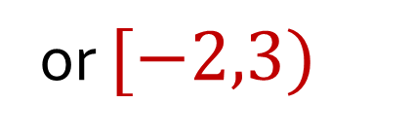
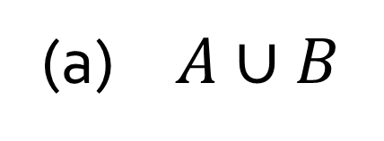
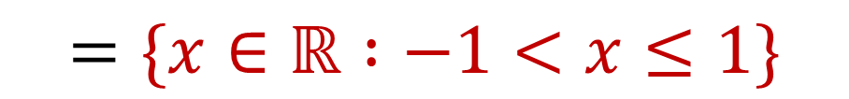
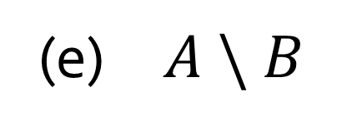
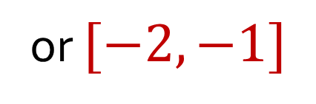
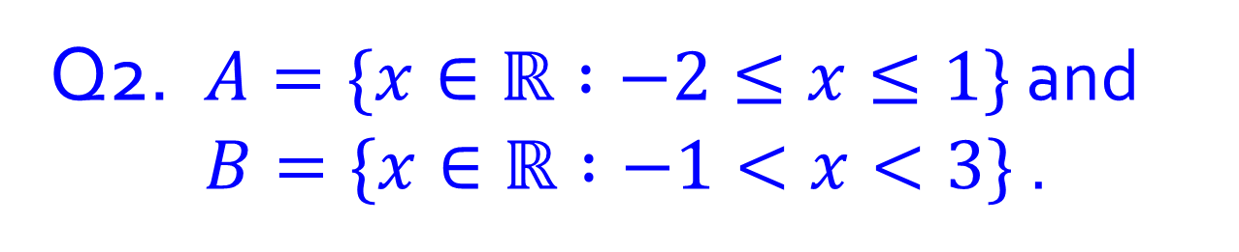
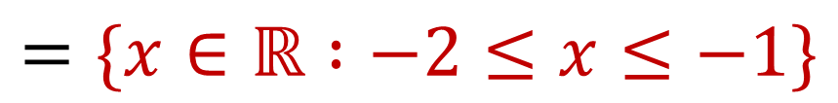
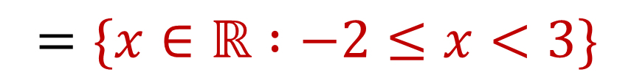
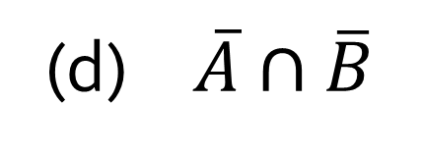
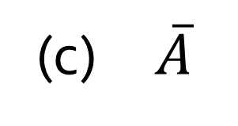
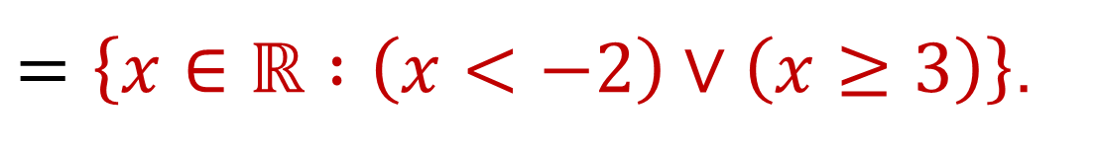

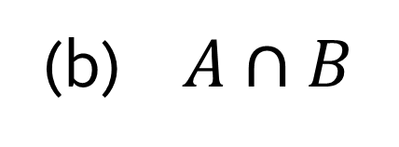

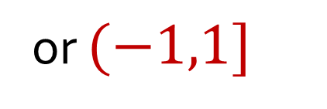
Q2. $A=\{x∈ℝ :−2≤x≤1\}$ and $B=\{x∈ℝ :−1<x<3\}$ .
$$A$$
-2
-1
0
1
2
3
$$B$$
(a) $A∪B$
$$=\{x∈ℝ :−2≤x<3\}$$
or $[−2,3)$
(b) $A∩B$
$$=\{x∈ℝ :−1<x≤1\}$$
or $(−1,1]$
(c) $\overline{A}$
$=\left\{x∈ℝ :\left(x<−2\right)∨\left(x>1\right)\right\}$.
(d) $\overline{A}∩\overline{B}$
$=\left\{x∈ℝ :\left(x<−2\right)∨\left(x≥3\right)\right\}$.
(e) $A \backslash B$
$$=\{x∈ℝ :−2≤x≤−1\}$$
or $[−2,−1]$

Slide 7
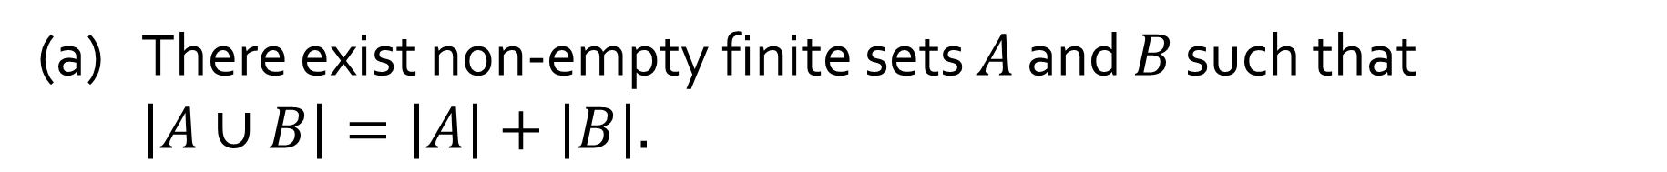
Q3.
(AY2022/23 Sem2 mid-term test)
For each of the following statements, prove whether it is true or false.
(a) $\text{There} \text{exist} \text{non}\text{−}\text{empty} \text{finite} \text{sets} A \text{and} B \text{such} \text{that} \left|A∪B\right|=\left|A\right|+\left|B\right|.$
True
Example?

Slide 8
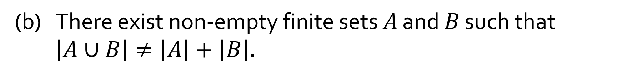
Q3.
(AY2022/23 Sem2 mid-term test)
For each of the following statements, prove whether it is true or false.
(b) $\text{There} \text{exist} \text{non}\text{−}\text{empty} \text{finite} \text{sets} A \text{and} B \text{such} \text{that} \left|A∪B\right|≠\left|A\right|+\left|B\right|.$
True
Example?

Slide 9
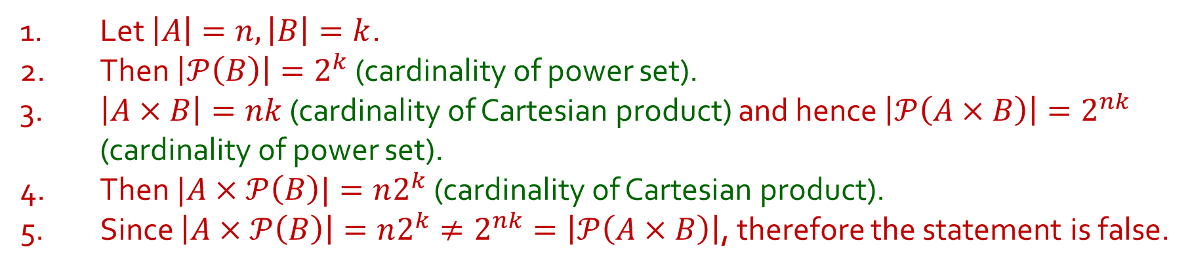
Q3.
(AY2022/23 Sem2 mid-term test)
For each of the following statements, prove whether it is true or false.
(c) $\text{There} \text{exist} \text{finite} \text{sets} A \text{and} B \text{such} \text{that} A×𝒫(B)=𝒫(A×B)\text{.}$
False
1. Let $\left|A\right|=n, \left|B\right|=k$.
2. Then $\left|𝒫\left(B\right)\right|=2^{k}$ (cardinality of power set).
3. $\left|A×B\right|=nk$ (cardinality of Cartesian product) and hence $\left|𝒫\left(A×B\right)\right|=2^{nk}$ (cardinality of power set).
4. Then $|A×𝒫\left(B\right)|=n2^{k}$ (cardinality of Cartesian product).
5. Since $\left|A×𝒫\left(B\right)\right|=n2^{k}≠2^{nk}=\left|𝒫\left(A×B\right)\right|$, therefore the statement is false.
Can you write a correct proof for this?

Slide 10
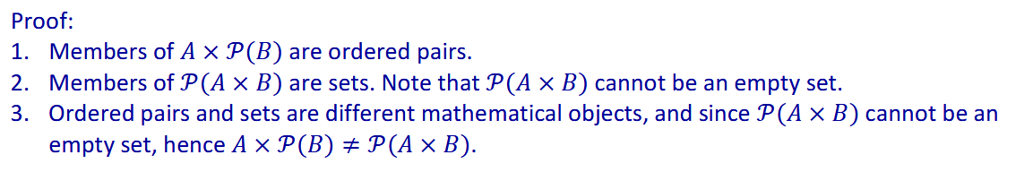

Q3.
(AY2022/23 Sem2 mid-term test)
For each of the following statements, prove whether it is true or false.
(c) $\text{There} \text{exist} \text{finite} \text{sets} A \text{and} B \text{such} \text{that} A×𝒫(B)=𝒫(A×B)\text{.}$
False
Why can’t $𝒫(A×B)$ be an empty set?

Slide 11
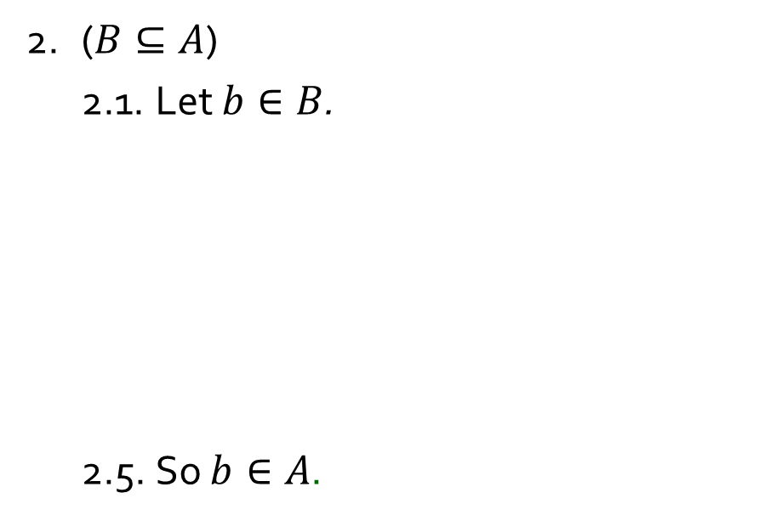
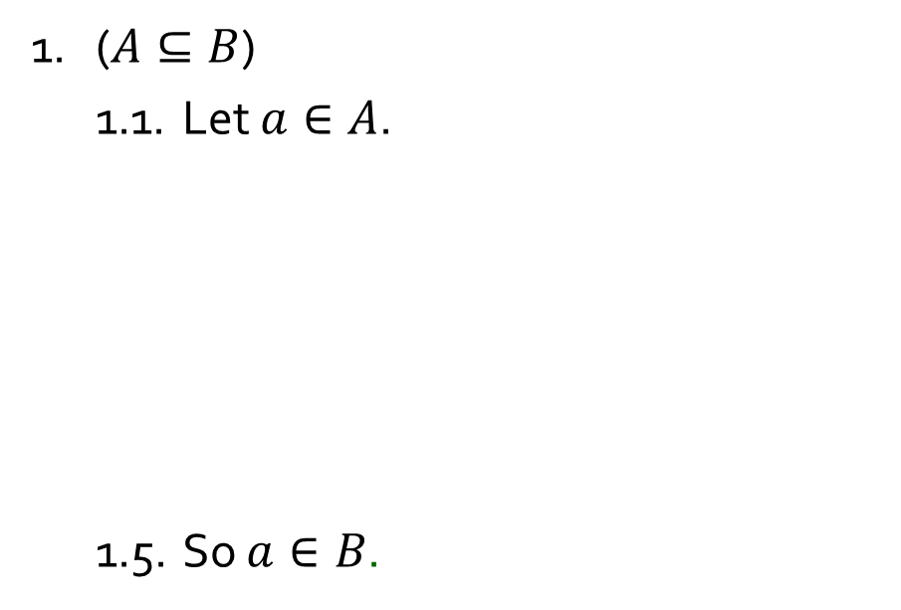
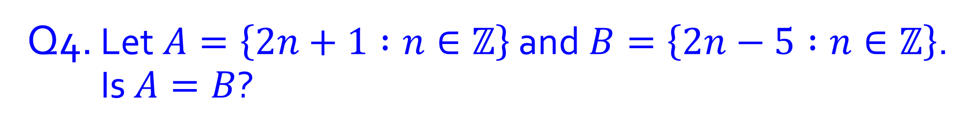
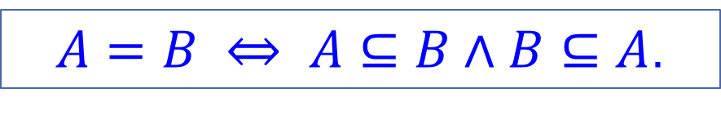
Q4. Let$A=\left\{2n+1 :n∈ℤ\right\}$ and$B=\left\{2n−5 :n∈ℤ\right\}$. Is $A=B$?
Yes or no?
$A=B ⇔ A⊆B∧B⊆A$.
1. ($A⊆B$)
1.1. Let $a∈A$.
1.5. So $a∈B$.
2. ($B⊆A$)
2.1. Let $b∈B$.
2.5. So $b∈A$.
3. Hence $A=B$ by the definition of set equality.

Slide 12
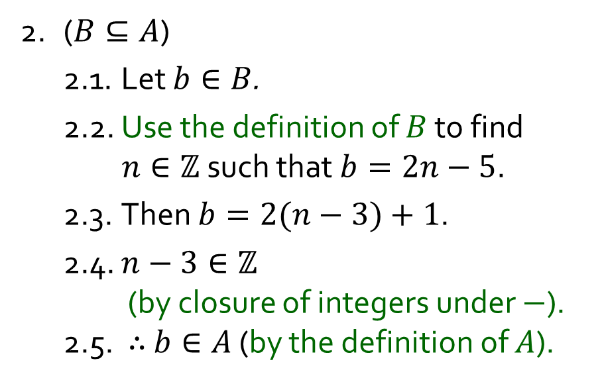
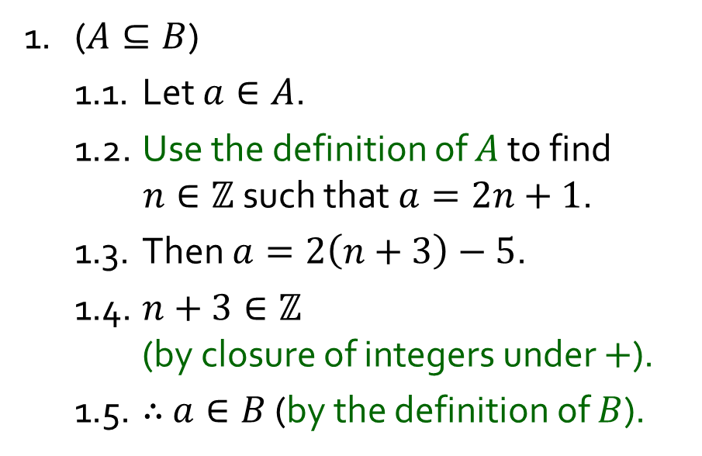
Q4. Let$A=\left\{2n+1 :n∈ℤ\right\}$ and$B=\left\{2n−5 :n∈ℤ\right\}$. Is $A=B$?
Yes or no?
$A=B ⇔ A⊆B∧B⊆A$.
1. ($A⊆B$)
1.1. Let $a∈A$.
1.2. Use the definition of $A$ to find $n∈ℤ$ such that $a=2n+1$.
1.3. Then $a=2\left(n+3\right)−5$.
1.4. $n+3∈ℤ$ (by closure of integers under $+$).
1.5. $∴$ $a∈B$ (by the definition of $B$).
2. ($B⊆A$)
2.1. Let $b∈B$.
2.2. Use the definition of $B$ to find $n∈ℤ$ such that $b=2n−5$.
2.3. Then $b=2(n−3)+1$.
2.4. $n−3∈ℤ$ (by closure of integers under $−$). 2.5. $∴$ $b∈A$ (by the definition of $A$).
3. $∴$ $A=B$ (by the definition of set equality).

Slide 13
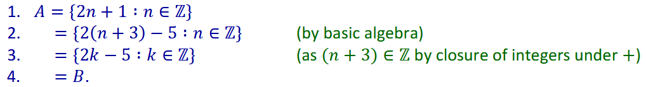

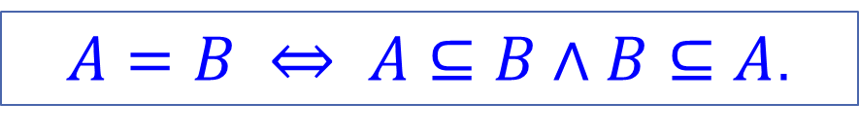
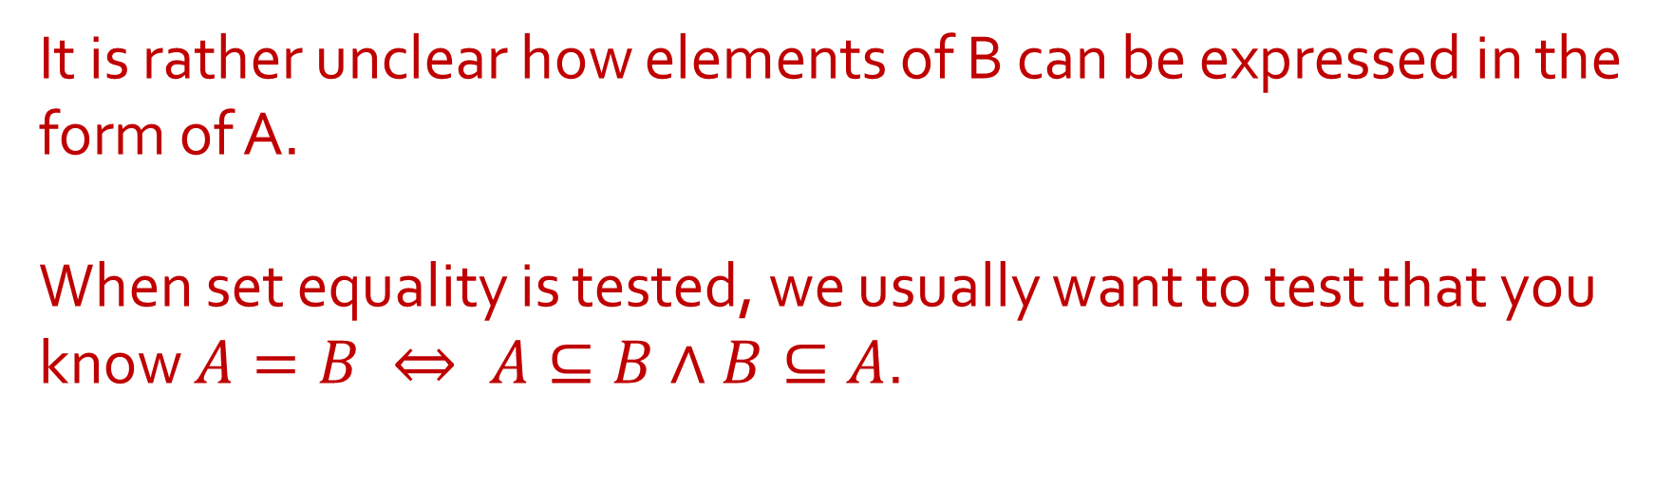
Q4. Let$A=\left\{2n+1 :n∈ℤ\right\}$ and$B=\left\{2n−5 :n∈ℤ\right\}$. Is $A=B$?
$A=B ⇔ A⊆B∧B⊆A$.
What about this?
It is rather unclear how elements of B can be expressed in the form of A.
When set equality is tested, we usually want to test that you know $A=B ⇔ A⊆B∧B⊆A$.

Slide 14
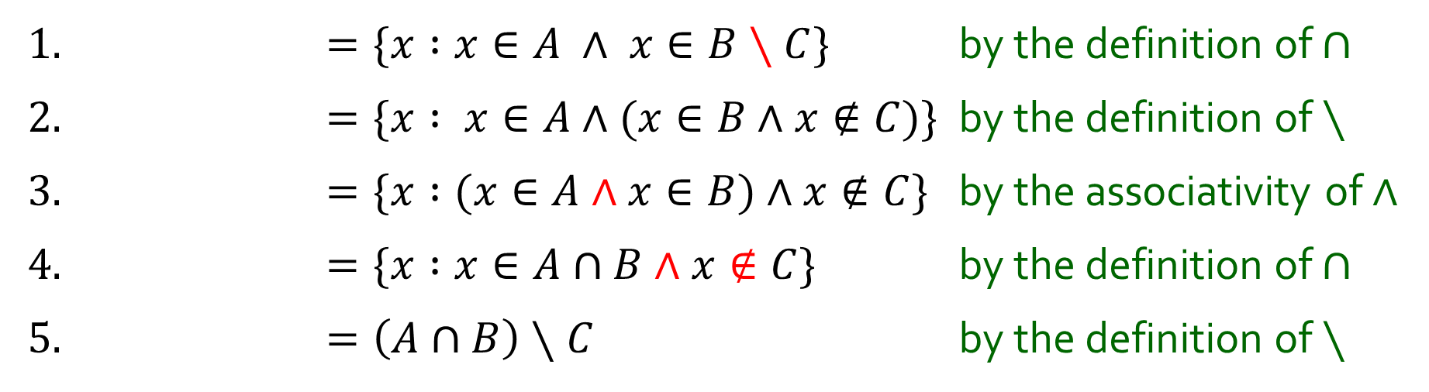
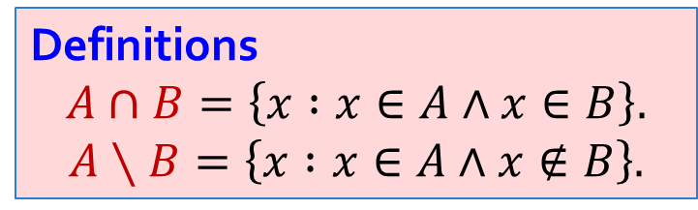
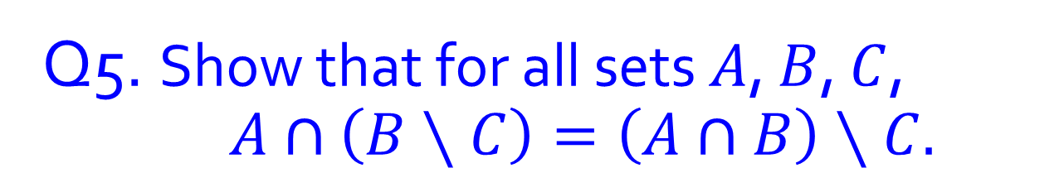

Q5. Show that for all sets $A$, $B$, $C$, $A∩\left(B∖C\right)=\left(A∩B\right)∖C.$
Definitions
$$A∩B=\left\{x :x∈A∧x∈B\right\}.$$
$$A∖B=\left\{x :x∈A∧x∉B\right\}.$$
1. $=\{x :x∈A ∧ x∈B∖C\}$ by the definition of $∩$
2. $=\{x : x∈A∧(x∈B∧x∉C$)} by the definition of $∖$
3. $=\{x :(x∈A∧x∈B)∧x∉C$} by the associativity of $∧$
4. $=\{x :x∈A∩B∧x∉C$} by the definition of $∩$
5. $=\left(A∩B\right)∖C$ by the definition of $∖$
$$A∩\left(B∖C\right)=$$

Slide 15
Break

Slide 16
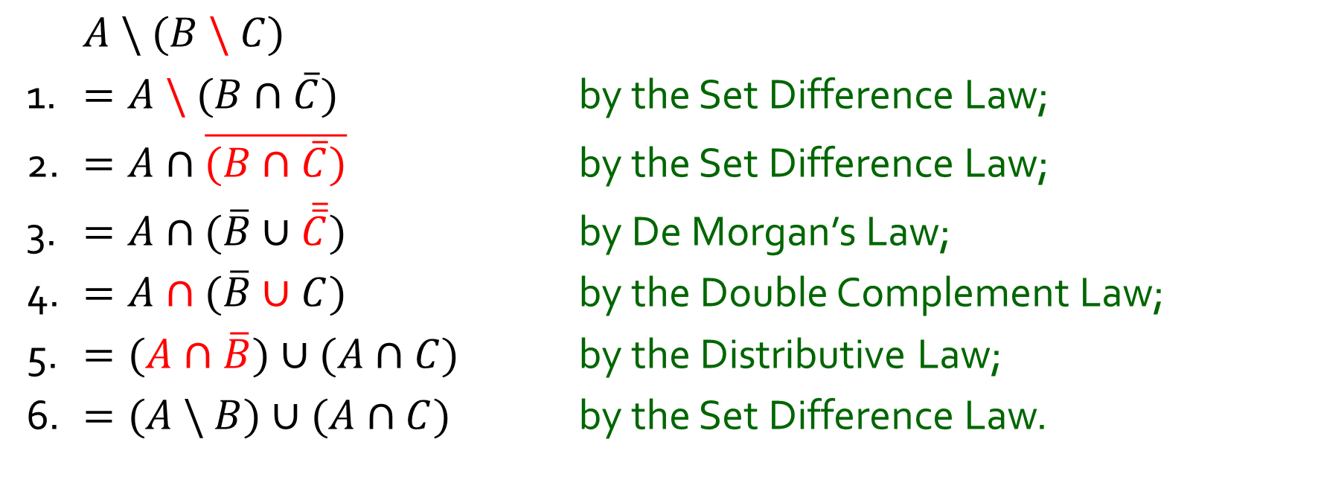

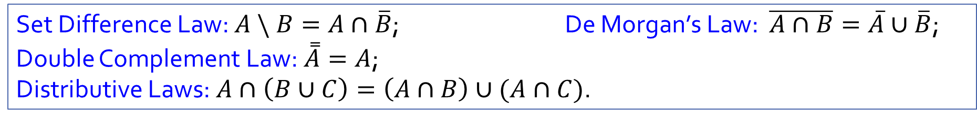
Q6. Prove that for all sets $A,B$ and $C$, $A \backslash (B \backslash C)=(A \backslash B)∪(A∩C)$.
$A \backslash (B \backslash C)$
1. $=A \backslash (B∩\overline{C})$ by the Set Difference Law;
2. $=A∩\overline{(B∩\overline{C})}$ by the Set Difference Law;
3. $=A∩(\overline{B}∪\overline{\overline{C}})$ by De Morgan’s Law;
4. $=A∩(\overline{B}∪C)$ by the Double Complement Law;
5. $=(A∩\overline{B})∪(A∩C)$ by the Distributive Law;
6. $=(A \backslash B)∪(A∩C)$ by the Set Difference Law.
Set Difference Law: $A \backslash B=A∩\overline{B}$; De Morgan’s Law: $\overline{A∩B}=\overline{A}∪\overline{B}$;
Double Complement Law: $\overset{̿}{A}=A$;
Distributive Laws: $A∩\left(B∪C\right)=\left(A∩B\right)∪(A∩C)$.

Slide 17
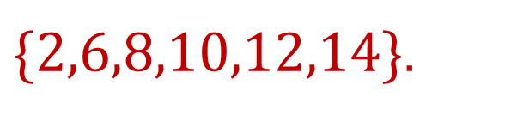
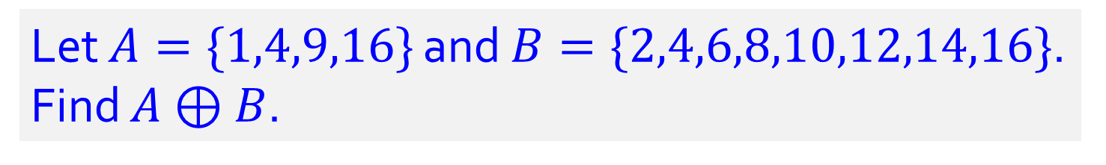
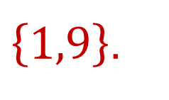
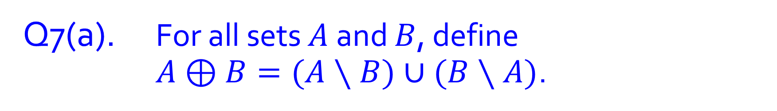
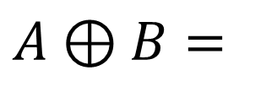
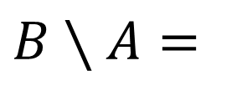
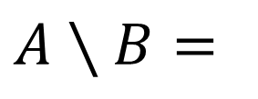

Q7(a). For all sets $A$ and $B$, define $A⊕B=(A∖B)∪(B∖A)$.
Let $A=\{1,4,9,16\}$ and $B=\{2,4,6,8,10,12,14,16\}$. Find $A⊕B$.
$$A∖B=$$
$\left\{1,9\right\}$.
$$B∖A=$$
$\{2,6,8,10,12,14\}$.
$$A⊕B=$$
$\{1,2,6,8,9,10,12,14\}$.

Slide 18



Q7(b). For all sets $A$ and $B$, define $A⊕B=(A∖B)∪(B∖A)$.
Set Difference Law:
$A∖B=A∩\overline{B}$.
Show that $A⊕B=\left(A∪B\right)∖(A∩B)$ for all sets $A$, $B$.
1. $A⊕B$
2. $=\left(A∖B\right)∪(B∖A)$ by the definition of $⊕$
3. $=(A∩\overline{B})∪(B∩\overline{A})$ by the Set Difference Law
4. $=\left(\left(A∩\overline{B}\right)∪B\right)∩\left(\left(A∩\overline{B}\right)∪\overline{A}\right)$ by the Distributive Law
5. $=\left(B∪\left(A∩\overline{B}\right)\right)∩\left(\overline{A}∪\left(A∩\overline{B}\right)\right)$ by the Commutative Law
6. $=\left(\left(B∪A\right)∩\left(B∪\overline{B}\right)\right)∩\left(\left(\overline{A}∪A\right)∩\left(\overline{A}∪\overline{B}\right)\right)$ by the Distributive Law
7. $=\left(\left(B∪A\right)∩\left(B∪\overline{B}\right)\right)∩\left(\left(A∪\overline{A}\right)∩\left(\overline{A}∪\overline{B}\right)\right)$ by the Commutative Law
8. $=\left(\left(B∪A\right)∩U\right)∩\left(U∩\left(\overline{A}∪\overline{B}\right)\right)$ by the Complement Law
9. $=\left(\left(A∪B\right)∩U\right)∩\left(\left(\overline{A}∪\overline{B}\right)∩U\right)$ by the Commutative Law
10. $=(A∪B)∩(\overline{A}∪\overline{B})$ by the Identity Law
11. $=(A∪B)∩(\overline{A∩B})$ by De Morgan’s Law
12. $=\left(A∪B\right)∖(A∩B$) by the Set Difference Law

Slide 19










Q8. Let $A$, $B$ be sets. Show that $A⊆B$ if and only if $A∪B=B$.
Definition.
$A∪B=\left\{x :x∈A∨x∈B\right\}$.
1. (“Only if” / $⇒$)
To show $A∪B=B$, need to show$A∪B⊆B$ and $A∪B⊇B$.
1.1. Suppose $A⊆B$.
1.2. (To show $A∪B⊆B$.)
1.2.1. Let $z∈A∪B$.
1.2.5. In all cases, $z∈B$.
1.3. (To show $A∪B⊇B$.)
1.3.1. Let $z∈B$.
1.3.3. So $z∈A∪B$
1.4. $∴A∪B=B$ by definition of set equality.
1.3.2. Then $z∈A∨z∈B$ by generalization.
by definition of$∪$.
1.2.2. Then $z∈A$ or $z∈B$ by defn of $∪$.
1.2.3. Case 1: Suppose $z∈A$.
Then $z∈B$ as $A⊆B$ by 1.1.
1.2.4. Case 2: Suppose $z∈B$.
Then $z∈B$.
Definitions.
$A⊆B ⇔ ∀z\left(z∈A⇒z∈B\right)$.
$A=B ⇔ ∀z\left(z∈A⇔z∈B\right)$.
2. (“If” / $⇐$) …

Slide 20


Q8. Let $A$, $B$ be sets. Show that $A⊆B$ if and only if $A∪B=B$.
Definition.
$A∪B=\left\{x :x∈A∨x∈B\right\}$.
1. (“Only if” / $⇒$) …
2. (“If” / $⇐$)
2.1. Suppose $A∪B=B$.
2.2. Let $z∈A$.
2.2.3. So $z∈B$
2.2.1. Then $z∈A$ $∨$ $z∈B$ by generalization.
2.2.2. So $z∈A∪B$ by definition of $∪$.
as $A∪B=B$ by 2.1.
2.3. Therefore, $A⊆B$.
3. $∴$ $A⊆B$ if and only if $A∪B=B$ by lines 1 & 2.
Definitions.
$A⊆B ⇔ ∀z\left(z∈A⇒z∈B\right)$.
$A=B ⇔ ∀z\left(z∈A⇔z∈B\right)$.

Slide 21


Q8. Let $A$, $B$ be sets. Show that $A⊆B$ if and only if $A∪B=B$.
Definitions.
$A⊆B ⇔ ∀z\left(z∈A⇒z∈B\right)$.
$A=B ⇔ ∀z\left(z∈A⇔z∈B\right)$.
(General strategy)
To show that $A⊆B$:
Let $z∈A$
…
$z∈B$
Hence, $A⊆B$

Slide 22
Q9. For all sets $A,B,C,$ $\left(A \backslash B\right)∪\left(B \backslash A\right)=\left(A∪B\right) \backslash (A∩B)$.
(a) Aiken wrote this proof:
What’s wrong with the proof?
(at least four mistakes)
1. $x∈\left(A \backslash B\right)∪\left(B \backslash A\right)$
2. $⇒x∈\left(A \backslash B\right)$ or $x∈\left(B \backslash A\right)$
3. $⇒x∈A$ and $x∉B$ or $x∈B$ and $x∉A$
4. $⇒x∈A$ or $x∈B$ and $x∉A$ and $x∉B$
5. $⇒x∈(A∪B)$ and $x∈(\overline{A∩B})$
6. $⇒x∈(A∪B)∩(\overline{A∩B})$
7. $⇒x∈\left(A∪B\right) \backslash (A∩B)$.
Therefore, $\left(A \backslash B\right)∪\left(B \backslash A\right)=\left(A∪B\right) \backslash (A∩B)$.

Slide 23
Q9. For all sets $A,B,C,$ $\left(A \backslash B\right)∪\left(B \backslash A\right)=\left(A∪B\right) \backslash (A∩B)$.
(b) Prove or disprove the claim.
1. $\left(A \backslash B\right)∪\left(B \backslash A\right)$
2. $=(A∩\overline{B})∪(B∩\overline{A})$ by the definition of $\backslash$
3. $=\left(\left(A∩\overline{B}\right)∪B\right)∩\left(\left(A∩\overline{B}\right)∪\overline{A}\right)$ by the distributive law
4. $=\left(B∪\left(A∩\overline{B}\right)\right)∩\left(\overline{A}∪\left(A∩\overline{B}\right)\right)$ by the commutative law (x2)
5. $=\left(\left(B∪A\right)∩\left(B∪\overline{B}\right)\right)∩\left(\left(\overline{A}∪A\right)∩\left(\overline{A}∪\overline{B}\right)\right)$ by the distributive law (x2)
6. $=\left(\left(B∪A\right)∩U\right)∩\left(\left(\overline{A}∪A\right)∩\left(\overline{A}∪\overline{B}\right)\right)$ by the complement law
7. $=\left(B∪A\right)∩\left(\left(\overline{A}∪A\right)∩\left(\overline{A}∪\overline{B}\right)\right)$ by the identity law
8. $=\left(A∪B\right)∩\left(\left(\overline{A}∪\overline{B}\right)∩\left(A∪\overline{A}\right)\right)$ by the commutative law (x3)
9. $=\left(A∪B\right)∩\left(\left(\overline{A}∪\overline{B}\right)∩U\right)$ by the complement law
10. $=\left(A∪B\right)∩\left(\overline{A}∪\overline{B}\right)$ by the identity law
11. $=\left(A∪B\right)∩(\overline{A∩B})$ by De Morgan’s law
12. $=\left(A∪B\right) \backslash (A∩B)$. by the definition of $\backslash$

Slide 24



Q9. For all sets $A,B,C,$ $\left(A \backslash B\right)∪\left(B \backslash A\right)=\left(A∪B\right) \backslash (A∩B)$.
(b) Prove or disprove the claim.

Slide 25

Q9. For all sets $A,B,C,$ $\left(A \backslash B\right)∪\left(B \backslash A\right)=\left(A∪B\right) \backslash (A∩B)$.
(b) Prove or disprove the claim.
Let $A⊕B=\left(A \backslash B\right)∪\left(B \backslash A\right)$, as defined in Tutorial 3 Q7
$A⊕B=\left(A∪B\right)∖(A∩B)$ for all sets A, B (by Tutorial 3 Q7b)
Hence, $\left(A \backslash B\right)∪\left(B \backslash A\right)=\left(A∪B\right) \backslash (A∩B)$

Slide 26


Q10. HSWW is the set of students in the Hogwarts School of Witchcraft and Wizardry, and G,H,R,S are the sets of students in the 4 houses. What are the necessary conditions for $\{G,H,R,S\}$ to be a partition of $HSWW$?
Every student is in exactly one of the four houses.
Each house has at least one student.
$$G∩H=G∩R=G∩S=H∩R=H∩S=R∩S=∅$$
$$G∪H∪R∪S=HSWW$$
$$G≠∅ ∧R≠∅∧H≠∅∧S≠∅$$
Notes:
Note to tutors:
In Sets, we introduce Partition informally. The last requirement that the components must be non-empty is not mentioned. In Relations, the complete definition of Partition is given.

Slide 27



Q11-12. For sets $A_{m},A_{m+1},…,A_{n}$, define
$$\bigcup_{i=m}^{n}{A_{i}}=A_{m}∪A_{m+1}∪…{∪A}_{n}$$
and
$$\bigcap_{i=m}^{n}{A_{i}}=A_{m}∩A_{m+1}∩…∩A_{n}$$

Slide 28











Q11. Let $A_{i}=\left\{x∈ℤ :i≤x≤2i\right\}$ for all integers $i$. Write $A_{−2}$, $\bigcup_{i=3}^{5}{A_{i}}$ and $\bigcap_{i=3}^{5}{A_{i}}$ in set-roster notation, set-builder notation and interval notation.
$$A_{−2}=$$
$$∅$$
$$\bigcup_{i=3}^{5}{A_{i}}=$$
$$\left\{3,4,5,6,7,8,9,10\right\}$$
$$=\left\{x∈ℤ :3≤x≤10\right\}$$
$$=[3,10]$$
$$\bigcap_{i=3}^{5}{A_{i}}=$$
$$\left\{5,6\right\}$$
$$=\left\{x∈ℤ :5≤x≤6\right\}$$
$$=[5,6]$$

Slide 29










Q12. Let $V_{i}=\left\{x∈ℝ :−\frac{1}{i}≤x≤\frac{1}{i}\right\}=\left[−\frac{1}{i},\frac{1}{i}\right]$ for all positive integers $i$.
$$\bigcup_{i=1}^{4}{V_{i}}=$$
$$\bigcap_{i=1}^{4}{V_{i}}=$$
$$\left[ −\frac{1}{4},\frac{1}{4} \right]$$
(a)
$$[−1,1]$$
(b)
$$\bigcup_{i=1}^{n}{V_{i}}=$$
$$\bigcap_{i=1}^{n}{V_{i}}=$$
$$\left[ −\frac{1}{n},\frac{1}{n} \right]$$
$$[−1,1]$$
(c)
(d)
(e)
Are $V_{1},V_{2},$ $V_{3},$… mutually disjoint? Why?

Slide 30
THE END

