Slide 1
Cs1231s tutorial #4
Relations & Equivalence relations
Adapted from slides by Goh Siau Chiak and Aaron Tan

Slide 2
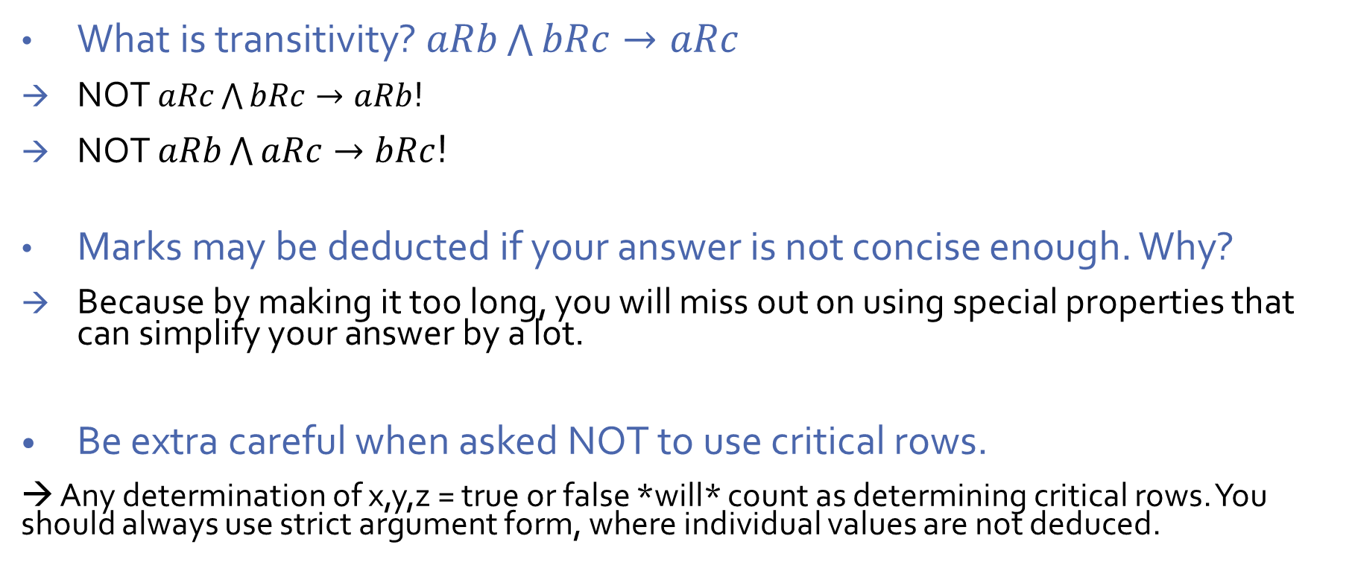
Pointers from Assignment
What is transitivity? $aRb\bigwedge{bRc}→aRc$
NOT $aRc\bigwedge{bRc}→aRb$!
NOT $aRb\bigwedge{aRc}→bRc$!
Marks may be deducted if your answer is not concise enough. Why?
Because by making it too long, you will miss out on using special properties that can simplify your answer by a lot.
Be extra careful when asked NOT to use critical rows.
→ Any determination of x,y,z = true or false *will* count as determining critical rows. You should always use strict argument form, where individual values are not deduced.

Slide 3
Pointers from Assignment
Do clarify any marking mistakes / ambiguities with me ASAP!
→ So that you can get marks where you are supposed to.
→ So that the entire cohort can have their feedback before the break for studying.

Slide 4
Learning objectives of this tutorial
Equivalence relations
Tell whether a relation is reflexive, symmetric, and transitive.
Work with equivalence relations and equivalence classes.

Slide 5





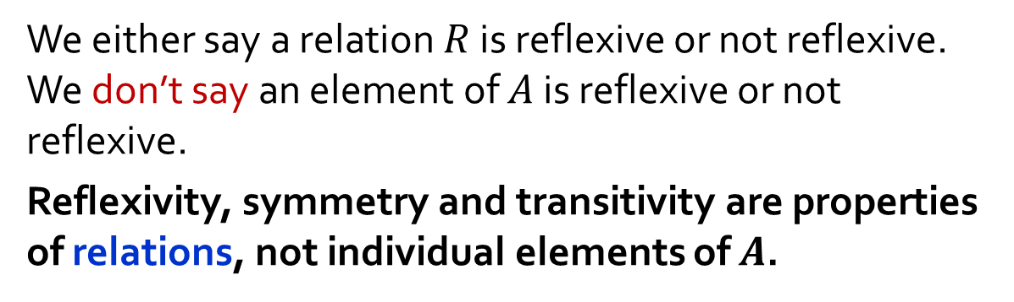
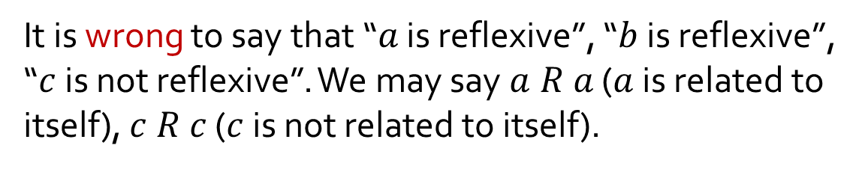
Common mistake
Given a set $A=\{a,b,c\}$and a binary relation defined on $A$ shown below:
$$R$$
It is wrong to say that “$a$ is reflexive”, “$b$ is reflexive”, “$c$ is not reflexive”. We may say $a R a$ ($a$ is related to itself), $c R c$ ($c$ is not related to itself).
$$a$$
$$b$$
We either say a relation $R$ is reflexive or not reflexive. We don’t say an element of $A$ is reflexive or not reflexive.
Reflexivity, symmetry and transitivity are properties of relations, not individual elements of $A$.
$$c$$

Slide 6

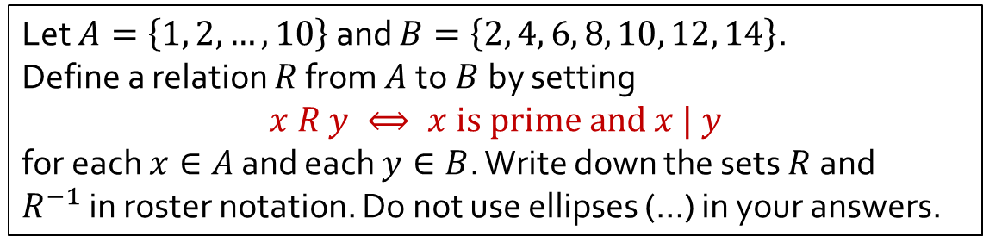



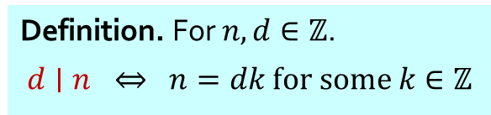


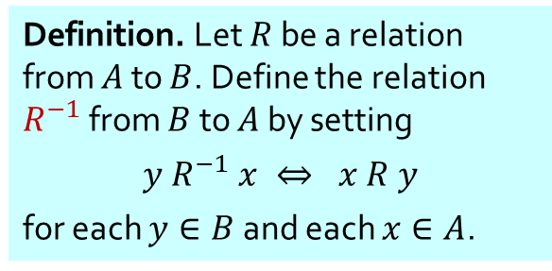


Q1
Let $A=\left\{1, 2, …, 10\right\}$ and $B=\left\{2, 4, 6, 8, 10, 12, 14\right\}$.
Define a relation $R$ from $A$to $B$by setting
$$x R y ⟺ x is prime and x | y$$
for each $x∈A$ and each $y∈B$. Write down the sets $R$and $R^{−1}$in roster notation. Do not use ellipses (…) in your answers.
Definition. A positive integer is prime if it has exactly two positive divisors.
Definition. For $n,d∈ℤ$.
$$d∣n ⇔ n=dk for some k∈ℤ$$
$$R^{−1}$$
Definition. Let $R$ be a relation from $A$ to $B$. Define the relation $R^{−1}$ from $B$ to $A$ by setting
$$y R^{−1} x ⇔ x R y$$
for each $y∈B$ and each $x∈A$.
$$A$$
$$R$$
$$B$$
$$A$$
$$B$$
(Arrow diagrams shown for illustration purpose only.)
1
2
3
4
5
6
7
8
9
10
2
4
6
8
10
12
14
1
2
3
4
5
6
7
8
9
10
•
•
•
•
•
•
•
•
•
•
2
4
6
8
10
12
14
•
•
•
•
•
•
•
•
•
•
$$R=$$
$$\{\text{(2,2), (2,4), (2,6), (2,8), (2,10), (2,12), }\text{(2,14),}\text{(3,6), (3,12), (5,10), (7,14)}\text{\}}\text{.}$$
$$R^{−1}=$$
$\{\text{(2,2), (4,2), (6,2), (8,2), (10,2), (12,2),}\text{(14,2),}\text{ (6,3), (12,3), (10,5), (14,7)}\text{\}}$.

Slide 7

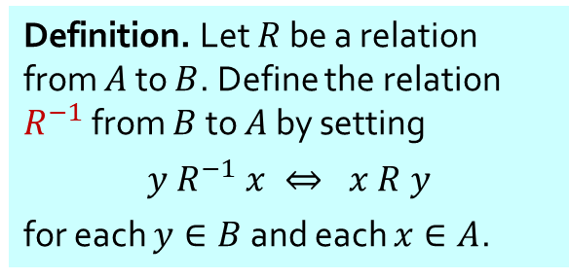

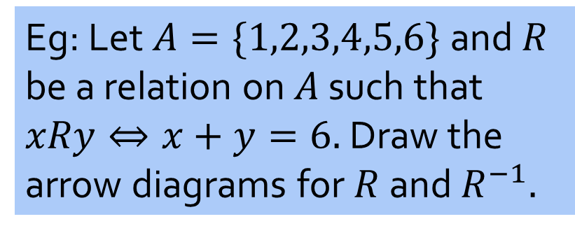
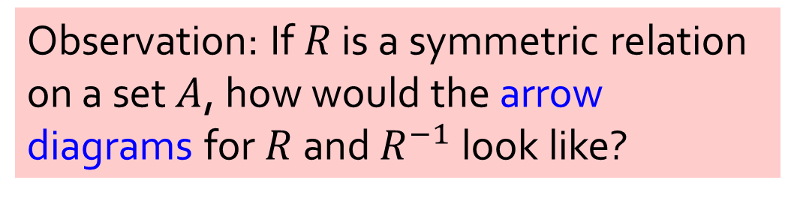
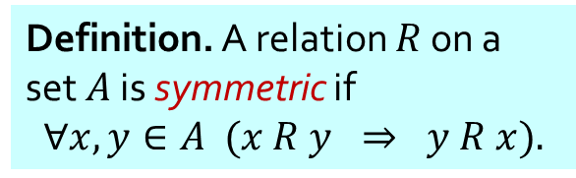
Observation: If $R$ is a symmetric relation on a set $A$, how would the arrow diagrams for $R$ and $R^{−1}$ look like?
Definition. A relation $R$ on a set $A$ is symmetric if
$$∀x,y∈A (x R y ⇒ y R x).$$
Definition. Let $R$ be a relation from $A$ to $B$. Define the relation $R^{−1}$ from $B$ to $A$ by setting
$$y R^{−1} x ⇔ x R y$$
for each $y∈B$ and each $x∈A$.
Eg: Let $A=\{1,2,3,4,5,6\}$and $R$ be a relation on $A$ such that $xRy⇔x+y=6.$Draw the arrow diagrams for $R$ and $R^{−1}.$
$$R$$
$$R^{−1}$$
• 6
• 6
• 1
• 1
• 5
• 5
• 2
• 2
• 4
• 4
• 3
• 3

Slide 8
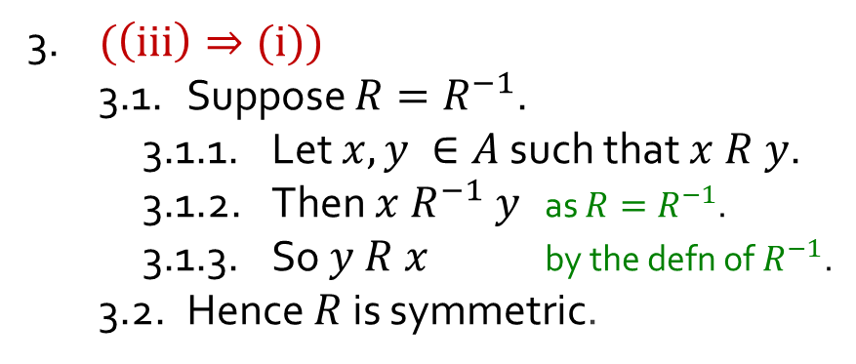
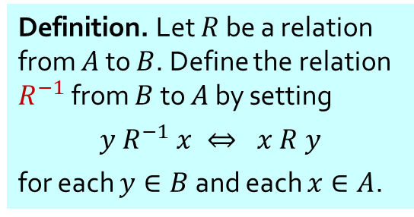
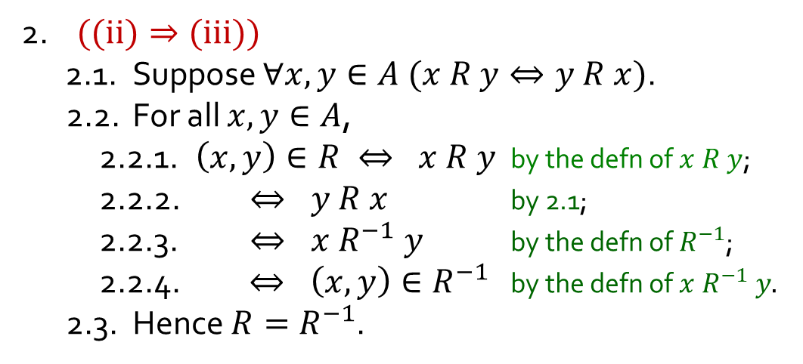

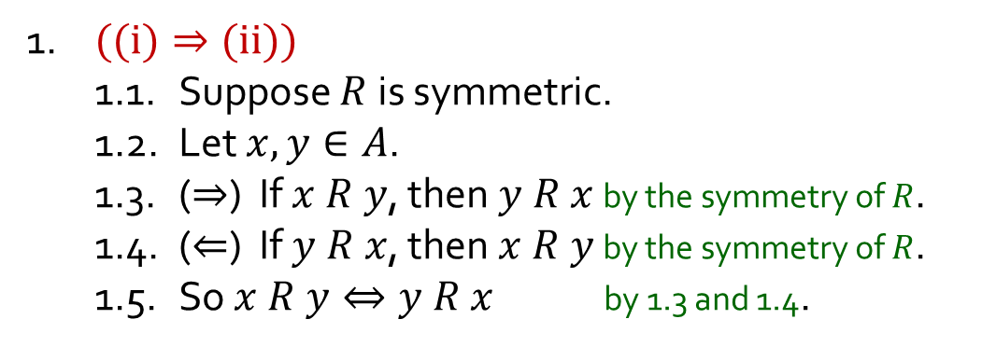
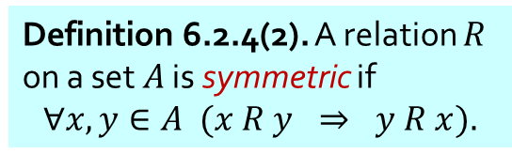

Q2
Let $R$be a relation on set $A$. Show that the following are logically equivalent.
(i) $R$ is symmetric; (ii) $∀x,y∈A (x R y⇔y R x)$; (iii) $R=R^{−1}.$
1. $((i)⇒(ii))$
1.1. Suppose $R$ is symmetric.
1.2. Let $x,y∈A$.
1.3. ($⇒$) If $x R y$, then $y R x$ by the symmetry of $R$.
1.4. ($⇐$) If $y R x$, then $x R y$ by the symmetry of $R$.
1.5. So $x R y⇔y R x$ by 1.3 and 1.4.
Definition 6.2.4(2). A relation $R$ on a set $A$ is symmetric if
$$∀x,y∈A (x R y ⇒ y R x).$$
To show (i) $⇒\text{(}\text{ii}\text{)}⇒\text{(}\text{iii}\text{)}⇒\text{(}\text{i}\text{)}$
Definition. Let $R$ be a relation from $A$ to $B$. Define the relation $R^{−1}$ from $B$ to $A$ by setting
$$y R^{−1} x ⇔ x R y$$
for each $y∈B$ and each $x∈A$.
2. $((ii)⇒(iii))$
2.1. Suppose $∀x,y∈A (x R y⇔y R x)$.
2.2. For all $x,y∈A$,
2.2.1. $\left(x,y\right)∈R ⇔ x R y$ by the defn of $x R y$;
2.2.2. $⇔ y R x$ by 2.1;
2.2.3. $⇔ x R^{−1} y$ by the defn of $R^{−1}$;
2.2.4. $⇔ \left(x,y\right)∈R^{−1}$ by the defn of $x R^{−1} y.$
2.3. Hence $R=R^{−1}$.
3. $(\left(iii\right)⇒(i))$
3.1. Suppose $R=R^{−1}$.
3.1.1. Let $x,y ∈A$ such that $x R y$.
3.1.2. Then $x{ R}^{−1} y$ as $R=R^{−1}$.
3.1.3. So $y R x$ by the defn of$R^{−1}$.
3.2. Hence $R$ is symmetric.
4. $∴$ (i), (ii) and (iii) are equivalent.

Slide 9

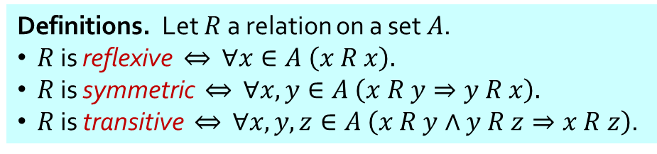
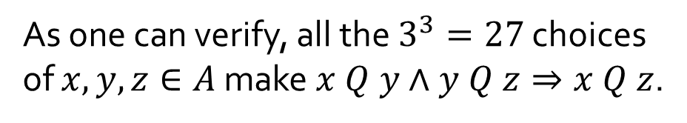
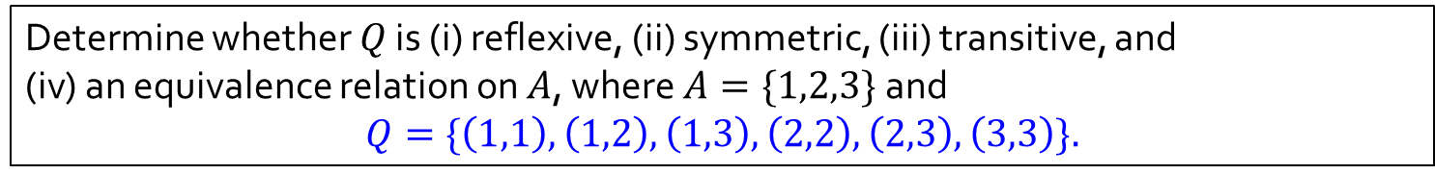
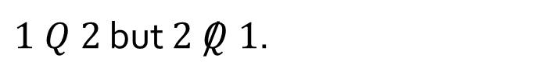

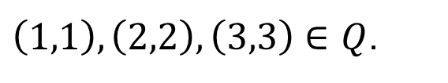

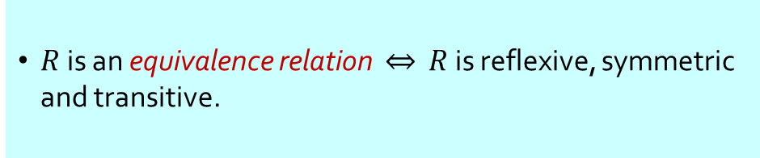

Q3(a)
Determine whether $Q$ is (i) reflexive, (ii) symmetric, (iii) transitive, and
(iv) an equivalence relation on $A$, where $A=\{1,2,3\}$ and $$Q=\{\left(1,1\right),\left(1,2\right),\left(1,3\right),\left(2,2\right),\left(2,3\right),\left(3,3\right)\}.$$
Definitions. Let $R$ a relation on a set $A$.
$R$ is reflexive $⇔$ $∀x∈A \left(x R x\right).$
$R$ is symmetric $⇔$ $∀x,y∈A \left(x R y⇒y R x\right).$
$R$ is transitive $⇔$ $∀x,y,z∈A \left(x R y∧y R z⇒x R z\right)$.
$R$ is an equivalence relation $⇔$ $R$ is reflexive, symmetric and transitive.
✓
Reflexive?
$\left(1,1\right),\left(2,2\right),\left(3,3\right)∈Q$.
$$1$$
✘
Symmetric?
$1 Q 2$ but $2 /Q 1$.
✓
Transitive?
As one can verify, all the $3^{3}=27$ choices of $x,y,z∈A$ make $x Q y∧y Q z⇒x Q z$.
$$2$$
$$3$$
✘
Equivalence relation?
$Q$ is not symmetric.

Slide 10
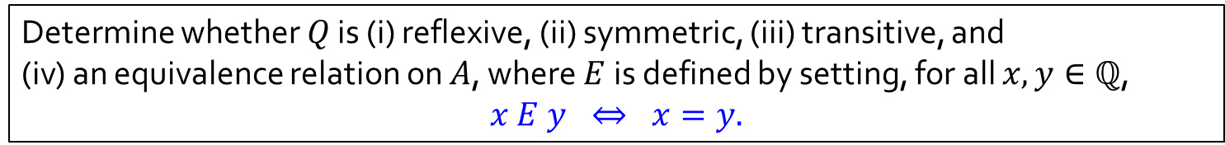

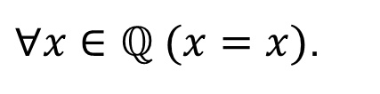

Q3(b)
Determine whether $Q$ is (i) reflexive, (ii) symmetric, (iii) transitive, and
(iv) an equivalence relation on $A$, where $E$ is defined by setting, for all $x,y∈ℚ$, $$x E y ⇔ x=y.$$
Definitions. Let $R$ a relation on a set $A$.
$R$ is reflexive $⇔$ $∀x∈A \left(x R x\right).$
$R$ is symmetric $⇔$ $∀x,y∈A \left(x R y⇒y R x\right).$
$R$ is transitive $⇔$ $∀x,y,z∈A \left(x R y∧y R z⇒x R z\right)$.
$R$ is an equivalence relation $⇔$ $R$ is reflexive, symmetric and transitive.
✓
Reflexive?
$∀x∈ℚ (x=x)$.
✓
Symmetric?
$$∀x, y∈ℚ (x=y ⇒y=x)$$
✓
Transitive?
$$∀x,y,z∈ℚ\left(x=y∧y=z⇒x= z\right)$$
✓
Equivalence relation?
Yes.

Slide 11

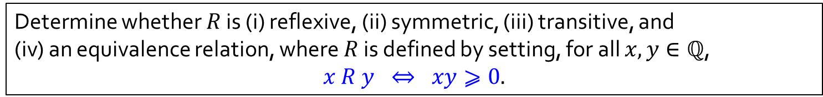
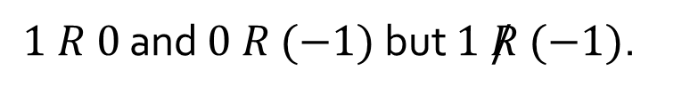
Q3(c)
Determine whether $R$ is (i) reflexive, (ii) symmetric, (iii) transitive, and
(iv) an equivalence relation, where $R$ is defined by setting, for all $x,y∈ℚ$, $$x R y ⇔ xy⩾0.$$
Definitions. Let $R$ a relation on a set $A$.
$R$ is reflexive $⇔$ $∀x∈A \left(x R x\right).$
$R$ is symmetric $⇔$ $∀x,y∈A \left(x R y⇒y R x\right).$
$R$ is transitive $⇔$ $∀x,y,z∈A \left(x R y∧y R z⇒x R z\right)$.
$R$ is an equivalence relation $⇔$ $R$ is reflexive, symmetric and transitive.
✓
Reflexive?
$$∀x∈ℚ \left(x∙x=x^{2}⩾0\right).$$
✓
Symmetric?
$∀x, y∈ℚ (xy⩾0 ⇒yx=xy⩾0)$ (by commutativity of multiplication)
✘
Transitive?
$1 R 0$ and $0 R (−1)$ but $1 /R (−1)$.
✘
Equivalence relation?
$R$ is not transitive.

Slide 12
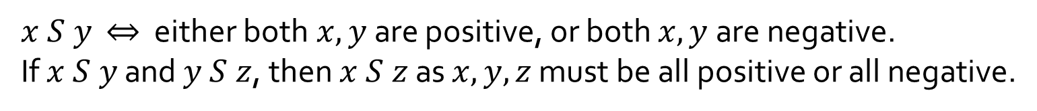

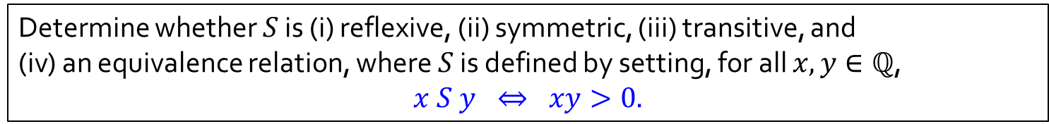

Q3(d)
Determine whether $S$ is (i) reflexive, (ii) symmetric, (iii) transitive, and
(iv) an equivalence relation, where $S$ is defined by setting, for all $x,y∈ℚ$, $$x S y ⇔ xy>0.$$
Definitions. Let $R$ a relation on a set $A$.
$R$ is reflexive $⇔$ $∀x∈A \left(x R x\right).$
$R$ is symmetric $⇔$ $∀x,y∈A \left(x R y⇒y R x\right).$
$R$ is transitive $⇔$ $∀x,y,z∈A \left(x R y∧y R z⇒x R z\right)$.
$R$ is an equivalence relation $⇔$ $R$ is reflexive, symmetric and transitive.
✘
Reflexive?
$$0 /S 0.$$
✓
Symmetric?
$∀x, y∈ℚ (xy>0⇒yx=xy>0)$ (by commutativity of multiplication)
$x S y$ $⇔$ either both$x,y$are positive, or both $x,y$are negative.
If $x S y$ and $y S z$, then $x S z$ as $x,y,z$ must be all positive or all negative.
✓
Transitive?
✘
Equivalence relation?
$S$ is not reflexive.

Slide 13
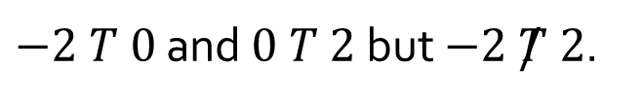

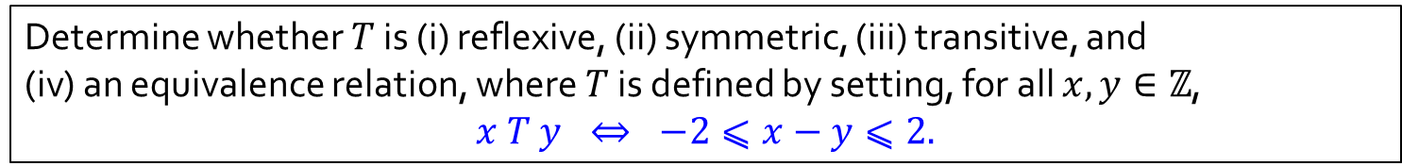

Q3(e)
Determine whether $T$ is (i) reflexive, (ii) symmetric, (iii) transitive, and
(iv) an equivalence relation, where $T$ is defined by setting, for all $x,y∈ℤ$, $$x T y ⇔ −2⩽x−y⩽2.$$
Definitions. Let $R$ a relation on a set $A$.
$R$ is reflexive $⇔$ $∀x∈A \left(x R x\right).$
$R$ is symmetric $⇔$ $∀x,y∈A \left(x R y⇒y R x\right).$
$R$ is transitive $⇔$ $∀x,y,z∈A \left(x R y∧y R z⇒x R z\right)$.
$R$ is an equivalence relation $⇔$ $R$ is reflexive, symmetric and transitive.
✓
Reflexive?
$$∀x∈ℤ (−2⩽x−x⩽2).$$
✓
Symmetric?
$∀x∈ℤ (−2⩽x−y⩽2 ⇒ −2⩽y−x⩽2)$.
Learning Point:
None of these three properties are necessarily related to one another, even if they seemingly do.
Remind yourself that for symmetric and transitive, the statement can always be vacuously true, while reflexive cannot.
✘
Transitive?
$−2 T 0$ and $0 T 2$ but $−2 /T 2$.
✘
Equivalence relation?
$T$ is not transitive.

Slide 14
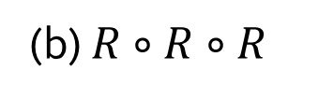



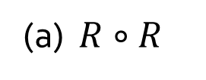



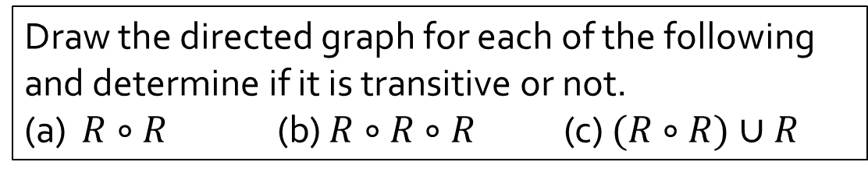





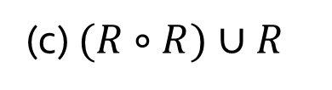

Q4
The directed graph of a binary relation $R$ on a set $A=\{a,b,c\}$ is shown below.
$$a$$
$$b$$
Draw the directed graph for each of the following and determine if it is transitive or not.
(a) $R∘R$ (b) $R∘R∘R$ (c) $(R∘R)∪R$
$$c$$
$$a$$
$$b$$
$$a$$
$$b$$
$$a$$
$$b$$
$$c$$
Not transitive
$$c$$
Not transitive
$$c$$
Transitive
(a) $R∘R$
(b) $R∘R∘R$
(c) $(R∘R)∪R$

Slide 15
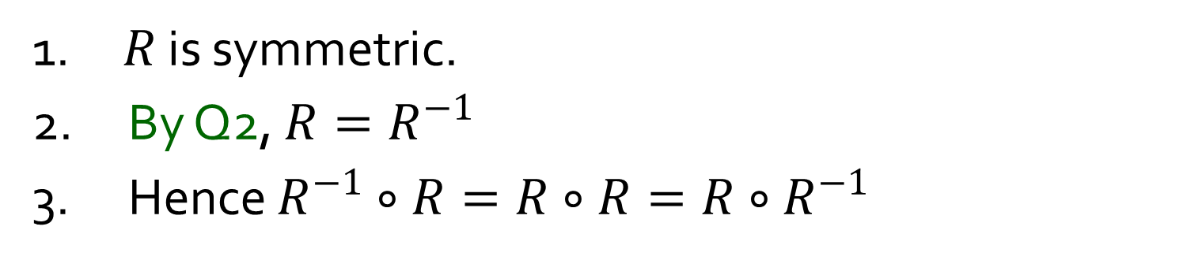
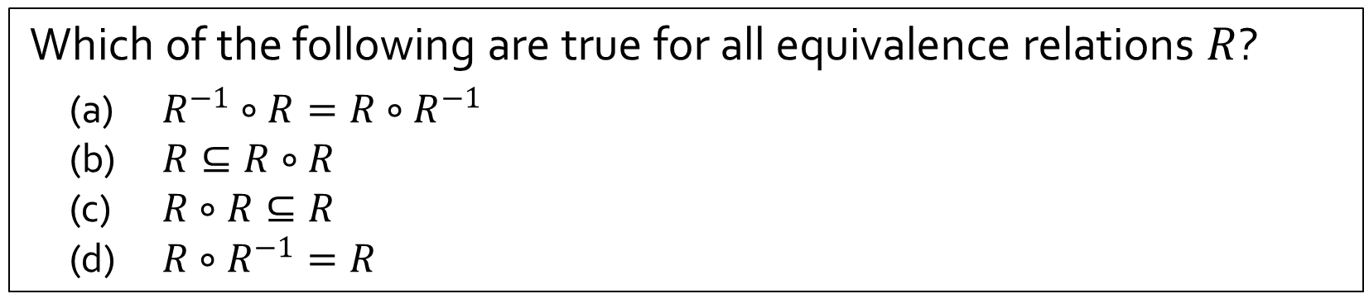
Q5
Which of the following are true for all equivalence relations $R$?
(a) $R^{−1}∘R=R∘R^{−1}$
(b) $R⊆R∘R$
(c) $R∘R⊆R$
(d) ${R∘R}^{−1}=R$
(a)
True
1. $R$ is symmetric.
2. By Q2, $R=R^{−1}$
3. Hence $R^{−1}∘R=R∘R=R∘R^{−1}$

Slide 16
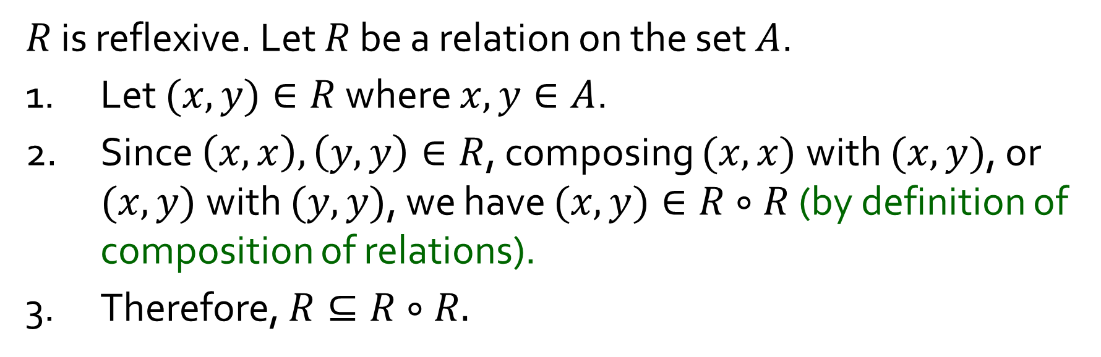
Q5
Which of the following are true for all equivalence relations $R$?
(a) $R^{−1}∘R=R∘R^{−1}$
(b) $R⊆R∘R$
(c) $R∘R⊆R$
(d) ${R∘R}^{−1}=R$
(b)
True
$R$ is reflexive. Let $R$ be a relation on the set $A$.
1. Let $(x,y)∈R$ where $x,y∈A$.
2. Since $\left(x,x\right),\left(y,y\right)∈R$, composing $(x,x)$with $(x,y)$, or $(x,y)$with $(y,y)$, we have $(x,y)∈R∘R$ (by definition of composition of relations).
3. Therefore, $R⊆R∘R.$

Slide 17
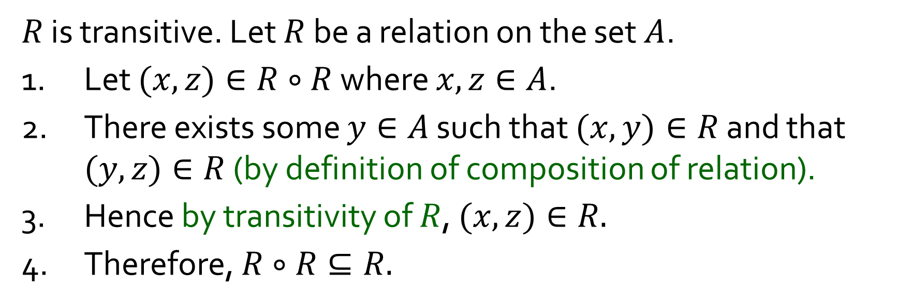
Q5
Which of the following are true for all equivalence relations $R$?
(a) $R^{−1}∘R=R∘R^{−1}$
(b) $R⊆R∘R$
(c) $R∘R⊆R$
(d) ${R∘R}^{−1}=R$
(c)
True
$R$ is transitive. Let $R$ be a relation on the set $A$.
1. Let $(x,z)∈R∘R$ where $x,z∈A$.
2. There exists some $y∈A$ such that $(x,y)∈R$ and that $(y,z)∈R$ (by definition of composition of relation).
3. Hence by transitivity of $R$, $(x,z)∈R.$
4. Therefore, $R∘R⊆R.$

Slide 18
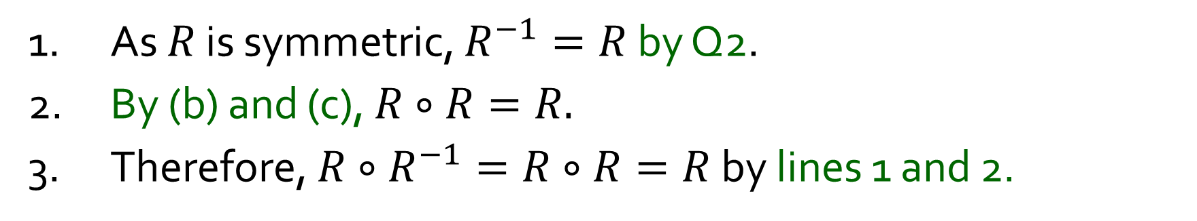
Q5
Which of the following are true for all equivalence relations $R$?
(a) $R^{−1}∘R=R∘R^{−1}$
(b) $R⊆R∘R$
(c) $R∘R⊆R$
(d) ${R∘R}^{−1}=R$
(d)
True
1. As $R$ is symmetric, $R^{−1}=R$ by Q2.
2. By (b) and (c), $R∘R=R.$
3. Therefore, $R∘R^{−1}=R∘R=R$ by lines 1 and 2.
While you won’t be asked to prove the same result, you may be asked to prove a similar-looking statement.

Slide 19
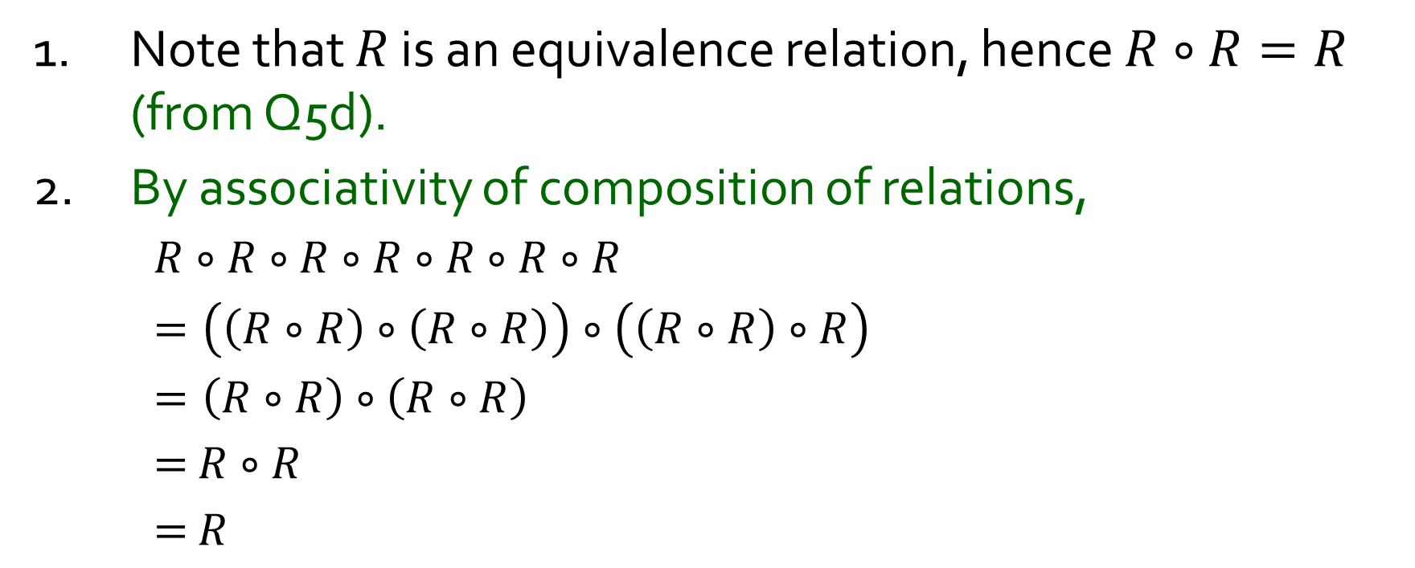
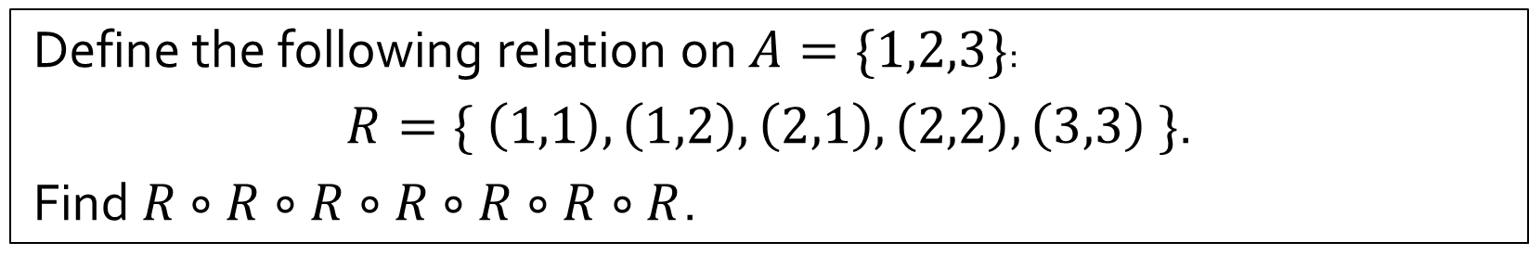
Q6
Define the following relation on $A=\{1,2,3\}$:
$R=\{ \left(1,1\right),\left(1,2\right),\left(2,1\right),\left(2,2\right),\left(3,3\right) \}$.
Find $R∘R∘R∘R∘R∘R∘R$.
1. Note that $R$ is an equivalence relation, hence $R∘R=R$ (from Q5d).
2. By associativity of composition of relations,
$R∘R∘R∘R∘R∘R∘R$
$=\left(\left(R∘R\right)∘\left(R∘R\right)\right)∘\left(\left(R∘R\right)∘R\right)$
$=\left(R∘R\right)∘\left(R∘R\right)$
$=$ $R∘R$
$=$ $R$
$$\left\{ \left(1,1\right), \left(1,2\right), \left(2,1\right), \left(2,2\right), \left(3,3\right)\right\}$$

Slide 20
5-min Break

Slide 21


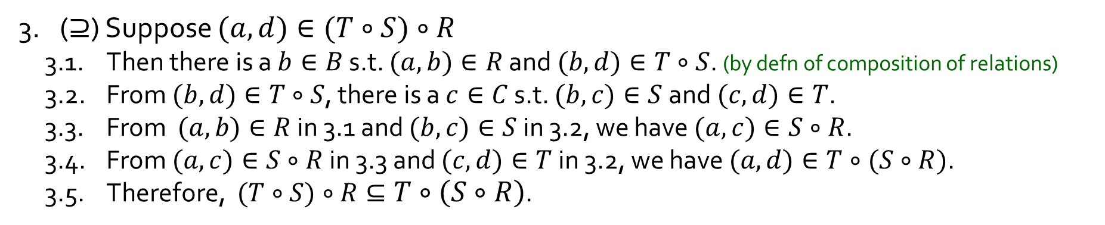
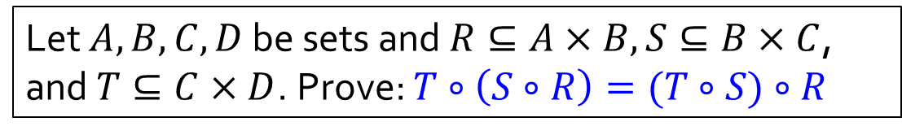






Q7
Let $A,B,C,D$ be sets and $R⊆A×B, S⊆B×C$, and $T⊆C×D$. Prove: $T∘\left(S∘R\right)=(T∘S)∘R$
$$A$$
$$B$$
$$C$$
$$D$$
$$R$$
$$S$$
$$T$$
1. Note that $S∘R⊆A×C$ and $T∘S⊆B×D$.
2. ($⊆$) Suppose $(a,d)∈T∘\left(S∘R\right)$
2.1. Then there is a $c∈C$ s.t. $(a,c)∈S∘R$ and $(c,d)∈T$. (by defn of composition of relations)
2.2. From $(a,c)∈S∘R$, there is a $b∈B$ s.t. $(a,b)∈R$ and $(b,c)∈S$.
2.3. From $(b,c)∈S$ in 2.2 and $(c,d)∈T$ in 2.1, we have $(b,d)∈T∘S$.
2.4. From $(a,b)∈R$ in 2.2 and $(b,d)∈T∘S$ in 2.3, we have $(a,d)∈(T∘S)∘R$.
2.5. Therefore, $T∘\left(S∘R\right)⊆(T∘S)∘R$.
3. ($⊇$) Suppose $(a,d)∈(T∘S)∘R$
3.1. Then there is a $b∈B$ s.t. $(a,b)∈R$ and $(b,d)∈T∘S$. (by defn of composition of relations)
3.2. From $(b,d)∈T∘S$, there is a $c∈C$ s.t. $(b,c)∈S$ and $(c,d)∈T$.
3.3. From $(a,b)∈R$ in 3.1 and $(b,c)∈S$ in 3.2, we have $(a,c)∈S∘R$.
3.4. From $(a,c)∈S∘R$ in 3.3 and $(c,d)∈T$ in 3.2, we have $(a,d)∈T∘(S∘R)$.
3.5. Therefore, $(T∘S)∘R⊆T∘\left(S∘R\right)$.
4. $∴ T∘\left(S∘R\right)=(T∘S)∘R$.
This means composition is associative!

Slide 22
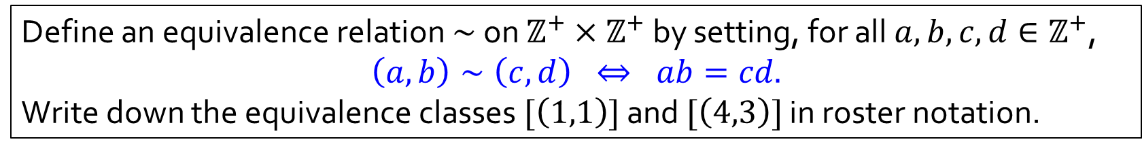

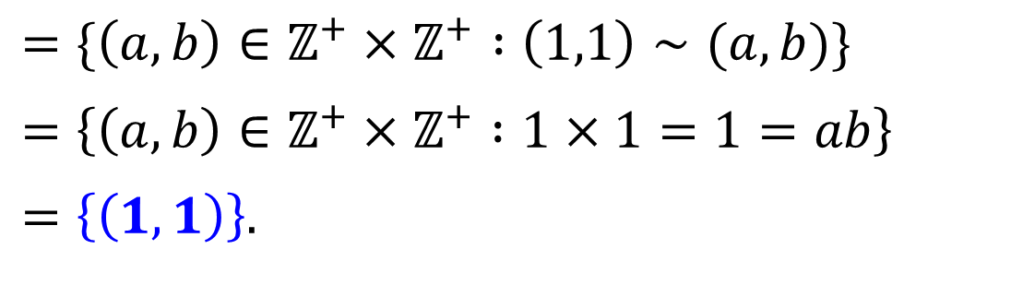

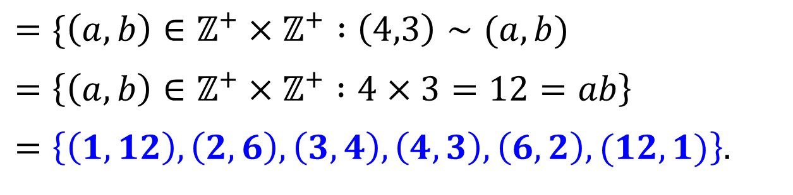
Q8
Define an equivalence relation $∼$ on $ℤ^{+}×ℤ^{+}$ by setting, for all $a,b,c,d∈ℤ^{+}$,
$$\left(a,b\right)∼\left(c,d\right) ⇔ ab=cd.$$
Write down the equivalence classes $[\left(1,1\right)]$ and $[\left(4,3\right)]$ in roster notation.
Definition. Let $∼$ be an equivalence relation on a set $A$, and $x∈A$. Then $\left[x\right]=\{y∈A :x∼y\}$.
$$\left[\left(1,1\right)\right]$$
$$=\{\left(a,b\right)∈ℤ^{+}×ℤ^{+} :\left(1,1\right)∼(a,b)\}$$
$$=\left\{\left(a,b\right)∈ℤ^{+}×ℤ^{+} :1×1=1=ab\right\}$$
$$=\left\{\left(1,1\right)\right\}.$$
$$\left[\left(4,3\right)\right]$$
$$=\{\left(a,b\right)∈ℤ^{+}×ℤ^{+} :\left(4,3\right)∼(a,b)$$
$$=\left\{\left(a,b\right)∈ℤ^{+}×ℤ^{+} :4×3=12=ab\right\}$$
$$=\left\{\left(1,12\right),\left(2,6\right),\left(3,4\right),\left(4,3\right),\left(6,2\right),(12,1)\right\}.$$

Slide 23
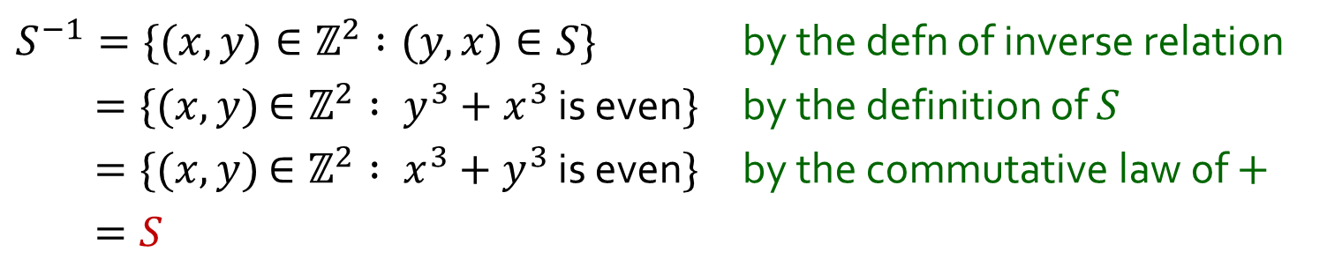
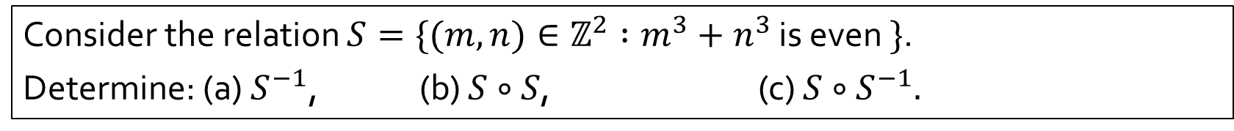
Q9
Consider the relation $S=\{(m,n)∈ℤ^{2} :m^{3}+n^{3}$ is even $\}$.
Determine: (a) $S^{−1}$, (b) $S∘S$, (c) $S∘S^{−1}.$
(a)
$S^{−1}=\{(x,y)∈ℤ^{2} :(y,x)∈S\}$ by the defn of inverse relation
$=\{(x,y)$ $∈ℤ^{2} : y^{3}+x^{3}$ is even$\}$ by the definition of $S$
$=\{(x,y)$ $∈ℤ^{2} : x^{3}+y^{3}$ is even$\}$ by the commutative law of $+$
$=S$

Slide 24
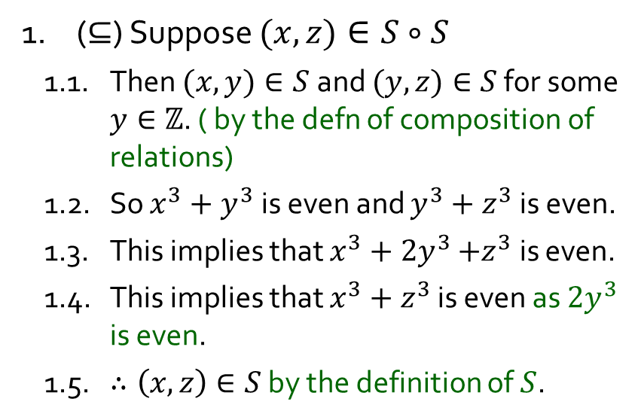

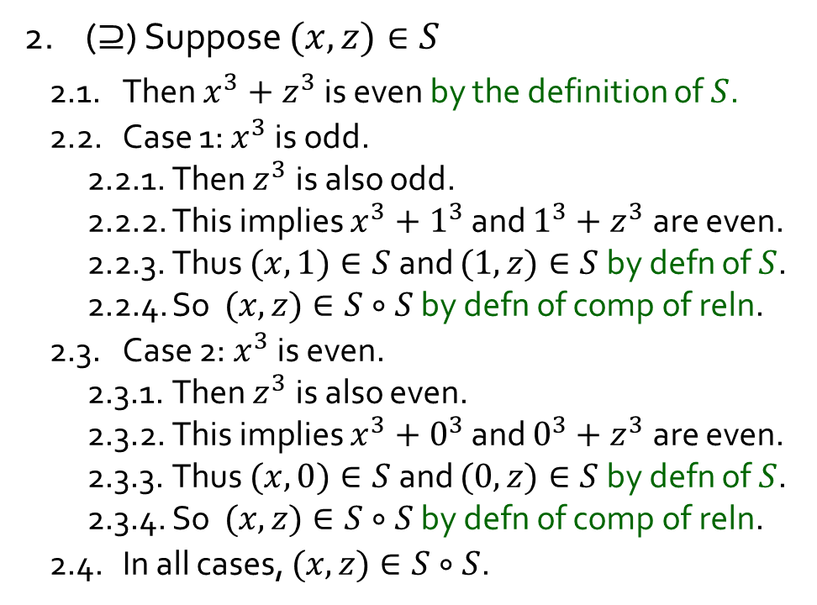

Q9
Consider the relation $S=\{(m,n)∈ℤ^{2} :m^{3}+n^{3}$ is even $\}$.
Determine: (a) $S^{−1}$, (b) $S∘S$, (c) $S∘S^{−1}.$
(b)
$$S∘S=S$$
2. ($⊇$) Suppose $(x,z)∈S$
2.1. Then $x^{3}+z^{3}$ is even by the definition of $S$.
2.2. Case 1: $x^{3}$ is odd.
2.2.1. Then $z^{3}$ is also odd.
2.2.2. This implies $x^{3}+1^{3}$ and $1^{3}+z^{3}$ are even.
2.2.3. Thus $(x,1)∈S$ and $(1,z)∈S$ by defn of $S$.
2.2.4. So $(x,z)∈S∘S$ by defn of comp of reln.
2.3. Case 2: $x^{3}$ is even.
2.3.1. Then $z^{3}$ is also even.
2.3.2. This implies $x^{3}+0^{3}$ and $0^{3}+z^{3}$ are even.
2.3.3. Thus $(x,0)∈S$ and $(0,z)∈S$ by defn of $S$.
2.3.4. So $(x,z)∈S∘S$ by defn of comp of reln.
2.4. In all cases, $(x,z)∈S∘S$.
1. ($⊆$) Suppose $(x,z)∈S∘S$
1.1. Then $(x,y)∈S$ and $(y,z)∈S$ for some $y∈ℤ$. ( by the defn of composition of relations)
1.2. So $x^{3}+y^{3}$ is even and $y^{3}+z^{3}$ is even.
1.3. This implies that $x^{3}+{2y}^{3}$ $+z^{3}$ is even.
1.4. This implies that $x^{3}+z^{3}$ is even as ${2y}^{3}$ is even.
1.5. $∴\left(x,z\right)∈S$ by the definition of $S$.
Proof is missing justifications here. Don’t forget to include them in your own!
3. Therefore $S∘S=S.$

Slide 25
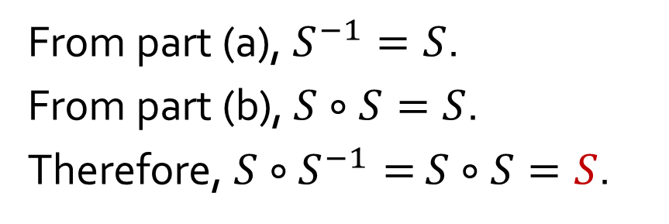
Q9
Consider the relation $S=\{(m,n)∈ℤ^{2} :m^{3}+n^{3}$ is even $\}$.
Determine: (a) $S^{−1}$, (b) $S∘S$, (c) $S∘S^{−1}.$
(c)
From part (a), $S^{−1}=S$.
From part (b), $S∘S=S$.
Therefore, $S∘S^{−1}=$ $S∘S=S$.

Slide 26




Q10
Define a relation $∼$ on $ℤ \backslash \{0\}$ as follows, for all $a,b∈ℤ \backslash \{0\}$,
$$a∼b ⇔ ab>0.$$
(a) Prove that $\sim$ is an equivalence relation.
1. (“Reflexivity”)
1.1. Let $a∈ℤ \backslash \left\{0\right\}$, since $a≠0$, we have $a^{2}>0$ by T21.
1.2. Thus $a\sim a$ by the definition of $\sim$.
1.3. Hence $\sim$ is reflexive.
T21. If $a≠0$, then $a^{2}>0$.
2. (“Symmetry”)
2.1. For any $a,b∈ℤ \backslash \left\{0\right\}$, if $a\sim b$, then $ab>0$ by the definition of $\sim$.
2.2. Then $ba>0$ by the commutative law of multiplication.
2.3. So $b\sim a$ by the definition of $\sim$.
2.4. Hence ~ is symmetric.

Slide 27


Q10
Define a relation $∼$ on $ℤ \backslash \{0\}$ as follows, for all $a,b∈ℤ \backslash \{0\}$,
$$a∼b ⇔ ab>0.$$
(a) Prove that $\sim$ is an equivalence relation.
1. (“Reflexivity”)
2. (“Symmetry”)
T21. If $a≠0$, then $a^{2}>0$.
3. (“Transitivity”)
3.1. For any $a,b,c∈ℤ \backslash \left\{0\right\}$, suppose $a\sim b$ and $b\sim c.$
3.2. Then $ab>0$ and $bc>0$ by the definition of $\sim$.
3.3. Multiplying $ab$ with $bc$ (both positive) gives $ab^{2}c>0$ by Ord1.
3.4. Then $\left(ac\right)b^{2}>0$ by the associative and commutative laws of multiplication.
3.5. Then both $(ac)$and $b^{2}$ are positive, or both are negative, by T25.
3.6. Since $b^{2}>0$ (by T21, as $b≠0$), $(ac)$must also be positive.
3.7. Thus $a\sim c$by the definition of $\sim$.
3.8. Hence $\sim$ is transitive.
Ord1. If $a$and $b$ are positive, so are $a+b$ and $ab$.
T25. If $ab>0$, then both $a$and $b$ are positive, or both are negative.
4. Therefore, ~ is an equivalence relation.

Slide 28



Q10
Define a relation $∼$ on $ℤ \backslash \{0\}$ as follows, for all $a,b∈ℤ \backslash \{0\}$,
$$a∼b ⇔ ab>0.$$
(b) Determine all the distinct equivalence classes formed by this relation $\sim$.
T25. If $ab>0$, then both $a$and $b$ are positive, or both are negative.
Thus, all positive integers are $\sim$-related to one another, and likewise, all negative integers are $\sim$-related to one another.
Equivalence classes: $\{a∈ℤ \backslash \left\{0\right\}:a>0\}$ and $\left\{a∈ℤ \backslash \left\{0\right\}:a<0\right\}.$
Or, $[1]$ and $[−1].$

Slide 29
END OF FILE

