Slide 1
Cs1231S tutorial #5
Relations & Partial orders
Adapted from Prof Aaron’s slides

Slide 2
Learning objectives of this tutorial
Partial orders
Determining whether a relation is antisymmetric
Determining whether a relation is asymmetric
Reasoning about partial orders
Drawing Hasse diagrams of partial orders
Knowing about comparability and compatibility of elements in a partial order
Distinguishing minimal/maximal elements from smallest/largest elements
Understanding linearizations

Slide 3
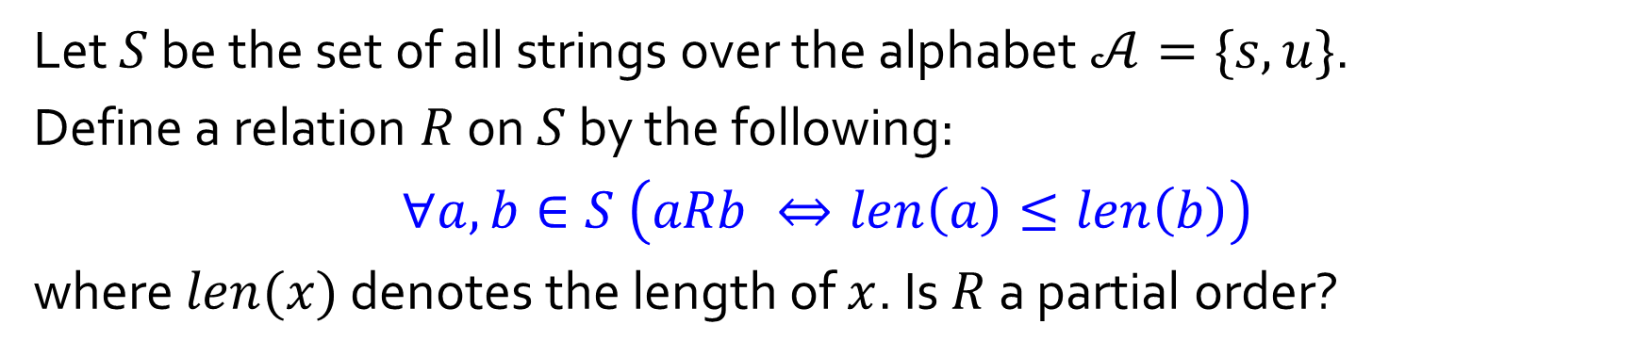
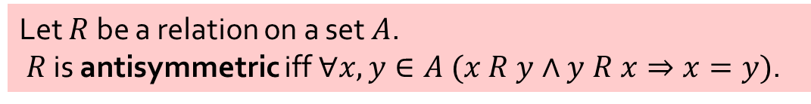
Q1.
Let $S$ be the set of all strings over the alphabet $𝒜=\{s,u\}$.
Define a relation $R$ on $S$ by the following:
$$∀a,b∈S \left(aRb ⇔len\left(a\right)≤len\left(b\right)\right)$$
where $len(x)$ denotes the length of $x$. Is $R$ a partial order?
No, it is not a partial order. Why?
It is not antisymmetric.
Counterexample?
Let $R$ be a relation on a set $A$.
$R$ is antisymmetric iff$∀x,y∈A (x R y∧y R x⇒x=y)$.
Notes:
Should be short question. Not partial order, not antisymmetric.
Counterexample: “su” R “us” and “us” R “su but “us” != “su”

Slide 4


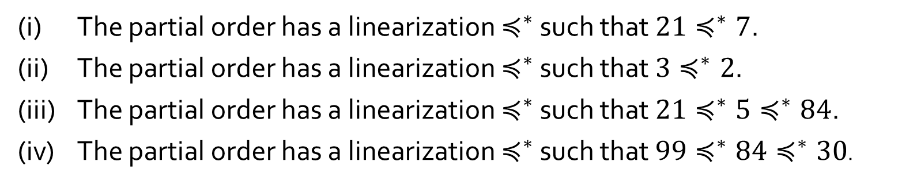
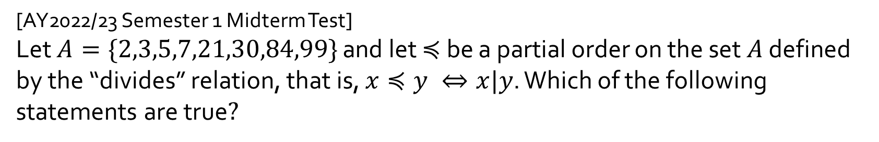
Q2.
[AY2022/23 Semester 1 Midterm Test]
Let $A=\{2,3,5,7,21,30,84,99\}$ and let $≼$ be a partial order on the set $A$ defined by the “divides” relation, that is, $x≼y ⇔x|y$. Which of the following statements are true$?$
(i) The partial order has a linearization $≼^{∗}$ such that $21≼^{∗}7$.
(ii) The partial order has a linearization $≼^{∗}$ such that $3≼^{∗}2$.
(iii) The partial order has a linearization $≼^{∗}$ such that $21≼^{∗}{5≼}^{∗}84$.
(iv) The partial order has a linearization $≼^{∗}$ such that $99≼^{∗}84≼^{∗}30$.
Noncomparable elements:
2 and 3
5 and 21
30, 84 and 99
Notes:
Short question.
21 !R 7
2 99
3 30
5 21 84
7

Slide 5
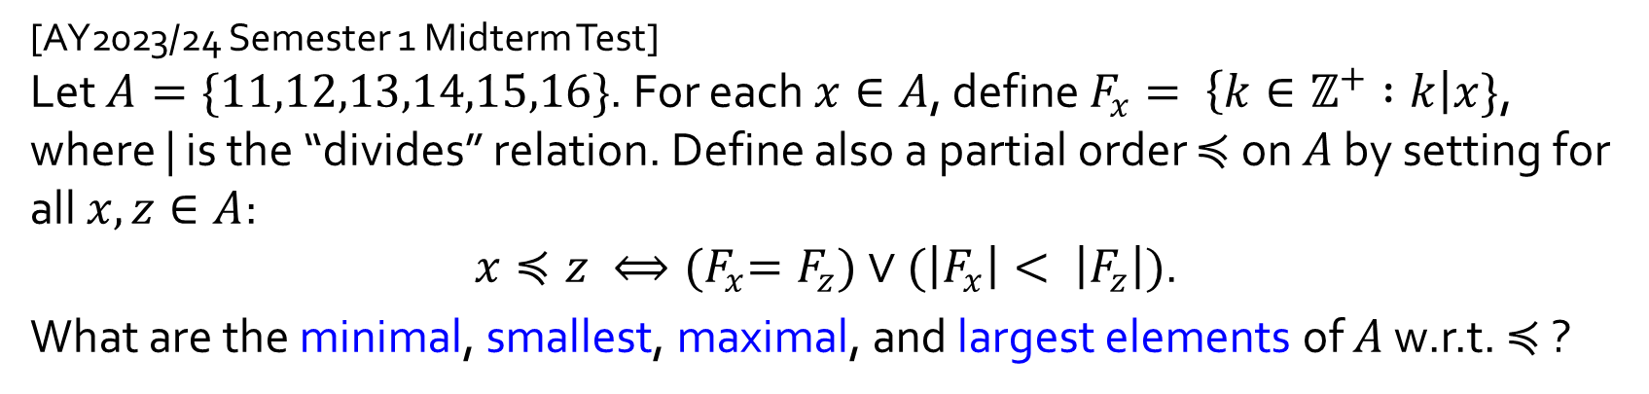



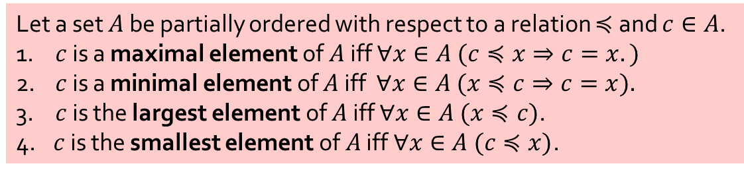
Q3.
[AY2023/24 Semester 1 Midterm Test]
Let $A=\{11,12,13,14,15,16\}$. For each $x∈A$, define $F_{x}= \left\{k∈ℤ^{+} :k\right|x\}$, where | is the “divides” relation. Define also a partial order $≼$ on $A$ by setting for all $x, z∈A$:
$x≼z ⟺{(F}_{x}=F_{z})∨(\left|F_{x}\right|< \left|F_{z}\right|)$.
What are the minimal, smallest, maximal, and largest elements of $A$ w.r.t. $≼$ ?
Minimal:
Smallest:
Maximal:
Largest:
$$11,13$$
12
None
$$12$$
16
$$12$$
14
15
Let a set $A$ be partially ordered with respect to a relation $≼$ and $c∈A$.
1. $c$ is a maximal element of $A$ iff $∀x∈A (c≼x⇒c=x.)$
2. $c$ is a minimal element of $A$ iff $∀x∈A (x≼c⇒c=x).$
3. $c$ is the largest element of $A$ iff $∀x∈A (x≼c)$.
4. $c$ is the smallest element of $A$ iff $∀x∈A (c≼x)$.
11
13
Notes:
xRz iff either x = z, or the no. of x’s divisors < the no. of z’s divisors.
Minimal: thing with least divisors: 11, 13
Smallest: none, since nothing is above one element
Maximal: 12, with most divisors
Largest: 12, since everything is below 12
Test: why do we have to have the first part of the partial order?

Slide 6

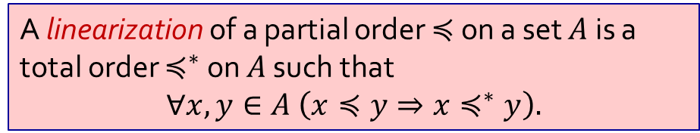
Q4.
Given the partial order $≼$ on $A$ in question 3 above, one of the linearizations $≼^{∗}$ of $≼$ is shown below:
$$11≼^{∗}13≼^{∗}14≼^{∗}15≼^{∗}16≼^{∗}12$$
Write out all the other possible linearizations $≼^{∗}$.
$$11≼^{∗}13≼^{∗}15≼^{∗}14≼^{∗}16≼^{∗}12$$
$$13≼^{∗}11≼^{∗}14≼^{∗}15≼^{∗}16≼^{∗}12$$
12
$$13≼^{∗}11≼^{∗}15≼^{∗}14≼^{∗}16≼^{∗}12$$
16
A linearization of a partial order $≼$ on a set $A$ is a total order $≼^{∗}$ on $A$ such that
$$∀x,y∈A \left(x≼y⇒x≼^{∗}y\right).$$
14
15
Kahn’s Algorithm. Pick out a minimal element and place it at the bottom of the total order. Repeat until nothing is left.
11
13
Notes:
11, 13 at same position
14, 15 at same position with 4 divisors
16 with 16 divisors
12: 6 divisors
Therefore, we only have 4 total linearizations

Slide 7
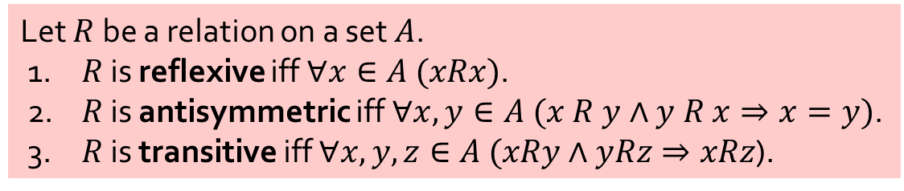

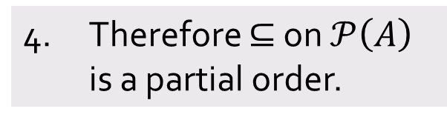
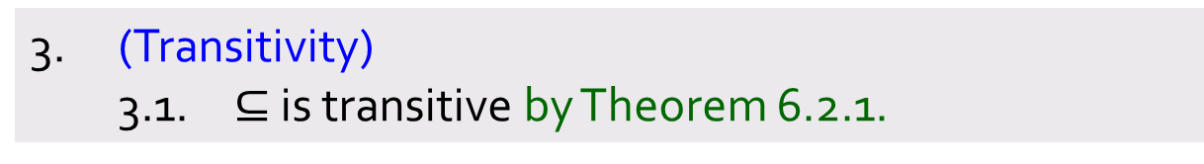
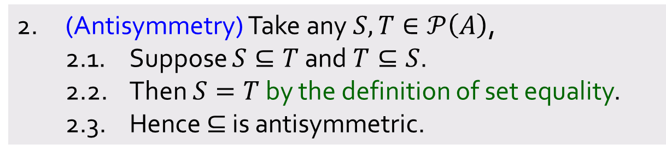
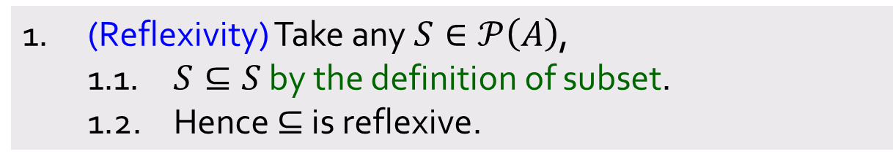
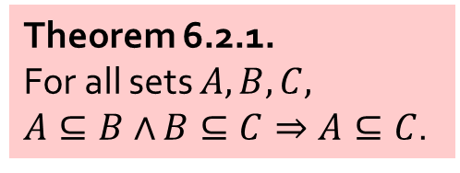
Q5.
Let $A$ be a set and $𝒫(A)$ the power set of $A$.
Prove that the binary relation $⊆$ on$𝒫(A)$ is a partial order.
1. (Reflexivity) Take any $S∈𝒫\left(A\right)$,
1.1. $S⊆S$ by the definition of subset.
1.2. Hence $⊆$ is reflexive.
2. (Antisymmetry) Take any $S,T∈𝒫\left(A\right)$,
2.1. Suppose $S⊆T$ and $T⊆S$.
2.2. Then $S=T$ by the definition of set equality.
2.3. Hence $⊆$ is antisymmetric.
Theorem 6.2.1.
For all sets $A,B,C,$
$A⊆B∧$ $B⊆C⇒A⊆C$.
3. (Transitivity)
3.1. $⊆$ is transitive by Theorem 6.2.1.
4. Therefore $⊆$ on $𝒫\left(A\right)$ is a partial order.
Let $R$ be a relation on a set $A$.
1. $R$ is reflexive iff $∀x∈A (xRx)$.
2. $R$ is antisymmetric iff$∀x,y∈A (x R y∧y R x⇒x=y)$.
3. $R$ is transitive iff $∀x,y,z∈A (xRy∧yRz⇒xRz$).
Notes:
POSET: prove all parts
Reflexivity: S subset of S by defn
Antisymmetry: S subset of T and T subset of S -> S = T by defn of set equality
Transitiviy: Theorem 6.2.1

Slide 8
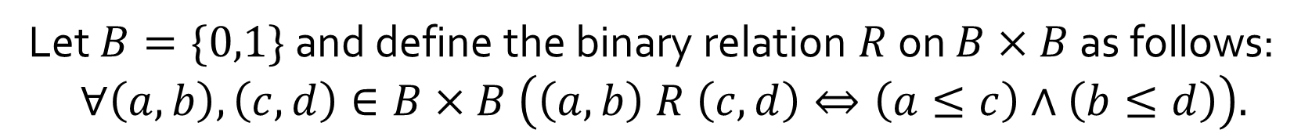
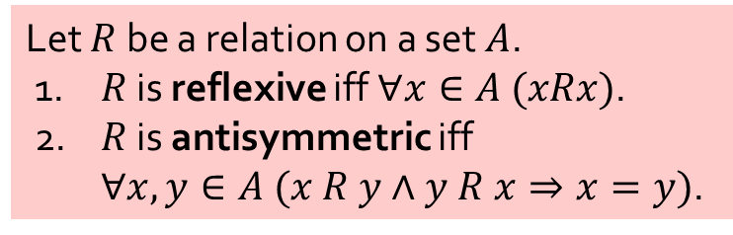
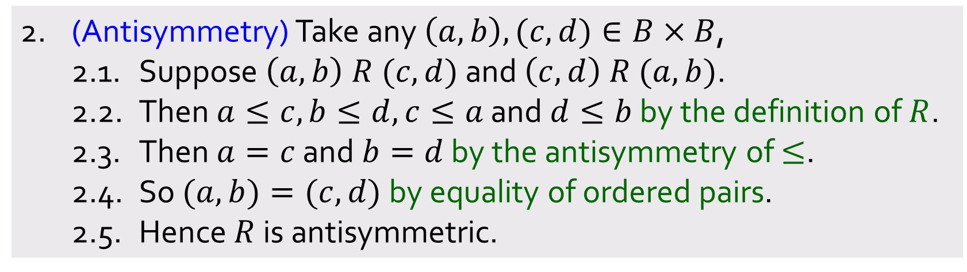
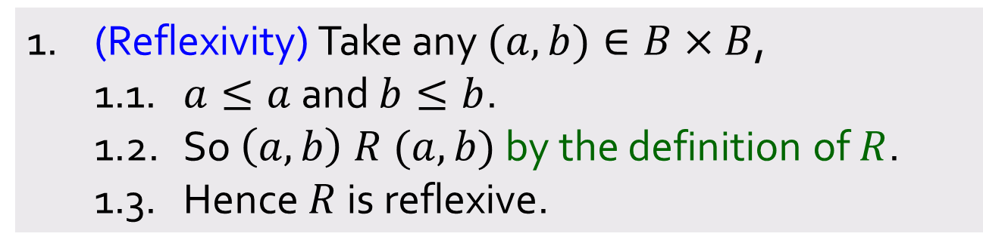
Q6.
Let $B=\{0,1\}$ and define the binary relation $R$ on $B×B$ as follows:
$$∀\left(a,b\right),\left(c,d\right)∈B×B \left(\left(a,b\right) R \left(c,d\right)⇔\left(a≤c\right)∧\left(b≤d\right)\right).$$
(a) Prove that $R$ is a partial order.
Let $R$ be a relation on a set $A$.
1. $R$ is reflexive iff $∀x∈A (xRx)$.
2. $R$ is antisymmetric iff
$∀x,y∈A (x R y∧y R x⇒x=y)$.
1. (Reflexivity) Take any $(a,b)∈B×B$,
1.1. $a≤a$ and $b≤b$.
1.2. So $\left(a,b\right) R (a,b)$ by the definition of $R$.
1.3. Hence $R$ is reflexive.
Aim:
2. (Antisymmetry) Take any $\left(a,b\right),(c,d)∈B×B$,
2.1. Suppose $\left(a,b\right) R (c,d)$ and $\left(c,d\right) R (a,b)$.
2.2. Then $a≤c,b≤d,c≤a$ and $d≤b$ by the definition of $R$.
2.3. Then $a=c$ and $b=d$ by the antisymmetry of $≤$.
2.4. So $(a,b)=(c,d)$by equality of ordered pairs.
2.5. Hence $R$ is antisymmetric.
Aim:
Notes:
Reflexivity quite trivial
Antisymmetry: quite trivial, means that a = c and b = d BY ANTISYMMETRY OF <=.
Therefore (a,b) = (c,d) by EQUALITY OF ORDERED PAIRS

Slide 9
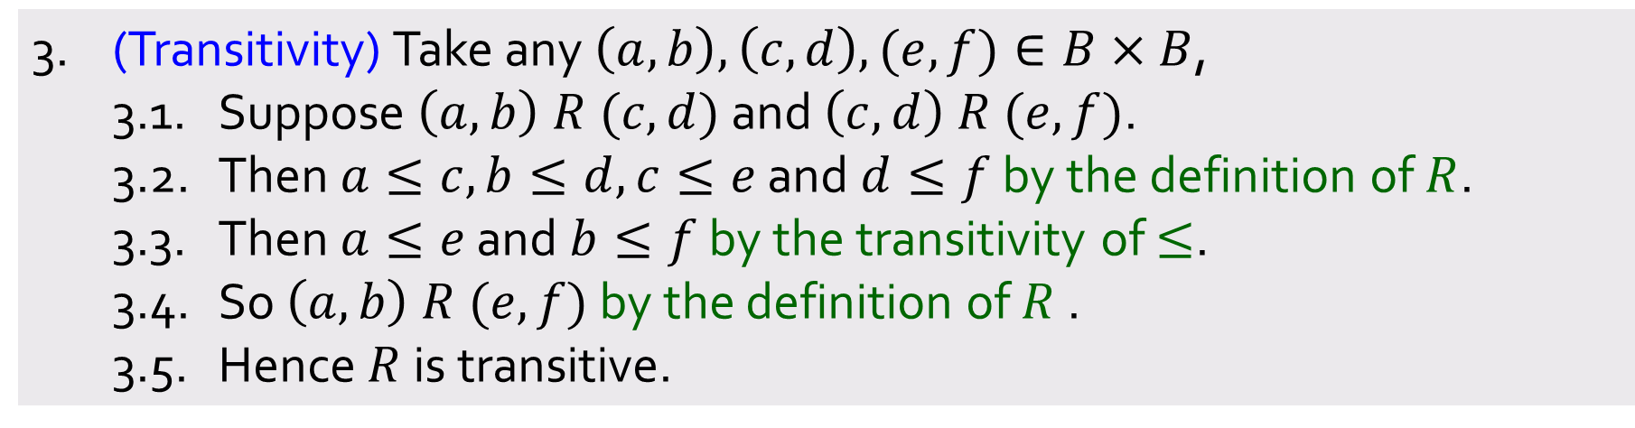
Q6.
Let $B=\{0,1\}$ and define the binary relation $R$ on $B×B$ as follows:
$$∀\left(a,b\right),\left(c,d\right)∈B×B \left(\left(a,b\right) R \left(c,d\right)⇔\left(a≤c\right)∧\left(b≤d\right)\right).$$
(a) Prove that $R$ is a partial order.
3. (Transitivity) Take any $\left(a,b\right),\left(c,d\right),(e,f)∈B×B$,
3.1. Suppose $\left(a,b\right) R (c,d)$ and $\left(c,d\right) R (e,f)$.
3.2. Then $a≤c,b≤d,c≤e$ and $d≤f$ by the definition of $R$.
3.3. Then $a≤e$ and $b≤f$ by the transitivity of $≤$.
3.4. So $\left(a,b\right) R (e,f)$ by the definition of $R$ .
3.5. Hence $R$ is transitive.
Aim:
4. Therefore $R$ on $B×B$ is a partial order.
Let $R$ be a relation on a set $A$.
1. $R$ is reflexive iff $∀x∈A (xRx)$.
2. $R$ is antisymmetric iff$∀x,y∈A (x R y∧y R x⇒x=y)$.
3. $R$ is transitive iff $∀x,y,z∈A (xRy∧yRz⇒xRz$).
Notes:
- Transitivity: again, just use transitivity of <=

Slide 10



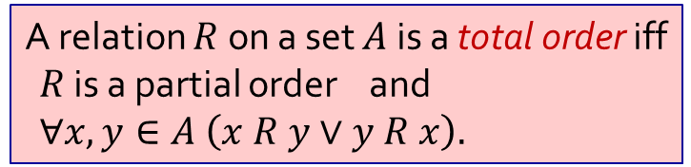

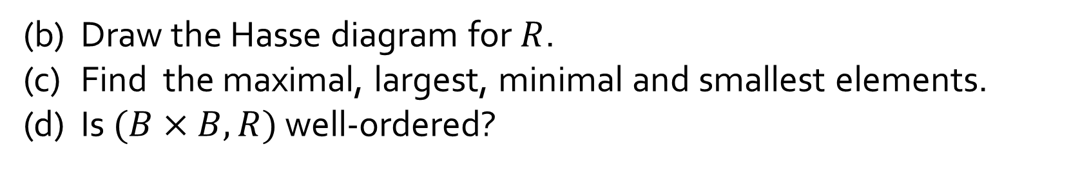
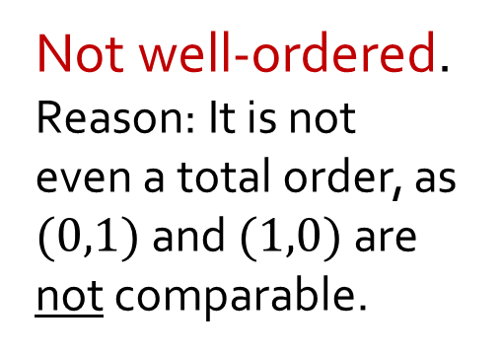
Q6.
Let $B=\{0,1\}$ and define the binary relation $R$ on $B×B$ as follows:
$$∀\left(a,b\right),\left(c,d\right)∈B×B \left(\left(a,b\right) R \left(c,d\right)⇔\left(a≤c\right)∧\left(b≤d\right)\right).$$
(b) Draw the Hasse diagram for $R$.
(c) Find the maximal, largest, minimal and smallest elements.
(d) Is $(B×B,R)$ well-ordered?
Maximal:
Largest:
Minimal:
Smallest:
$$(1,1)$$
(1,1)
Not well-ordered.
Reason: It is not even a total order, as $(0,1)$and $(1,0)$are not comparable.
$$(1,1)$$
(1,0)
(0,1)
$$(0,0)$$
$$(0,0)$$
(0,0)
Let a set $A$ be partially ordered with respect to a relation $≼$ and $c∈A$.
1. $c$ is a maximal element of $A$ iff $∀x∈A (c≼x⇒c=x.)$
2. $c$ is a minimal element of $A$ iff $∀x∈A (x≼c⇒c=x).$
3. $c$ is the largest element of $A$ iff $∀x∈A (x≼c)$.
4. $c$ is the smallest element of $A$ iff $∀x∈A (c≼x)$.
A relation $R$ on a set $A$ is a total order iff
$R$ is a partial order and
$∀x,y∈A \left(x R y∨y R x\right).$
Notes:
Hasse Diagram: just repr of partial order, with simplified arrows reperesentating relations.
Maximal: (1,1)
Largest: (1,1)
Minimal: (0,0)
Smallest: (0,0)
Well-ordered defn: total order &
Total order: everything is the set A is comparable to one another

Slide 11
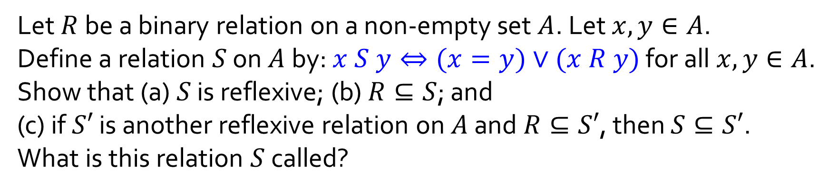
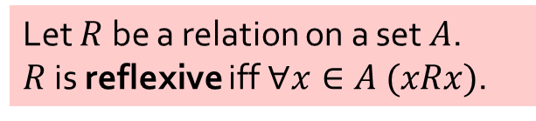
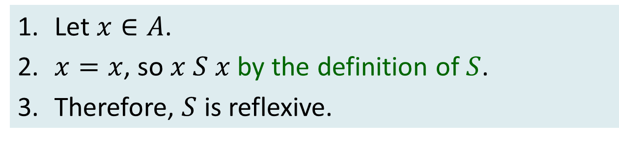
Q7.
Let $R$ be a binary relation on a non-empty set $A$. Let $x,y∈A$.
Define a relation $S$ on $A$ by: $x S y⇔(x=y)∨(x R y)$ for all $x,y∈A$.
Show that (a) $S$ is reflexive; (b) $R⊆S$; and
(c) if $S′$ is another reflexive relation on $A$ and $R⊆S′$, then $S⊆S′$.
What is this relation $S$ called?
(a)
1. Let $x∈A$.
2. $x=x$, so $x S x$ by the definition of $S$.
3. Therefore, $S$ is reflexive.
Let $R$ be a relation on a set $A$.
$R$ is reflexive iff $∀x∈A (xRx)$.
Notes:
a) By definition of S, ez

Slide 12
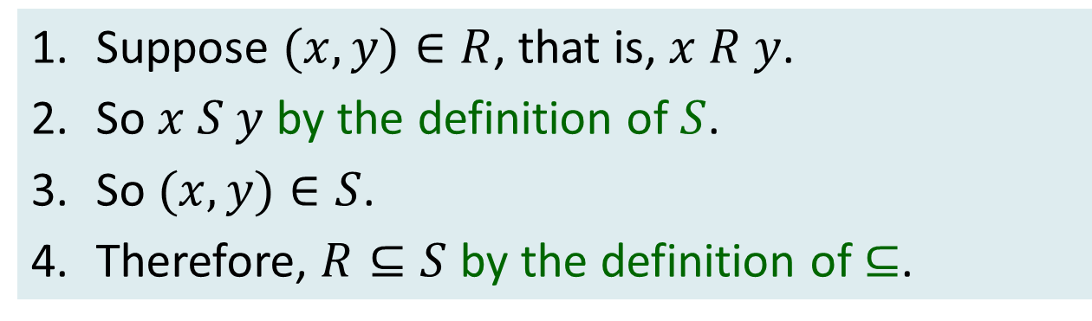

Q7.
Let $R$ be a binary relation on a non-empty set $A$. Let $x,y∈A$.
Define a relation $S$ on $A$ by: $x S y⇔(x=y)∨(x R y)$ for all $x,y∈A$.
Show that (a) $S$ is reflexive; (b) $R⊆S$; and
(c) if $S′$ is another reflexive relation on $A$ and $R⊆S′$, then $S⊆S′$.
What is this relation $S$ called?
(b)
1. Suppose $(x,y)∈R$, that is, $x R y$.
2. So $x S y$ by the definition of $S$.
3. So $(x,y)∈S$.
4. Therefore, $R⊆S$ by the definition of$⊆$.
Aim: To arrive at $(x,y)∈S$.
Notes:
Just by defn of S

Slide 13
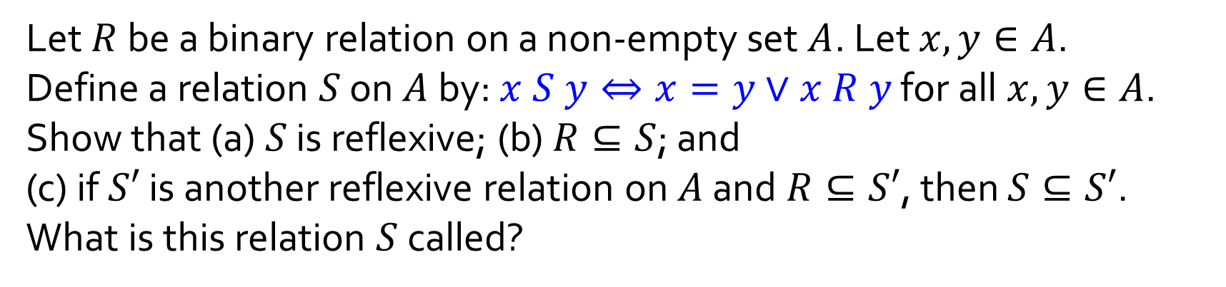
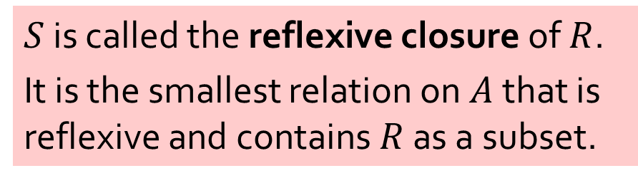
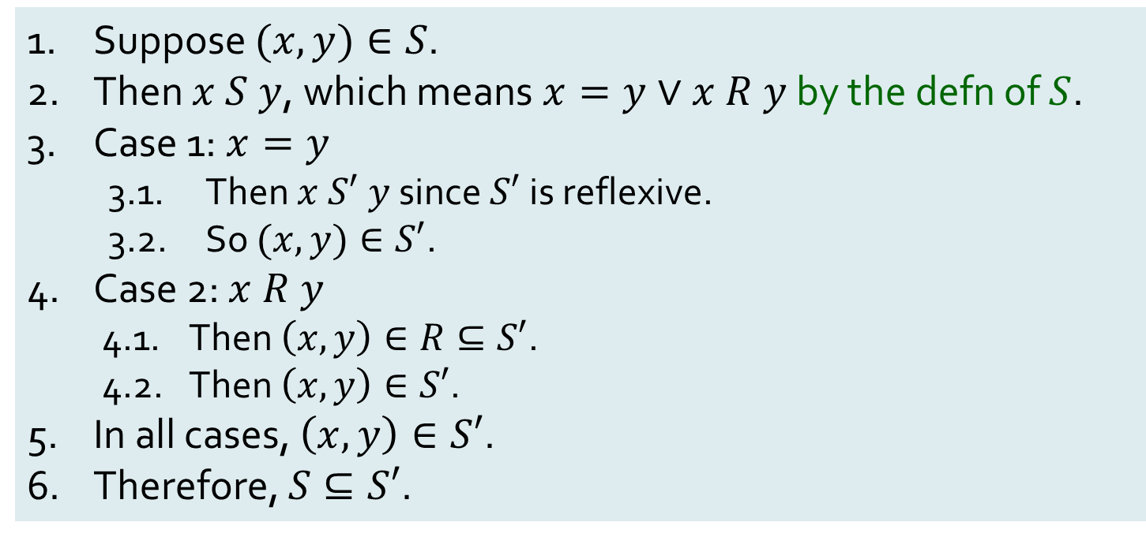
Q7.
Let $R$ be a binary relation on a non-empty set $A$. Let $x,y∈A$.
Define a relation $S$ on $A$ by: $x S y⇔x=y∨x R y$ for all $x,y∈A$.
Show that (a) $S$ is reflexive; (b) $R⊆S$; and
(c) if $S′$ is another reflexive relation on $A$ and $R⊆S′$, then $S⊆S′$.
What is this relation $S$ called?
(c)
Suppose $(x,y)∈S$.
Then $x S y$, which means $x=y∨x R y$ by the defn of $S$.
Case 1: $x=y$
3.1. Then $x S′ y$since $S′$ is reflexive.
3.2. So $(x,y)∈S′$.
Case 2: $x R y$
4.1. Then $\left(x,y\right)∈R⊆S′$.
4.2. Then $\left(x,y\right)∈S′$.
In all cases, $\left(x,y\right)∈S′$.
Therefore, $S⊆S′$.
$S$ is called the reflexive closure of $R$.
It is the smallest relation on $A$ that is reflexive and contains $R$ as a subset.
Aim:
Notes:
(x,y) element of S
Either x = y or xRy
xRx by reflexivity of S’
Or xRy, means (x,y) element of R
By subset, (x,y) element of S’

Slide 14


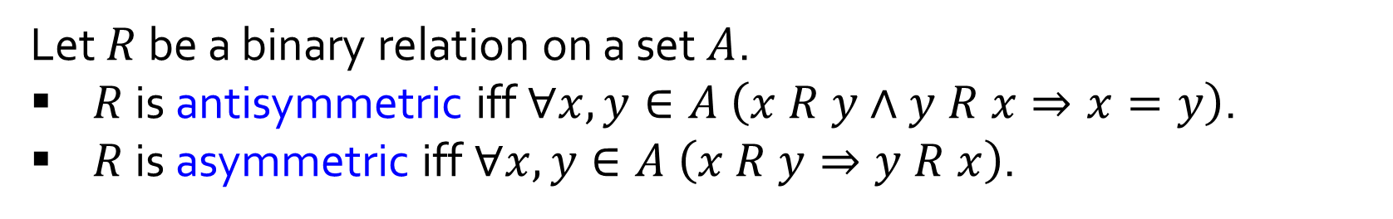









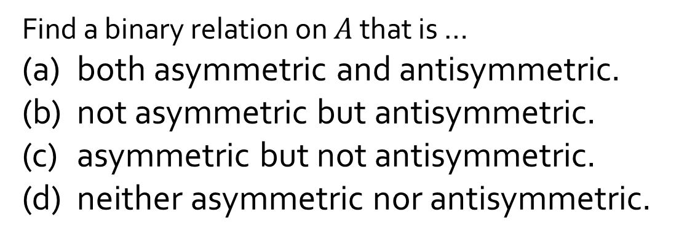


Q8.
Let $R$ be a binary relation on a set $A$.
$R$ is antisymmetric iff $∀x,y∈A \left(x R y∧y R x⇒x=y\right)$.
$R$ is asymmetric iff $∀x,y∈A \left(x R y⇒y R x\right)$.
Find a binary relation on $A$ that is …
(a) both asymmetric and antisymmetric.
(b) not asymmetric but antisymmetric.
(c) asymmetric but not antisymmetric.
(d) neither asymmetric nor antisymmetric.
Let $A=\{a,b,c\}.$
(a)
(b)
(c)
(d)
$$R=\left\{\left(a,b\right),\left(a,c\right)\right\}.$$
$$R=\left\{\left(a,a\right),\left(b,c\right)\right\}.$$
$$R=\left\{\left(a,b\right),\left(b,a\right),\left(a,c\right)\right\}.$$
$$a$$
$$a$$
?
$$a$$
$$b$$
$$b$$
$$b$$
$$c$$
$$c$$
$$c$$
Notes:
Asymmetry -> Antisymmetry.
But for asymmetry, it cannot be ‘reflexive’.
Just use a ‘typical’ case of antisymmetry
Case of antisymmetry with reflexive case
Does not exist!
A typical symmetric case

Slide 15
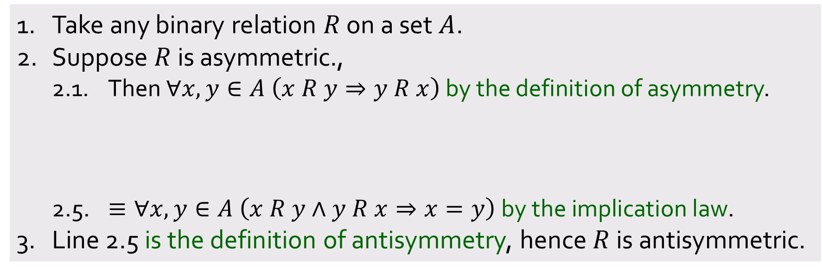
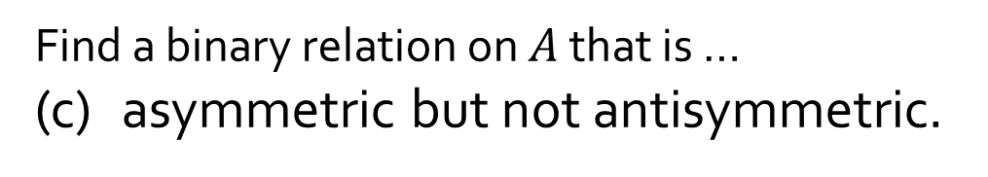
Q8.
Let $R$ be a binary relation on a set $A$.
$R$ is antisymmetric iff $∀x,y∈A \left(x R y∧y R x⇒x=y\right)$.
$R$ is asymmetric iff $∀x,y∈A \left(x R y⇒y R x\right)$.
Find a binary relation on $A$ that is …
(c) asymmetric but not antisymmetric.
To prove:
Every asymmetric relation is antisymmetric.
1. Take any binary relation $R$ on a set $A$.
2. Suppose $R$ is asymmetric.,
2.1. Then $∀x,y∈A \left(x R y⇒y R x\right)$ by the definition of asymmetry.
2.5. $≡∀x,y∈A \left(x R y∧y R x⇒x=y\right) \text{by} \text{the} \text{implication} \text{law}\text{.}$
3. Line 2.5 is the definition of antisymmetry, hence $R$ is antisymmetric.
2.2. $≡∀x,y∈A \left(x R y∨y R x\right) \text{by} \text{the} \text{implication} \text{law}\text{.}$
2.3. $⇒∀x,y∈A \left(\left(x R y∨y R x\right)∨x=y\right) \text{by} \text{generalization}\text{.}$
2.4. $≡∀x,y∈A \left(\sim \left(x R y∧y R x\right)∨x=y\right) \text{by} \text{the} \text{De} \text{Morgan}\text{′}\text{s} \text{law}\text{.}$
Aim:
Notes:
Just show this very quickly
Use of implication -> genen -> de Morgan’s - >implication
Asymmetry ⬄ Antisymmetry and (NOT reflexive)

Slide 16

Q8.
Let $R$ be a binary relation on a set $A$.
$R$ is antisymmetric iff $∀x,y∈A \left(x R y∧y R x⇒x=y\right)$.
$R$ is asymmetric iff $∀x,y∈A \left(x R y⇒y R x\right)$.
Does this mean that asymmetry ⬄ antisymmetry and not reflexive?
No!
Take into consideration A = {1, 2} and R = {(1,2), (2,2)}.
R is not reflexive.
R is antisymmetric.
But R is NOT asymmetric.
So, is there an equivalent statement? Look out for the term irreflexive.
Notes:
Just show this very quickly
Use of implication -> genen -> de Morgan’s - >implication
Asymmetry ⬄ Antisymmetry and (NOT reflexive)

Slide 17

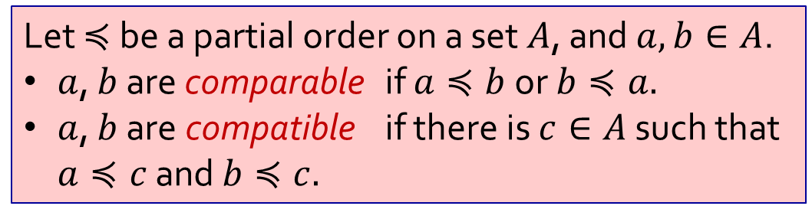
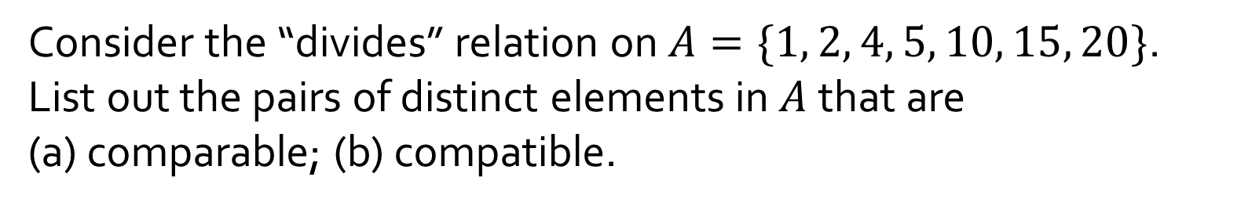

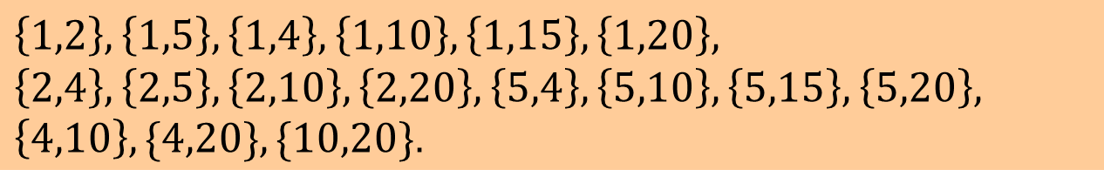

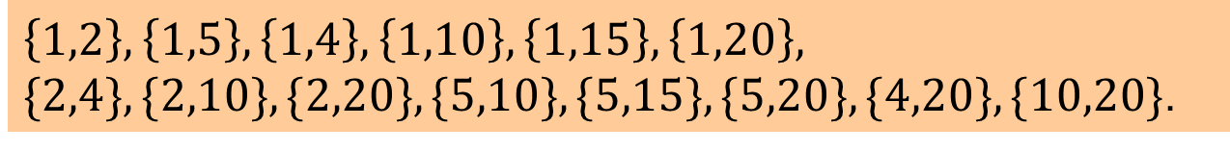




Q9.
Consider the “divides” relation on $A=\{1, 2, 4, 5, 10, 15, 20\}$. List out the pairs of distinct elements in $A$ that are
(a) comparable; (b) compatible.
$$20$$
Let $≼$ be a partial order on a set $A$, and $a, b∈A$.
$a$, $b$ are comparable if $a≼b$ or $b≼a.$
$a$, $b$ are compatible if there is $c∈A$ such that $a≼c$ and $b≼c.$
$$4$$
$$10$$
$$15$$
$$2$$
$$5$$
$$1$$
(a) Comparable:
$$\left\{1,2\right\}, \left\{1,5\right\},\left\{1,4\right\},\left\{1,10\right\},\left\{1,15\right\},\left\{1,20\right\},$$
$\{2,4\},\{2,10\},\{2,20\},\{5,10\},\{5,15\},\{5,20\},\{4,20\},\{10,20\}$.
(b) Compatible:
$$\left\{1,2\right\}, \left\{1,5\right\},\left\{1,4\right\},\left\{1,10\right\},\left\{1,15\right\},\left\{1,20\right\},$$
$$\left\{2,4\right\},\left\{2,5\right\},\left\{2,10\right\},\left\{2,20\right\},\left\{5,4\right\},\left\{5,10\right\},\left\{5,15\right\},\left\{5,20\right\},$$
$\left\{4,10\right\},\{4,20\},\{10,20\}$.
Notes:
Just manual, quickly show.
-> New addition can be on the same level, but also can be on separate levels.

Slide 18
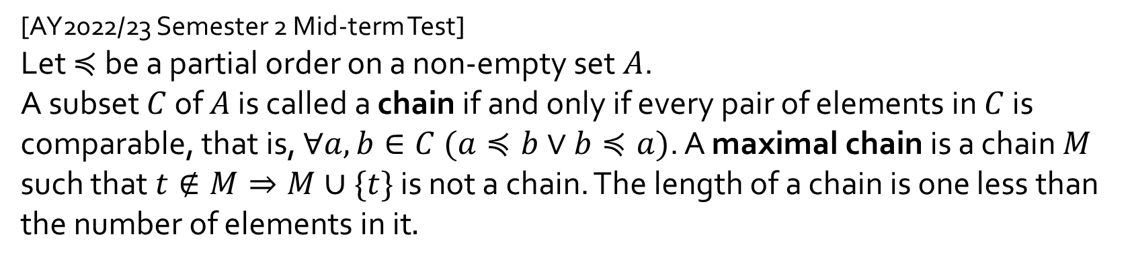
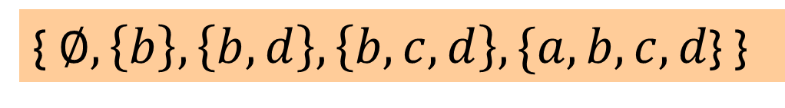
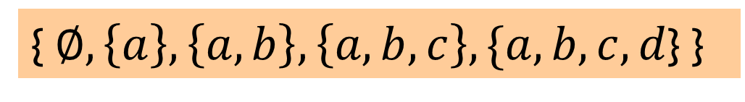
Q10.
[AY2022/23 Semester 2 Mid-term Test]
Let $≼$ be a partial order on a non-empty set $A$.
A subset $C$ of $A$ is called a chain if and only if every pair of elements in $C$ is comparable, that is, $∀a,b∈C (a≼b∨b≼a)$. A maximal chain is a chain $M$ such that $t∉M⇒M∪\{t\}$ is not a chain. The length of a chain is one less than the number of elements in it$.$
(a) Let $A=\{a,b,c,d\}$ and $\left(𝒫\left(A\right),⊆\right)$ be a poset on $𝒫(A)$, where $𝒫(A)$ denotes the power set of $A$. Write out two maximal chains in $\left(𝒫\left(A\right),⊆\right)$.
Many possible answers.
{$∅,\left\{a\right\},\left\{a,b\right\},\left\{a,b,c\right\},\{a,b,c,d$} }
{$∅,\left\{b\right\},\left\{b,d\right\},\left\{b,c,d\right\},\{a,b,c,d$} }
Notes:
Intuitition: maximal chain is a chain where:
You cannot add anything else
Must be one straight line, cos if not, sth is not comparable to another thing
Just from 0 -> all elements

Slide 19
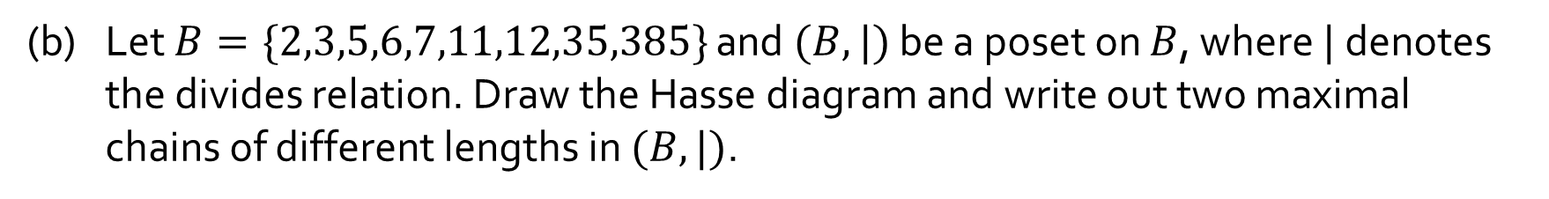
Q10.
[AY2022/23 Semester 2 Mid-term Test]
Let $≼$ be a partial order on a non-empty set $A$.
A subset $C$ of $A$ is called a chain if and only if every pair of elements in $C$ is comparable, that is, $∀a,b∈C (a≼b∨b≼a)$. A maximal chain is a chain $M$ such that $t∉M⇒M∪\{t\}$ is not a chain. The length of a chain is one less than the number of elements in it$.$
(b) Let $B=\{2,3,5,6,7,11,12,35,385\}$ and $(B,|)$ be a poset on $B$, where $|$ denotes the divides relation. Draw the Hasse diagram and write out two maximal chains of different lengths in $(B,|)$.
{2, 6, 12} and {11, 385}
12
385
{3, 6, 12} and {11, 385}
6
35
{5, 35, 385} and {11, 385}
2
3
5
7
11
{7, 35, 385} and {11, 385}
Notes:
Many possible chains possible.
What if switch the elements inside the set?

Slide 20
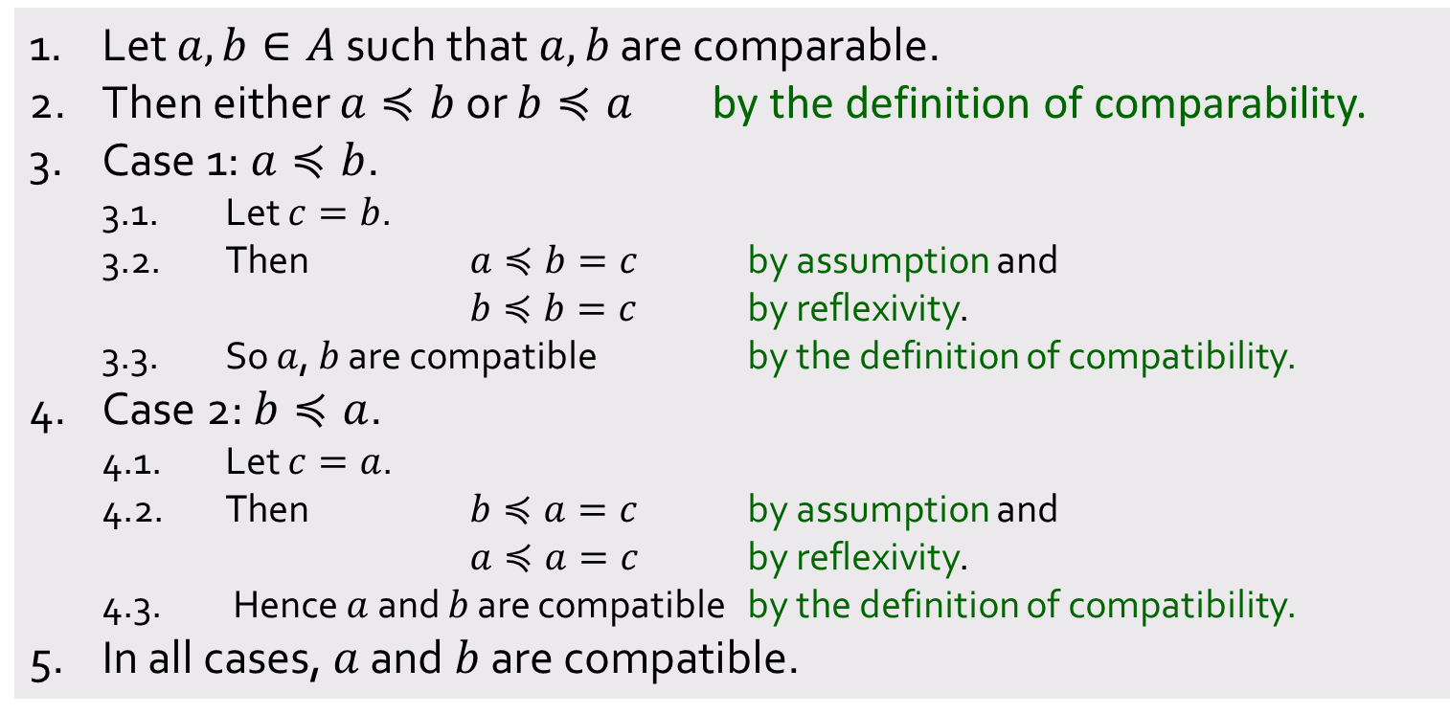
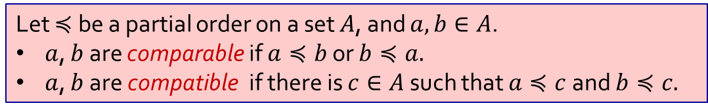
Q11.
State whether the following is true or false and justify your answer.
Let $≼$ be a partial order on a set $A$, and $a, b∈A$.
$a$, $b$ are comparable if $a≼b$ or $b≼a.$
$a$, $b$ are compatible if there is $c∈A$ such that $a≼c$ and $b≼c.$
(a) In all partially ordered set, any two comparable elements are compatible.
True
1. Let $a, b∈A$ such that $a,b$ are comparable.
2. Then either $a≼b$ or $b≼a$ by the definition of comparability.
3. Case 1: $a≼b$.
3.1. Let $c=b$.
3.2. Then $a≼b=c$ by assumption and
$b≼b=c$ by reflexivity.
3.3. So $a$, $b$ are compatible by the definition of compatibility.
4. Case 2: $b≼a$.
4.1. Let $c=a$.
4.2. Then $b≼a=c$ by assumption and
$a≼a=c$ by reflexivity.
4.3. Hence $a$ and $b$ are compatible by the definition of compatibility.
5. In all cases, $a$ and $b$ are compatible.
The 2 cases are symmetrical, so may just use WLOG to prove one of the cases.
Notes:
True with pretty trivial proof. Just quickly show for time’s sake.
If comparable, set c = b. thus auto compatible.
Highlight WLOG here.
b) Give counterexample

Slide 21
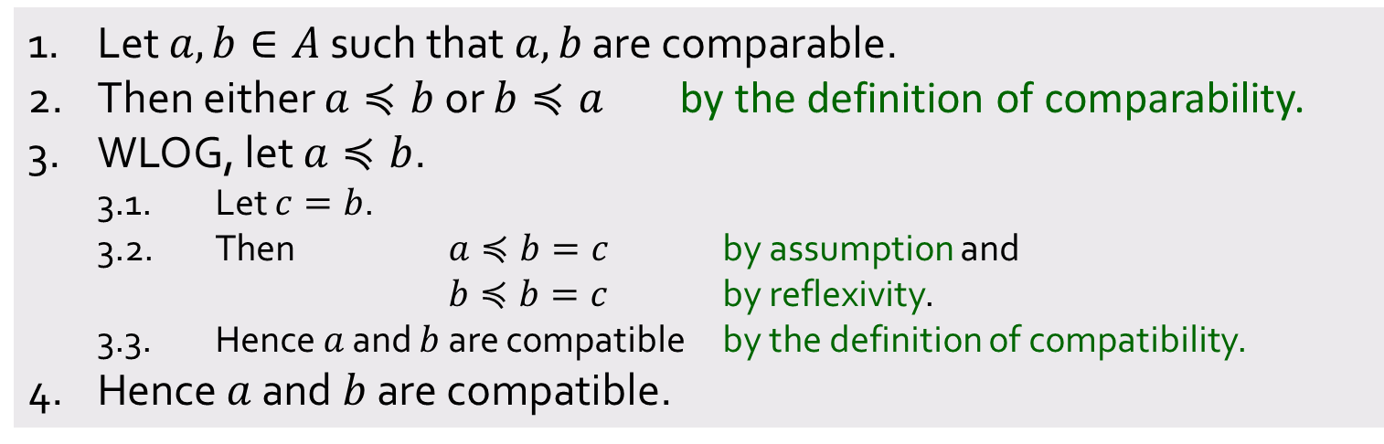
Q11.
State whether the following is true or false and justify your answer.
Let $≼$ be a partial order on a set $A$, and $a, b∈A$.
$a$, $b$ are comparable if $a≼b$ or $b≼a.$
$a$, $b$ are compatible if there is $c∈A$ such that $a≼c$ and $b≼c.$
(a) In all partially ordered set, any two comparable elements are compatible.
True
1. Let $a, b∈A$ such that $a,b$ are comparable.
2. Then either $a≼b$ or $b≼a$ by the definition of comparability.
3. WLOG, let $a≼b$.
3.1. Let $c=b$.
3.2. Then $a≼b=c$ by assumption and
$b≼b=c$ by reflexivity.
3.3. Hence $a$ and $b$ are compatible by the definition of compatibility.
4. Hence $a$ and $b$ are compatible.

Slide 22
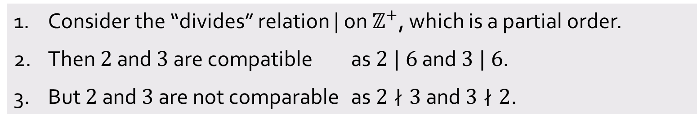
Q11.
State whether the following is true or false and justify your answer.
Let $≼$ be a partial order on a set $A$, and $a, b∈A$.
$a$, $b$ are comparable if $a≼b$ or $b≼a.$
$a$, $b$ are compatible if there is $c∈A$ such that $a≼c$ and $b≼c.$
(b) In all partially ordered set, any two compatible elements are comparable.
False
1. Consider the “divides” relation | on $ℤ^{+}$, which is a partial order.
2. Then $2$ and $3$ are compatible as $2 | 6$ and $3 | 6$.
3. But $2$ and $3$ are not comparable as $2∤3$ and $3∤2$.

Slide 23
End of Tutorial 5
Good luck for your midterms!

