Slide 1

Sample size calculation
Ioannis Karagiannis
Notes:
Lecture on measures of disease occurence

Slide 2
How large should your sample size be?
A national Salmonella outbreak has occurred with several hundred cases;
You plan a case-control study to identify if consumption of food X is associated with infection;
How many cases and controls should you recruit?

Slide 3
How much power do you have?
An outbreak of 14 cases of hepatitis A has occurred in school X;
You suspect exposure to food item Y is associated with illness and plan to undertake a cohort study;
With the available cases, how much power will you have to detect a RR of 1.5?

Slide 4
Objectives: sample size
To understand:
  Why we estimate sample size
  Principles of sample size calculation
  Ingredients needed to estimate sample size

Slide 5
Why estimate sample size?
How many people are needed to answer your study objectives?
  Pointless if power is too small;
  Waste of resources if sample size needed is too large.

Slide 6
Issues in sample size estimation
  Estimate sample needed to measure the
  factor of interest
  Trade-off between study size and resources….
  Sample size determined by various factors:
    significance level (α)
    power (1-β)
    expected prevalence of factor of interest

Slide 7
Significance testing: null and alternative hypothesis
Null hypothesis (H₀)
  There is no difference
  Any difference is due to chance
Alternative hypothesis (H₁)
  There is a true difference

Slide 8
Examples of null hypotheses
Case-control study
  H₀: OR=1
  “the odds of exposure among cases are the same as
  the odds of exposure among controls”
Cohort study
  H₀: RR=1
  “the AR among the exposed is the same as the AR among the unexposed”

Slide 9
Significance and power
 | Truth
 |  | H₀ true No difference | H₀ false Difference
Decision | Cannot reject H₀ | Correct decision | Type II error = β
 | Reject H₀ | Type I error level =α significance | Correct decision power = 1-β

Slide 10
Significance level (p-value)
probability of finding a difference (RR≠1, reject H₀), when no difference exists;
α or type I error; usually set at 5%;
p-value used to reject H₀
(significance level);
a hypothesis is never “accepted”

Slide 11
Type II error and power
β is the type II error
  probability of not finding a difference, when a difference really does exist
Power is (1-β) and is usually set to 80%
  probability of finding a difference when a difference really does exist (=sensitivity)

Slide 12
Power
Easiest ways to increase power are to:
  increase sample size
  increase desired difference (or effect size) required
    NB! increasing the desired difference in RR/OR means move it away from 1!
  increase significance level desired (α error) to e.g. 10%
    → Less wide confidence intervals

Slide 13
The effect of sample size
Consider 3 cohort studies looking at exposure to oysters with
N=10, 100, 1000
In all 3 studies, 60% of the exposed are ill compared to 40% of unexposed
(RR = 1.5)

Slide 14
Table A
 |  | Became ill
 |  | Yes | Total | AR
Ate oysters | Yes | 3 | 5 | 3/5
 | No | 2 | 5 | 2/5
 | Total | 5 | 10 | 5/10
RR=1.5, 95% CI: 0.4-5.4, p=0.53

Slide 15
Table B
 |  | Became ill
 |  | Yes | Total | AR
Ate oysters | Yes | 30 | 50 | 30/50
 | No | 20 | 50 | 20/50
 | Total | 50 | 100 | 50/100
RR=1.5, 95% CI: 1.0-2.3, p=0.046

Slide 16
Table C
 |  | Became ill
 |  | Yes | No | AR
Ate oysters | Yes | 300 | 500 | 300/500
 | No | 200 | 500 | 200/500
 | Total | 500 | 1000 | 500/1000
RR=1.5, 95% CI: 1.3-1.7, p<0.001

Slide 17
Sample size and power
In Table A, with n=10 sample, there was no significant association with oysters, but there was with a larger sample size.
This illustrates the relationship between power and sample size

Slide 18
Steps in estimating sample size for descriptive survey
Identify major study variable
Determine type of estimate
(%, mean, ratio,...)
Indicate expected frequency of factor of interest
  Literature, expert opinion
Decide on desired precision of the estimate

Slide 19
Cohort sample size: issues to consider
Risk ratio worth detecting
Expected frequency of disease in unexposed population
Ratio of unexposed to exposed
Desired level of significance (α)
Power of the study (1-β)
  to detect at a statistically significant level a particular risk ratio

Slide 20
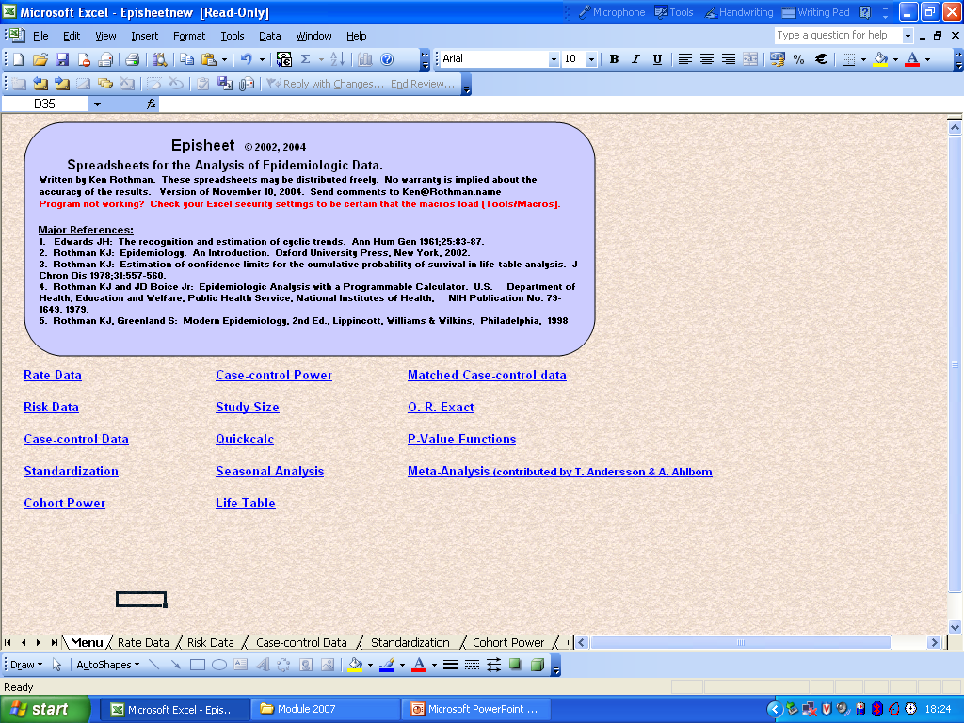

Slide 21
Cohort:
Episheet Power calculation
Risk of alpha error 5%
Population exposed 100
Exp freq disease in unexposed 5%
Ratio of unexposed to exposed 1:1
RR to detect >1.5
Notes:
The power of a statistical test is the probability that the test will reject a false null hypothesis, or in other words that it will not make a Type II error. The higher the power, the greater the chance of obtaining a statistically significant result when the null hypothesis is false.
Statistical power depends on the significance criterion, the size of the difference or the strength of the similarity (that is, the effect size) in the population, and the sensitivity of the data.
The power of a statistical test is the probability that the test will reject a false null hypothesis, or in other words that it will not make a Type II error. The higher the power, the greater the chance of obtaining a statistically significant result when the null hypothesis is false.

Slide 22
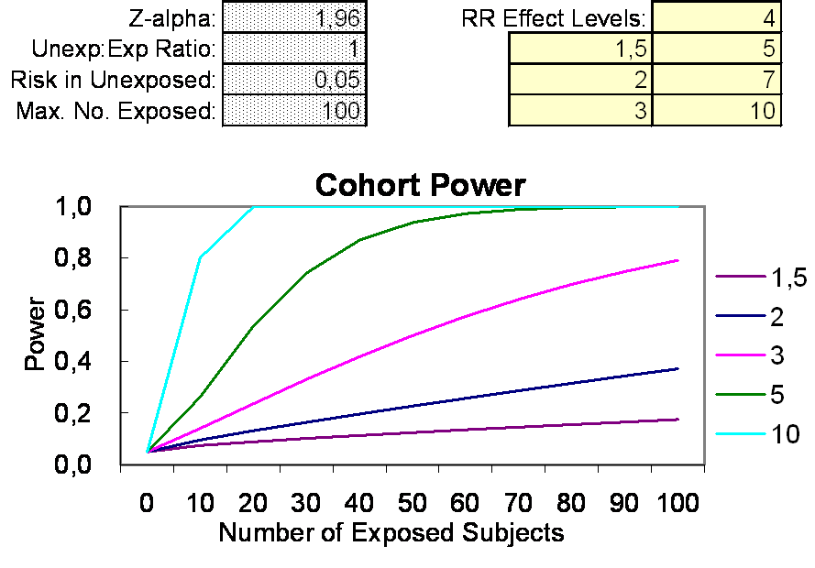

Slide 23
Case-control sample size: issues to consider
Number of cases
Number of controls per case
OR ratio worth detecting
% of exposed persons in source population
Desired level of significance (α)
Power of the study (1-β)
  to detect at a statistically significant level a particular odds ratio

Slide 24
Case-control:
Power calculation
Risk of α error 5%
Number of cases 200
Proportion of controls exposed 5%
OR to detect >1.5
No. controls:case 1:1
Notes:
The power of a statistical test is the probability that the test will reject a false null hypothesis, or in other words that it will not make a Type II error. The higher the power, the greater the chance of obtaining a statistically significant result when the null hypothesis is false.
Statistical power depends on the significance criterion, the size of the difference or the strength of the similarity (that is, the effect size) in the population, and the sensitivity of the data.
The power of a statistical test is the probability that the test will reject a false null hypothesis, or in other words that it will not make a Type II error. The higher the power, the greater the chance of obtaining a statistically significant result when the null hypothesis is false.

Slide 25
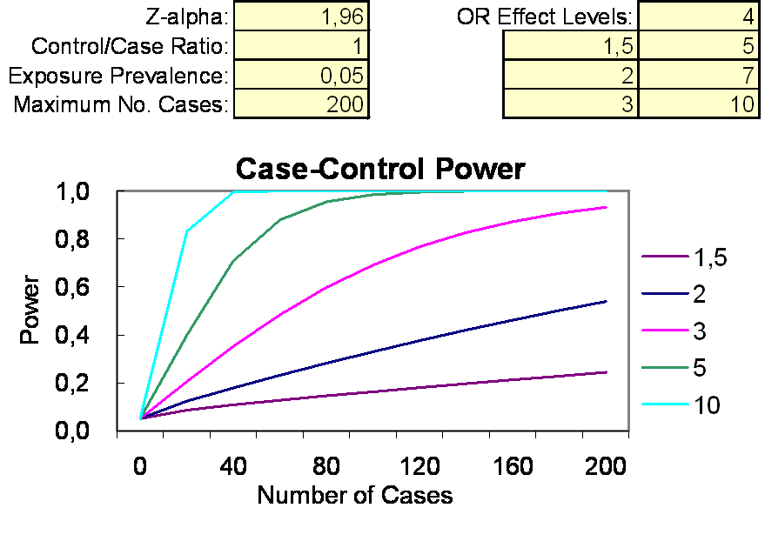

Slide 26
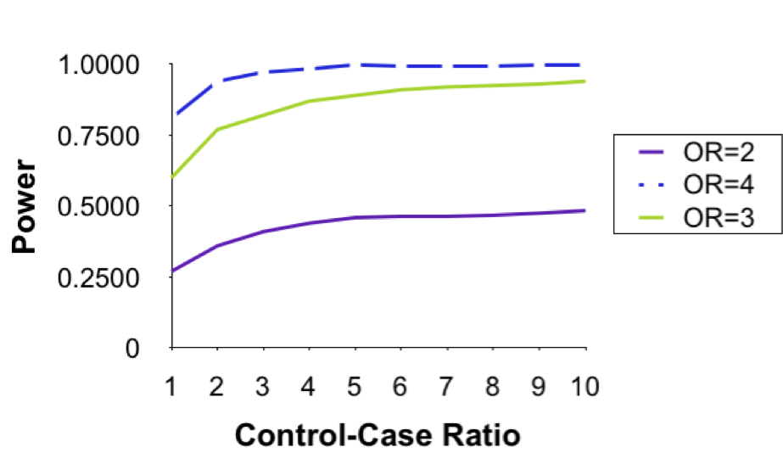
Statistical Power of a
Case-Control Study for different control-to-case ratios and odds ratios (50 cases)
Notes:
a probability is a number between 0 and 1;
the probability of an event or proposition and its complement must add up to 1; and
the joint probability of two events or propositions is the product of the probability of one of them and the probability of the second, conditional on the first.
Representation and interpretation of probability values
The probability of an event is generally represented as a real number between 0 and 1, inclusive. An impossible event has a probability of exactly 0, and a certain event has a probability of 1, but the converses are not always true: probability 0 events are not always impossible, nor probability 1 events certain. The rather subtle distinction between "certain" and "probability 1" is treated at greater length in the article on "almost surely".
Most probabilities that occur in practice are numbers between 0 and 1, indicating the event's position on the continuum between impossibility and certainty. The closer an event's probability is to 1, the more likely it is to occur.
For example, if two mutually exclusive events are assumed equally probable, such as a flipped coin landing heads-up or tails-up, we can express the probability of each event as "1 in 2", or, equivalently, "50%" or "1/2".
Probabilities are equivalently expressed as odds, which is the ratio of the probability of one event to the probability of all other events. The odds of heads-up, for the tossed coin, are (1/2)/(1 - 1/2), which is equal to 1/1. This is expressed as "1 to 1 odds" and often written "1:1".
Odds a:b for some event are equivalent to probability a/(a+b). For example, 1:1 odds are equivalent to probability 1/2, and 3:2 odds are equivalent to probability 3/5.
There remains the question of exactly what can be assigned probability, and how the numbers so assigned can be used; this is the question of probability interpretations.

Slide 27
Conclusions
Don’t forget to undertake sample size/power calculations
Use all sources of currently available data to inform your estimates
Try several scenarios
Adjust for non-response

Slide 28
Conclusions
If in doubt…
Call a statistician !!!!

Slide 29
Acknowledgements
Nick Andrews
Richard Pebody
Viviane Bremer

