Slide 1
Strange Attractors
From Art to Science
J. C. Sprott
Department of Physics
University of Wisconsin - Madison
Presented to the
Society for chaos theory in psychology and the life sciences
On August 1, 1997
Notes:
Illustrated with Microsoft PowerPoint 97
120 MHz Pentium Toshiba laptop PC running Windows 95
$8000 Panasonic LCD projector
Entire presentation available on WWW

Slide 2
Outline
Modeling of chaotic data
Probability of chaos
Examples of strange attractors
Properties of strange attractors
Attractor dimension
Simplest chaotic flow
Chaotic surrogate models
Aesthetics

Slide 3
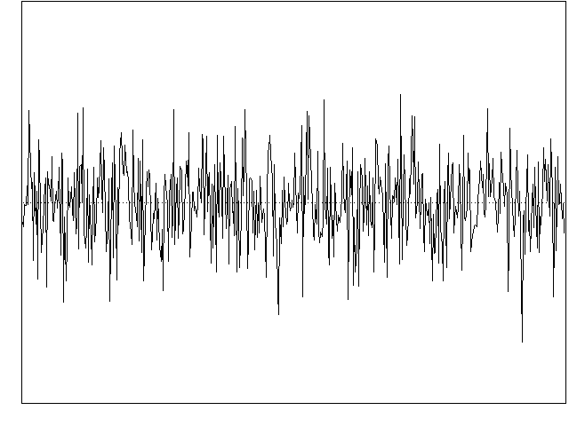
Typical Experimental Data
5
x
-5
0
Time
500
Notes:
Not usually shown in textbooks
Could be:
Stock market data
Meteorological data
EEG or EKG
Ecological data
etc...
Until recently, no hope of detailed understanding
Could be an example of deterministic chaos

Slide 4
Determinism
x_{n+1} = f (x_{n}, x_{n-1}, x_{n-2}, …)
where f is some model equation with adjustable parameters
Notes:
This is a discrete time dynamical system
Also called an iterated map

Slide 5
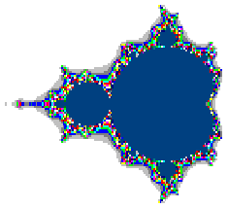
Example (2-D Quadratic Iterated Map)
x_{n+1} = a₁ + a₂x_{n} + a₃x_{n}² + a₄x_{n}y_{n} + a₅y_{n} + a₆y_{n}²
y_{n+1} = a₇ + a₈x_{n} + a₉x_{n}² + a₁₀x_{n}y_{n} + a₁₁y_{n} + a₁₂y_{n}²
Notes:
Equivalence (diffeomorphism) between systems with:
1 variable with many time delays
Multiple variables and no delay
Takens' theorem (1981)
A generalization of the Mandelbrot set equations

Slide 6
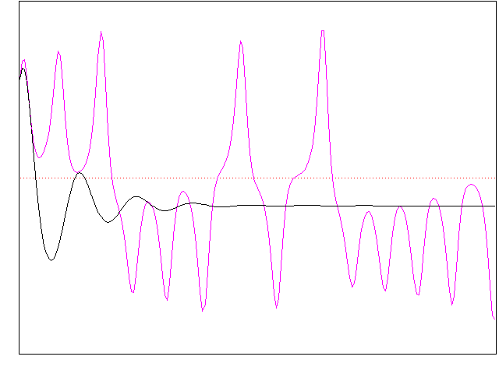
Solutions Are Seldom Chaotic
20
Chaotic Data (Lorenz equations)
Chaotic Data
(Lorenz equations)
x
Solution of model equations
Solution of model equations
-20
0
Time
200
Notes:
Best attempt to fit previous equation to data from the Lorenz attractor
Uses Principal Component Analysis
(AKA: Singular Value Decomposition)
Good short-term prediction (optimized for that)
Bad long-term prediction (seldom chaotic)
More complicated models don't help

Slide 7
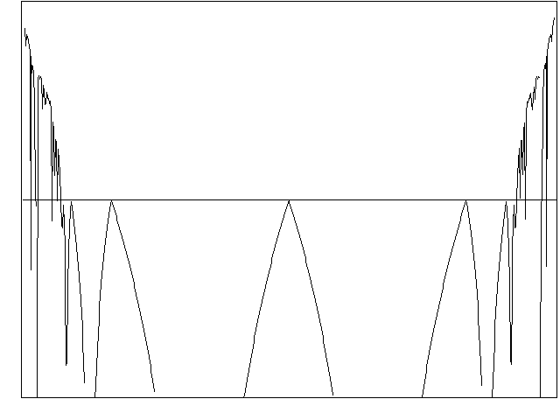
How common is chaos?
1
Logistic Map
x_{n+1} = Ax_{n}(1 - x_{n})
Lyapunov Exponent
-1
-2
A
4
Notes:
Simplest 1-D chaotic system
Chaotic over 13% of the range of A
Solutions are unbounded outside the range plotted (hence unphysical)

Slide 8
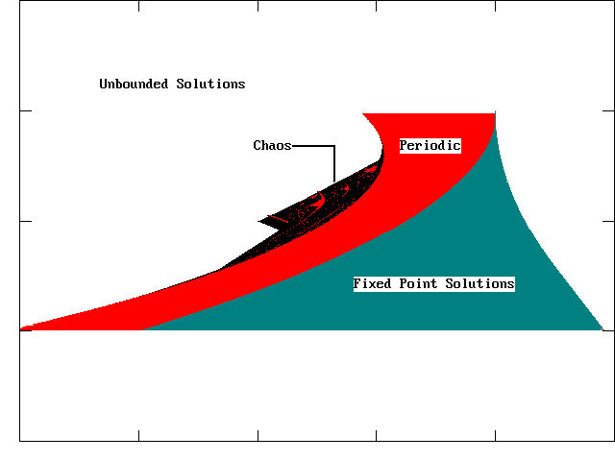
A 2-D example (Hénon map)
2
b
x_{n+1} = 1 + ax_{n}² + bx_{n-1}
-2
-4
a
1
Notes:
Simplest 2-D chaotic system
Two control parameters
Reduces to logistic map for b = 0
Chaotic "beach" on NW side of "island" occupies about 6% of area
Does probability of chaos decrease with dimension?

Slide 9
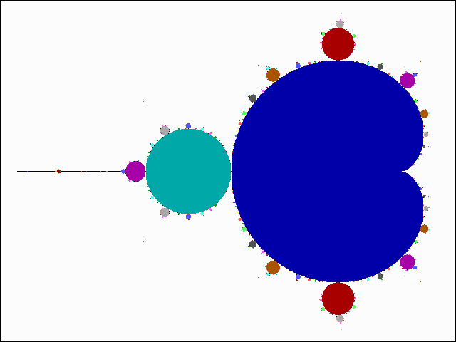
Mandelbrot set
x_{n+1} = x_{n}² - y_{n}² + a
y_{n+1} = 2x_{n}y_{n} + b
a
b
Notes:
"The most complicated mathematical object ever seen"
Only the bounded orbits are shown
Usual plot show escape time of unbounded orbits
All periods are represented somewhere
Chaotic orbits are very rare (probability zero?)

Slide 10
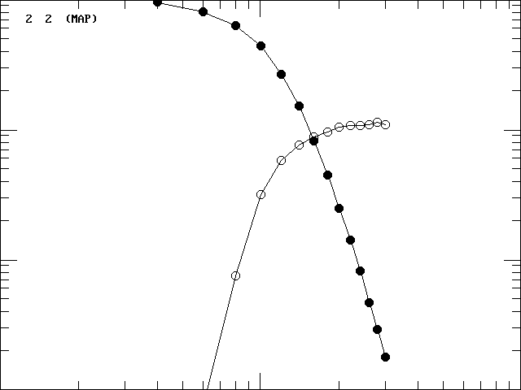
General 2-D quadratic map
100 %
10%
Bounded solutions
Chaotic solutions
1%
0.1%
0.1
1.0
a_{max}
10
Notes:
12 coefficients ==> 12-D parameter space

Slide 11
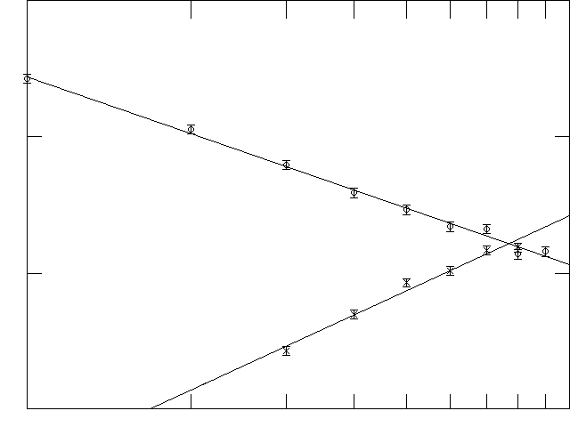
Probability of chaotic solutions
100%
Iterated maps
10%
Continuous flows (ODEs)
1%
0.1%
1
Dimension
10
Notes:
Chaotic flows must be at least 3-D
Do the lines cross at high D?
Is this result general or just for polynomials?

Slide 12
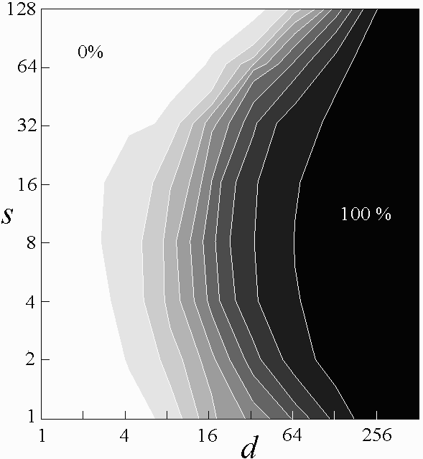
% Chaotic in neural networks
Notes:
Large collection of feedforward networks
Single (hidden) layer (8 neurons, tanh squashing function) - always bounded
Randomly chosen weights (connection strengths with rms value s)
d inputs (dimension / time lags)
Single output

Slide 13
Examples of strange attractors
A collection of favorites
New attractors generated in real time
Simplest chaotic flow
Stretching and folding
Notes:
This leads us to the subject of the talk - Strange Attractors
Essentially all chaotic systems produce strange attractors
Detecting chaos in experimental data ==> finding a strange attractor
Here are samples from my book (colorized)
Most are from simple 2-D polynomial maps

Slide 14
Strange attractors
Limit set as t → ∞
Set of measure zero
Basin of attraction
Fractal structure
  non-integer dimension
  self-similarity
  infinite detail
Chaotic dynamics
  sensitivity to initial conditions
  topological transitivity
  dense periodic orbits
Aesthetic appeal
Notes:
Occur in infinite variety (like snowflakes)
Produced many millions, looked at over 100,000
Like pornography, know it when you see it
Show stretching and folding (previous slide)

Slide 15
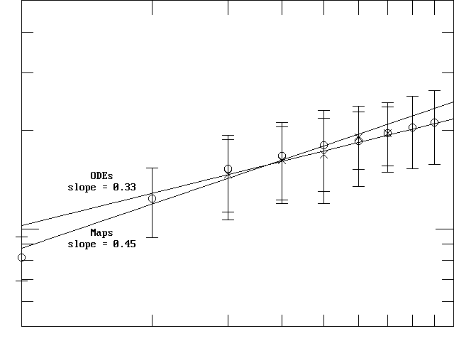
Correlation dimension
5
Correlation Dimension
0.5
1
System Dimension
10
Notes:
As described by Grassberger and Procaccia (1983)
Error bars show standard deviation
Scaling law approximately SQR(d)
Useful experimental guidance

Slide 16
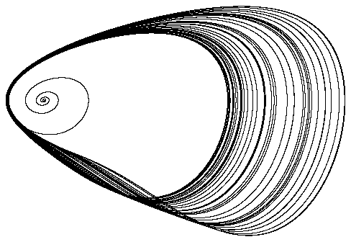
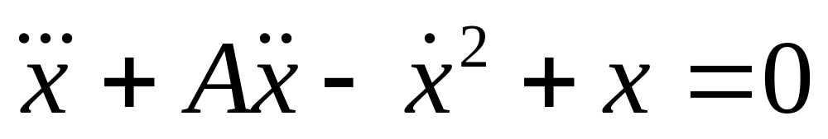
Simplest chaotic flow
dx/dt = y
dy/dt = z
dz/dt = -x + y² - Az
2.0168 < A < 2.0577
Notes:
Discovered last summer
Jerk function: j = da/dt
Compare
- Lorenz equations (7 variables, 2 NL)
- Rossler equations (7 variables, 1 NL)
Attractor
- Dimension 2.0265
- Approximately a Mobius strip
- Basin resembles a hairy tadpole

Slide 17
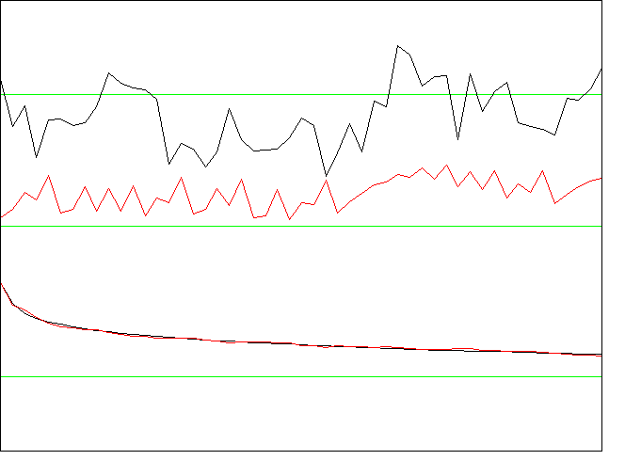
Chaotic surrogate models
x_{n+1} = .671 - .416x_{n} - 1.014x_{n}² + 1.738x_{n}x_{n-1} +.836x_{n-1} -.814x_{n-1}²
Data
Model
Auto-correlation function (1/f noise)
Notes:
Can use arbitrary nonlinear functions
Brute-force method (variant of simulated annealing)
Easy to fit particular characteristics (i.e., power spectrum)
Not good for prediction (doesn't preserve dynamics)
Model is (usually) NOT unique, but (usually) IS robust to small variations of parameters

Slide 18
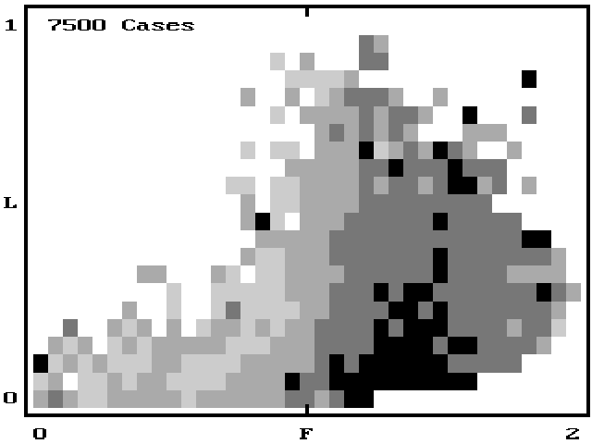
Aesthetic evaluation
Notes:
7500 attractors of various Lyapunov exponents and Correlation Dimension
Rated on scale of 1 - 5 by 3 artists and 4 scientists
Strong preference for low L and intermediate F
Some suggestion of individual preferences:
- Scientists prefer simplicity
- Artists more tolerant of complexity

Slide 19
References
http://sprott.physics.wisc.edu/ lectures/satalk/
Strange Attractors: Creating Patterns in Chaos (M&T Books, 1993)
Chaos Demonstrations software
Chaos Data Analyzer software
sprott@juno.physics.wisc.edu

