Slide 1
DIABETES PREDICTOR USING ML
Saloj G
Deepa F
Indira D
Darshan P
Firecrackers

Slide 2
Introduction
Objective : Predict Diabetics using Machine Learning Model
Dataset : Kaggle [Diabetes Dataset]
Technology : Python, sklearn,pickle,Flask,Html,CSS

Slide 3
Project Phases
Exploratory Data Analysis [EDA]
Machine Learning
Model Building
Model Evaluation
Visualization (Predictor App)

Slide 4
Exploratory Data Analysis
Data source : Kaggle
Dataset Format : csv
Dataset Properties : 768 R & 9 C
Data Cleaning : Python

Slide 5
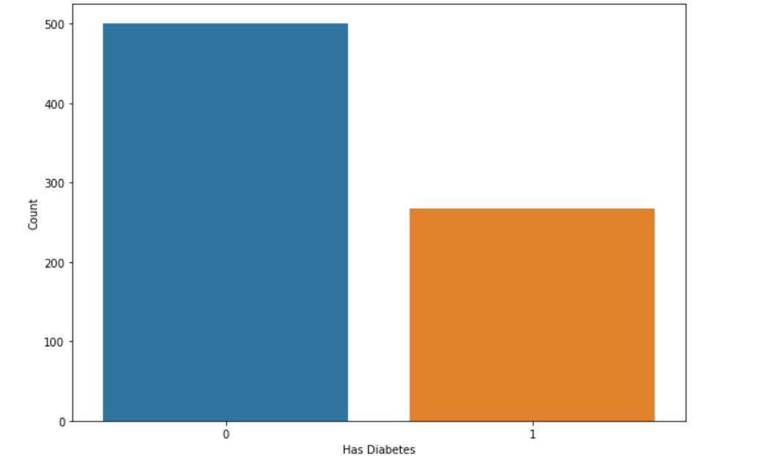
Statistics
Diabetic Patients – 268
Non-Diabetic - 500

Slide 6
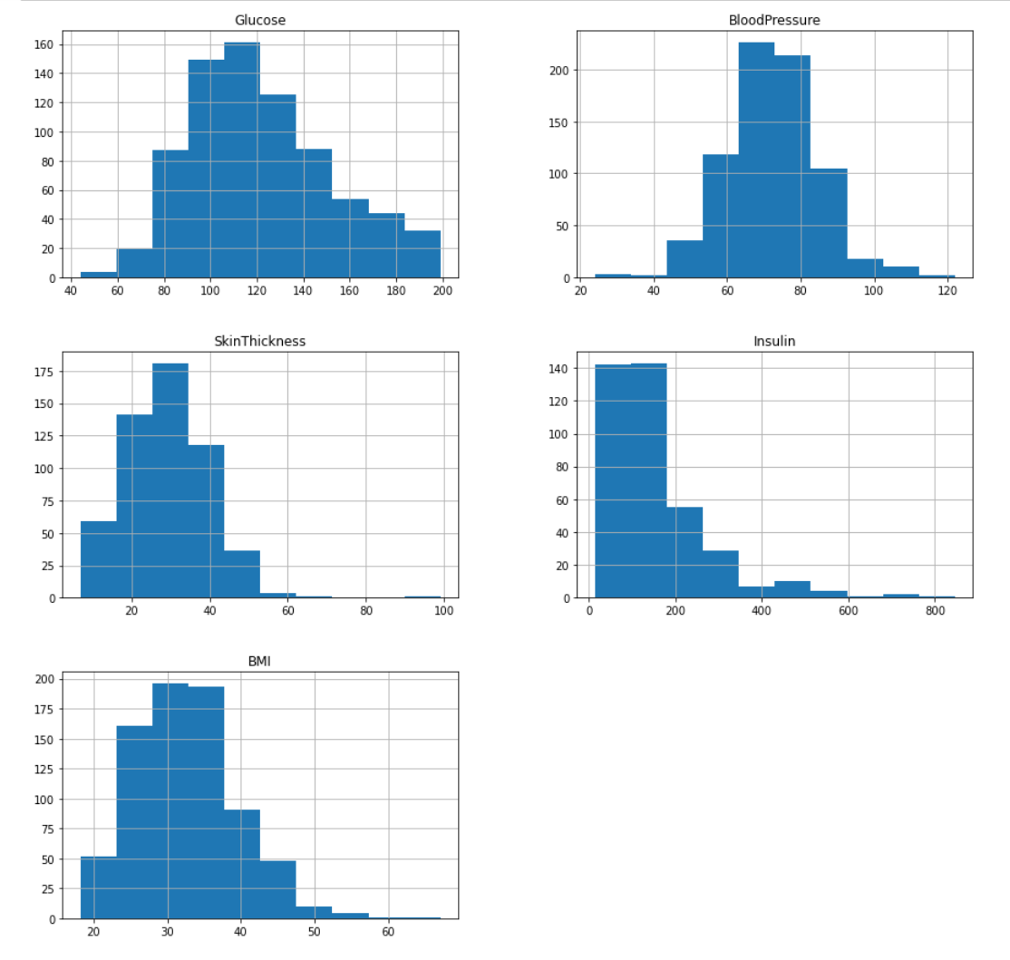
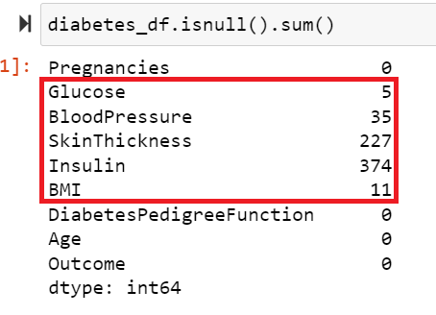
Data Pre-Processing

Slide 7

Machine Learning
4 Models
Random Forest
Logistic Regression
ADA Boost
XG Boost

Slide 8
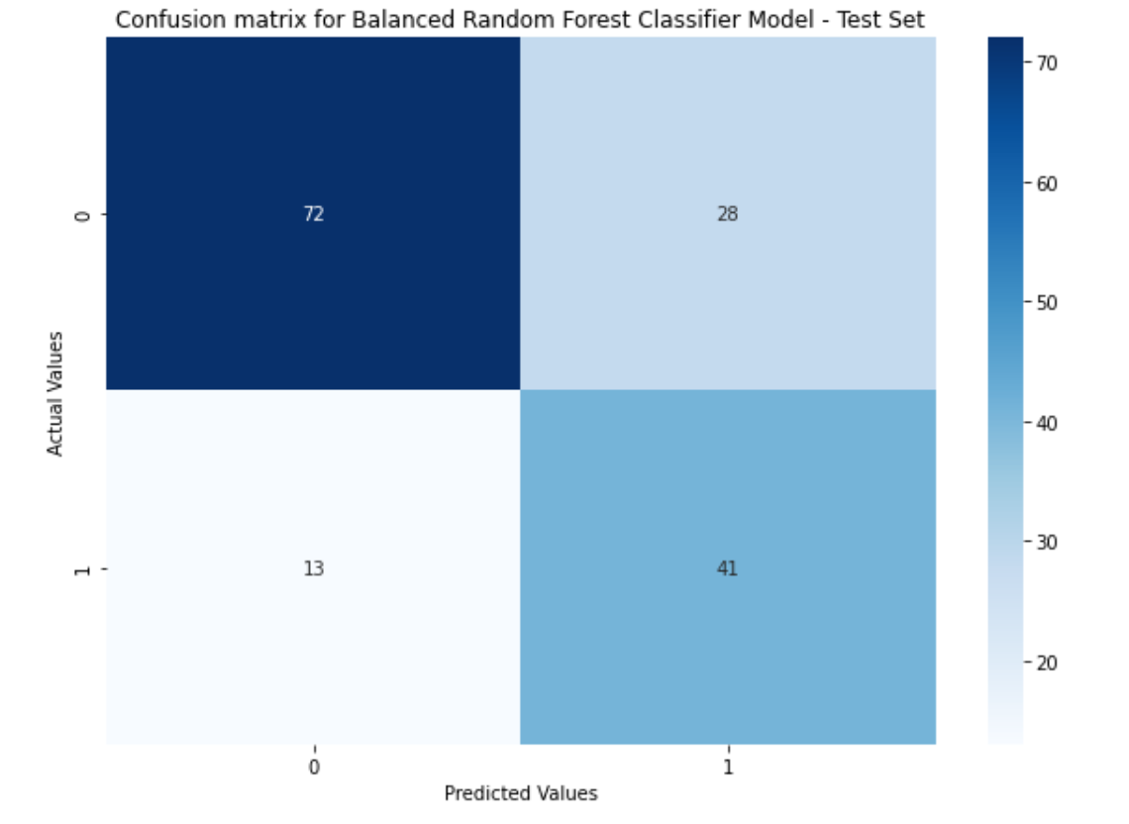
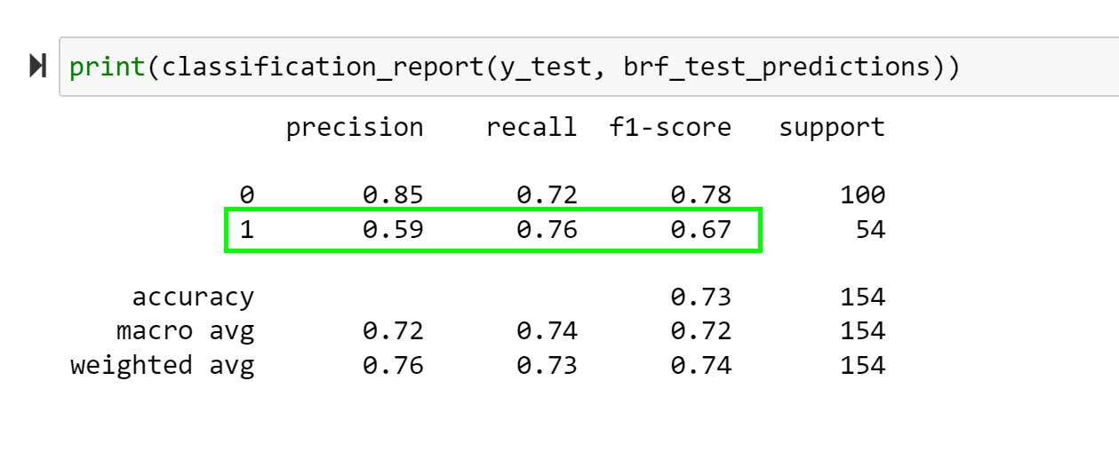
Model Evaluation-BRF –CM & CR

Slide 9
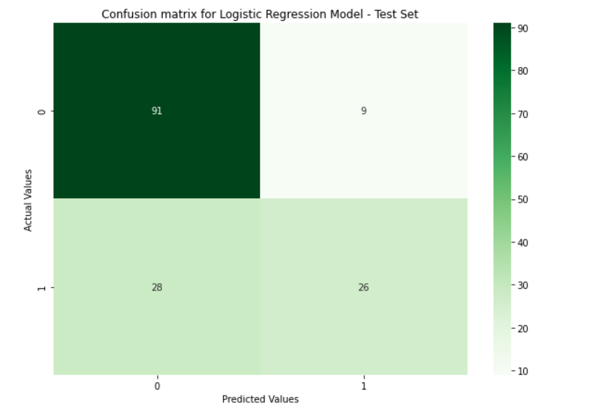
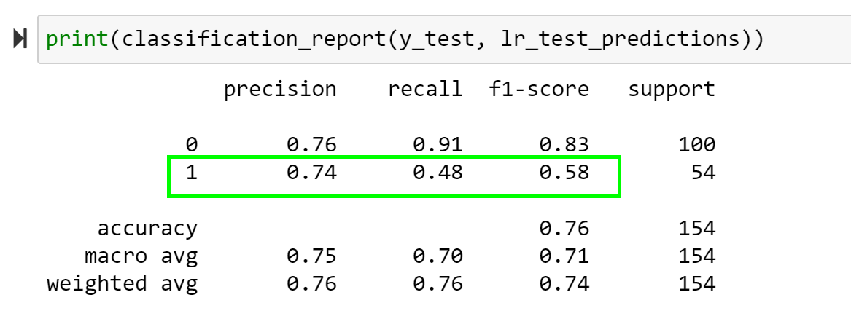
Model Evaluation-LR –CM & CR

Slide 10
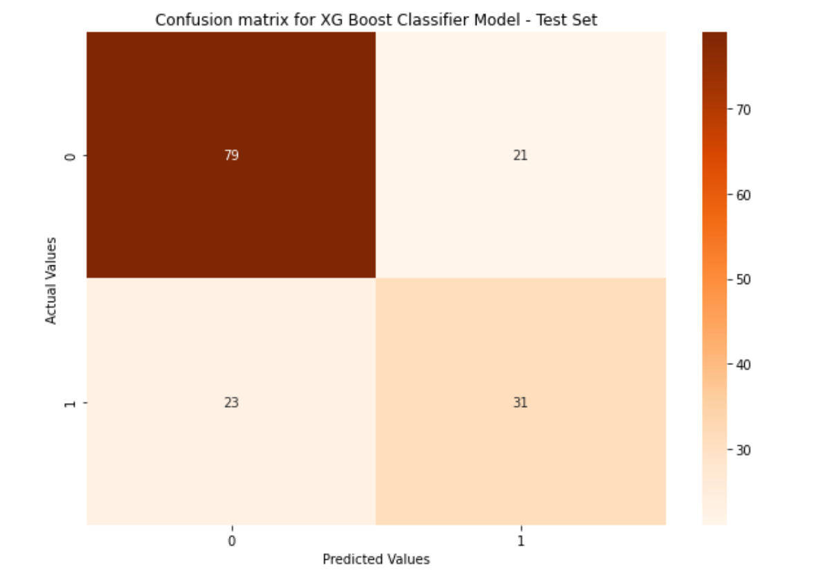
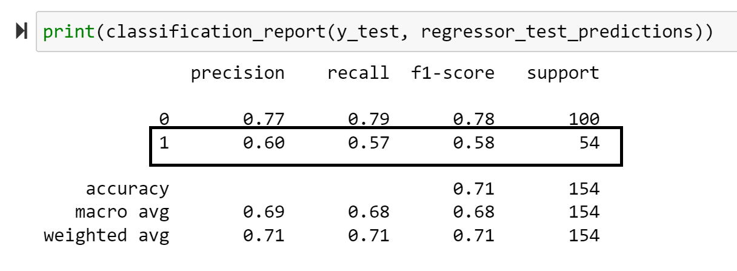
Model Evaluation-ADB –CM & CR

Slide 11
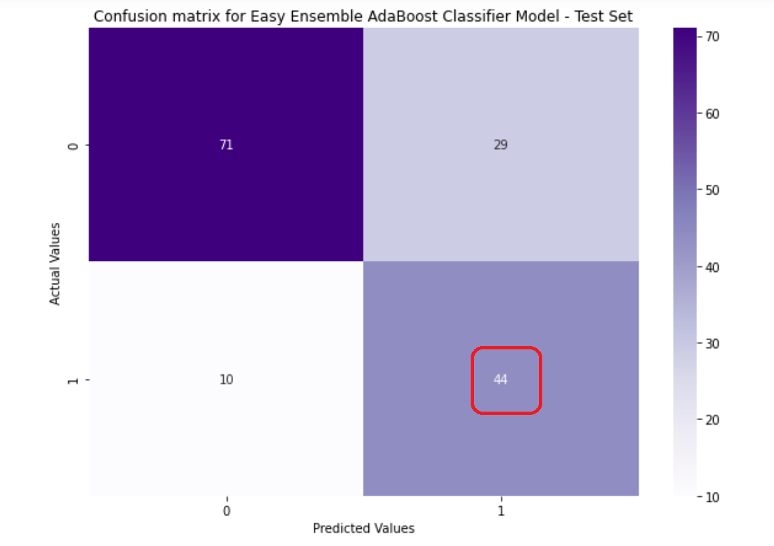
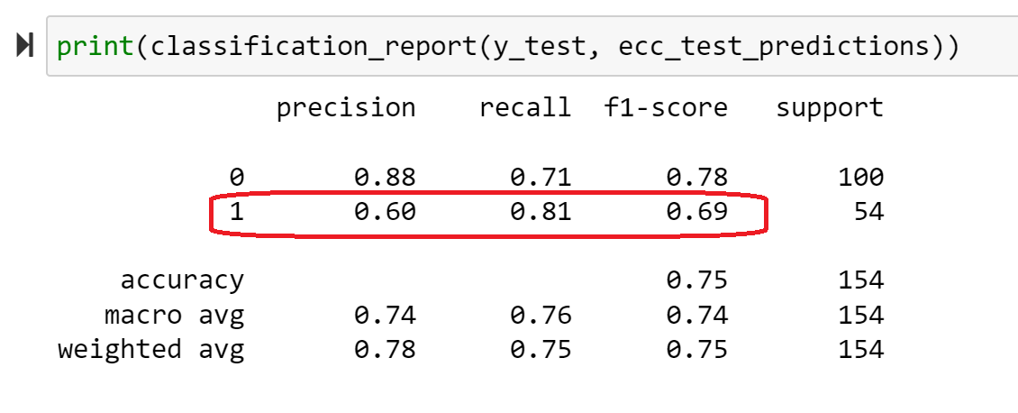
Model Evaluation-ADB –CM & CR
We selected ADA Boost as for ML model for the predictor App based.
It has better Precision , Recall & f1 Score compared to other three.

Slide 12
Visualization
Flask
pickle file
Html styled using bootstrap CSS

Slide 13
DEMO

Slide 14
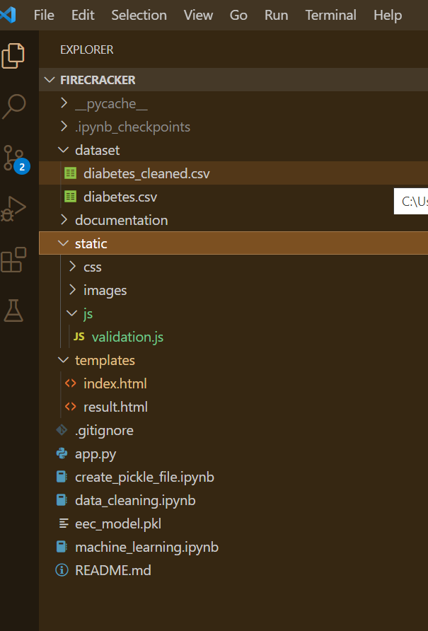
GitHub Repo- Folder Structure
Database
EDA
Machine Modelling
Pickle File
App.py

Slide 15

FireCracker Thank you…

Slide 16
Reference
Data Imputation: https://vitalflux.com/pandas-impute-missing-values-mean-median-mode/#a:~:text=You%20can%20use%20central%20tendency%20measures%20such%20as,using%20median%20or%20mode%20with%20skewed%20data%20distribution
Pima Indians Dataset Statistic: :https://www.asc.ohiostate.edu/goel.1//STATLEARN/PROJECTS/Presentations/Diabetes_PimaIndians.pdf
Pickling Machine Learning Models : https://betterprogramming.pub/pickling-machine-learning-models-aeb474bc2d78
XGBoost for Classification problems : https://towardsdatascience.com/beginners-guide-to-xgboost-for-classification-problems-50f75aac5390

